Slide 1
2013 IBT Summary
Kerr Lake Regional Water System
Union County
Wake County (Cary/Apex/Morrisville)
Brunswick County
Charlotte / Mecklenburg Utilities Dept.

Slide 2
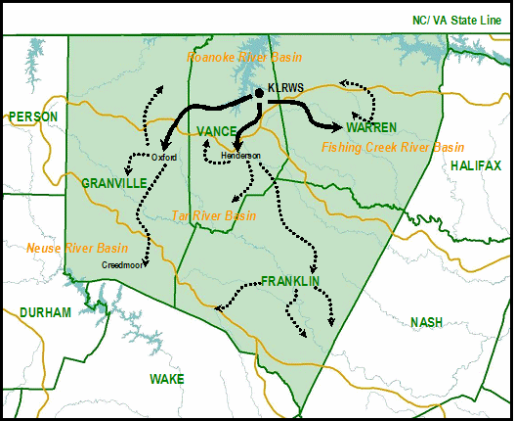
Proposed Kerr Lake Regional Water System IBT
Request to transfer approximately 26 million gallons per day from Roanoke Basin to Tar, Fishing and Neuse Basins.
Running Draft Roanoke River Basin OASIS model.
Draft EIS expected in 2014.
Notes:
Oxford, Henderson and Warren County are partners in the KLRWS. Water sales to an additional 15 communities (not public water systems- the number of those has not been determined. Identified 20 surface water purchases as PWSS and over 200 groundwater systems).
Proposing to increase their existing interbasin transfer to account for future growth. This is not a request for additional allocation from Kerr Lake (USACE allocated the storage in 2005 giving them a 20 MGD average day withdrawal). Nearly all of the proposed increase is going to existing customers with the exception of creedmoor.
Currently transferring:
5 MGD from Roanoke to Tar and Fishing and
0.3 MGD from Roanoke to Neuse.
10 MGD is their grandfathered capacity.
Requesting:
24 MGD from Roanoke to Tar and Fishing and
2.1 from Roanoke to Neuse.

Slide 3
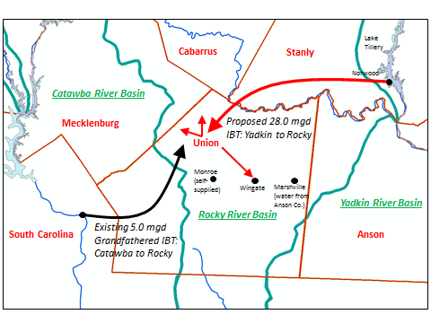
Proposed Union County IBT
Request to transfer approximately 28 million gallons per day from Roanoke Basin to Yadkin
Basin.
Notice of Intent submitted August 2013 and three public meetings held in October 2013.
Environmental Impact Statement document is currently being developed.

Slide 4
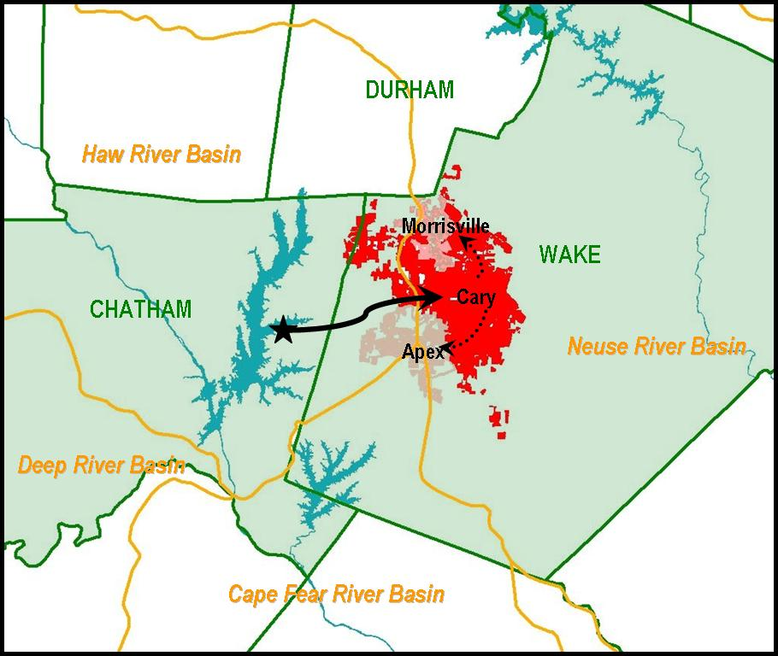
Cary/Apex/Morrisville IBT Modification
Request to increase IBT transfer from approximately 24 million gallons per day to 35 million gallons per day from Haw Basin to Neuse Basin.
NOI submitted September 2013.
Environmental document is currently being developed.

Slide 5
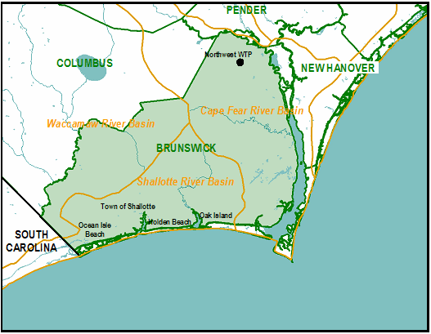
Brunswick County IBT
IBT Certificate issued November, 2013. The request was for increase approved IBT amount
from 10.5 million gallons per day to 17 million gallons per day from Cape Fear basin to
Waccamaw and Shallotte Basins.

Slide 6
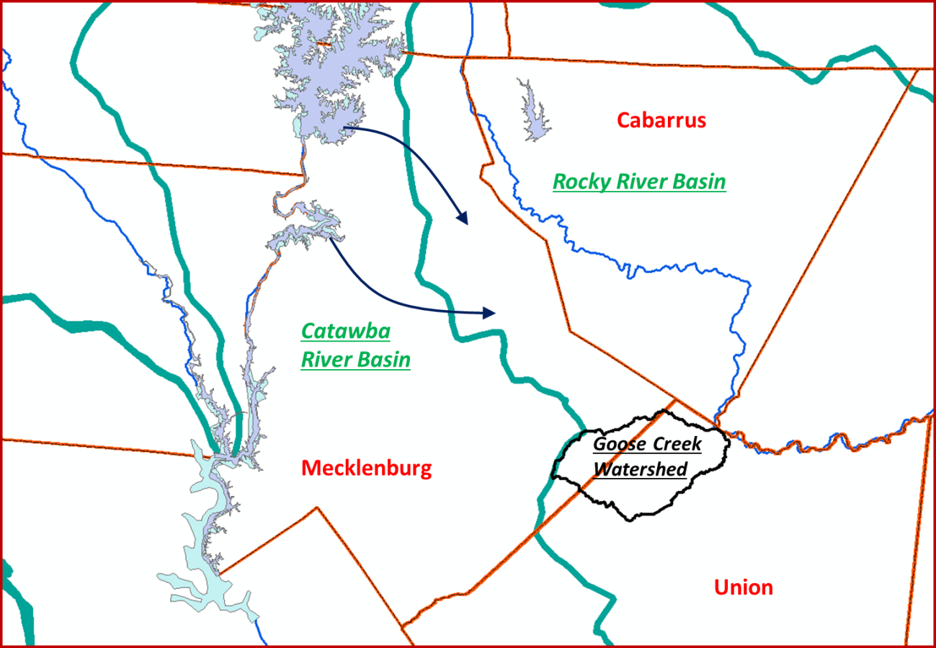
Charlotte/Mecklenburg IBT Modification
EMC granted the removal of Condition 3 from the existing (2002) IBT Certificate.
Condition 3: The Goose Creek subbasin in Mecklenburg County is removed from the area to be served by the IBT, until the impacts of additional urban growth on the endangered species are fully evaluated.
The transfer amount of 33 MGD from the Catawba Basin to the Rocky Basin remained unchanged.

