Slide 1
Department of Environmental Quality
Interbasin Transfer Program Update
Water Allocation Committee January 10, 2018

Slide 2
Proposed Project Description
Primary Applicant: | Pender County
Source Basin: | Cape Fear River
Receiving Basin: | Northeast Cape Fear River, South River, & New River
Grandfathered Allowance: | N/A
Total Requested IBT (2045 Demands): | 14.5 MGD (avg day/max mth)
    New Certificate, following G.S. 143-215.22L(w)
Department of Environmental Quality

Slide 3
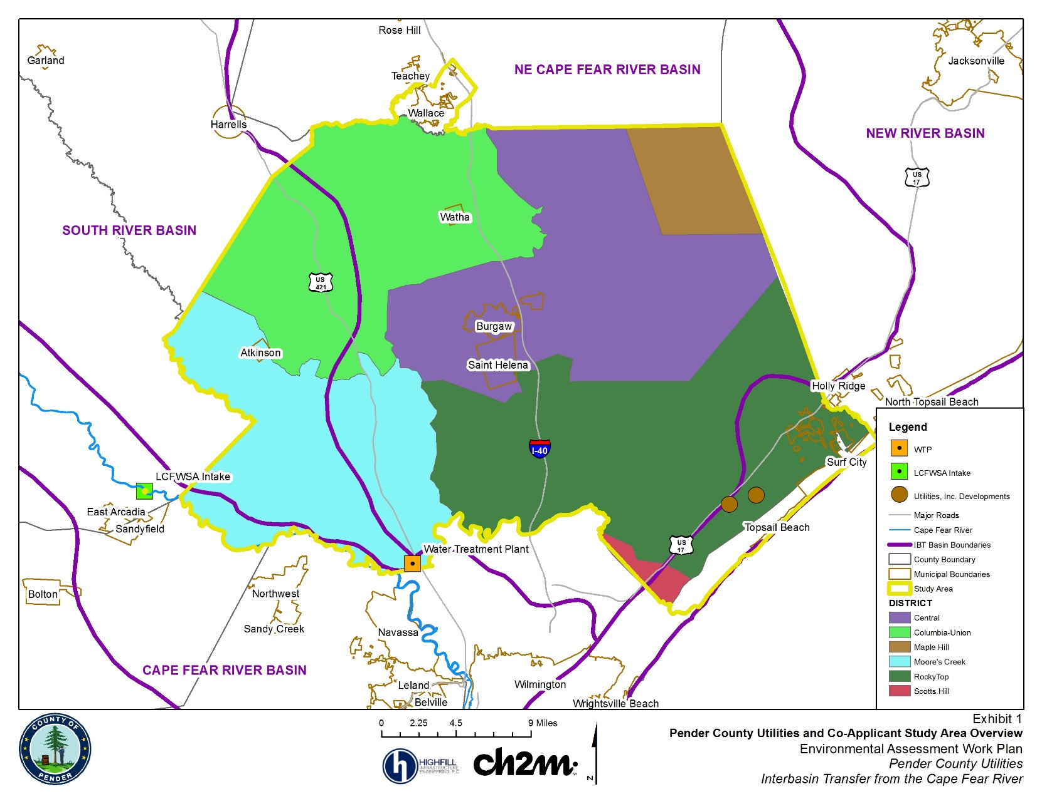
Pender County and IBT Basins

Slide 4
IBT Process § 143-215.22L(w)
Requirements for Coastal Counties
I. Applicant submits Notice of Intent to file a petition
II. Applicant submits draft environmental document (EA) pursuant to State Environmental Policy Act (SEPA)
Applicant submits EA to NCDEQ for review and comment
NCDEQ issues finding of no significant impact (FONSI)
EA and FONSI published for 30-day review/comment period through State Clearinghouse
III. Applicant submits petition
NCDEQ prepares written response to comments
Public notice of petition and 30-day notice of hearing
Comments accepted for 30 days after hearing
Public hearing on the petition
EMC issues final determination

Slide 5
Current Status and Steps Forward
Petition, Water Conservation Plan, and Drought Management Plan were finalized and determined to be adequate at the end of November 2017.
In December, the Petition and related documents were published for public review through State Clearinghouse along with a 30-day notice for the public hearing.
Public hearing to be held Thursday, January 18, 2018 in Burgaw. Commissioner Keen will be hearing officer.
Final determination from EMC anticipated at May 10, 2018 meeting.
Department of Environmental Quality

Slide 6
Contact Information
Kim Nimmer
NCDEQ - Division of Water Resources
kim.nimmer@ncdenr.gov
919-707-9019
Department of Environmental Quality

