Slide 1
NPDES MS4 Permit Compliance & Enforcement

Slide 2
Presentation Overview
MS4 Permit Compliance Audits
Audit Schedule
How to Prepare
What to Expect
What Happens Next
Enforcement Mechanisms
NOD and NOV
Templates
Duty to Comply
Department of Environmental Quality

Slide 3

What is an MS4 Permit Compliance Audit?
An MS4 Audit is a structured review of the Stormwater Management Program to evaluate whether the MS4 is meeting the requirements specified in the
NPDES MS4 Permit & Stormwater Management Plan (SWMP)
AKA do you have your ducks in a row?
Department of Environmental Quality

Slide 4
How Do I Know If My MS4 is Being Audited?
The DEMLR MS4 5-year Audit Schedule
  Lists the year the MS4 is scheduled to be audited
  5-year schedule audits are part of each permit renewal process
EPA or DEMLR may also audit any MS4 at any time.
EPA/DEMLR will notify the MS4 of specific audit date(s) at least 30 calendar days prior.
Department of Environmental Quality

Slide 5
Audit Schedule for Eastern NC MS4s
Permittee | MS4 Permit Number | AUDIT YEAR | Current Expiration Date | Permit Cycle
Archdale | NCS000434 | 2019 | 02-16-2022 | Short Cycle
Clemmons | NCS000410 | 2019 | 02-19-2022 | Short Cycle
Concord | NCS000423 | 2022 | 02-19-2022 | Extended
High Point | NCS000421 | 2019 | 02-19-2022 | Short Cycle
Hillsborough | NCS000466 | 2023 | 02-19-2022 | Extended
Jamestown | NCS000400 | 2023 | 02-19-2022 | Extended
Kernersville | NCS000483 | 2020 | 02-19-2022 | Short Cycle
Lewisville | NCS000494 | 2020 | 02-19-2022 | Short Cycle
Lexington | NCS000584 | 2020 | 11-10-2021 | No Change
Mebane | NCS000402 | 2021 | 02-19-2022 | No Change
Thomasville | NCS000436 | 2023 | 02-19-2022 | Extended
Trinity | NCS000502 | 2020 | 02-19-2022 | Short Cycle
Department of Environmental Quality

Slide 6
What Happens Before an MS4 Audit?
Preliminary Documentation Request
  Current SWMP
  Latest Annual Report
  Organizational chart & associated program responsibilities
  MS4 permitted area map with receiving waters
  Formal agreements with other entities that implement MS4 program components
Scope of Audit Decided
  May request additional information prior to audit
Department of Environmental Quality

Slide 7

What Does DEMLR Audit?
Specific MS4 Program components are audited for compliance with the Permit & SWMP:
  Program administration is always evaluated
  Some or all of the required six MCMs will be evaluated
    Public Education & Outreach
    Public Involvement & Participation
    Illicit Discharge Detection & Elimination
    Construction Site Runoff Controls (delegated ESC programs only)
    Post-Construction Site Runoff Controls
    Pollution Prevention & Good Housekeeping for Municipal Operations
  TMDLs may be evaluated (if applicable)

Slide 8

How Long Does an MS4 Audit Take?
It Depends….
Availability of information
Size and complexity of the MS4 program
Number of MCMs evaluated
Geographic distance between sites visited
Distance the auditor must travel to the MS4
Auditor will give you a general idea before the audit
Won’t be less than one day
Won’t be more than three days
Department of Environmental Quality

Slide 9
MS4 Responsibilities
Submit Documentation by Deadlines
Provide an Appropriate Meeting Room
Invite Appropriate Participants
  Operations & Field Staff
  Department Managers
  Elected Officials
  Potential specific people (i.e. City Manager, Municipal PIO, collection or pretreatment staff, sediment/erosion inspectors, review engineers, emergency response, parks and recreation, streets maintenance, etc.)
Provide Choices and Directions for Site Visits

Slide 10

What Happens on the Day(s) of an MS4 Audit?
1) Opening Conference
2) Office Interview
Program implementation questions & documentation review
3) Site Visits
MS4 industrial facility inspections
Construction site inspections (delegated ESC programs only)
Evaluates how MS4 program is run, not if sites are in compliance
4) DEMLR Confers on Preliminary Findings
5) Closing Conference
Preliminary summary of identified issues
Request for additional documentation

Slide 11

How Do You Ace an MS4 Audit?
Stage the meeting – staff, documents, GIS, etc. on hand
Know your program (Permit, SWMP, Annual Reports, implementation)
Demonstrate the permitted program is implemented:
  Enforceable local ordinances
  Legal agreements with any external parties
  MS4 mapping – storm sewer system & outfalls
  Inspections, documentation, tracking, SOPs
  Documented education, outreach & staff training programs
  Dry weather screening
Department of Environmental Quality

Slide 12

What Happens After an MS4 Audit?
If the MS4 aced the audit:
  Receive a Notice of Compliance and an Audit Report within 60 days,
  Set to work preparing an updated SWMP and permit renewal application.
Department of Environmental Quality

Slide 13

What Happens After an MS4 Audit?
If the MS4 DID NOT ace the audit:
Receive an Audit Report within 60 days, and
Be issued a Notice of Deficiency (NOD) or a Notice of Violation (NOV).
Department of Environmental Quality
Notes:
Submit a Council resolution to fund, implement and comply with the NPDESMS4 Permit conditions and requirements,
Obtain a new 5-year permit, and
Submit a 5-year SWMP detailing the path to full compliance.

Slide 14

What if you detour from the SWMP?
Civil Penalty Assessment
Notice of Recommendation for Enforcement Action
Notice of Violation (NOV)
Notice of Deficiency (NOD)
Department of Environmental Quality
Notes:
Submit a Council resolution to fund, implement and comply with the NPDESMS4 Permit conditions and requirements,
Obtain a new 5-year permit, and
Submit a 5-year SWMP detailing the path to full compliance.

Slide 15
What Does the NOD say?
The NOD requires the permittee to do 4 things:
Submit a written response to the Notice (30 days)
Conduct a self-audit of the MCMs DEMLR didn’t audit (120 days)
Develop a SWMP addressing all the deficiencies (120 days)
Submit an NPDES MS4 permit application within 30 days of DEMLR approving the SWMP
Department of Environmental Quality

Slide 16
What Does the NOD say?
Submittal Timeline for NOD Requirements:
30
120
30
DAYS
Receipt of NOD
Submit written response to NOD
Conduct a self-audit and develop a SWMP
DEMLR approves SWMP
Submit MS4 permit application & final SWMP
Department of Environmental Quality

Slide 17
What Does the NOV say?
The NOV requires the permittee to do 5 things:
Submit a written response to the Notice (30 days)
Adopt a council resolution demonstrating support for a compliant stormwater program (60 days)
Conduct a self-audit of the MCMs DEMLR didn’t audit (120 days)
Develop a SWMP addressing all the deficiencies (120 days)
Submit an NPDES MS4 permit application within 30 days of DEMLR approving the SWMP
Department of Environmental Quality

Slide 18
What Does the NOV say?
Submittal Timeline for NOV Requirements:
30
60
120
30
DAYS
Receipt of NOV
Submit written response to NOV
Adopt a council resolution
Conduct a self-audit and develop a SWMP
DEMLR approves SWMP
Submit MS4 permit application & final SWMP
Department of Environmental Quality

Slide 20
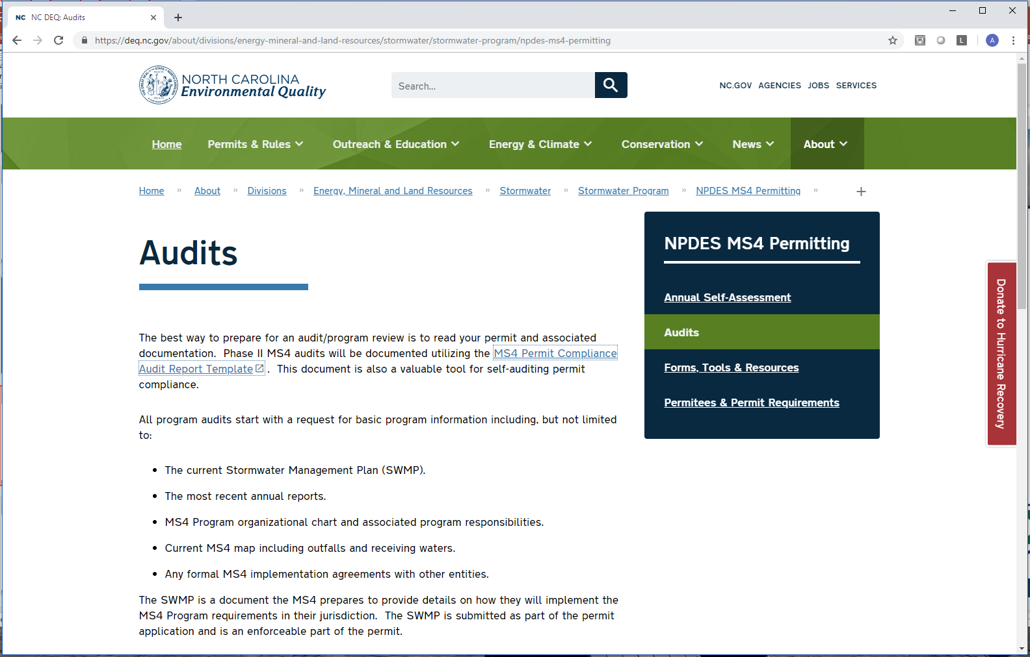
Self-Audit Template
Type in deq.nc.gov/sw in your browser
Click on NPDES MS4 Permitting in the menu to the right
Click on Audits in the sub menu

Slide 21
Duty to Comply
Any permit noncompliance constitutes a violation of the Clean Water Act and is grounds for enforcement action.
All NPDES MS4 permits are subject to federal and/or state compliance and enforcement actions.
Compliance with the requirements of a state-issued NOD or NOV, and/or issuance of civil penalties from DEMLR, does not preclude the EPA from carrying out its own enforcement case against the permittee.
Under state law, a daily civil penalty of not more than $25,000 per violation may be assessed against any person who fails to act in accordance with the requirements of a permit.
Under federal law, a daily civil penalty of not more than $37,500 per violation may be assessed against any person who violates a permit condition.
Department of Environmental Quality
Notes:
Submit a Council resolution to fund, implement and comply with the NPDESMS4 Permit conditions and requirements,
Obtain a new 5-year permit, and
Submit a 5-year SWMP detailing the path to full compliance.

Slide 22
Alaina Morman
Environmental Specialist
(919) 707-9236 alaina.morman@ncdenr.gov
For questions concerning compliance and enforcement, please contact:

