Slide 1
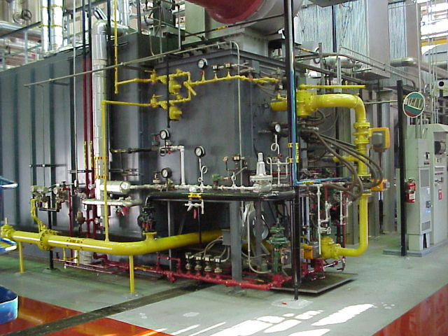
Boiler and Cooling Tower Blowdown
Keyes McGee, E.I.
Pretreatment Unit,
NC Division of Water Quality

Slide 2
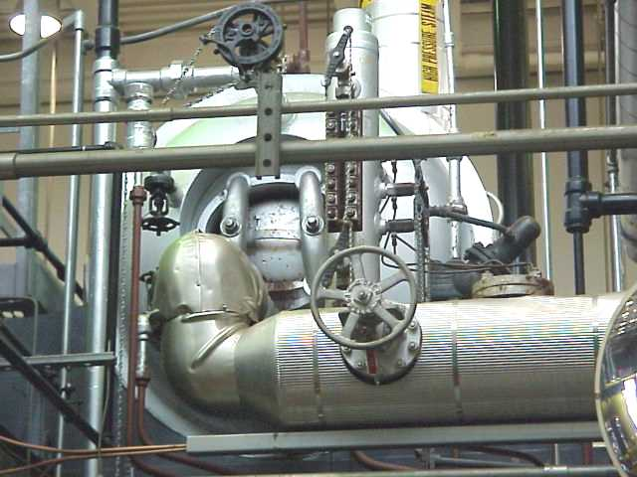
Practical Guidance for Publicly Owned Treatment Works
POTW Responsibilities
Boiler and Cooling Tower overviews.
Water Chemistry Requirements.
Purpose of Blowdown.
Blowdown Effluents.

Slide 3
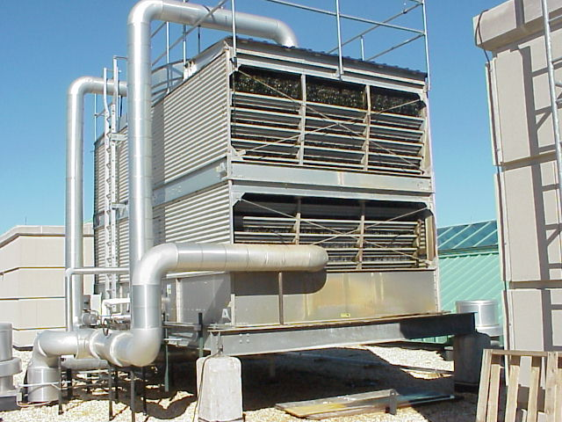
POTW Responsibilities
Inspection of facilities connected to POTWs, reference 40 CFR 403.8 (f)(1)(v).
Flow measurements.
Heat > 40ºC (140 ºF), reference 40 CFR 403.5 (b)(5).
Toxicity issues.

Slide 4
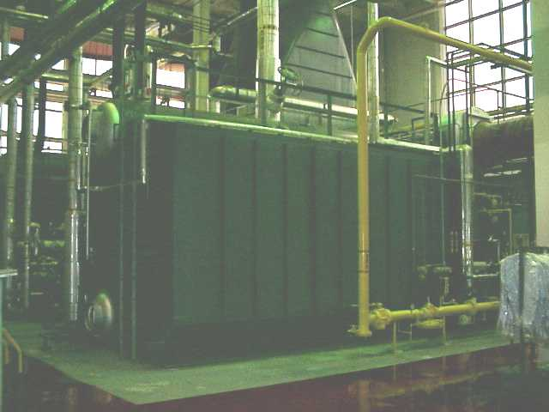
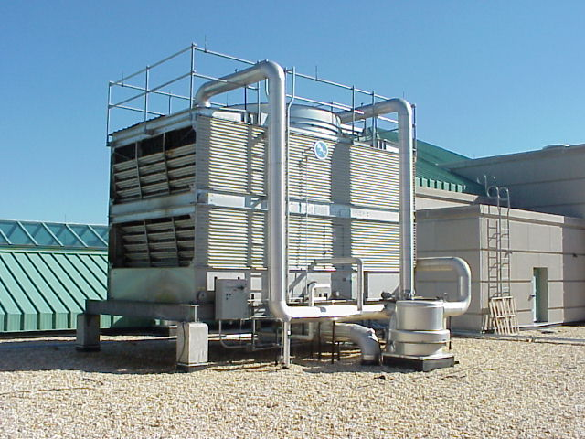
Boilers and Cooling Towers
“Heat Capacity” is the essential property of H₂O.
Boilers and Cooling Towers are both parts of “Heat Engines”.
Boilers convert combustion heat to steam for energy transfer.
Cooling Towers use the latent heat of vaporization to transfer energy to the atmosphere (sensible heat exchange also).

Slide 5
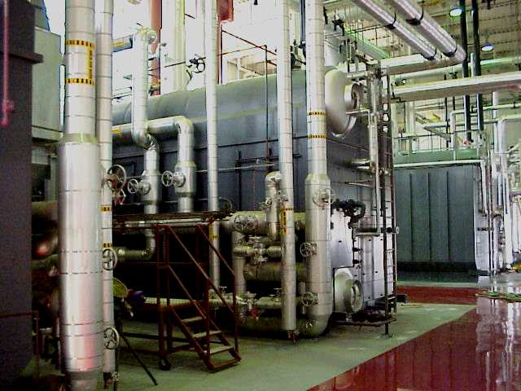
Boilers
Heat of combustion is transferred to H₂O.
H₂O flow is from H₂O Drum (lower) thru tubes to the Steam Drum (upper).
Steam is sent out the upper drum with a high energy state.
Condensed Steam is recycled.

Slide 6
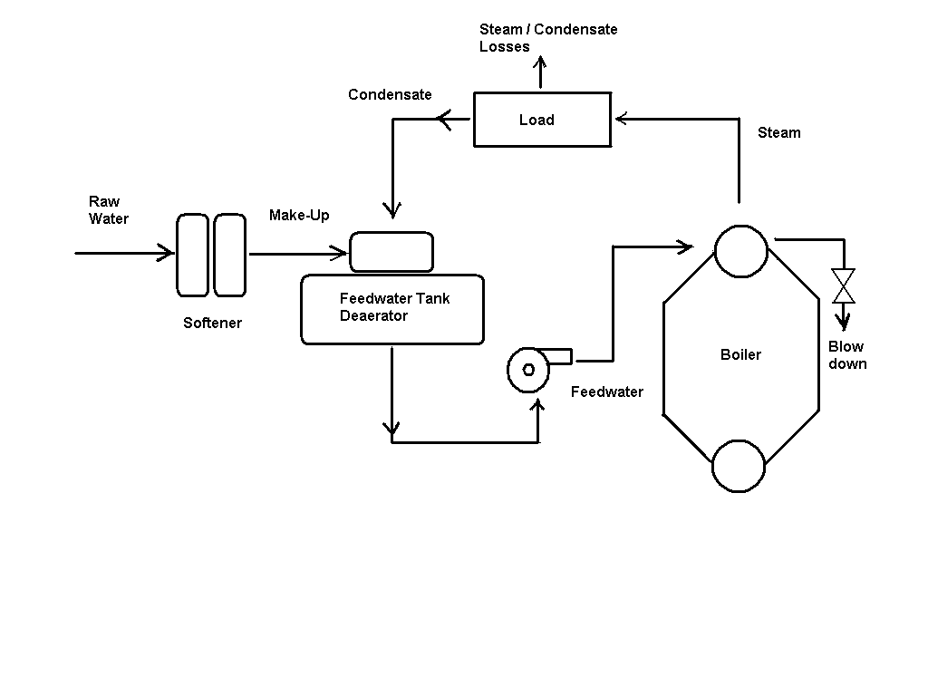
Boiler Schematic

Slide 7
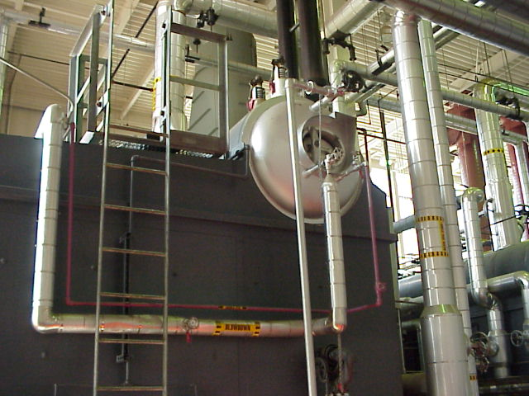
Boiler Feed Water
Common H₂O Impurities of concern are:
Hardness.
Alkalinity.
Silica.
Iron.
Oxygen.

Slide 8
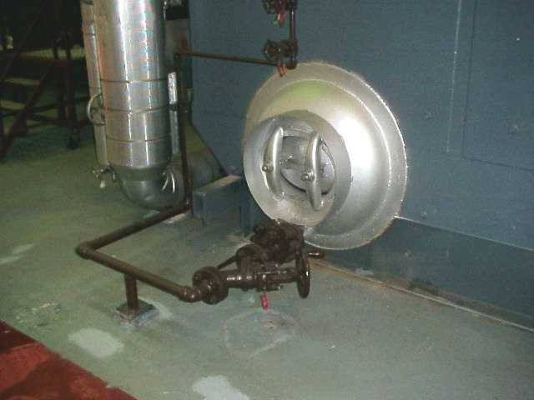
Three Major “Waterside” Problems in Boilers
Corrosion
Scale
Deposits

Slide 9
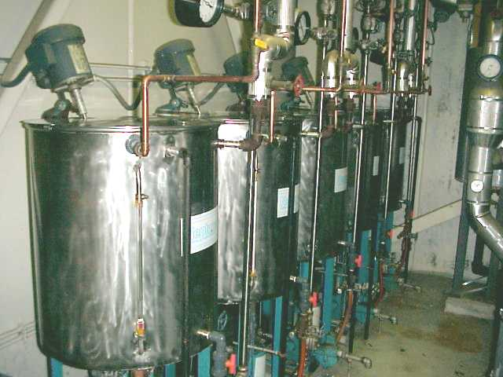
Boiler Water Treatments
Sodium Cycle Softening for all Make-Up H₂O.
Mechanical and Chemical dissolved oxygen removal.
Precipitating Programs - Dispersants.
Solubilizing Programs - Sequesterants.
Combination Program.

Slide 10
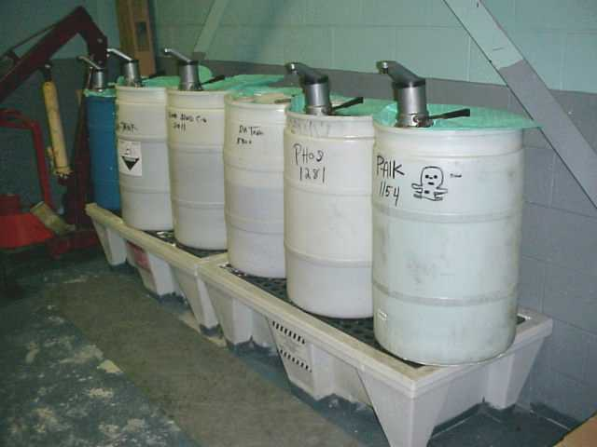
Condensate Water Treatment
(Post Boiler System)
Neutralizing Amines
Filming Amine
Blend of Neutralizing and Filming Amines.

Slide 11
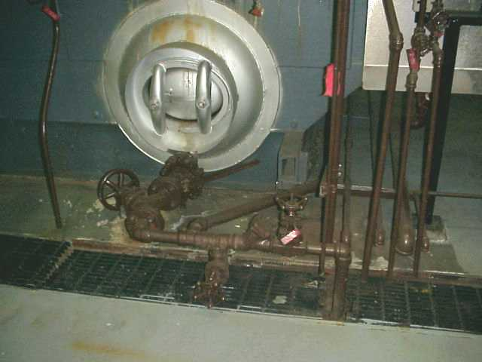
Boiler Blowdown -
Removal of a portion of the concentrated boiler water from the system.
Controls cycles of concentration within the specified ranges for impurities of concern.
Removes any sludge or other debris accumulated in the boiler.
Use of chemicals minimized to save $.
Bottom Blowdown.
Continuous Blowdown.

Slide 12
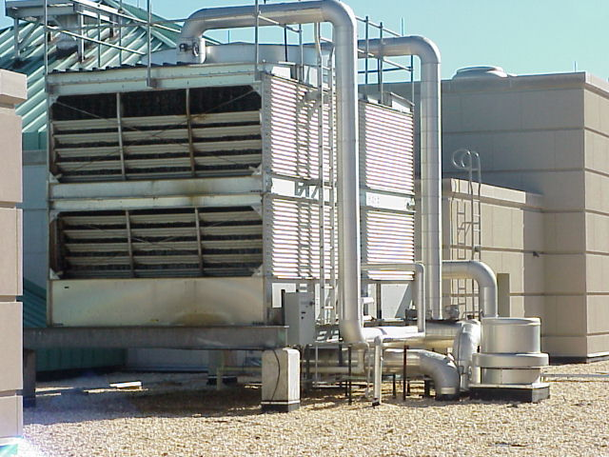
Cooling Towers
Provides chilled water to an air handling unit, serving as a heat rejecter in a mechanical refrigeration system.
Or
Releases heat from a process H₂O Condenser System loop.

Slide 13
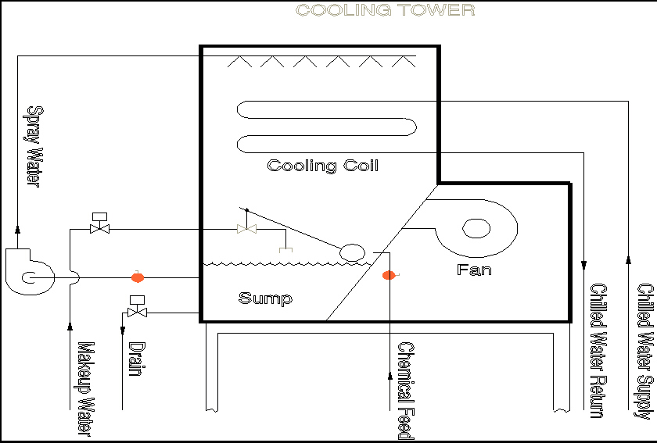
Typical Cooling Tower

Slide 14
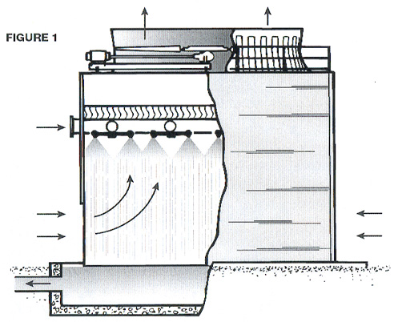
Types of Cooling Towers
Counterflow - Water flows vertically down, counter to the upward air flow.
Crossflow - Water flows vertically down, air flows horizontally.

Slide 15
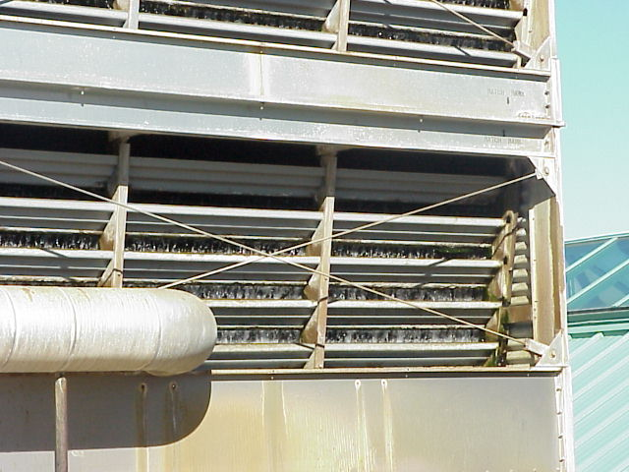
Cooling Tower Water Treatment Objectives:
Prevent and control:
Scale Formation.
Corrosion.
pH between 8 & 9.
Fouling -
  Particulate Matter.
  Biological Growth.

Slide 16
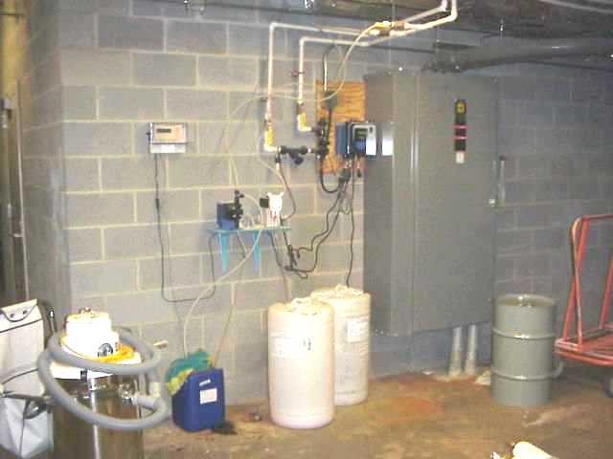
Biocides used for Cooling Tower Water
Biocide Treatment Program includes alternate use of oxidizing and non-oxidizing biocides.
Oxidizing Biocides
  Chlorine.
  Chlorine Dioxide.
  Bromine.
  Ozone.
Non-Oxidizing Biocides
  Carbamate.
  Organo-Bromide.
  Methylenebis-Thiocyanate.
  Isothiazoline.
  Quaternary Ammonium Salts.
  Organo-Tin / Quaternary Ammonium Salts.
  Glutaraldehyde.
  Dodecylguanidine.
  Triazine.

Slide 17
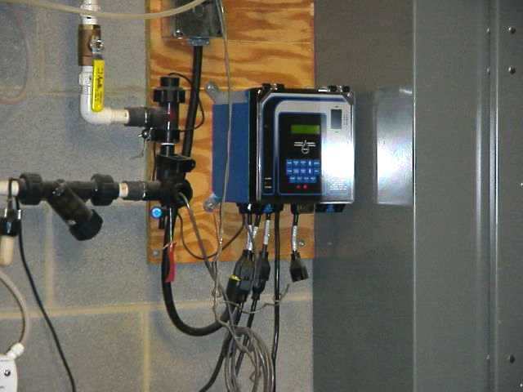
Corrosion Inhibitors in Cooling Tower Water
Molybdate.
Nitrite.
Aromatic Azoles.
Chromate.
Polyphosphate.
Zinc.
Orthophosphate.
Benzotriazole.
Tolyltriazole.
Silicate.
Note:
Corrosion is monitored with corrosion coupons (sacrificial metal tabs).

Slide 18
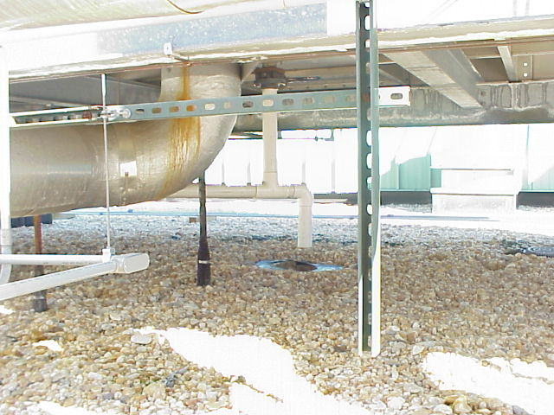
Dispersants in Cooling Tower Water
Dispersants prevent suspended and dissolved solids from settling out or forming scale in the system, remove existing deposits, and enhance biocide effectiveness.
Polyacrylate.
Polymethacrylate.
Polymaleic Acid.
Surfactants.
Note:
Side stream filtration is recommended to maintain system cleanliness.

Slide 19
Blowdown Flows
Blowdown is either discharged to the Publicly Owned Treatment Works (with POTW permission) or directly to the receiving waters of the state (with a General NPDES Permit).
Blowdown flow is make-up flow minus the calculated evaporative losses using:
  Manufacturers design calculations.
  AND
  Best Professional Judgement concerning equipment operations.

Slide 20
Biocide / Chemical Pretreatment Worksheet Form PT101
Essentially a Headworks Analysis for chemicals remaining in the Blowdown Wastestream.
Worksheet must be completed for each Biocide / Chemical Product in use.
Consultant (Vendor) must complete the worksheet due to proprietary constituents not listed on the product labeling.

Slide 21
Next Class: BB201,
Biocide Worksheet Guidance
For the Biocide / Chemical Worksheet see the Pretreatment Unit Webpage.
Please call your Pretreatment Unit contact person if you need help!
Thank you for doing a good job!

