Slide 1
North Carolina Flood Resiliency Blueprint
Coastal Resources Commission

Slide 2

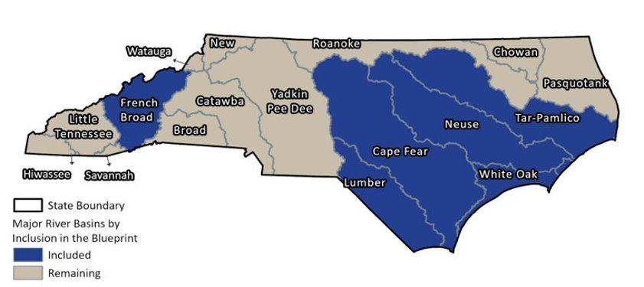
Goals:
Increase community resilience to flooding
Serve as the backbone of State flood planning
Reduce the cost and complexity for local governments in the planning and implementation of flood risk reduction projects
Should ultimately lead to a prioritized set of projects and funding strategies that the State can implement.
Targeted River Basins: Neuse, Cape Fear, Lumber, Tar-Pamlico, White Oak, and French Broad
Department of Environmental Quality
Notes:
…

Slide 3
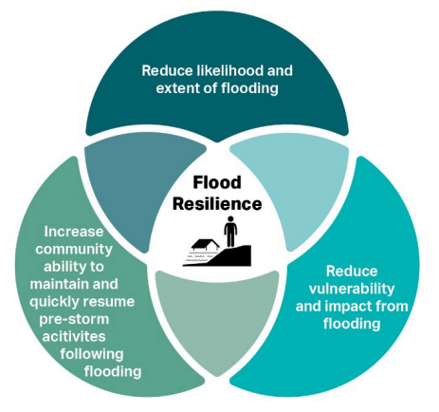
Provide local governments, the state, and partners with the data, tools, and support to guide investments that minimize the cost and disruption of future flooding.
Strategically fund priority projects, addressing gaps in current mitigation efforts.

Slide 4
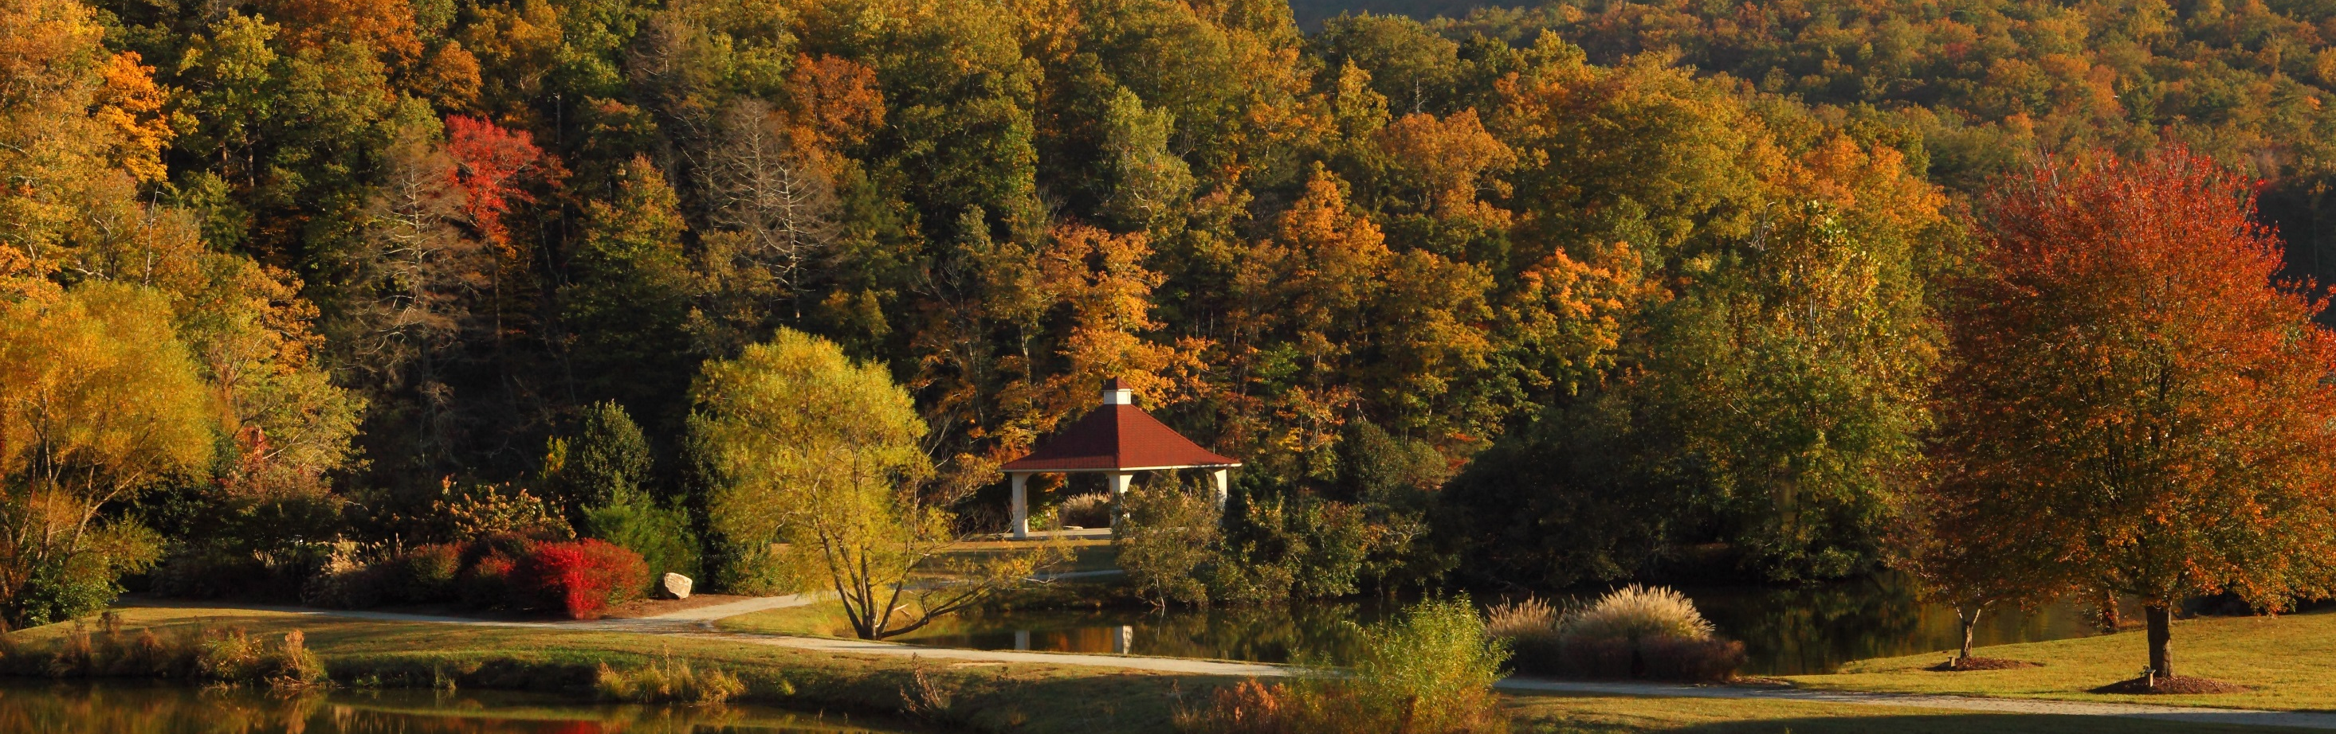
Data

Slide 5
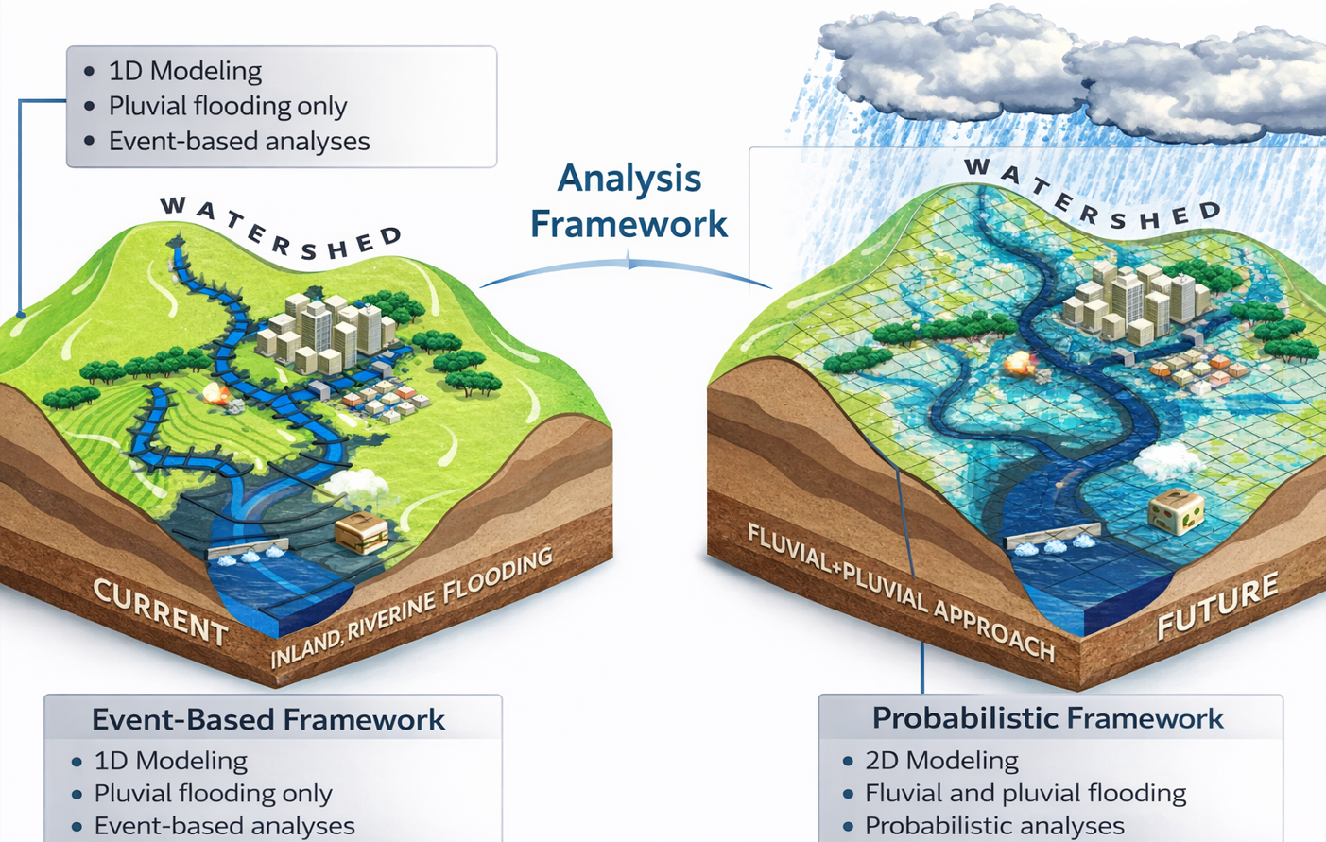
Data
Aggregate and synthesize existing data to support resilience planning.
  Develop new metrics
Improved flood modeling
  Mapping and risk data

Slide 6

Regulatory
1% Annual Chance
(100-Year Floodplain)
DEQ Advisory
1% Annual Chance
(100-Year Floodplain)
DEQ Future 2100
1% Annual Chance
(100-Year Floodplain)
Regulatory and Advisory Floodplains
Wilmington, NC
Notes:
Stu

Slide 7
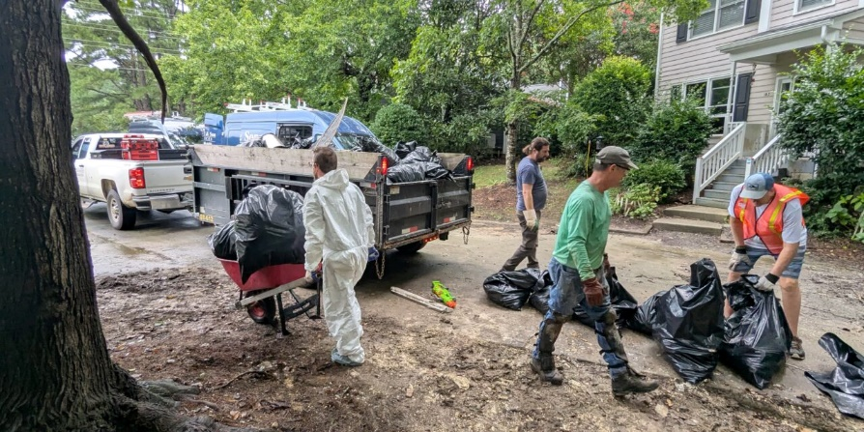
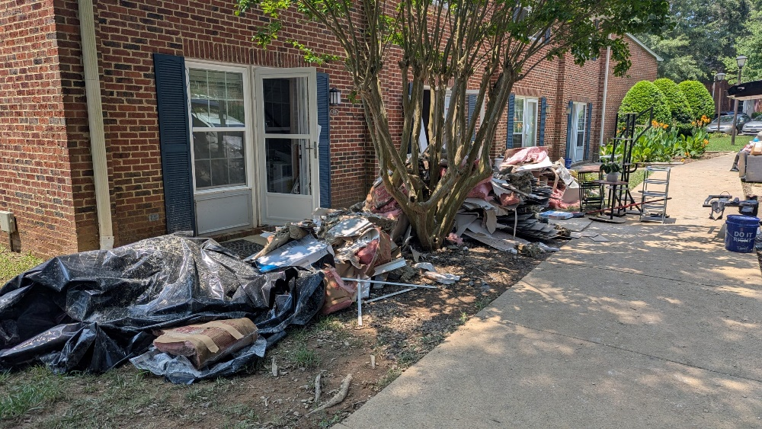
Regulatory and Advisory Floodplains
Chantal Flooding Examples
Carrboro, NC
Photo: Chapelboro.com
Regulatory
1% Annual Chance
(100-Year Floodplain)
DEQ Advisory
1% Annual Chance
(100-Year Floodplain)
DEQ Future 2100
1% Annual Chance
(100-Year Floodplain)
Photo: Brighton McConnell/Chapel Hill Media Group, via Chapelboro.com
Notes:
Use Cases –
Individual – Preparedness, decisions about mitigation, decisions about whether to buy flood insurance, whether to
Community or municipality – Preparedness, Public Safety,

Slide 8
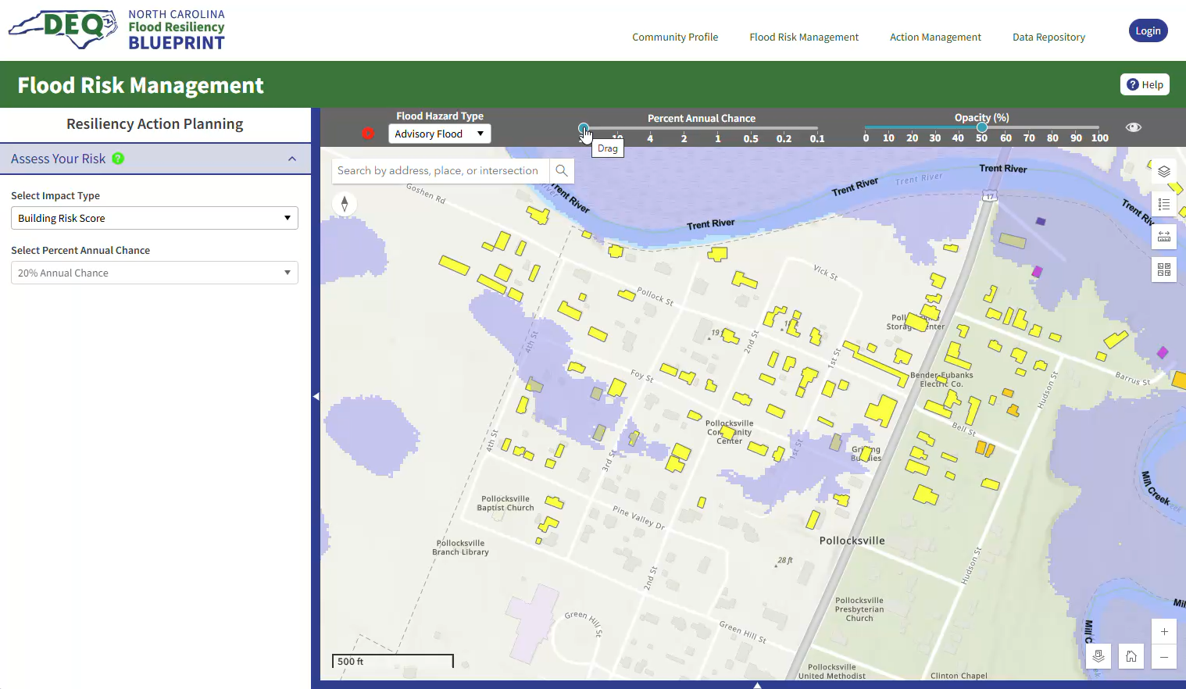
Flood Mapping and Flood Risk Data
Blueprint Tool Flood Mapping Quick Start Guide
Notes:
We have this. It is in the tool it is public facing.

Slide 9
Tools

Slide 10
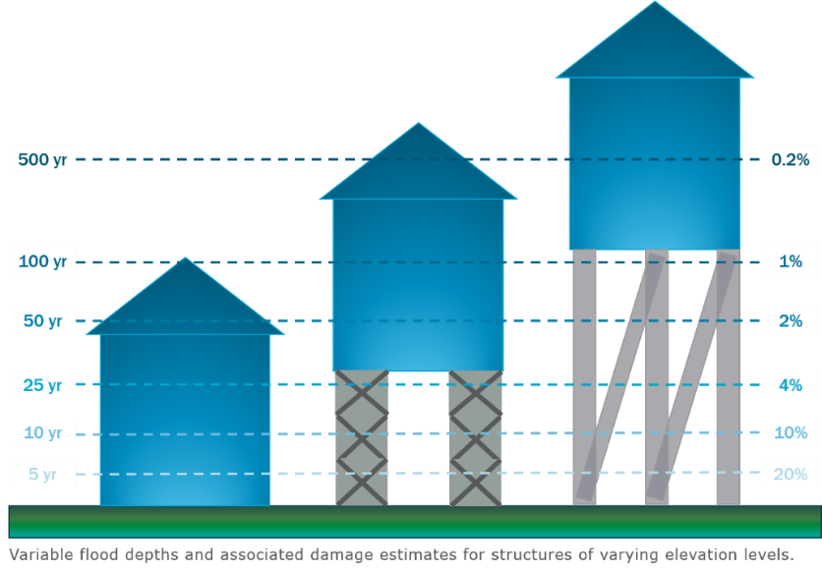
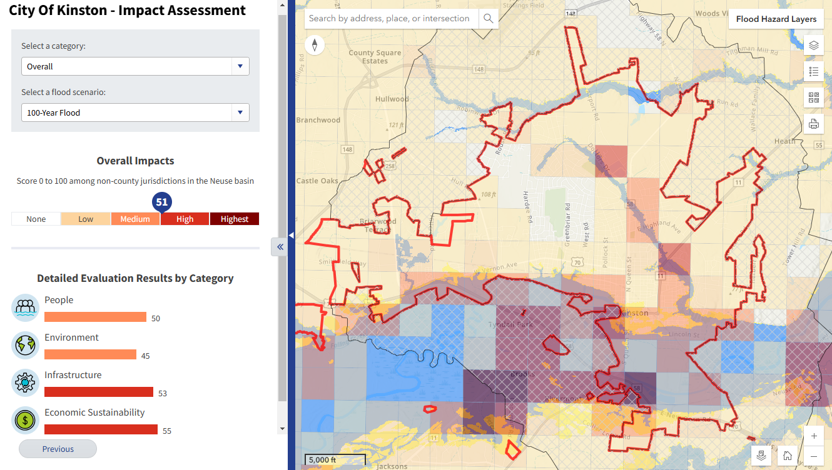
Blueprint Tool
Be a resource for communities, local governments, and other partners for the planning and implementation of resilience actions
  Provide users with accurate, data-driven flood risk and vulnerability assessments
  Allows users to explore, develop, evaluate, and prioritize effective flood resilience actions
frbt.deq.nc.gov

Slide 11
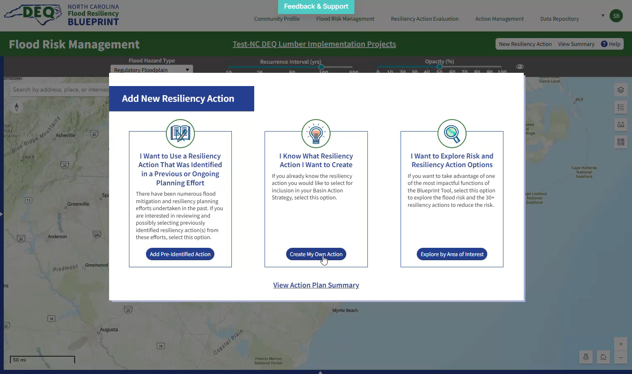
Blueprint Tool
Be a resource for communities, local governments, and other partners for the planning and implementation of resilience actions
  Provide users with accurate, data-driven flood risk and vulnerability assessments
  Allows users to explore, develop, evaluate, and prioritize effective flood resilience actions
Concept
Resilience Action
With estimated Costs, Impacts, Complexity, Score
frbt.deq.nc.gov

Slide 12
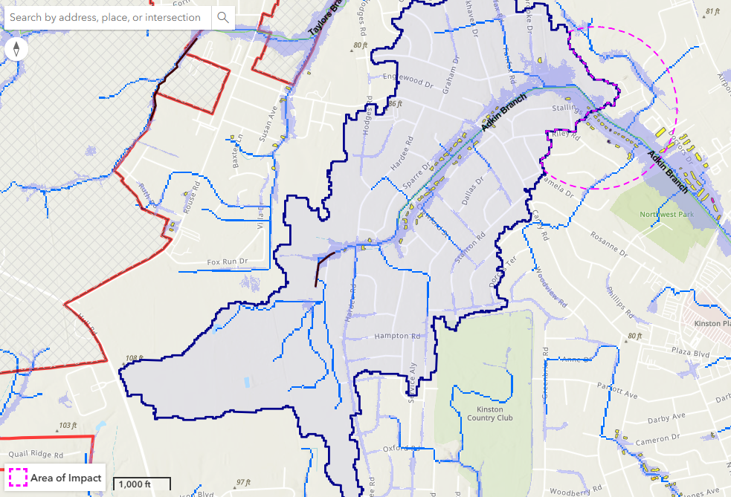
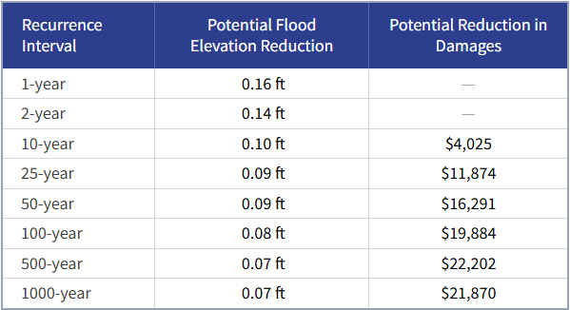
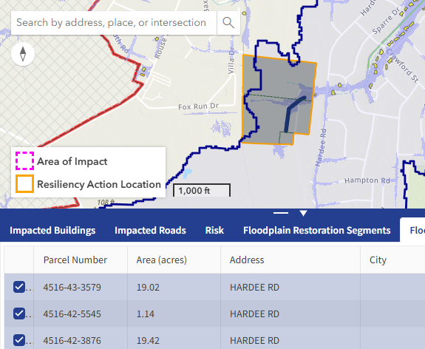
Floodplain Restoration
Constructed Cost: $231,750
Flood Storage: 2 Acre-Feet
Average Annual Losses Avoided: $1,325

Slide 13
Blueprint Tool
Types of Resilience Actions
Building Level Mitigation
Utility Elevation
Structural Elevation
Reconstruction
Wet Floodproofing
Dry Floodproofing
Critical Infrastructure
Acquisition/Demolition
Channel Modifications
Channel Dredging, Widening, Diversion
Nature Based Solutions
Bioretention
Raingardens/Sand Filters/Bio-Swales
Green Roofs
Living Shorelines
Permeable Pavement
Afforestation
Flood Storage Wetlands
Floodplain Restoration
Riparian Buffers
Floodplain Preservation
Infrastructure and Control Structures
Dams
Roadway Elevation/Road Crossing Modification
Storm Water Management Activities
Quarries
Policy and Planning
Land Use/Impervious Area Restrictions
Multi-use Floodplains
Stormwater, Water Quality, Floodplain Regulations
Relocation
Debris Removal
Water Farming
Levee/Dike/Berm
Enhanced Zoning
Beaver Management

Slide 14
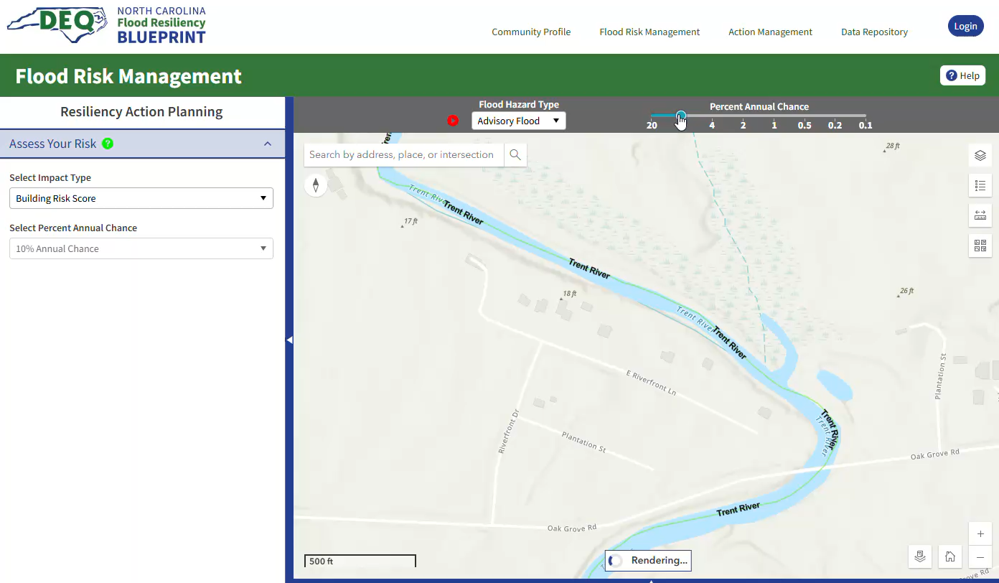
Blueprint Tool
All Users
Explore flood risk data
Community Profile
  Critical Infrastructure
  Emergency Services
  Environmental Concerns
  Historical Buildings & Areas
  Housing
  Land Use
  Population & Demographics
View submitted resilience Actions and plans
Partners Communities (Cities, Towns, Counties), COGs, NGOs, Fellow state agencies
Action development and ranking
Local plan development
Identify funding opportunities
frbt.deq.nc.gov

Slide 15
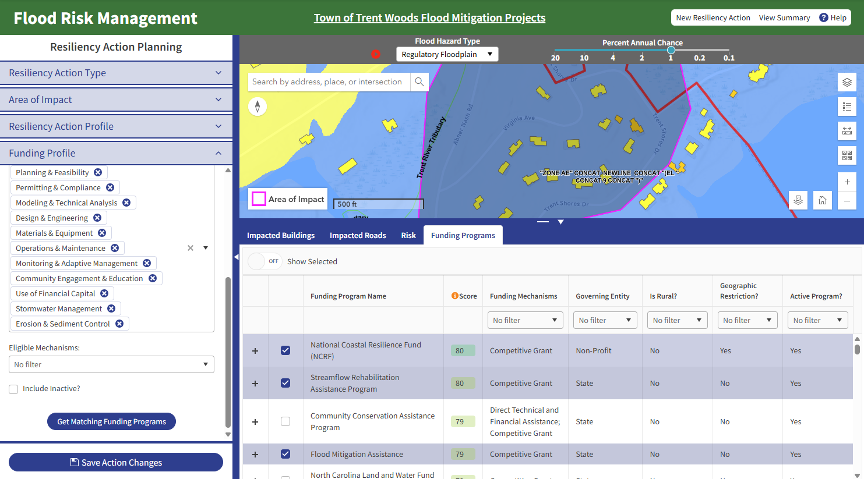
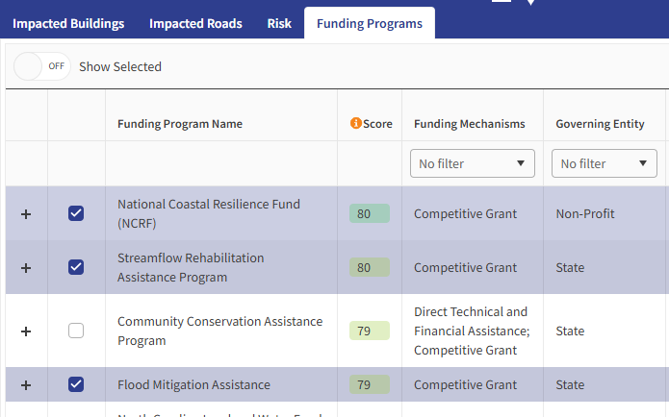
Fund Matching Tool
Notes:
There is an enormous amount need across our state . funding for engineering and implementation is always going to be a limitation funding effectively as possible , identify and marshal outside of their funding sources …in order to be successful we will continue to work with the agencies to make sure that everyone is pulling tin the same direction.
The Blueprint has demonstrated the value of leveraging implementation funding to strategically support priority projects and address gaps in existing mitigation efforts. Through targeted investments and coordinated planning, the Blueprint is enabling agencies and programs statewide to make more informed, effective decisions about flood resilience.
If we can take advantage o Economic development grants or Transportation grants we’ll be far more effective.

Slide 16
Process

Slide 17
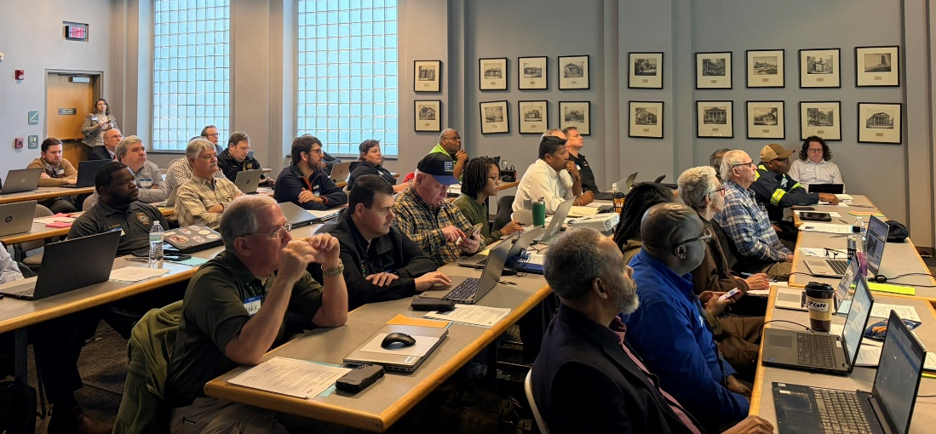
♦♦♦♦♦♦♦♦♦♦♦♦♦♦♦♦♦♦♦♦♦♦♦♦♦♦♦♦♦♦♦♦♦♦♦♦♦♦♦♦♦♦♦♦♦♦♦♦♦♦♦♦♦♦♦♦♦♦♦♦♦♦♦♦♦♦♦♦♦♦♦♦♦♦♦♦♦♦♦♦♦♦♦♦♦♦♦♦♦♦♦♦♦♦♦♦♦♦♦♦♦♦♦♦♦♦♦♦♦♦♦♦♦♦♦♦♦♦♦♦♦♦♦♦♦♦♦♦♦♦♦♦♦♦♦♦♦♦♦♦♦♦♦♦♦♦♦♦♦♦♦♦♦♦♦♦♦♦♦♦♦♦♦♦♦♦♦♦♦♦♦♦♦♦♦♦♦♦♦♦♦♦♦♦♦♦♦♦♦♦♦♦♦♦♦♦♦♦♦♦♦♦♦♦♦♦♦♦♦♦♦♦♦♦♦♦♦♦♦♦♦♦♦♦♦♦♦♦♦♦♦♦♦♦♦♦♦♦♦♦♦♦♦♦♦♦♦♦♦♦♦♦♦♦♦♦♦♦♦♦♦♦♦♦♦♦♦♦♦♦♦♦♦♦♦♦♦♦♦♦♦♦♦♦♦♦♦♦♦♦♦♦♦♦♦♦♦♦♦♦♦♦♦♦♦♦♦♦♦♦♦♦♦♦♦♦♦♦♦♦♦♦♦♦♦♦♦♦♦♦♦♦♦♦♦♦♦♦♦♦♦♦♦♦♦♦♦♦♦♦♦♦♦♦♦♦♦♦♦♦♦♦♦♦♦♦♦♦♦♦♦♦♦♦♦♦♦♦♦♦♦♦♦♦♦♦♦♦♦♦♦♦♦♦♦♦♦♦♦♦♦♦♦♦♦♦♦♦♦♦♦♦♦♦♦♦♦♦♦♦♦♦♦♦♦♦♦♦♦♦♦♦♦♦♦♦♦♦♦♦♦♦♦♦♦♦♦♦♦♦♦♦♦♦♦♦♦♦♦♦♦♦♦♦♦♦♦♦♦♦♦♦♦♦♦♦♦♦♦♦♦♦♦♦♦♦♦♦♦♦♦♦♦♦♦♦♦♦♦♦♦♦♦♦♦♦♦♦♦♦♦♦♦♦♦♦♦♦♦♦♦♦♦♦♦♦♦♦♦♦♦♦♦♦♦♦♦♦♦♦♦♦♦♦♦♦♦♦♦♦♦♦♦♦♦♦♦♦♦♦♦♦♦♦♦♦♦♦♦♦♦♦♦♦♦♦♦♦♦♦♦♦♦♦♦♦♦♦♦♦♦♦♦♦♦♦♦♦♦♦♦♦♦♦♦♦♦♦♦♦♦♦♦♦♦♦♦♦♦♦♦♦♦♦♦♦♦♦♦♦♦♦♦♦♦♦♦♦♦♦♦♦♦♦♦♦♦♦♦♦♦♦♦♦♦♦♦♦♦♦♦♦♦♦♦♦♦♦♦♦♦♦♦♦♦♦♦♦♦♦♦♦♦♦♦♦♦♦♦♦♦♦♦♦♦♦♦♦♦♦♦♦♦♦♦♦♦♦♦♦♦♦♦♦♦♦♦♦♦♦♦♦♦♦♦♦♦♦♦♦♦♦♦♦♦♦♦♦♦♦♦♦♦♦♦♦♦♦♦♦♦♦♦♦♦♦♦♦♦♦♦♦♦♦♦♦♦♦♦♦♦♦♦♦♦♦♦♦♦♦♦♦♦♦♦♦♦♦♦♦♦♦
Flood Resilience Actions/Concepts
“…a successful blueprint should ultimately lead to a prioritized set of projects and funding strategies that the State can implement.”
(S.L. 2021-180)
Tiered Planning Process
Local Planning
♦♦♦♦♦♦♦♦♦♦♦♦♦♦♦♦♦♦♦♦♦♦♦♦♦♦♦♦♦♦♦♦♦♦♦♦♦♦♦♦♦♦♦♦♦♦♦♦♦♦♦♦♦♦♦♦♦♦♦♦♦♦♦♦♦♦♦♦♦♦♦♦♦♦♦♦♦♦♦♦♦♦♦♦♦♦♦♦♦♦♦♦♦♦♦♦♦♦♦♦♦♦♦♦♦♦♦♦♦♦♦♦♦♦♦♦♦♦♦♦♦♦♦♦♦♦♦♦♦♦♦♦♦♦♦♦♦♦♦♦♦♦♦♦♦♦♦♦♦♦♦♦♦♦♦♦♦♦♦♦♦♦♦♦♦♦♦♦♦♦♦♦♦♦♦♦♦♦♦♦♦♦♦♦♦♦♦♦♦♦♦♦♦♦♦♦♦♦♦♦♦♦♦♦♦♦♦♦♦♦♦♦♦♦♦♦♦♦♦♦♦♦♦♦♦♦♦♦♦♦♦♦♦♦♦♦♦♦♦♦♦♦♦♦♦♦♦♦♦♦♦♦♦♦♦♦♦♦♦♦♦♦♦♦♦♦♦♦♦♦♦♦♦♦♦♦♦♦♦♦♦♦♦♦♦♦♦♦
Basin Planning
♦♦♦♦♦♦♦♦♦♦♦♦♦♦♦♦♦♦♦♦♦♦♦♦♦♦♦♦♦♦♦♦♦♦♦♦♦♦♦♦♦♦♦♦♦♦♦♦♦♦♦♦♦♦♦♦♦♦♦♦♦♦♦♦♦♦♦♦♦♦♦♦♦♦♦♦♦♦♦♦♦♦♦♦♦♦♦♦
Feasibility, Engineering & Design
Implementation

Slide 18
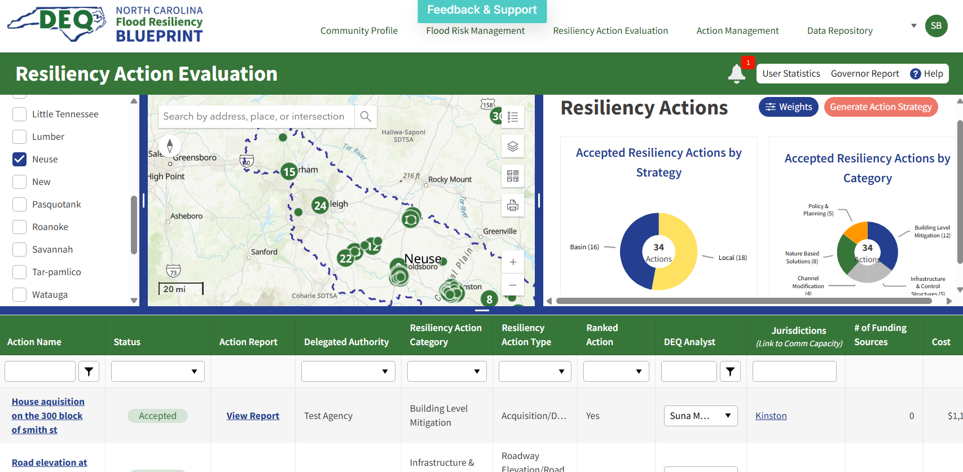
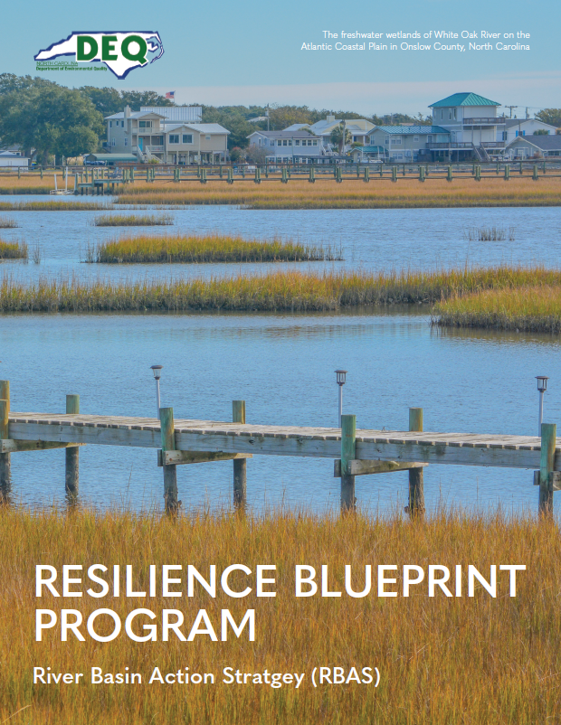
A River Basin Action Strategy outlines specific actions for increasing flood resilience for the communities included in a specific river basin
What are we delivering?
  Data, Gap Analysis, Inventory of Actions
  Vulnerability Assessments
  Capacity Assessments
  Prioritized list of actions and funding strategies
Department of Environmental Quality

Slide 19
Progress and Milestones – River Basin Action Strategies
2025
2026
Jun | Jul | Aug | Sep | Oct | Nov | Dec | Jan | Feb | Mar | Apr | May | Jun | Jul | Aug | Sep | Oct | Nov | Dec | Jan
Cape Fear River Basin Action Strategy
Basin Modeling & Data
Basin Modeling & Data
Lumber River Basin Action Strategy
Basin Modeling & Data
Tar-Pamlico River Basin Action Strategy
Basin Modeling & Data
Basin Modeling & Data
White Oak River Basin Action Strategy
Basin Modeling & Data
Basin Modeling & Data
Updated Neuse River Basin Action Strategy
Basin Modeling & Data
Basin Modeling & Data
French Broad River Basin Action Strategy
Basin Modeling & Data
Notes:
The first round of this process is currently underway
5 eastern basins
French broad had to redo modeling and recover following Helene
What are we delivering to the General assembly?
THIS IS NOT THE END OF OUR WORK IN THESE BASINS…
Our staff
Update / Develop new local action plans
Consistent resource for these basins

Slide 20
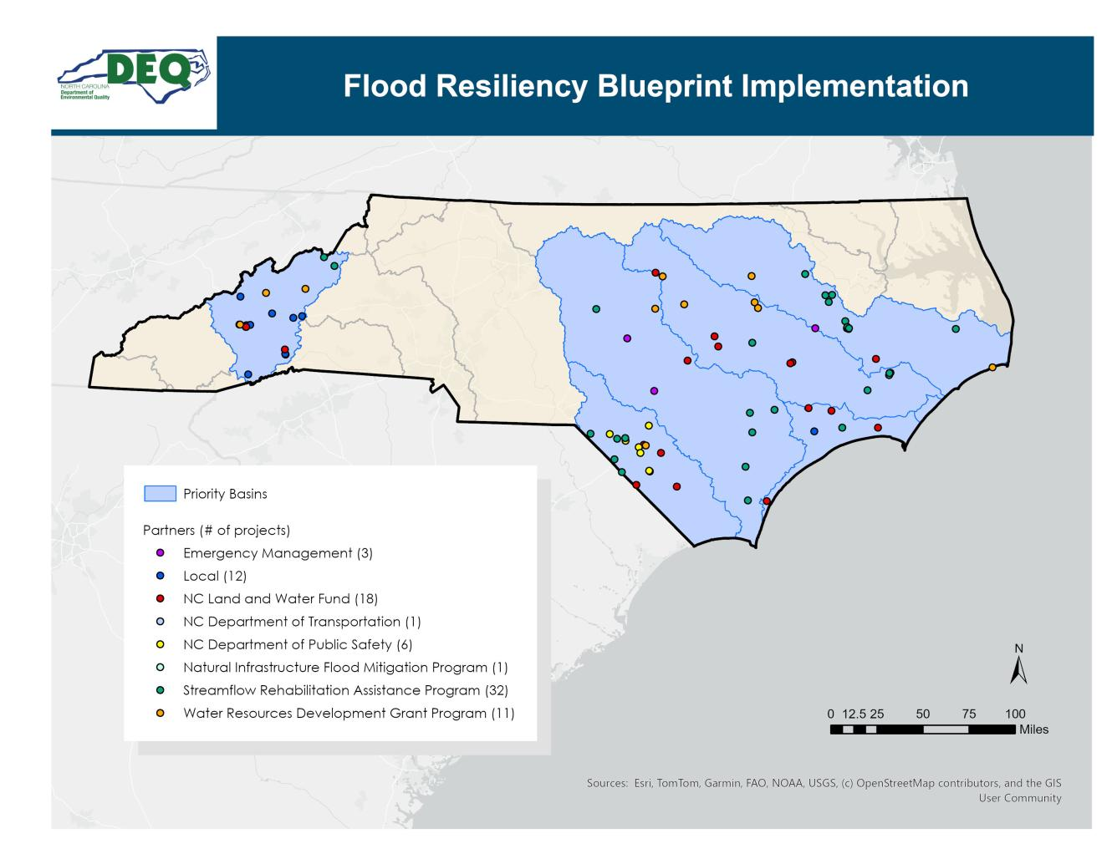
“Strategically fund priority projects, addressing gaps in current mitigation efforts.”

Slide 21
Next Steps

Slide 22
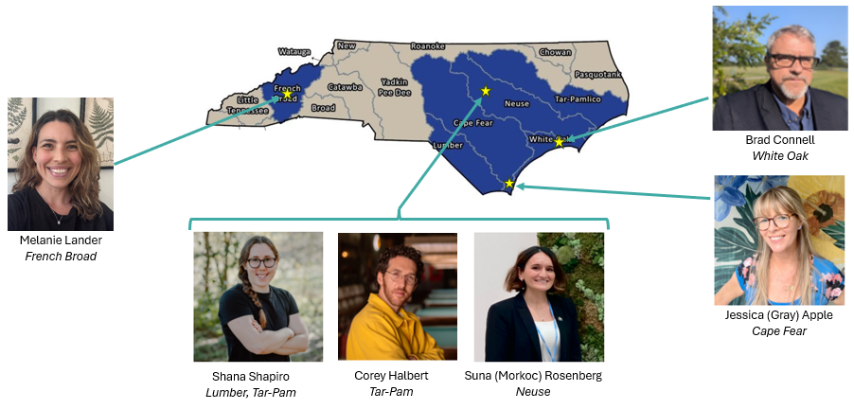
2026 Legislative Session - Budget
Funded:
$850,000 Staff (1- year time limited)
$4.5M Implementation
Department of Environmental Quality

Slide 23
Next Steps – Long-Term (1+ Years)
Program Needs
Permanent positions for staff
Statewide Expansion
  Staff Support
  Data and Tool development for 11 basins
  Modeling remaining basins
  River Basin Action Strategies
Future Tool Maintenance & Improvements
Project Development (Feasibility, E&D)
Department of Environmental Quality

Slide 24
Next Steps – Near-Term (12 Months)
Public Solicitation ~$14M
  Application Process
  Projects must be part of a Local Action Plan
Local Planning (in six river basins)
Blueprint Tool – maintenance, development, improvement
River Basin Action Strategies
  Completing RBASs – RBAS Review
  Data collection statewide – working with COGs, Universities, other partners

Slide 25
Questions?
Contact:
Stuart Brown | Program Manager | stuart.brown@deq.nc.gov | 919-703-7944
Brad Connell | White Oak River Basin | brad.connell@deq.nc.gov | 919-707-8668
Jessica Gray | Cape Fear River Basin | jessica.gray@deq.nc.gov | 910-796-7407
Melanie Lander | French Broad River Basin | melanie.lander@deq.nc.gov | 828-793-0415
Suna Morkoc | Neuse River Basin | suna.morkoc@deq.nc.gov | 919-707-8308
Shana Shapiro | Lumber River Basin | shana.shapiro@deq.nc.gov | 919-707-8958
Corey Halbert | Tar-Pamlico River Basin | corey.halbert@deq.nc.gov | 919-707-8936
Department of Environmental Quality

