Slide 1
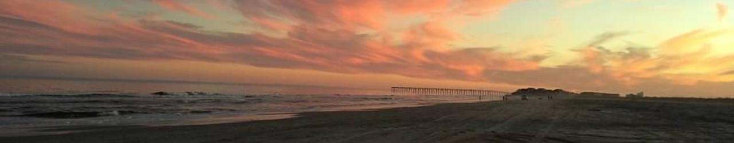

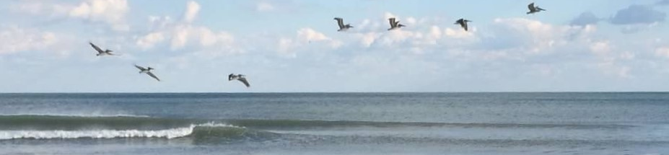
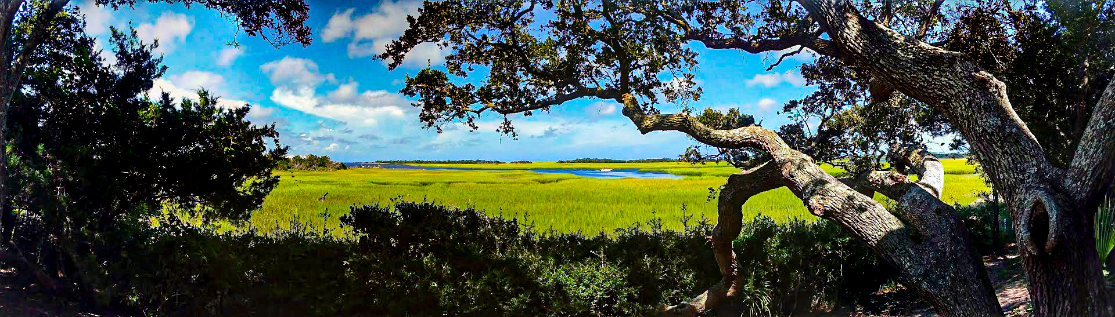
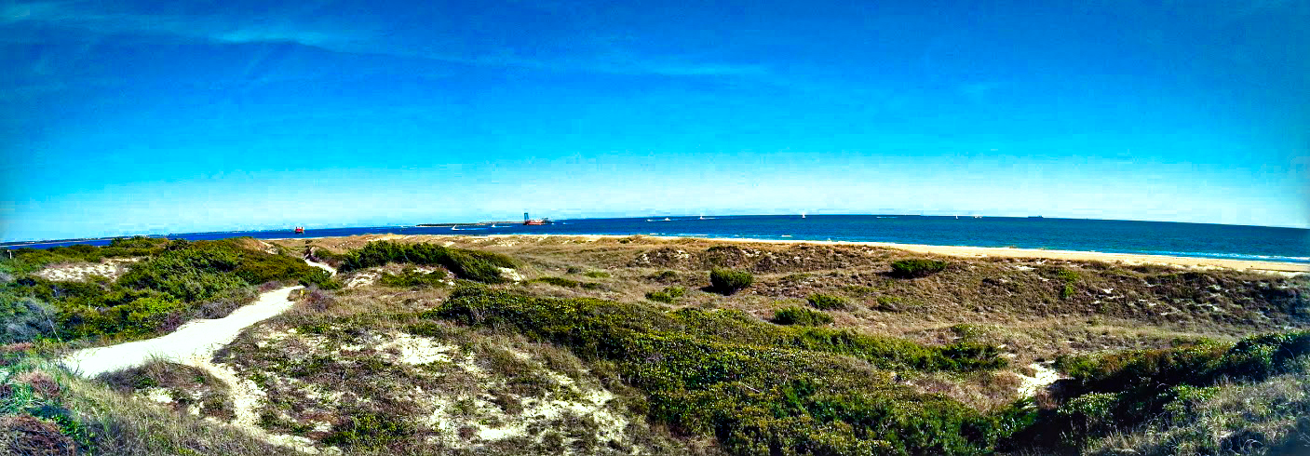
November 19, 2025
2025 Hurricane/Storms Update
Robb Mairs
NC Division of Coastal Management

Slide 2
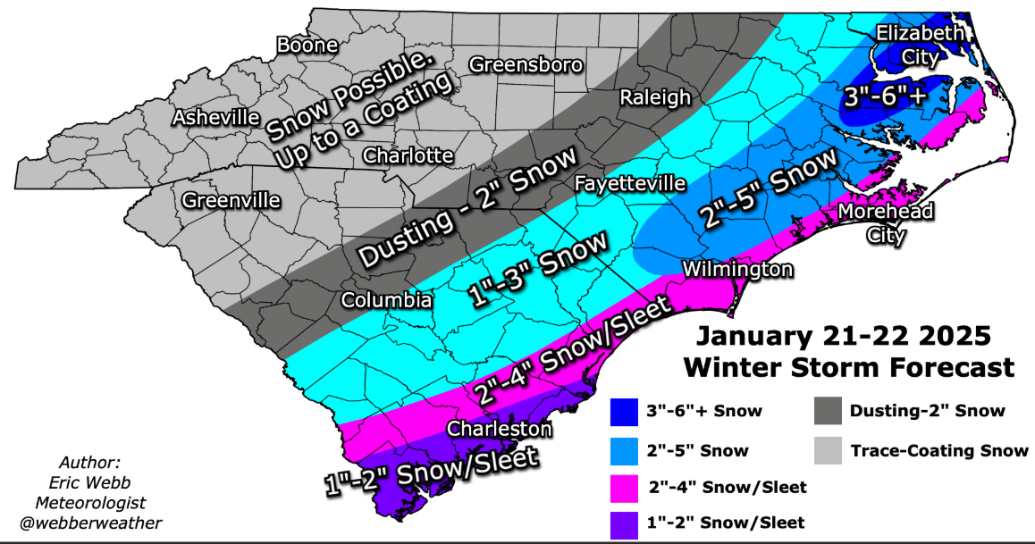

Unnamed Winter Storms
Notes:
Storm season started early this year with the first storm event in 2025 was the one during Jan. 21 -22

Slide 3
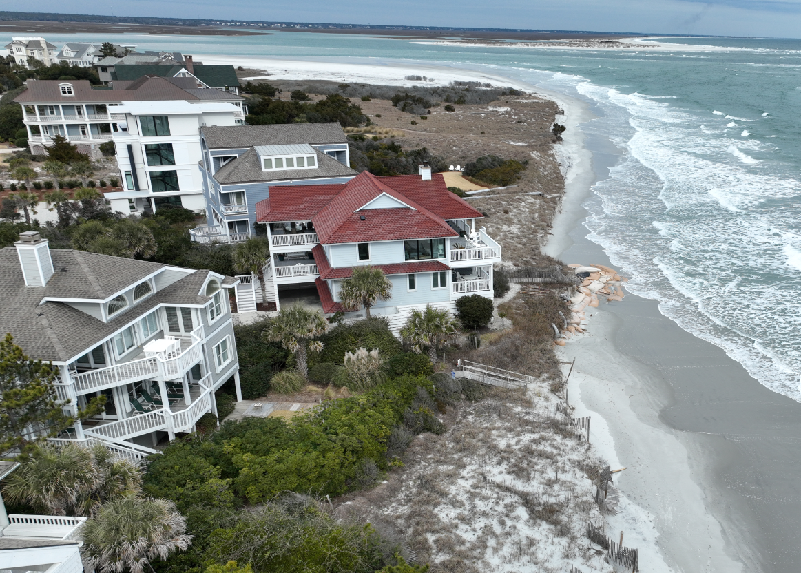
Unnamed Winter Storms
Photo Source: CPS, LLC
Facing North 1-21-25
Notes:
Drone image following an unnamed winter storm event along the coast on 1-21-25 resulted with significant snowfall across the NC coast along with beach erosion
This information was included for the property owners for accelerated erosion along Inlet Hook Rd. was authorized on 1/29/25 by DCM Director Miller

Slide 4
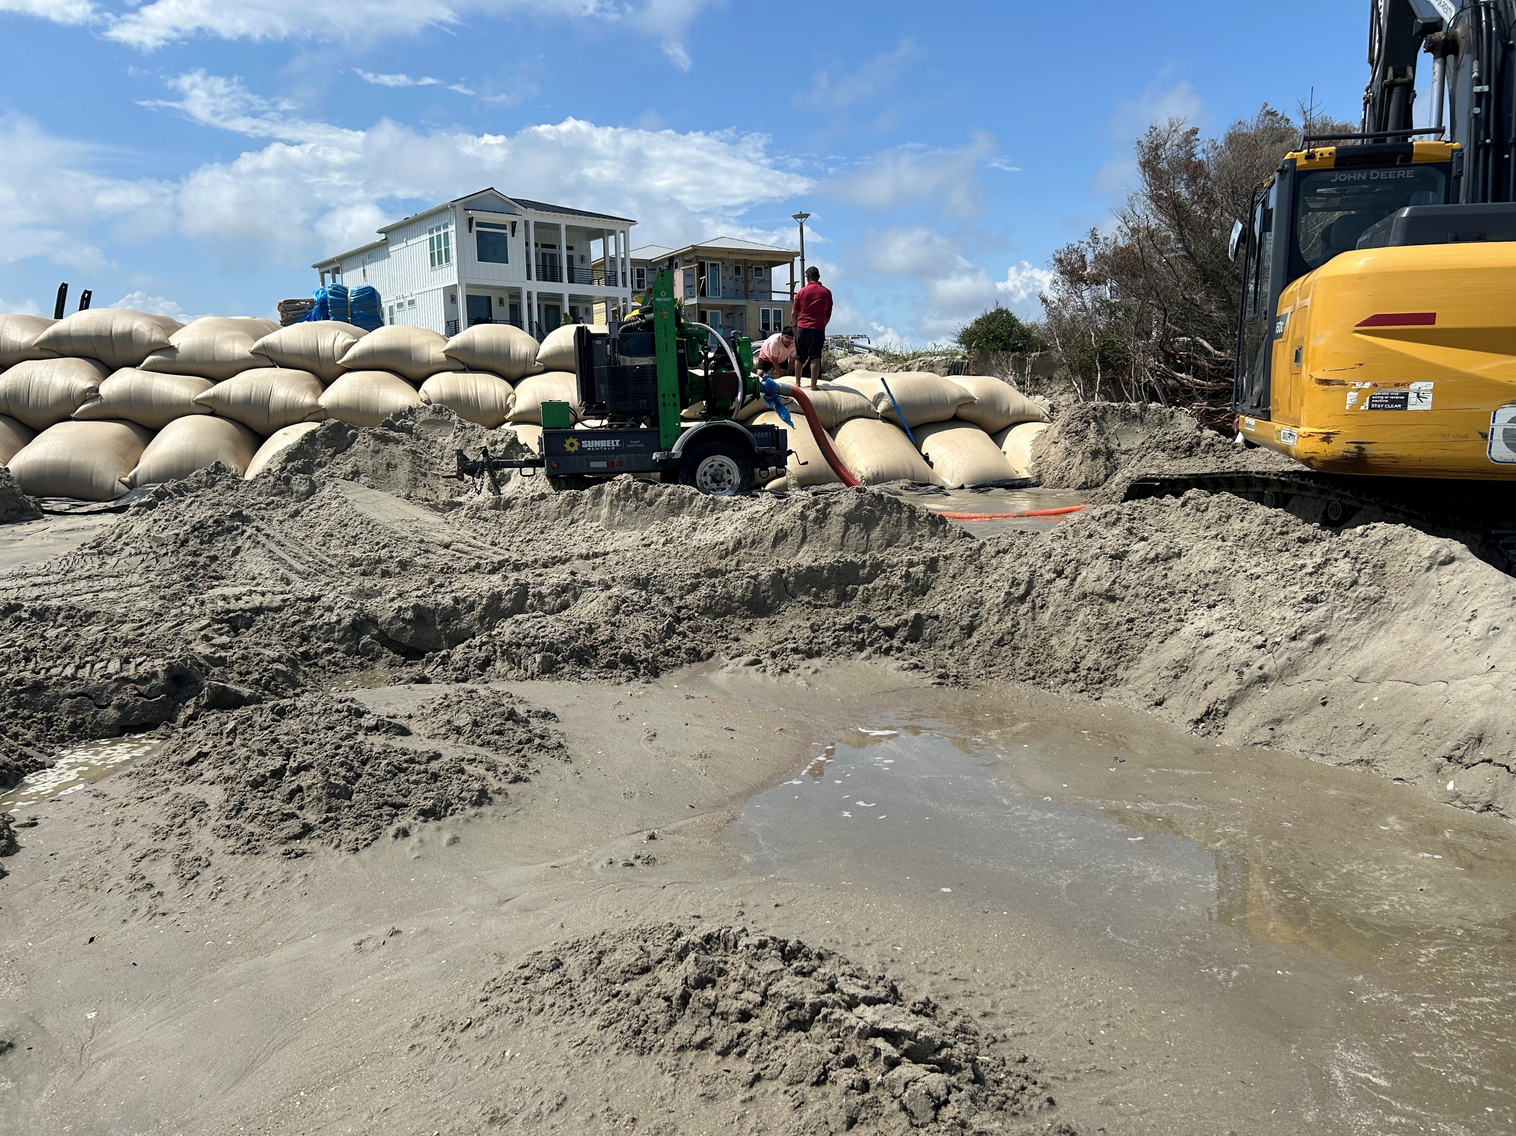
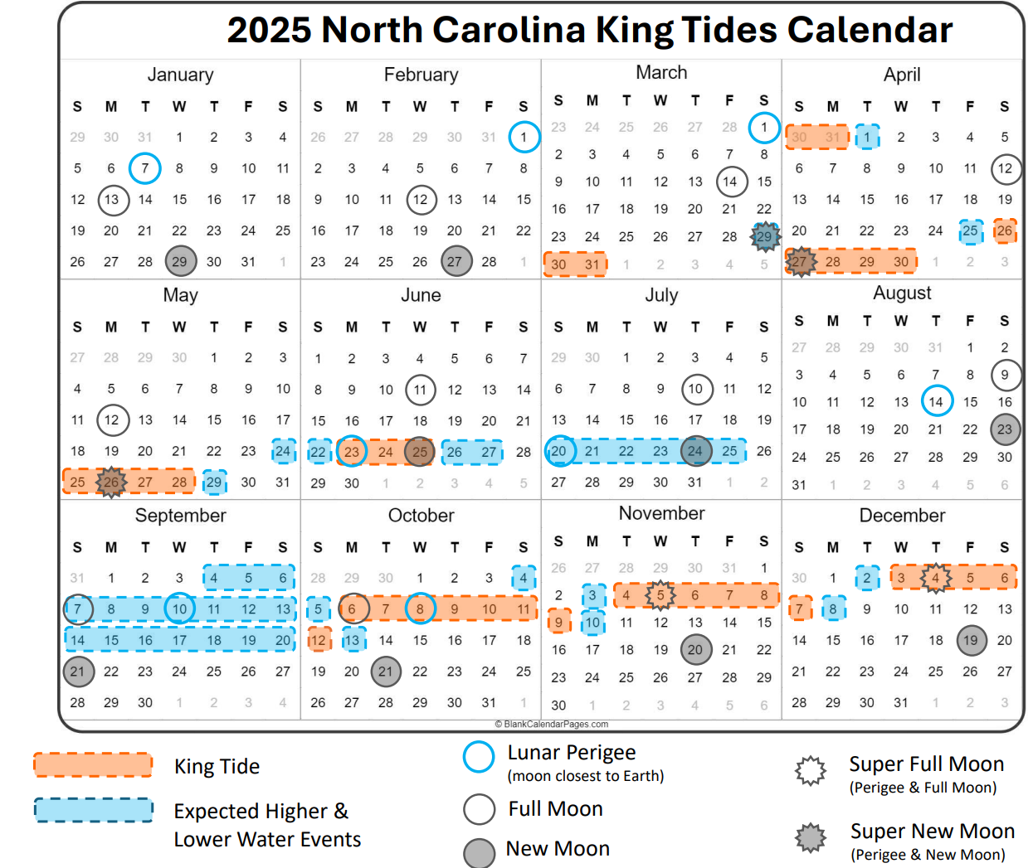
King Tides
Photo Source: NC DCM Staff 6/11/25
Notes:
DCM staff respond during a late May king tide resulted with significant NC coast along with beach erosion. Staff issued an emergency sandbag permit to protect a threatened community ROW

Slide 5
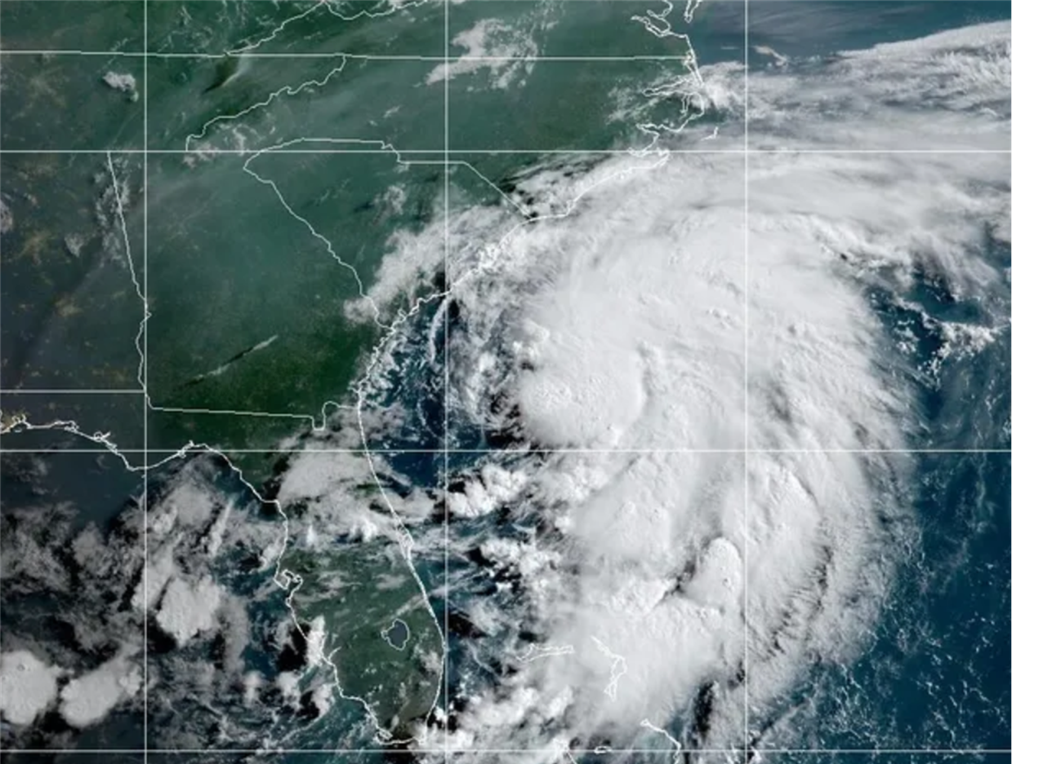
Hurricanes and Tropical Storms
Tropical Storm Chantal 7-5-25
Photo Source: NOAA/National Weather Service

Slide 6
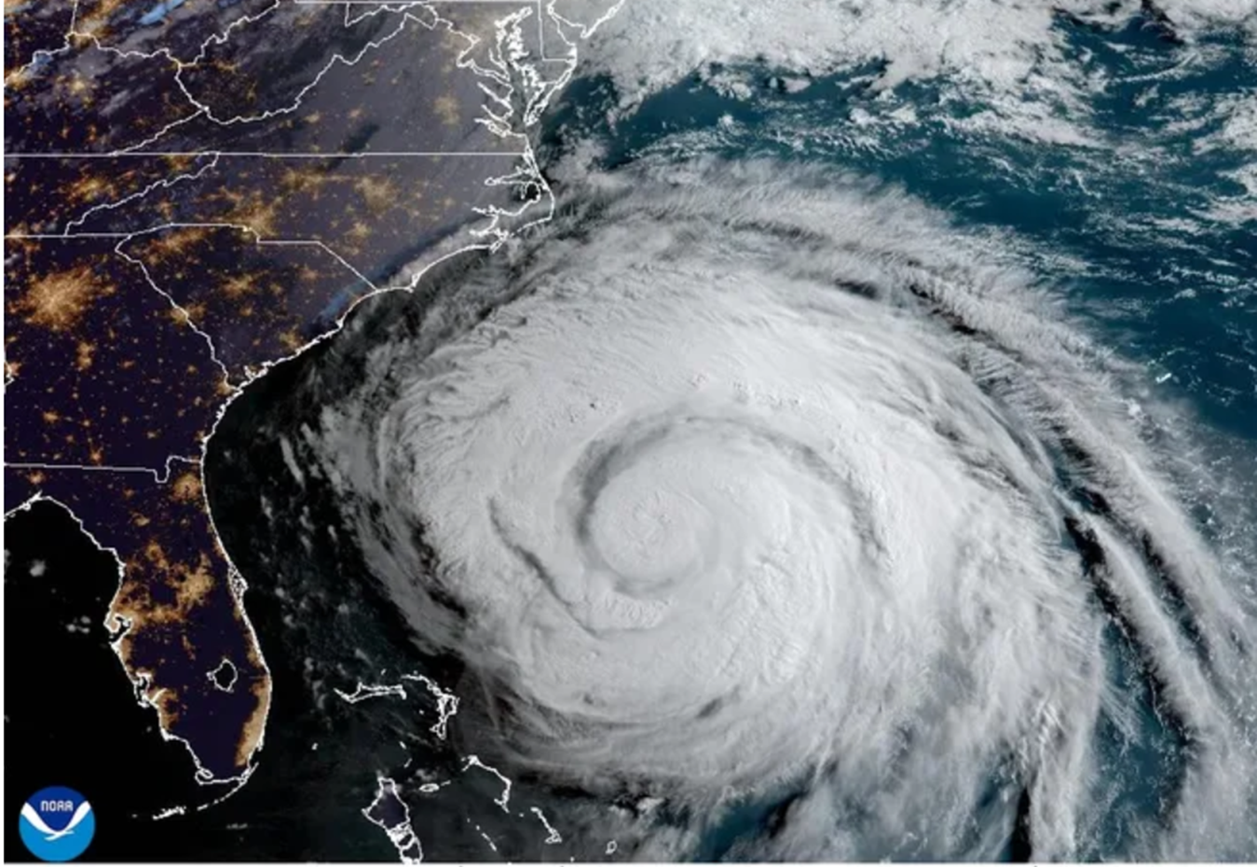
Hurricanes and Tropical Storms
Hurricane Erin 8-20-25
Notes:
Hurricane Erin crawls along the U.S. East Coast on the morning of Aug. 20, 2025.

Slide 7
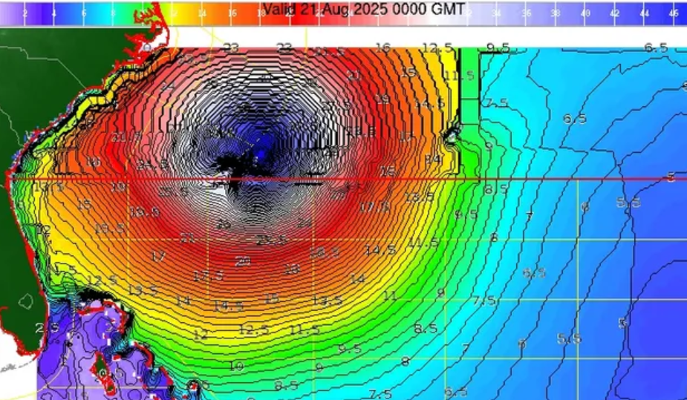
Hurricanes and Tropical Storms
Hurricane Erin 8-20-25
Hurricane Erin 8-20-25
Provided By NOAA/National Weather Service
Notes:
Wave heights offshore could reach heights of 50 feet near the eye of Hurricane Erin as the storm passes the U.S. East Coast on Aug. 19-21. It's massive wind field is stirring up the ocean across an area hundreds of miles wide.

Slide 8
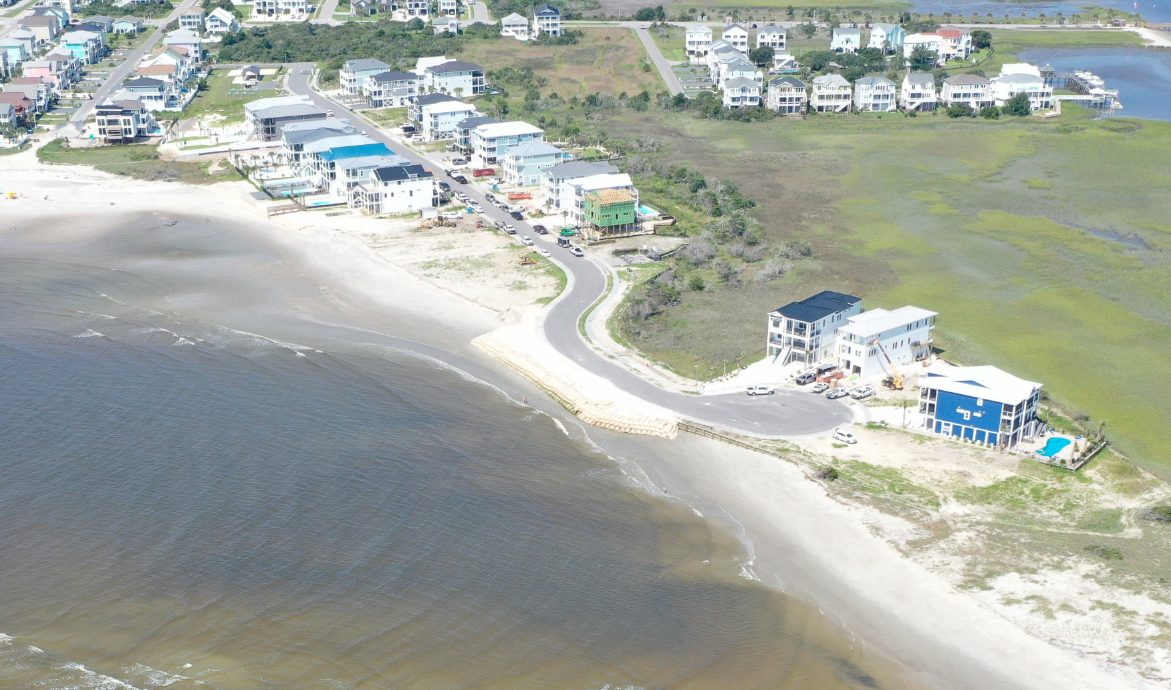
Hurricanes and Tropical Storms
Photo Source: NC DWR
Notes:
Drone flight pre Hurricane Erin 8/18/25

Slide 9
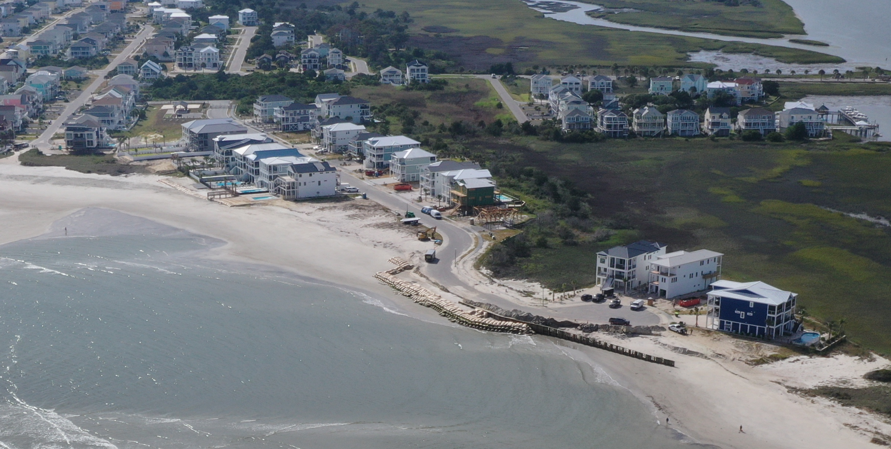
Hurricanes and Tropical Storms
Photo Source: NC DWR
Notes:
Drone flight post Hurricane Erin 9/22/25

Slide 10
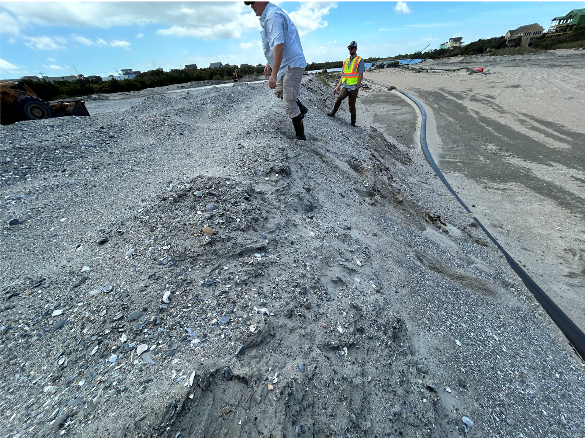
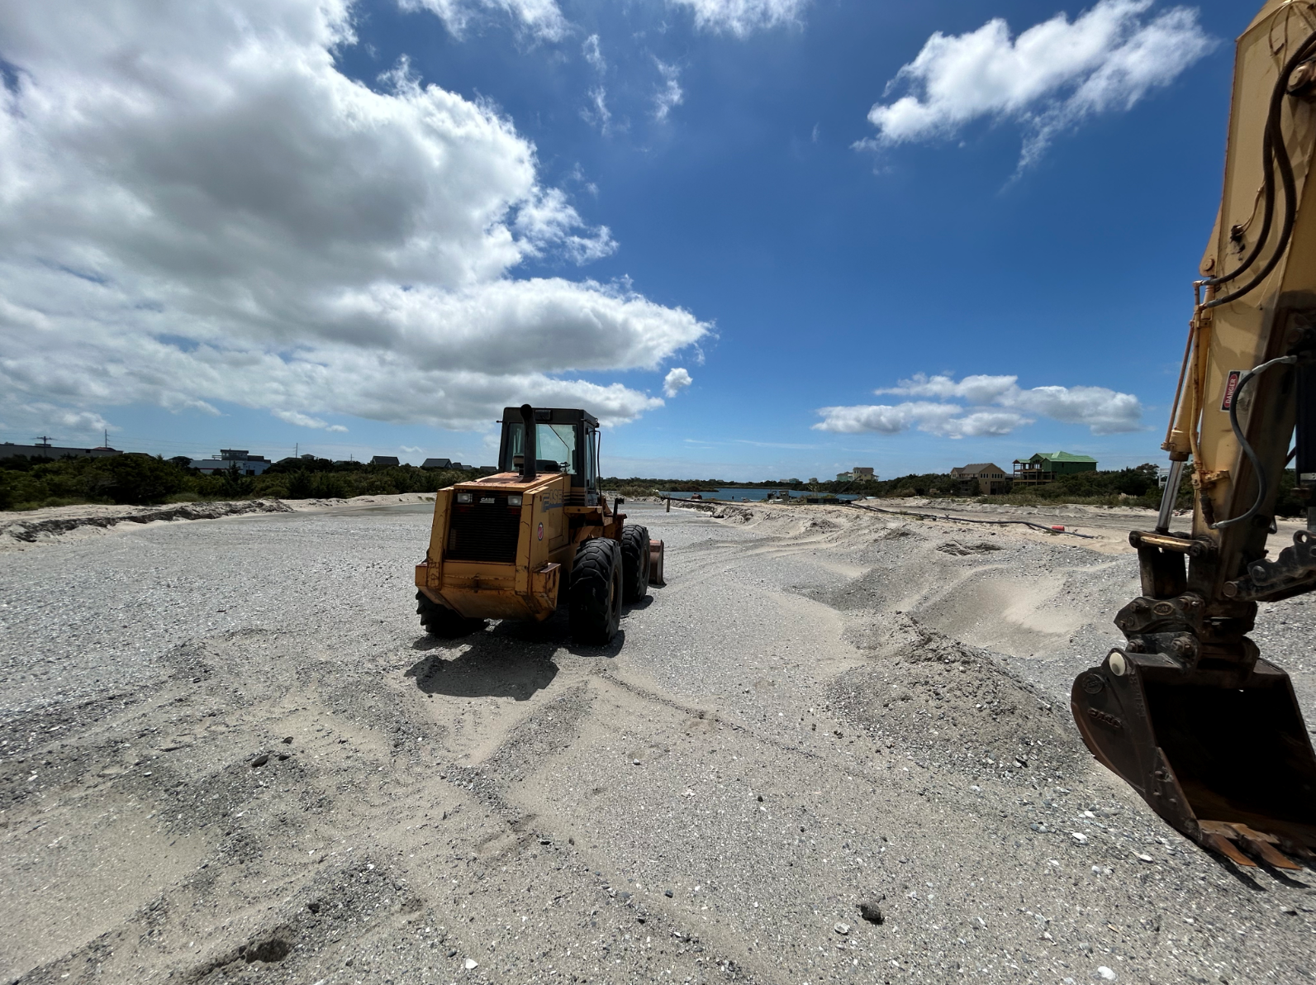
Unnamed Storms and King Tides
NCDCM and DOT Staff Avon Sand Mine/Pit Inspection 8/22/25 Prior to Hurricane Erin
Notes:
10/31/25 DOT image
DOT maintains active CAMA Major Permits for Hwy 12 on Hatteras Is. and Ocrakoke Is. and DCM and DOT work closely together on a routine basis to ensure maintenance and repair of HWY 12
To allow for dune reconstruction

Slide 11
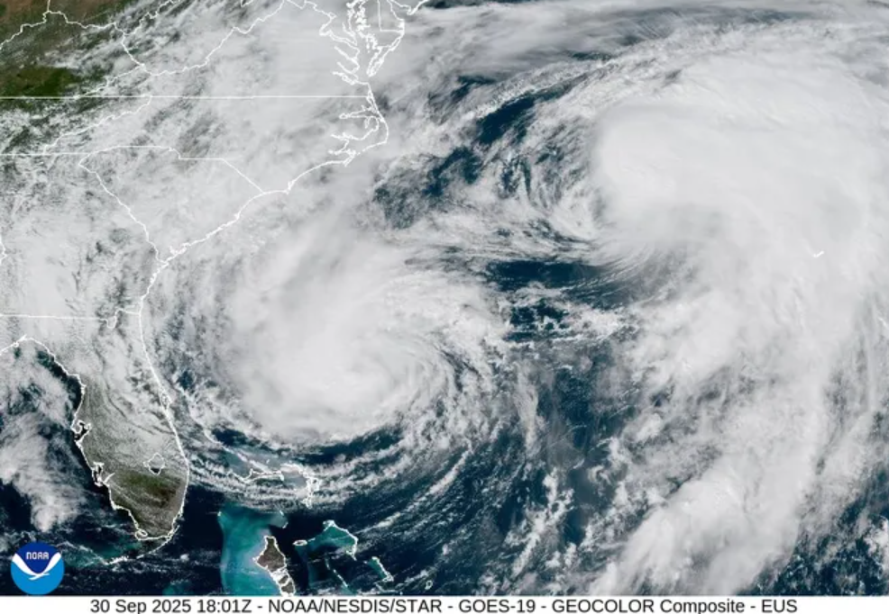
Hurricanes and Tropical Storms
Hurricanes Imelda and Humberto 9-30-25
Hurricane Erin 8-20-25
Notes:
Hurricanes Imelda and Humberto swirl in the Atlantic Ocean on Sept. 30, 2025 in this image from NOAA's GOES 19 satellite.

Slide 12
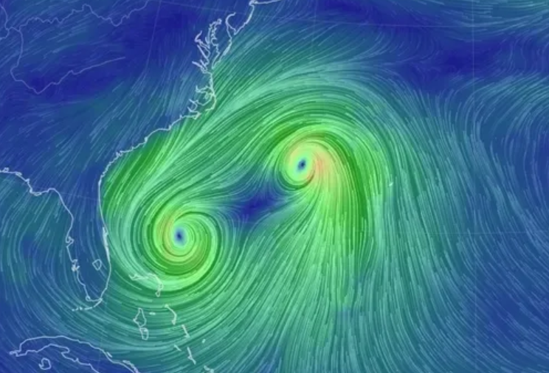

Hurricanes and Tropical Storms
Hurricanes Imelda and Humberto 9-30-25
Source: Cameron Beccario/Nullschool Technologies
Notes:
Hurricanes Imelda and Humberto swirl in the Atlantic Ocean on Sept. 30, 2025 in this image from NOAA's GOES 19 satellite.

Slide 13
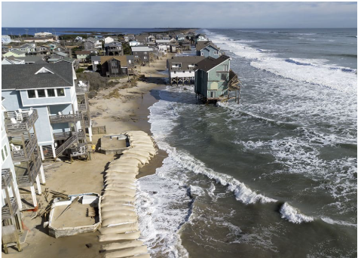
Hurricanes and Tropical Storms
Photo Source:
DCM Staff 10/7/25
Photo Source:
Don Bowers-Island Free Press
Notes:
Aerial image of the completed sandbag revetment in late Sept. 2025 to protect residential structures along Cape Court which were authorized by DCM EC Office Staff

Slide 14
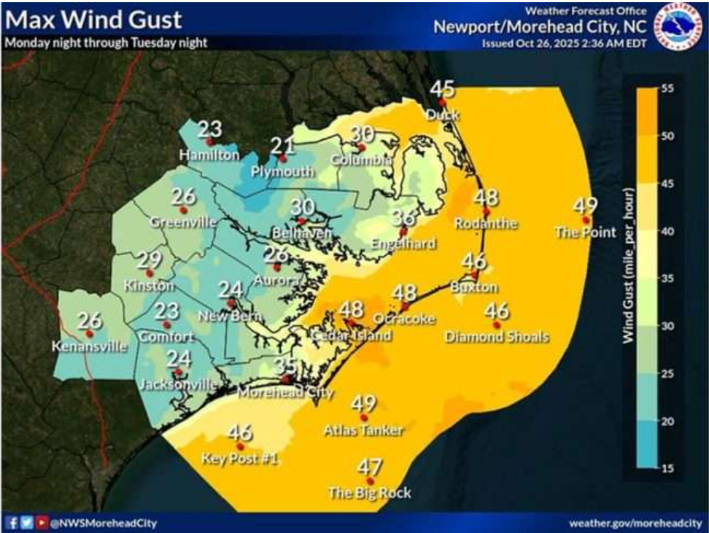
Unnamed Storms and King Tides
Notes:
Coastal Low pressure system event 10/9-10/12 during a king tide resulted with significant beach erosion and damage to buildings

Slide 15
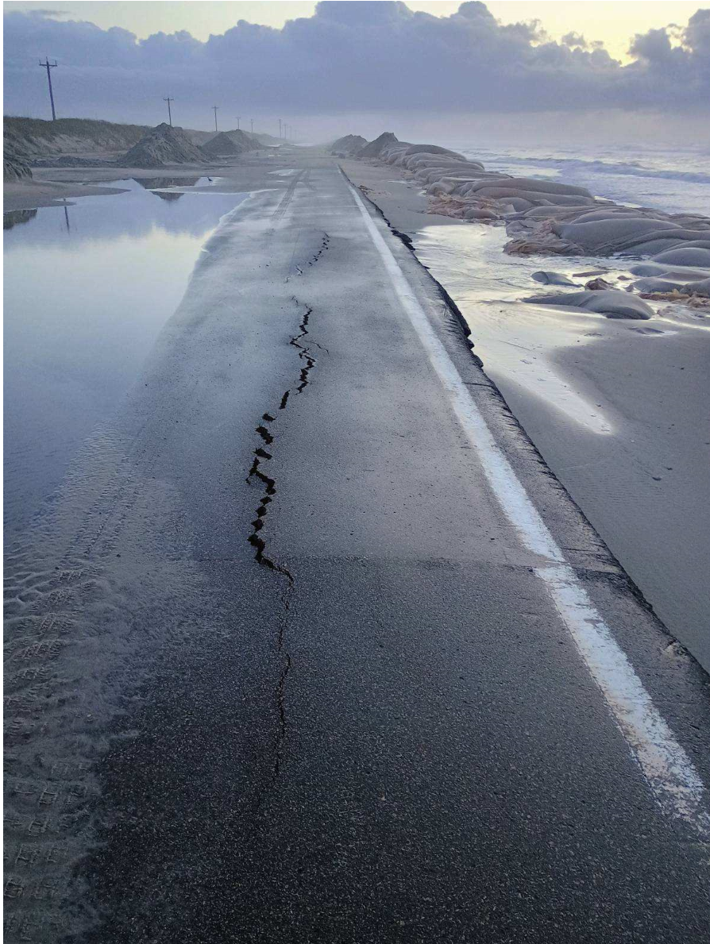
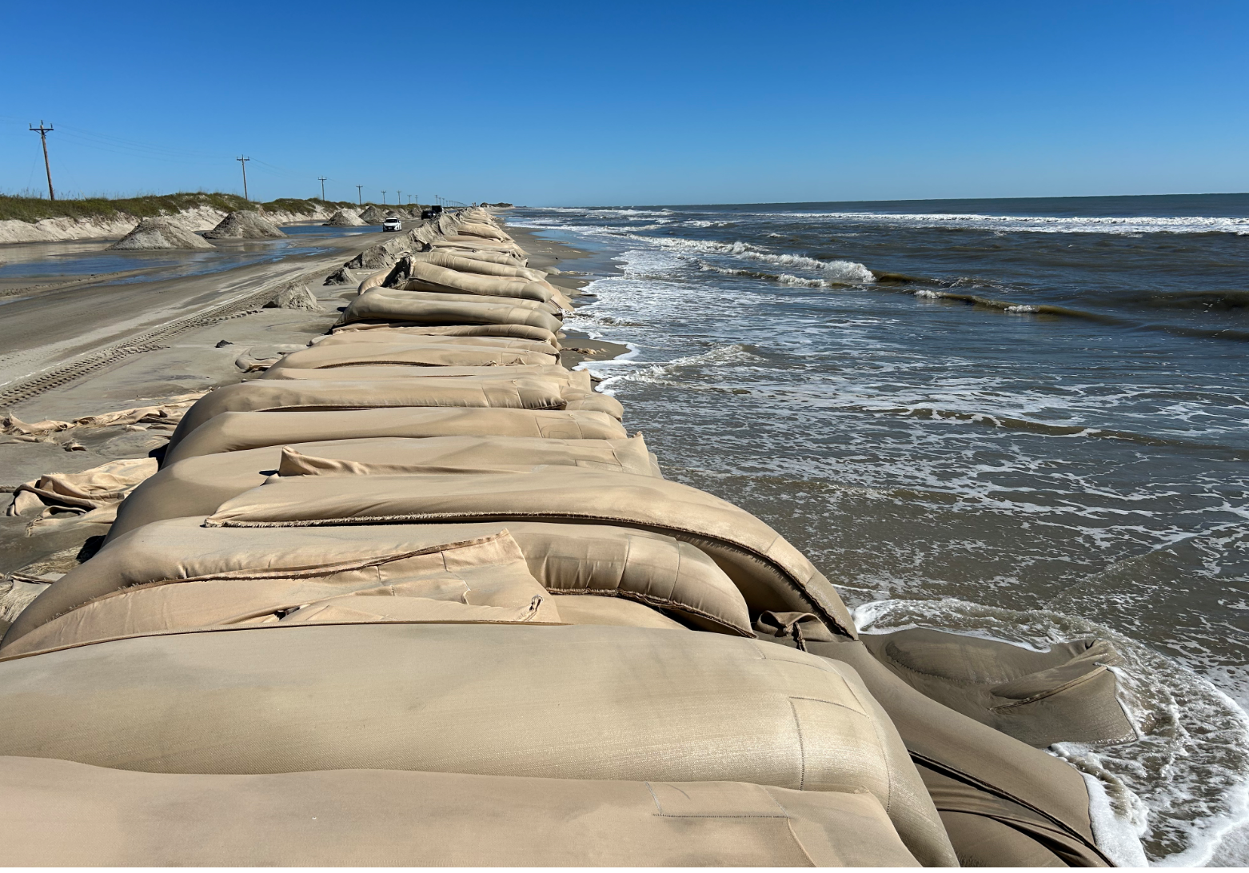
Unnamed Storms and King Tides
Photo Source: NC DCM Staff Post Mid-October Nor’easter
Notes:
“Hot Spot” area located between South Dock Ferry Terminal and the NPS Pony Pen. You can see the eroded/exposed road shoulder and some asphalt damage. CAMA Major Permit 24-03 covers the sandbag alignment along this stretch of Hwy 12.

Slide 16
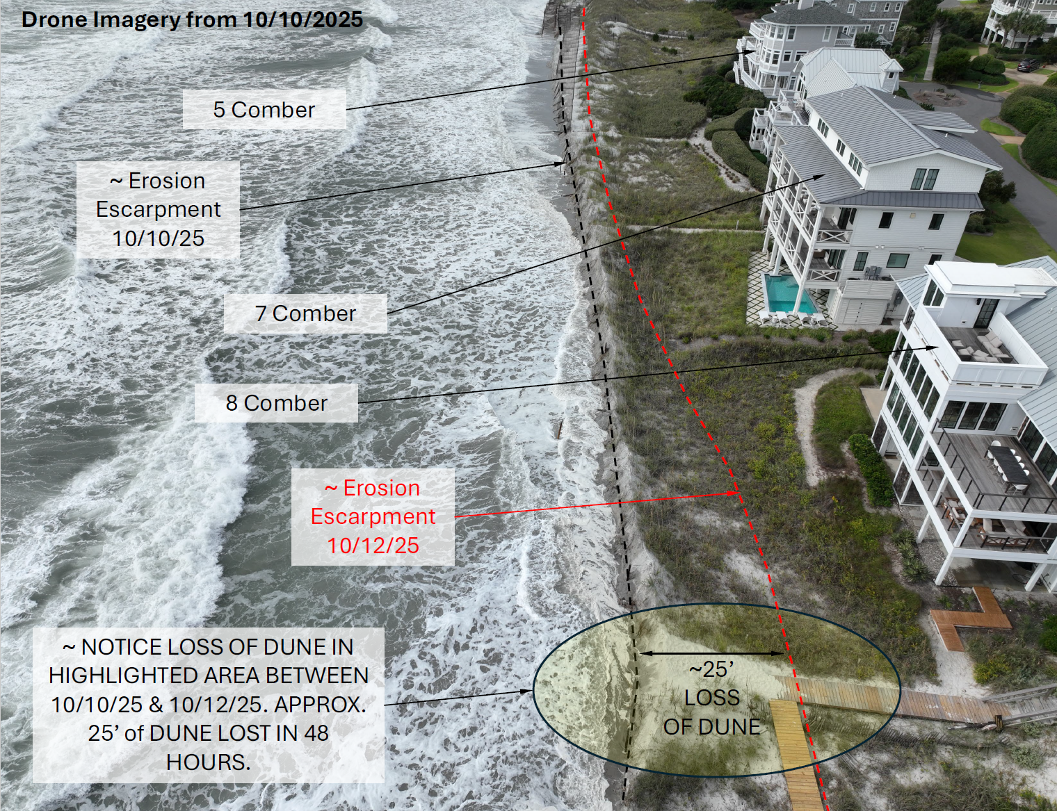
Unnamed Storms and King Tides
DCM Staff at North End of Figure 8 Island
Facing North 10-14-25
Photo Source:
DCM Staff 10/7/25
Source: CPS, LLC Facing West 10-20-25
Notes:
Coastal Low pressure system event on 10/15 during a king tide resulted with significant beach erosion and damage to buildings
This information was included for the property owners for accelerated erosion between 5-8 Comber Road that was authorized on 10/13/25 by DCM Director Miller

Slide 17
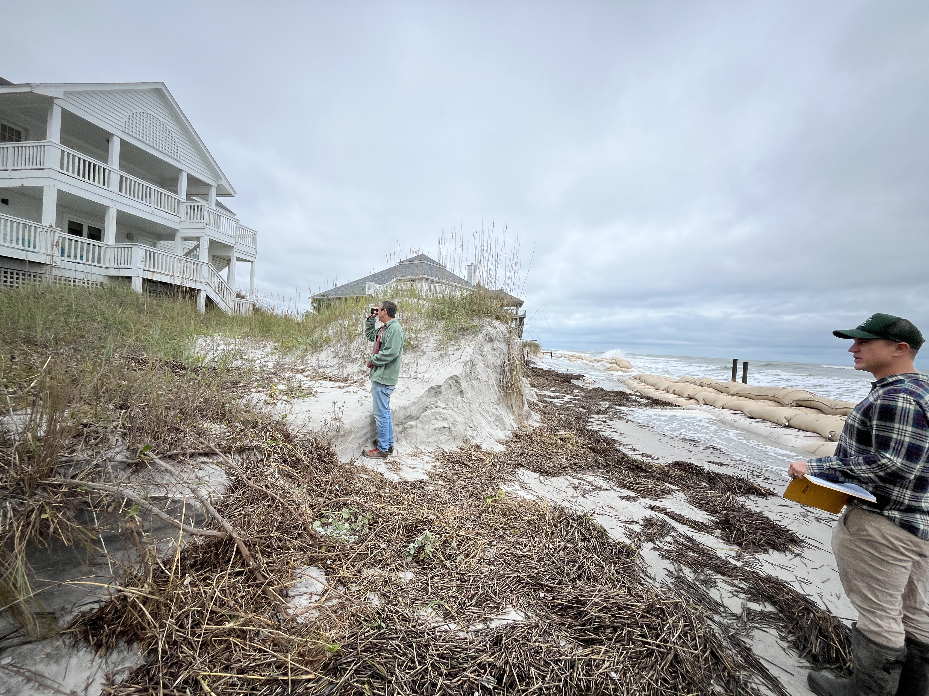
Unnamed Storms and King Tides
DCM Staff at North End of Figure 8 Island
Facing North 10/13/25
Photo Source:
DCM Staff 10/7/25
Notes:
DCM site visit responding to accelerated erosion request prior to issuance of 4 emergency sandbags CAMA General permits
Note the sandbag revetments that were authorized by DCM staff in 2/2025

Slide 18
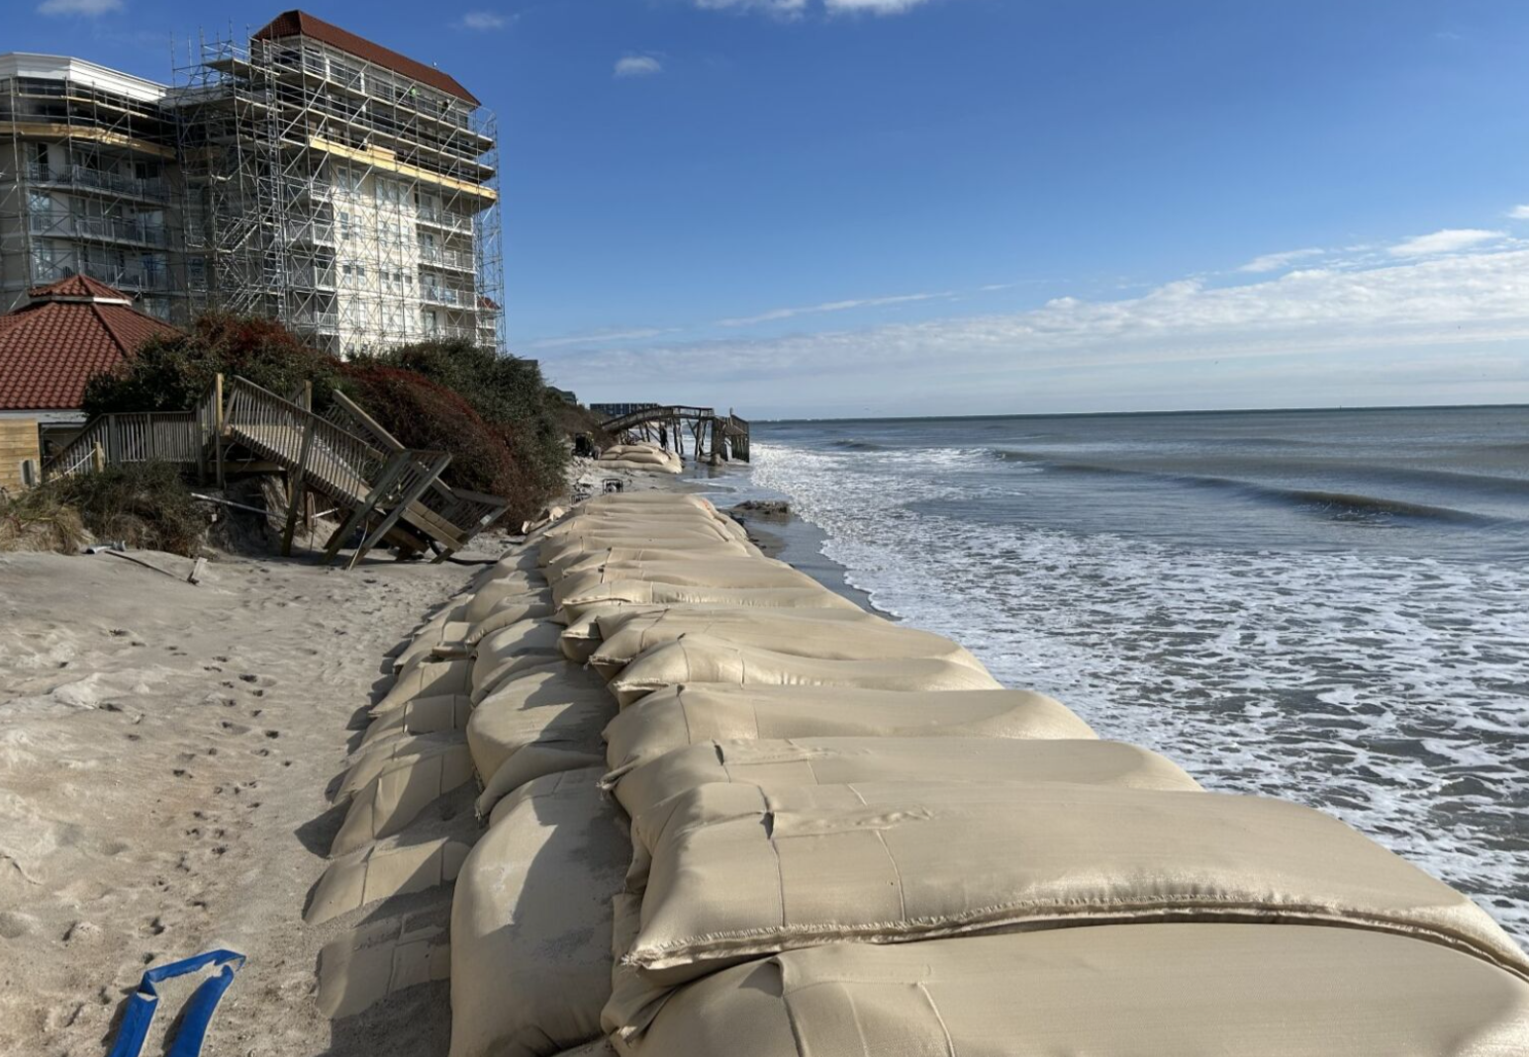
Unnamed Storms and King Tides
Source:Town of NTB Staff Photo
Facing North 10-27-25
Notes:
Coastal Low pressure system event 10/7-10/12 during a king tide resulted with significant beach erosion and threatened structures. New Sandbag revetment installation at St. Regis condominium complex NTB authorized by DCM MHC office through a accelerated erosion determination by Director Miller.

Slide 19
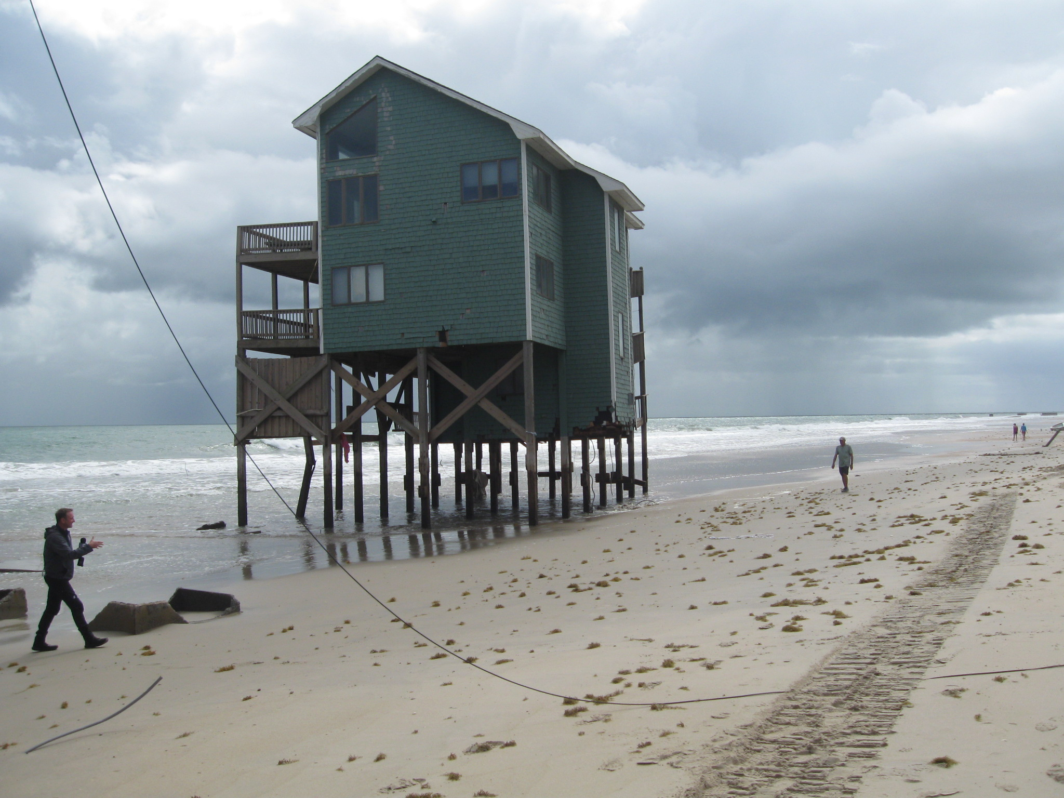
Unnamed Storms and King Tides
Photo Source:
DCM Staff 10/7/25
Notes:
Coastal Low pressure system event 10/7-10/12 during a king tide resulted with significant beach erosion and damage to buildings

Slide 20
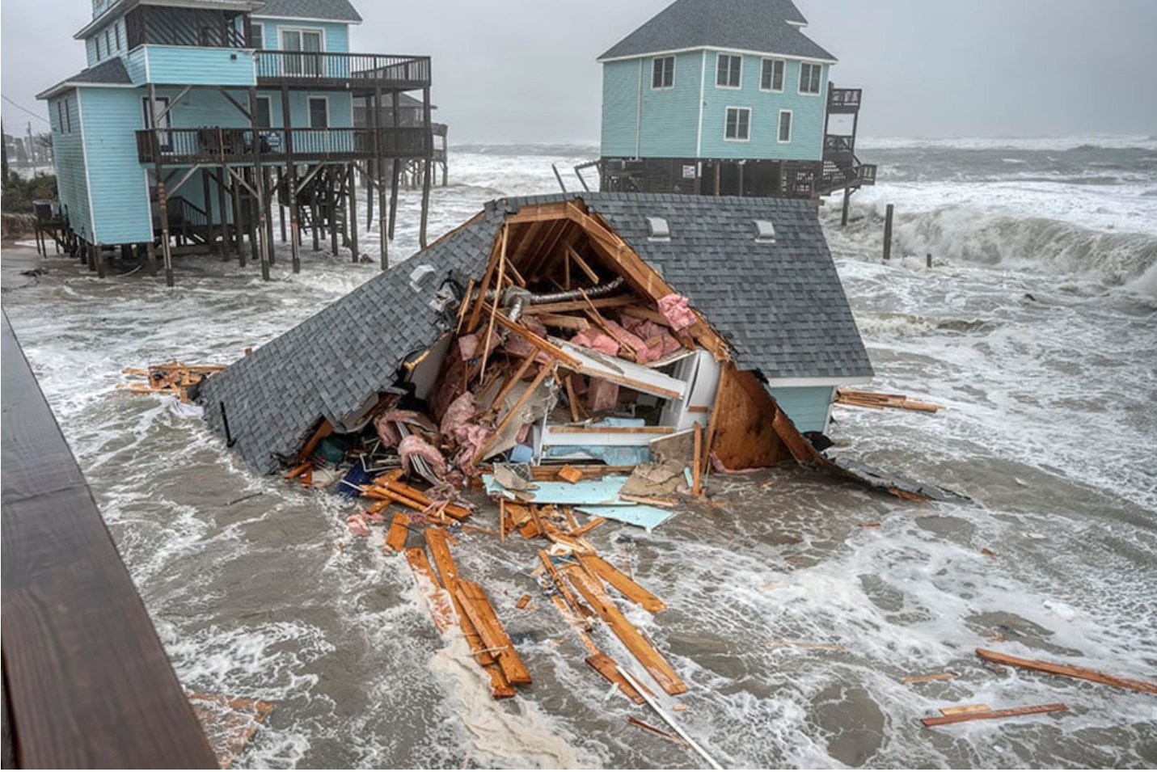
Unnamed Storms and King Tides
Photo Source:
DCM Staff 10/7/25
Photo Source:
Don Bowers-Island Free Press
Notes:
Here’s an image taken along Ocean Dr. in Buxton during the late October storm resulting in the loss of sixteen homes total this storm season

Slide 21
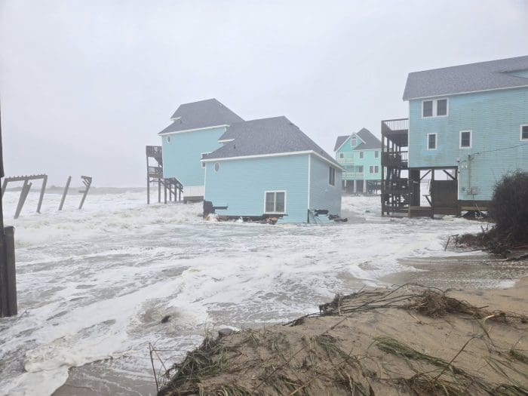
Oceanfront Home Collapses on Hatteras Island 2025
46006 Cottage Avenue, Buxton – Collapsed on October 18.
23047 G.A. Kohler Court, Rodanthe – Collapsed on October 3.
46221 Tower Circle Road, Buxton – Collapsed on October 2
46207 Tower Circle Road, Buxton – Collapsed on October 1.
46203 Tower Circle Road, Buxton – Collapsed on September 30.
46001 Cottage Avenue, Buxton – Collapsed on September 30.
46002 Cottage Avenue, Buxton – Collapsed on September 30.
46007 Cottage Avenue, Buxton – Collapsed on September 30.
46209 Tower Circle Road, Buxton – Collapsed on September 30.
46211 Tower Circle Road, Buxton – Collapsed on September 30.
46227 Tower Circle Road, Buxton – Collapsed on September 16.
46002 Ocean Drive, Buxton – Collapsed on October 28.
46223 Tower Circle Road, Buxton – Collapsed on October 28.
46003 Ocean Drive, Buxton – Collapsed on October 28.
46016 Cottage Avenue, Buxton – Collapsed on October 28.
46213 Tower Circle Road, Buxton – Collapsed on October 28.
Source: Joy Crist and Don Bowers-Island Free Press
Notes:
Tuesday Oct. 28th incidents mark the 12th, 13th, 14th, 15th, and 16th oceanfront home collapses on Hatteras Island since mid-September,

Slide 22
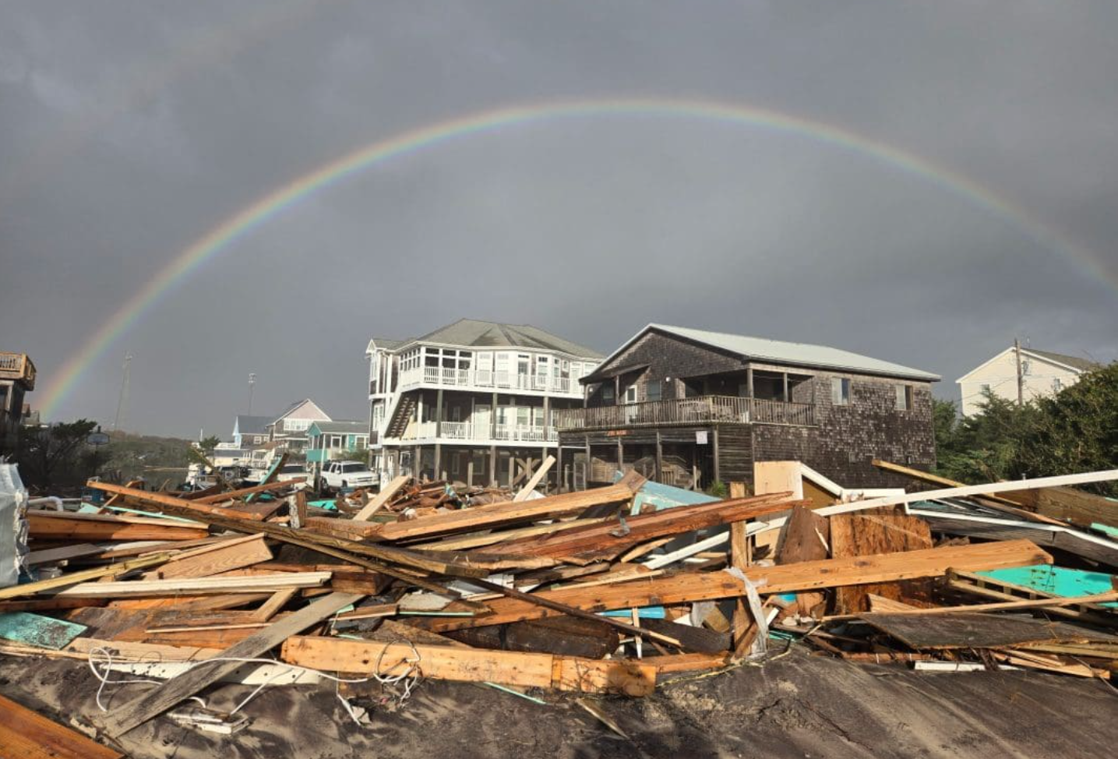
Unnamed Storms and King Tides
Photo Source:
DCM Staff 10/7/25
Photo Source:
Don Bowers-Island Free Press
Photo Source:
Don Bowers-Island Free Press
Notes:
This storm damage resulted in dangerous debris, including pilings and household materials, that was reported in the surf and along the adjacent shoreline. Combined clean up efforts were handled by the Cape Hatteras National Seashore Parks Service, Dare County, property owners and volunteers.

Slide 23
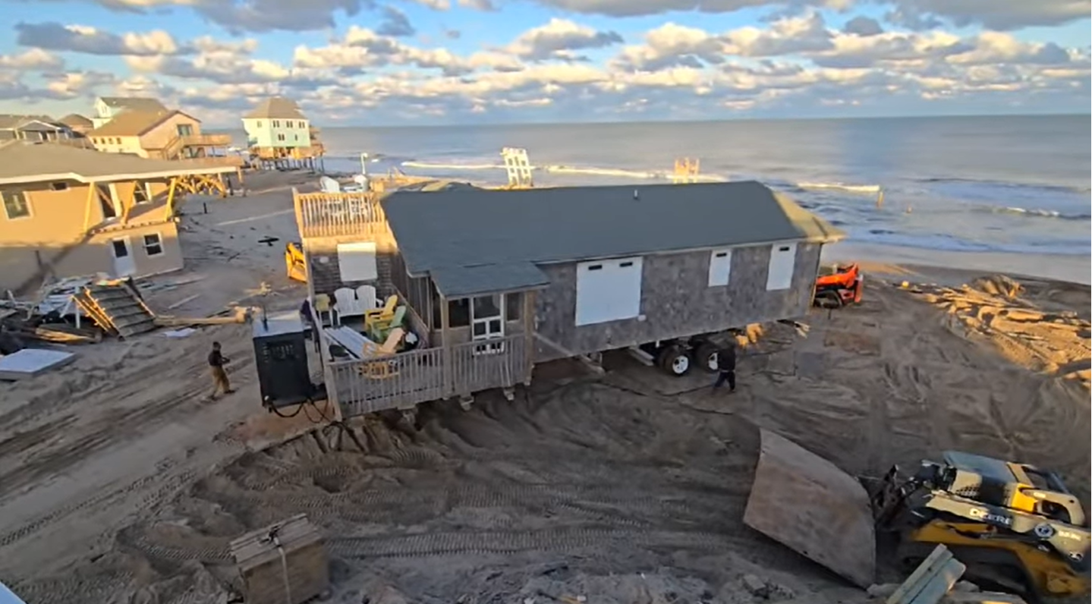
Unnamed Storms and King Tides
Source: Don Bowers-Island Free Press
Notes:
Success story of a threatened family home on Cottage Ave. being moved and relocated in Buxton early Nov. 2025

