Slide 1

Update on the NC Nutrient Criteria
Development Plan
Notes:
We are referring to this as the “NCDP”

Slide 2
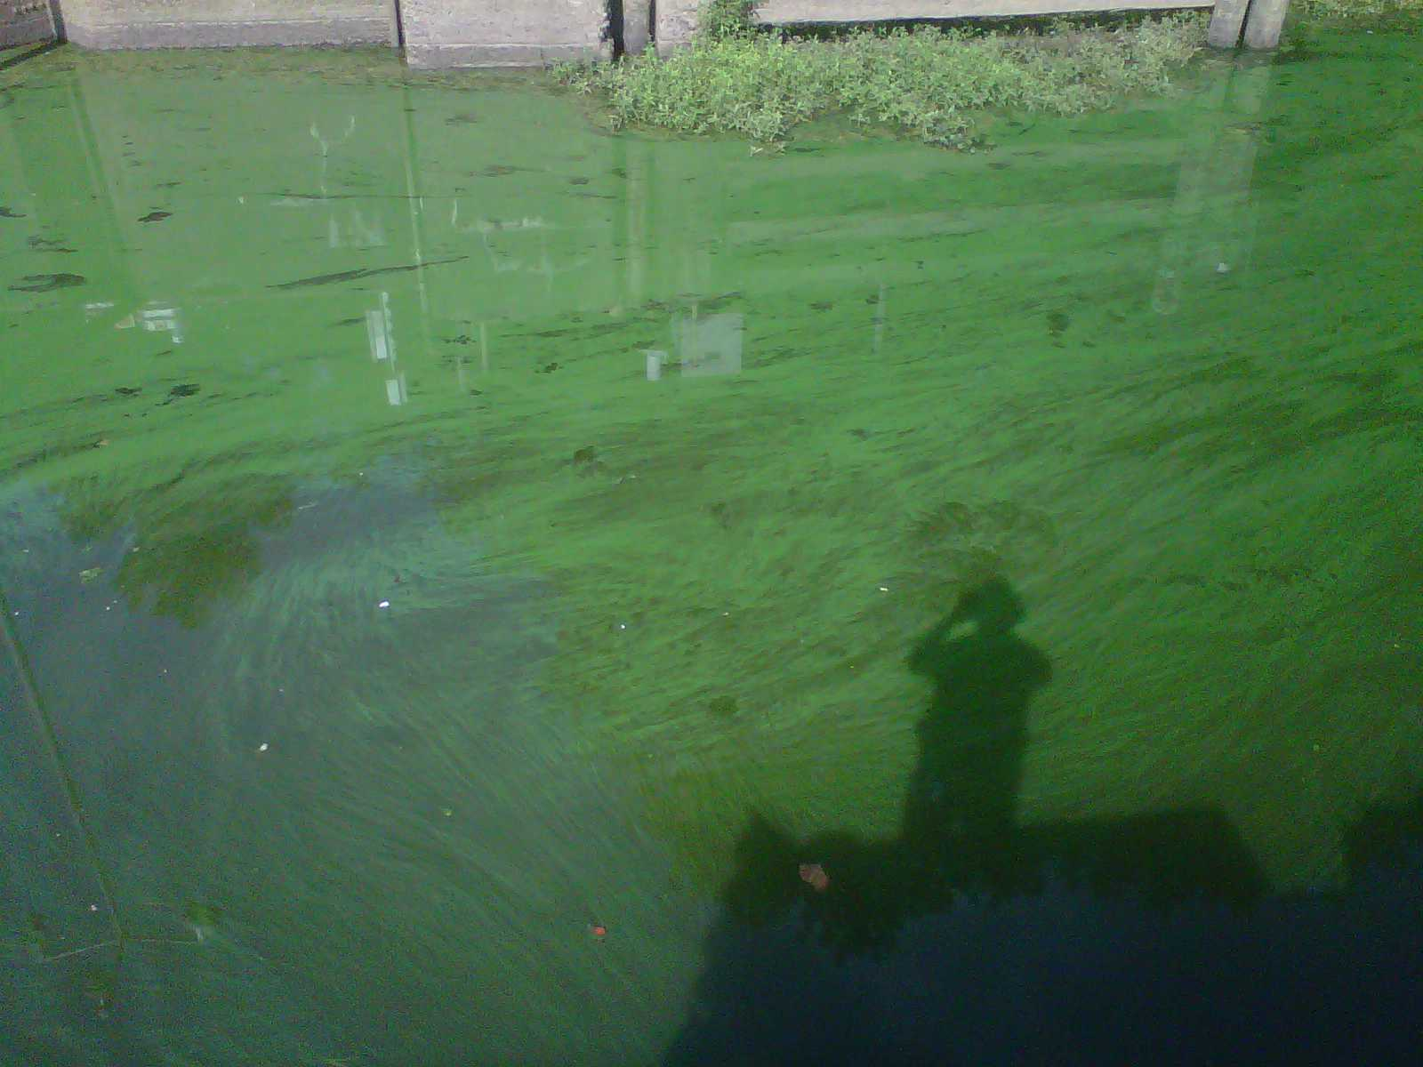
Nutrients =
Nitrogen + Phosphorus
Over-enrichment can lead to algae blooms, fish kills

Slide 3
NC Nutrient Management Strategies
COASTAL | INLAND
Chowan – 1981 | Wylie - 1996
Tar-Pamlico- 1990 | Randleman - 1997
New -1991 | Jordan - 2009
Neuse -1998 | Falls - 2011
 | PENDING: High Rock

Slide 4
Nutrients, EPA & NC
~2000
2004
2011
2012
2013
National Ecoregional Numeric Nitrogen & Phosphorus Criteria published by US EPA
NC’s 1st Nutrient Criteria Development Plan
EPA does not concur on updated NC NCDP
EPA acts on N & P for Florida
Draft NC NCDP & Stakeholder Meetings

Slide 5
Recent EMC Activities
January 2009 –January 2011
  Proposed modified chlorophyll a criteria
    Part of triennial review
  Chlorophyll a thresholds
May 2012
  NC Forum on Nutrient Over-Enrichment

Slide 6
Nutrient Over-Enrichment Forum
May 2012
Alternatives to numeric N & P criteria
Clearer understanding of science
Thresholds on something other than chlorophyll a
Other “trending” or “change” indicators
Review of costs and savings
Notes:
6

Slide 7
Forum Panelists’ Highlights
Site-specific & waterbody type- specific approaches
Scientific, balanced, & fair
Stakeholders
Goals & targets
Proactive & integrative
Improve NC’s current approach
Notes:
7

Slide 8
NCDP: The Backbone
Evaluation of current criteria
  Chlorophyll a, dissolved oxygen, pH
Waterbody Approaches
  Rivers & Streams, Water Supplies, Sounds
Response variables
EPA – Nitrogen & Phosphorus
Notes:
Streams and Rivers and Sounds
Response Parameters:
• Chlorophyll a
• Phytoplankton community
• Periphyton community
• Macrophytes
• Diurnal DO range
• Minimum DO
• Diurnal pH range
Waters Classified for Drinking Water Supply
Response Parameters:
• Total Organic Carbon
• Algal Toxins
• Taste and odor species
Causal Parameters:
• Nitrogen
• Phosphorus
8

Slide 9
NCDP Development
Public Meetings – December 2012
New Draft – April 2013
End Comment Period - May 24, 2013
New Draft – August 2013
Commenter Meeting – September 25, 2013
EMC approved draft – early 2014

Slide 10
NCDP Implementation
EPA agreement
Implement plan
  Stakeholder participation
  Draft criteria
  Implementation discussions to refine criteria
EMC determines what moves forward (rule-making)

Slide 11
Questions?
Notes:
11

