Slide 1
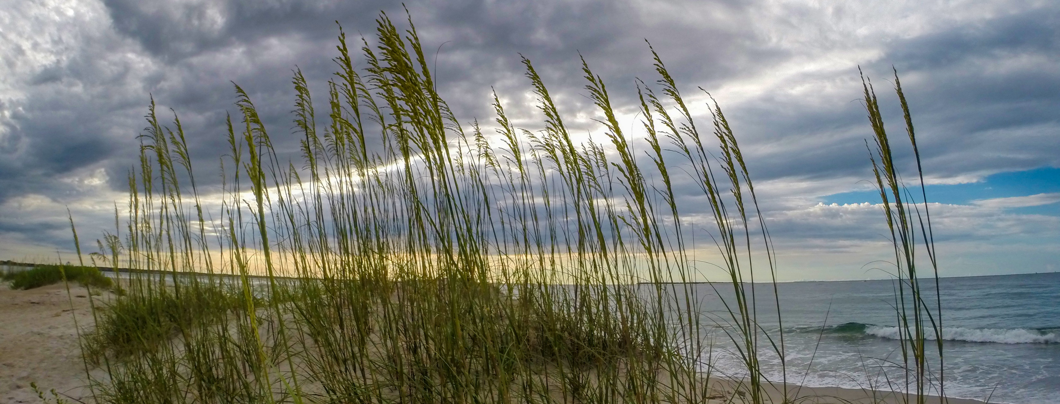
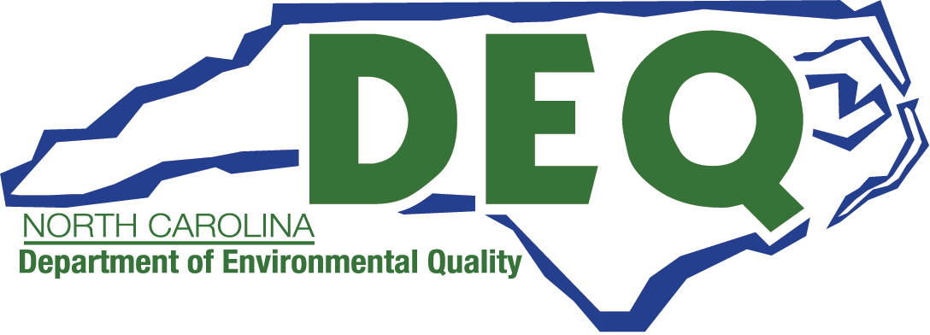
Ocean Hazard Areas: History of Setbacks
Ken Richardson
NC Division of Coastal Management
February 27, 2025

Slide 2
Septic Tank
Image Source: ABC11
Image Source: US Park Service
Notes:
At your last meeting in November meeting, National Park Superintendent Dave Hallac discussed the ongoing challenges facing the national seashore along North Carolina’s coast. When a structure is lost to erosion, the impact extends beyond the property owner - adjacent neighbors, beachgoers, and even the smallest creatures living along the shoreline suffer consequences resulting from exposed and failed septic systems and far-reaching swath of construction material debris.

Slide 3
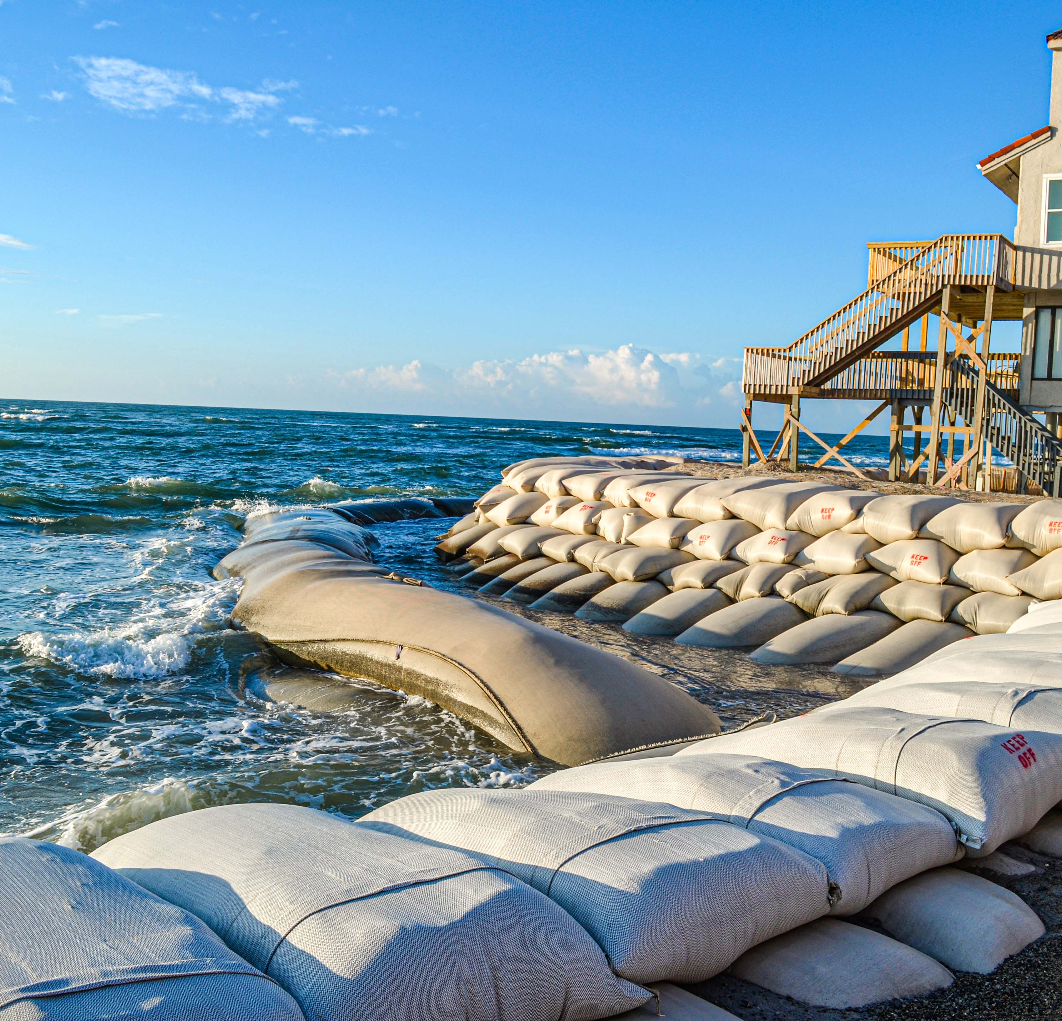
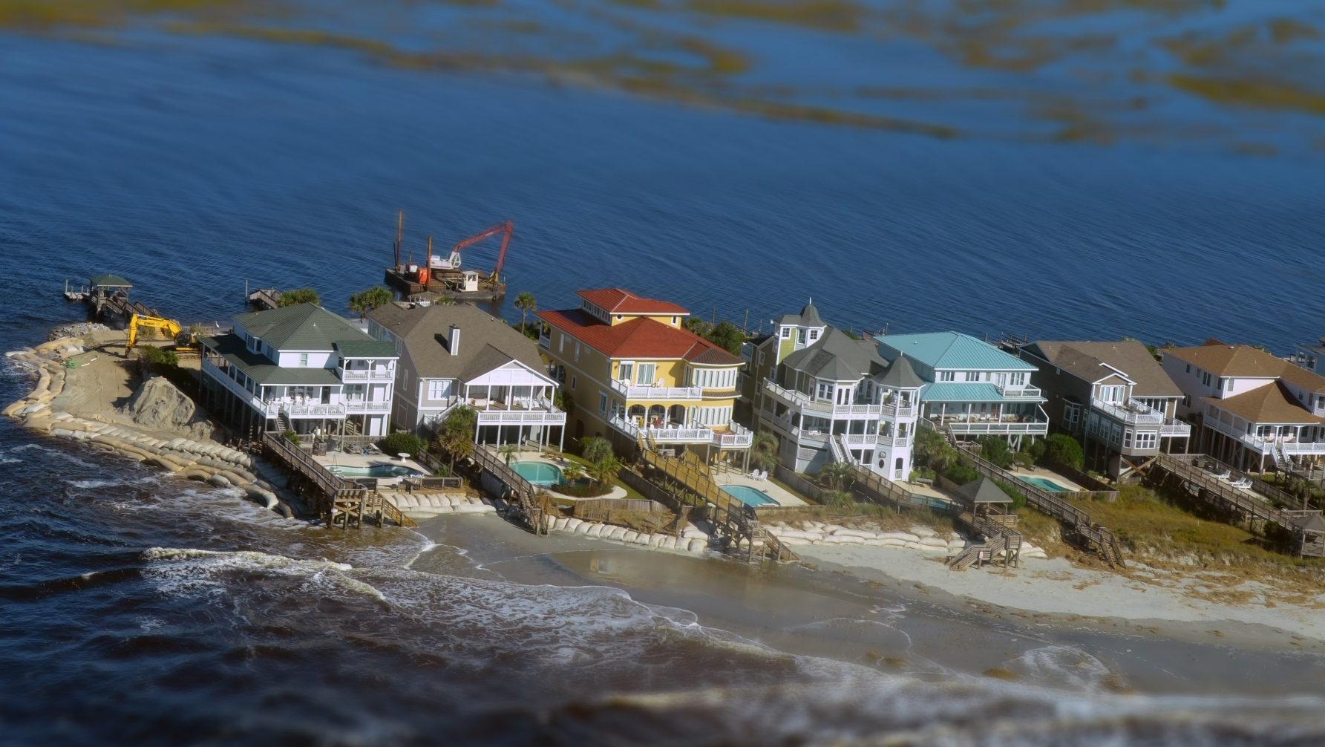
Image Source: NC DCM
Notes:
Superintendent Hallac also posed a question, “what happens when the CRC’s oceanfront setback expires? ... where the forces of mother nature confront stationary structures on land that naturally wants to migrate. Perhaps not asked in these words, it is however a question that is relevant coastwide and not just to one street or one community on the Outer Banks.

Slide 4
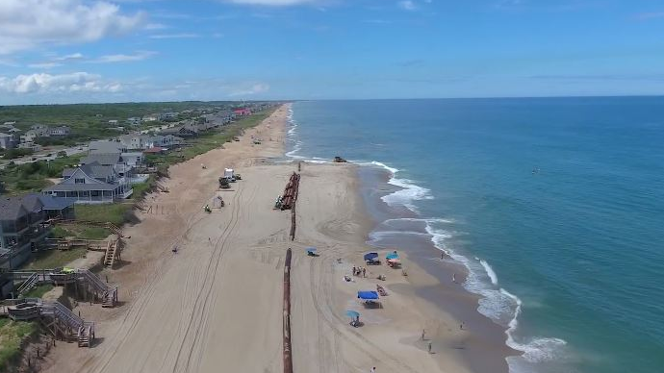
NC’s Development & Coastal Erosion “Toolbox”
“Soft” Strategy
Combination
Relocate/Retreat
Do nothing
“Hard” Strategy
Beach Nourishment
Sandbags
Groin
Jetty
Breakwater
Riprap
Policy
Notes:
Before speaking more specifically to that question, it’s important to first step back and take a look at the processes leading up to today. While setbacks don’t theoretically expire, they do shift with the NC’s barrier islands as they migrate in response to the forces of mother nature. But, because permanent structures remain fixed, they are unable to adapt to these changes in relation to current setbacks.
North Carolina has an extensive history of feeling the impacts of coastal erosion along with a growing array of efforts aimed at preventing damage to property, structures, and infrastructure while maintaining access to public trust lands. To make management more complex, solutions that prove effective in one location may not work in another – potentially making adaptive, site-specific approaches critical for long-term coastal management.
In attempts to address these challenges, North Carolina has relied on a combination of tools, including beach nourishment, sandbags, and hard erosion control structures. However, policy has also played a crucial role. While often met with criticism, policy is essential in balancing environmental resilience, economic stability, and public safety - particularly in the dynamic and vulnerable coastal regions of the state’s oceanfront and inlets.
Since the Coastal Resources Commission (CRC) began developing policy in 1977, it has recognized that this balancing act is one of the most complex in the state. The very ground beneath our feet is constantly shifting, sea levels are fluctuating, populations are growing, habitats are shrinking, and the public costs associated with these changes only continues to rise.

Slide 5
CRC’s Conceptual Oceanfront Policy Foundation
Self-education about natural processes: what the threats are, and what is threatened
A comprehensive survey and evaluation of the full range of management techniques
The development of consensus on clear objectives
An analysis of the accuracy and adequacy of hazard data and information
A commitment to a process of openness to public input, and for reevaluation, reassessment and fine tuning throughout the time it took to put the program in place
Notes:
Management challenges along NC’s coast are not unique to today’s conditions, but one could argue that the scale of the issues and problems have grown significantly since the CRC first deliberated policies in 1977. The initial effort to develop policy took eight years, involved many stakeholders and included these 5 elements within the process - that I’ll refer to as the CRC’s 5 policy-making principles:
Self-education
Evaluation of management techniques
Inventory of data and information
Development of consensus on clear objectives
Commitment of a process that includes public input and reassessment and fine tuning throughout the time it took to put the program in place
As the management program was developed, it expanded to incorporate several key elements. The primary focus was on creating regulations for development within the Areas of Environmental Concern (AECs), including setbacks, structural standards, and restrictions on shoreline hardening.
During early planning discussions, it became evident that land acquisition might also be a necessary management tool, particularly in areas considered too hazardous to develop or difficult to regulate effectively. This prompted deliberations on potential funding strategies such as tax credits to encourage donations, discouraging public investments (infrastructure) in certain areas, and efforts were made to influence the Federal Flood Insurance program.
However, ultimately, the program chose to prioritize public education and outreach, with an emphasis on improving understanding of the process and coastal management efforts.

Slide 6
CRC Identified 3 Reasons for Oceanfront Setbacks
1
Mitigating losses of life and property resulting from storms and long-term erosion
2
Preventing encroachment of permanent structures on the public beach
3
Reducing the public cost resulting from poorly sited development
Notes:
From the beginning, the Commission has gone to great lengths to better understand the risks and the areas affected along the oceanfront. Before establishing setback rules, the CRC sought information to assess erosion and the extent of ongoing changes. At the time, there was a significant amount of reliable long-term erosion data available from North Carolina State University (NCSU), the U.S. Park Service, and other sources – specifically, Dr. Robert Dolan at University of Virginia who had conducted studies on the northern Outer Banks. However, then there was no storm erosion data, which prompted a contract with NCSU to gather the additional information. While the storm erosion data proved sufficient for defining the hazard and permit jurisdiction zone, (later referred to in rule as the Ocean Erodible Area (OEA)), those data alone were not adequate for establishing setbacks or guiding individual permit decisions. It’s worth noting that at the same time, an internal study was conducted to identify inlet hazard zones, which would become the Inlet Hazard Areas (IHAs). Ultimately, the OEA and IHA defined most of the area within NC’s Ocean Hazard Areas (OHA).
In a CRC memo dated October 13, 1980 (CRC-135), these 3 reasons for establishing setbacks were identified by CRC:
Mitigating losses of life and property resulting from storms and long-term erosion.
Preventing encroachment of permanent structures on the public beach.
Even if structures are built to withstand worse case scenarios, long-term erosion could potentially leave them positioned on the beach or in the water. The state owns the land below MHW and has a legal obligation to protect public interest in the free use of these areas – in addition, the public also has the right to use the dry-sand beach. The existence of open, uncluttered beaches is essential to the economic prosperity of many coastal communities as their economy centers on recreation and tourism.
Reducing the public cost of poorly sited development. If development is located where it is likely to be damaged or destroyed, there are likely to be costs to the taxpayer as well as the owners of the property.

Slide 7
Setbacks Applied: Ocean Hazard Areas
Ocean Erodible
Inlet Hazard
Unvegetated Beach
where there exists a possibility of excessive erosion and significant shoreline fluctuation
“natural hazard” areas that are especially vulnerable to erosion, flooding, and other adverse effects associated with inlet dynamics…
where no stable natural vegetation is present due to major storm
State Port Inlet Mgmt. Area
unique due to the influence of federally maintained channels, and the critical nature of maintaining shipping access to North Carolina’s State Ports (Cape Fear & Beaufort Inlets)
Notes:
As mentioned, the CRC also identified jurisdictional zones, which are referred to in your rules as Areas of Environment Concern (AECs). The Commission acknowledged that the areas seaward of the setback should be regarded as highly hazardous and dynamic zones unsuitable for new permanent structures. They acknowledged that they are not intended to serve as precise predictions of where the shoreline would be in the future (30 years). Instead, they should be considered hazard zones, inherently unsuitable for new permanent construction due to historical trends of shoreline movement caused by erosion and storms.
Setbacks are applied inside Ocean Hazard Areas, which currently consists of 4 Areas of Environmental Concern (AECs):
Ocean Erodible Area: where there exists a possibility of excessive erosion and significant shoreline fluctuation. Before 2009 this area was calculated by multiplying 60 x erosion rate + 100-Year Storm Recession Rate, but since 2009 it is calculated by multiplying Setback Factor by 90 (OEA = SF x 90). OEA is measured landward from FLNV or PPVL. While not mapped, the information to update its landward is calculated approximately once every 5 years.
Inlet Hazard Area: “natural hazard” areas that are especially vulnerable to erosion, flooding, and other adverse effects associated with inlet dynamics. Sufficient landward boundary to encompass migration and erosion based on statistical analyses, and consider previous inlet territory, structurally weak areas, and external influences such as jetties, channelization, and beach nourishment. Current IHA boundaries were established in 1979, and while the CRC’s Science Panel on Coastal Hazards did submit updated boundaries first in 2010, then in 2018, and will again this year, updates to these boundaries have not gone into effect. Currently, setbacks applied inside the IHA are actual the rate pulled from it’s adjacent OEA.
Unvegetated Beach: areas within the OEA where no stable natural vegetation is present due to major storm. Historically, this serves as a temporary AEC until vegetation is re-established.
State Port Inlet Management Areas: which are areas influenced by federally maintained channels critical for state port operations (Beaufort and Cape Fear Inlets). These went into effect in 2020, and started as proposed IHA boundaries in the Science Panel’s 2010 proposal.

Slide 8
Setback History
Setbacks 1978
Setbacks 1979
2009 to Present (2025):
Setbacks 1983
1981 Note
at least 10 times long-term erosion rate from the dune line
setbacks must be behind frontal dune, and 30 times the erosion rate measured from the vegetation line
CRC adopted an exception to erosion rate setbacks for pre-existing lots (prior to June 1, 1979) meeting 60 feet minimum setback
Small structure setbacks (30 x erosion rate) – served as “basic setback”
Large structure setbacks (60 x erosion rate), if rate greater than 3.5, then rate x 60 + 105 feet (3.5 x 30)
Graduated setbacks – ranges from 30 to 90 times erosion rate
Notes:
Like many of the CRCs rules, setbacks too have evolved over time since their conception in the late 1970s.
1. While short-lived, the 1978 proposal was to multiply erosion rate times 10, and measure from dune line.
2. On June 1, 1979, the CRC’s setback rules went into effect, which was 30 times the erosion rate setback factor measured from the vegetation line. At the time the CRC felt that a minimum of 60 feet was needed even if the beach appeared to be relatively stable because it was still subject to storms and short-term fluctuations.
3. In 1981, CRC adopted exceptions to erosion rate setbacks, which also came to know as the “small structure exception” (proposed rule amendments later today).
4. In 1983, the CRC made a distinction be between large and small structure, with large being defined by “use” - 4 dwelling unit multi-family or commercial.
- small structure (residential) setbacks 30 x SBF – with minimum of 60 feet, and it served as the “basic setback”
- large structure setbacks 60 x SBF – However, if the distance was more than 105 feet longer than the “basic setback,” then the setback is the basic setback 30 x SBF + 105 feet.
5. Leading up to 2009, the CRC recognized that single-family structures were becoming larger, some exceeding 13K sqft, and that a structure’s use should not be the defining factor between large and small. After a thorough structure size inventory was completed, the CRC amended setback rules to remove structure “usage” and as a defining factor, and created setbacks defined by structure size and erosion rate. These amendments went into effect in 2009, and are often referred to as the CRC’s graduated setback rules.

Slide 9
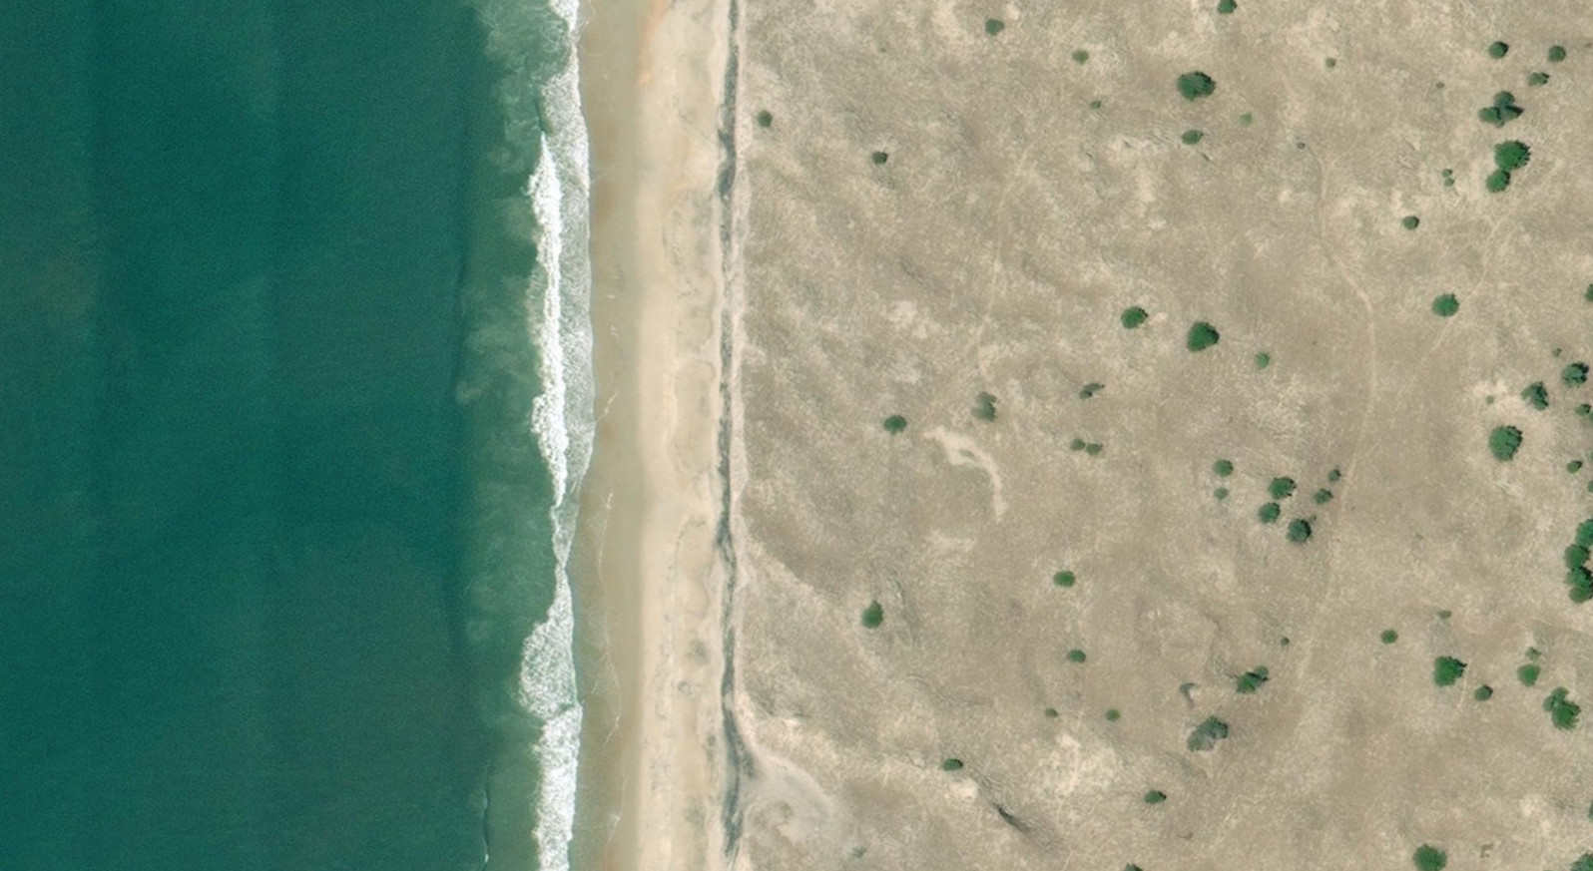
Current Oceanfront Setbacks: 15A NCAC 07H.0306
Structure Size | Minimum Setback (feet)
< 5,000 sqft. | 30 x SBF (min. 60 ft)
≥ 5,000 sqft. | 60 x SBF (min. 120 ft)
≥10,000 sqft. | 65 x SBF (min. 130 ft)
≥20,000 sqft. | 70 x SBF (min. 140 ft)
≥40,000 sqft. | 75 x SBF (min. 150 ft)
≥60,000 sqft. | 80 x SBF (min. 160 ft)
≥80,000 sqft. | 85 x SBF (min. 170 ft)
≥100,000 sqft. | 90 x SBF (min. 180 ft)
60
140
160
180
Maximum setback & OEA
Vegetation Line
Notes:
The 2009 update to setback rules was driven by concerns over the risks posed by growing number of large oceanfront structures. The CRC recognized that larger structures increase the threat to human life and property due to erosion while also contributing to the loss or degradation of public beach areas, natural coastal features, and ecosystems. Additionally, they placed a financial strain on public resources, increasing costs for flood insurance, erosion control, storm protection, disaster relief, and essential services such as water, sewer, and emergency response. Their size and permanence also made relocation increasingly challenging and expensive as shorelines continued to erode – so, the CRC agreed that a graduated setback approach, one that would put more distance between larger structures and the hazard was needed.
(refer to graphic)

Slide 10
Setback Distance Measured From Applicable Feature
First Line of Stable & Natural Vegetation
Pre-Project Vegetation Line
Measurement Line
No Large-Scale beach fill project
or if, CRC approves Beach Management Plan
Established when beach fill project exceeds 300,000 cy
Never expires
Storm damaged vegetation
Unvegetated Beach AEC
Notes:
Setbacks are measured from 1 of 3 features:
First Line of Stable and Natural Vegetation
Pre-Project Vegetation Line (formerly referred to as Static Vegetation)
Measurement Line

Slide 11
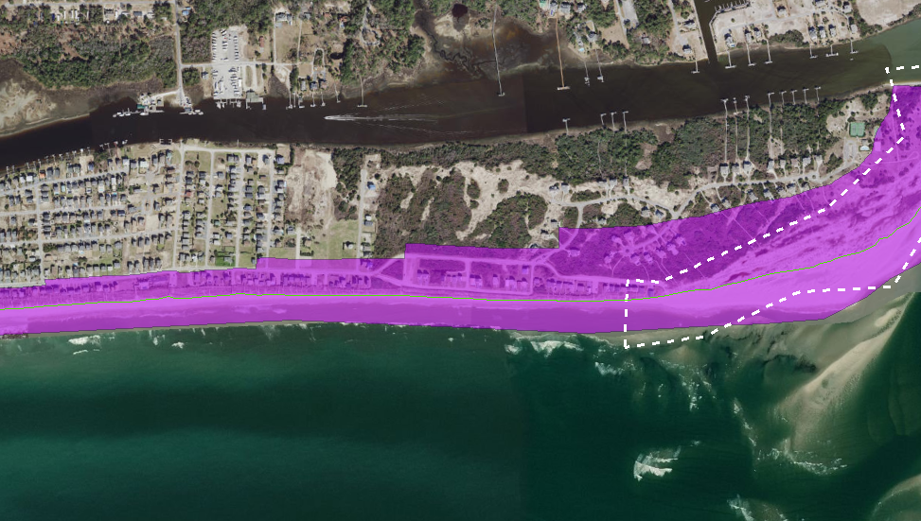
Ocean Hazard Areas
Ocean Hazard Area = Inlet Hazard + Ocean Erodible + Unvegetated Beach Areas
7
Ocean Erodible Area
(example)
630 ft.
Vegetation Line
630 ft.
7
450 ft.
315 ft.
225 ft.
180 ft.
3.5
7
2
2.5
5
OEA = 90 x SBF
Example (OEA = 90 x 3.5 = 315 ft.)
Inlet Hazard Area
(current)
MLW
Adjacent OEA erosion setback factor applied inside IHA
Image source: NC DCM GIS
Notes:
You will not see a map of the Ocean Hazard Area because the landward boundary of the Ocean Erodible Area is not mapped given that it is measured from the FLSNV, PPVL, or ML – whichever is applicable and farthest landward, so its boundary is measured in the field and on an as needed basis. As you might imagine, where it is today, may not be where it is tomorrow. This map image simply illustrates what the Ocean Hazard Area boundary would like if it were mapped
OEA is measured from the vegetation line (90 x erosion rate SBF); and extends to MLW. Following the pink area from left to right, we can see the application of how an increasing graduated setback affects the landward boundary. As the erosion rate increases, so does the landward distance of the OEA.
Base on current rules, the adjacent OEA SBF is applied throughout IHA. For this example, the oceanfront SBF adjacent to the IHA is 7, so a SBF of 7 is applied inside the IHA.
This map image reflects the idea that as the hazard risk increases, so should the setback requirements for new permanent development.

Slide 12
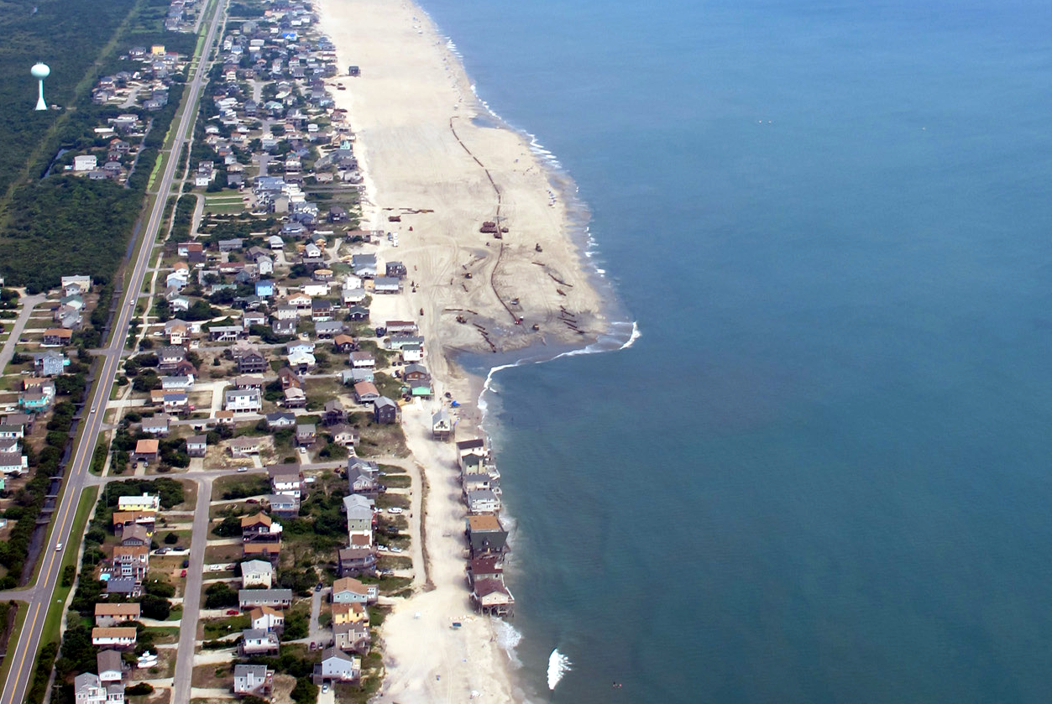
Pre-Project Vegetation Lines
Pre-Project Vegetation Line
“Large-scale” beach fill project defined as:
> 300,000 cubic yards
Setback
Before Nourishment
(structures at water’s edge)
Photo source: Town of Nags Head, NC
Notes:
A large-scale beach nourishment project is one that exceeds the placement of 300,000 cy of sediment, which requires the establishment of a PPVL, it never expires, and setbacks are measured from it, or the FLSNV, whichever is farther landward.

Slide 13
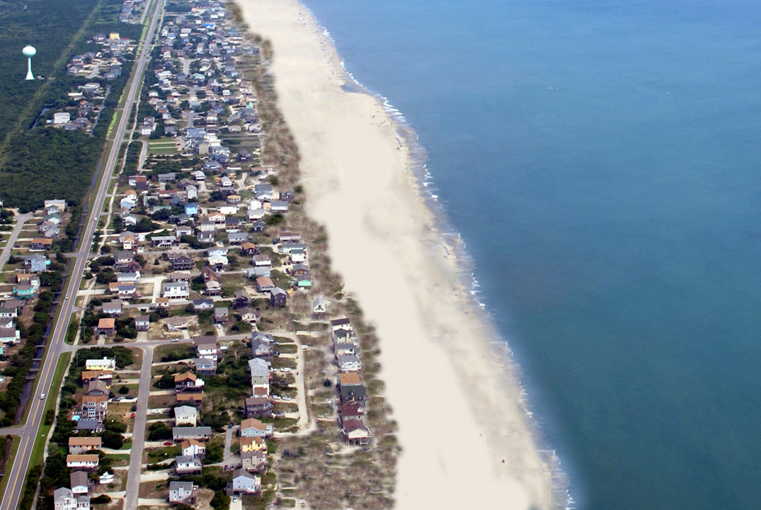
Pre-Project Vegetation Line
Regular maintenance and reduced storm frequency & intensity:
Wide beach maintained
Oceanward vegetation growth
New Vegetation
photo simulation showing completed beach fill project
Notes:
With the completion of the initial large-scale project, and with regular maintenance and with reduced storm frequency and intensity, it can be possible for a wider beach to be maintained with oceanward growth of vegetation.

Slide 14
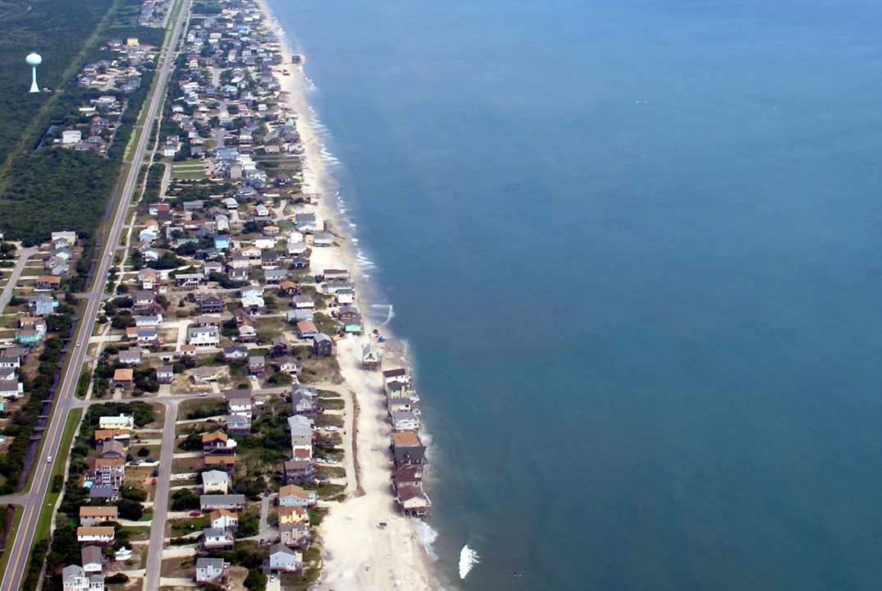
Pre-Project Vegetation Line
Without regular maintenance combined with increased storm frequency & intensity
Beach erosion continues
Vegetation loss continues
Vegetation Loss
photo simulation showing completed beach fill project
Notes:
Without regular maintenance and/or increased storm intensity and frequency, the nourished beach will erode returning the hazard to pre-project conditions before it continues even farther landward.
The CRC’s PPVL rule was based on three primary issues:
evidence that nourished beaches can have higher erosion rates than natural beaches,
no assurance that funding for future nourishment projects would be available for maintenance work as the original project erodes away, and
structures could be more vulnerable to erosion damage since their siting was tied to an artificially-forced system.

Slide 15
Beach Management:
Community | PPVL | SVL Exception | Beach Mgmt. Plan
Ocean Isle | Yes | Yes | Draft Pending
Oak Island | Yes | No | Yes
Caswell Beach | Yes | No | No
Bald Head Island | Yes | No | No
Kure Beach | Yes | No | Yes
Carolina Beach | Yes | Yes | Draft Pending
Wrightsville Beach | Yes | No* | Yes
Figure Eight Island | No | No | No
Topsail Beach | Yes | No | No
Surf City | Draft | No | No
North Topsail Beach | Yes | No | No
Emerald Isle | Yes | Yes | Draft Pending
Indian Beach | Yes | Yes | Draft Pending
Salter Path | Yes | Yes | Draft Pending
Pine Knoll Shores | Yes | Yes | Draft Pending
Atlantic Beach | Yes | Yes | Draft Pending
Buxton | Yes | No | No
Rodanthe | Yes | No | No
Nags Head | Yes | No | No
Kill Devil Hills | Yes | No | No
Kitty Hawk | Yes | No | No
Southern Shores | Yes | No | No
Duck | Yes | No | No
Notes:
To recognize local government efforts to address erosion through a documented long-term commitment to beach nourishment, and to offer relief from the PPVL requirements, the CRC adopted Static Vegetation Line Exception procedures in 2009, later to become Beach Management Plan (BMP) Rules (15A NCAC 07J.1200) in August 2022. The BMP allows a community to measure setbacks from the vegetation line rather than the PPVL, but includes certain limitations and conditions.
To be eligible for a CRC approved BMP, a community must petition the CRC by providing a beach management plan that describes the project area and design; identify sediment sources; identify funding sources to maintain the initial large-scale project; and, provide an update on project effectiveness and how it will continue to be maintained. The plan must be updated and presented to the CRC every 5 years for reauthorization. With an approved BMP, development must meet the required setback from the vegetation line, no portion of a building or structure can be oceanward of the landward-most adjacent neighbor or an average line of construction is determined by DCM, and no swimming pools may be permitted seaward of PPVL.
Currently there are 22 communities with a PPVL, and 1 pending. 8 of those communities either have or had CRC-authorized Static Vegetation Line Exceptions, with 3 currently having CRC approved Beach Management Plans.

Slide 16
“What happens when the CRC’s oceanfront setback expires?”
Image Source: ABC11
Image Source: US Park Service
Notes:
Circling back to Superintendent Hallac’s question, “what happens when the CRC’s oceanfront setback expires?

Slide 17
NC’s Erosion Rates:
Updated every 5 years
Setbacks
Landward OEA Boundary
FEMA CRS Credits (50 points)
Cape Hatteras
Cape Lookout
Cape Fear
Erosion
Accretion
Notes:
Since 1979, the statewide long-term average erosion rate has consistently been approximately 2 ft/yr. Looking at this map the red areas show measured erosion, and green showing accretion – and you could perhaps argue that long-term nourishment practices in the southern portion of the state have influenced erosion rates by artificially lowering them or resulting in measured accretion.
While setback policies continue to serve as the foundation for the CRCs oceanfront management rules, the unfortunate reality is that for most of NCs oceanfront communities they eventually become dependent on beach nourishment as a way of resetting the erosion clock, or if we want to think of it as resetting the setback expiration date. When the CRC updates erosion rates approximately every 5 years, setbacks and the landward boundary of the Ocean Erodible Area are updated to reflect current data. These updates also serve as benefits in the form of FEMA CRS credits (50 points) for theoretically maintaining open space between development and the hazard – which can translate into reduced flood insurance premiums. However, existing development doesn’t have the luxury of shifting with updated information.

Slide 18
Source: ASBPA, 2024
https://asbpa.org/national-beach-nourishment-database/
Notes:
That leaves beach nourishment as NCs primary tool in the toolbox. As stated, beach nourishment has served as a resetting of the erosion clock, or a resetting the setback expiration date. And while beach nourishment has been a common and a relatively effective short-term solution for many oceanfront communities – specifically those south of Cape Lookout, it’s not as common along the developed shoreline on the Outer Banks.
NC has approximately 320 miles of oceanfront shoreline and approximately half of that (160 miles) is considered developed. Currently 81% of the communities along those 160 miles have a history of installing beach fill projects on all or at least a portion of its shoreline within their oceanfront jurisdiction to account for a total of 112 miles of nourished shoreline. 77% have installed large-scale projects placing more than 300,000 cy of material on 108 miles of shoreline. This graph illustrates total length of shoreline per decade.

Slide 19
Source: ASBPA, 2024
https://asbpa.org/national-beach-nourishment-database/
Notes:
This graph illustrates volume per decade. As you can see from both graphs, more shoreline is being nourished more frequently and we’re placing greater volumes of sand on the beach. Which begs the question, is beach nourishment a long-term solution for every community.
Given the limited resources - funding or availability of high-quality beach sand, can the practice of beach nourishment meet the long-term needs of all.

Slide 20
In Conclusion
Self-education
Evaluation of management techniques
Inventory of data and information
Development of consensus on clear objectives
Commitment of a process that includes public input and reassessment and fine tuning throughout the time it took to put the program in place
Notes:
In conclusion, with persistent erosion, rising sea levels and limited sand resources, the CRC’s policy work remains as vital today as it was in 1977. By continuously adapting regulations to account for changing coastal conditions, sea-level rise, and the increasing costs associated with storm damage and recovery, the CRC continues to play a critical role in trying to balance property rights, public access, and environmental and economic resiliency. The ongoing process of:
Self-education
Evaluation of management techniques
Inventory of data and information
Development of consensus on clear objectives
Commitment of a process that includes public input and reassessment and fine tuning throughout the time it took to put the program in place
Are perhaps more relative to policy-making today, as they were more than 50 years ago.

