Slide 1
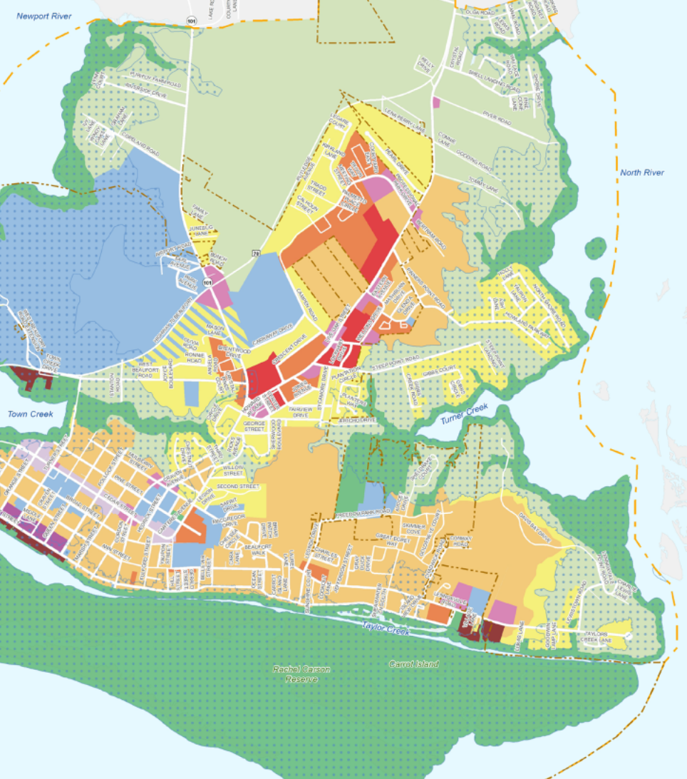
Periodic Review Process
and
Periodic Review of Existing Rules – 15A NCAC 07B
Rachel Love-Adrick
February 2025 CRC Meeting
Notes:
Good afternoon, Madam Chair, members of the Commission. My name is Rachel Love-Adrick and today, I will be reviewing the Periodic Review process with you and then outline a timeline for the periodic review of the Land Use Planning Rules found in 15A NCAC 07B.
In 2013, the General Assembly enacted Session Law 2013-413 which added a “Periodic Review and Expiration of Existing Rules” section to the Administrative Procedure Act. This statute requires agencies to review all of their rules every 10 years under a process and schedule established by the Rules Review Commission (RRC). If an agency does not conduct the review, its rules will expire and be removed from the Administrative Code, unless the rule is required to implement or conform to federal law. Prior to 2013, rules did not expire.

Slide 2
PERIODIC REVIEW PROCESS
60 Day Public Comment Period on Initial Report
Agency approve/deny Final Report
RRC reviews Final Report
Final Report to APOC
Permanent Rulemaking Process
Agency classifies rules as Necessary or Unnecessary
Notes:
The Periodic Review Process beings by agencies reviewing their existing rules and classifying them as:
Necessary or Unnecessary. And unnecessary rule is a rule the agency determines to be obsolete, redundant or otherwise not needed.

Slide 3
PERIODIC REVIEW PROCESS
60 Day Public Comment Period on Initial Report
Agency approve/deny Final Report
RRC reviews Final Report
Final Report to APOC
Permanent Rulemaking Process
Agency classifies rules as Necessary or Unnecessary
Notes:
These classifications are then posted on the Office of Administrative Hearings (OAH) and DEQ web sites. Public comments are to be accepted for a period of at least 60 days and agencies are required to review the comments and prepare a brief response to the merits of each comment.

Slide 4
PERIODIC REVIEW PROCESS
60 Day Public Comment Period on Initial Report
Agency approve/deny Final Report
RRC reviews Final Report
Final Report to APOC
Permanent Rulemaking Process
Agency classifies rules as Necessary or Unnecessary
Notes:
Once the comment period ends the agency makes a final determination to approve of deny the Final Report.

Slide 5
PERIODIC REVIEW PROCESS
60 Day Public Comment Period on Initial Report
Agency approve/deny Final Report
RRC reviews Final Report
Final Report to APOC
Permanent Rulemaking Process
Agency classifies rules as Necessary or Unnecessary
Notes:
The Agency then sends the report to the RRC. This report includes the agency's determinations, public comments received, and the agency’s responses to those comments. The RRC will review the final report and public comments to determine if it agrees with the agency’s classification of its rules.
The RRC may change a classification of a rule from “unnecessary” to “necessary” but does not have the authority to declare a rule as “unnecessary.”

Slide 6
PERIODIC REVIEW PROCESS
60 Day Public Comment Period on Initial Report
Agency approve/deny Final Report
RRC reviews Final Report
Final Report to APOC
Permanent Rulemaking Process
Agency classifies rules as Necessary or Unnecessary
Notes:
The RRC then sends the report to the Joint Legislative Administrative Procedure Oversight Committee (APOC) for consultation. The final determination on an agency’s rules becomes effective when the APOC approves the report or on the 61st day after having received the report from the RRC if the APOC does not meet. The APOC may disagree with the Commission’s determination and recommend to the General Assembly that the agency conduct a review of the rule the following year.

Slide 7
PERIODIC REVIEW PROCESS
60 Day Public Comment Period on Initial Report
Agency approve/deny Final Report
RRC reviews Final Report
Final Report to APOC
Permanent Rulemaking Process
Agency classifies rules as Necessary or Unnecessary
Notes:
Rules designated as “necessary” must be readopted as if they were new rules following the permanent rulemaking procedures (Article 2A of G.S. 150B). If the rules are not readopted, they will be removed from the Administrative Code. Rules designated as “unnecessary” will be removed.

Slide 8
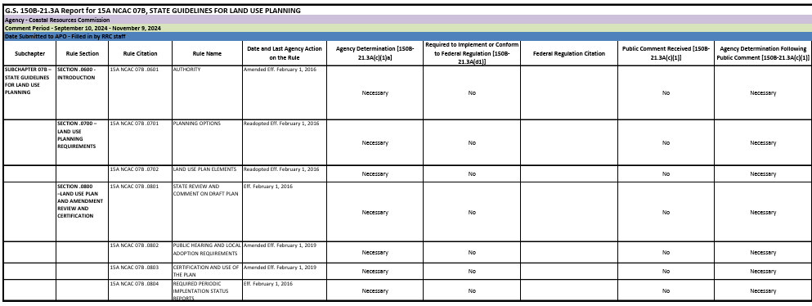
FINAL REPORT FOR 15A NCAC 07B
Notes:
Staff has reviewed the land use planning rules and recommended that the seven rules be classified as “Necessary”. Ιφ τηε ΧΡΧ αpproves the initial classification report with “Necessary” designations at today's meeting staff proposed the following timeline to meet the RRC June 2025 deadline.

Slide 9
7B PERIODIC REVIEW PROCESS
60 Day Public Comment Period on Initial Report
CRC decision on Final Report
RRC reviews Final Report
Final Report to APOC
Permanent Rulemaking Process
CRC approved initial classifications as Necessary
August 28, 2024
Sept. 10 to
Nov. 9, 2024
Today
June 2025
TBD
TBD
Notes:
Where are we in the process? At your August meeting the initial report was approved with the rules classified as “necessary”.
The Ινιτιαλ Ρεπορτ ωασ ποστεδ φορ 60 δαψσ βψ OAH and DEQ for public comments. No public comments were received.
• Τοδαψ Ι αμ ασκινγ φορ αππροϖαλ οφ τηε Φιναλ Ρεπορτ ωιτη α φινδινγ τηατ τηε ρυλεσ αρε Νεχεσσαρψ, τηε φιναλ ρεπορτ ωιλλ τηεν βε φιλεδ with OAH before May 20, 2025 to meet the deadline for the June RRC review.

