Slide 1
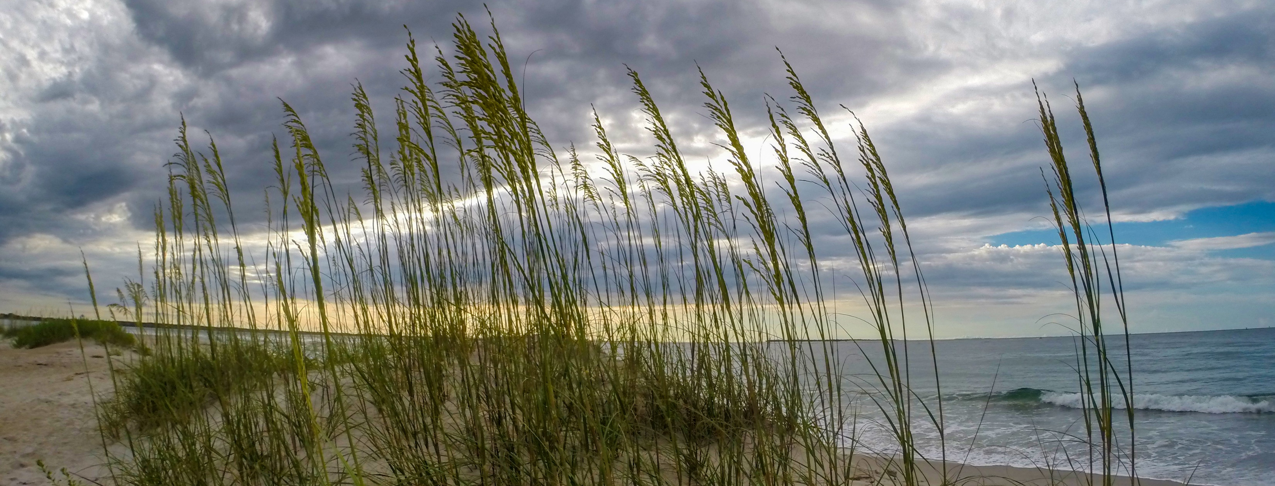
Rule Amendments: 15A NCAC 07H .0309(b)
Ken Richardson
NC Division of Coastal Management
February 27, 2025
Notes:
The Commission first approved these amendments to 15A NCAC 07H.0309(b) in April 2023, followed by the approval of the accompanying fiscal analysis in June 2023. At that time, both were scheduled for a public hearing as part of the formal rule-making process. However, this effort was temporarily paused before the amendments could be adopted and made effective.
At your November 2024 meeting, the Commission revisited this issue following a variance request and directed staff to reintroduce the proposed amendments for consideration. This decision effectively restarts the rule-making process given the lapse in time.

Slide 2
Rule Amendments: 15A NCAC 07H .0309(b)
Current Rule
15A NCAC 07H.0309(b)
Lots BEFORE June 1, 1979
Repealed Rule (08/1/2022)
15A NCAC 07H.0104
Lots ON-AFTER June 1, 1979
Setback 60 feet
Behind toe of frontal dune
No greater than 2,000 sqft.
Footprint ≤ 1,000 sqft.
Setback in place at time when the lot was created option
No greater than 2,000 sqft.
Landward-most adjacent neighbor
Notes:
Before diving into the specifics associated with these amendments, I want to first take a few minutes to refresh everyone’s memories on why this rule change is being proposed. Prior to August 1, 2022, the Commission’s rules essentially contained 2 small-structure exceptions that allowed for the sighting of new construction when proposed development could not meet the current setback requirement, but could meet the setback under conditions specified in one of the two applicable sets of rules. Each were commonly referred to as small-structure exceptions, and both defined small-structure as one being no greater than 2,000 square feet. However, the square footage limitation was the singular common condition, while the others in each set of rules differed, and were often sited as a source of confusion.
When both rules were in effect
First, 07H.0309(b), which is a current rule, defines use standards for Ocean Hazard Area Exceptions.
Second, 07H.0104, which was repealed on August 1, 2022.

Slide 3
Rule Amendments: 15A NCAC 07H .0309(b)
Remove
June 1, 1979 condition in (b)
Remove 1,000 sqft footprint condition in (b)(4)(B)

Slide 4
Rule Amendments: 15A NCAC 07H .0309(b)
CRC Approval
Fiscal Analysis
Public Hearing
CRC Adoption
RRC Approval
Rule Effective
February 2025
August 2025
October 2025
May 2025
June-July 2025
September 2025
Notes:
If approved, staff will update the fiscal analysis which would need to be approved by the Department, Office of State Budget and Management (OSBM) and CRC before they all go to public hearing. Without any unforeseen obstacles, it is anticipated that these rule amendments could go into effect in October.
Unless you have any questions, Staff is asking the Commission to consider approving these amendments to start the rule-making process.

