Slide 1
Department of Environmental Quality
Annette Lucas, PE
Minimum Measure 4: Construction Program
April 2019

Slide 2
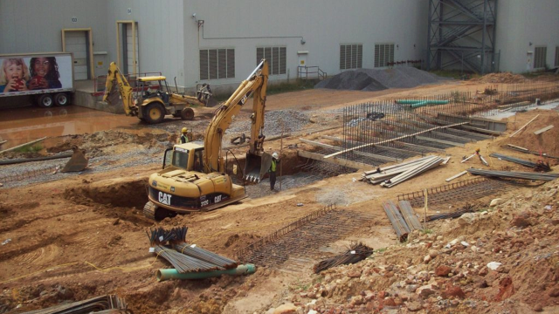
Construction Program: SWMP Requirements
Construction program required for projects that disturb > one acre and smaller projects that are part of a common plan of development that disturbs > one acre.
Reliance upon a North Carolina Sediment Pollution Control Act of 1973 (SPCA) program as defined in 15A NCAC Chapter 04 may be used to meet most of the permit requirements.
Department of Environmental Quality

Slide 3
Construction Program: E&SC Permit Conditions
Ordinance or other regulatory mechanism to require E&SC measures.
Procedures for site plan review.
Procedures for site inspection and enforcement.

Slide 4
Options for Meeting E&SC Permit Conditions
Implement your own locally delegated E&SC Program.
Have your jurisdiction covered under your county’s locally delegated E&SC program.
Have your jurisdiction covered under DEMLR’s Sediment Program.
The updated permit does not change how E&SC Plan approvals, inspections & enforcements occur in your jurisdiction.

Slide 5
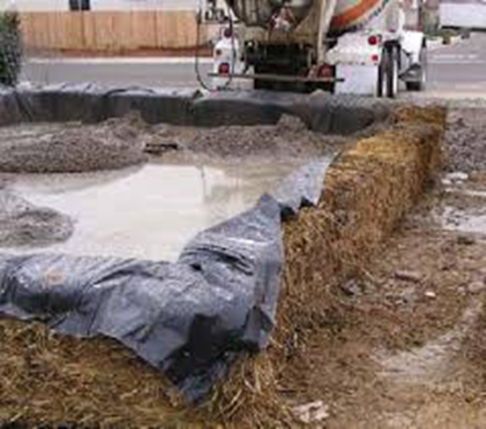
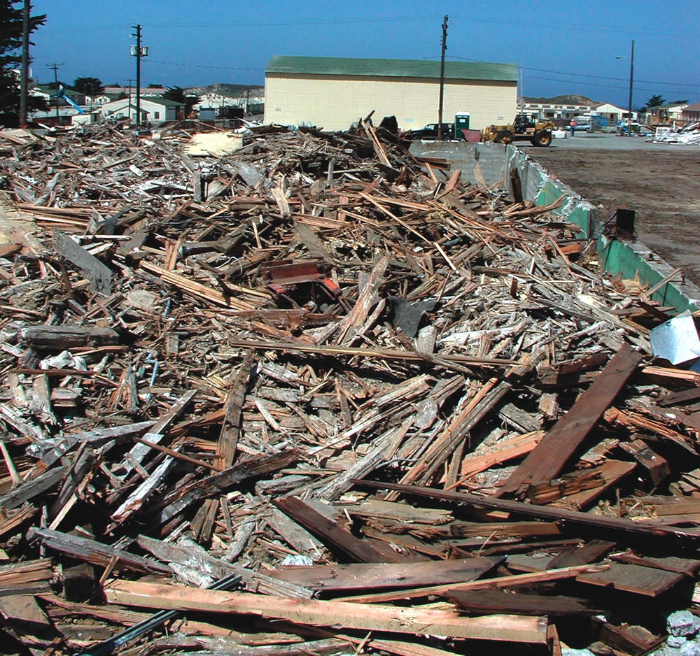
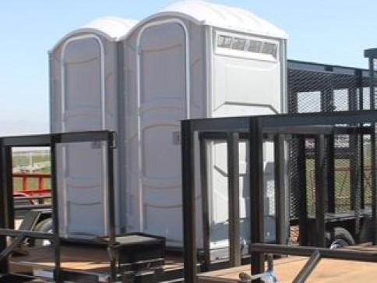
Construction Program
Materials Handling Permit Condition
Require construction site operators to control waste such as discarded building materials, concrete truck washout, chemicals, litter, and sanitary waste at the construction site that may cause adverse impact to water quality.

Slide 6
Permit Requirements
Provide & promote a means for the public to notify the appropriate authorities of observed E&SC problems.
Who are the “appropriate authorities?” . . . THAT DEPENDS.
For building materials, concrete truck washout, chemicals, litter, and sanitary waste, your community’s staff.
For E&SC Plan, the entity with E&SC Plan authority (your community, the county, or the state).

Slide 8
Highlights of the New NCG01 Permit
The New Application Process
e-NOI: Electronic Notice of Intent, and on-line NCG01 application form that takes about 20 minutes to complete.
COC: Certificate of Coverage, an approval issued specifically to YOUR project that indicates that you are covered under the NCG01.
e-NOT: Electronic Notice of Termination.
It’s Simple: After your E&SC Plan is approved, complete the e-NOI. In three business days or less, DEMLR will email you a COC. The timeframe for DEMLR express projects will be 24 business hours or less. You cannot legally begin ground disturbance until you have your COC.

Slide 9
Highlights of the New Permit
Table of Contents
PART I NCG01 Permit Coverage
PART II Stormwater Pollution Prevention Plan
PART III Self-Inspection, Record-Keeping and Reporting
PART IV Standard Conditions
PART V Definitions
Department of Environmental Quality

Slide 13
Tools to Help the Permittee
NCG01 Compliance Plan Sheets
Two sample plan sheets:
Ground stabilization and materials handling,
Self-inspection, record-keeping and reporting.
Note you have to comply with the items on these plan sheets even if a local E&SC program does not require it.
Department of Environmental Quality

Slide 16
Tools to Help the Permittee
Fact Sheet on the New NCG01
Explains the new process and answers common Qs.
Available at deq.nc.gov/NCG01.
Information on the overall SW program at deq.nc.gov/SW.
Department of Environmental Quality

Slide 17
Common Q&As
Existing E&SC Plan Approvals
Q: If an E&SC Plan is approved before April 1, which permit applies?
A: Projects with existing E&SC Plans will automatically follow the new NCG01 permit, but will not need to fill out an e-NOI or pay an annual permit fee. However, the permittees should print the new permit and the two standard detail sheets, adhere to them, and have them on site.
Department of Environmental Quality

Slide 18
Common Q&As
Project Completion
Q: What happens to the COC when the construction activity is complete?
A: When a project is complete, the permittees will contact DEMLR or the local delegated program to close out the E&SC Plan. After DEMLR or the local E&SC program inform the permittee of the project close out via inspection report, the permittee will visit deq.nc.gov/NCG01 to submit an e-NOT.
Department of Environmental Quality

Slide 19
Common Q&As
Compliance Requirements
Q: Will there be a grace period for adherence to the new process?
A: DEMLR does not have the authority to grant a grace period from a federally mandated permit. Permittees will be informed of the new process via web site, E&SC Plan approval letters and list servs.
Q: What will happen if an e-NOI is not submitted?
A: If a construction site that disturbs > 1 acre fails to submit an e-NOI after approval of its E&SC Plan, this is a violation of federal permitting requirements.
Department of Environmental Quality

Slide 20
And lastly . . .
The Annual Permit Fee
Initially, we will not charge an annual permitting fee for the NCG01 COC. However, on or after June 1, 2019, we will begin collecting a $100 annual fee per NCGS 143-215.3D.
This fee will allow us to improve the application process so that when you apply to DEMLR for the E&SC Plan approval, we can incorporate the NOI in the same form. (The process will likely remain separate for projects under a local E&SC program.)
Department of Environmental Quality

Slide 21
Still have questions?
Feel free to reach out!
annette.lucas@ncdenr.gov
deq.nc.gov/SW
(919) 707-3639
Department of Environmental Quality

Slide 22
Department of Environmental Quality

