Slide 1
Department of Environmental Quality
Volkswagen Settlement Draft Mitigation Plan
2018
Mike Abraczinskas, Director, NC Division of Air Quality

Slide 2
Draft VW Mitigation Plan
Early feedback gathered through a Request For Information (RFI) – November-December 2017
Helped shape this proposal
Key messages:
  Invest in maximum allowable in light-duty Zero Emission Vehicle supply equipment/infrastructure.
  Don’t forget the rural counties.
  Public sector needs are far greater than the resources available.
  Interest in a broad range of alternative fuel types.
Department of Environmental Quality

Slide 3
Mobile NOx Emissions in NC 2014
Department of Environmental Quality

Slide 4
Mobile Sector NOx Emissions by Source
Mobile NOx Emissions Source | Eligible | Emissions (tons/year) | Percentage
Commercial Marine Vessels | Y | 10,953 | 5.08%
Non-Road Equipment – Diesel | Y | 23,439 | 10.86%
On-Road Diesel Light Duty Vehicles | Y | 4,850 | 2.25%
On-Road Diesel Heavy Duty Vehicles | Y | 49,716 | 23.04%
Locomotives | Y | 7,304 | 3.39%
On-Road Non-Diesel Light Duty Vehicles | N | 103,753 | 48.08%
Other
On-Road Non-Diesel Heavy Duty Vehicles | N | 981 | 0.45%
Aircraft | N | 5,417 | 2.51%
Non-Road Equipment – Gasoline | N | 6,846 | 3.17%
Non-Road Equipment – Other | N | 2,514 | 1.17%
Department of Environmental Quality

Slide 5
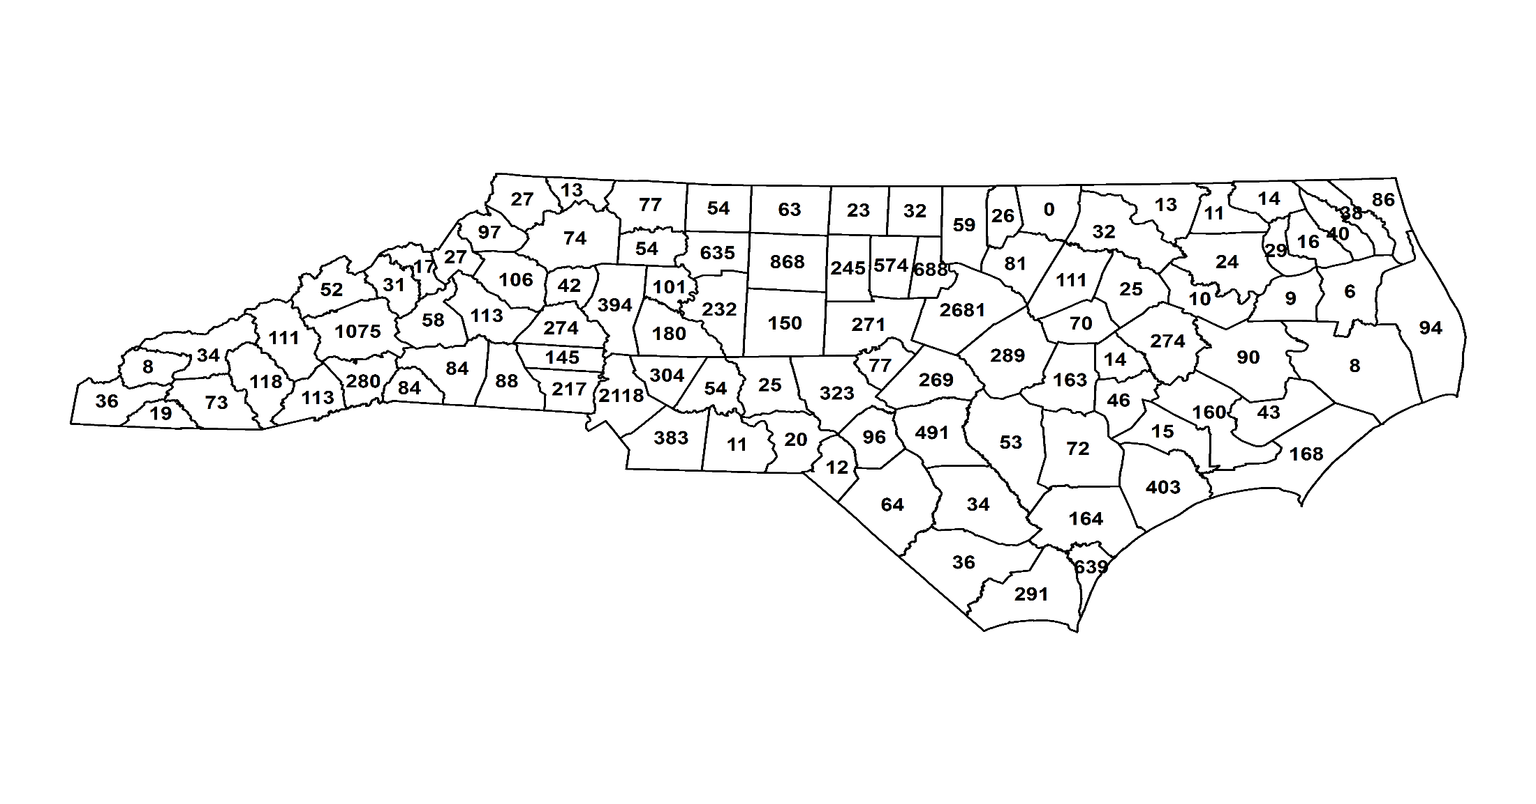
All VW Subject Diesel Vehicles
Department of Environmental Quality
Notes:
North Carolina ranked 9th in the country for the population of subject vehicles in the country. N.C. had a total of 18,471 subject vehicles.

Slide 6
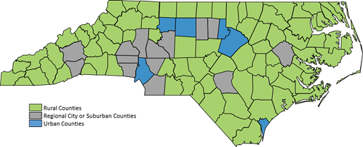
NC County Classifications
County classifications as defined by the N.C. Rural Center.
Department of Environmental Quality

Slide 7
Subject Vehicles by County Classification
Department of Environmental Quality

Slide 8
Main Mitigation Plan Goals
Maximize the air quality benefits (VW dollar per ton NOx)
Consider where the subject VW vehicles were located
Use or build on existing processes and programs to select projects
Consider environmental justice areas
Award funds through a transparent public process
Devote 15% of trust funds to light duty zero emission vehicle (ZEV) supply equipment
Department of Environmental Quality

Slide 9
Phased Plan Approach
The proposed three phases of funding are:
  Phase 1: $30.68 million – 2018 – 2020 – public-sector projects
  Phase 2: $30.68 million – 2020 – 2022 –
  develop spending plan after public input
  Phase 3: $30.68 million – 2022 – 2024 – remaining funds allocated
Department of Environmental Quality
Notes:
Phase 1: We will solicit input and review and revise the plan for Phase 2 prior to the conclusion of Phase 1.
Phase 2: We will solicit input on spending priorities for Phase 3 and review and revise the plan prior to the conclusion of Phase 2.

Slide 10
Phase 1 (2018 – 2020)
NC Grant Programs (2018-2020) | Eligible Action Category | Eligible Fuels | 2018-2020 Funding (Phase 1)
 |  |  | Targeted Percent* | Targeted Funding Amount
School bus replacement program | School buses | All (diesel, propane, natural gas, electric) | 35% | $10,738,660
Transit bus replacement program | Transit buses | All (diesel, propane, natural gas, electric) | 20% | $6,136,377
Clean heavy-duty on-road equipment program | Class Local Freight 4-8 trucks | All (diesel, propane, natural gas, electric) | 10% | $3,068,189
Clean heavy-duty off-road equipment program | Switcher locomotives, ferries, tugs, forklifts, port cargo handling equipment, ocean-going vessel shore power, Diesel Emission Reduction Act (DERA) | All (diesel, propane, natural gas, electric) | 15% | $4,602,283
ZEV infrastructure |  |  | 15% | $4,602,283
Administrative Costs |  |  | 5% | $1,534,094
 | Total: |  |  | $30,681,886
Department of Environmental Quality

Slide 11
Example of Vehicle Costs
Category: School buses
Proposed Phase 1 Allocation ($10,738,660)
Bus Type | Estimated Cost (per vehicle) | Number of Buses | Estimated Emission Reductions (per vehicle) | Estimated Total Cost | Estimated Emission Reductions (tons/year)
Diesel | $95,000 | 77 | NOx: 0.085 PM_{2.5}: 0.007 | $7,315,000 | NOx: 6.6 PM_{2.5}: 0.53
Propane | $90,000 | 16 | NOx: 0.205 PM_{2.5}: 0.006 | $1,440,000 | NOx: 3.3 PM_{2.5}: 0.09
All-electric | $400,000 | 5 | NOx: 0.357 PM_{2.5}: 0.011 | $2,000,000 | NOx: 1.8 PM_{2.5}: 0.06
Total buses |  | 98 |  | $10,755,000
Note: The number of vehicles per fuel type is not binding and does not represent
a proposal, but rather is used to be illustrative of the number of total vehicles
that could be replaced for the proposed allocation in this category.
Department of Environmental Quality

Slide 12
Funding Process
The DEQ may establish more than one process to fund projects. Funding processes may include:
  Reimbursement
  Direct-to-vendor
  Forward funded projects
  Vouchers
Department of Environmental Quality

Slide 13
Environmental Justice
North Carolina has this goal for all communities and persons across the state. It will be achieved when everyone enjoys:
The same degree of protection from environmental and health hazards, and
Equal access to the decision-making process to have a healthy environment in which to live, learn and work.
Department of Environmental Quality
Notes:
Environmental justice is the fair treatment and meaningful involvement of all people regardless of race, color, national origin, or income, with respect to the development, implementation, and enforcement of environmental laws, regulations and policies.

Slide 14
Proposed Project Selection Criteria
The DEQ will consider factors such as, but not limited to:
Cost Effectiveness (VW$ funded per NOx tons reduced)
NO_{x} Emissions Reductions
Location of project
Co-Benefits
Sustainability of the Project
Timeliness
Useful life of vehicle replaced
Other Selection Criteria
Department of Environmental Quality
Notes:
Cost Effectiveness (VW$ funded per NOx tons reduced): cost effectiveness is based on applicant provided information using an accepted calculation tool and if applicable, matching funds
NO_{x} Emissions Reductions: NOx emission reduction calculation based on applicant provided information using an accepted calculation tool
Location of project: how many subject vehicles were registered in project area
Co-Benefits: e.g. other emission reductions (SOx, PM, VOC, GHG and CO)
Sustainability of the Project: longevity of the funded equipment and additional long term benefits
Timeliness: ability to complete project within two years of award, e.g., project complete and providing emission reductions
Useful life of vehicle replaced: Vehicle should have at least 3-5 years of useful life remaining
Other Selection Criteria: employed as necessary for the selection of proposals, e.g., located in an environmental justice area, innovative technology or approaches.

Slide 15
Comment Submission / More Information
The comment period for Mitigation Plan comments ended May 3, 2018.
For additional information regarding the VW Settlement, please visit our webpage.
https://deq.nc.gov/about/divisions/air-quality/motor-vehicles-and-air-quality/volkswagen-settlement
or
ncair.org …and click on Volkswagen Settlement
Department of Environmental Quality

Slide 16
Informational Meeting Locations and Dates
7-9 p.m. Monday, March 26: Land of Sky Regional Council, 339 New Leicester Hwy., Asheville
3-5 p.m. Tuesday, March 27: Kannapolis Train Station, Multipurpose Room, 201 S. Main St., Kannapolis
5-7 p.m. Monday, April 16: Lenoir Community College, Bullock Building, Room 150, Kinston
1-3 p.m. Tuesday, April 17: Triangle J Council of Governments, 4307 Emperor Blvd., Suite 110, Durham
9-11 a.m. Friday, April 20: Cape Fear Community College, Union Station, Room 512, 502 N. Front St., Wilmington

Slide 17
Next Steps
Plan submission to trustee (Summer 2018)
Release request for proposals (Fall 2018)
Proposal evaluations (Winter/Spring 2018-2019)
Phase 1 project awards (Spring 2019)
Phase 2 planning (Fall 2019/Winter 2020)
Department of Environmental Quality

Slide 18
Contacts
Robin Barrows, Allied Programs Supervisor
Phone: 919-707-8445
Email: robin.barrows@ncdenr.gov
Dave Willis, Environmental Program Consultant
Phone: 919-733-1482
Email: dave.willis@ncdenr.gov
Sheila Blanchard, Environmental Specialist
Phone: 919-707-8423
Email: sheila.blanchard@ncdenr.gov
Department of Environmental Quality

Slide 19
Thank You!
Brian Phillips, EIT, CPM
Mobile Sources Compliance Branch Supervisor
Division of Air Quality
919-707-8426
Brian.Phillips@ncdenr.gov
https://deq.nc.gov/about/divisions/air-quality/motor-vehicles-and-air-quality/volkswagen-settlement
or
ncair.org …and click on Volkswagen Settlement
Department of Environmental Quality

Slide 20

Questions

