Slide 1
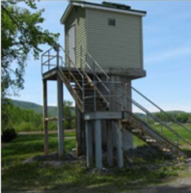
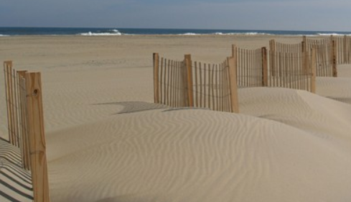
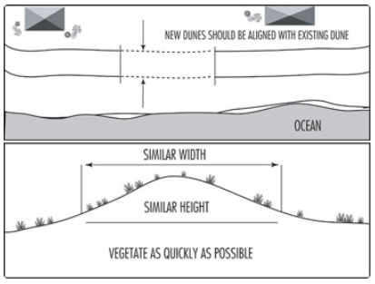
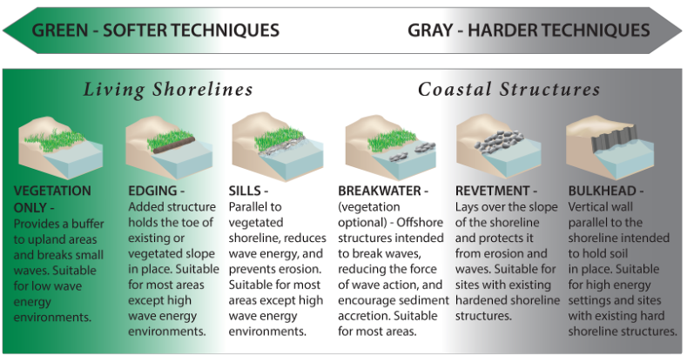
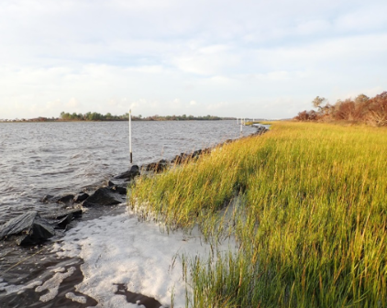

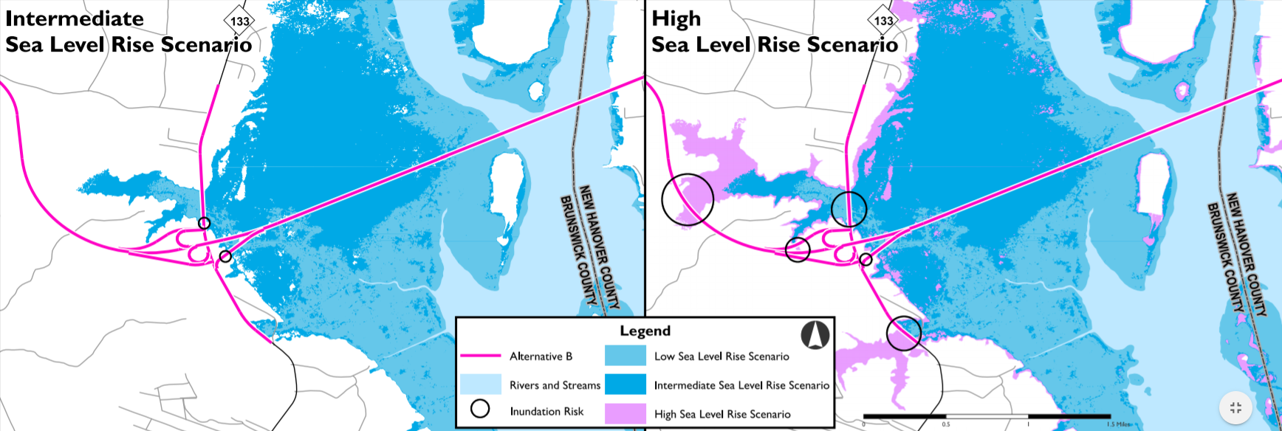

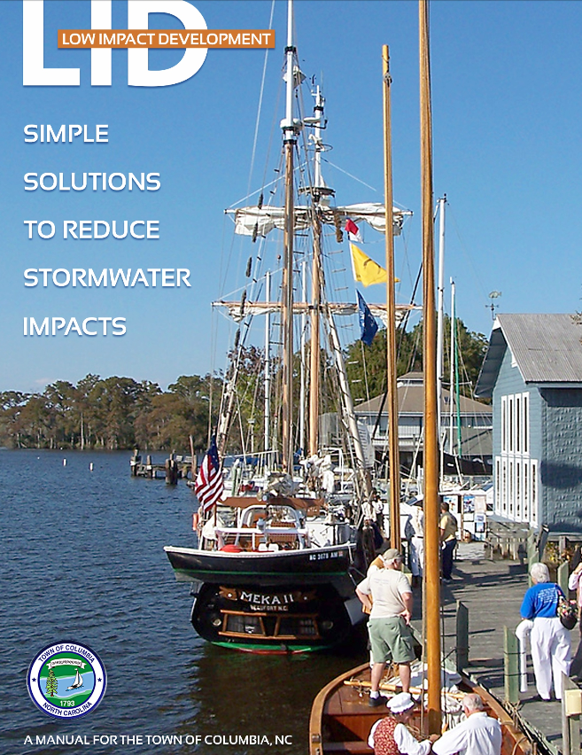
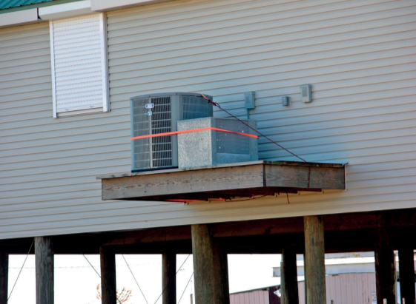
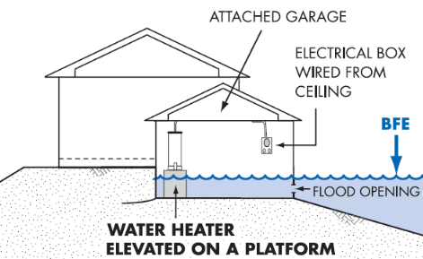
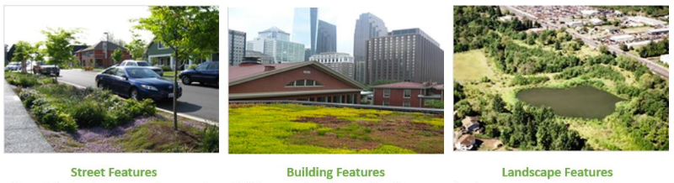
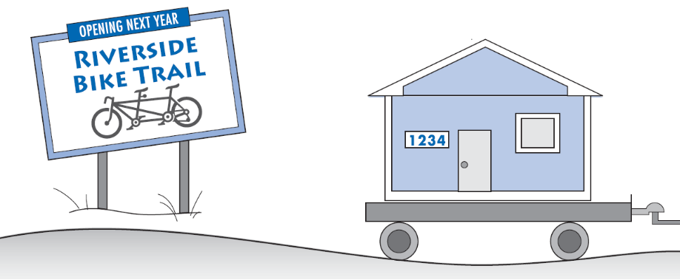

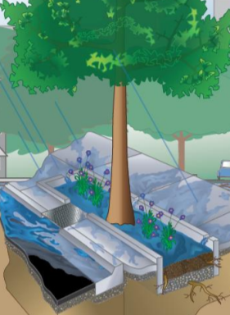
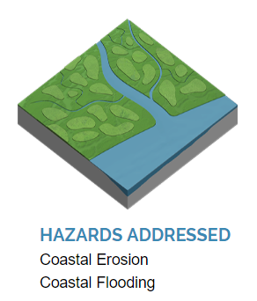
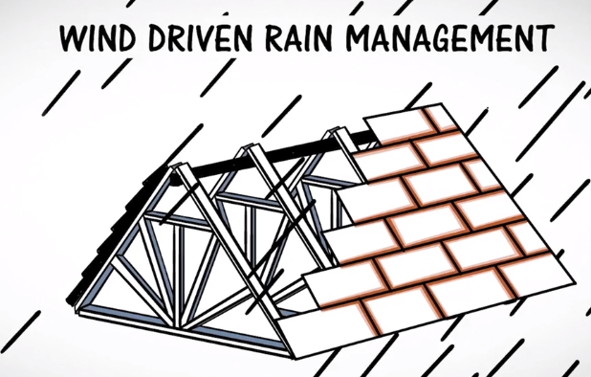
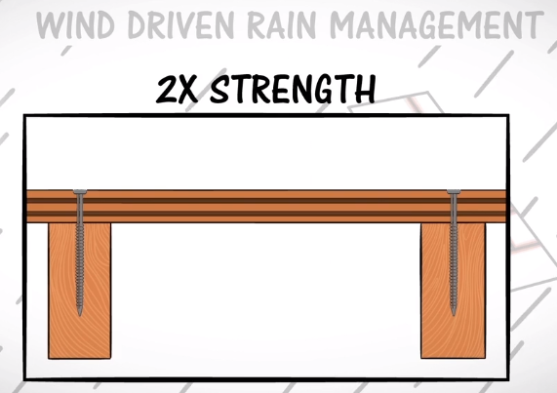
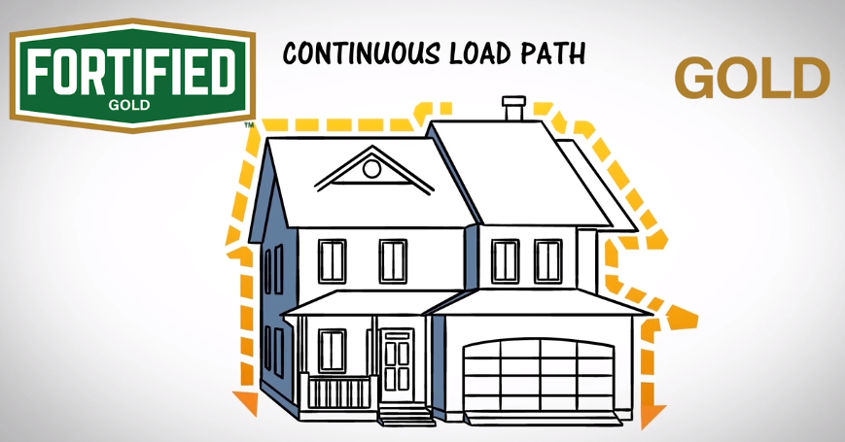
Infrastructure and Nature-based Measures Resiliency Tools
Building Retrofits & Weatherization
Elevating Water Utility and Transportation Assets
Dune Management
Marsh Sills:
A Type of Living Shoreline
    Retrofitting homes and businesses to have more energy and cost efficient fixtures can help save money to invest in other resilience measures (elevating structure, purchasing a back-up generator, etc.)
    Example: Coastal Community Action – Weatherization Assistance Program
    Changes like elevating critical and vulnerable transportation routes above the level of potential floodwaters, or ensuring access to critical water facilities ensure that these services and public infrastructure are designed for their lifespan and account for future conditions.
    New construction or repairs should consider the future risks of sea level rise and other hazards using scenario planning when possible
    Sand dunes provide a natural buffer against the erosive forces of wind, water and waves. Sometimes it's necessary to stabilize or strengthen existing sand dunes or build new ones to protect oceanfront buildings and roads.
    Dune establishment and stabilization projects must be thoughtfully planned and carried out to avoid damaging the beach and dune system.
    Shoreline stabilization technique using natural habitat elements (e.g. tall grasses and wetlands) that increases resilience to coastal erosion and flooding
    Traps sediment reducing wetland or marsh edge loss, dissipates wave energy and storm surges, provides ecosystem services
    *NEW* Marsh Sill General Permit (15A NCAC 7H .2700)
Shoreline stabilization techniques
Little to No Damage to
Morris Landing Rock Sill
1-month Post-Florence
Holly Ridge, NC
2019 Sea Level Rise Assessment
Cape Fear Crossing – Alternative B –
Intermediate and High SLR Scenarios
(NC DOT)
Wellhead Elevated above BFE
(U.S. EPA)
Town of Nags Head Sand Fences
    N.C. DCM
    Systems Approach to Geomorphic Engineering
    N.C. Coastal Reserve and NERR
Elevating Critical Components Above BFE
Low Impact Development (LID) & Green Infrastructure
Pre- & Post-disaster Home Buyout Program
Habitat Conservation
    Unlike entire buildings or structures, elevating critical components like HVAC, electrical panels, and back-up generators can ensure key assets (e.g. pump station or other) aren’t completely compromised during a flood.
    A higher design flood elevation standard may be appropriate for critical facilities rather than for single-family homes.
    Replacing impervious surface with natural features allows for more effective water quantity and quality management
    Example measures include:
    A form of hazard mitigation
    Property owner gets paid fair-market value (pre-storm) to have home demolished and kept as open space in perpetuity falling under the ownerships of the municipality or county (unless a third party is arranged such as a community land trust, or the land is leased for $1 to a neighboring resident.
    Buyout properties have been: restored as wetlands, reforested, turned into parks, pedestrian or biking trails, Frisbee golf courses, community garden space, or left vacant to be used as temporary excess parking space.
    Public acquisition of undeveloped land lessens or prevents the impacts of flooding, keeps development out of risky areas and protects water resources.
    Communities can purchase land outright or use tools such as land use/regulation or easements to ensure flood prone areas are set aside.
    This strategy is most effective on a large scale with (1) identification or mapping of existing conservation areas and available open space, (2) prioritization of parcels and (3) acquisition of land.
    Downspout Disconnection
Rainwater Harvesting
Rain Gardens
Planter Boxes
Bioswales
Permeable Pavements
Green Streets and Alleys
Green Parking
Green Roofs
Urban Tree Canopy
Land Conservation
Town of Columbia LID Manual
Federal Funds for Home Buyouts
Pre-disaster | FEMA PDM FEMA FMA
Post-disaster | FEMA FMA FEMA HMGP HUD CDBG-DR
U.S. EPA
NC Floodplain Management QuickGuide
Georgetown Climate Center: Green Infrastructure Toolkit
NC Floodplain Management QuickGuide
North Carolina Wildlife Resources Commission provides a guidebook, training and
Natural Heritage data to help communities with conservation planning.
FORTIFIED Roof/Building Construction
Urban Forest and Tree Management
Coastal & Wetland Restoration
Other Examples?
Insert Sticky Note Below
    FORTIFIED is a nationally recognized building method and standard (3 levels: Roof, Silver & Gold) based on observations by the Insurance Institute for Business and Home Safety (IBHS)
    It is code-plus and exceeds the vast majority of building codes by improving the performance of buildings against natural hazards and reducing the risk of personal property losses.
    A FORTIFIED Evaluator is the only professional who can help you earn a FORTIFIED Designation and take advantage of all the programs benefits.
    The program starts by focusing on the roof, which is the most important and vulnerable part of every building.
    The FORTIFIED Commercial Program makes new and existing commercial buildings more resistant to damage from severe weather
A single tree may store 100 gallons or more of rainfall, and it is estimated that the urban forest can reduce annual runoff by 2 to 7 percent.
    Natural features like coastal marsh and wetlands can absorb flood waters and provide a buffer to coastal communities from flooding, erosion and storm surge.
    Coastal marshes provide flood protection, shoreline stabilization, erosion control, and protect water quality by filtering water.
    Wetlands mitigate floods and droughts, purifying and storing surface water.
    Restoring these areas allow for storage of water increasing the overall ability of a system to handle extreme weather.
    Provide description of how it contributes to future resilience, where it occurs, as well as what partners are involved
Trees offer many advantages to an urban landscape:
Raise the attractiveness of an urban area.
Form part of the ambiance of shopping districts.
Shade a pedestrian walkway or open-air mall.
Draw businesses, such as shops and street vendors.
Revive blighted urban areas.
Keep city streets cooler and reduce indoor air conditioning costs.
Filter pollutants from the air and provide oxygen.
Reduce stress and otherwise improve health.
Offer shade for seating, children’s play areas and other recreation sites.
Reduce stormwater runoff.
Provide respite from the heat and opportunities for social gathering as pocket parks and squares.
Provide recreational opportunities and wildlife corridors, such as urban river walks and other tree-lined routes.
Provide habitat for birds and other wildlife.
Naturally Resilient Solutions
For more information, contact:
Spencer Rogers of N.C. Sea Grant
rogerssp@uncw.edu
These types of actions usually fall into one of four categories: #1. Avoid (prohibit or discourage putting infrastructure in harm’s way);
#2. Accommodate (build/retrofit so asset can maintain critical function during disruption); 3) Protect (installing barriers to reduce hazard exposure) and #4. Relocate (retroactively moving critical infrastructure and through voluntary programs, homes and businesses out of harm’s way.

Slide 2
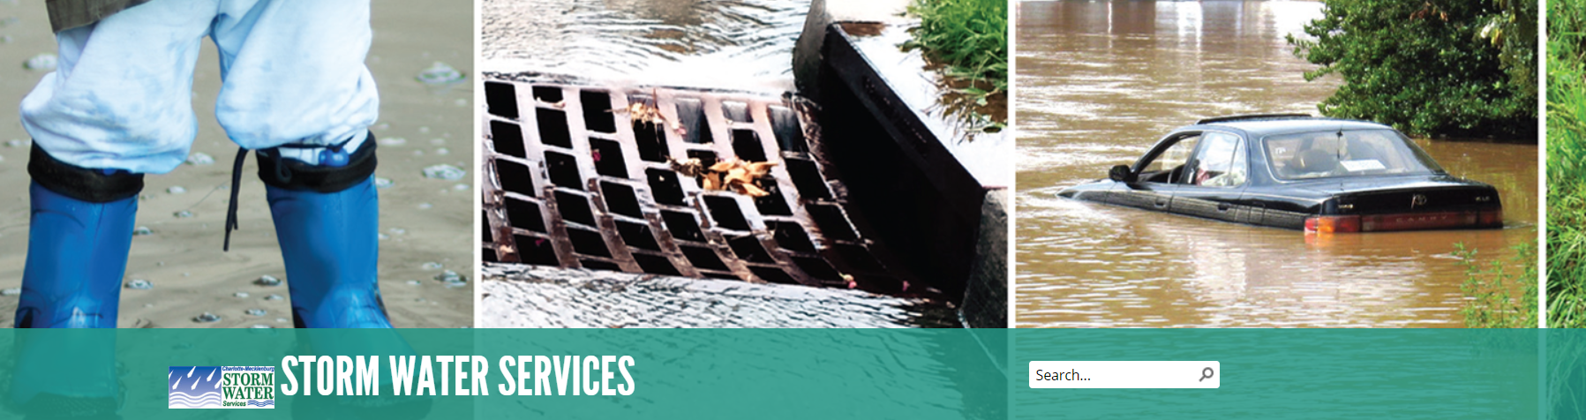
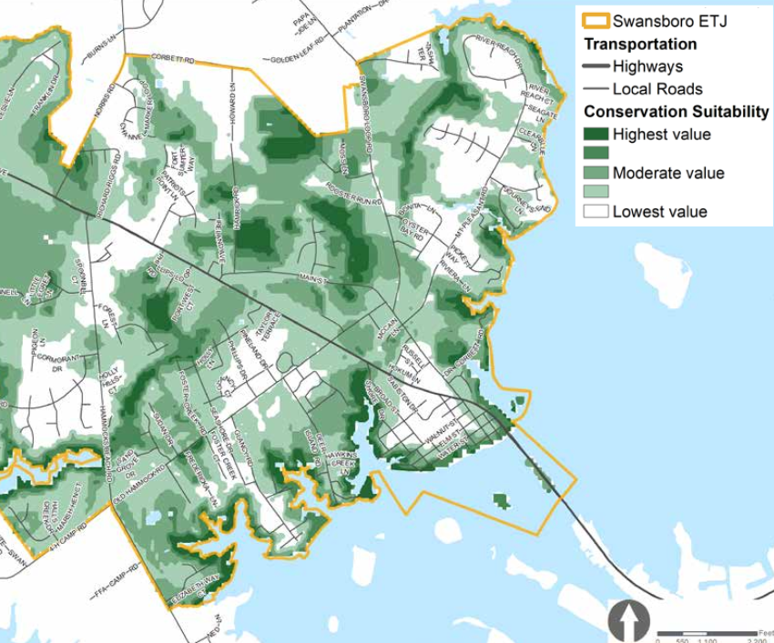
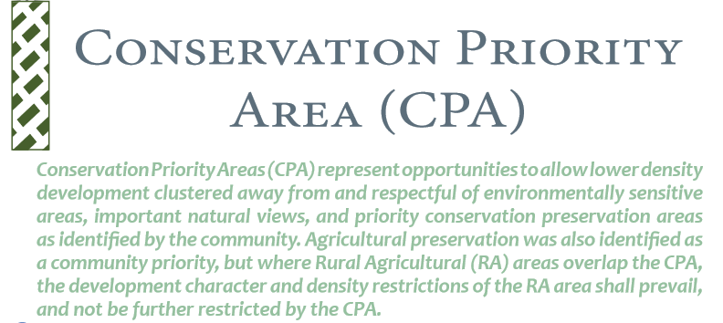
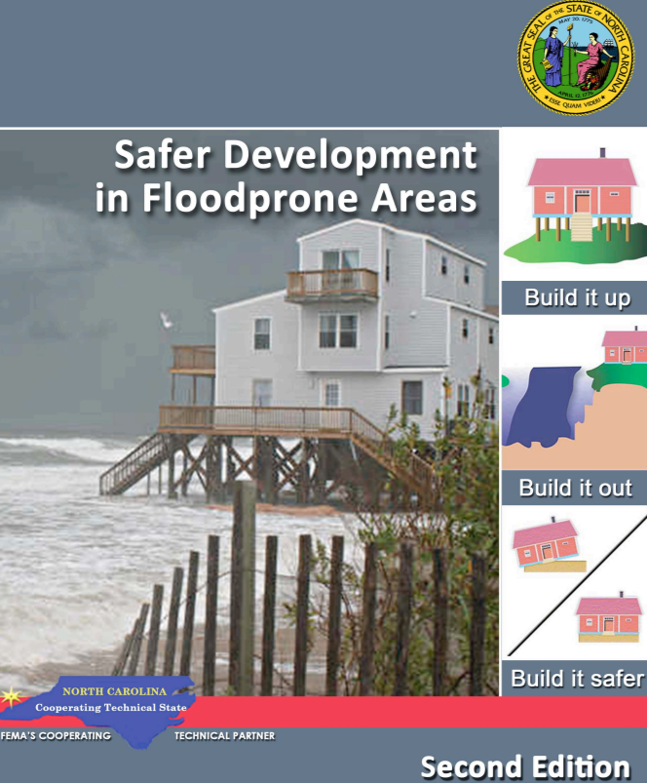
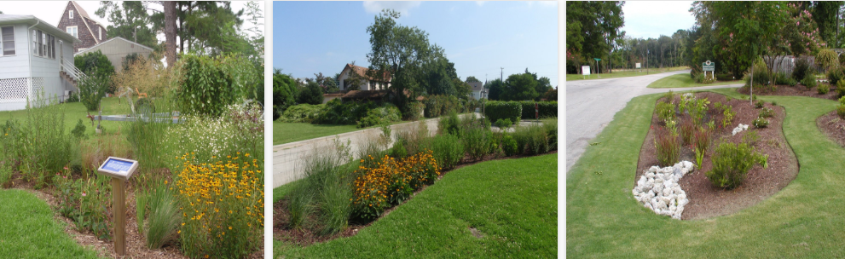
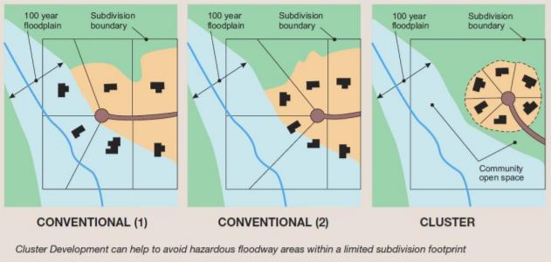
Local Policy and Regulations Resiliency Tools
Stormwater
Utility Fee
Conservation
Overlay Zone
Dune and Beach Protection Ordinance
Other Examples?
Insert Sticky Note Below
    Adding fees in addition to normal drinking water and sewer bills can fund improvements to water infrastructure.
    If feasible, the establishment of a local stormwater utility and collection of stormwater permit fees during new development can be used to upgrade stormwater infrastructure and even fund hazard mitigation projects for structure (e.g., acquisition).
    These measures can help address water quality concerns and community flooding issues.
    Using multi-criteria land suitability analysis or other screening tool can help prioritize areas that are most valuable in terms of protecting or enhancing natural habitat and ecosystem services, reducing hazard (flood, sea level rise, storm surge) risks, and other benefits – these areas can be identified as part of a Conservation Overlay Zone
    Limit intensity and density of uses and location of development to minimize impacts to these critical conservation areas
    To manage and protect dunes and beaches regulations such as zoning, buffers, and set-backs that restrict development in these natural areas will encourage this type of shoreline protection.
    Provide description of how it contributes to future resilience, where it occurs, as well as what partners are involved
    Other Examples: Provide description of how it contributes to future resilience, where it occurs, as well as what partners are involved
Charlotte-Mecklenburg's Storm Water Services utilizes stormwater
fees to partly fund a floodplain buyout or acquisition program
Swansboro Conservation Priority Area Overlay & Underlying Conservation Suitability
Flood Damage
Prevention Ordinance
Landscaping, Vegetation, and Tree Ordinances
Residential Cluster Development Ordinance
Other Examples?
Insert Sticky Note Below
    Designed to minimize public and private losses due to flood conditions within flood prone areas by: restricting or prohibiting uses, controlling alteration of floodplain, channels, or natural barriers, control filing, grading, dredging or other development that may increase erosion or flood damage
    At minimum, regulates development in the special flood hazard area (SFHA) or 1% annual chance flood area & required for NFIP communities
    Encouraging or requiring use of native plants and other best management practices for green infrastructure can better retain flood waters, treat non-point source pollution
Tree conservation ordinances can
creates a framework for the municipality to monitor tree removal and protect trees or areas deemed to be of value to the community.
create an income stream to help finance tree planting, tree maintenance and staff.
helps educate residents and developers about trees and the practices that affect them
    Guides development to certain portion of a property while retaining certain percentage as permanent open space or undeveloped natural resources (e.g. conservation easement, agriculture or buffer)
    The preserved open space or natural habitat that results from clustering development can serve as flood retention or prevention areas (e.g., forests, marshes, low-lying wetlands which reduce storm surge)
    Provide description of how it contributes to future resilience, where it occurs, as well as what partners are involved
    Can account for ‘future floodplain conditions’ affected by climate change impacts, increased development, etc. through higher regulatory standards such as increased ‘freeboard’ in 1% and 0.2% flood zones
Cost to raise footprint of 1,500 s.f. house by 1 ft
Pre-construction | ~ $4,100
Post-storm | ~ $30,000
Other Examples?
Insert Sticky Note Below
Other Examples?
Insert Sticky Note Below
Other Examples?
Insert Sticky Note Below
Other Examples?
Insert Sticky Note Below
    Provide description of how it contributes to future resilience, where it occurs, as well as what partners are involved
    Provide description of how it contributes to future resilience, where it occurs, as well as what partners are involved
    Provide description of how it contributes to future resilience, where it occurs, as well as what partners are involved
    Provide description of how it contributes to future resilience, where it occurs, as well as what partners are involved

Slide 3
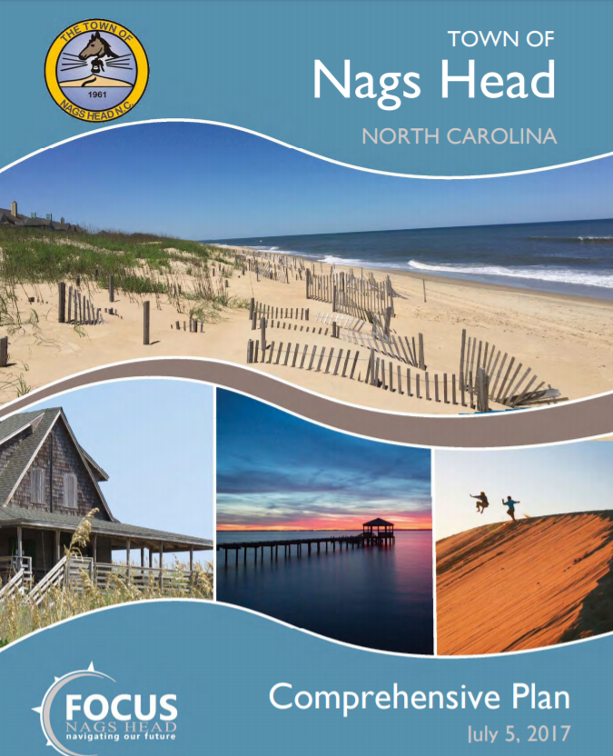
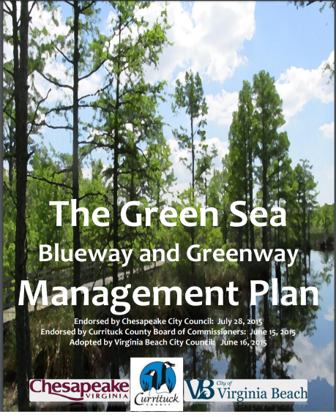
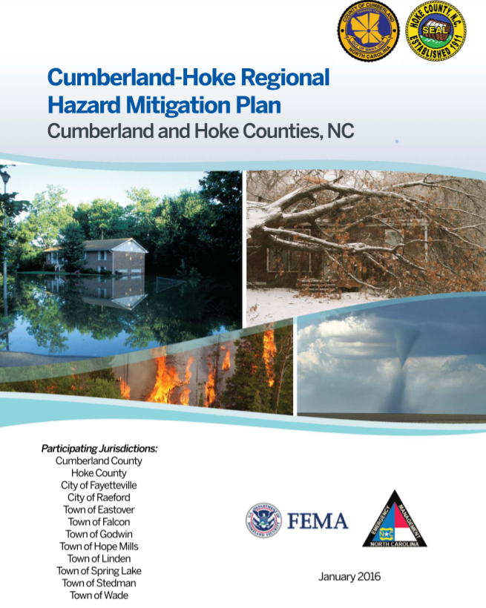
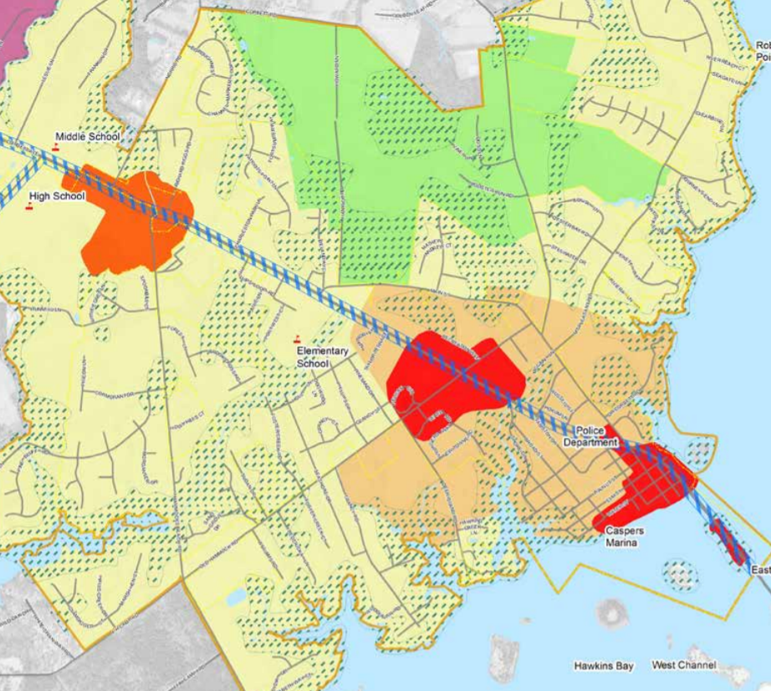
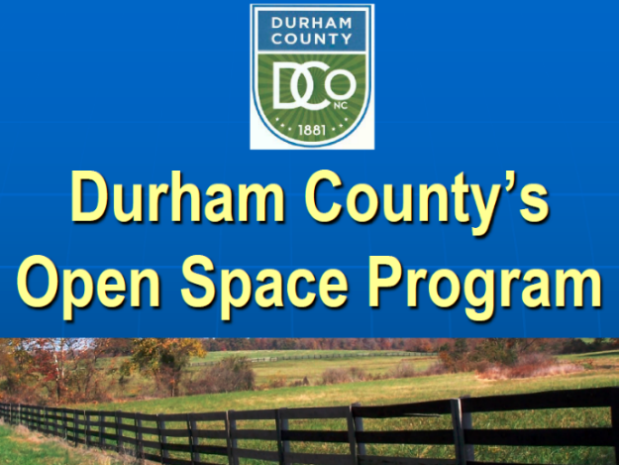
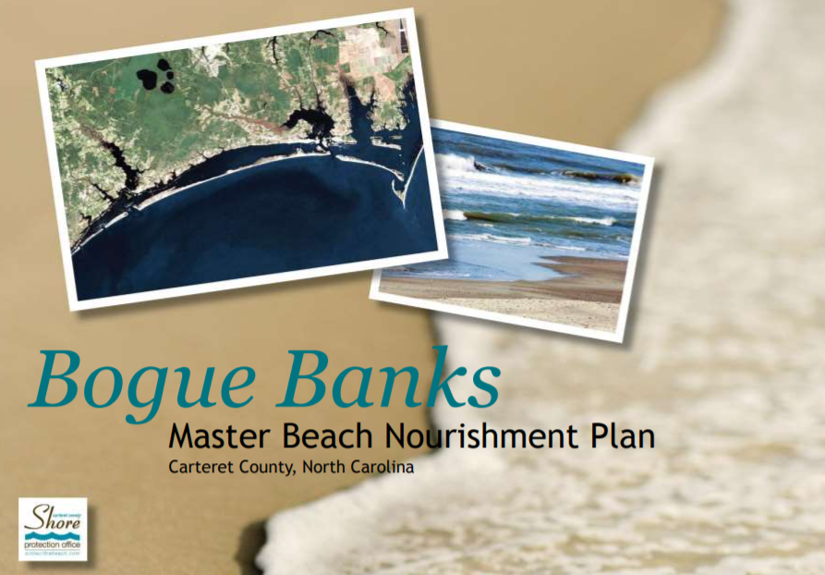
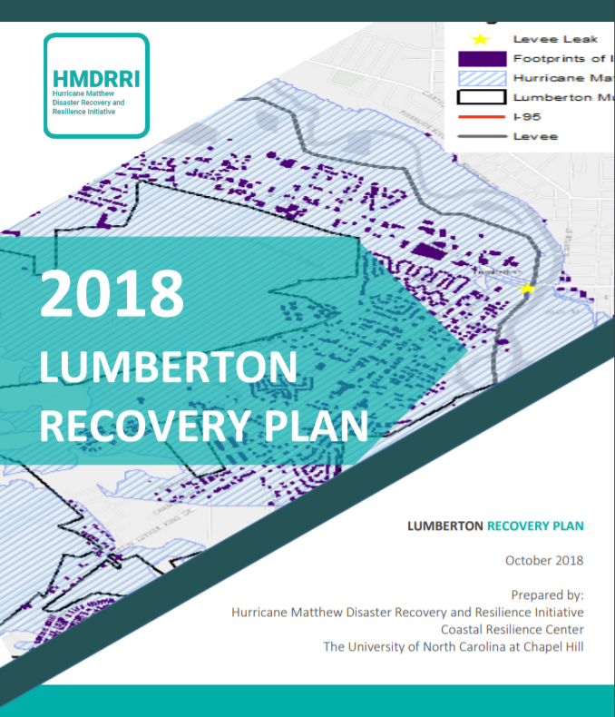
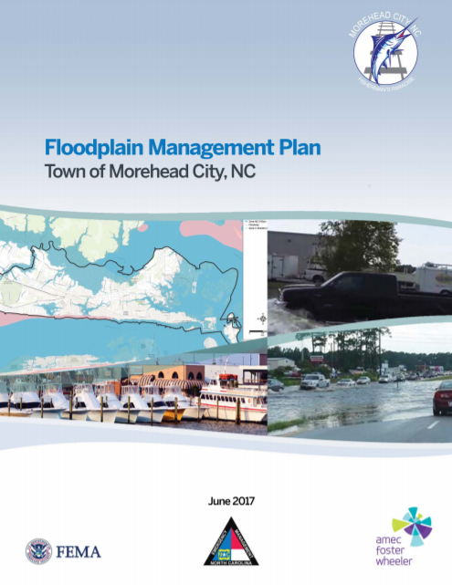
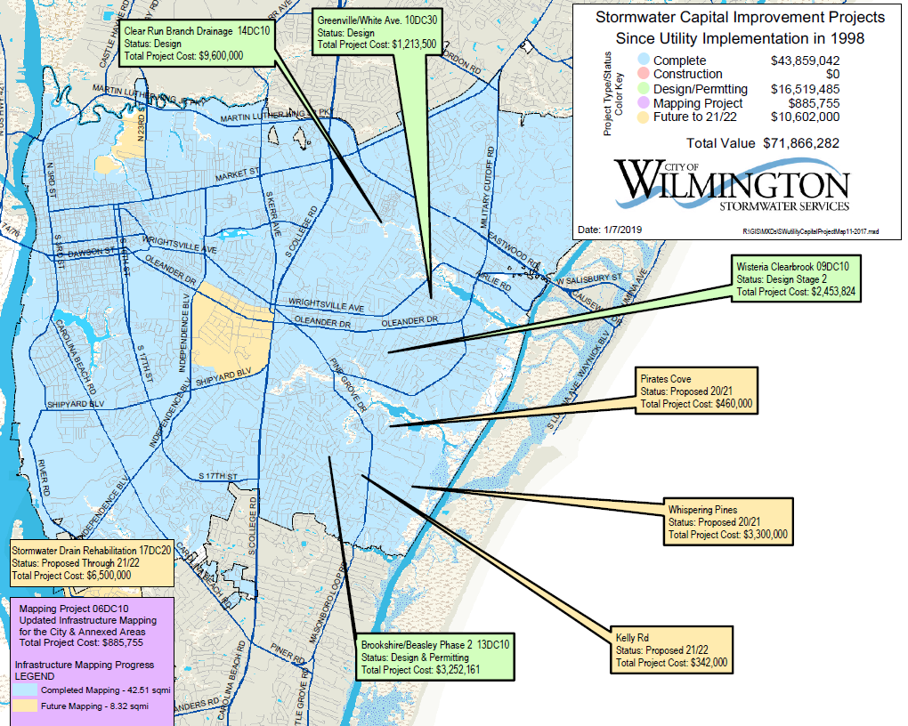
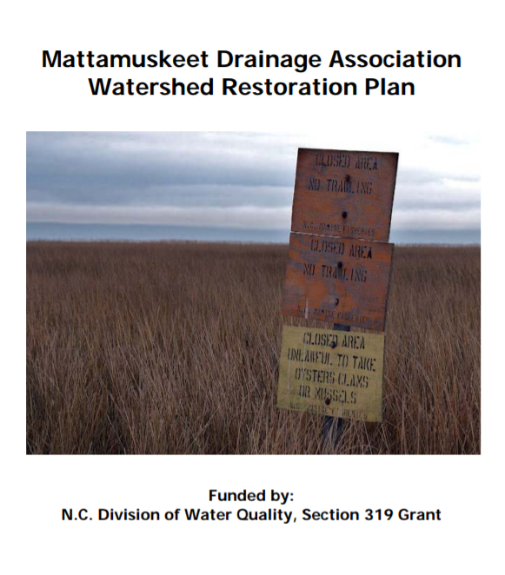
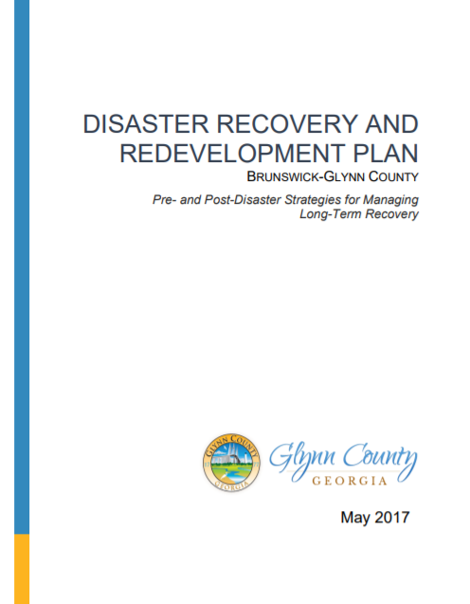
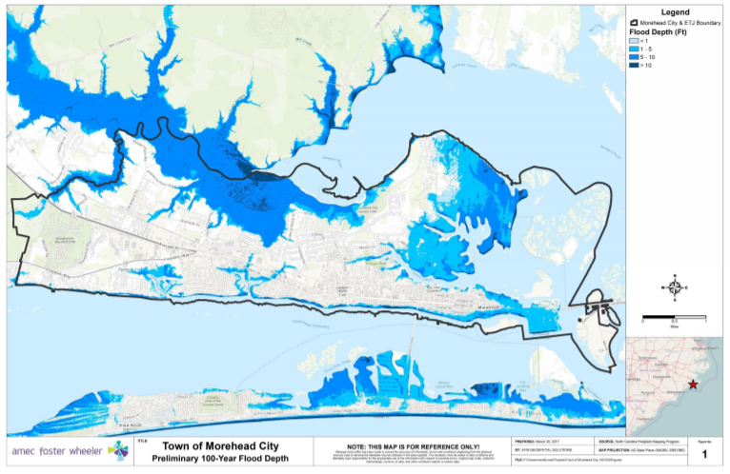
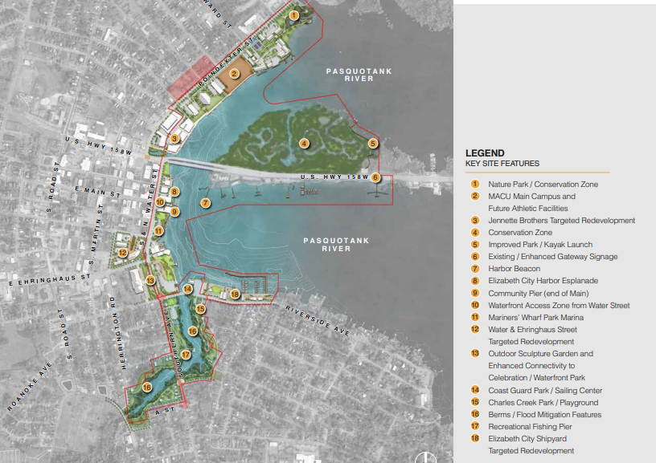
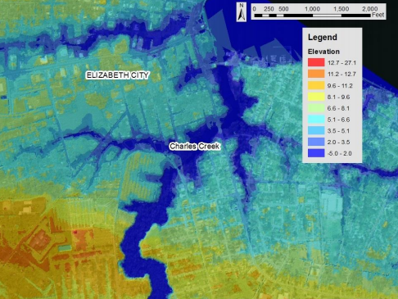
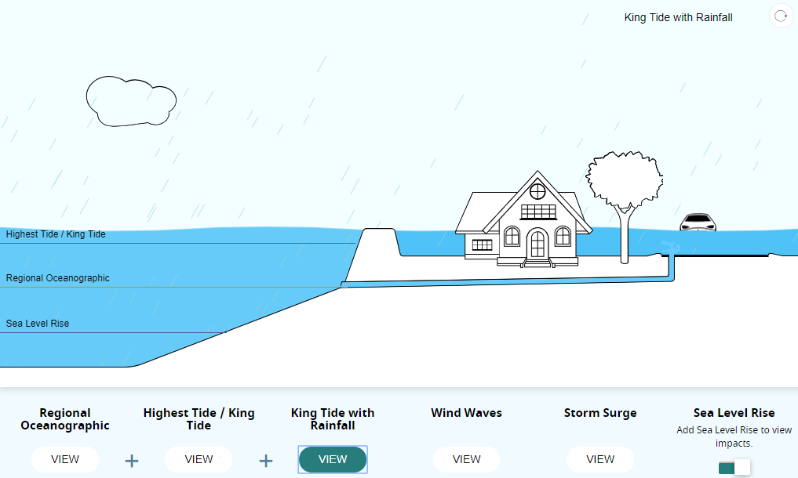
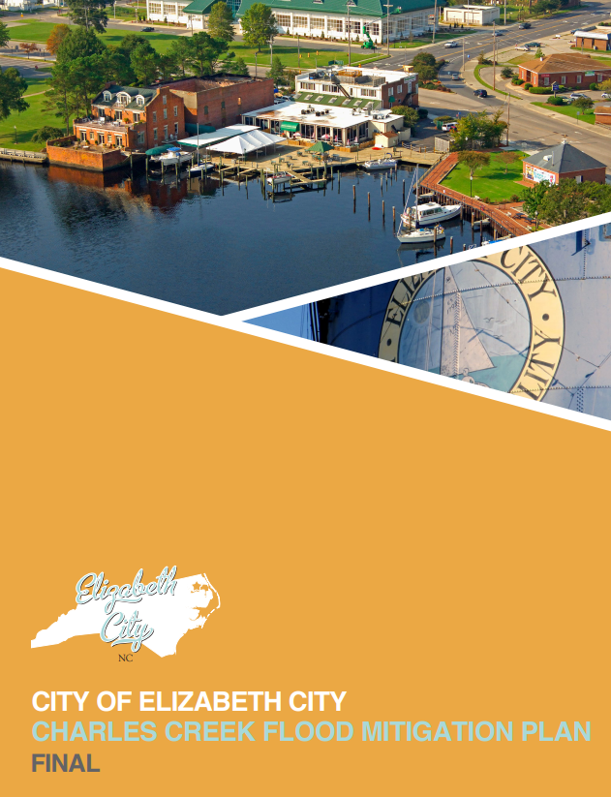
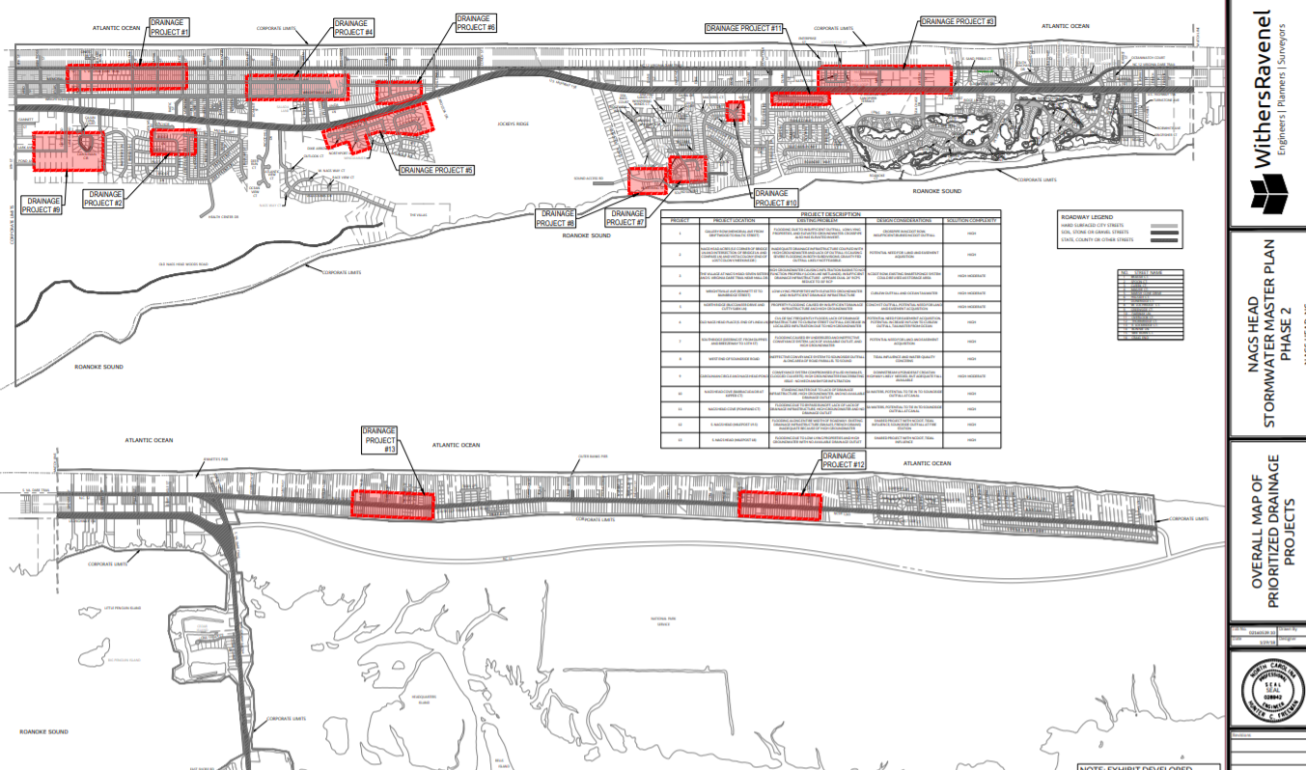
Local and Regional Plans Resiliency Tools
Comprehensive/
CAMA Land Use
Hazard Mitigation Plan
Open Space and Recreation Plan
Beach/Shore Protection Management Plan
    Description: 20- to 30- year planning horizon, tackling broad scope of community goals by guiding future growth, development, and land use; includes significant public engagement
    Requirement: Yes, for Coastal Area Management Act (CAMA) communities per 15A NCAC 07B
    Resilience Connection: Can provide fact-base, public engagement/education and policy guidance linking hazard mitigation, floodplain management, sea level rise projections, and long-term recovery to support development of regulations/higher standards and incentive programs
    Description: Includes a detailed hazard identification and risk assessment (HIRA) for residential and commercial builds, critical infrastructure/assets.
    Requirement: Yes, for FEMA funding eligibility (PDM, FMA, HMGP, etc.)
    Resilience Connection: Provides analysis to justify investment in pre-and post-disaster mitigation or adaptation actions to reduce risk posed by natural hazards, including those exacerbated by climate change (coastal flooding and sea level rise)
    Description: Developed to protect and enhance community open space resources
    Requirement: No, but can receive FEMA Community Rating System points
    Resilience Connection: Can absorb and store water with natural features, and coastal open spaces (such as wetlands and marsh) can act as erosion and wave buffers. Equitable access to open spaces/recreation can lead to better public health outcomes thereby reducing vulnerability. May tie into flood buyout or future transfer of development rights program.
    Description: Up to 50-yr planning horizon, outlining strategies for actual and potential coastal erosion and its relation to planned or existing development activities on the coast. Plans focus on projects with minimal environmental harm; ideally regional & self-sustaining.
    Requirement: Yes, to be eligible for FEMA Public Assistance per 44 CFR 206.225(j)(2)
    Resilience Connection: Often the primary strategy for reducing risks to beach communities associated with ocean-front erosion caused by storms; projected elevation profile should account for sea level rise scenarios; an important example of pre-disaster recovery planning
Nags Head
Comprehensive Plan
Currituck County & Va. Beach
Cumberland-Hoke Regional
Hazard Mitigation Plan
Swansboro Conservation
Priority Overlay
Durham County’s program protects water quality, habitat, passive recreation, and preserves farmland
Capital Improvements Plan (CIP)
Pre- or Post-Disaster Recovery Plan
Watershed Restoration Plan
Floodplain Management Plan
    Description: 4- to 6-year plan identifying capital projects (stormwater, transportation, water supply, and other infrastructure) and forecasting funding.
    Requirement:
    Resilience Connection: Can leverage funding to implement hazard mitigation measures that take future conditions into account and provides opportunity to review and consider the impact of proposed improvements on hazard vulnerability (e.g. guide new growth to safer areas); legal question of abandoning or not repairing vulnerable infrastructure post-disaster.
    Description: Ideally done during ‘blue-sky’ conditions, this type of plan identifies policies, operational strategies, and roles and responsibilities for implementation that will guide decisions that affect long-term recovery and redevelopment of the community after a disaster
    Requirement: No
    Resilience Connection: Planning for recovery before a disaster can lead to a faster, more efficient and more equitable recovery, allow a community to ‘build back better’, and provides more local control over the lengthy and complicated recovery process.
    Description: aims to identify causes of impairment and pollutant sources, necessary nutrient load reduction levels and management measures and other components to increase favorable water quality and quantity outcomes that support a healthy environment and economy
    Requirement: Yes, to be eligible for 319(h) grant funding
    Resilience Connection: maintaining and restoring the natural functions of watersheds and their floodplains can reduce flood risks and, enhance natural habitat and protect a variety of economic interests (aquaculture, beaches, etc.)
    A localized floodplain management plan that goes beyond a regional hazard mitigation plan to conduct a risk assessment that identifies and profiles flood hazards that pose a risk to the community, assesses community vulnerability to these hazards, and examines the capabilities in place to mitigate them. The flood hazards typically profiled in this type of plan include:
      Climate Change and Sea Level Rise (1-3 ft)
      Dam/Levee Failure
      Flood: 100-/500-year
      Flood: Stormwater/Localized Flooding
      Hurricane and Tropical Storm
      Stream Bank Erosion
City of Wilmington
CIP Map
City of Lumberton
Recovery Plan
Mattamuskeet Drainage
Association Watershed
Restoration Plan
Town of Morehead City
Floodplain Management Plan (2017)
    Results and recommendations from this type of effort should account for future conditions (more extreme rainfall events, higher sea levels & storm surge, etc.) and inform updates to other plans and ordinances guiding development or investment.
Brunswick-Glynn County, GA
DRRP
Other Examples?
Insert Sticky Note Below
Other Examples?
Insert Sticky Note Below
Economic Development or Waterfront Master Plan
Stormwater
Master Plan
    Provide description of how it contributes to future resilience, where it occurs, as well as what partners are involved
    Provide description of how it contributes to future resilience, where it occurs, as well as what partners are involved
    Economic prosperity and opportunities are key to building a community’s resilience to disruptions caused by major events or slow-onset stressors
    Ensuring that goals, policies, and incentives used for economic development purposes are aligned and do not conflict entirely with hazard mitigation or disaster recovery activities
    Strategic placement, relocation, reinvestment, and infrastructure retrofits of key assets can help achieve multiple resilience goals
    Description: a long-term strategy to reduce flood damages and water quality issues associated with outdated or inadequate stormwater drainage systems
    Requirement: No, unless an MS4 community
    Resilience connection: increasing extreme rainfall events, higher sea levels, and storms put stress on stormwater infrastructure built before there was a clear picture of flood risks. New investments should try to take into account these factors
Elizabeth City Waterfront Master Plan
(Moffat and Nichol)
Elizabeth City Charles Creek Flood Mitigation Plan
(Moffat and Nichol)
Town of Nags Head Stormwater
Master Planning (WithersRavanel)
Adapting Stormwater Management to
Coastal Flooding (NOAA tool)
A successful approach to resilience depends on incorporating future conditions/scenarios as well as integrating across plans where feasible to maximize co-beneficial policies/actions and staff capacity and minimize conflicting actions.

Slide 4
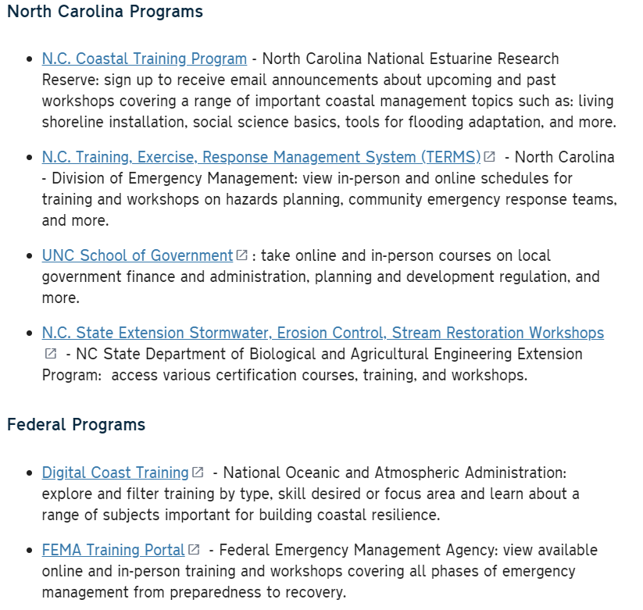
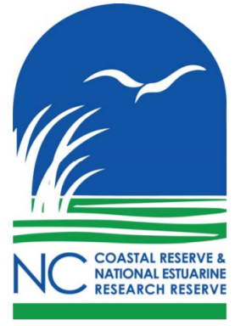
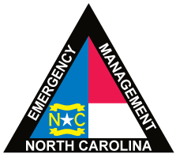
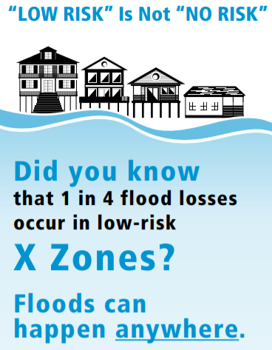
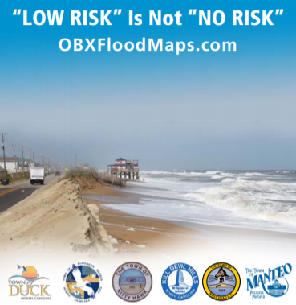
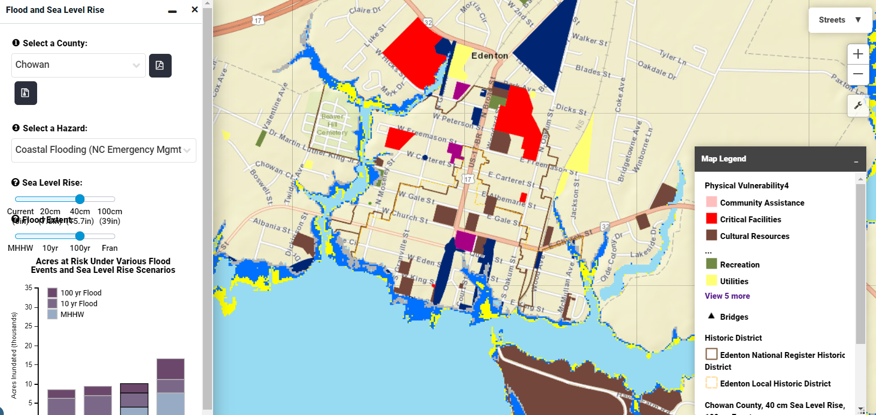

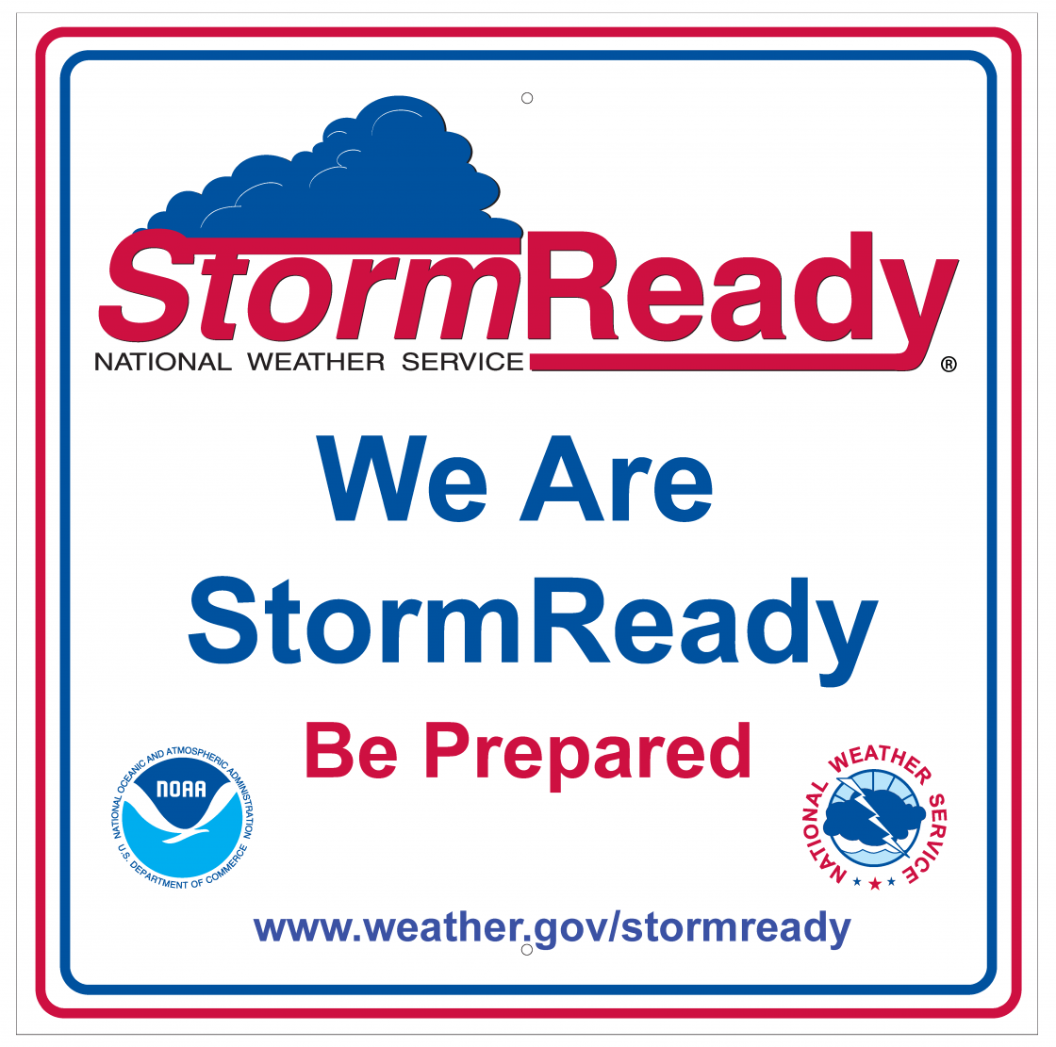

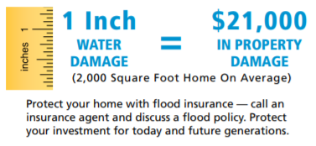
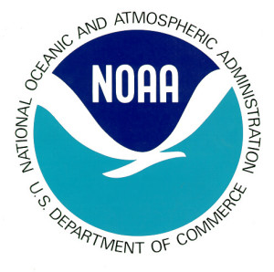

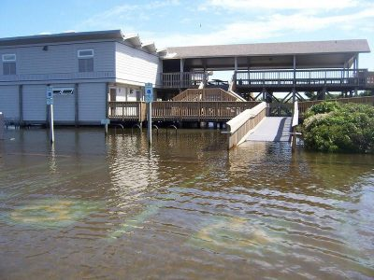
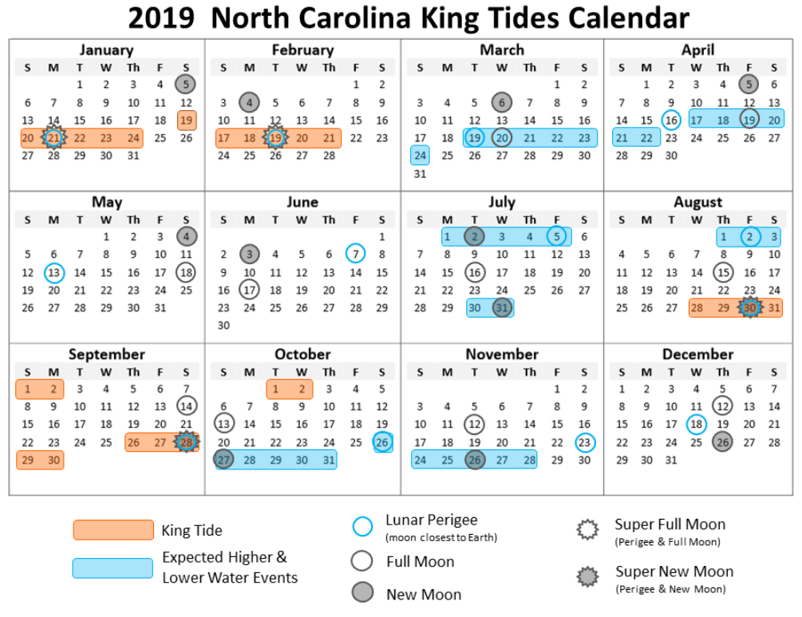






Education, Awareness, & Incentive Programs Resiliency Tools
Digitizing Community Knowledge of Hazards
Staff Training & Professional Development
NWS ‘StormReady’ Community Status
Flood Risk and Flood Insurance Outreach
    It’s crucial to supplement hazard risk maps and models along with the knowledge of residents get the ‘complete picture’
    Community asset mapping exercises help identify chronic problem areas or ‘hot spots’ for poor or inadequate drainage as well as give insight into various flood depth history
    Used to ‘ground-truth’ risk for updates to hazard mitigation plans, flood map updates, comprehensive plans, stormwater master plans and parks and recreational strategies
    Sound community decision-making relies heavily on a knowledgeable and well-trained staff – attending trainings and workshops to stay sharp on resilience-related best practices is crucial
StormReady uses a grassroots approach to help communities develop plans to handle all types of extreme weather—from tornadoes to winter storms. The program encourages communities to take a new, proactive approach to improving local hazardous weather operations by providing emergency managers with clear-cut guidelines on how to improve their hazardous weather operations. Applying is easy. To be officially StormReady, a community must:
    Making Flood insurance more accessible and affordable is one of the most effective resilience measures
    Coordinated outreach campaigns done at a multi-jurisdictional level (e.g. Dare County) can lead to more effective messaging and lead to greater action
Establish a 24-hour warning point and emergency operations center
Have more than one way to receive severe weather warnings and forecasts and to alert the public
Create a system that monitors weather conditions locally
Promote the importance of public readiness through community seminars
Develop a formal hazardous weather plan, which includes training severe weather spotters and holding emergency exercises.
Example: Pine Knoll Shores
    The Town of Edenton community asset map digitized and integrated into The Nature Conservancy’s Coastal Resilience Mapping Tool
    OBXfloodmaps.com
    OBXfloodmaps.com
Dune Vegetation Cost-Share Program
Citizen Science – N.C. King Tides Project
Community Emergency Response Teams (CERTs)
FEMA Community Rating System (CRS)
    Encourage the preservation and enhancement of dunes through a cost-share program that reimburses ocean-front property owners for costs associated with planting vegetation.
    Engage public in monitoring and responding to high water events. Install a water level gauge in publicly accessible and visible locations. Encourage the public to document events through photos shared on the website.
    CERT educates individuals about disaster preparedness for hazards that may impact their area and trains them in basic disaster response skills, such as fire safety, light search and rescue, team organization, and disaster medical operations. Using training learned in the classroom and during exercises,
    CERT volunteers can assist others in their community following a disaster when professional responders are nor immediately available to help. CERT volunteers are also encourages to support emergency response agencies by taking an active role in emergency preparedness projects.
    FEMA’s CRS is a voluntary point-based program that encourages communities to earn a discount on flood insurance premiums for actions that contribute to their flood risk reduction. See CRS Manual and CRS Green Guide.
    Serves as one potential measure for a community’s resilience
    Activity 420 - Open Space Preservation (OSP) is most often the highest point-getter – partners at The Nature Conservancy can help identify these areas
    N.C.’s coastal region has an OBX CRS Users group and Southeast CRS Users group that meet to learn from and help each other find ways to get the most points possible
    Existing or newly created CERTs may be helpful for informing long-term recovery and resilience planning
    “The true first responders are your neighbors”
    “Disasters begin and end at the local level”
    Fort Macon State Park
    2015 Heavy Rain + King Tide
    The Nature Conservancy
Other Examples?
Insert Sticky Note Below
Other Examples?
Insert Sticky Note Below
Other Examples?
Insert Sticky Note Below
CRS Program for Public Information (PPI)
    Provide description of how it contributes to future resilience, where it occurs, as well as what partners are involved
    Provide description of how it contributes to future resilience, where it occurs, as well as what partners are involved
    Provide description of how it contributes to future resilience, where it occurs, as well as what partners are involved
National Flood Insurance Community Rating System offers credit to communities that establish a Program for Public Information (PPI). Points are available for public information related to hazard disclosure, flood protection information and assistance, open space preservation, and drainage system maintenance
PPI is an ongoing local effort to identify, prepare, implement, and monitor a range of public information activities on hazard awareness
PPIs can be done by a single jurisdiction
or be done at a regional scale
Examples: City of Biloxi, Mississippi
    City of Biloxi PPI for CRS

