Slide 1
Department of Environmental Quality
Volkswagen Settlement DC Fast Charging Application Instructions
2019
Dave Willis, Environmental Program Consultant, NC Division of Air Quality

Slide 2
Links in this presentation are only active when used in presentation mode.

Slide 3
What to Expect Today
Overview of DC Fast Charging program and application process
When/how to submit your application
What happens to your application once it is submitted
Where to find answers after this workshop
Break
Example application
Question and answers
This is not a public forum for comments on implementation of the VW Settlement

Slide 4
NCDEQ VW Application Instructions
RFPs were released June 17, 2019
Applications were released July 1, 2019
Diesel Bus and Vehicle Programs
DC Fast Charge Program
Applications due: September 30, 2019 5:00 PM ET

Slide 5
2019 DC Fast Charge Application
This is a reimbursement program.

Slide 6
2019 DC Fast Charge Application
Eligible applicants include:
Government organizations
Non-government organizations
Specific details can be found in the RFP.
Eligible DC Fast Charging Projects
Light-duty electric vehicle supply equipment: 50kW or higher
Publicly accessible.
Adjacent to Priority Corridors.

Slide 7
DC Fast Charging Priority Corridors
Priority corridors.
  Sites along the priority
  corridors will receive
  preference
Filling Gaps (50 miles) is the priority.
If not Awarded in Phase1 you will need to reapply.
Level 2 RFP
Notes:
NC DEQ in coordination with NC DOT looked at the existing DC fast infrastructure data in NC (excluding DC fast chargers at dealerships) obtained from the U.S. Department of Energy, Alternative Fuels Data Center and the Annual Average Daily Traffic Map provided by NC DOT to determine the priority corridors along interstates and pending interstates across the state for Phase 1 where infrastructure was lacking.
Level 2 phase 1 does not have a release.

Slide 8
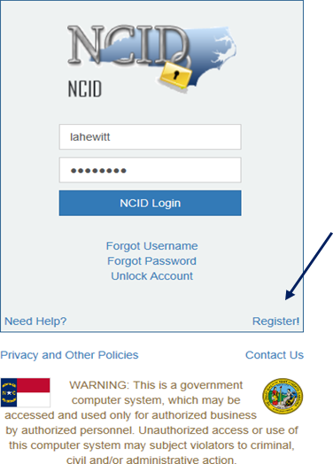
NCDEQ VW Application Instructions
BEFORE YOU BEGIN any application, you will need an NCID to complete the application.
Setting up an NCID:
https://ncid.nc.gov.
Instructions are found here: How-to-Create-a-NC-ID.pdf
Notes:
Can I get a show of hands – who has their NCID?
Okay for those that don’t you can go home now!
Can I get a show of hands – who has downloaded the application and spreadsheet and correctly named them?

Slide 9
2019 DC Fast Charge Application
Application materials include: on the VW Site https://deq.nc.gov/VWsettlement
  DC Fast Application Form
  DC Fast Application Checklist
Due date for completed application and all supporting materials:
  September 30, 2019 by 5:00 PM ET
Please Email all applications to:
svc.NCVWApplication@ncdenr.gov
Please Email questions to:
  daq.NC_VWGrants@ncdenr.gov

Slide 10
2019 DC Fast Charge Program
Adobe Reader: https://get.adobe.com/reader/
General Application Requirements (All applications)
________ NCID
________ Applicant/All Project Affiliates/Organization Contact Information
________ Project Information
________ Organization Federal Tax ID
Zero Emission Vehicle Infrastructure Charging Program
(See Application for more Details)
_______ GPS coordinates of Charging Station Location
_______ Charging Equipment Information (# of ports, spaces, model, manuf., etc.)
_______ Materials/Services/Labor estimated costs
_______ Site Host Letter of Commitment (if necessary) (for Upload)
_______ Utility Assessment of Site (for Upload)
_______ Local map to show amenities (for Upload)
_______ Plans to show exact charging station and parking space location (for Upload)
_______ Any other additional documentation to support application (Including use surveys, etc.)
Before beginning the application, please make sure you have the following information available.
The application checklist can be found here: Checklist

Slide 11
2019 DC Fast – Eligible Expenditures
50kW or higher DC fast charging station infrastructure (Level 2 has not been released)
Utility equipment upgrades such as transformers and utility extensions up to $15,000 per charging station
Conduit, cable/wiring, electrical service box disconnect addition
Concrete or asphalt addition or replacement
Signage
Bollards
Paint stripping and stenciling of the station parking spaces
Permit costs including engineering and site design costs
Labor for researching and securing the host site, directly related to the acquisition, site design and
Engineering, installation, commissioning or activation, and maintenance
Shipping of equipment
Maintenance and warranty costs for the DC fast charging equipment
Refer to the VW Settlement ZEV DC Fast RFP Phase 1
Notes:
The RFP lists many ineligible expenditures.

Slide 12
2019 DC Fast Charge Application
Before working on the application it is important that you know whether you have Adobe Acrobat DC Reader© installed on the computer your using. You will not be able to complete the application without these programs installed on your computer. If you need Adobe Acrobat DC Reader©, you can find it here:
https://get.adobe.com/reader/
You MUST save all DC Fast Charge Program files in Adobe pdf form. For example the application must be saved as the following. [Organization_Name]_[Project_Title]_ZEVDCFast_application.pdf
NOTE: If the required attachments and supporting files are not named correctly the application will be returned. The naming convention is on the last page of the application.

Slide 13
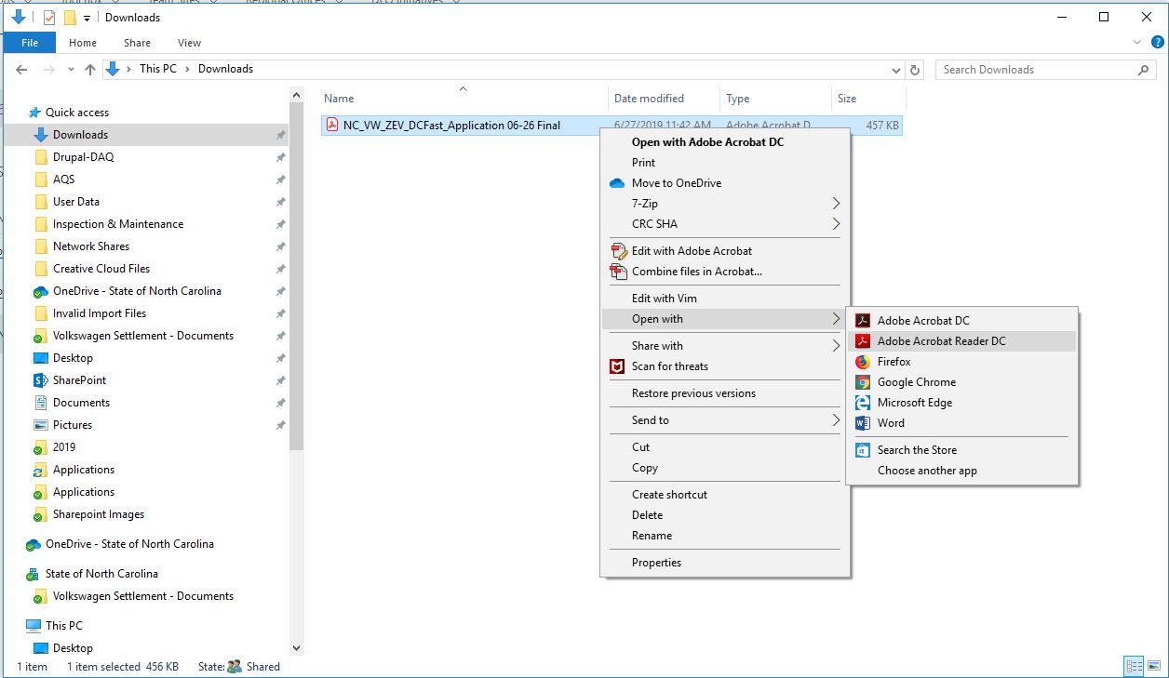
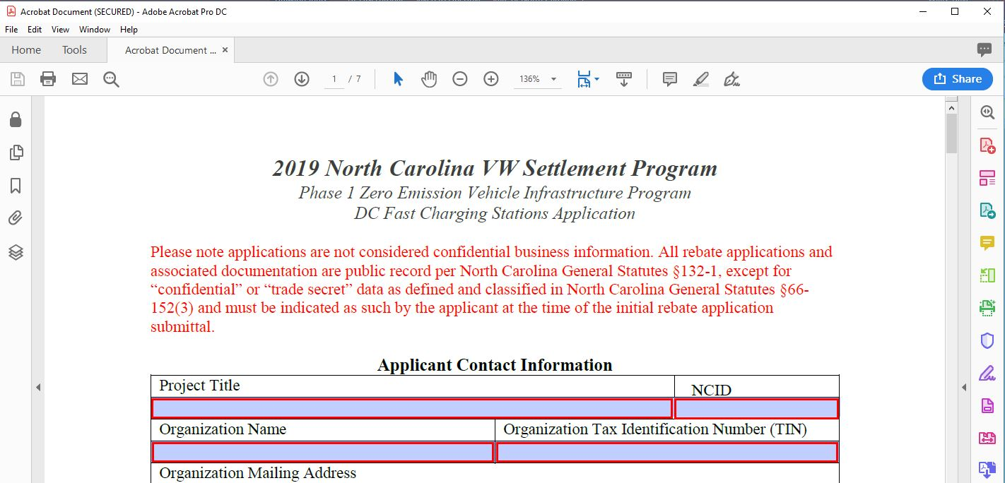
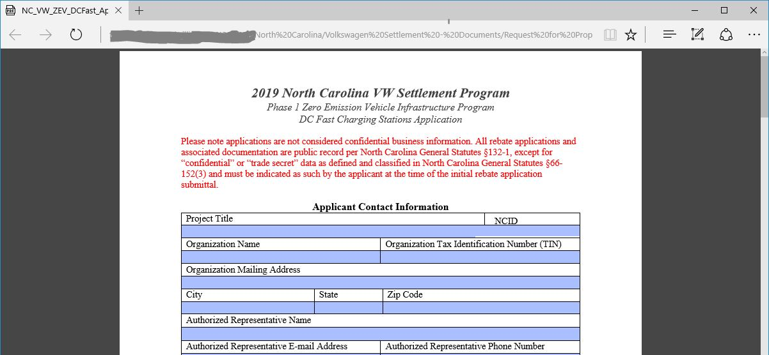
2019 DC Fast Charge Application

Slide 14
2019 DC Fast Charge Application

Slide 15
Tips and Things to Know
Do not sign any agreements with vendors prior to fully executed contract
APPLICATION AWARD IS NOT A FULLY EXECUTED CONTRACT
Budget information should be as accurate as possible
Partial funding will be used as appropriate in awarding projects
Essays will be used to assist in evaluating projects that score similarly to determine awardees
We will not accept paper, faxed or scanned applications. We will not accept applications after the due date.

Slide 16
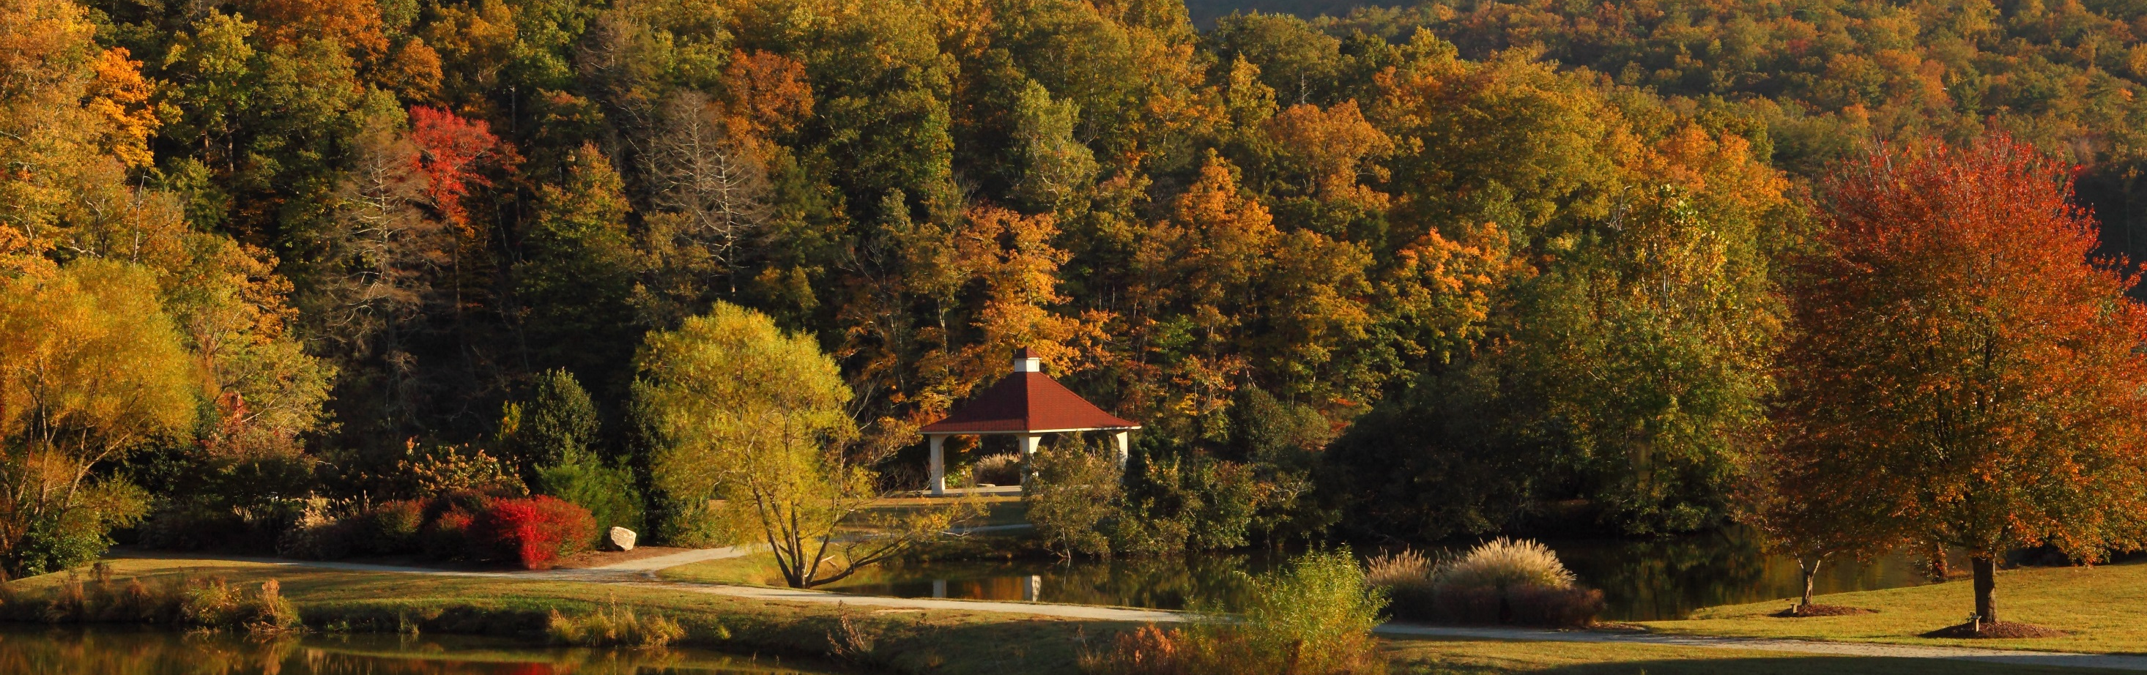
DC Fast Application Scoring
Department of Environmental Quality

Slide 17
Project Selection Criteria – DC Fast
The NCDEQ will consider factors such as, but not limited to:
Cost Effectiveness (VW$ funded per NOx tons reduced)
Distance off interchange
Distance to other DC Fast charging sites
Environmental Justice
Traffic Density
Accessibility
Notes:
DC-FAST
Cost Effectiveness (VW$ funded per NOx tons reduced): cost effectiveness is based on applicant provided information using a NCDEQ developed calculation tool and if applicable, matching funds
Distance off interchange: site location from interchange
Distance to other DC Fast charging sites: How many miles to existing DC Fast charging sites (not including dealerships or Tesla supercharger locations along the interstate to project area.
Environmental Justice: based on ranking developed by NCDEQ Environmental Justice team
Traffic Density: Annual average daily traffic of proposed project area from NCDOT data.
Accessibility: Accessibility and proximity to amenities. Distance to restrooms, food, local restaurants and retail shopping.

Slide 18
Cost Effectiveness: VW$ funded per NOx tons reduced
(20 points)
Cost effectiveness is based on applicant provided information using the NCDEQ EV Charger Mitigation Measure Tool and if applicable, matching funds. Under this criterion, projects are ranked from most cost effective to least cost effective (i.e. VW $/amount of NOx reduced per year).
• Top 20%: 20 points
• Next 20%: 15 points
• Next 20%: 10 points
• Next 20%: 5 points
• Last 20%: 0 points

Slide 19
Distance off interchange (15 points)
Ranked highest to lowest; based on proposed site location from
interchange.
• Less than 2 miles: 15 points
• 2 to 3 miles: 10 points
• Over 3 miles but less than 5 miles: 5 points
• Over 5 miles: 0 points

Slide 20
Distance to other DC fast chargers (25 points)
How many miles to existing DC fast charging sites (not including dealerships or Tesla Supercharger locations) along interstate to project area? DC fast charging site data used from U.S. Department of Energy, Alternative Fuels Data Center
• Over 100 miles: 25 points
• 99 to 51 miles: 20 points
• 50 to 26 miles: 15 points
• Less than 25 miles: 5 points

Slide 21
Environmental Justice (10 points)
The environmental justice score is developed from the NCDEQ’s Social Vulnerability Index (SVI)* and the mobile NOx emissions in tons per year/per county from the 2014 National Emissions Inventory (Version 2).
The Environmental Protection Agency defines environmental justice (EJ) as “the fair treatment and meaningful involvement of all people regardless of race, color, national origin, or income, with respect to the development, implementation, and enforcement of environmental laws, regulations, and policies.” (US EPA). Historically, people of color and people of low-income, along with other vulnerable populations, have been disproportionately exposed to harmful pollutants.
*The Social Vulnerability Index (SVI) uses the NC Department of Commerce Tier System and The American Community Survey demographic data.

Slide 22
Sample of EJ Scoring
2014 NEI County NOx Emissions (Tons) | County | Classification | Mobile NOx Bin | SVI | EJ Final Score
874.2 | Alamance | Suburban | 4 | 2 | 7
132.1 | Alexander | Rural | 1 | 2 | 4
50.5 | Alleghany | Rural | 0 | 4 | 6
157.2 | Anson | Rural | 1 | 3 | 5.5
122.8 | Ashe | Rural | 0 | 2 | 3
102.6 | Avery | Rural | 0 | 2 | 3
243 | Beaufort | Rural | 1 | 3 | 5.5
143.8 | Bertie | Rural | 1 | 4 | 7
221.5 | Bladen | Rural | 1 | 4 | 7
659.2 | Brunswick | Rural | 3 | 1 | 4.5
1651.8 | Buncombe | Suburban | 4 | 1 | 5.5
524.4 | Burke | Rural | 3 | 2 | 6
1088.2 | Cabarrus | Suburban | 4 | 1 | 5.5
318 | Caldwell | Rural | 2 | 2 | 5
Department of Environmental Quality

Slide 23
Traffic Density of location (15 points)
Annual Average Daily Traffic (AADT) of the proposed project area. (AADT map can be found in Appendix C of the RFP)
• 90,001 – 195,000: 15 points
• 42,001 – 90,000: 10 points
• 1,600 – 42,000: 5 points

Slide 24
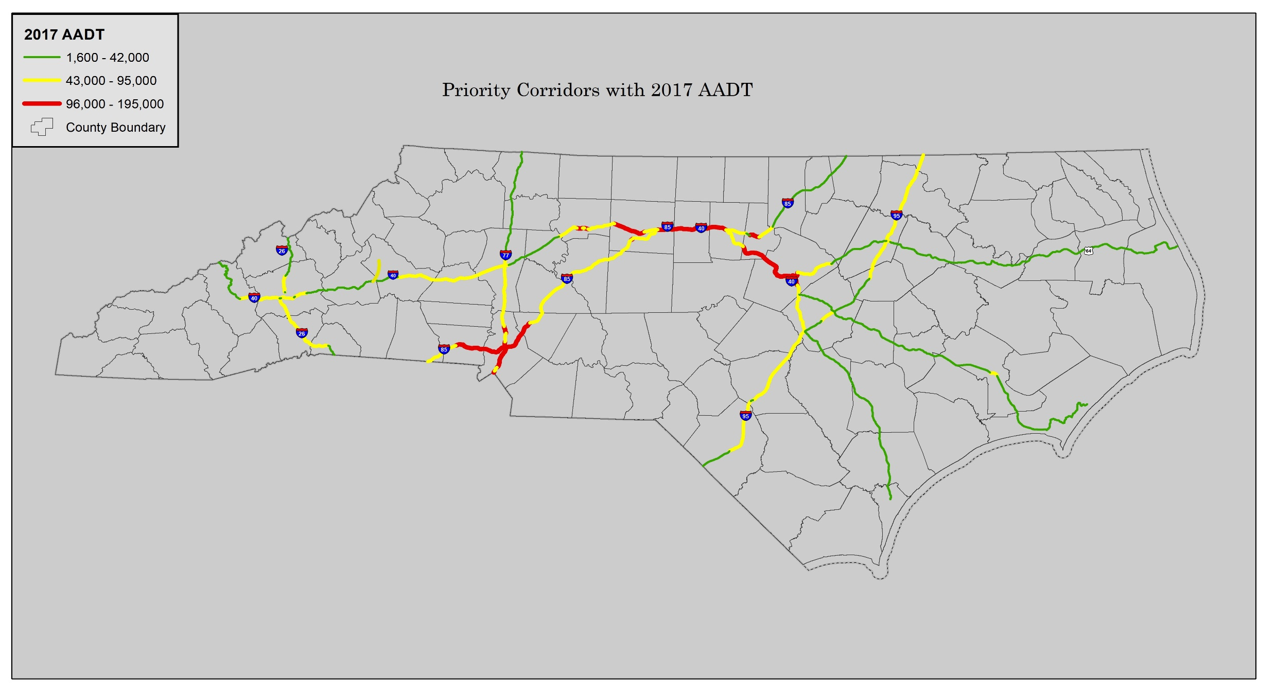
Annual Average Daily Traffic Map

Slide 25
Accessibility and proximity to amenities (15 points)
Distance to amenities such as restrooms, food, local restaurants, and retail shopping
• Onsite: 15 points
• Less than ¼ mile from amenities: 10 points
• ¼ mile from amenities: 5 points

Slide 26
Renewable Energy: Bonus Points (10 points)
Renewable Energy Certificates: Percentage of electricity to power the DC fast charging station for five years.
• 100%: 10 points
• 51 – 99%: 7.5 points
• 26% – 50%: 5 points
• 1 – 25%: 2.5 points

Slide 27

In Closing
Department of Environmental Quality

Slide 28
2019 DC Fast Charge Application
Due date for application and all supporting materials:
  September 30, 2019 by 5:00 PM ET
Please Email all applications to:
svc.NCVWApplication@ncdenr.gov
We will not accept paper, faxed or scanned applications.
We will not accept applications after the due date.
Notes:
Due date
Email
Scanned forms not accepted DAQ will be compiling all data fields for as public information and for the upcoming Grants Management System.

Slide 29
Additional Workshops
July 15 Asheville
July 16 Charlotte
July 18 Wilmington
July 19 Raleigh
July 22 Greenville
July 24 Fayetteville
July 25 Winston-Salem
Online tutorial: VW Application - DC Fast tutorial

Slide 30
Phase 1 RFP Timeline
Release of RFP June 17, 2019
Proposal application available for download July 1, 2019
RFP application training sessions July 15 – 26, 2019
Proposal applications due date September 30, 2019
Proposal application evaluations Summer/Fall 2019
Phase 1 project selections Fall 2019
Grant awards announced Fall 2019/Winter 2020

Slide 31
Application Receipt
Application sent via email
Within 2 business days of receipt, each applicant will receive an email acknowledgement of application receipt.
Each applicant will receive an email when the application has been reviewed for completeness or if additional information/clarification is required.
If a request for additional information/clarification is sent applicants have 10 business days in which to respond otherwise the application will be rejected.

Slide 32
Where to get more information after today?
DC Fast RFP - Frequently Asked Questions
https://deq.nc.gov/VWSettlement
E-mail questions to: daq.NC_VWGrants@ncdenr.gov

Slide 33

Department of Environmental Quality

Slide 34
2019 DC Fast Charge Application
Link to DC Fast Application
Link to Checklist

