Slide 1
Department of Environmental Quality
Volkswagen Settlement Diesel Bus and Vehicle Application Instructions
2019
Jill Vitas, Environmental Engineer, NC Division of Air Quality

Slide 2
Links in this presentation are only active when used in presentation mode.

Slide 3
What to Expect Today
Overview of diesel program and application process
When/how to submit your application
What happens to your application once it is submitted
Where to find information after this workshop
Break
Example application
Questions and answers
This is not a public forum for comments on implementation of the VW Settlement

Slide 4
NCDEQ VW Application Instructions
RFPs were released June 17, 2019
Applications were released July 1, 2019
Diesel Bus and Vehicle Programs
DC Fast Charge Program
Applications due: September 30, 2019 5:00 PM ET

Slide 5
2019 Diesel Bus and Vehicle Programs
This is a reimbursement program.

Slide 6
2019 Diesel Bus and Vehicle Programs
Eligible applicants include:
local, state, and tribal government organizations,
public or private nonprofit organizations, and
public-private partnerships where the lead applicant represents a public sector, public or private nonprofit organization.
Specific details on eligible applicants can be found in the RFP.
Notes:
Determined for Phase 1 based on comments received during mitigation plan preparation process
Examples: local/state/tribal – City of Durham
public or private nonprofit organization -

Slide 7
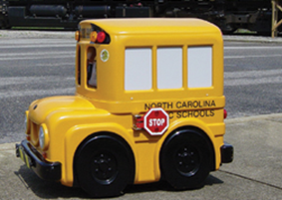
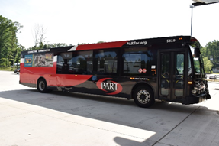
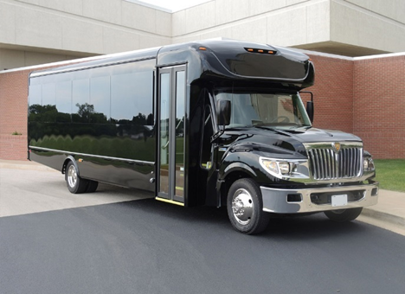
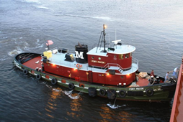
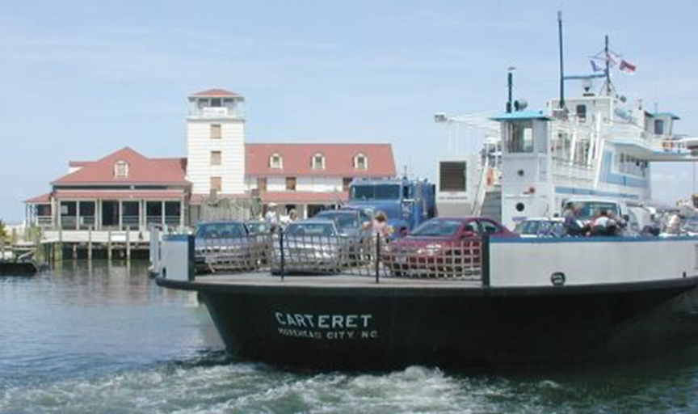
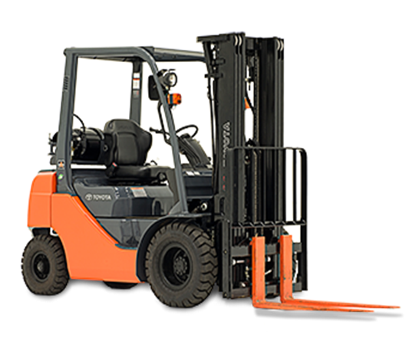
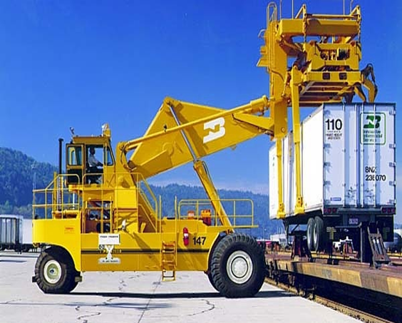
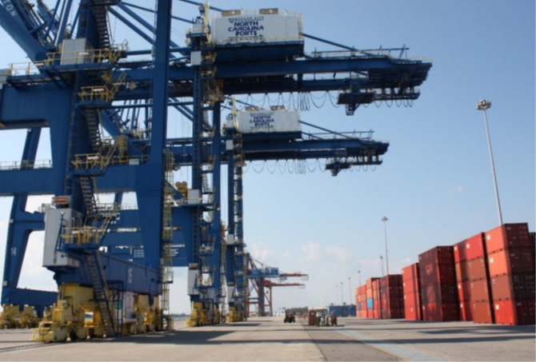
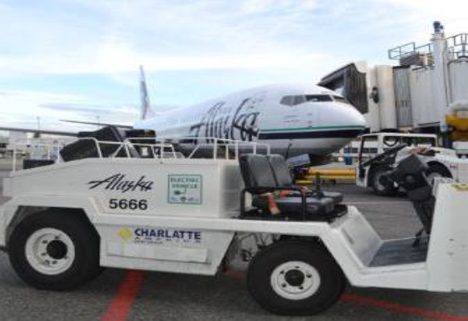
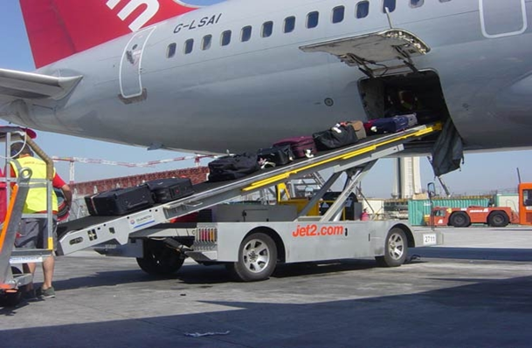
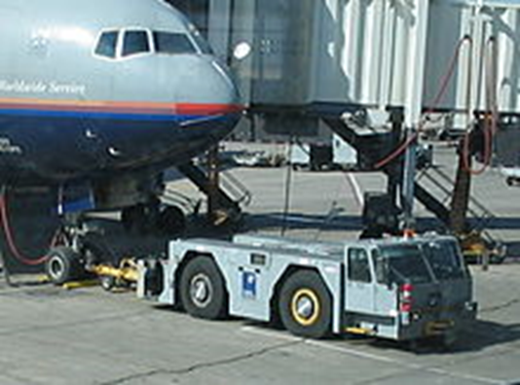
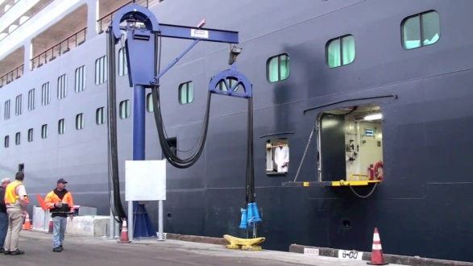
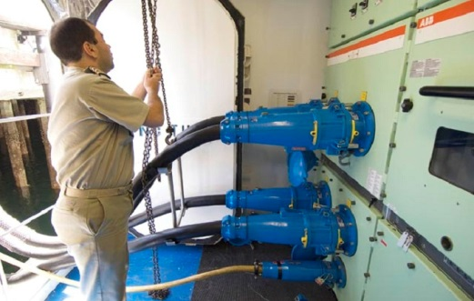
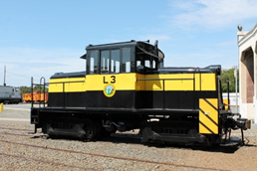
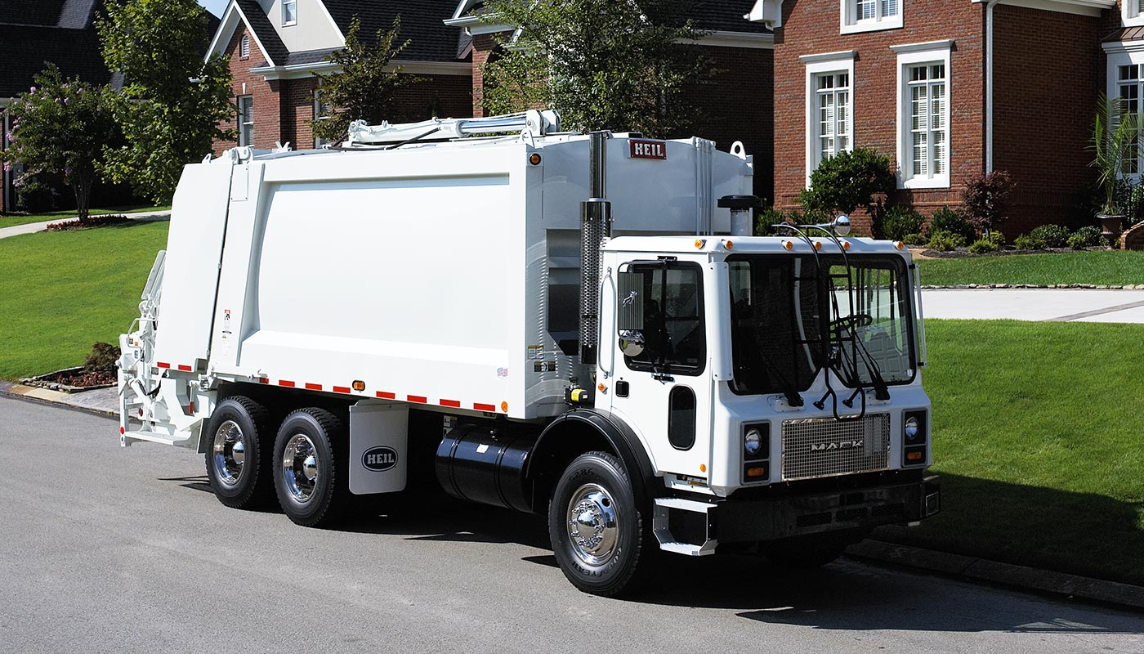
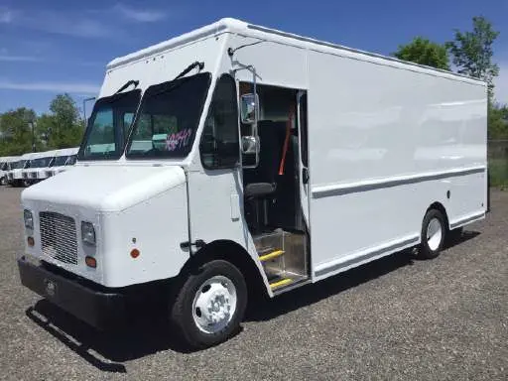
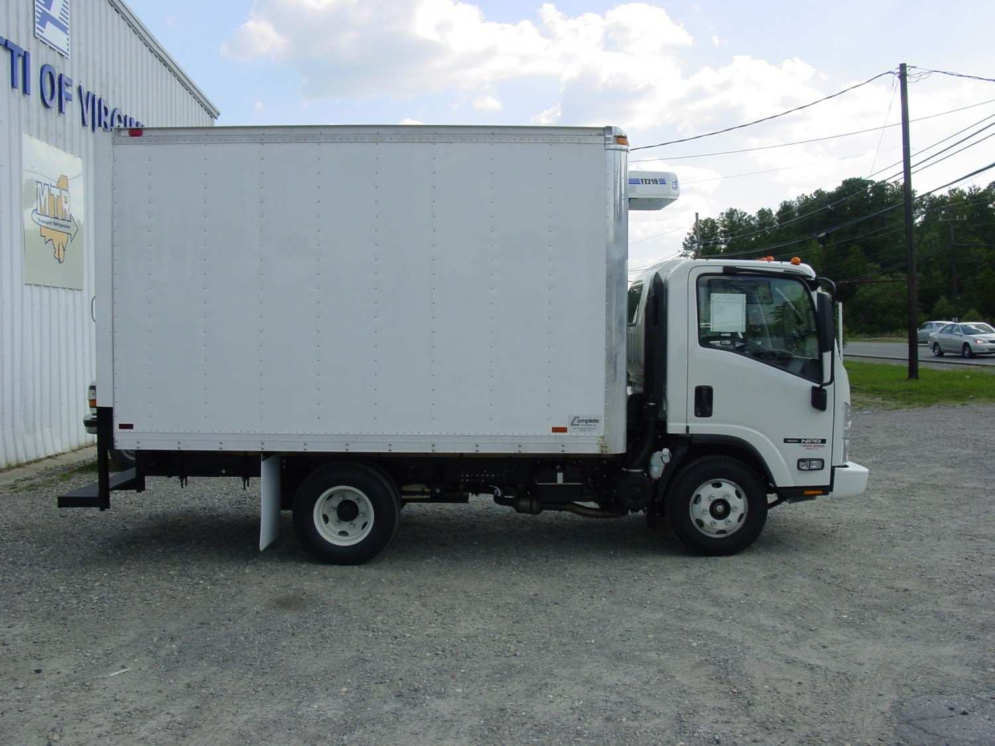
2019 Diesel Bus & Vehicle – Eligible Vehicles

Slide 8
Eligible Mitigation Actions (1-8), as specified in the NC VW Mitigation Plan include:
NC Grant Programs (2018-2020) | Eligible Action Category | Eligible Fuels | 2018-2020 Funding (Phase 1)
 |  |  | Targeted Percent* | Targeted Funding Amount
School bus replacement program | School buses | Diesel | 25% | $7,670,472
 |  | Propane & Natural Gas | 10% | $3,068,189
 |  | All-electric | 5% | $1,534,094
Transit bus replacement program | Transit buses | All (diesel, propane, natural gas, electric) | 20% | $6,136,377
Clean heavy-duty on-road equipment program | Class 4-8 Local Freight trucks | All (diesel, propane, natural gas, electric) | 10% | $3,068,189
Clean heavy-duty off-road equipment program | Switcher locomotives, ferries, tugs, forklifts, port cargo handling equipment, ocean-going vessel shorepower, airport ground support equipment | All (diesel, propane, natural gas, electric) | 10% | $2,739,302
 | Diesel Emission Reduction Act (DERA) |  |  | $328,887
 | Total: |  |  | $24,545,510
There will be a separate process for DERA eligible projects.

Slide 9
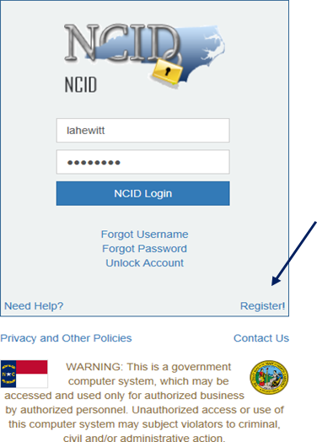
NCDEQ VW Application Instructions
BEFORE YOU BEGIN any application, you will need an NCID to complete the application.
Setting up an NCID:
https://ncid.nc.gov.
Instructions are found here: How-to-Create-a-NC-ID.pdf
https://files.nc.gov/ncdeq/Air%20Quality/motor/grants/files/VW/How-to-Create-a-NC-ID.pdf

Slide 10
2019 Diesel Bus and Vehicle Application
Application materials include: on the VW Site https://deq.nc.gov/VWsettlement
  Diesel Bus & Vehicle Single County Application Form
  Diesel Bus & Vehicle Multi-County Application Form
  Diesel Bus & Vehicle Excel© Spreadsheet
  Diesel Bus & Vehicle Application Checklist
Due date for completed application and all supporting materials:
  September 30, 2019 by 5:00 PM ET
Please submit all applications to:
svc.NCVWApplication@ncdenr.gov
Please submit questions to:
  daq.NC_VWGrants@ncdenr.gov

Slide 11
2019 Diesel Bus and Vehicle Programs
General Application Requirements (All applications)
________ NCID
________ Applicant/All Project Affiliates/Organization Contact Information
________ Project Information
________ Organization Federal Tax ID
All REPLACED vehicle/engine information
__________ Vehicle License Plate number __________ Vehicle Make
__________ Vehicle Model __________ VIN
__________ Engine Make __________ Engine Model
__________ Engine horsepower __________ Engine serial number
__________ Lift capacity (as applicable) __________ GVWR of vehicle
__________ Annual gallons of fuel used __________ Idling hours
__________ Annual vehicle mileage __________ Total vehicle mileage
__________ Remaining vehicle life in years
All REPLACEMENT/REPOWER vehicle/engine information
__________ New Vehicle Replacement/Engine Repower Cost quote
__________ New Vehicle Make (if replacing vehicle)
__________ New Vehicle Model (if replacing vehicle)
__________ New Engine Make
__________ New Engine Model
__________ New Engine horsepower/capacity
__________ New vehicle GVWR (if replacing vehicle)
__________ New Fuel type
__________ Annual gallons of diesel fuel reduced
__________ Lift capacity (as applicable)
__________ Infrastructure information and cost estimate
(For projects with EV replacement vehicles only)
__________ Any other additional documentation to support application
(Including use surveys, etc.)
Before beginning the application, please make sure you have the following information available.
The application checklist can be found here: Checklist

Slide 12
2019 Diesel Bus and Vehicle Application
If you need Adobe Acrobat Reader DC©, you can find it here:
https://get.adobe.com/reader/
Excel is included in the Microsoft Office© Suite.
You MUST save both the Adobe form and the Excel worksheet on your computer to fill it out. Click the links, and save the Adobe form as:
[Organization Name]_[Project Title]_VWDiesel_application.pdf
And save the Excel form as:
  [Organization Name]_[Project Title]_ VWDiesel_application.xls
NOTE: If the required attachments and supporting files are not named correctly the application will be returned. The naming convention is on the last page
of the application.

Slide 13
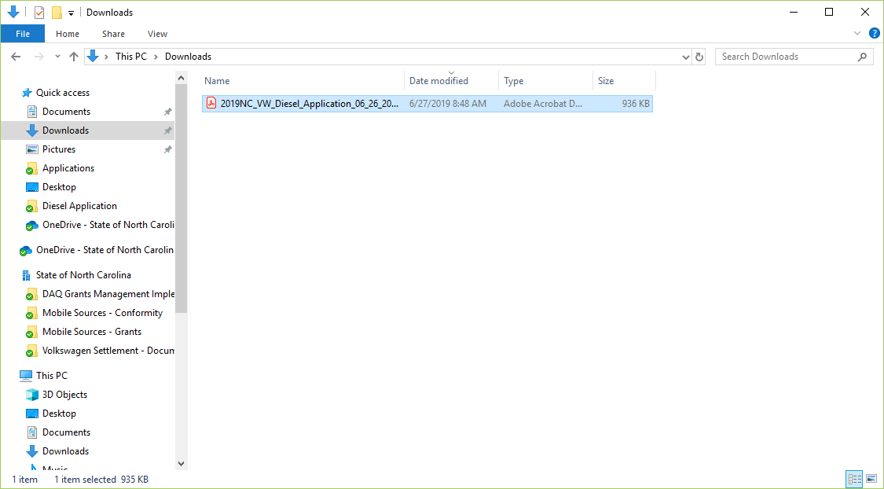
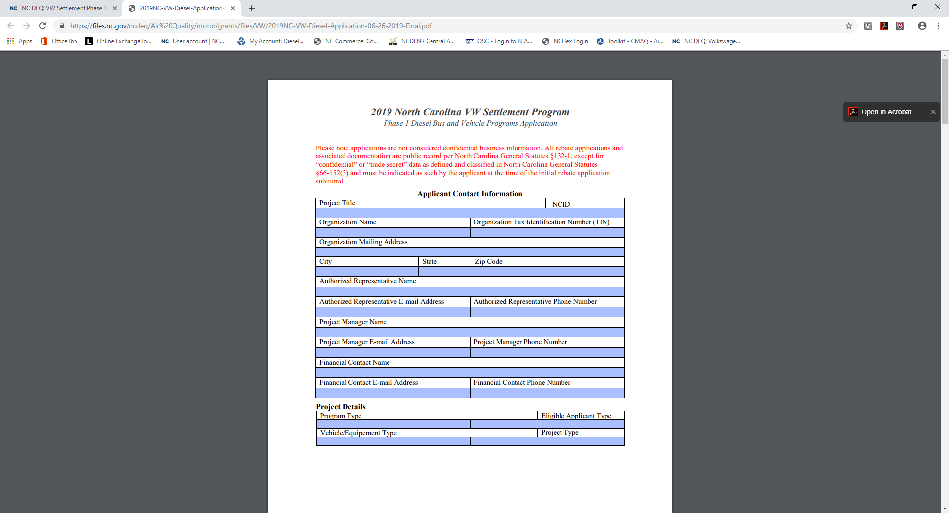
2019 Diesel Bus and Vehicle Application

Slide 14
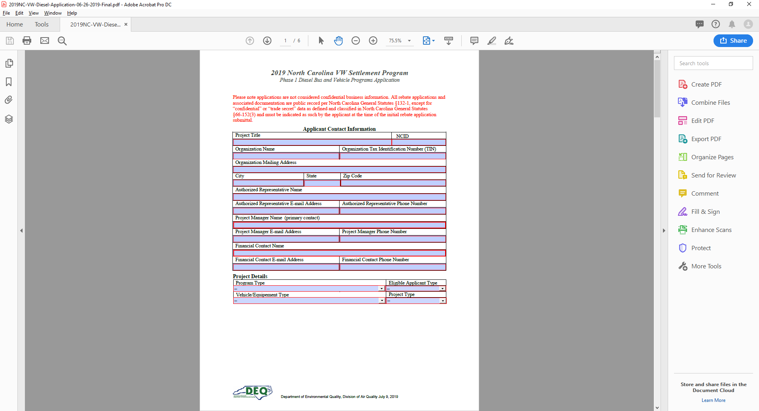

Slide 15
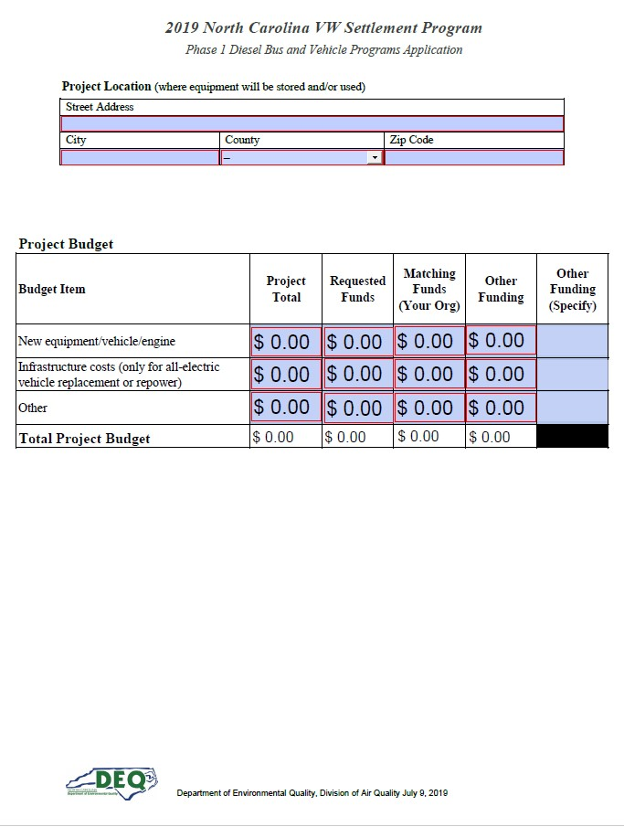
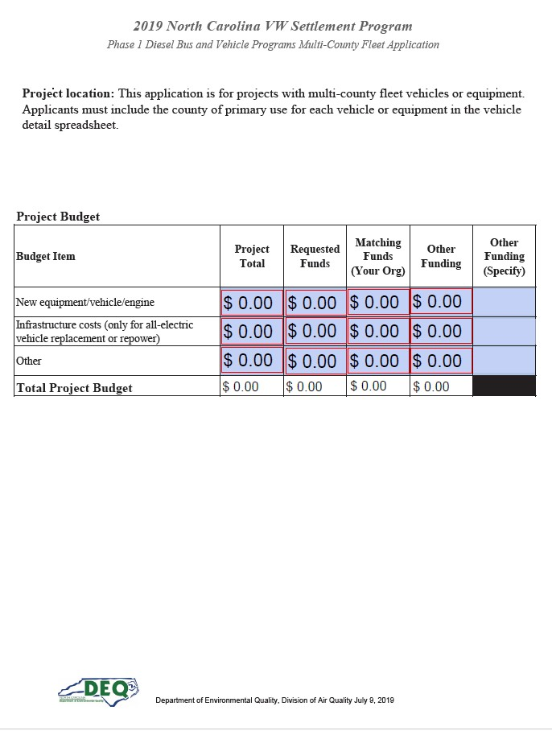

Slide 16
Tips and Things to Know
Increases in fleet size are not allowed
Replacement vehicle must be “like for like” with the original vehicle
Do not sign any agreements with vendors or start work until your contract is fully executed
APPLICATION AWARD IS NOT A FULLY EXECUTED CONTRACT
Budget information should be as accurate as possible
Partial funding will be used as appropriate in awarding projects
Essays will be used to assist in evaluating projects that score similarly to determine awardees
We will not accept paper, scanned, or faxed applications. We will not accept applications after the due date.

Slide 17
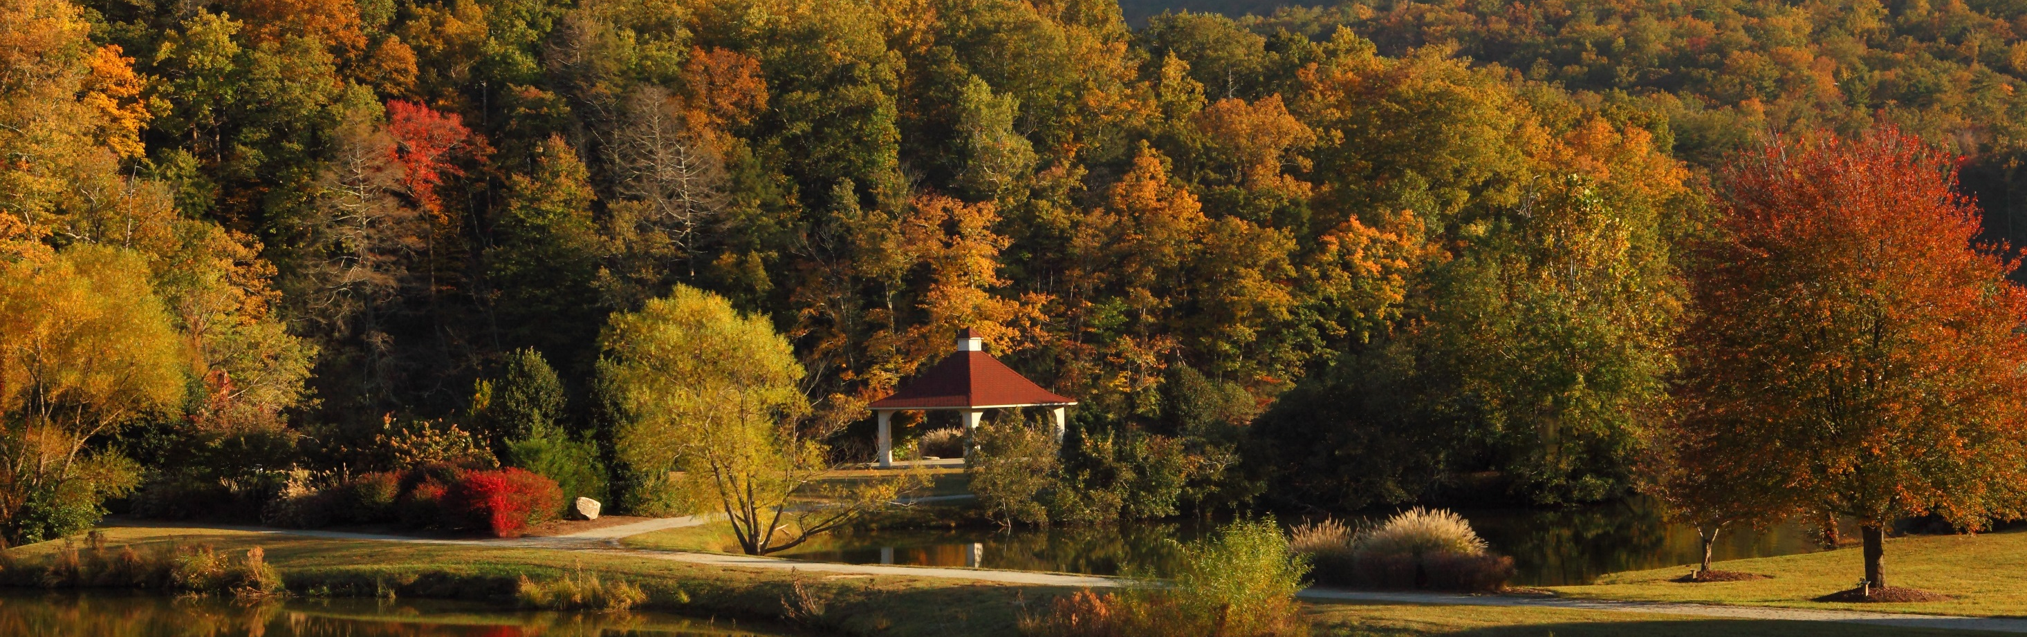
Diesel Bus and Vehicle Application Scoring
Department of Environmental Quality

Slide 18
Project Selection Criteria
The NCDEQ will consider factors such as, but not limited to:
Cost Effectiveness (VW$ funded per NOx tons reduced)
NO_{x} Emissions Reductions
Location of project
Co-Benefits
Sustainability of the Project
Timeliness
Useful life of vehicle replaced

Slide 19
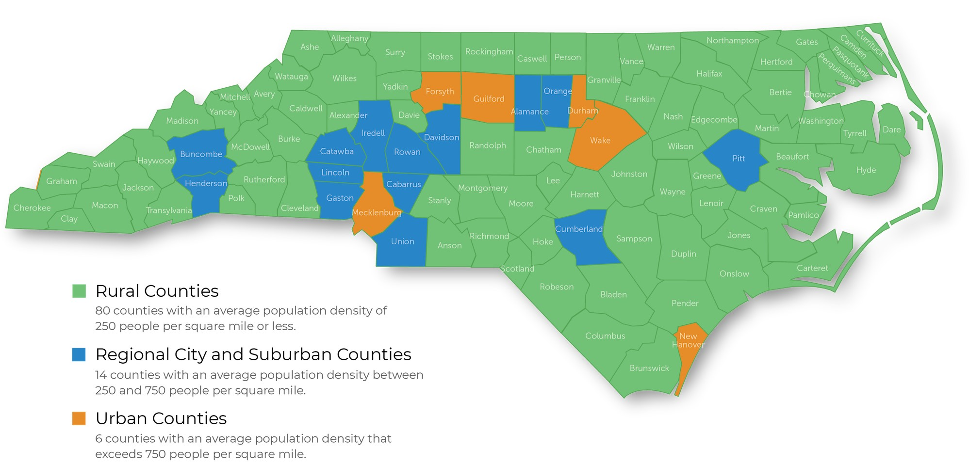
NC Rural Center County Classifications

Slide 20
Cost Effectiveness: VW$ funded per NOx tons reduced
(30 points)
Cost effectiveness is based on applicant provided information using the USEPA Diesel Emission Quantifier and if applicable, matching funds. Under this criterion, projects are ranked from most cost effective to least cost effective (i.e. VW $/amount of NOx reduced per year). Urban/Suburban projects and Rural Projects will be ranked separately.
• Top 15%: 30 points
• Next 15%: 25 points
• Next 15%: 20 points
• Next 15%: 15 points
• Next 15%: 10 points
• Last 25%: 5 points

Slide 21
NOx Emissions Reductions (30 points)
Ranked highest to lowest: NOx emission reduction calculation based on applicant-provided information using the USEPA Diesel Emission Quantifier tool. Urban/suburban projects and rural projects will be ranked separately.
• Top 15%: 30 points
• Next 15%: 25 points
• Next 15%: 20 points
• Next 15%: 15 points
• Next 15%: 10 points
• Last 25%: 5 points

Slide 22
Location of Project (20 points)
How many affected VW vehicles were registered in project area?
• Greater than 1,000: 20 points
• 501-1,000: 15 points
• 101-500: 10 points
• 0-100: 5 points

Slide 23
Environmental Justice (10 points)
The environmental justice score is developed from the NCDEQ’s Social Vulnerability Index (SVI)* and the mobile NOx emissions in tons per year/per county from the 2014 National Emissions Inventory (Version 2).
The Environmental Protection Agency defines environmental justice (EJ) as “the fair treatment and meaningful involvement of all people regardless of race, color, national origin, or income, with respect to the development, implementation, and enforcement of environmental laws, regulations, and policies.” (US EPA). Historically, people of color and people of low-income, along with other vulnerable populations, have been disproportionately exposed to harmful pollutants.
*The Social Vulnerability Index (SVI) uses the NC Department of Commerce Tier System and The American Community Survey demographic data.

Slide 24
Sample of EJ Scoring
2014 NEI County NOx Emissions (Tons) | County | Classification | Mobile NOx Bin | SVI | EJ Final Score
874.2 | Alamance | Suburban | 4 | 2 | 7
132.1 | Alexander | Rural | 1 | 2 | 4
50.5 | Alleghany | Rural | 0 | 4 | 6
157.2 | Anson | Rural | 1 | 3 | 5.5
122.8 | Ashe | Rural | 0 | 2 | 3
102.6 | Avery | Rural | 0 | 2 | 3
243 | Beaufort | Rural | 1 | 3 | 5.5
143.8 | Bertie | Rural | 1 | 4 | 7
221.5 | Bladen | Rural | 1 | 4 | 7
659.2 | Brunswick | Rural | 3 | 1 | 4.5
1651.8 | Buncombe | Suburban | 4 | 1 | 5.5
524.4 | Burke | Rural | 3 | 2 | 6
1088.2 | Cabarrus | Suburban | 4 | 1 | 5.5
318 | Caldwell | Rural | 2 | 2 | 5
Department of Environmental Quality

Slide 25
Co-Benefits (10 points)
These include additional emissions reductions benefits (co-benefits) for other air pollutants (PM 2.5, CO, VOC and GHG).
NCDEQ developed a sample matrix (included in the RFP) of expected co-benefit emission reductions (as determined by model year of vehicle replaced and vehicle type) for various types of eligible mitigation projects using the USEPA Diesel Emissions Quantifier and Argonne National Laboratory Greenhouse gases, Regulated Emissions, and Energy use in Transportation (GREET) tools.
NCDEQ staff will determine the actual co-benefit point totals based on the project-specific information provided in each application and the project-specific output values from the USEPA Diesel Emission Quantifier and GREET tools on a per vehicle basis.

Slide 26
Sample of Co-Benefits Scoring
Upgrade Type | Diesel | Compressed Natural Gas | Liquid Natural Gas | Liquid Propane Gas | Electric Vehicle | Hydrogen Fuel Cell
School Bus (1992) | 7.5 | 7.5 | 7.5 | 7.5 | 8.5 | 8.5
School Bus (2009) | 4.5 | 4.5 | 4.5 | 4.5 | 8.5 | 8.5
Transit Bus (1992) | 7.5 | 7.5 | 7.5 | 7.5 | 8.5 | 8.0
Transit Bus (2009) | 5.0 | 5.0 | 5.0 | 5.0 | 8.5 | 8.0
Class Local Freight 4-5 (1992) | 7.5 | 7.5 | 7.5 | 7.5 | 8.5 | 8.0
Class Local Freight 4-5 (2009) | 4.5 | 4.5 | 4.5 | 4.5 | 8.5 | 8.0
Class Local Freight 6-7 (1992) | 7.5 | 7.5 | 7.5 | 7.5 | 8.5 | 8.0
Class Local Freight 6-7 (2009) | 4.5 | 4.5 | 4.5 | 4.5 | 8.5 | 8.0
Class Local Freight 8 (1992) | 7.5 | 7.5 | 7.5 | 7.5 | 8.5 | 8.0
Class Local Freight 8 (2009) | 4.5 | 4.5 | 4.5 | 4.5 | 8.5 | 8.0
Department of Environmental Quality

Slide 27
Other Criteria: Yes/No
To be considered for funding, projects MUST show evidence of meeting at
least two out of three of the following threshold criteria:
  • Sustainability: Longevity of funded equipment. Minimum of five years.
  • Timeliness: Ability to complete project within two years of award.
  • Useful Life of Vehicle to be Replaced: Vehicle should have at least three
  years of useful life remaining.

Slide 28
Project Scoring Criteria
Cost Effectiveness | 30
NOx Emissions Reductions | 30
Location of Project | 20
Environmental Justice | 10
Co-Benefits | 10
Other Criteria | Yes/No
Total Points Possible | 100

Slide 29
2019 Diesel Bus and Vehicle Applications
Due date for application and all supporting materials:
  September 30, 2019 by 5:00 PM ET
Please submit all applications to:
svc.NCVWApplication@ncdenr.gov
We will not accept paper, scanned, or faxed applications. We will not accept applications after the due date.

Slide 30
Additional Workshops
July 15 Asheville
July 16 Charlotte
July 18 Wilmington
July 19 Raleigh
July 22 Greenville
July 24 Fayetteville
July 25 Winston-Salem
Online tutorial: VW Application - Diesel tutorial

Slide 31
Phase 1 RFP Timeline
Release of RFP June 17, 2019
Proposal application available for download July 1, 2019
RFP application training sessions July 15 – 26, 2019
Proposal applications due date September 30, 2019
Proposal application evaluations Summer/Fall 2019
Phase 1 project selections Fall 2019
Grant awards announced Fall 2019/Winter 2020

Slide 32
Application Receipt
Application sent via email
Within 2 business days of receipt, each applicant will receive an email acknowledgement of application receipt.
Each applicant will receive an email when the application has been reviewed for completeness or if additional information/clarification is required.
If a request for additional information/clarification is sent applicants have 10 business days in which to respond otherwise the application will be rejected.

Slide 33
Where to get more information after today?
Diesel Bus & Vehicle RFP - Frequently Asked Questions
https://deq.nc.gov/VWSettlement/DieselFAQ
E-mail questions to: daq.NC_VWGrants@ncdenr.gov

Slide 34

Department of Environmental Quality

Slide 35
2019 Diesel Bus & Vehicle Program Links
Link to Application
Link to Multi-County Application
Link to Spreadsheet
Link to Checklist

