Slide 1
Federal Consistency Process
Notes:
I would like change things up a little bit today and give a presentation on Federal Consistency its purpose and it’s process

Slide 2
Federal Consistency Purpose
Federal actions must be found consistent with the enforceable policies of a state’s federally approved coastal program
Applies to federal actions that:
could have reasonably foreseeable coastal effects
are within or outside the state’s coastal zone (20 coastal counties to 3NM)
Federal consistency provisions of CZMA provide states a strong voice in federal agency actions in the coastal zone
Notes:
The purpose of federal consistency is it requires federal agency
So essentially
Three key points to consider when applying federal consistency are, is it a FEDERAL ACTION, will it have a Coastal Effect, what are Enforceable Policies that apply

Slide 3
Federal Agency Actions
Federal Agency Activities
Federal Licenses or Permits
Outer Continental Shelf Plans
Federal Assistance
Notes:
Fall into four categories

Slide 4
Federal Agency Activities
Naval exercises
U.S. Army Corps of Engineers beach and navigation (dredging) projects
Improvements to a U.S. military base
National Park/Seashore projects
Direct federal activities must be found consistent to the maximum extent practicable w/ state’s enforceable policies
Notes:
Activities conducted by a federal agency or by a contractor on behalf of the federal agency
Repairing a coast guard dock or adding a boat ramp at cherry point
Off road vehicle plan
Maximum extent practicable is defined in the federal register as activities that must be found fully consistent unless prohibited by federal law requirements applicable to that activity

Slide 5
Federal Licenses or Permits / OCS Plans
Activities performed by a non-federal entity requiring federal permits, licenses or other forms of federal authorization, e.g:
Corps permits (Clean Water Act, Rivers and Harbors Act)
Bureau of Ocean Energy Management permits (energy)
Must be found fully consistent with state’s enforceable policies
States must have a previously-approved list of activities subject to review
Notes:
Corps permits for development projects actually outside of CAMA jurisdiction that may have a coastal effect.
However, state must have previously requested and listed those federal permits they believe could have a coastal effect, and this list must have been approved by NOAA before federal consistency can be applied. If a state wishes to review an “unlisted” federal permit, state must notify the applicant and the federal agency and seek NOAA approval to review the activity based on states belief the proposal will have a reasonably foreseeable coastal effects

Slide 6
Federal Assistance
Federal Highway Administration Funds
Hazardous Waste Management Funds
Housing and Urban Development Grants
Must be found fully consistent w/ state’s enforceable policies.

Slide 7
Coastal “Effects Test”
Any reasonably foreseeable effect on any coastal use or resource resulting from a federal agency action.
Not just environmental effects - also any effects on coastal uses
Includes both direct effects, resulting from activity at same time and place, and indirect (cumulative and secondary) effects
Notes:
When applying Federal Consistency that federal action must have a coastal effect
such as and effect on recreational and commercial fishing and tourism

Slide 8
Enforceable Policies
State policies that have been approved and incorporated into federally-approved coastal program:
NC Coastal Area Management Act (CAMA)
N.C. Dredge and Fill Law
CRC rules that are legally binding under state law and that have been reviewed and approved by NOAA
Notes:
What are our enforceable policies
When you amend or adopt a rule DCM staff must submit that rule to NOAA for approval before it can be applied in a federal consistency determination

Slide 9
Federal Consistency Determinations
DCM evaluates to determine if “complete”
Circulated to appropriate state agencies for comment
Public notice or public hearing (as warranted)
Review of proposed activity for conformance with enforceable policies
Found consistent, consistent with conditions, or objection
In the event of objection, ongoing coordination or begin mediation/appeal process through NOAA
Notes:
Once a Federal agency has decided that their proposal is a federal action and has a coastal effect

Slide 10
Recent Federal Consistency Determinations
Average of 50 submissions / year (approx. 95% found consistent)
State Ports’ Dredged Material Management Plans (USACE)
E.g. required a supplemental consistency review if, at the end of 8 years, Corps has not conducted at least 2 sand placement projects on Bogue Banks from Morehead City/Beaufort Inlet channel
Proposed wind energy lease and site assessment activities for Kitty Hawk Wind Energy Area (BOEM)
Required coordination with DCM and DMF prior to approval of any site assessment plans in order to avoid, minimize, and mitigate impacts or conflicts
Notes:
Most of these are Routine projects, However, the federal consistency process has played an important role in our ability to coordinate on important and sometimes controversial projects for example
With commercial or recreational fishing or habitats offshore

Slide 11
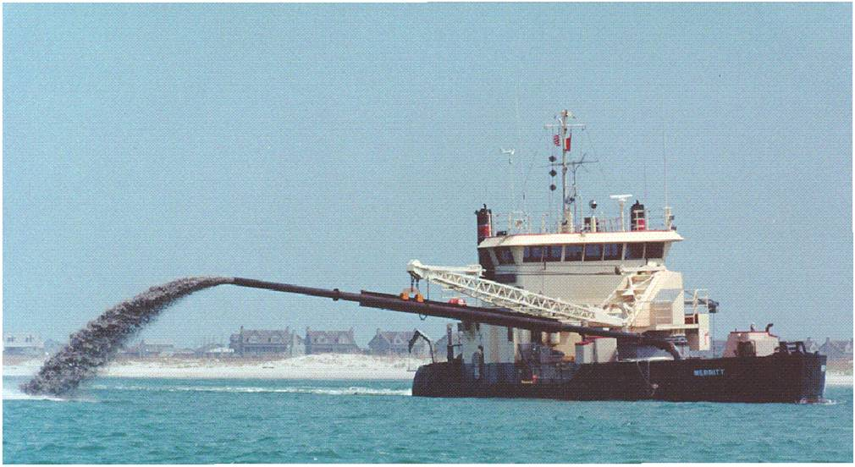
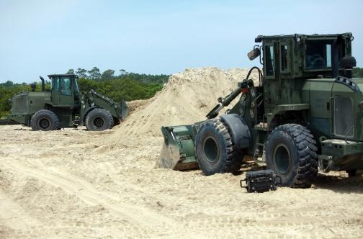
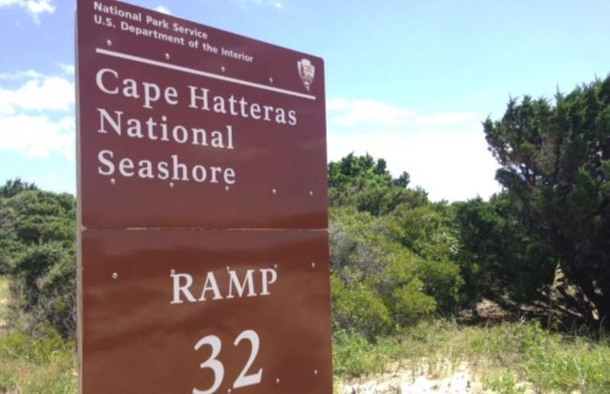
Questions
Notes:
USDA proposed to remove feral swine with a helicopter and trained marksmen from areas in Currituck County

