Slide 1
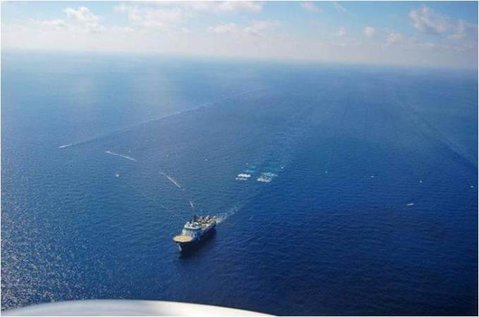
Ocean Energy Activities Update

Slide 2
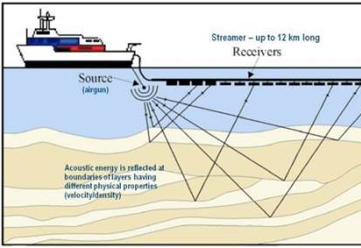
Geological & Geophysical surveys - “Seismic Surveys”
        Used to evaluate potential for offshore oil, gas, methane hydrate resources, mineral resources, and geologic hazards
        Survey vessels tow an acoustic source (usually highpressure airgun or airgun array)
        Acoustic signal penetrates several thousand feet into subsurface, then reflects to surface receivers

Slide 3
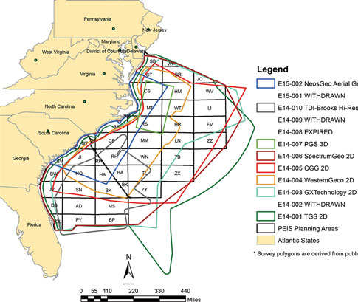
“Unlisted Activity” Request for State Review
DCM notified of 9 applications to BOEM to conduct seismic surveys in the Atlantic Ocean off NC (July 2014)
DCM submitted an “unlisted activity” review request to NOAA (Aug. 2014)
NOAA granted DCM’s request to review proposed G&G surveys for the following applicants: TGS, GXT, Western, CGG, Spectrum and PGS (Nov. 2014)
Federal consistency review required, but limited to review of impacts on recreational and commercial fisheries

Slide 4
      Seismic Survey Federal Consistency Determinations
In 2015, DCM received four federal consistency determinations:
  Spectrum Geo Inc
  GXT
  TGS-NOPEC
  MCNV Marine North America CGG
Public notice placed in newspapers throughout the N.C. coastal region
Circulated to other state agencies with regulatory or resource interests
Public hearing held in Morehead City (April, 2015)
Numerous comments received concerning potential impacts on marine life and habitats, including concerns raised by DMF

Slide 5
      Seismic Survey Federal Consistency Determinations
    DCM found the proposed surveys to be consistent (or did not find them to be inconsistent) with the relevant enforceable policies of North Carolina’s approved coastal management program, specifically 15A NCAC 07H and 15A NCAC 07M, when performed with the condition outlined below:
      Required a pre-survey meeting with representatives from DMF and DCM so that precise survey transects and timing can be reviewed and discussed in advance to avoid, minimize, and mitigate any possible impacts or conflicts with resources and users

Slide 6
Additional Recommendations

Slide 7
      Incidental Harassment Authorizations
Applicants have since been waiting on “Incidental Harassment Authorizations” from NOAA / National Marine Fisheries Service in accordance with the federal Marine Mammals Protection Act
For incidental, not intentional, “taking” of a small numbers of marine mammals
IHAs must be issued to the seismic companies before BOEM issues a final permit authorizing G&G survey activities
NMFS issued a Federal Register Notice as part of IHA review process
  Governor Cooper and NC DEQ submitted comments and requested denial of the applications due to significant threats to marine mammals off the coast of North Carolina

Slide 8
      15 CFR 930.66 Supplemental Consistency Requests
In Dec. 2017, DCM requested “supplemental consistency determinations” from each of the four companies that received conditional concurrences in 2015
Formal legal requests based on new information that the proposed surveys will affect NC’s marine resources “substantially different than originally described.” (15 CFR 930.66)
  Based on scientific studies published after the 2015 approvals describing impacts of seismic testing on fish behaviors, zooplankton (including fish larvae), shellfish, and crustaceans, among other concerns

Slide 9
      National OCS Oil and Gas Leasing Program (2019-2024)
Establishes a schedule of oil and gas lease sales proposed for the planning areas of the U.S. Outer Continental Shelf (OCS)
The first step in the development process is a Request for Information, which was published in the Federal Register on July 3, 2017
The Governor and DEQ submitted comments in opposition to oil and gas leasing off North Carolina’s coast due to potential impacts to our coastal economy and environment
Governor Cooper and coastal leaders met with federal Interior Secretary Zinke in late Jan. as part of this process, requested additional meetings along the coast
Currently, ongoing 60-day public comment period on draft proposed program

Slide 10

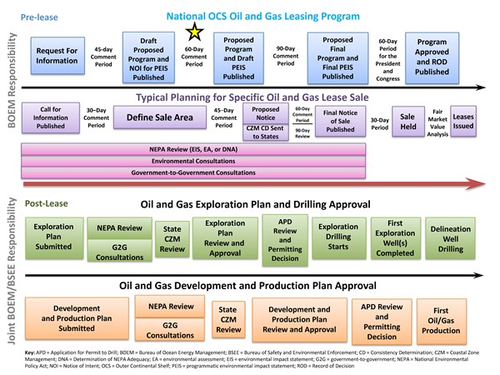
      National OCS Oil and Gas Leasing Program (2019-2024)
We are here

Slide 11
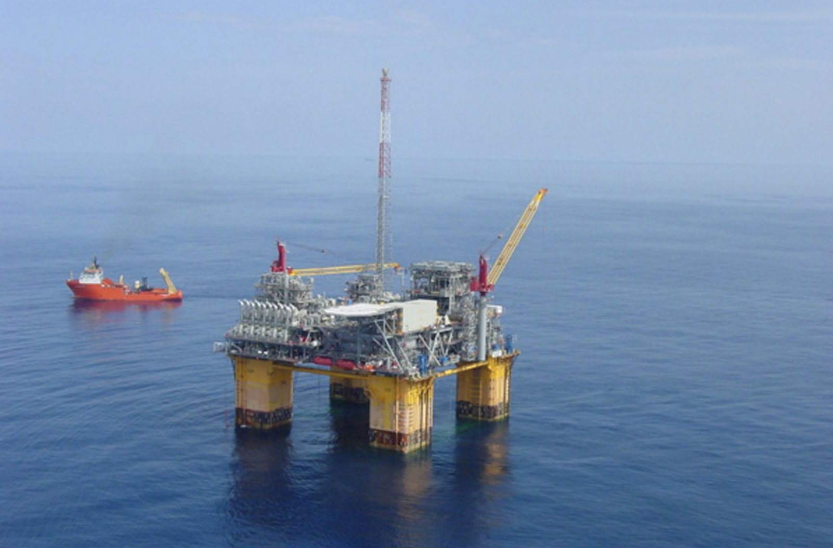
Questions

