Slide 1
Overview of Today’s Meeting
Gain an understanding of:
  Nutrient Criteria Development Plan (NCDP)
  Water Quality Standards / Criteria
The CIC’s role
Timeline

Slide 2
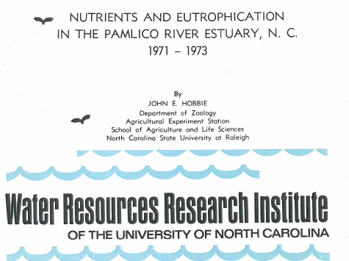

Slide 3

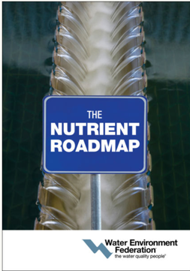


Slide 4
Important NCDP Points
Not a contract
Not a MOA
Contains “anticipated deadlines”
Select milestones are in EPA 106 workplans

Slide 5
North Carolina’s NCDP
1. Establish Scientific Advisory Council and Criteria Implementation Committee
Specific Water Body | Water Body Type
2. High Rock Lake 2018 | 5. Reservoirs and Lakes 2024
3. Albemarle Sound 2020 | 6. Estuaries 2023
4. Central Cape Fear River 2021 | 7. Rivers and Streams 2025

Slide 6
NCDP Team Members
Ecosystems: Carrie Ruhlman, Tammy Hill and Steve Kroeger
Standards: Jeff Manning, Connie Brower and Chris Ventaloro
Modeling: Pam Behm
NPDES Permitting: Mike Templeton
Nonpoint Source: Rich Gannon (John Huisman)
APNEP: Jim Hawhee

Slide 7
Why you were chosen
Diverse backgrounds
Broad expertise
Interested in helping

Slide 8
What the Division Needs from the CIC
Advise DWR on the feasibility, implications and implementation of proposed nutrient criteria
Assist in the development of fiscal notes for all criteria going through rule-making.
Notes:
DENR Mission Statement: http://portal.ncdenr.org/web/guest/mission-statement

Slide 9
SAC Work Overview
High Rock Lake (2015-2016)
Albemarle (2015-2018)
Central Cape Fear (2016 - ____)
  Rocky River/Haw River
  Middle Cape Fear River

Slide 10
Getting to Nutrient Criteria
A Nutrient Criteria Development Process

Slide 11

Based on Designated Use(s) for Waterbody, Select Management Goal(s)
Refine Management Goal(s)
* Narrative criteria or statement reflective of protecting designated use(s)
Evaluate Potential Criteria
* Come up with way(s) to protect the use (numeric, narrative, both) - measurable & most sensitive
* Generate recommended indicator list
* Data gap analysis
Develop Conceptual Model
* Shows relationship between nutrients and criteria - EX: algal blooms, organic carbon, dissolved oxygen, chlorophyll a, etc.
Analysis/Approach
* Select approach to derive criteria: reference conditions, stressor-response, mechanistic model, other...reflective of protecting designated use(s)
* Fulfill any data/research needs
Develop Estimates for Criteria & Assessment Protocols
Evaluate Feasibility of Accomplishing Criteria
DWR Selects Scientifically Defensible, Feasible Criteria
Begin Adoption of Recommendations into Water Quality Standards
Draft Rule, Fiscal Note, Public Hearings, etc.
Notes:
What I’m presenting is a basic idea, drawn from other state’s successes and failures and from EPA guidance. NC’s nutrient criteria development process may or may not happen this way, but this should give you an idea of HOW to get from A to Z.

Slide 12
The Goal
Scientifically Sound Defensible Economically Feasible NUTRIENT CRITERIA
Notes:
So let’s start at the end. What we’re working towards is:

Slide 13
Designated Use & Management Goal(s)
Designated use = surface water classification
  Already determined for each waterbody
    Class C, Class B, Water supply, etc.
    Management Goal(s) = narrative statement reflective of protecting the Designated Use
      Ex: The river shall support and maintain biological integrity
Notes:
This part is already done. Each waterbody has a designated use(s) and the Division has management goals, which are statements reflective of protecting that designated use, as Connie explained. The management goals are WHERE WE NEED TO BE.

Slide 14
Evaluate Potential Criteria
Come up with way(s) to protect the designated use (e.g., recreation, biology, drinking water, etc.)
  How do we make sure the water isn’t green so people can swim?
  How do we protect the biological integrity of the stream?
Numeric and/or Narrative
Measurable & Most Sensitive
Notes:
This is where the SAC comes in. The first step for this group is really a brainstorm. We need you to throw all the ideas on the table and sift thru them. You’ll also be looking at data gaps and your product will be a RECOMMENDED INDICATOR LIST.

Slide 15
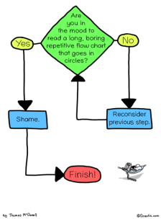
Conceptual Model
Clearly explain the linkage and key relationships between nutrients, response variables and what is being protected
  Ex: Leaking septic systems introduce nutrients into the stream which cause algal blooms in the downstream lake that prohibit people from swimming
Notes:
Then we take it a step further and show HOW the potential criteria will do what we need them to do. So, we’ll develop a conceptual approach and clearly link the causal variable(s) to the response variable(s) to what is being protected (designated use(s)).
Something like increased nutrient load into a healthy stream with low flow and lots of light causes algal growth that inhibits the downstream uses.

Slide 16
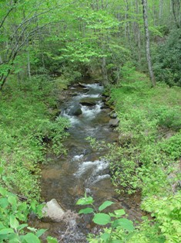
Analysis/Approach
Select approach(es) to derive nutrient criteria
    Reference Condition
    Stressor-Response
    Mechanistic Modeling
    Weight-of-Evidence
    Best Professional Judgment
    Other
  Do we have the information we need to know how much is too much in the system?
Notes:
In this step, we’re looking for a way to derive criteria. And we also need to think about whether or not we have the information we need to answer the question: “how much is too much in the system” and perform any additional studies necessary to help develop estimates for criteria and answer that question.
These are just some examples of approaches and we’ll go into more detail later on.

Slide 17
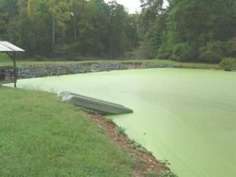
Develop Estimates for Criteria
Number and/or Narrative statement
Shows how the criteria will actually protect the designated use of the waterbody (causal models)
Come up with Assessment Protocols
Notes:
In this step, you actually come up with the number or the narrative statement that takes into account MAGNITUDE, DURATION & FREQUENCY.

Slide 18


The CIC Considers…
Application
Feasibility
Implications
Implementation
Is this feasible?
Are the benefits expected to outweigh the costs?
How will we consistently do this?
Notes:
This is where the Criteria Implementation Committee plays a very important role. Though they’ll be engaged through the entire process and likely be doing this the whole time so that your work is not veering in an impossible direction. And we expect this process to go back and forth because this is the point where you really hash out HOW to make it work.

Slide 19
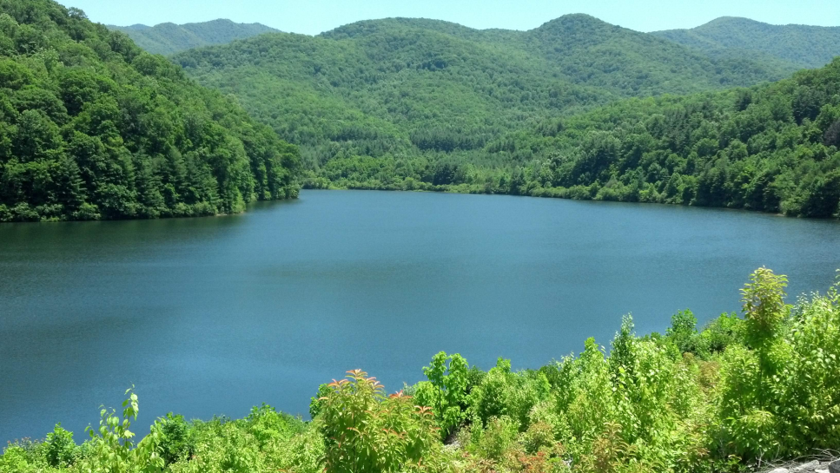
Criteria Selection & Standards Adoption
Most scientifically defensible, feasible criteria will be selected
DWR will work with the EMC to follow the process for water quality standards rule adoption
Notes:
So after all of this work is done, it’s DWR’s responsibility to take everything into consideration and select criteria.

Slide 20
Select Management Goal(s)
Refine Management Goal(s)
* Narrative statement reflective of protecting designated use(s)
Evaluate Potential Criteria
* Come up with way(s) to protect the use (numeric, narrative, both) - measurable & most sensitive
* Generate recommended indicator list
* Data gap analysis
Develop Conceptual Model
* Shows relationship between nutrients and criteria - EX: algal blooms, organic carbon, dissolved oxygen, chlorophyll a, etc.
Analysis/Approach
* Select approach to derive criteria: reference conditions, stressor-response, mechanistic model, other...reflective of protecting designated use(s)
* Fulfill any data/research needs
Develop Estimates for Criteria & Assessment Protocols
Evaluate Feasibility of Accomplishing Criteria
Select Scientifically Defensible, Feasible Criteria
Begin Adoption of Recommendations into Water Quality Standards
Draft Rule, Fiscal Note, Public Hearings, etc.
= SAC
= DWR
= CIC
Notes:
In this simplistic flow-chart, we also need to introduce other processes like stakeholder involvement and NMS or other options for implementation. The CIC will also be involved in those processes (Rich will touch on this a little later).

Slide 21
Questions?

Slide 22

What is Necessary to Create Approvable Nutrient Water Quality Standards?
NCDP Criteria Implementation Committee
August 5, 2015
Notes:
We are referring to this as the “NCDP”

Slide 23
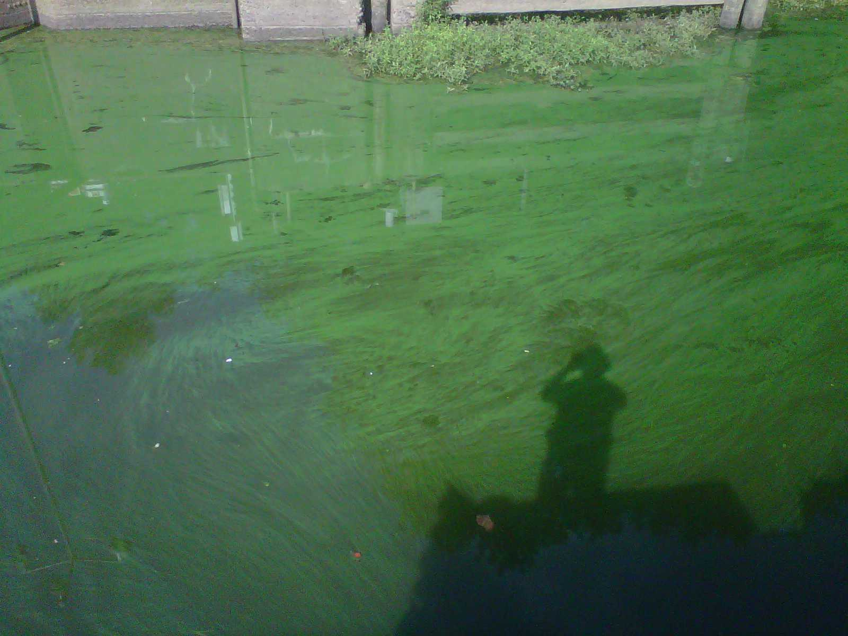
An Abbreviated History of Nutrient Criteria Development in North Carolina
Notes:
Open with a joke?

Slide 24
What are the Goals of the NCDP?
North Carolina has established flexible nutrient control strategies based upon
  Chlorophyll a criteria
  Use of a Nutrient Sensitive Waters (NSW) designation
  HOWEVER…………..Nutrients continue to affect water quality
  So, the focus of the SAC will be to develop (where the SAC deems appropriate) nutrient criteria, defined as a causal and/or response variables for the designated use of the waters:
  Causal Variables: Nitrogen, Phosphorus ….. Others?
  Response Variables: Chlorophyll-a; Phytoplankton, Periphyton, Macrophytes, D.O….. Others?

Slide 25
What is a Water Quality Standard?
Water quality standards define the goals for a waterbody by designating its uses, setting criteria to protect those uses, and establishing provisions to protect water quality from pollutants.
Criteria may be numeric or narrative or both.

Slide 26
Four Components of a Water Quality Standard
1. Designated uses of water: Examples are public water supply, recreation, propagation of aquatic life/wildlife, irrigation
2. Water quality criteria: specifies amounts of pollutants that may be present in those waters without impairing designated uses
Criteria include any one or more of three components: magnitude, duration & frequency
May be Narrative or Numeric (or a combination)
3. Antidegradation: requirements to maintain and protect uses and high quality waters, and
4. General policies: address implementation issues (e.g., low flows, variances, mixing zones)

Slide 27
Current Designated Uses/ Current Criteria
“Class C”: “freshwaters protected for secondary recreation, fishing, aquatic life including propagation & survival, and wildlife”
  ≤ 40 ug/l chlorophyll a-for lakes, reservoirs & other waters subject to growths of macroscopic or microscopic vegetation.
  “Trout”: “freshwaters protected for natural trout propagation & survival of stocked trout”
  ≤ 15 ug/l chlorophyll a for lakes, reservoirs & other trout waters
  “Nutrient Sensitive Waters” (NSW)
  requires development of comprehensive nutrient control strategies

Slide 28


What are Water Quality Criteria &
How are they Developed and Applied?
What are Water Quality Criteria?
“Elements of State water quality standards, expressed as constituent concentrations, levels or narrative statements, representing water quality that supports a particular designated use. When criteria are met, water quality will generally protect the designated use”.
Definition of Criteria from the Clean Water Act 40 CFR 131.3 (b)
How are Criteria Developed and Applied?
Implement water quality protection & monitoring programs to support the Water Quality Standard.
Define the Designated Use of a water body.
Develop Criteria that support the Designated Use.
Establish the Criteria as a Water Quality Standard in state law.
Consider:
  Antidegradation
  Magnitude, Frequency, and Duration
  Spatial & Temporal Effects
  Downstream Uses
Notes:
Final version of criteria poster for NCDP. August 3, 2015. - CJV

Slide 29
High Rock Lake: Background and Existing Information
NC Division of Water Resources
NC NCDP CIC
1st Meeting
August 5, 2015
Notes:
High Rock is unique in the NCDP process – it is the only one that already has models developed, monitoring is done, and we have a pretty extensive existing impairment.

Slide 30
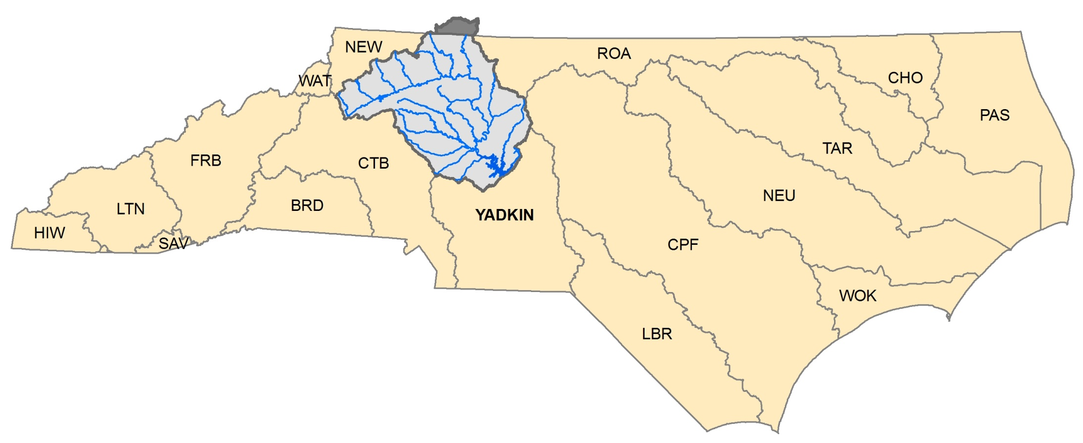
High Rock Lake Watershed
Notes:
To orient you to the area, this is a map of the High Rock Lake watershed. We are about here right now (point to it). As you can see, the High Rock Lake watershed covers the upper half of the Yadkin River Basin. A small portion extends above the North Carolina state line up into VA (CLICK) .
This is a huge watershed, almost 4,000 square miles.

Slide 31
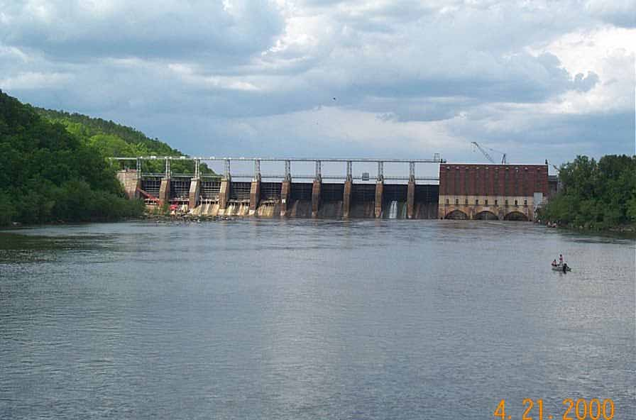
History
1928 - Dam construction completed
Dam owned and operated by Alcoa Power Generating, Inc
www.gorowan.com
Notes:
High Rock Lake is an impoundment of the Yadkin River. Construction of the dam was completed in 1928 to provide hydroelectric power. The dam is currently owned and operated by the Yadkin Division of Alcoa Power Generating, Incorporated (APGI).

Slide 32
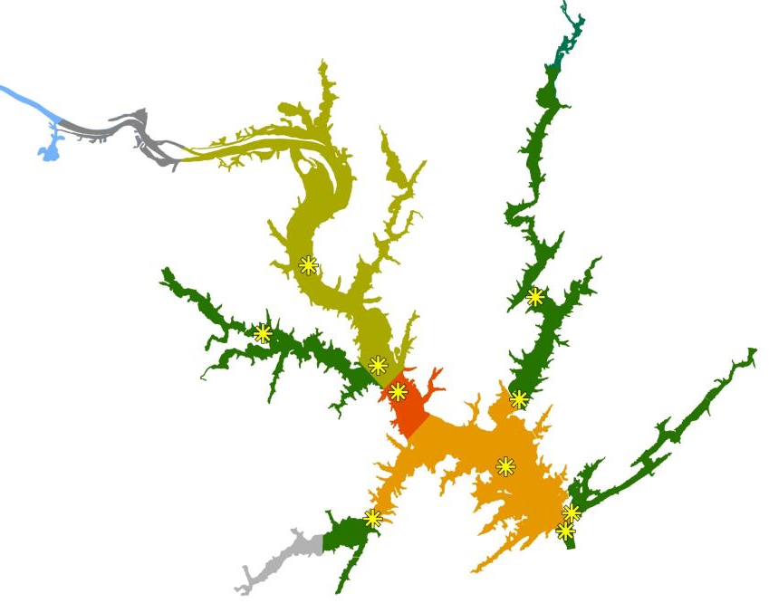
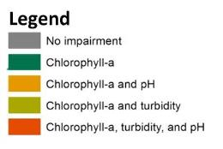
2014 303(d) List
Chlorophyll-a Standard: 40 μg/L
Notes:
High Rock has officially been impaired, meaning on the 303(d) list, since 2004.
As of the 2014 list, the entire lake is impaired for chl-a, read from slide.
The yellow asterisks indicate the monitoring locations in the lake. The way we currently assess for water quality in the lake is each station is assessed separately. So, if there are exceedances of existing standards at one station and not at others, just that part of the lake would be listed for impairment.

Slide 33
Addressing the Impairment
What is a Nutrient Management Strategy?
Similar to TMDL:
Requires reductions
Allocations to sources
Requires state rulemaking:
Stakeholder process, public hearings
Fiscal analysis
EMC approval
Notes:
In order to address the impairment, the division has been working towards development of a Nutrient Management Strategy for High Rock Lake. This process started in 2005, read from slide.

Slide 34
Addressing the Impairment
Questions
Where are the nutrients coming from and how much?
  Tool: Watershed Model
What reductions in nutrient loading are necessary to achieve water quality standards in the lake? Nitrogen? Phosphorus? Both?
  Tool: Nutrient Response Model
Notes:
In developing the strategy, there are 2 primary tools that have been developed. Read from slide.

Slide 35
High Rock TAC Members
Winston-Salem
Salisbury
Kernersville
Duke Energy
Alcoa
Yadkin Riverkeeper* (since Mar 2009)
DWR
NC DOT
DSWC
Piedmont-Triad COG
Keep Iredell Clean
DEH*
(since Sept 2009)
Notes:
Since 2005, the division has been working with a Technical Advisory Committee to develop the tools for the nutrient management strategy. The TAC provided input on the monitoring plan and has reviewed the models.

Slide 36
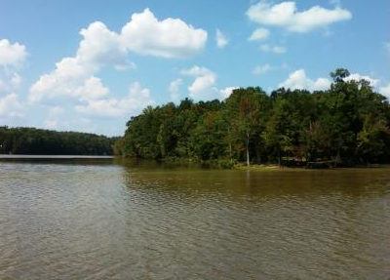
Model Status/Next Steps
Model reports are on website:
http://portal.ncdenr.org/web/wq/ps/mtu/specialstudies#HRL
DWR staff running scenarios to evaluate model performance
Notes:
The model reports are on our website at the address on the slide. Right now, staff are running scenarios to evaluate model performance. It is not clear if or how the models will be used for criteria development, but they are potential tools that we do have available.

Slide 37
Tasks for SAC
What concentration/frequency/duration of chlorophyll-a is right to protect aquatic life? How to express N&P?
Is chlorophyll-a standard enough as a response indicator? Are other response indicators appropriate?
Is resulting criteria translatable to other lakes?
Notes:
Read from slide….

Slide 38
Contact Information
Pam Behm
919-807-6419
Pamela.behm@ncdenr.gov
High Rock Lake Information:
http://portal.ncdenr.org/web/wq/high-rock-lake

Slide 39
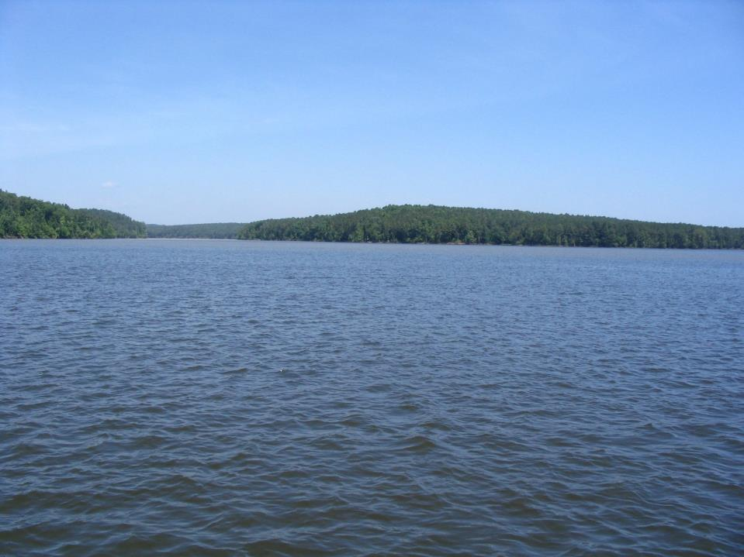
HRL Rulemaking Stakeholder Process?
Factors – current, projected:
NPSB staff additions – Sept & Dec 2015
  Earliest desirable stakeholders start-up = Spring 2016. 1⁺-year process
SAC NNC rec’s - Summer 2016
  DWR sets NNC, develops translator to N, P needs – ?
Wild card – H97 Section 14.5.(e):
  The Department and Commission shall consider and include in situ strategies as described in subsection (a) of this section, in their development, review, and modifications of basinwide water quality management plans or related water quality mitigation modeling
  Open Questions for HRL:
  Role of CIC re. stakeholders
  DENR HRL management interests post-2015 legislature
  Scenarios to Consider:
  Engage CIC a.s.a. Fall 2015 – implications of current lake model N, P findings
  No H97 – joint CIC/stakeholders Summer 2016, adapt plan to revised NNC prior to formal rulemaking
  H97 – Dept. direction &/or extend timeframes to evaluate implications of bill, potentially of Jordan results

