Slide 1

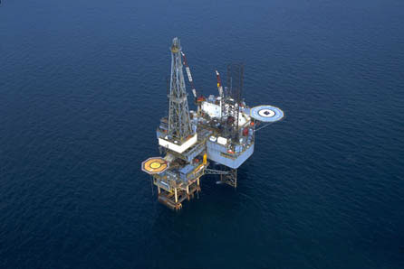

Mike Lopazanski
NC Dept of Environmental Quality
Division of Coastal Management
15A NCAC 7M .0400 Coastal Energy Policies
February 14, 2018

Slide 2
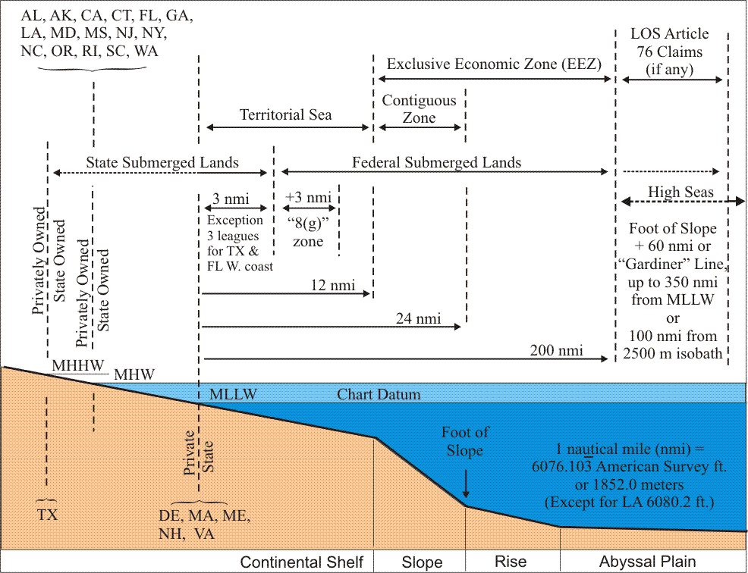
    NC Ocean Jurisdiction
    State boundaries established by fed Submerged Lands Act (1953) & Territorial Sea Proclamation (1988)
    NC – Mean High Tide to 3 Miles
    Federal – Territorial Sea (12 mi) EEZ (200 mi)

Slide 3

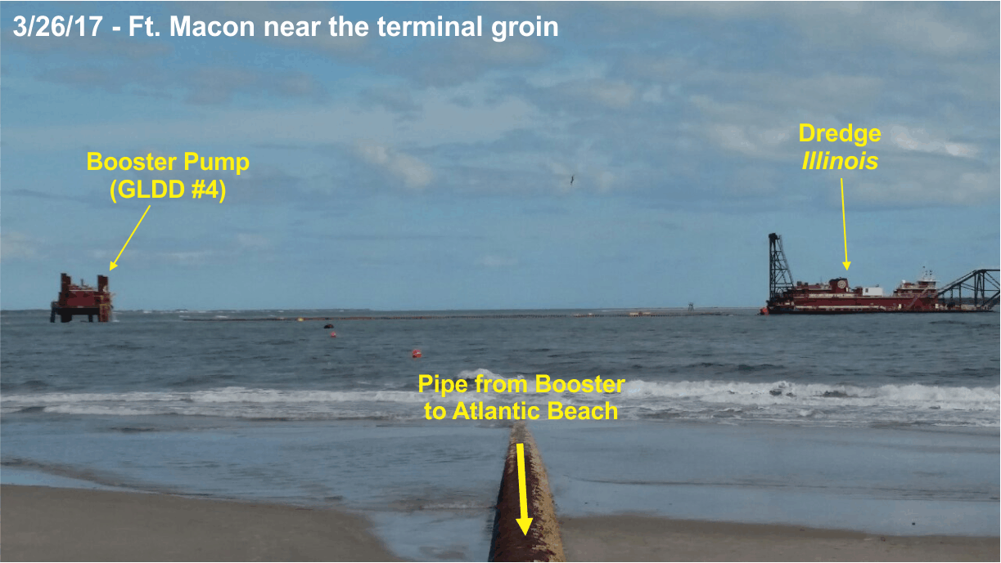

    Federally licensed activities must be consistent with NCCMP; federal activities must be consistent to max extent practicable
    After a coordinated state review, DCM issues either a consistency concurrence or denial
Carteret Co. Shore Protection Office

Slide 4


Consistency Components
N.C. program received approval from NOAA
in 1978 pursuant to federal CZMA
Administrative rules & policies of the CRC and local land use plans.
Ex. Order 15 (issued by Gov. Hunt) requires other state agency actions to be consistent with the NC Coastal Program.

Slide 5
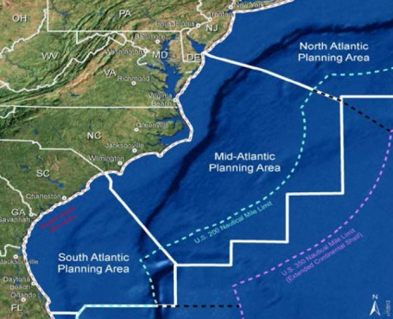
Ocean Energy Project Authorities
Outer Continental Shelf Lands Act (OCLA)
Fed Coastal Zone Management Act (CZMA)
NC CAMA
15A NCAC 7M.0400 Coastal Energy Polices

Slide 6
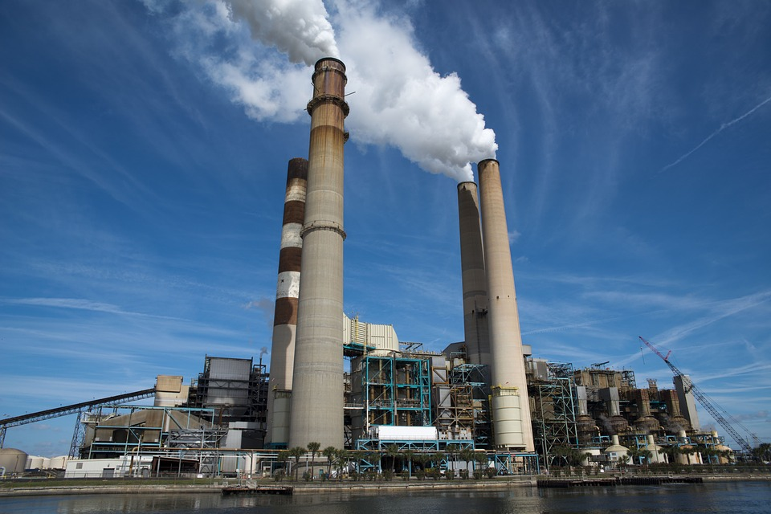
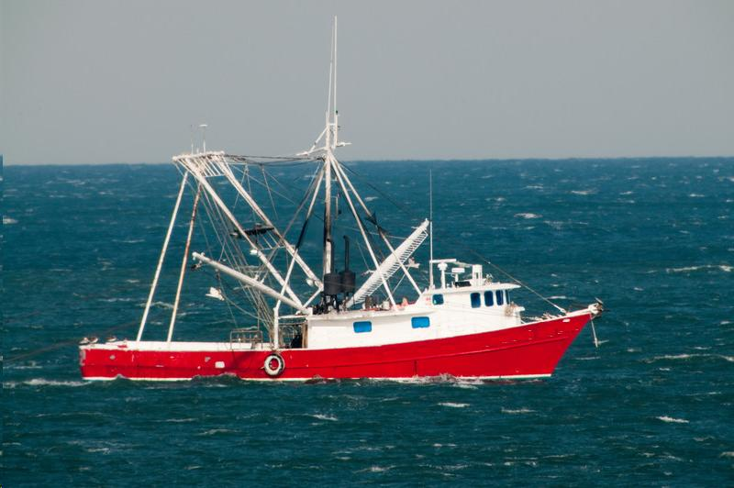
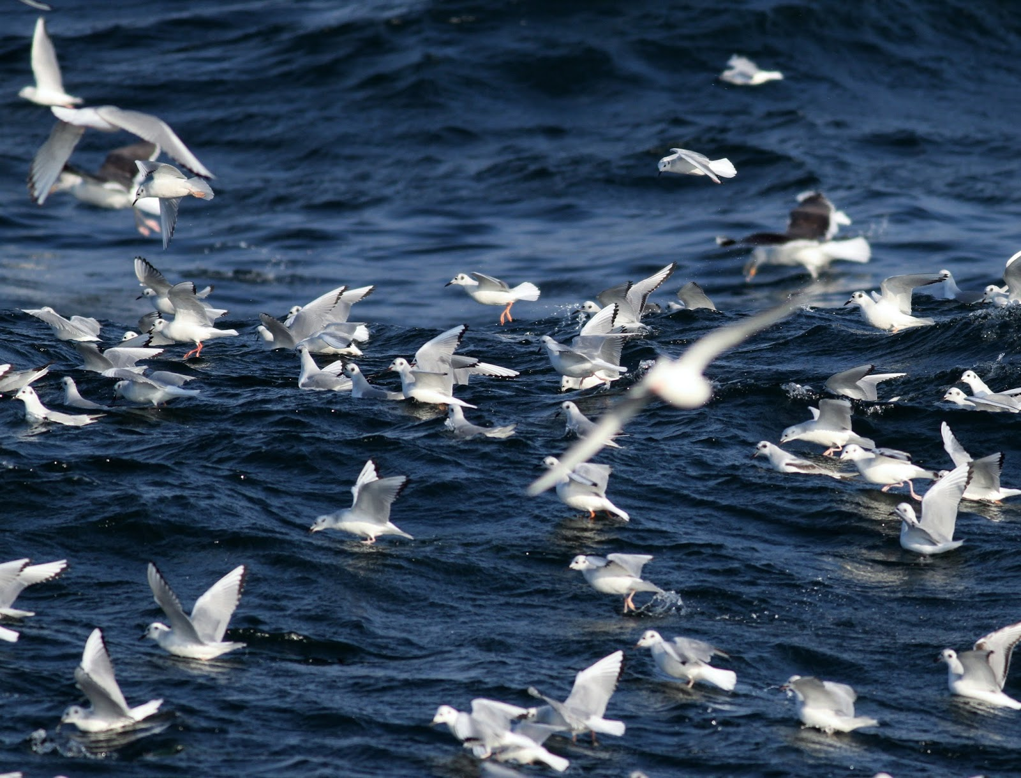
Coastal Energy Policies 15A NCAC 7M .0400
Originally adopted 1979
  Broad and general policies
  Focused on land-based energy facilities
1993 DCM NC Ocean Resources Task Force
  Recommended CRC amend energy policies to clarify information needs for consistency reviews
1996 CRC Amendments
  Expanded definition of major energy facilities
  Identified specific sensitive areas (offshore hard bottom, SAV, PNAs, fish spawning areas, turtle nesting beaches, Reserves, Refuges, historic sites, shipwrecks/reefs)
  Required mitigation of impacts
  Address the scenic qualities of the coastal area
  Fishing, navigation, recreational impacts
  Geologically unstable areas
  Decommissioning

Slide 7

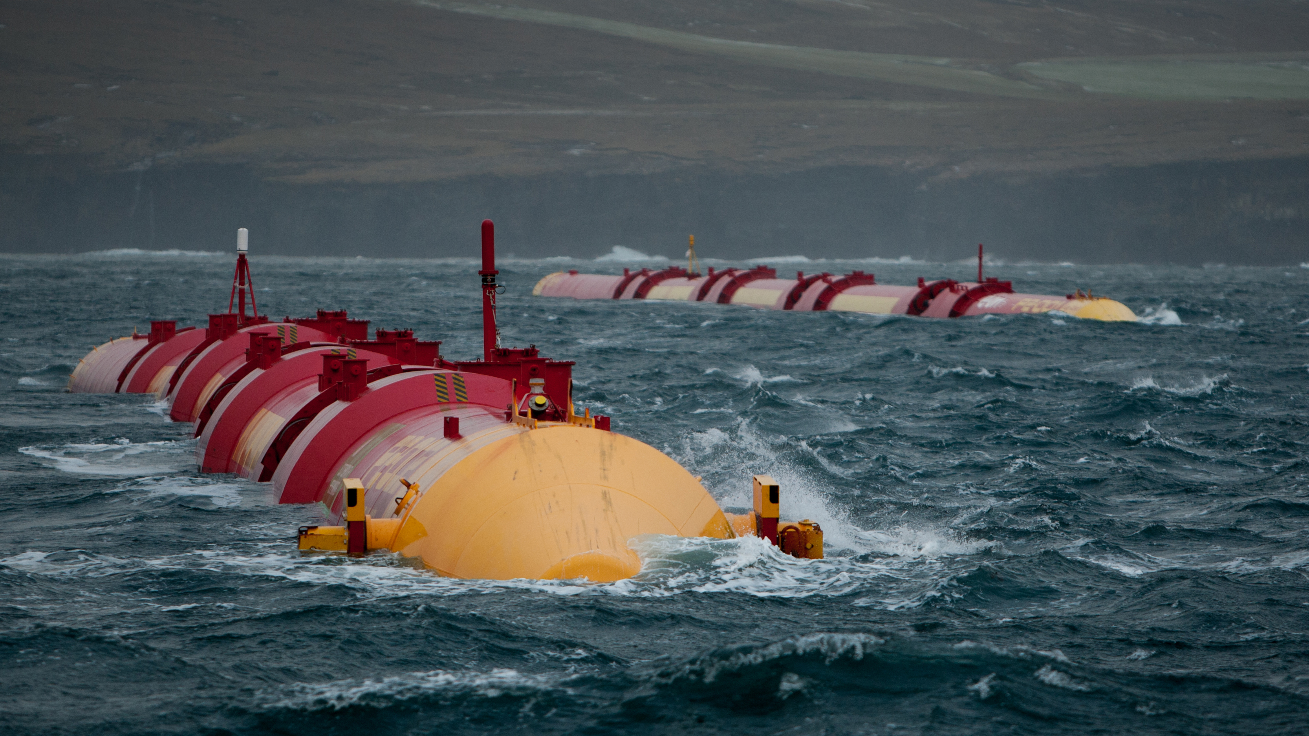
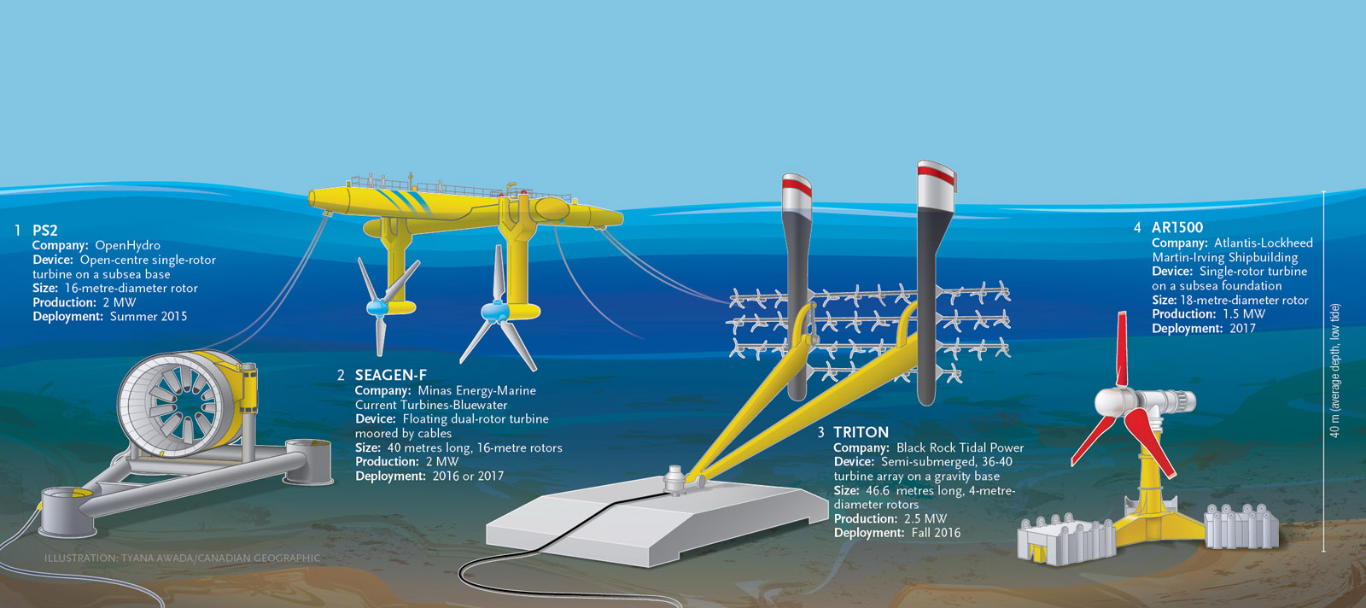
2009 DCM Ocean Policy Steering Committee
Alternative Energy Recommendations
Review 7M Energy polices
  Expand to address new technologies
  Allow alternative energy facilities as water-dependent structures
  Allow transmission lines to cross the beach front
  Coordinate with EMC wind energy efforts
Image credit: Andy Dingley

Slide 8
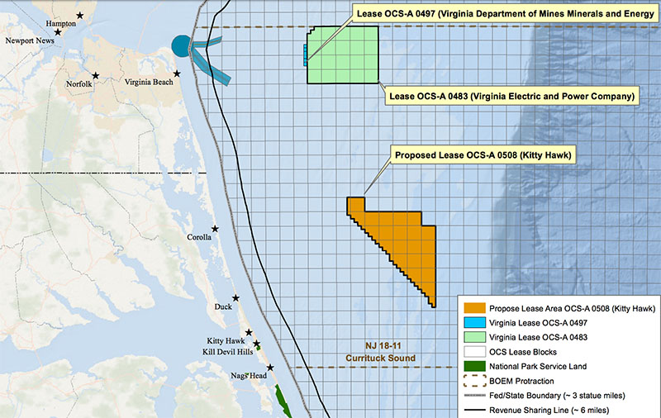
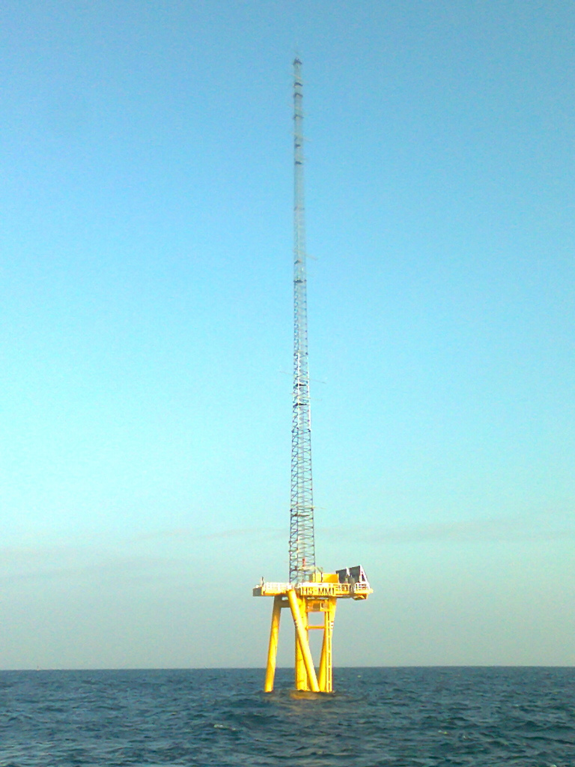
2009 Coastal Energy Polices Amendments
Wind Energy Facilities
Followed recommendation of the EMC
Incorporated Wind Facilities in 7H .0208(b)(13)
Created a definition of wind facilities – 7H .0106(5)
Amended 7H .0309(g) to allow transmission line to cross
beach front
Developed siting criteria, application requirements

Slide 9

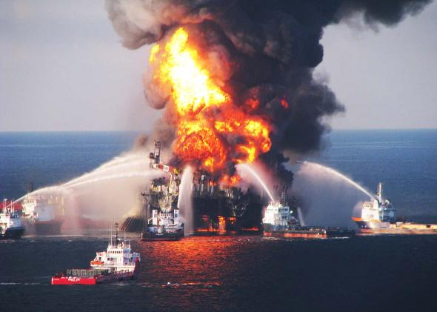
2010 BP Spill and NC Legislative Response
Session Law 2010-179
Liability Limits
CAMA Amendment (Info required for consistency review)
CRC Review of Laws and Regulations
Review of State Oil Spill Contingency Plan
DENR (DEQ) Review of Oil Pollution & Hazardous
Substance Control Act
US Coast Guard

Slide 10
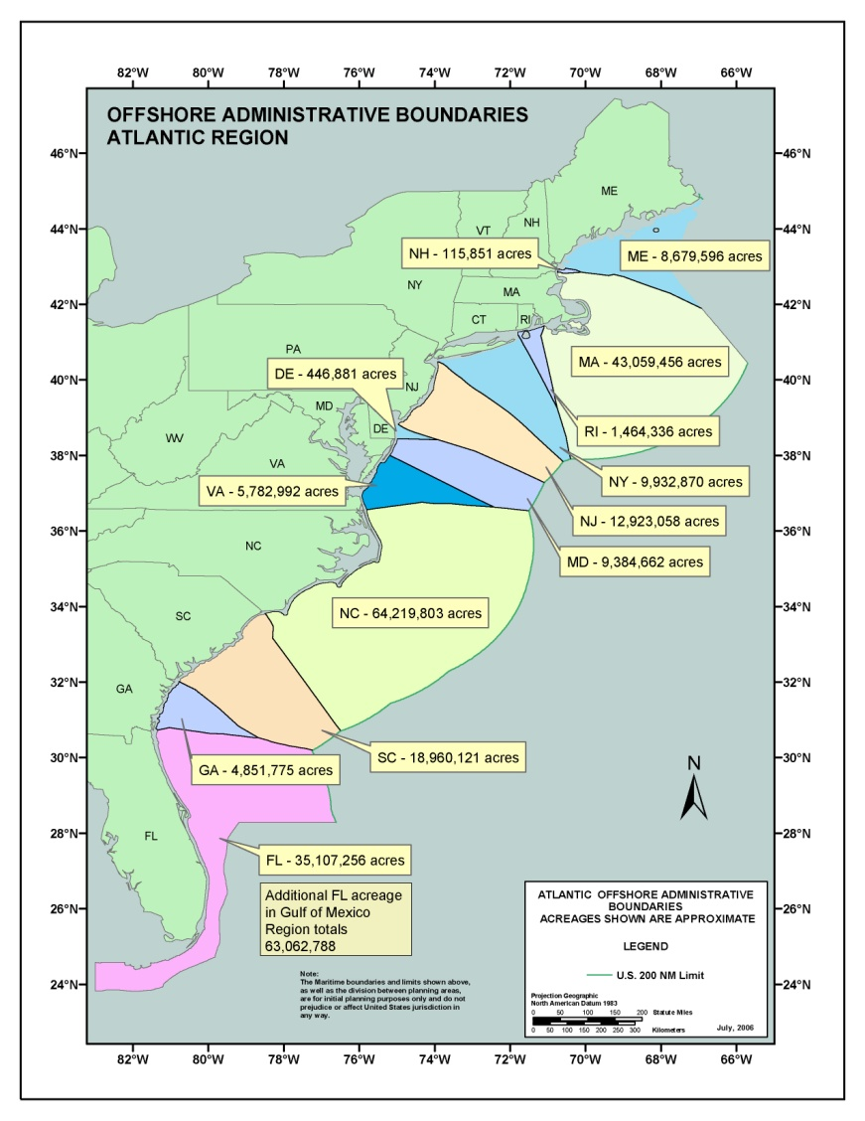
2010 CAMA Amendments
  Created new section: 113A-119.2 Review of Offshore Fossil Fuel Facilities
    Additional Definitions – Specifically incorporated 7M .0403 Coastal Fishing Waters, Discharge, Offshore Fossil Fuel Facility and Oil
    Incorporates federal requirements associated with Spill Prevention and Response Plans

Slide 11
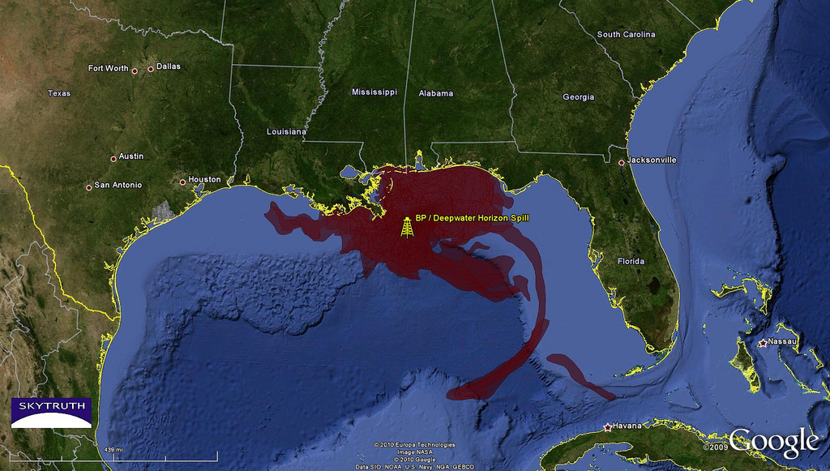
BP Spill Related Amendments
  CAMA Amendments
    Federal requirements related to spills
    Assessment of alternatives to an offshore facility that would minimize spills
    Assessment of spills causing a temporary or permanent violation of water quality standards

Slide 12
Oil Pollution and Hazardous Substance Control Act
  N.C.G.S. 143-215.75 et seq
  Complements federal Water Pollution Control Act
    Establishes liability for petroleum spill
    Reporting requirements
    Corrective actions
    Restitution for cleanup activities
    Liability for damages and civil penalties

Slide 13
Oil Pollution and Hazardous Substance Control Act
  N.C.G.S. 143-215.75 et seq
  Amendments
    Dissociates State law from federal liability cap for spill occurring in State Waters
    Expands liability to include exploration activities
    Damages from cleanup (dispersants)
    Expands definition of “Offshore Waters”

Slide 14
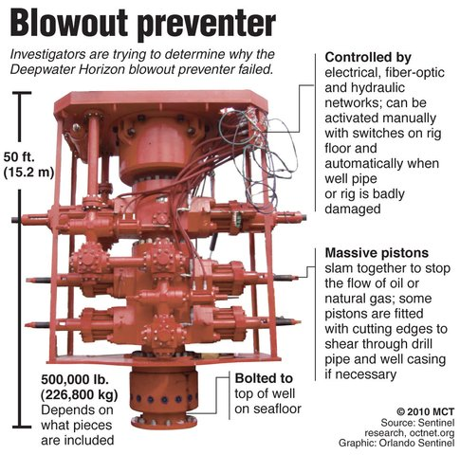
Federal Requirements for Spill Response
    Bonds
    Financial Responsibility
    Relief Well
    Suspension of Activities
    Blowout Scenarios
    Spill Response Plan
      Equipment Availability
      Response Organization
      Worst Case Scenario
      Modeling
15A NCAC 7M .0402 & .0403 – provisions for what’s to be included in an impact assessment as well as an assessment of the risk of spills.

Slide 15
NC Offshore Energy Study Groups
    DCM Ocean Policy Study Committee - 2009
      Wind Energy Rules
      Broadening of Coastal Energy Polices
    EMC Renewable Energy Committee - 2009
      Wind Permitting Study
    Legislative Research Commission Advisory Subcommittee on Offshore Energy Exploration - 2011
      Further Studies and Analyses
      Coordination with Governor’s Advisory Panel
    Governor’s Scientific Advisory Panel on Offshore Energy - 2011
      High Potential for Offshore Energy
      Further Studies
      Revenue Sharing
      Review of BP Final Report
      Consider NC and National Energy Policy

Slide 16

MOBIL
1988 - Mobil
Proposed to drill in block 467
1990 - found inconsistent due to inadequate info
Mobil appealed consistency determination
Consistency determination upheld by US DOC
Mobil sues fed gov’t
Congress passes OBPA in 1990
Mobil initially loses breach of contract suit but then
wins on appeal to US Supreme Court in 2000
As a result of winning, Mobil relinquishes leases

Slide 17

CHEVRON
1997 - Chevron
Sept 1997 - Proposes to drill in block 467 or 510
Plans exploratory well in 2000
*NC Issued Favorable Consistency Determination - 1982
Plan Of Exploration to be submitted in 1999
State forms OCS Advisory Committee in 1998
OCS Technical Review Team –
Focus on missing info from Mobil proposal
      *Socioeconomic impacts
      *Economic importance of “The Point” area
      *Recreational fishery
      *Laval fish impacts
      *Hydrocarbon monitoring

Slide 18

CHEVRON cont.
1997 - Chevron
1997 - Gov Hunt enacts CRC 1996 amendments to Coastal
Energy Policies by Executive Order
1998 – MMS (BOEM) funds several studies to better define
the importance of “The Point” area
1998 – President Clinton withdraws areas not already
under annual Congressional moratorium
1999 – Gas drops below $1 per gallon
Early 2000 – Conoco purchases remaining interest in
Manteo Block leases

Slide 19
Moratorium
June 1998 – President Clinton withdraws all unleased area in Atlantic OCS through June 2012
April 1999 – Chevron relinquishes all interest in
Manteo Unit
Amerada Hess surrenders lease in Currituck Block
July 2000 – Mobil’s leases terminated
November 2000 – Conoco relinquishes interest in last
remaining active blocks
  Cites area off NC as too controversial

Slide 20
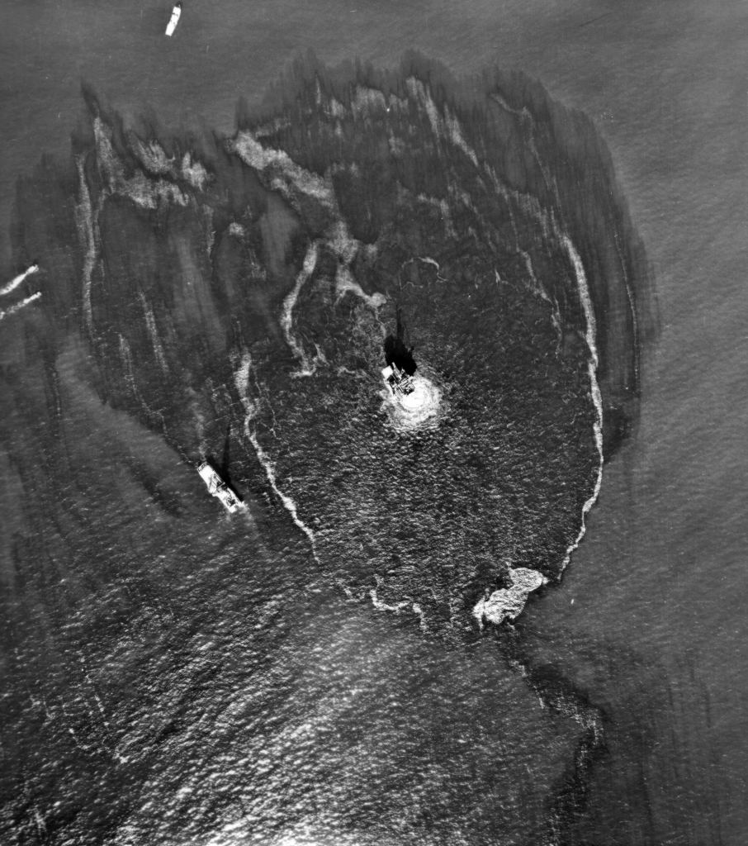
Moratoriums
Santa Barbara, CA – January 1969
Union Oil Co Platform Blowout
3 million gallon spill
800 sq. mi. slick
Soiled 35 miles of beaches
Local Ballot Issue
Local zoning ordinances that
preclude on shore support
facilities

Slide 21
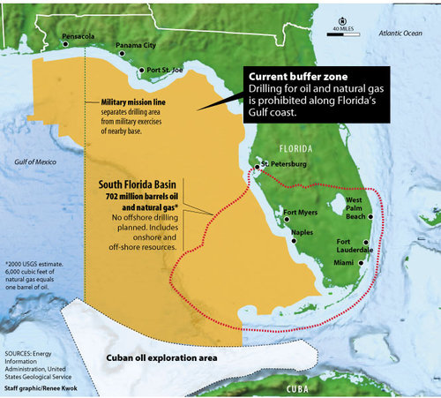
Federal Moratoriums
1982 Pre-Leasing ban for California waters
1983 North Atlantic Pre-Leasing Ban
1988 Gulf of Mexico Drilling Ban
1990 Presidential Drilling Ban
1990 Outer Bank Protection Act
1998 Presidential Ban Extend to 2012

Slide 22
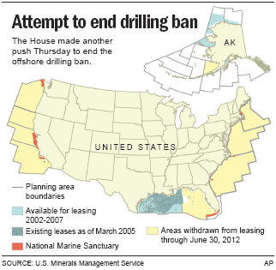
Lifting of Moratoriums
Lifting of Presidential Moratorium
July 2007 – Gasoline Prices reach $4.00
More calls for increasing domestic production
President Bush lifts moratorium in June
MMS (BOEM) directed to begin new 5-Year Lease Program
Congressional Moratorium Lapse
Annual Renewal
Included in DOI Appropriations Bill
Legislative Proposals Including Bans
No Action Taken – Moratorium ended Sept 30, 2008
Gulf of Mexico Energy Security Act
No leases within 100 miles of FL (eastern Gulf)
effective until 2022

Slide 23
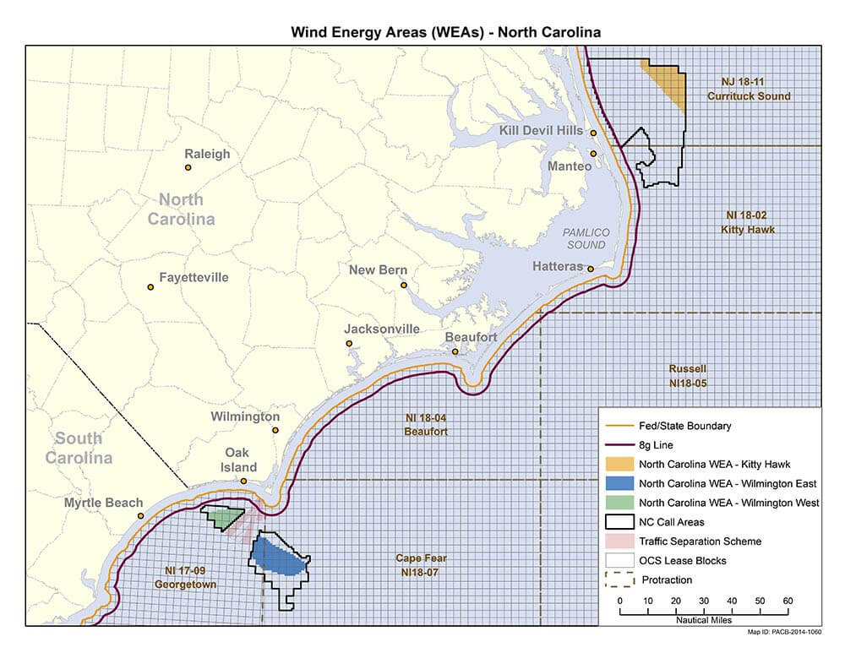
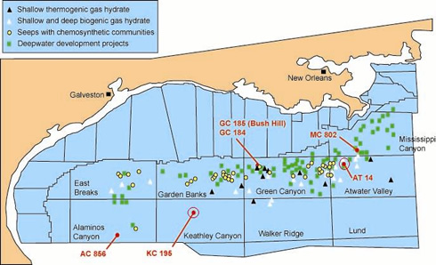
5-Year Lease Program
Consists of a schedule of lease sales
Blocks to be offered
Size and location
Leases
- Period of 5 to 10 years
- BOEM determines if bids are fair market value
- Each lease sale subject to state consistency

Slide 24

2007-2012 5-Year Lease Programs
Effective July 1, 2007 – June 30, 2012
Developed under Presidential and Legislative Moratoriums
Did not include banned areas – including NC
NC commented on Program
- Concerns about fisheries
- Tourism impacts
- Supported existing moratorium
Included Special Interest Sale off 50 miles VA
Gov Easley objected to inclusion
- NC would bear direct adverse impact with no benefit

Slide 25
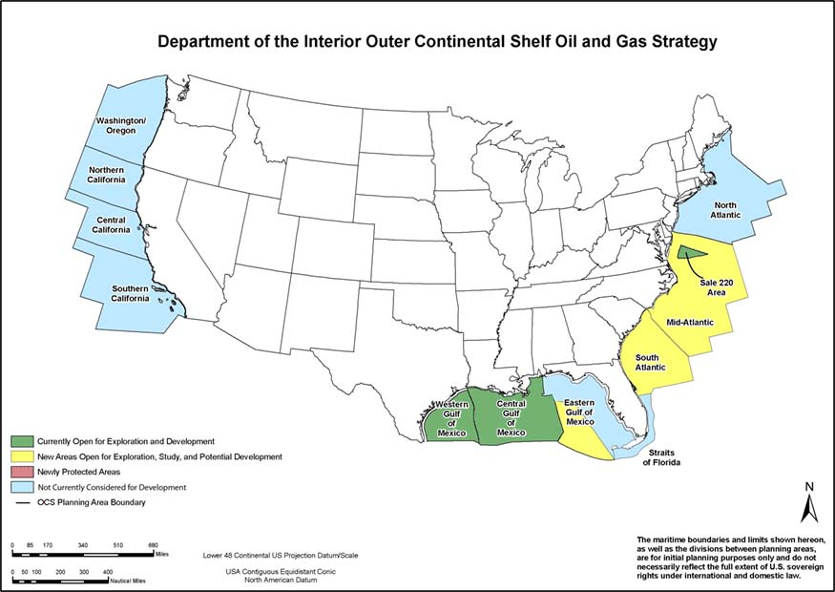
2012-2017 Five Year Lease Program
Obama Administration Comprehensive Energy Strategy
Expansion of oil & gas development on OCS
Eastern Gulf of Mexico
Arctic Ocean
Mid & South Atlantic
Goals of Strategy
“Right ways, right places”
Order & certainty for industry
Interests of taxpayers
Protection of fisheries/tourism
Science & new technology
NC admin bndy 64.2M acres
No provisions for revenue
sharing beyond 3 miles of state
waters.

Slide 26
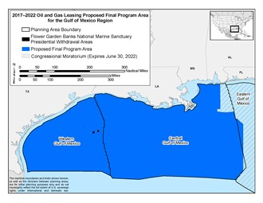
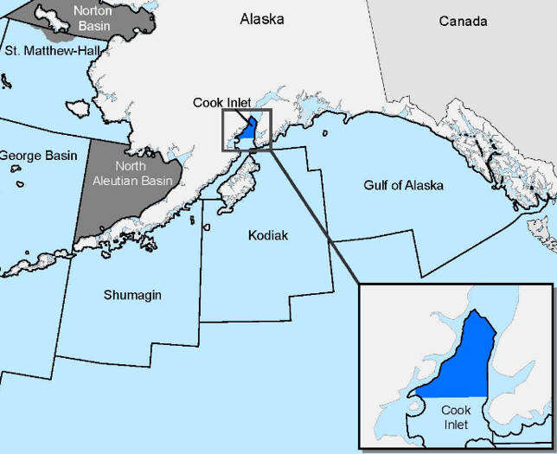
2017-2022 Five Year Lease Program
November 18, 2016
Final Proposed Program published, NC is included
11 potential lease sales in two program areas
10 sales in the combined Gulf of Mexico (GOM) Program Area
1 sale in the Cook Inlet Program Area offshore Alaska.
No lease sales are scheduled for the Pacific or Atlantic OCS.
January 17, 2017
Secretary of Interior approved the 5-Year Lease Program

Slide 27
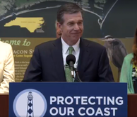
2019-2024 Five Year Lease Program
April 28 , 2017
Executive Order 13795 directs DOI to initiate new 5-Year Program
2019-2024 would supersede current program
June 29, 2017
BOEM notifies NC of intent to develop new 5-Year Lease Program
August 17, 2017
Gov Cooper & DEQ Secretary Regan notify BOEM of NC opposition to inclusion in 5-Year Lease Program
March 9, 2018
Comments due on Draft Proposed Program or Programmatic EIS

Slide 28
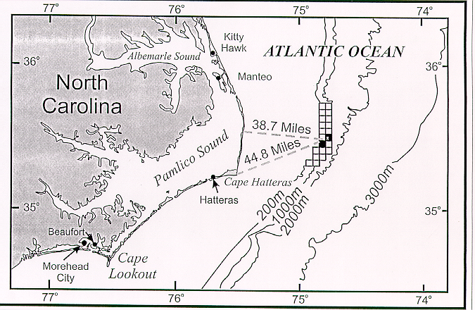
“The Point”

Slide 29



What’s out there?
40 miles offshore
2,200 feet deep
Late Jurassic - Early Cretaceous shelf-edge carbonate reef
11,000 – 15,000 feet below the seafloor
Estimates from the 1990’s
7% chance of finding hydrocarbons
2% chance of a commercial find
5 – 6 trillion ft³ natural gas
Could be one of the largest
domestic discovery since
Prudoe Bay Alaska

Slide 30
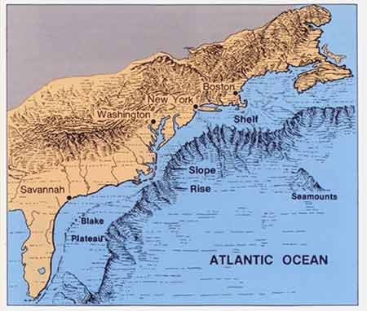
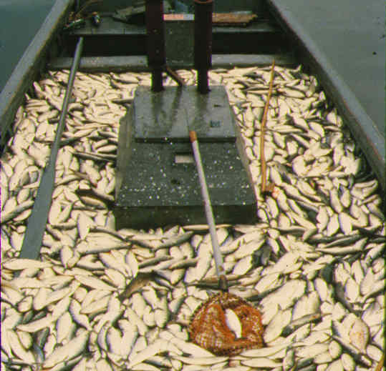
“The Point” – What’s so special
Southward flowing Labrador Current
Northward flowing Gulf Stream
Western Boundary Undercurrent
Unique bathymetric features
Upwelling of nutrients
Enhanced ocean productivity
Greatest diversity of marine
mammals on the east coast

Slide 31

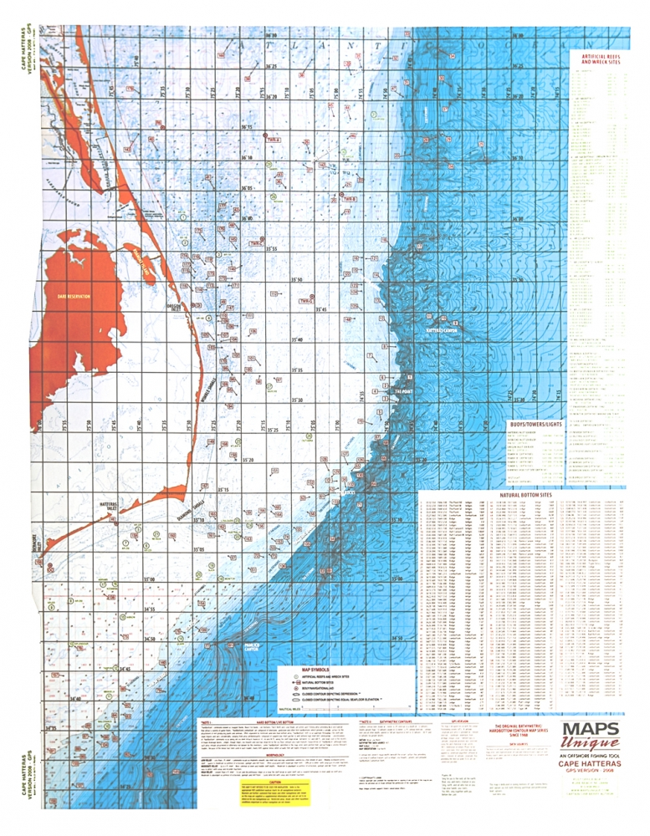


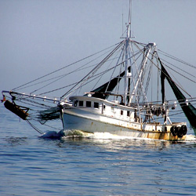
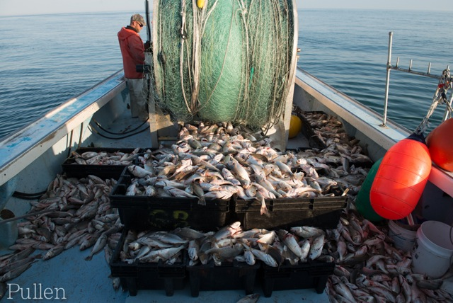
“The Point” – What’s so special
Fisheries offshore managed by NMFS
Fisheries Management Plans (FMP)
Essential Fish Habitat Designations (EFH)
Important to migratory species
The Point
Ten Fathom Ledge
Big Rock
Cape Lookout shoals
Cape Fear shoals
Cape Hatteras shoals

Slide 32


Closer to shore
320 miles of ocean shoreline
21 barrier islands
2,973 active commercial fisherman
575 seafood dealers
* 7,410 jobs; $166M income; $388M sales*
1.4M recreational anglers making 5.4M trips
* 15,069 jobs; $621M income; $1.57B sales *
Coastal Tourism – 30,000 jobs
Visitors spent $3B on the coast (2015)
* $650M income; $160M state taxes; $160M local taxes *

Slide 33
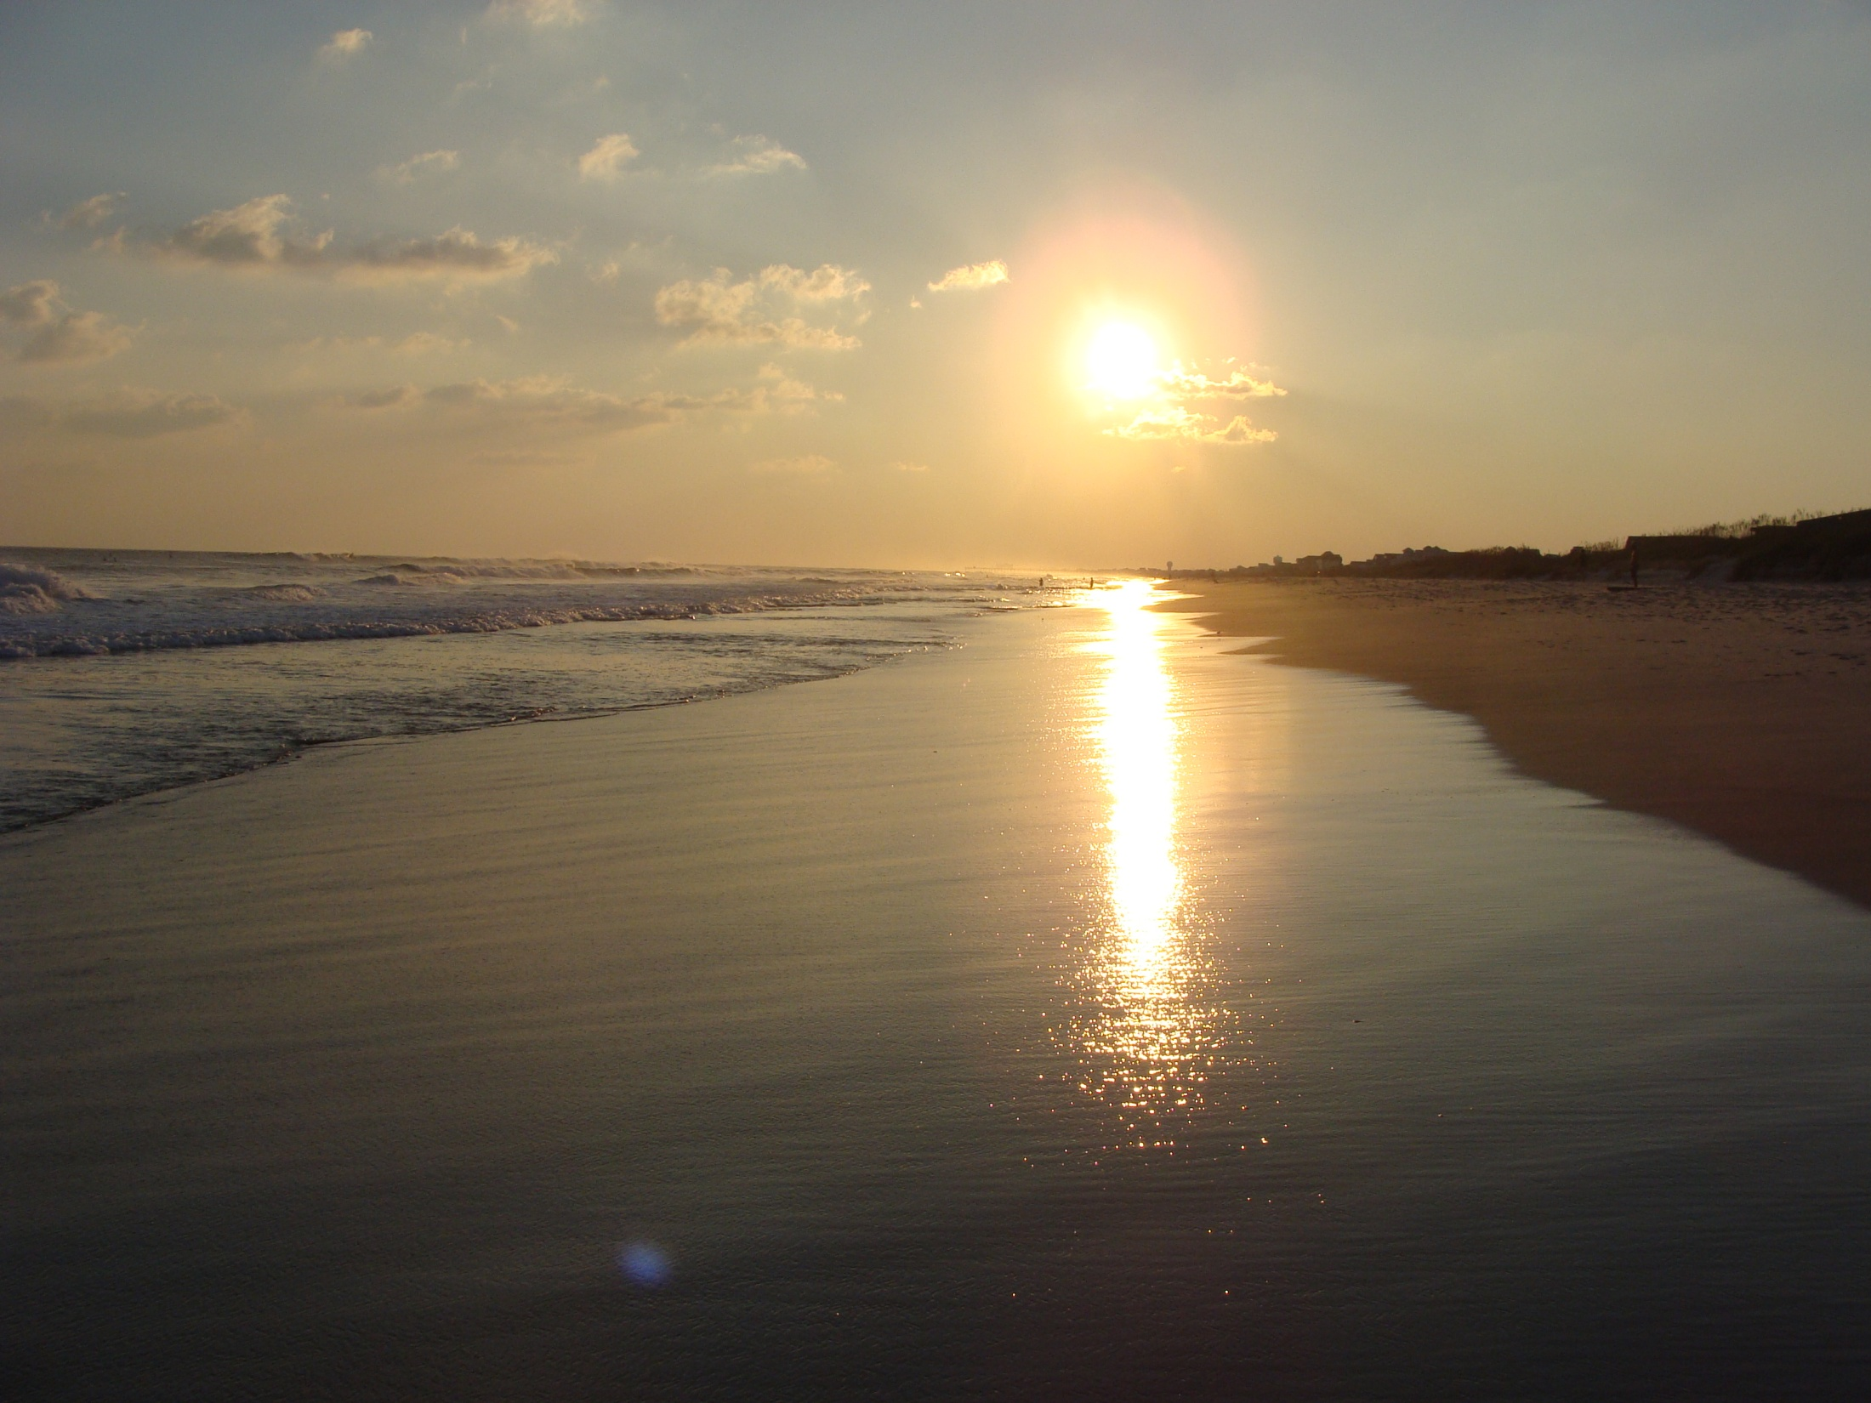
For More Information…
Mike.Lopazanski@ncdenr.gov
www.nccoastalmanagement.net

