Slide 1
Department of Environmental Quality
NC CRC Science Panel Update
February 14, 2018
Ken Richardson
CRC Meeting – Sunset Beach, NC

Slide 2
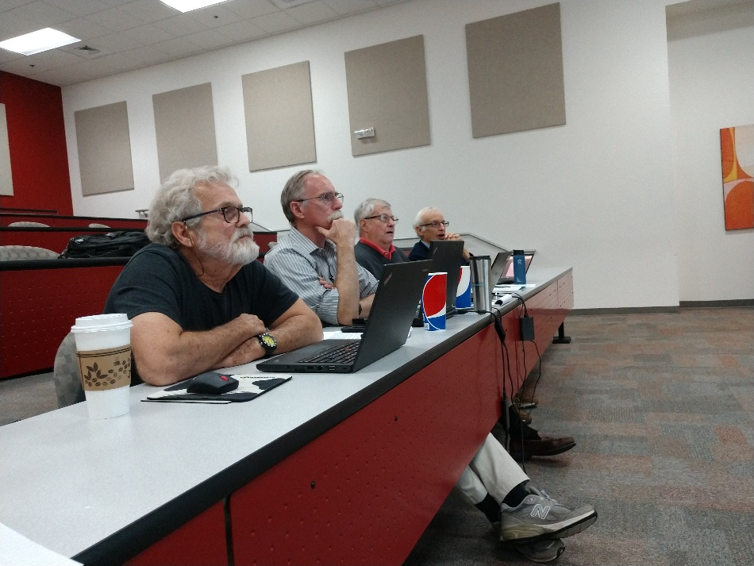
NC CRC Science Panel: Background
10 Coastal Geologists & Engineers
Scientific input for CRC Policy Development:
  Calculating long-term beach erosion rates
  Establishing sediment criteria for beach nourishment
  Delineating Inlet Hazard Areas
  Monitoring and analysis of terminal groin effects
  Synthesizing information on sea level rise
Division of Coastal Management
Notes:
In the late 1990’s NC’s coast experienced several back-to-back major hurricanes. In fact, we experienced five presidentially declared disasters within a twelve month period. As a result, Governor Hunt formed a Disaster Recovery Task Force in October 1996 to develop a comprehensive set of recommendations to facilitate the state’s recovery. One of the issues addressed was the review of the CRC’s hazard mitigation rules and Ocean Hazard Areas. Specifically, the Commission was requested to evaluate the methodologies used to delineate hazard areas including an assessment of erosion rate calculations, setback requirements and accuracy of ocean and inlet hazard area delineations. From this effort, the CRC’s Science Panel was formed.
The Science Panel provides the Coastal Resources Commission with scientific data and recommendations pertaining to coastal topics of interest. The volunteer panel is composed of coastal geologists and engineers - and one biologist (Pete Peterson) who was an integral part of the sediment criteria discussions.

Slide 3
NC CRC Science Panel: Projects
Sediment Criteria Development (2002 - 2007)
Review Innovative Erosion Control Structures - Holmberg Stabilizer System (2002 - 2003)
Review results from updated Erosion Rate study (2004)
Inlet Hazard Areas Analysis & Delineation (2007 – 2010; per HB-819 continue study in 2013)
Terminal Groins (Review Feasibility Study 2009)
Terminal Groins (Guidance on monitoring for adverse impacts 2011- 2012)
Sea Level Rise Assessment (2009 to Present)
Review results from updated Erosion Rate study (2011)
Updating Inlet Hazard Area Boundaries (Present)
Evaluating oceanfront shoreline change rate calculation methods (summer 2018)
Division of Coastal Management
Notes:
Summary of projects that the Panel has worked on:
Reminders (in case needed):
In 1985, the CRC, a policy-making body for the coastal management program, studied the effects of hard structures on beaches in other states. The CRC concluded that the potential negative effects of such structures could cause irreversible damage to North Carolina’s beaches. As a result, the CRC recommended banning the construction of hard structures to protect buildings at the coast.
The regulatory ban on hard structure existed in practice for 15 years before it was upheld in court in a 2000 case. In 2003, the North Carolina General Assembly voted unanimously to formally adopt the hard structures ban as law.
In 2011 by passing the Senate Bill 110 the North Carolina General Assembly repealed a 30-year-old ban on hardened structures and allowed up to four “test” terminal groins to be built in North Carolina.
In the 2015 session of the General Assembly the legislators passed a bill that will allow two more terminal groin projects

Slide 4
NC CRC Science Panel: Current Membership
Dr. Margery Overton (NCSU Dept. of Civil, Construction & Environmental Engineering, and current Chair)
Mr. William Birkemeier (USACE Field Research Facility, ERDC/CHL, Retired, and Co-Chair)
Mr. Steve Benton (coastal geologist, retired DCM)
Dr. William Cleary (Retired, UNC-W Center for Marine Science)
Mr. Tom Jarrett P.E. (USACE, retired)
Dr. Charles “Pete” Peterson (UNC-CH, Institute of Marine Sciences)
Mr. Spencer Rogers (NC Sea Grant)
Dr. Elizabeth Sciaudone, P.E. (NCSU Dept. of Civil, Construction & Environmental Engineering, NCSU)
Mr. Greg “Rudi” Rudolph (Carteret County Shore Protection Office)
Division of Coastal Management
Notes:
Current Science Panel Members

Slide 5
NC CRC Science Panel: Nominating New Members
Call for nominations (coastal engineers & geologists)
Nominees will need to provide the CRC, CRAC or Science Panel member with a resume, CV and any other qualifying information that will be forwarded to the DCM Director
Nominations reviewed by the Science Panel and recommendations made to the Science Panel Chair.
A subcommittee of the CRC, including the CRC Executive Committee (CRC committee chairs, CRAC Chair and Executive Secretary) and Science Panel Chair, would then review the nominees and make a recommendation to the CRC Chair.
The Chair would then make the appointments known at the next CRC meeting
Division of Coastal Management
Notes:
At the May 2013 CRC meeting in Beaufort, the Commission unanimously approved the following Science Panel nomination process:
For vacant Science Panel slots, the Division will send a call for nominations letter to CRC, CRAC and Science Panel members seeking nominations for engineers and geologists.
The CRC’s charge to the Science Panel will be used as guidance for qualifications.
Nominees will need to provide the CRC, CRAC or Science Panel member with a resume, CV and any other qualifying information that will be forwarded to the DCM Director
The call for nominations will also request that the potential nominee be contacted prior to submission to ensure their interest in serving.
The nominations period will be open for 30 days.
Nominations would then be reviewed by the Science Panel and recommendations made to the Science Panel Chair.
A subcommittee of the CRC, including the CRC Executive Committee (CRC committee chairs, CRAC Chair and Executive Secretary) and Science Panel Chair, would then review the nominees and make a recommendation to the CRC Chair. Having the Executive Committee and Science Panel Chair make recommendations incorporates all the Commission’s leadership into the process.
The Chair would then make the appointments known at the next CRC meeting
“Ad hoc” Science Panel Membership: The Science Panel could indicate that they need a certain number of members with specified expertise. The Commission or Advisory Council could also suggest a number of members with specific expertise. The call for nominations would be handled and reviewed in the same manner as above, with the specifics dictated by the needs.
At their December 2017 meeting, the Science Panel expressed their desire to add new members to the Panel in order to fill existing vacancies.
Should the CRC desire to fill existing vacancies, the DCM is prepared to send a call for nominations.

