Slide 1
Technical Standards for Beach Fill Projects 15A NCAC 07H. 0312
February 14, 2018
Ken Richardson
CRC Meeting – Sunset Beach, NC
Notes:
(page 261)
I will be discussing technical standards for beach fill projects (07H.0312), or “sediment criteria rules:”

Slide 2
Sediment Criteria: Outline
Introduction
07H .0312(1) Characterize Native Beach Sediment
07H .0312(2) Characterize Borrow Area Sediment
07H .0312(3) Determine Sediment Compatibility
07H .0312(4) Excavation and Placement of Sediment
Notes:
Given the amount of detail and complexity of your Sediment Criteria rules I will:
Review current rules for each section, and how they are generally applied
Immediately following each section, I will then review staff’s proposed amendments that also considers stakeholder input and feedback. It is worth noting that not all proposed amendments were fully supported by all stakeholders.
Discuss recipient beach sediment characterization
Discuss borrow area sediment characterization
Discuss sediment compatibility, how it is determined
Discuss excavation and placement

Slide 3
Sediment Criteria: Introduction
Goal: ensure that sand used for beach nourishment is compatible with existing sand on the beach.
Science Panel developed sediment characterization & compatibility standards (2002-2007)
Rule Adopted: CRC adopted & with an original effective date of February 1, 2007
To Reach the Goal – Must First Define Compatibility: requires sediment analysis of both the existing beach and potential borrow sites.
Grain Size
Composition
Notes:
NC’s sediment criteria rules are perhaps the most comprehensive in the nation.
Also wanted to note that Rules have been amended once (2014)
amendments in core sampling and spacing rules reduced the number of core sample by approximately half, thus cutting the cost by half - (2)(e)
Bogue Banks example sampling 2 offshore borrow areas approximately 140 acres each: the result was an approximate $27-$28,000 cost savings since the required number of cores was reduced by half.

Slide 4
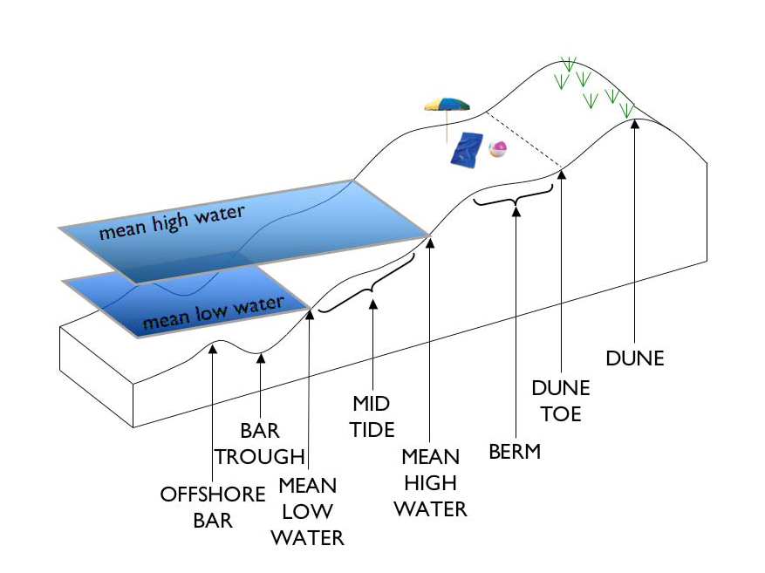
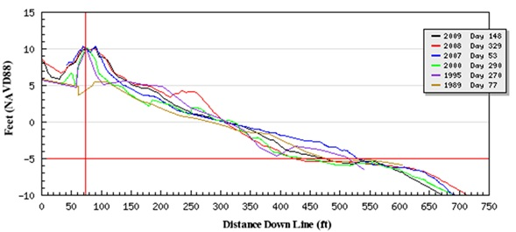
1) Characterize Native Beach Sediment
Minimum of 13 samples required on each transect
Note:
Recipient beach characterization not required if sand is coming from a navigation channel.
-20 ft.
2,400 ft.
Notes:
Beach Sediment Characterization 07H.0312(1):
Requires sampling and analysis for the purpose of capturing the three-dimensional spatial variability of sediment characteristics (grain size, sorting, & mineralogy)
Currently, Characterization of recipient beach is not required for the placement of sediment that directly that comes from and is completely confined to a maintained navigation or associated sediment basin(s) within the active nearshore beach or shoal system.
Shore-perpendicular transects are established for the purpose of collecting topographic and bathymetric surveying data using the following standards:
Minimum of 5 shore-perpendicular transects, evenly spaced throughout the entire project area
Each transect shall extend from the front-dune-crest seaward to depth of -20 feet or a distance of 2,400 feet measured from mean low water, whichever is in a more landward position.
Transect spacing shall not exceed 5,000 feet
Elevation data referenced in NAVD 88 feet
No fewer than 13 sediment samples shall be taken along each transect (beach profile)
total samples landward of MLW shall equal the total samples collected seaward of MLW
Depth increments from 6 feet to 20 feet, or a distance of 2,400 feet, whichever is in a most landward position.
At least 1 sample shall be taken from each morphodynamic zone where present (frontal dune, dune-toe, mid-berm, mhw, mid-tide, mlw, trough, & bar crest
Beaches that received nourishment prior to the effective date of this rule, shall characterize sediment that is consistent with current rules.

Slide 5
1
2
3
4
5
6
Notes:
(See page 263 of your packet)
References 15A NCAC 07H.0308(b) for the purpose of consistency with Dune rules
Section (1) Once the recipient beach has been characterized, that will serve as the baseline for subsequent beach fill projects
Section (1)(a) Meets S.L. 2017-10 (S131) Section 3.15 mandate to exempt sediment characterization of beaches receiving material from cape shoals.
Section (1)(b) Transect spacing reduced from 5,000 feet to one-half mile. Stakeholder feedback felt 5,000 was too much spacing.
Section (1)(d) Eliminates the required number of samples, but we’re retaining language that requires each morphodynamic zone to be sampled.
Section (1)(d) Eliminates the required number of samples from above and below MLW…just need at least one sample from each zone.

Slide 6
1
Notes:
(Page 263-264 of your packet)
Section (1)(h) Changes method of quantifying shell material > 3 inches (76 mm)
From 50,000 sq. ft. randomly selected area
To 3 square meter surface from each sample point along the transect between frontal dune toe to MLW
“Background value” = grand mean of all samples

Slide 7
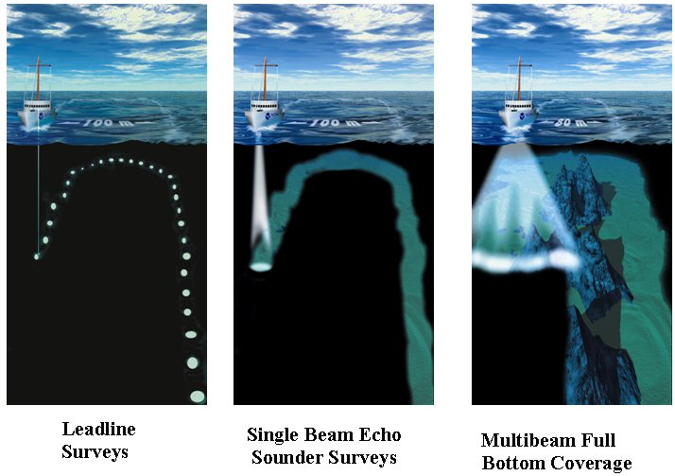
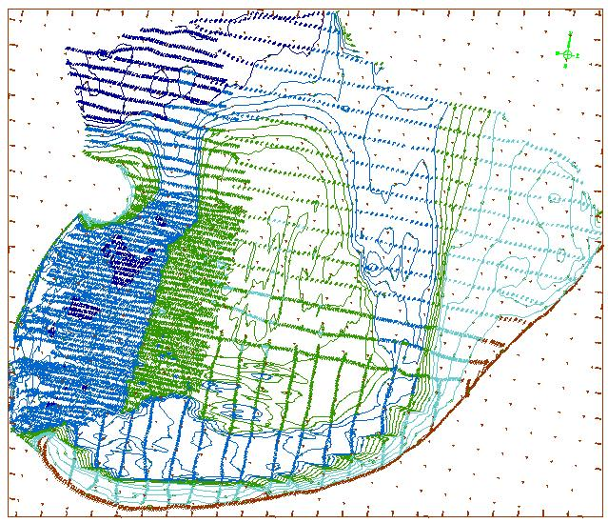
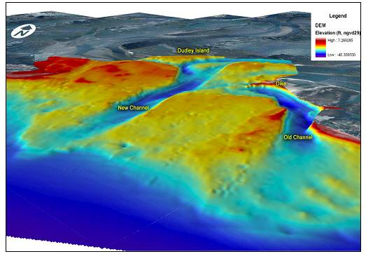
2) Characterize Borrow Area Sediment
Multibeam (swath) vs. Single-beam
Seafloor Imaging
http://what-when-how.com/gps/gps-applications-part-2/
http://www.nauticalcharts.noaa.gov/mcd/learnnc_surveytechniques.html
http://www.sgsurveys.ae/projects3.html
Notes:
Locating Potential Borrow Areas:
Single Beam – less coverage, less expensive
Multibeam (swath) – more coverage, can collect backscatter data at same time (don’t need to collect sidescan later), can be 15% more expensive than singlebeam.
Seafloor Surveys:
Shall measure elevation and cover 100% of submarine borrow site
Use survey-grade swath sonar (multibeam or similar technologies) in accordance with USACE standards for navigation and dredging.
Seafloor scanning without elevation component (sidescan sonar) shall also cover 100% of borrow site.
Shallow submarine areas (water depths less than 10 feet), may not require acoustic measurements, and alternatives for measuring elevation may be evaluated on a case by case basis.
For offshore dredged material disposal sites (ODMDS), only 1 set of imagery without elevation is required.
Sonar imaging without elevation is not required for borrow sites completely confined to maintained navigational channels, sediment deposition basins within nearshore, beach or shoal systems.

Slide 8
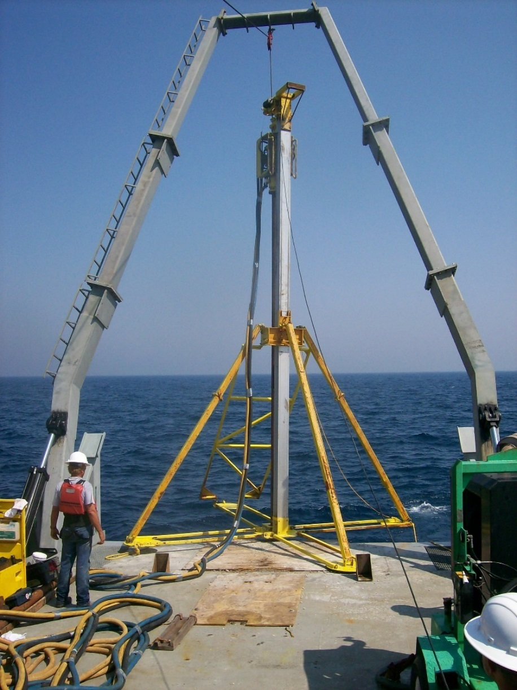
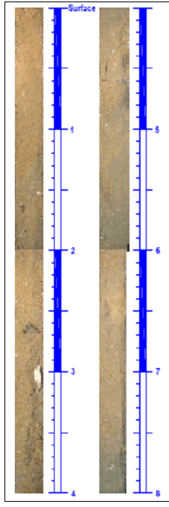
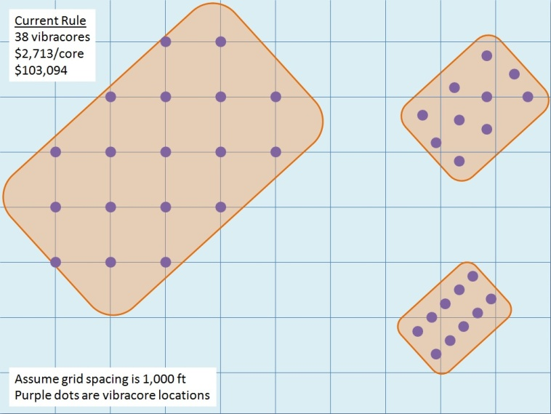
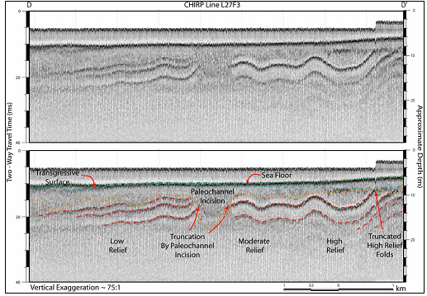
2) Characterize Borrow Area Sediment
Vibracores
Swath Bathymetry
multibeam
Core Sampling
Geophysical Subsurface
Sidescan Sonar
Notes:
Geophysical Imaging:
Shall be used to characterize each borrow site
Grids with line spacing not to exceed 1,000 feet.
ODMDS shall use spacing not to exceed 2,000 feet
Sediment Sampling of Borrow Site:
Shall use a device no less than 3 inches (76mm) wide.
No fewer than 5 evenly spaced cores, or 1 core per 23 acres (grid spacing of 1,000 ft.), whichever is greater.
Areas completely confined to maintained navigational channels or sediment deposition basins within the active nearshore, beach or inlet shoal system, shall use no fewer than 5 evenly spaced vertical samples per channel or sediment basin, or sample spacing of no more than 5,000 linear feet, whichever is greater.
2 sets of sampling data (with at least 1 dredging event in between) from maintained navigational channels or sediment deposition basins within the active nearshore beach or inlet shoal system, may be used to characterize sediment for subsequent nourishment events from those areas if the sampling results are found to be compatible as define in rules.
In submarine borrow sites other than maintained navigational channels or associated sediment deposition basins within the active nearshore system where water depths are no greater than 10 feet, geophysical data of and below the seafloor are not required, and sediment sample spacing shall be no less than 1 core per six acres, or grid spacing of 500 feet.
Vertical sampling shall penetrate to a depth equal to or greater than the permitted dredge or excavation depth.

Slide 9
1
2
3
Notes:
(Page 264)
Section (2) Meets S.L. 2017-10 (S131) Section 3.15 mandate to exempt sediment characterization of borrow areas within the cape shoal systems (Frying Pan at Cape Fear, Lookout at Cape Lookout, Diamond Shoals at Cape Hatteras)
Section (2)(b) If sampling method is consistent with rules, this will permit the use of historical data
Section (2)(c) Sample borrow site 100% or the maximum extent practicable. It’s worth noting that for new borrow sites, Cultural Resources already requires 100% sampling.

Slide 10
1
2
3
Notes:
(Page 265)
Section (2)(d) Eliminates grid spacing requirement
Section (2)(e) Simplifies core spacing requirement at 1 every 23 acres. This gives flexibility to applicant or their contractor to design their own sampling protocol.
Section (2)(e) further simplifies core sampling and spacing requirements to allow more flexibility and efficiency – especially in the event of sampling challenges. (i.e.. Highly consolidated sediment where a core cannot penetrate.

Slide 11
1
Notes:
(page 265)
Current Section (2)(f) Eliminates specifics related to sampling and spacing in ODMDS (offshore dredge material disposal sites)
Thought being that material placed here is beach quality, therefore this requirement in rule is not required.

Slide 12
3) Determine Sediment Compatibility
76
gravel
5%
“Gravel”
+15% CaCO₃
4.76
granules
10%
“Granular”
2
1
North Topsail Example | Borrow Area
Mean Grain Size (mm) | 0.21
Phi Sorting | 1.07
Silt Percentage (%) | 6.82
Volume (cy) | 7,581,634
Grain Size (mm)
Compatibility Threshold Category
(weight % allowable above native beach)
0.50
No
Restrictions
sand
0.25
Example: CP&E, 2006
0.125
0.0625
silt
5%
“Fine”
Notes:
Sediment Compatibility:
Sediment grain size defined as:
Fines: less than 0.0625 mm
Sand: greater than or equal to 0.0625 mm, less than 2 mm
Granular: greater than 2 mm, less than 4.76 mm
Gravel: greater than 4.76 mm, less than 76 mm
% by weight of each of the 4 grain sizes shall be reported for each sample
A composite of the simple arithmetic mean for each of the 4 grain sizes shall be calculated for each transect
A grand mean shall be established for each of the 4 grain categories by summing the mean for each transect and dividing by the total number of transects.
Calcium Carbonate: shall be calculated from a composite of all sediment samples along each transect.
“Native Calcium Carbonate” is defined by the grand mean calculated by summing the average percentage by weight calcium carbonate for each transect and then dividing by the number of transects.
For beaches on which fill activities have occurred prior to this rule, DCM shall consider visual estimates of shell content as a proxy for weight percentage.
Sediment and shell material greater than 76 mm in diameter, observable on the surface (between mlw & frontal dune toe) shall be calculated for an area of 50,000 sqft within the project boundary. This area is considered a representative sample for the entire project area, and referred to as the “background” value.
Sediment Compatibility Defined:
Considered compatible if the average percent by weight of fine-grained sediment (less than 0.0625 mm) is less than 10 percent.
Average percentage by weight of fine-grain sediment (less than 0.0625 mm) in each borrow site shall not exceed the average percentage by weight of fine-grained sediment of the recipient beach characterization plus 5%.
Average percentage by weight of granular sediment (greater than or equal to 2 mm and less than 4.76 mm) in a borrow site shall not exceed the average percentage by weight of coarse-sand of the recipient beach characterization plus 10%
Average percentage by weight of gravel (greater than or equal to 4.76 mm and less than 76 mm) in a borrow site shall not exceed the average percentage by weight of gravel-size sediment for the recipient beach characterization plus 5%.
Average percentage by weight of calcium carbonate in borrow site shall not exceed the average percentage by weight of calcium carbonate of the recipient beach characterization plus 15%
Techniques that take incompatible sediment within a borrow site and make it compatible with that of the recipient beach characterization shall be evaluated on a case by case basis.
Sediment excavation or dredging shall not exceed the maximum depth of recovered core at each coring location.

Slide 13
1
Notes:
(page 266)
1. Section (3) Clarifying rule language to define who can certify sediment compatibility by referring to NC General Statutes 89C & 89E where it defines professional or licensed engineer, land surveyor, and geologist.

Slide 14
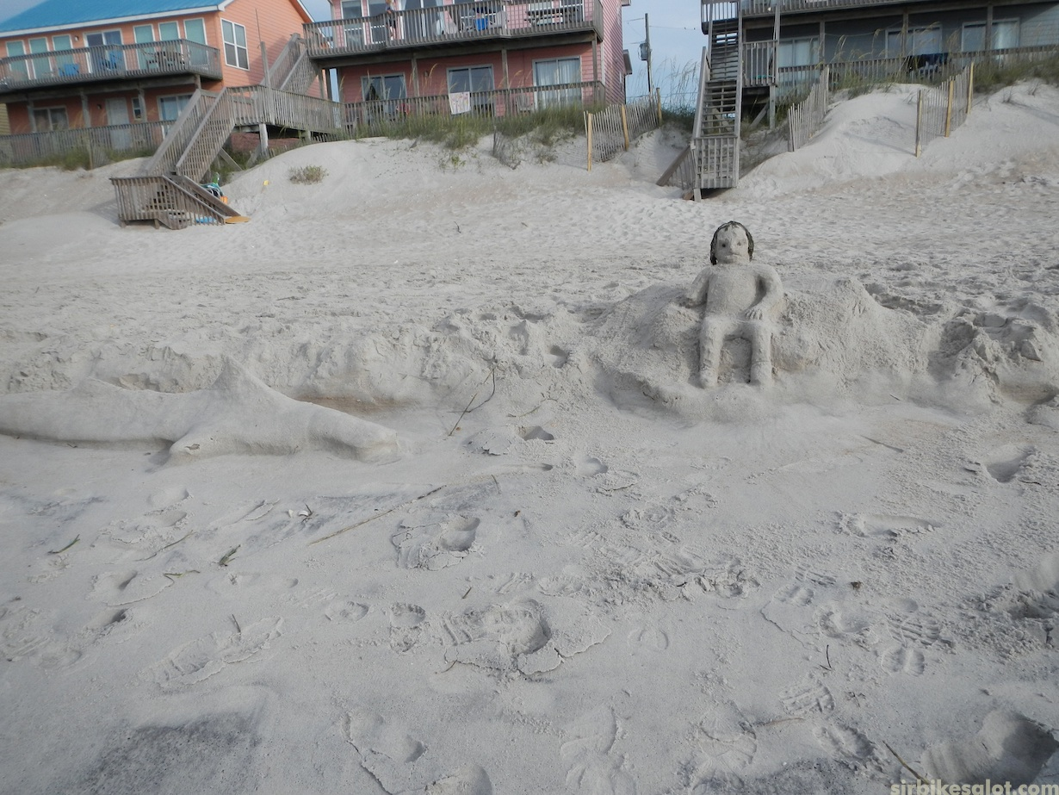
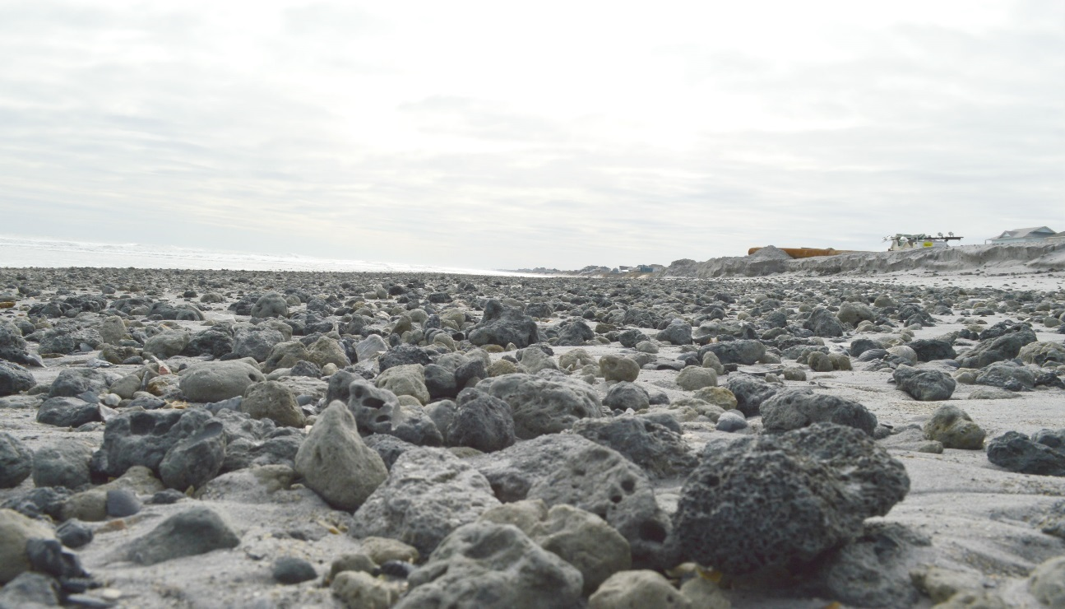
4. Excavation and Placement of Sediment
Native beach
Native beach
“You’ll know it when you see it”

Slide 15
1
2
3
Notes:
(page 266)
Section (4)(a) Removes requirement that excavation of sediment is limited to depth of core sample
New Section (a) Rule clarification – changing “time” to “any moratorium” for protection of endangered or threatened species; and clarifies “agency”
Current Section (c), New Section (b) Rule clarification referring to large shell material (>3 inches) - that removal action shall occur in the event that twice the background value of incompatible material is placed on the beach.

Slide 16
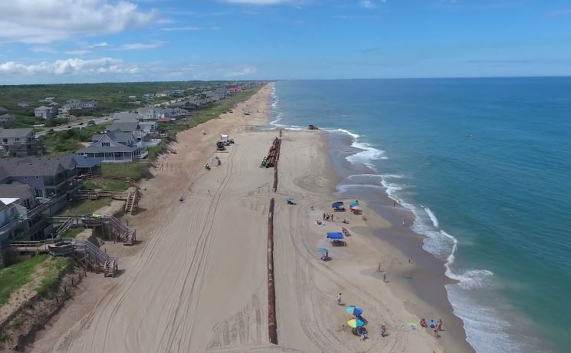
Sediment Criteria: Proposed Amendments Discussion
Ken Richardson
Shoreline Management Specialist
NC Division of Coastal Management
Ken.Richardson@ncdenr.gov
Stakeholders:
Greg “Rudi” Rudolph – Carteret County Shore Protection
Layton Bedsole – New Hanover County
Spencer Rogers – NC Sea Grant
Chris Freeman – Geodynamics
Ken Wilson – APTIM
Johnny Martin – Moffatt & Nichol
Notes:
DCM staff assessment of the sediment criteria information provided by project applicants requires a significant amount of time to review, and is typically delivered in several volumes of technical data. Eliminating the rigid protocol in favor of a simpler process where the project’s consultant/engineer designs a sampling protocol that assures sediment compatibility between the beach and borrow area will significantly reduce the amount of effort on the part of DCM’s regulatory staff in reviewing this aspect of beach nourishment proposals.
The sampling protocol associated with the sediment criteria rules is highly precise with regards to sample design, spacing, numbers of cores, etc. This precision can limit flexibility in sample design, opportunities, and can also limit abilities of communities to pursue small projects or respond to nourishment opportunities in a rapid fashion. The sampling protocol can severely limit applicants ability to use existing data. For example, during the development of the Town of Nags Head project, they had to take extra core samples over and above what the USACE had previously taken during the USACE’s work on a possible 50- or 30-year CSDR project.
Even with the detailed sampling protocol language as it is currently written, an applicant can still satisfy the technical criteria, but still have unsuitable sediment placed on the beach (including rock that was missed during the sampling), and argue that they met the sampling standards, and therefore are not in violation.
Additionally, the current sampling protocol may eliminate the ability of communities to take advantage beneficial use projects that present themselves late in the planning process (i.e. too late to be able to hire a firm and or mobilize to take extra samples required by rules).
Could limit ability to alter the recipient beach at the last moment in response to a recent erosion event.
DCM’s Proposal:
Keep the standards for the various grain sizes such as the percentage of fines shall not exceed more than 5% over recipient beach - but use language similar to that in the terminal groin legislation to require the applicant’s consultant/engineer to attest to or certify sediment compatibility. For example, “Compatibility with these sediment standards shall be documented and certified by a professional engineer licensed to practice pursuant to Chapter 89C of the General Statutes. (or Geologist GS 89E)
Benefits of proposal:
By reducing sampling protocol in rule requirements, will allow professionals to design a project to meet the needs of the applicant.
Compatibility between the borrow site and the recipient beach are ensured, but with the burden and flexibility for establishing the sampling protocol placed on the project’s applicant. Which would allow staff to devote more time to the environmental review components of the project and possibly decreasing the time of permit issuance.
Should the Commission want to support these proposed amendments, staff will continue the rule-making process and begin work on fiscal analysis.

