Slide 1



Notes:
Our Division Mission is to protect and improve North Carolina’s environment and economy through:
Providing customer-focused assistance,
Facilitating a greater understanding of environmental permitting and compliance,
Encouraging wider adoption of sustainable practices,
Promoting increased recycling and reduced waste disposal and,
Reducing impacts from resource consumption.
The division is comprised of three sections: CBAS, WRP, and EAC.

Slide 2
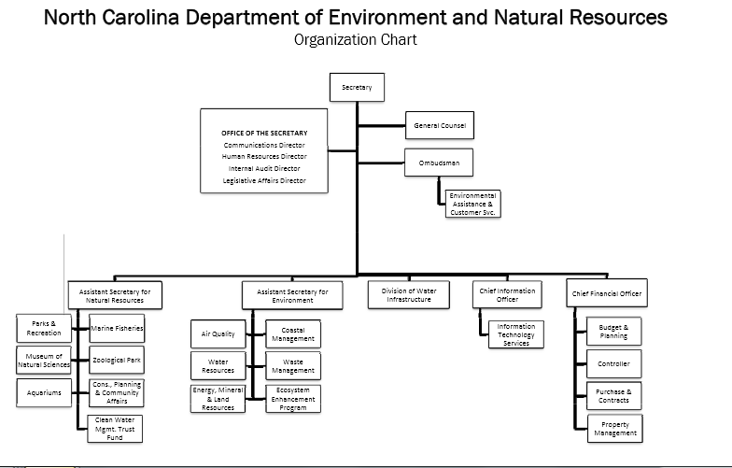
Department of Environment and Natural Resources
Joe Harwood
DEACS

Slide 3
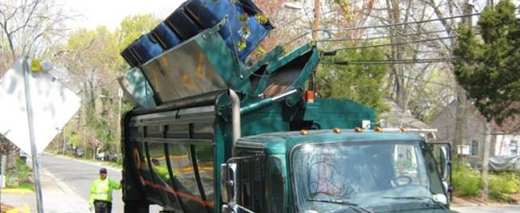
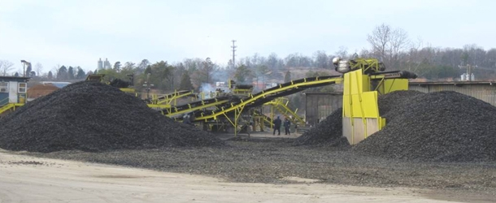
Community and Business Assistance Section (CBAS)
Technical assistance for local governments, recycling businesses and solid waste generators on waste reduction, recycling, and composting, including operational and financial assistance
Recycling is Picking Up in North Carolina
Old Tires Get New Life
Notes:
Picture caption:
Used tires collected by North Carolina's counties are used in civil engineering, industrial, athletic field, paving and landscaping applications as well as fuel for kilns, mills and power plants
Curbside and multifamily recycling collection provides citizens with services that help prevent the disposal of materials important to North Carolina’s economy.

Slide 4
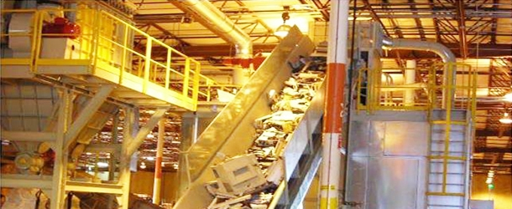
Recycling Business Assistance Center (RBAC)
Offers technical assistance to new, existing or relocating recycling businesses
Provides market research
Recycling business development grants
Promotes need to purchase products with recycled
Con
Electronics Recycling Becoming Big Business
Notes:
End-of-life electronics processing is becoming more automated as the recycling infrastructure is developed.

Slide 5

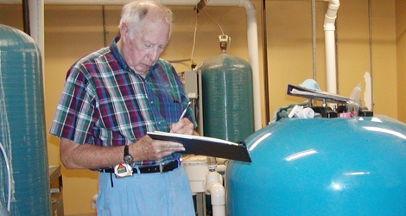
Provides consulting services to businesses and institutions to identify cost-savings through
  water efficiency audits
  energy efficiency assessments
  solid waste reduction measures
  Lean and Green reviews
Staff - highly experienced retired engineers and scientists
Over $60.2 million in client cost saving
Services are confidential; provided at no cost to client; supported through government and utility-sponsored grants

Slide 6
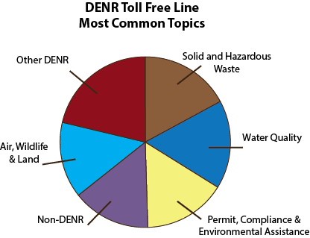
Environmental Assistance
Center
Regional One-stop Permit Coordinators/Environmental Assistance Coordinators (7 DENR Regional Offices)
Small Business Environmental Assistance
Technical Assistance Staff
DENR Customer Service Hotline:
Toll free (877) 623-6748
DEACS staff answer over 5000 calls/year on DENR hotline
Notes:
The Environmental Assistance Center is available for on-site assistance that addresses air emissions, water pollutants and solid and hazardous wastes.

Slide 7
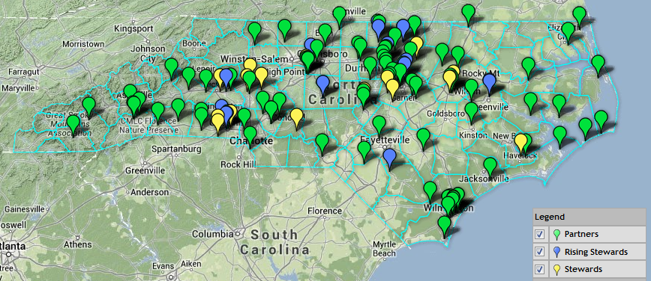

Environmental Stewardship Initiative (ESI)
ESI is a DENR recognition program for business, industry and local/state government that strive for superior environment performance
Celebrating 11 years of helping facilities go beyond regulatory requirements
Provide training and technical assistance
Currently there 140 member sites
  Stewards: 20
  Rising Stewards: 14
  Partners: 106
Reported savings of:
  Over 3 million tons of solid and hazardous waste
  Realized cost savings of over $55.4 million
Notes:
Within DEACS there are two programs that provide state-level recognition for environmental performance. Membership in these two programs allows access to training, networking events and a point of contact for our divisional resources.

Slide 8

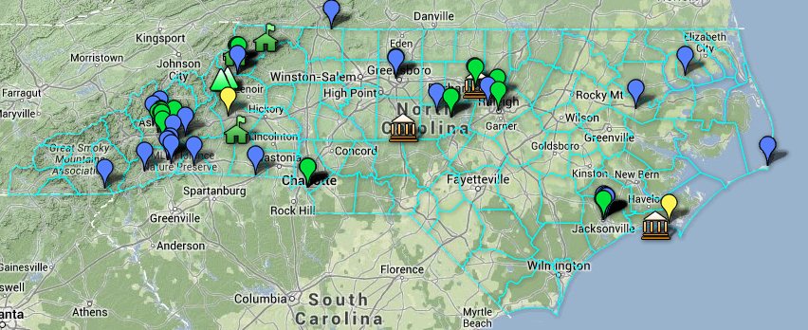
NC Green Travel is a free recognition program promoting robust economic growth and environmental stewardship in the travel and hospitality sector.
There are currently over 70 members in NCGreenTravel!

Slide 9
Resources:
Lean/Green Mfg. Trainings
RMD/WT/BT
Solid Waste Audit Assistance
Recycling tax credits (DSW)
DEACS
EAC
WRP/USI
Company Inc.
Process/Product
Processer/ Hauler
Markets
Equipment
CBAS
“Waste”
Employees
Potential Path:
“Dumpster dives”/Waste audit
Metrics
Work with Supply Chain
ZWTL
Implement Lean/Green tools
Recycle/Compost
Contract waste logistics company
WTE
Recycler Resources:
Grants
Technical Assistance
Notes:
Whether your organization is new to the state or established, there are services and staff members within DEACS and DENR that can provide varying levels of assistance to help you on your path to ZWTL.

Slide 10
DEACS Contacts
Waste Reduction Partners
  Terry Albrecht: terry.albrecht@ncdenr.gov 828 251-7475
Community and Business Assistance Section
  Scott Mouw: scott.mouw@ncdenr.gov 919 707-8114
Environmental Assistance Center
  Division Director: Ted Bush
  Ted.bush@ncdenr.gov
  919 707-8206
DEACS Outreach Coordinator
  Jamie Ragan: jamie.ragan@ncdenr.gov
  919 707-8141
ESI
  Scott Fister
  scott.fister@ncdenr.gov
  919 707-8131
Zero Waste Website:
ncesi.org/web/deao/ea/zerowaste
Notes:
END

Slide 11
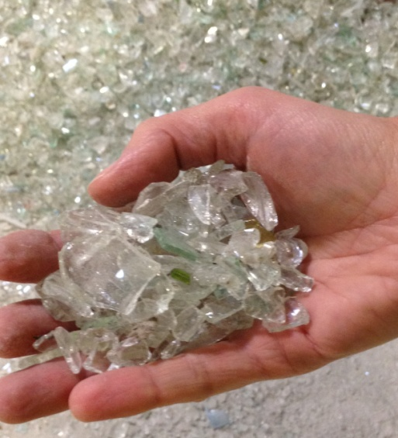
Recycling Markets
Recycling Markets Directory: continuously updated, fully searchable on-line directory that lists more than 600 companies that collect, transport, broker, process or remanufacture recovered materials in NC www.p2pays.org/dmrm
Waste Trader: marketplace for discarded
or surplus materials and products
  www.ncwastetrader.org
Biomass Trader: convenient, free online
waste exchange for surplus and waste biomass
www.ncbiomasstrader.org

Slide 12
North Carolina Recycling Tax Treatment Applies to:
http://portal.ncdenr.org/web/wm/sw/taxcert
Real and personal property tax
Corporate state income tax
Franchise tax on domestic and foreign corporations
Division of space is allowed
Part-time use of equipment is not

Slide 13



Recycling Outreach Campaigns
Contact: Heather Cashwell at 919-707-8127

Slide 14
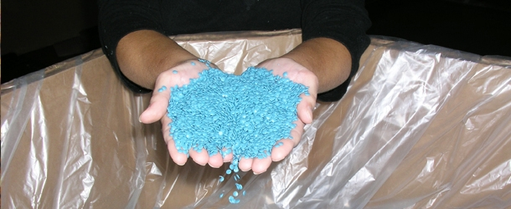
CBAS: Recycling Assistance
Recycling Grants
Recycling Business and Local Gov’t Assistance
Technical Assistance & Educational Outreach
Recycling Market Development

Slide 15
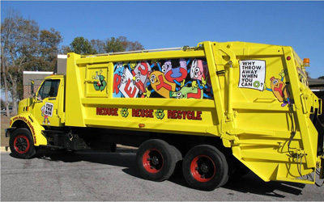
Local Government Technical Assistance Group
Team of analysts with solid waste and recycling backgrounds in both public and private sectors
Financial assistance and grant programs
Technical assistance and program support
Recycling education and outreach tools
Directory of local solid waste contacts

Slide 16
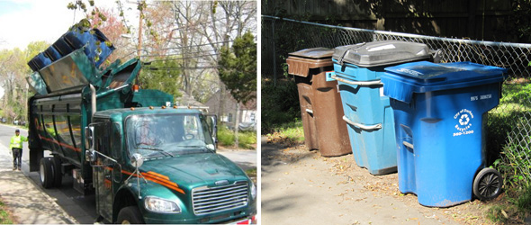
Grants for Governmental Agencies
Community Waste Reduction and Recycling Grant
  Contact: Rob Taylor at 919-707-8139
Recycling Roll-out Cart Grant Program
  Contact: Joseph Fitzpatrick at 919-707-8121
Abandoned Manufactured Homes Grant Program Application Guidelines
  Contact: David Hance at 919-707-8122
Mercury Products Recycling Grant
  Contact: Joseph Fitzpatrick at 919-707-8121
State Agency Grants
  Contact: Matt Ewadinger at 704-264-2980

Slide 17
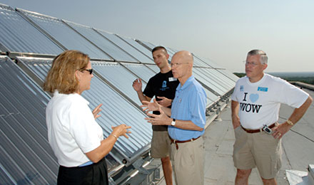
Utility Savings Initiative
Provides assistance to public facilities:
  cut utility costs
  improve energy management
  examine facility upgrades through performance contracting process
Avoided utility costs of more than $553 million
Progress towards 30% energy reduction goal by 2015
Stretch goals through states commitment to Better Building Challenge
Contact: Len Hoey at 919-707-9250

Slide 18
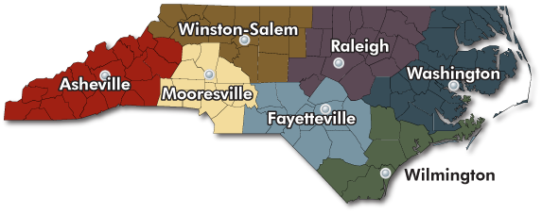
Regional Offices
Asheville Regional Office
Alison Davidson
20Highway 70
Swannanoa, NC 28778
828/296-4500
FAX 828/299-7043
Fayetteville Regional Office
David Lee (Raleigh)
Systel Building
225 Green St., Suite 714 ,
Fayetteville, NC 28301-5094
910/433-3300
FAX 910/486-0707
Mooresville Regional Office
Patrick Grogan
610 East Center Ave.
Mooresville, NC 28115
704/663-1699
FAX 704/663-6040
Raleigh Regional Office
David Lee
3800 Barrett Drive
Raleigh, NC 27609
919/791-4200
FAX 919/571-4718
Washington Regional Office
Lyn Hardison
943 Washington Square mall
Washington, NC 27889
252-946-6481
FAX 252-975-3716
Wilmington Regional Office
Cameron Weaver & Janet Russell
127 Cardinal Drive Extension
Wilmington, NC 28405
910/796-7215
FAX 910/350-2004
Winston-Salem Regional Office
Patrick Grogan
585 Washington Street
Winston-Salem, NC 27107
336/771-5000
FAX 336/771-4631
Notes:
Permit scoping meetings typically comprised of collection of local, state and federal resource staff as well as clients and consultants; purpose is to bring all permitting representatives to table to discuss possible permits and any foreseeable obstacles

