Slide 1


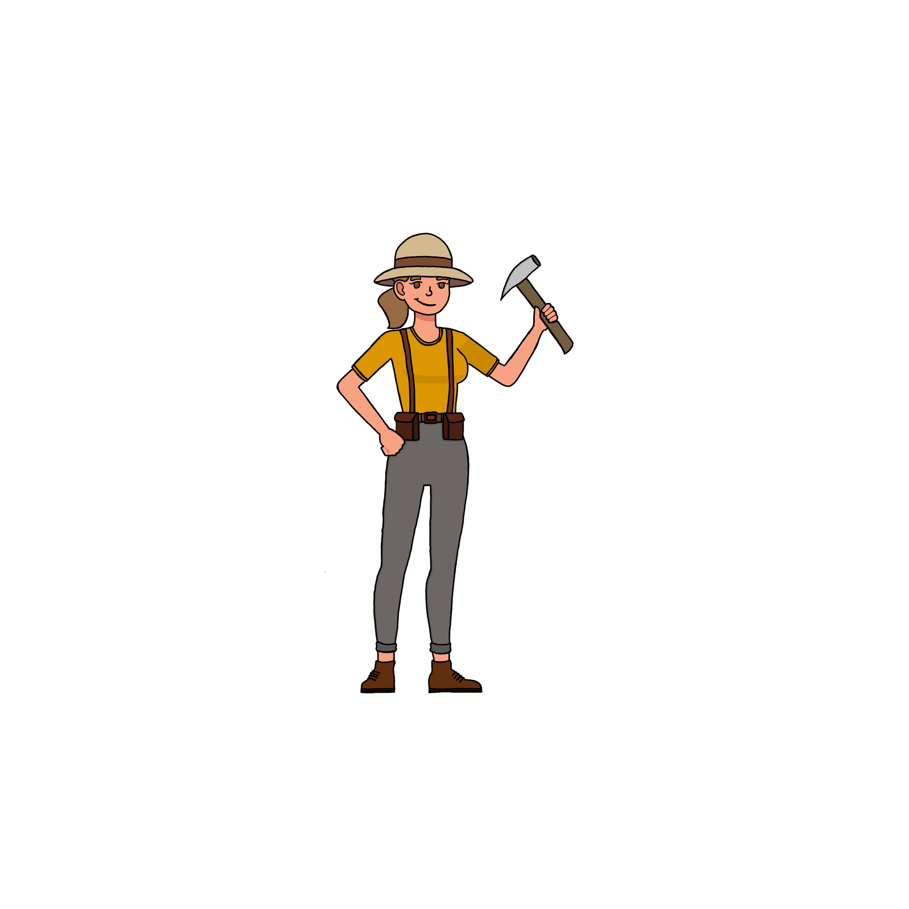

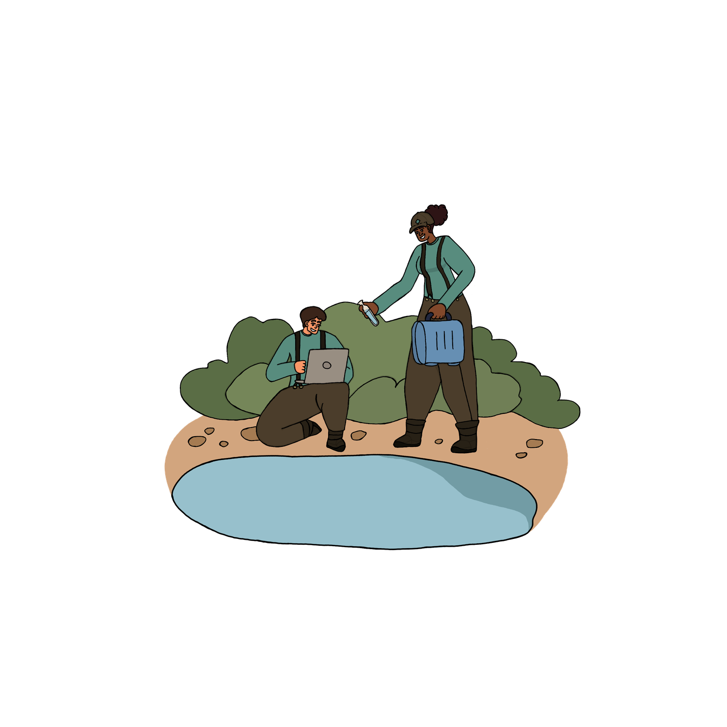
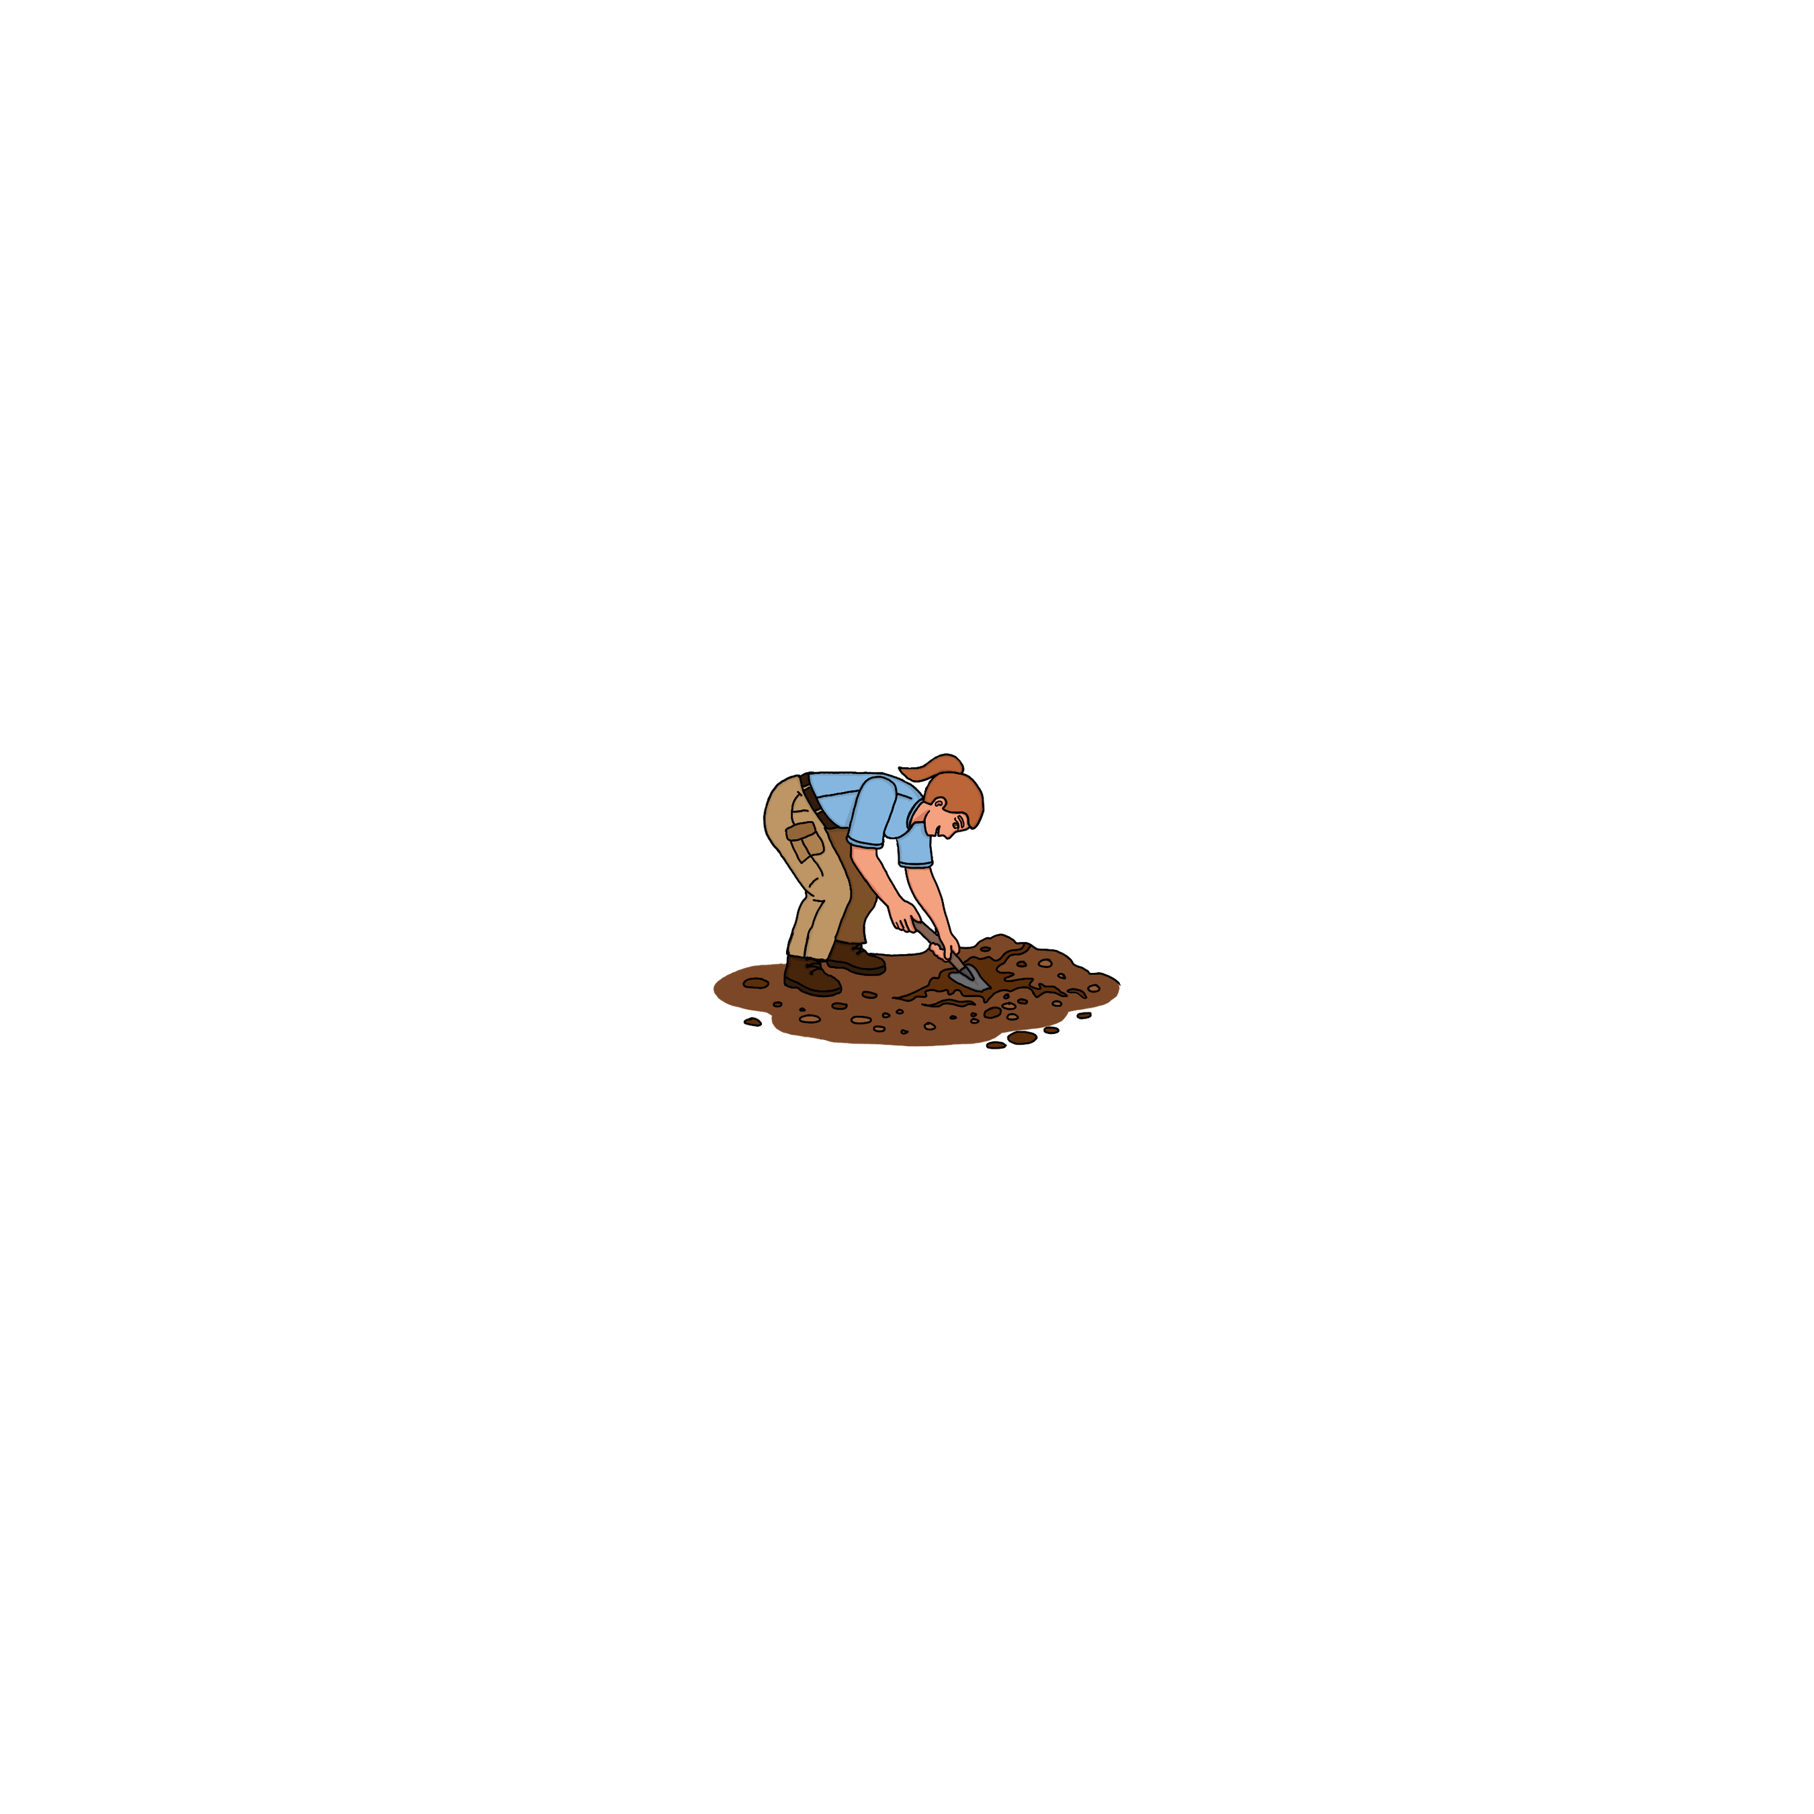


The Erosion Patrol
Showdown!

Slide 2
How to Play
1
There can be as many as five people (or teams) playing.
5
Whether a team gives a correct answer or not, it's the next team's turn to play.
People (or teams) take turns choosing a category and a point value.
6
Click the “Back to Game Board” button on the slide to return to the main board.
2
Each team has one minute to respond with their answer.
7
The game continues until all questions in all categories have been chosen and answered correctly. The team with the most points wins!
3
4
If the answer is correct, they earn points.
If not, the question stays on the board.
8
Now, let the game begin!
Note to teacher: Feel free to edit the instructions as needed.

Slide 3

eROSION pATROL sHOWDOWN!
Soil Superstars
Erosion in Motion
Water Watch
BMPs to the Rescue
Erosion Patrol HQ
100
100
100
100
100
200
200
200
200
200
300
300
300
300
300
400
400
400
400
400
500
500
500
500
500

Slide 4
Name one of the three types of soil texture.
Back to gameboard

Slide 5
What is soil
made of?
Back to gameboard

Slide 6
How long does it take to form one inch of topsoil?
Back to gameboard

Slide 7
True or False:
Soil is a threatened natural resource.
Back to gameboard

Slide 8
Why is soil conservation important?
Back to gameboard

Slide 9
What is erosion?
Back to gameboard

Slide 10
Name two natural causes of erosion.
Back to gameboard

Slide 11
What is splash erosion?
Back to gameboard

Slide 12
Which erodes more: grass-covered or bare soil?
Back to gameboard

Slide 13
Why should bare soil be covered as soon as possible?
Back to gameboard

Slide 14
What is runoff?
Back to gameboard

Slide 15
What does sedimentation mean?
Back to gameboard

Slide 16
What is nonpoint source pollution?
Back to gameboard

Slide 17
Why is turbidity a bad thing?
Back to gameboard

Slide 18
How are erosion and water quality connected?
Back to gameboard

Slide 19
What is ground cover?
Back to gameboard

Slide 20
How can you prevent splash erosion?
Back to gameboard

Slide 21
Name three types of BMPs.
Back to gameboard

Slide 22
What is the difference between permeable and impermeable surfaces?
Back to gameboard

Slide 23
What are BMPs, and why are they important?
Back to gameboard

Slide 24
Name one Erosion Patrol profession.
Back to gameboard

Slide 25
Name some tools the Erosion Patrol uses.
Back to gameboard

Slide 26
What is a geologist?
Back to gameboard

Slide 27
What information could an Erosion Patrol member record in a field notebook?
Back to gameboard

Slide 28
As an Erosion Patrol Scout, what can you do to help prevent erosion?
Back to gameboard

