Slide 1
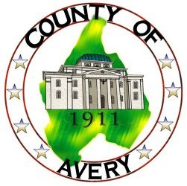
Avery County
Avery County Planning Department
Erosion and Sedimentation
Local Program
March 28 & 29, 2017

Slide 2
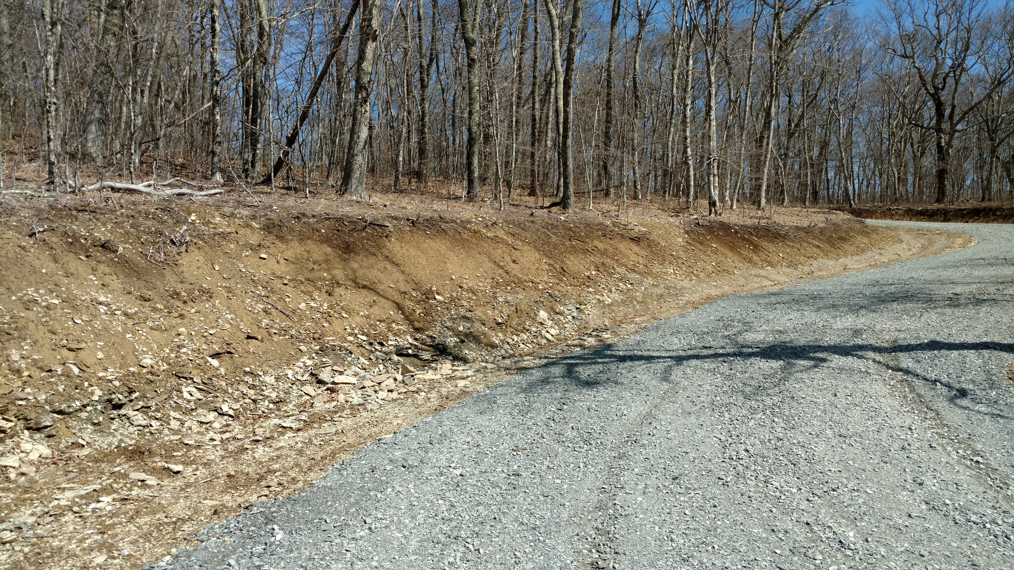
Avery County Bonding Projects:
To Bond or Not To Bond?
Reasons for Bonding:
Guarantee a certain level of work to be completed for said project.
To protect against the insolvency of a developer of contractor.

Slide 3
Avery County Bonding Determination:
Qualifying Projects
The major determining factor in requiring a bond is how much equity does the owner or owners already have invested in a project or industry.
This may also fall under the category of “vested rights”

Slide 4
Avery County Bonding of Commercial/P.U.D’s/Residential
Major residential subdivisions (10 lots or more)
Plan unit developments: Condominiums, apartments, townhomes (more than 8 units)
Commercial Projects: Shopping centers, retail or wholesale stores, greater than 12,000 sq.ft., amusement parks.
Note: Greater than 10 acres disturbed area for commercial projects.

Slide 5
Avery County Bond Determination:
Bonds are determined by the:
Planning Board
Board of Adjustments
Appeals are to be petitioned to the Board of County Commissioners

Slide 6
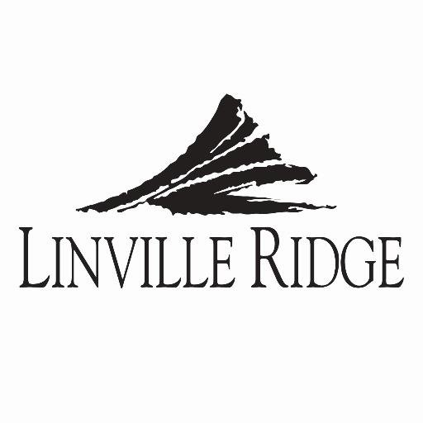
Avery County Exemptions to Bonding Requirements:
Equity Securities:
Existing development or commercial activities in the county (real property)
Letters of credit issued to Avery Planning Department

Slide 7
Avery County Surety Bonds:
A surety bond is defined as a contract among at least three parties: the obligee: the party who is the recipient of an obligation. the principal: the primary party who will perform the contractual obligation. the surety: who assures the obligee that the
The principal: developer or project owner
The obligee: county, recipient of the obligation
The surety: the company that issues the surety or performance bond (insurance company)

Slide 8
Avery County Focus:
The Avery County Planning Departments primary focus is to ensure that the site will not be left as rough grade or unvegetated, in the event the developer becomes insolvent.

Slide 9
Avery County Financial Guarantees:
Avery County sets a definite amount for the surety bond. This amount normally ranges from 10% to 50% of the total project cost.
We want to be assured that the site can be reclaimed and remediated upon any unfortunate event, bankruptcy or insolvencies.
Surety and performance bonds can place a large financial burden on developers and contractors and should be administered with open discretion for each project that is being considered.

Slide 10
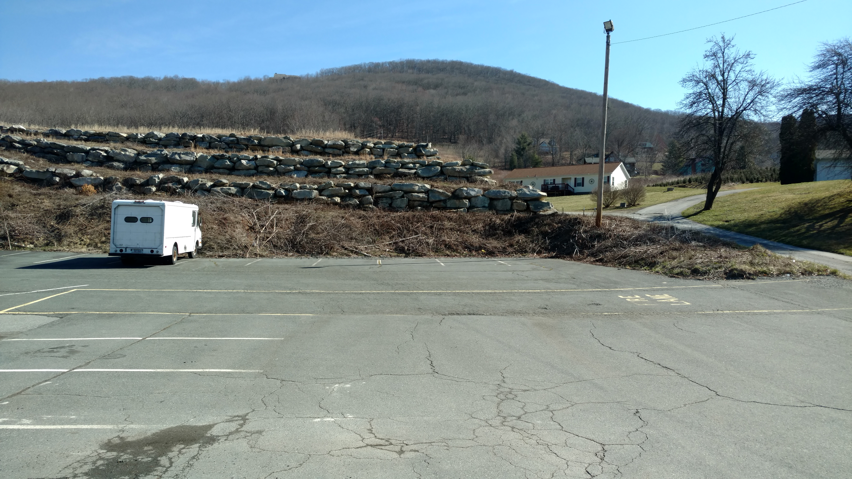
Avery County Financial Guarantees continued..
Many times, the developers financial statements can address the liability being undertaken.

Slide 11
Avery County Limited Liability Corporations:
Limited liability corporations with very little assets value should be evaluated closely for the risk of which is about to be undertaken.
Some developers have signed personal guarantees for their corporations.

