Slide 1
Department of Environmental Quality
Annette Lucas, PE
What’s New In Stormwater
2017

Slide 2
The New MDC
The New Design Manual
The New Application Forms
The New Credit Manual

Slide 3
How the MDC Came to Be…

Slide 4
2013 Legislative Mandates
MDC & Fast Track: § 143-214.7B requires DEQ to work with stakeholders to develop Minimum Design Criteria and a Fast-Track Permitting Process.
Rules Review & Re-Adoption: § 150B-21.3A directs state agencies to review and update their rules every 10 years.
Department of Environmental Quality

Slide 5
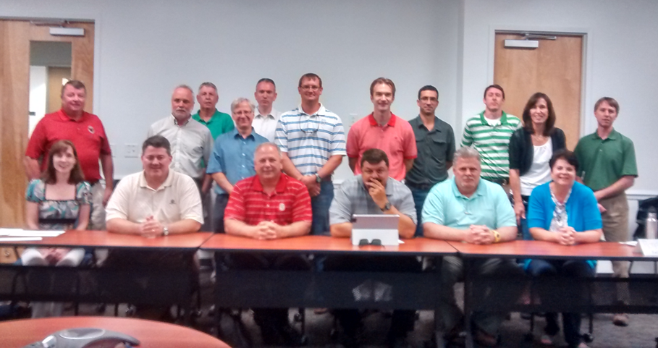
The MDC Team
Engineering/design community (8)
Home Builder’s Association (1)
Construction (1)
Local government (4)
Environmental Group (2)
Landscape Architect (1)
Academia (2)
Soil Scientist (1)
DOT (1)
DEQ(4)

Slide 6
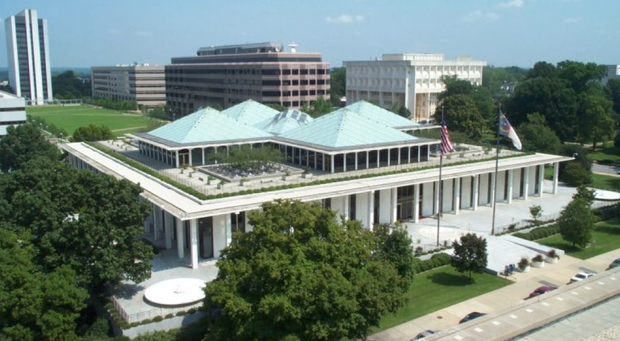
Legislature defines “MDC”
All-inclusive list of requirements for siting, design, construction, and O&M for the fast-track stormwater permitting program.

Slide 7
MDC to Cover Whole State

Slide 8
New Lingo!
-------
SCM
BMP
--------------------------
Primary & Secondary SCMs
85% TSS Removal

Slide 9
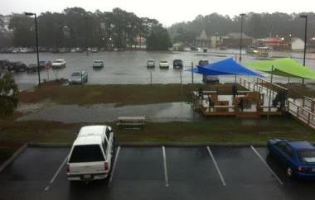
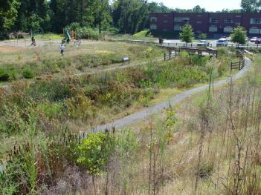
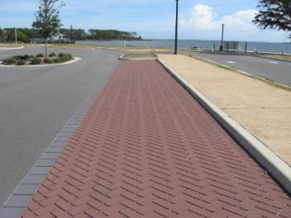
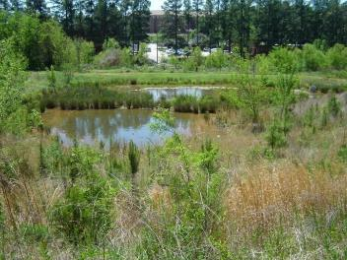
WHERE are the MDC?
15A NCAC 2H .1050: MDCs for all SCMs
.1051 through .1062: MDCs for individual SCMs
.1052 Bioretention
.1055 SW Wetland
.1058 Permeable Pavement
.1054 Wet Pond
.1051 Infiltration
9

Slide 10
Important Dates
The MDC went into effect on January 1, 2017.
Updated Stormwater Design Manual:
Partial draft public posted on 1/4/17
Complete draft on 3/31/17

Slide 11
How have SCM designs changed?
In general:
Shorter list of requirements
Requirements more objectives-based.
More flexibility & responsibility for designers.
Had to be included in the rules.
Some highlights of the updates . . .

Slide 12
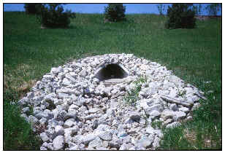
.1050 General MDC (5) Erosion Protection
Inlet(s) and outlet shall be protected from erosion.
Department of Environmental Quality

Slide 13
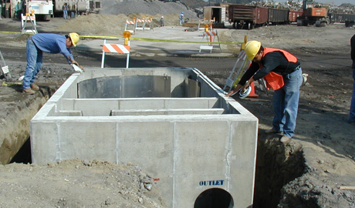
.1050 General MDC (6) Excess Flows
Include an overflow device for volumes in excess or the treatment volume or the peak attenuation volume.
Department of Environmental Quality

Slide 14
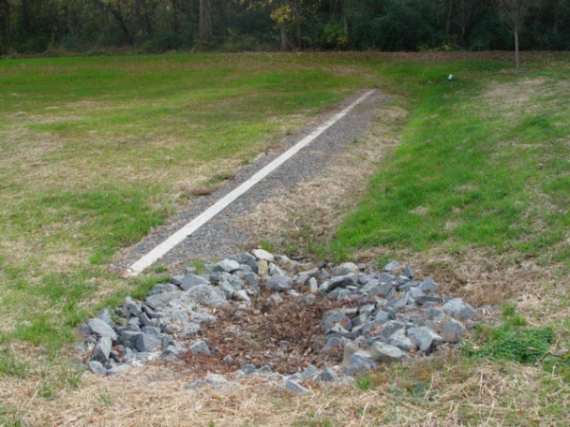
No more level spreaders downslope of wet ponds & infiltration systems!

Slide 15
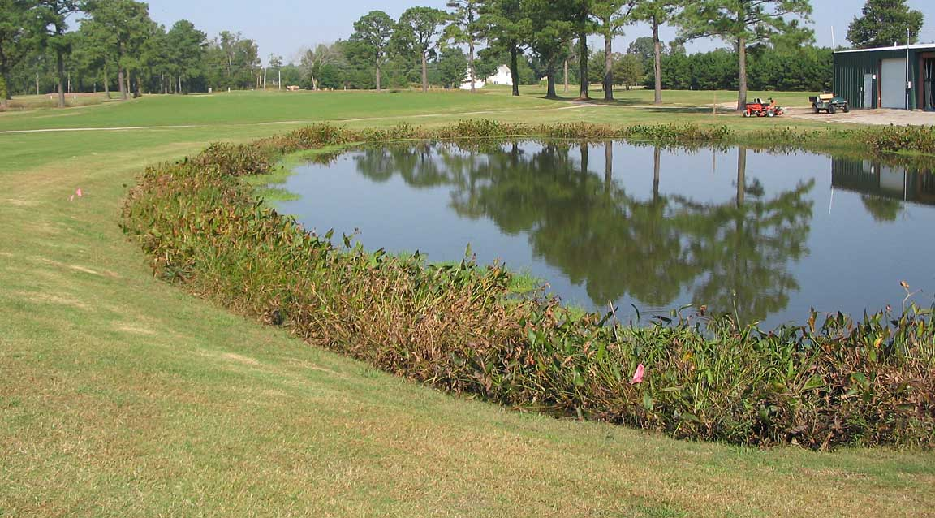
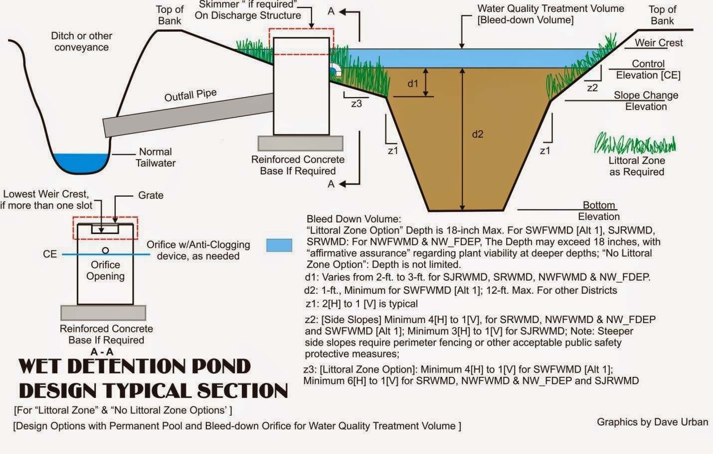
.1053 MDC for Wet Ponds
A
Forebay
Main Pool
Outlet
A
Exclude shelf from average depth calcs.
Vegetated shelf reduced to 6 feet.
DV
2.5*DV
Hydraulic Retention Time Method

Slide 16
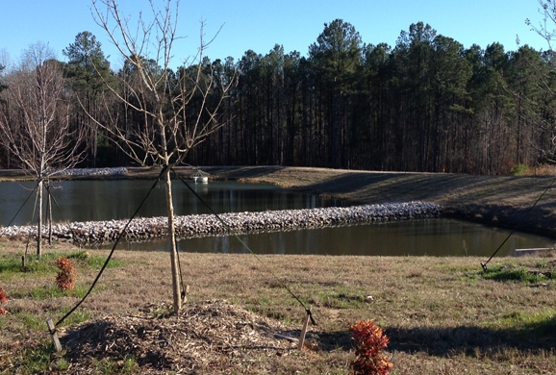
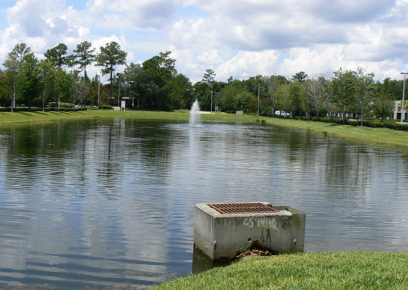
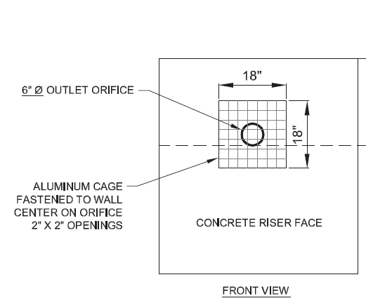
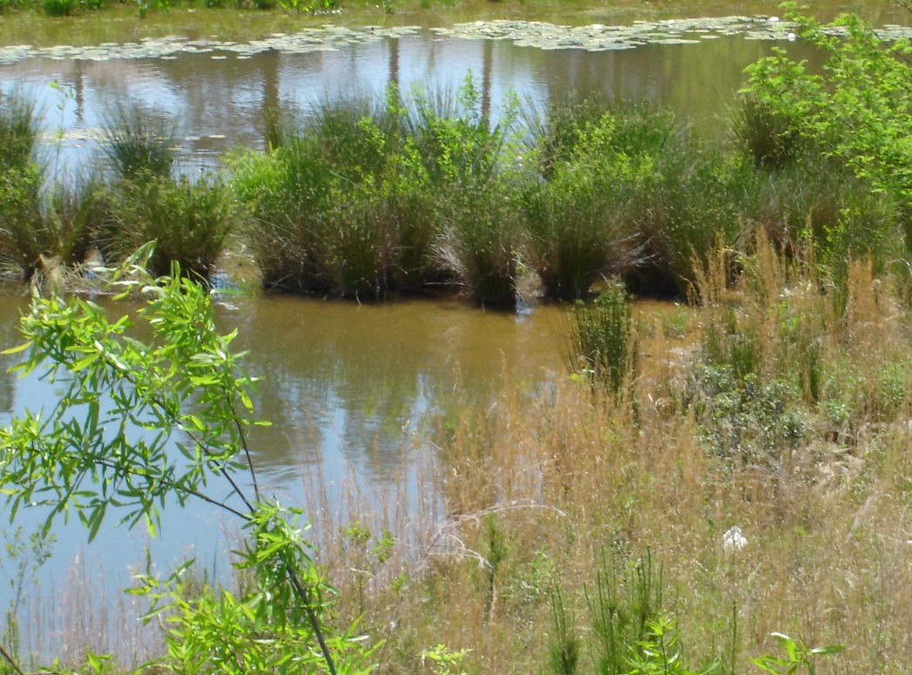
.1053 MDC for Wet Ponds
Forebay 15-20% of main pool.
Fountains shall not resuspend sediment or erode side slopes.
Updated vegetation specs.
A trash rack is required.

Slide 17
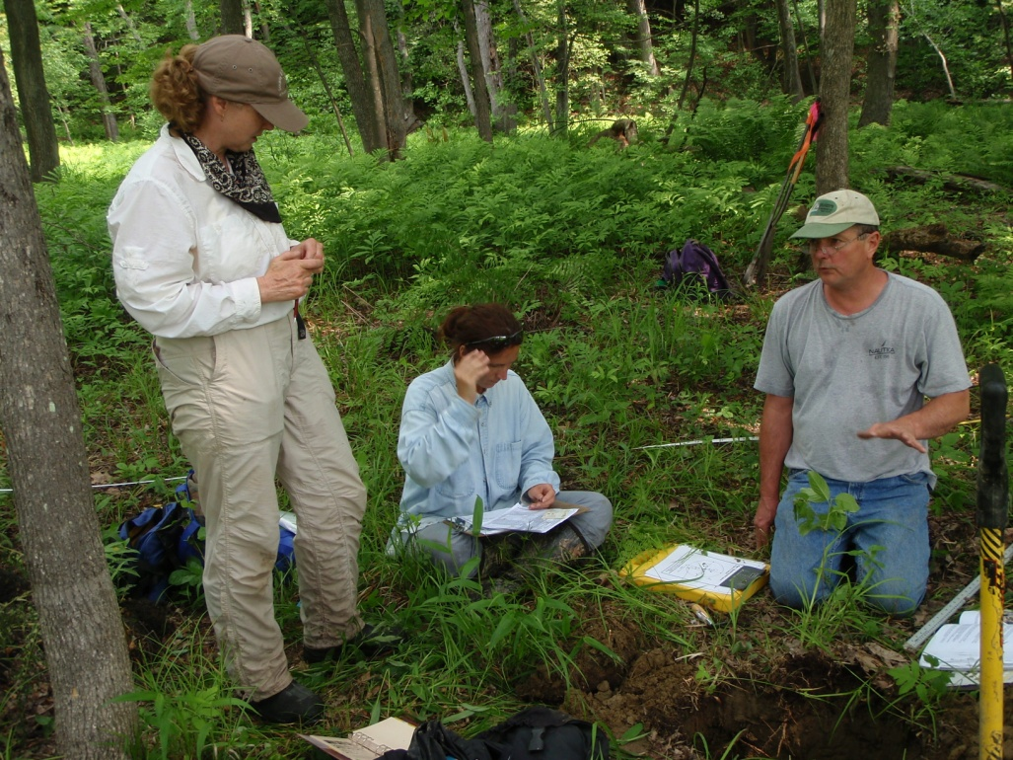
.1052 MDC for Infiltration Systems
Shall dewater within 72 hours based on a soil investigation.
No longer require a flow splitting device.

Slide 18
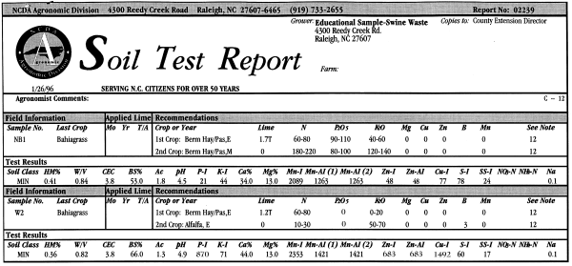
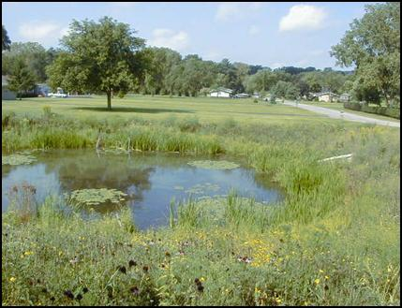
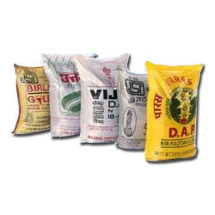
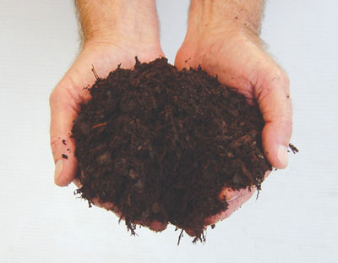
.1055 MDC for Stormwater Wetlands
Ponding depth increased from 12 to 15 inches.
The first 12” of soil shall be adjusted for plant growth.

Slide 19
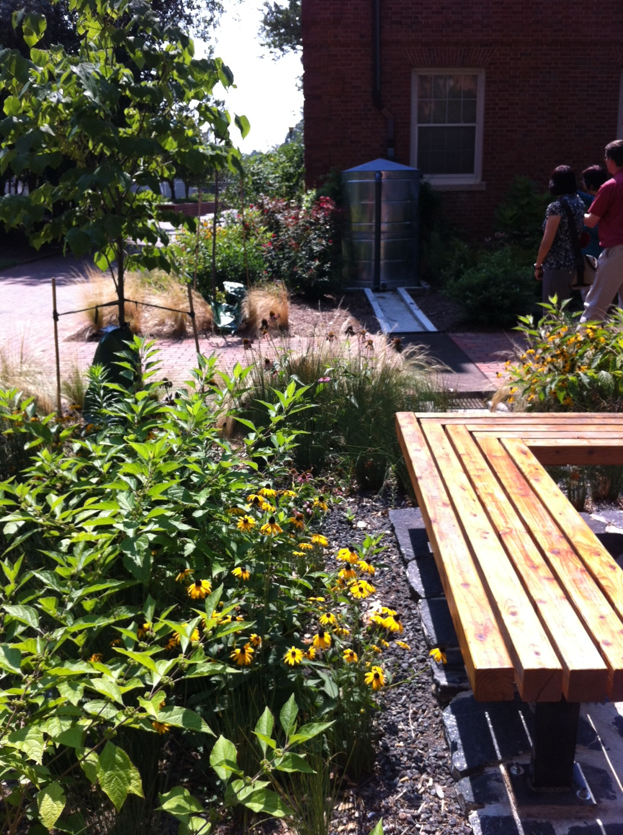
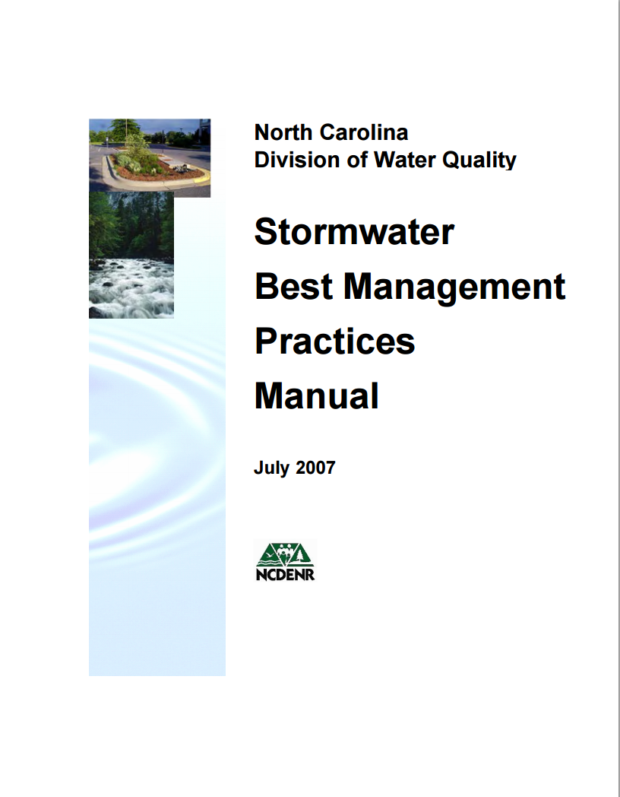
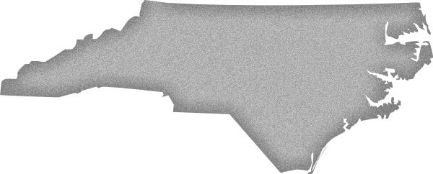
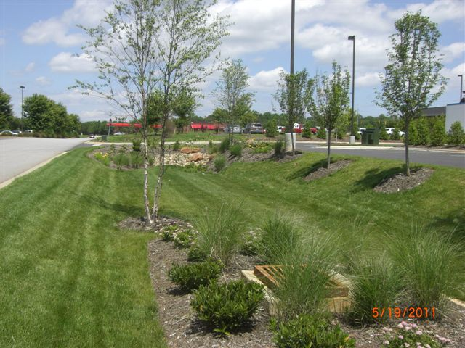
What will happen to the BMP Manual?
North Carolina
Design Manual
Rules = Requirements
Manual = Guidance
Stormwater

Slide 20
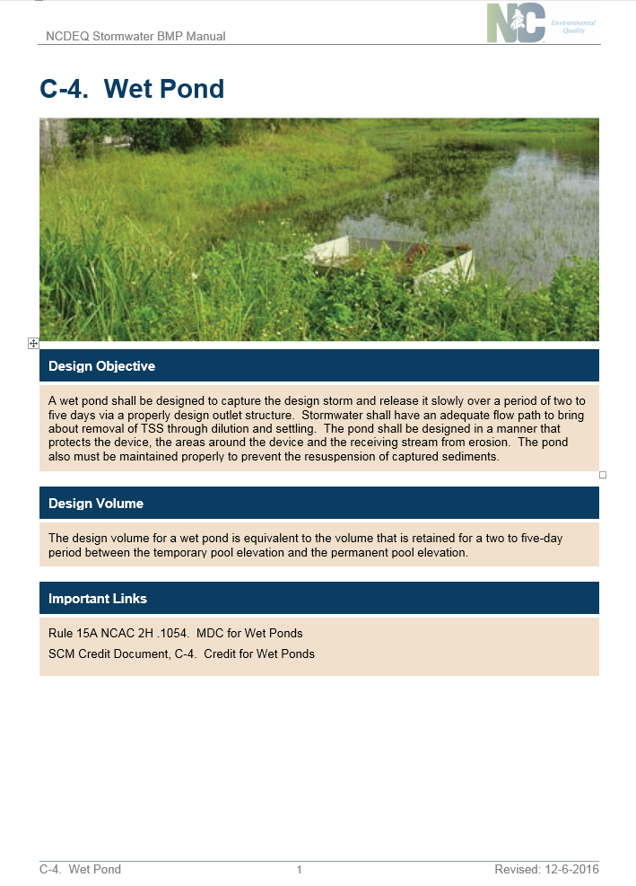
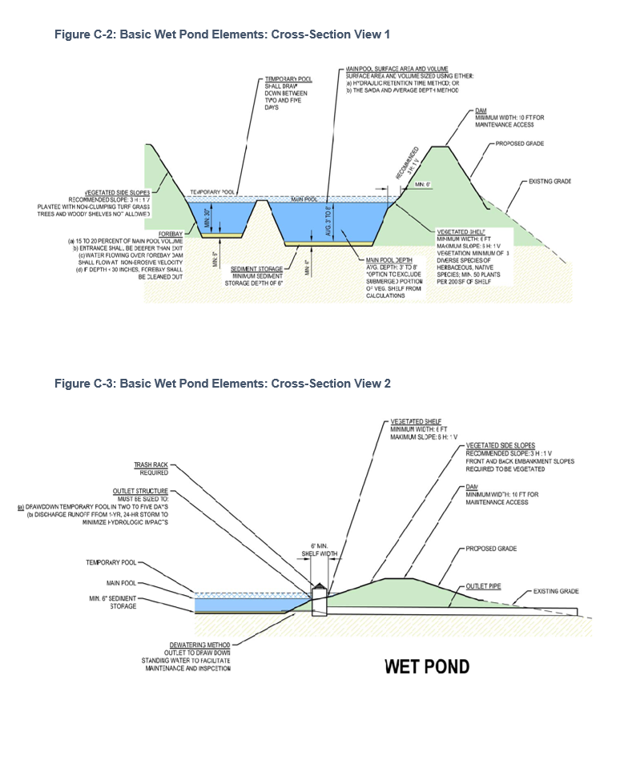

Slide 21
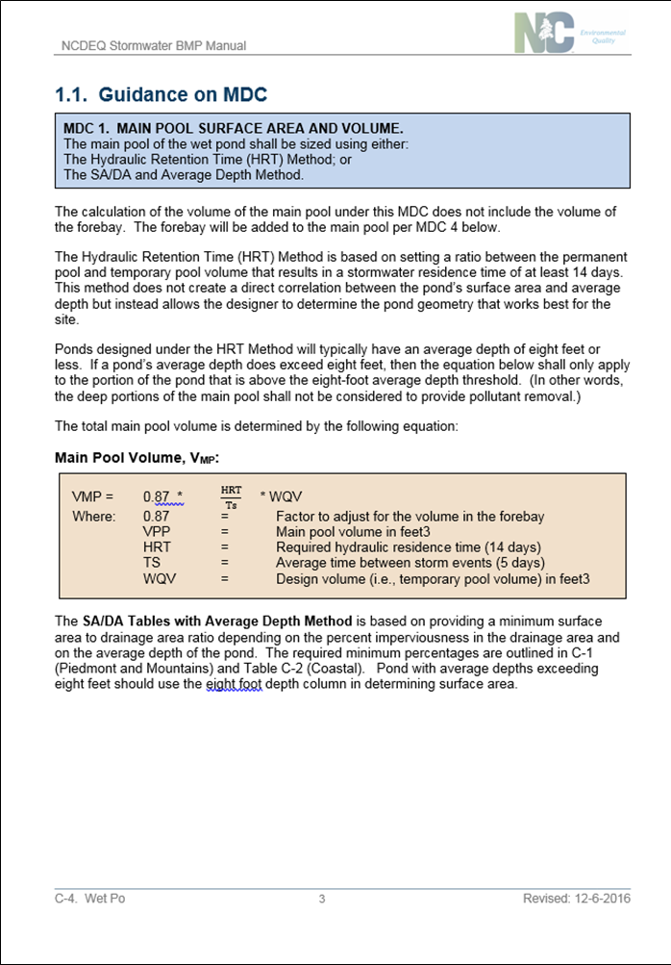
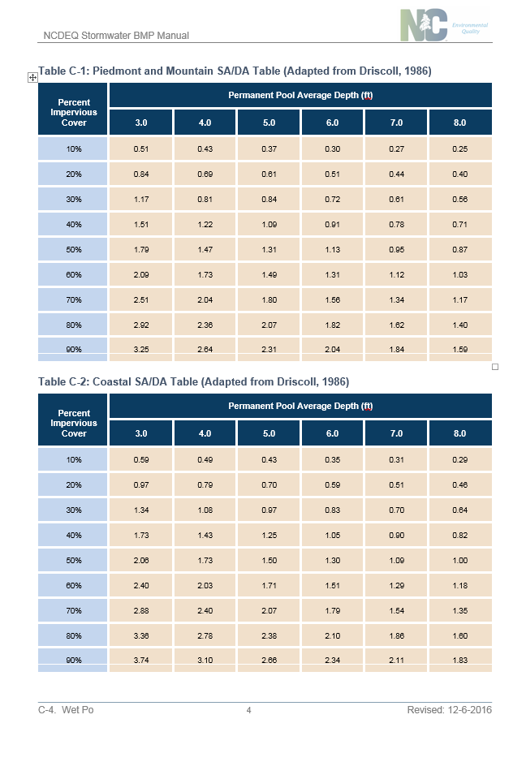

Slide 22
Other Updates
O&M-EZ
Supplement-EZ
Also, we’re working on on-line application forms for projects under DEQ’s authority.

Slide 23
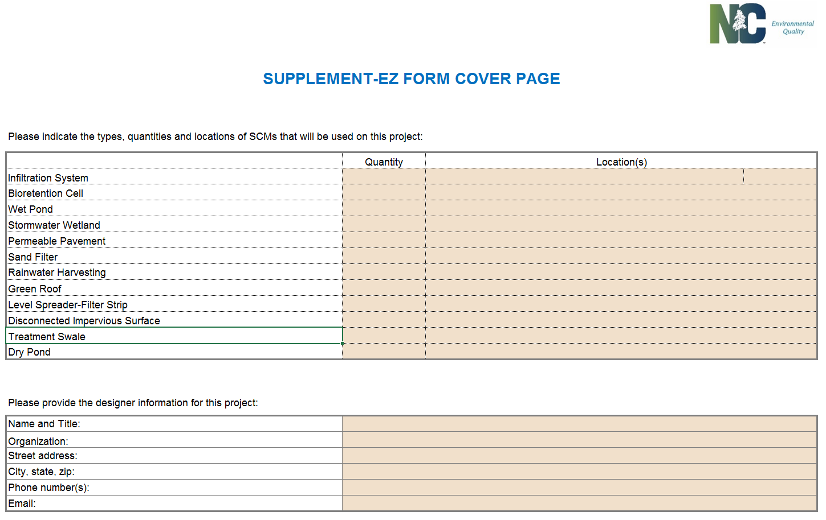
Supplement-EZ

Slide 24
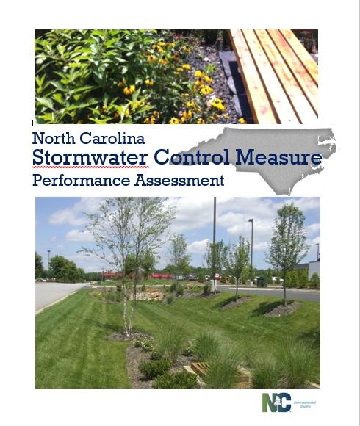
Explain why SCMs were classified primary v. secondary.
Update our SCM credits based on current research.
Consistent between all NC SW programs.
Credit Manual

Slide 25
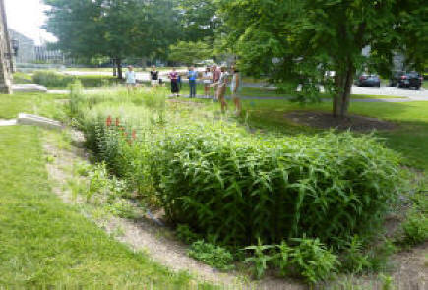
Primary SCM
From 2H .1002:
A wet pond, SW wetland, infiltration system, sand filter, bioretention cell, permeable pavement, green roof, rainwater harvesting, or an approved new stormwater technology that is in accordance with the MDC.
Can stand alone when designed per the MDC to treat the design storm depth.

Slide 26
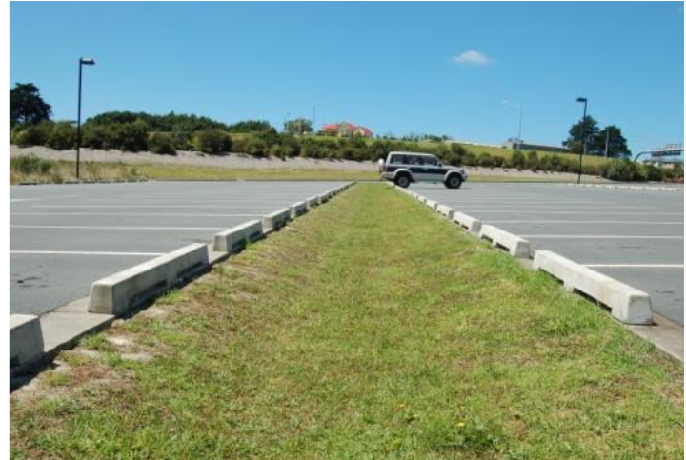
Secondary SCM
From 2H .1002:
An SCM that does not achieve the annual reduction of TSS of a Primary SCM but can be used in a treatment train with a primary SCM to provide pre-treatment or hydraulic benefits.
May not stand alone; must be used with another SCM.

Slide 27
Primary SCMs | Secondary SCMs
Wet Pond Stormwater Wetland Infiltration System Sand Filter Bioretention Cell Permeable Pavement Rainwater Harvesting Green Roof | DIS LS-FS Pollutant Removal Swale Dry Pond

Slide 28
Explanation
WHY don’t we say
85% TSS removal
any more?
Because it’s wrong!

Slide 29
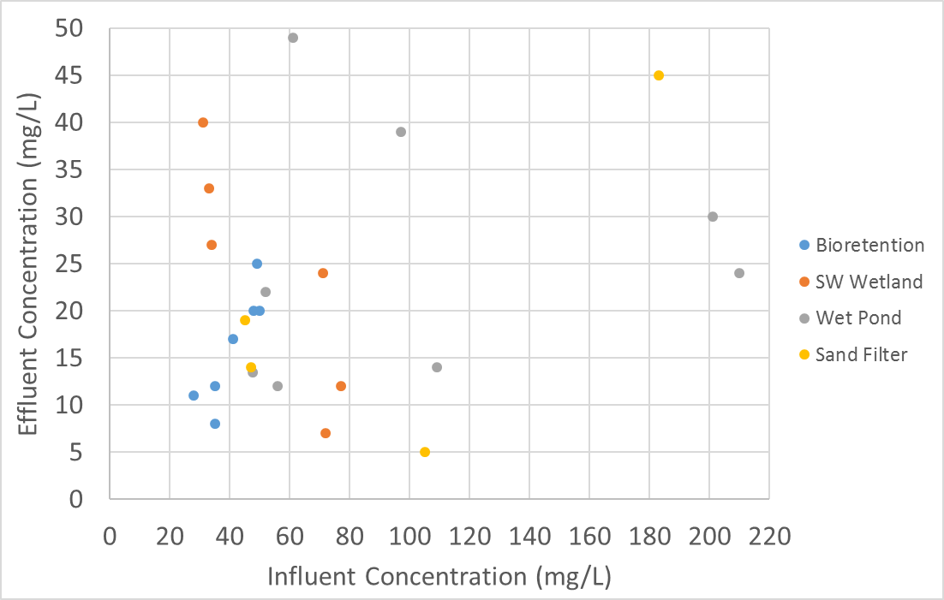
SCM Performance per Research

Slide 30
Standards for Primary SCMs
Test Not Valid
29%
25 mg/L
75%
Primary
Secondary

Slide 31
Options in New Rules
Runoff treatment: SW from all of the built-upon area is treated in primary SCMs or a combo of Primary and Secondary SCMs that provides equal or better treatment. (one Drainage Area, one Primary SCM)
Runoff volume match (aka LID): the annual runoff volume after development does is not more than 10% higher than the amount annual runoff volume before development. (5% in SA waters)

Slide 32
Runoff Volume Match: More Complicated!
For SCMs we need to know:
How much SW is treated versus untreated?
Of the treated SW, how much is effluent v. ET&I?
SW into SCM
Untreated Runoff
Treated Runoff
Effluent
ET&I

Slide 33
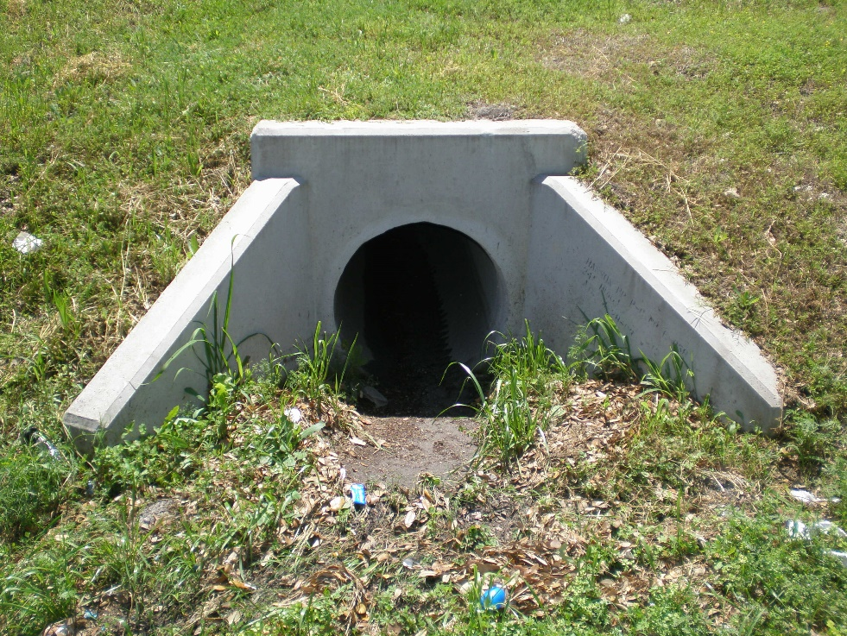
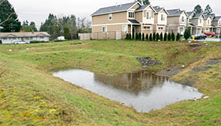
Fates of Treated Runoff:
Effluent
Treated discharge from an SCM
ET&I
Infiltration, ET, Harvest

Slide 34
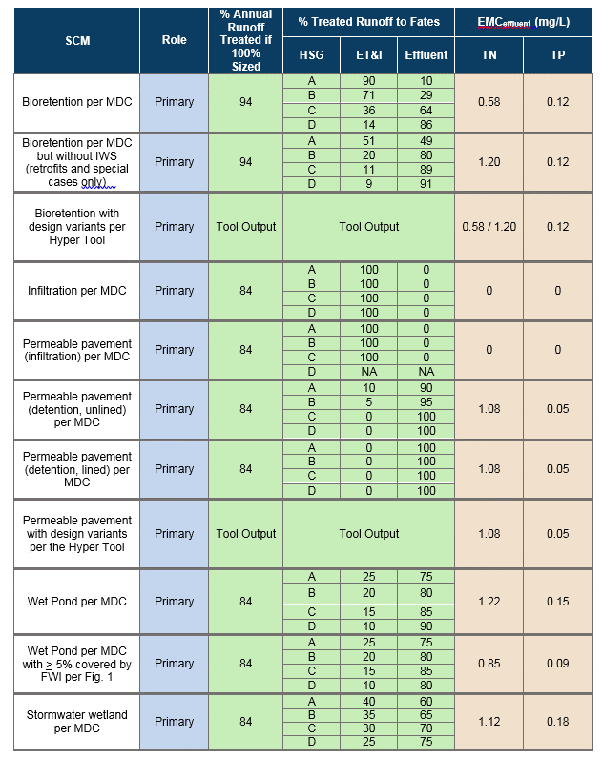
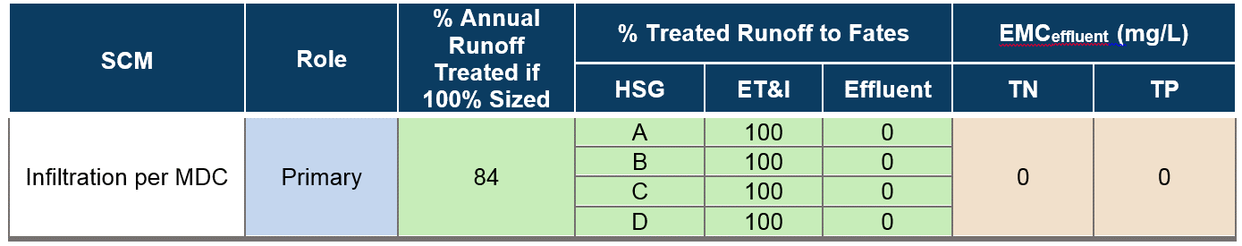

Slide 35
SCMs (designed per the MDC unless otherwise specified) | % of annual runoff treated if 100% sized
Infiltration Permeable Pavement Wet Pond Stormwater Wetland Dry Pond | 84%
Bioretention | 94%
Sand Filter (open or closed) StormFilter | 90%
LS-FS DIS Pollutant Removal Swale | 90%
Rainwater Harvesting | 85%

Slide 36

SW into SCM (on an annual basis)
Untreated Runoff
Treated Runoff
Infiltration Permeable Pavement Wet Pond Stormwater Wetland Dry Pond | 84%
Effluent
ET&I

Slide 37
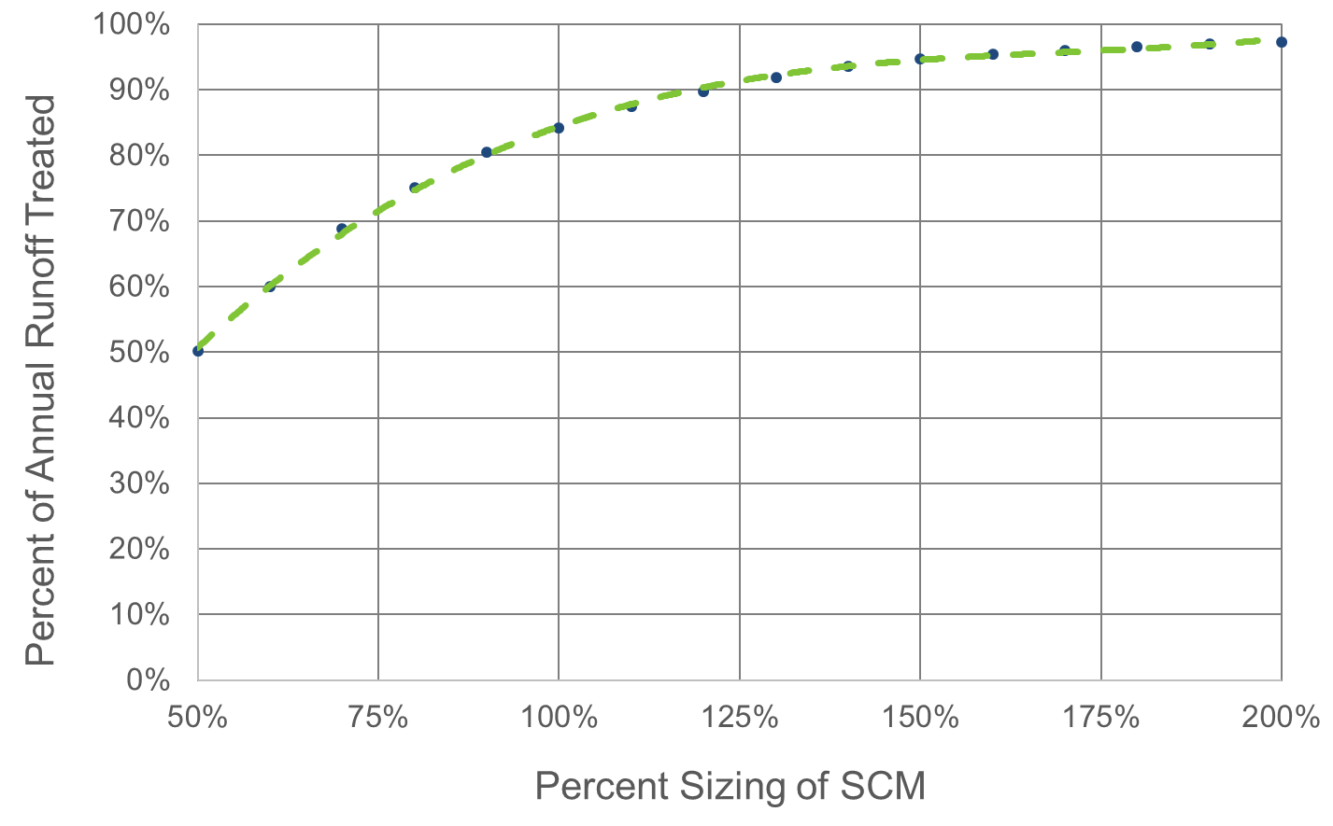
Size V. Runoff Treated
84%

Slide 38
SCMs (designed per the MDC unless otherwise specified) | % of annual runoff treated if 100% sized
Infiltration Permeable Pavement Wet Pond Stormwater Wetland Dry Pond | 84%
Bioretention | 94%
Sand Filter (open or closed) StormFilter | 91%
LS-FS DIS Pollutant Removal Swale | 90%
Rainwater Harvesting | 85%

Slide 39
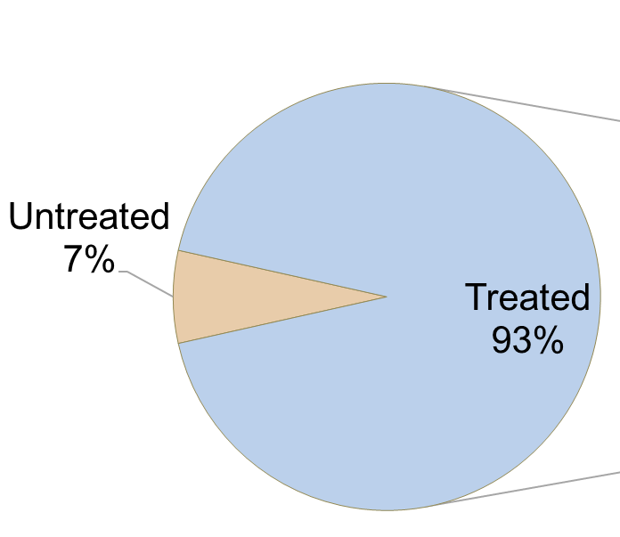
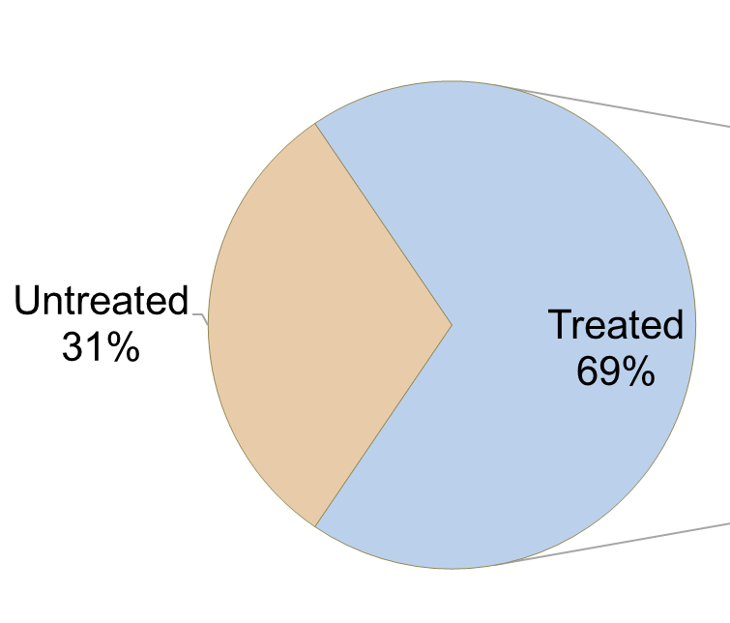
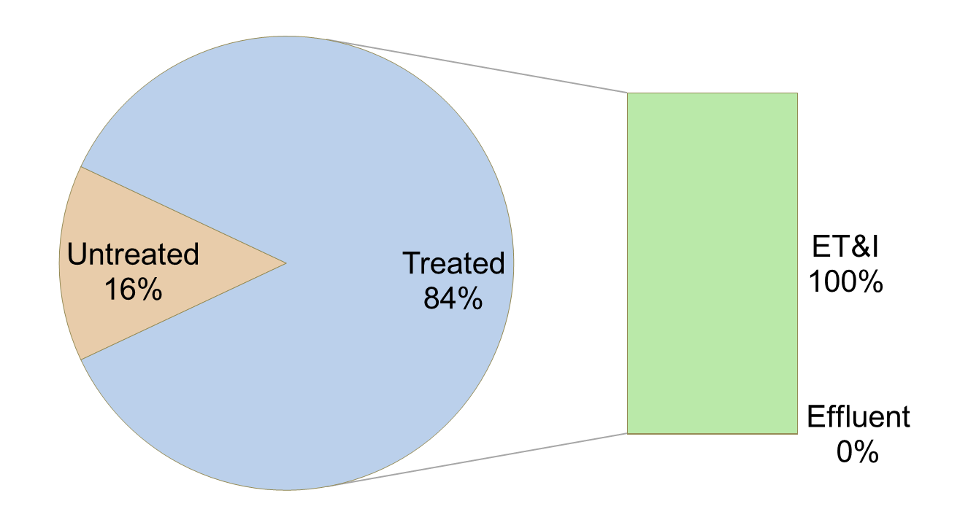
Sizing versus Runoff Fates for Infiltration Systems
130% Sizing
70% Sizing
100% Sizing

Slide 40
What if I can’t remember all of this?
This is all programmed into the Jordan Falls tool!
Storm-EZ needs to be updated….
A goal for 2017 will be to finish the “SNAP” tool that will do both nutrient and LID calculations

Slide 41
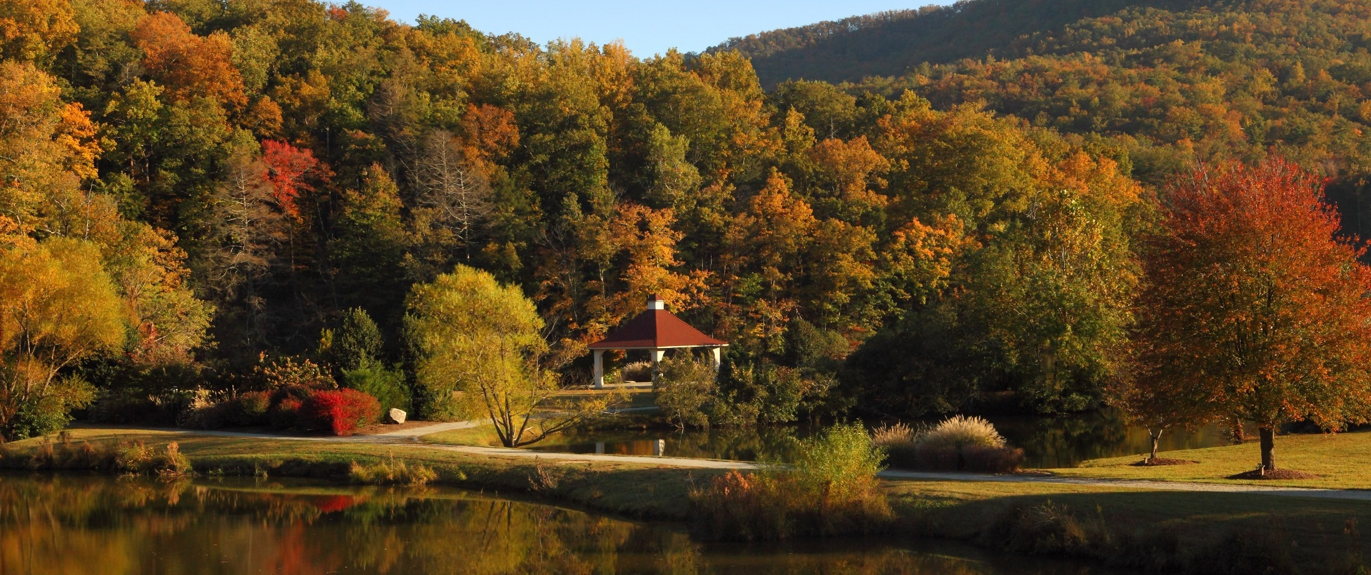
Questions?
Department of Environmental Quality

