Slide 1
Innovative Technologies
Jay Wilson, CPESC
City of Charlotte
March 28, 2017

Slide 2
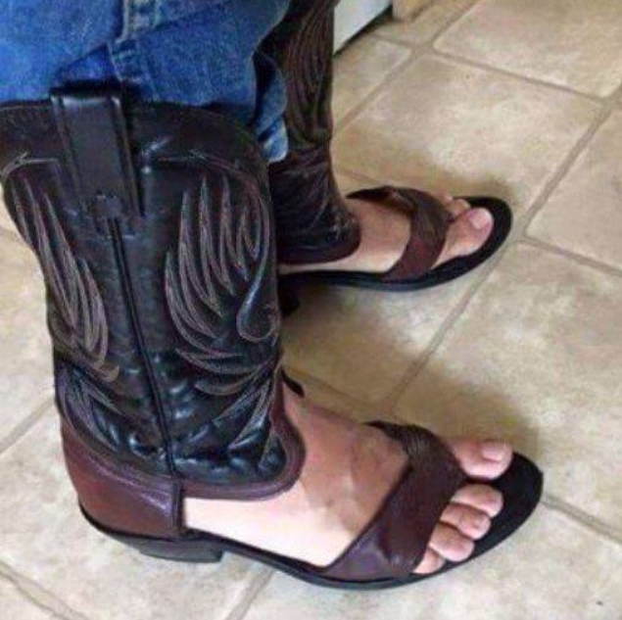
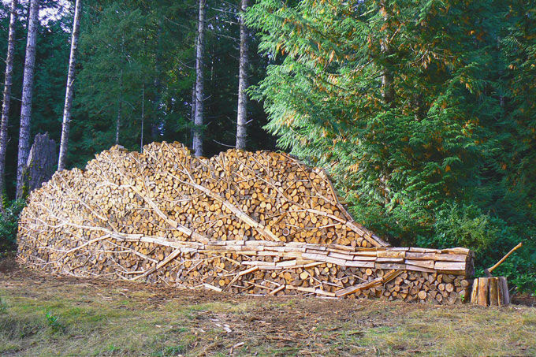
INNOVATION
What does it mean?
The introduction of something new
A new idea, method or device
… The standard for employing “innovative practices” isn’t impossibly high…

Slide 3
INNOVATION
Why is it important?
Because under NPDES
Effluent limits are performance based
Effluent limits are technology based

Slide 4
INNOVATION
Why is it important?
In Charlotte, it is part of the ordinance:
Section 17-34(b) Innovative measures - … Innovative techniques and ideas will be considered and may be used following approval by the City Engineer if it can be demonstrated that such techniques and ideas are likely to produce successful results.

Slide 5
INNOVATION
Why is it important?
And sometimes it leads to industry-changing standards that help us fulfill our mission of keeping surface waters free of excessive sedimentation…

Slide 6
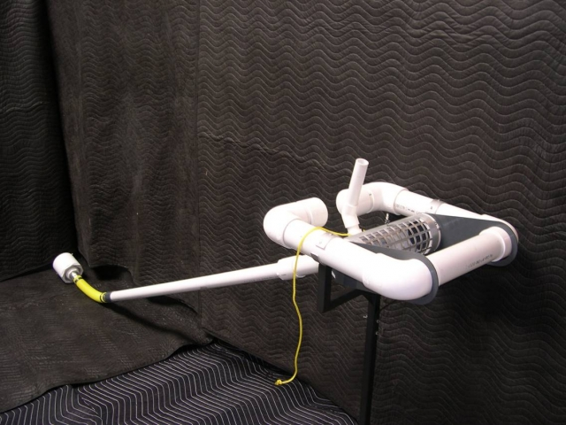
INNOVATION

Slide 7
INNOVATION
If it doesn’t perform – improve it!
“As a county Erosion Control Supervisor, Warren was concerned that traditional methods for containing sediment on construction sites were not effective, resulting in sediment pollution in streams and waterways.”
-J.W. Faircloth & Sons; http://www.fairclothskimmer.com/about-us

Slide 8
INNOVATION

Slide 9
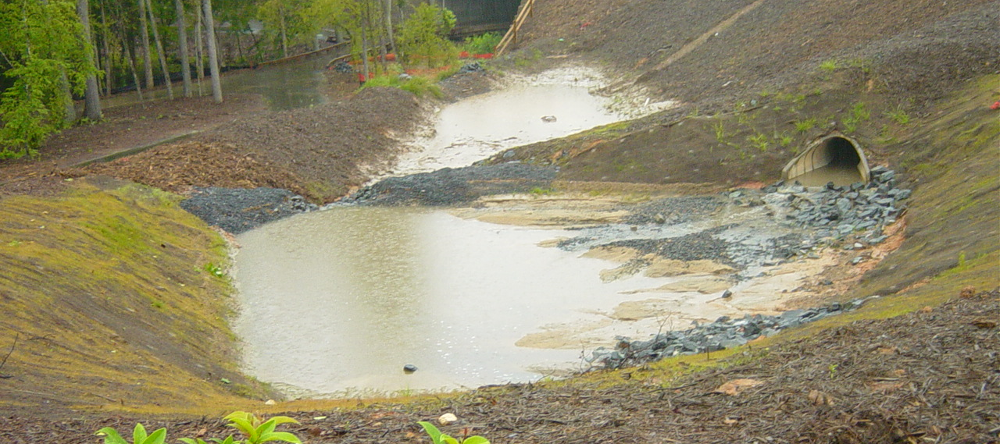
INNOVATION
Seep berms…

Slide 10
INNOVATION?

Slide 11
INNOVATION?

Slide 12
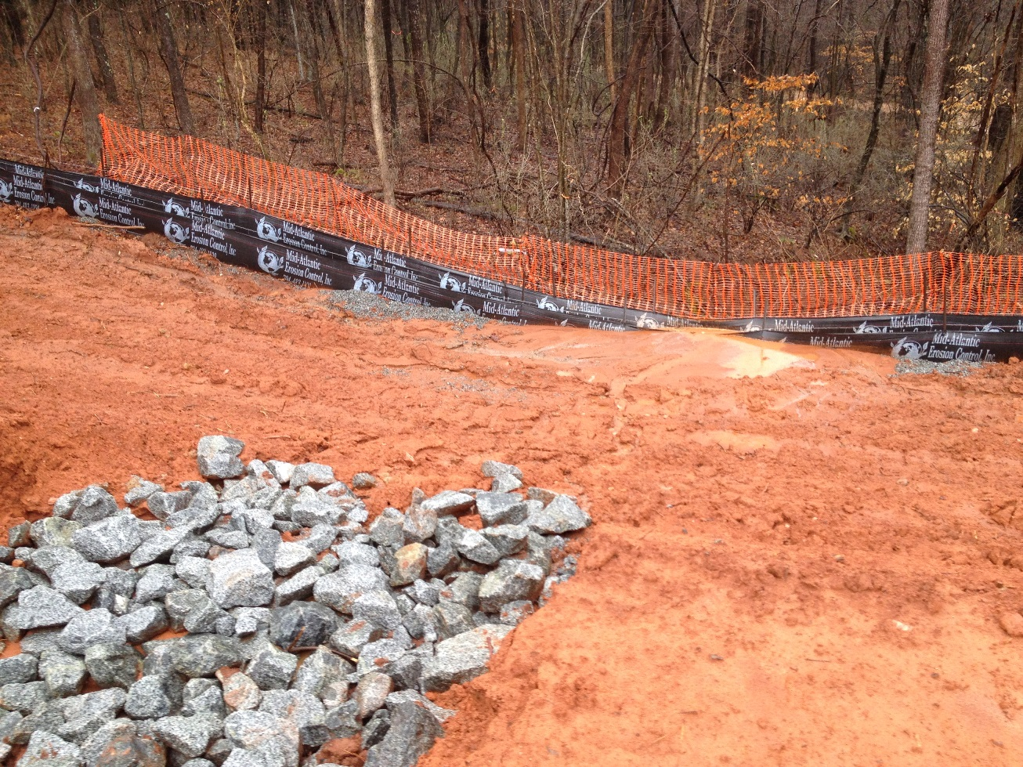
INNOVATION
If doesn’t perform – improve it!

Slide 13
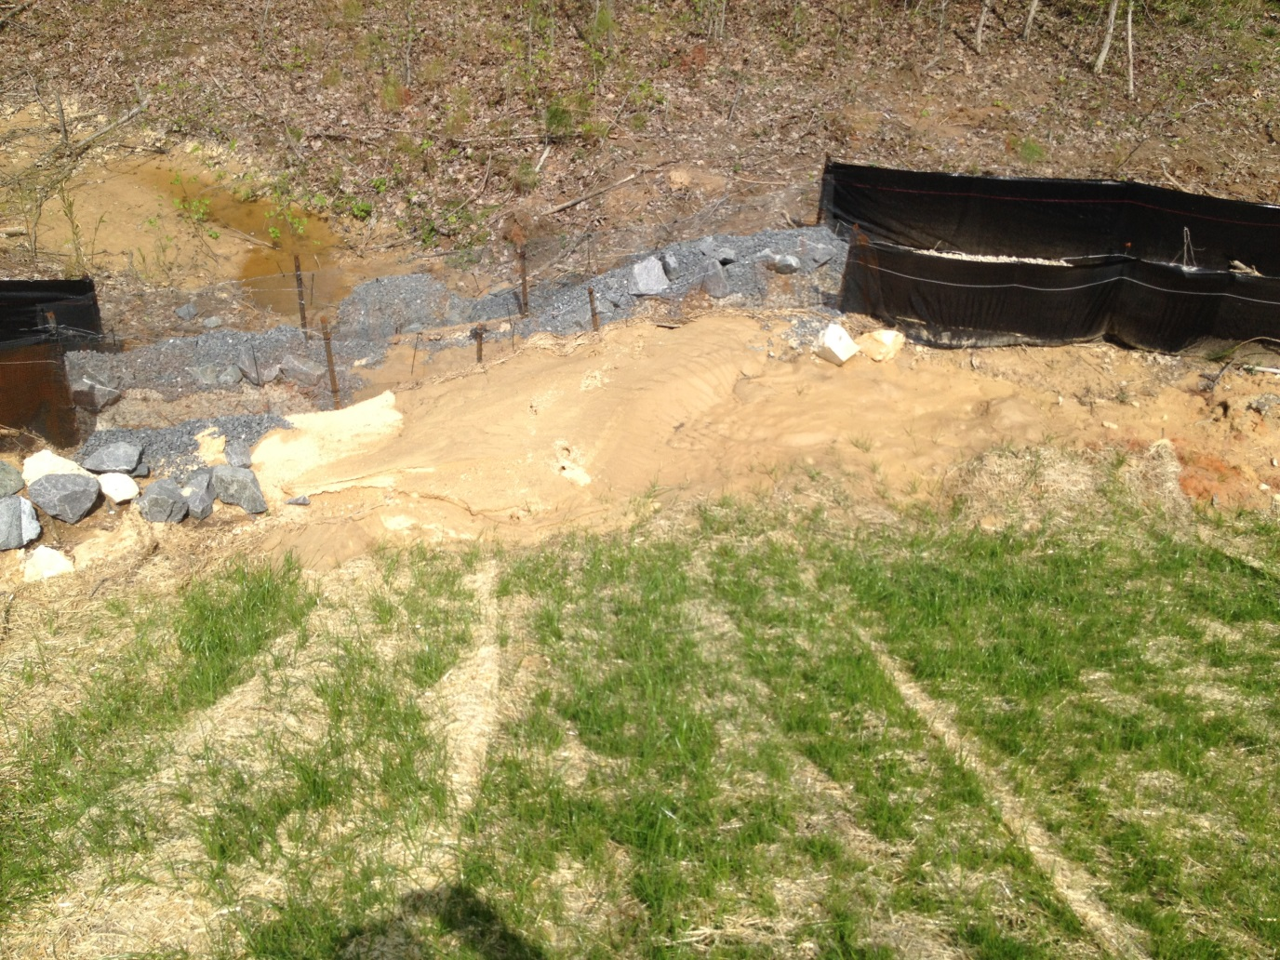
INNOVATION
Then refine it…

Slide 14
INNOVATION

Slide 15
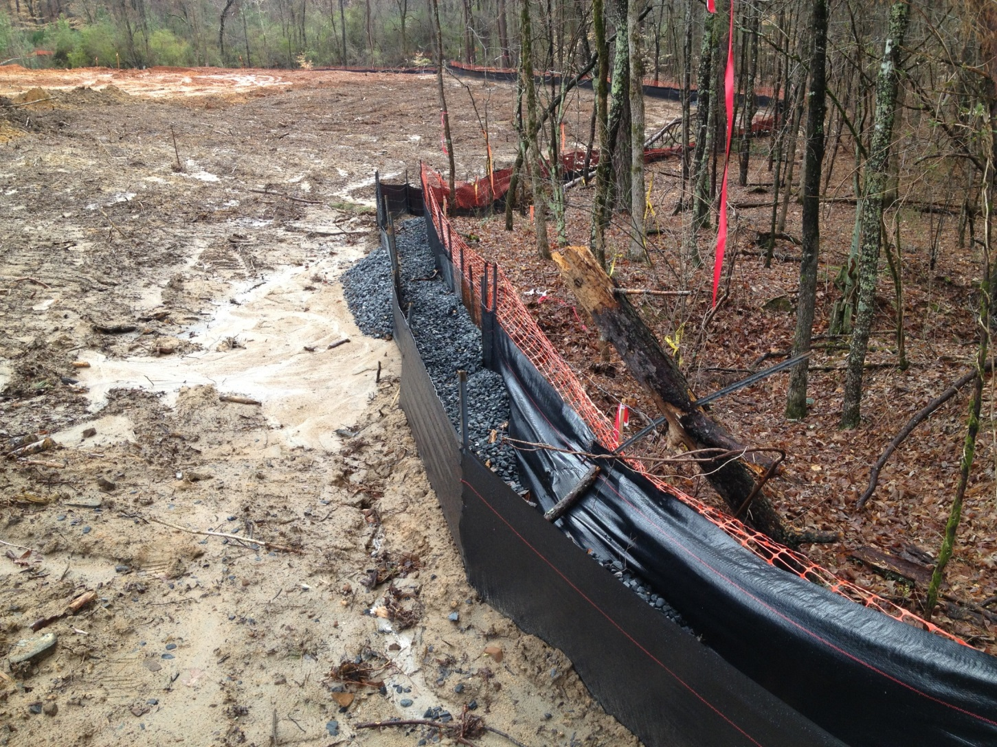
INNOVATION
Until you achieve the desired results

Slide 16
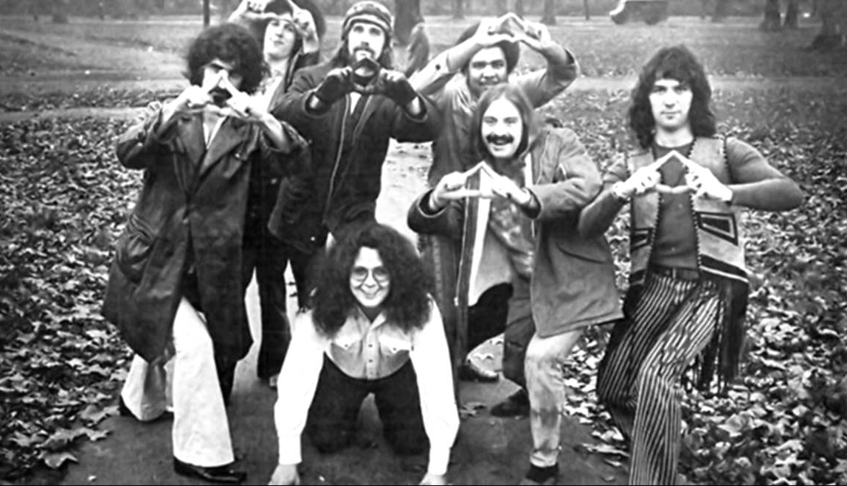
NECCESITY…
Is the mother of invention…
Not to be confused with:

Slide 17
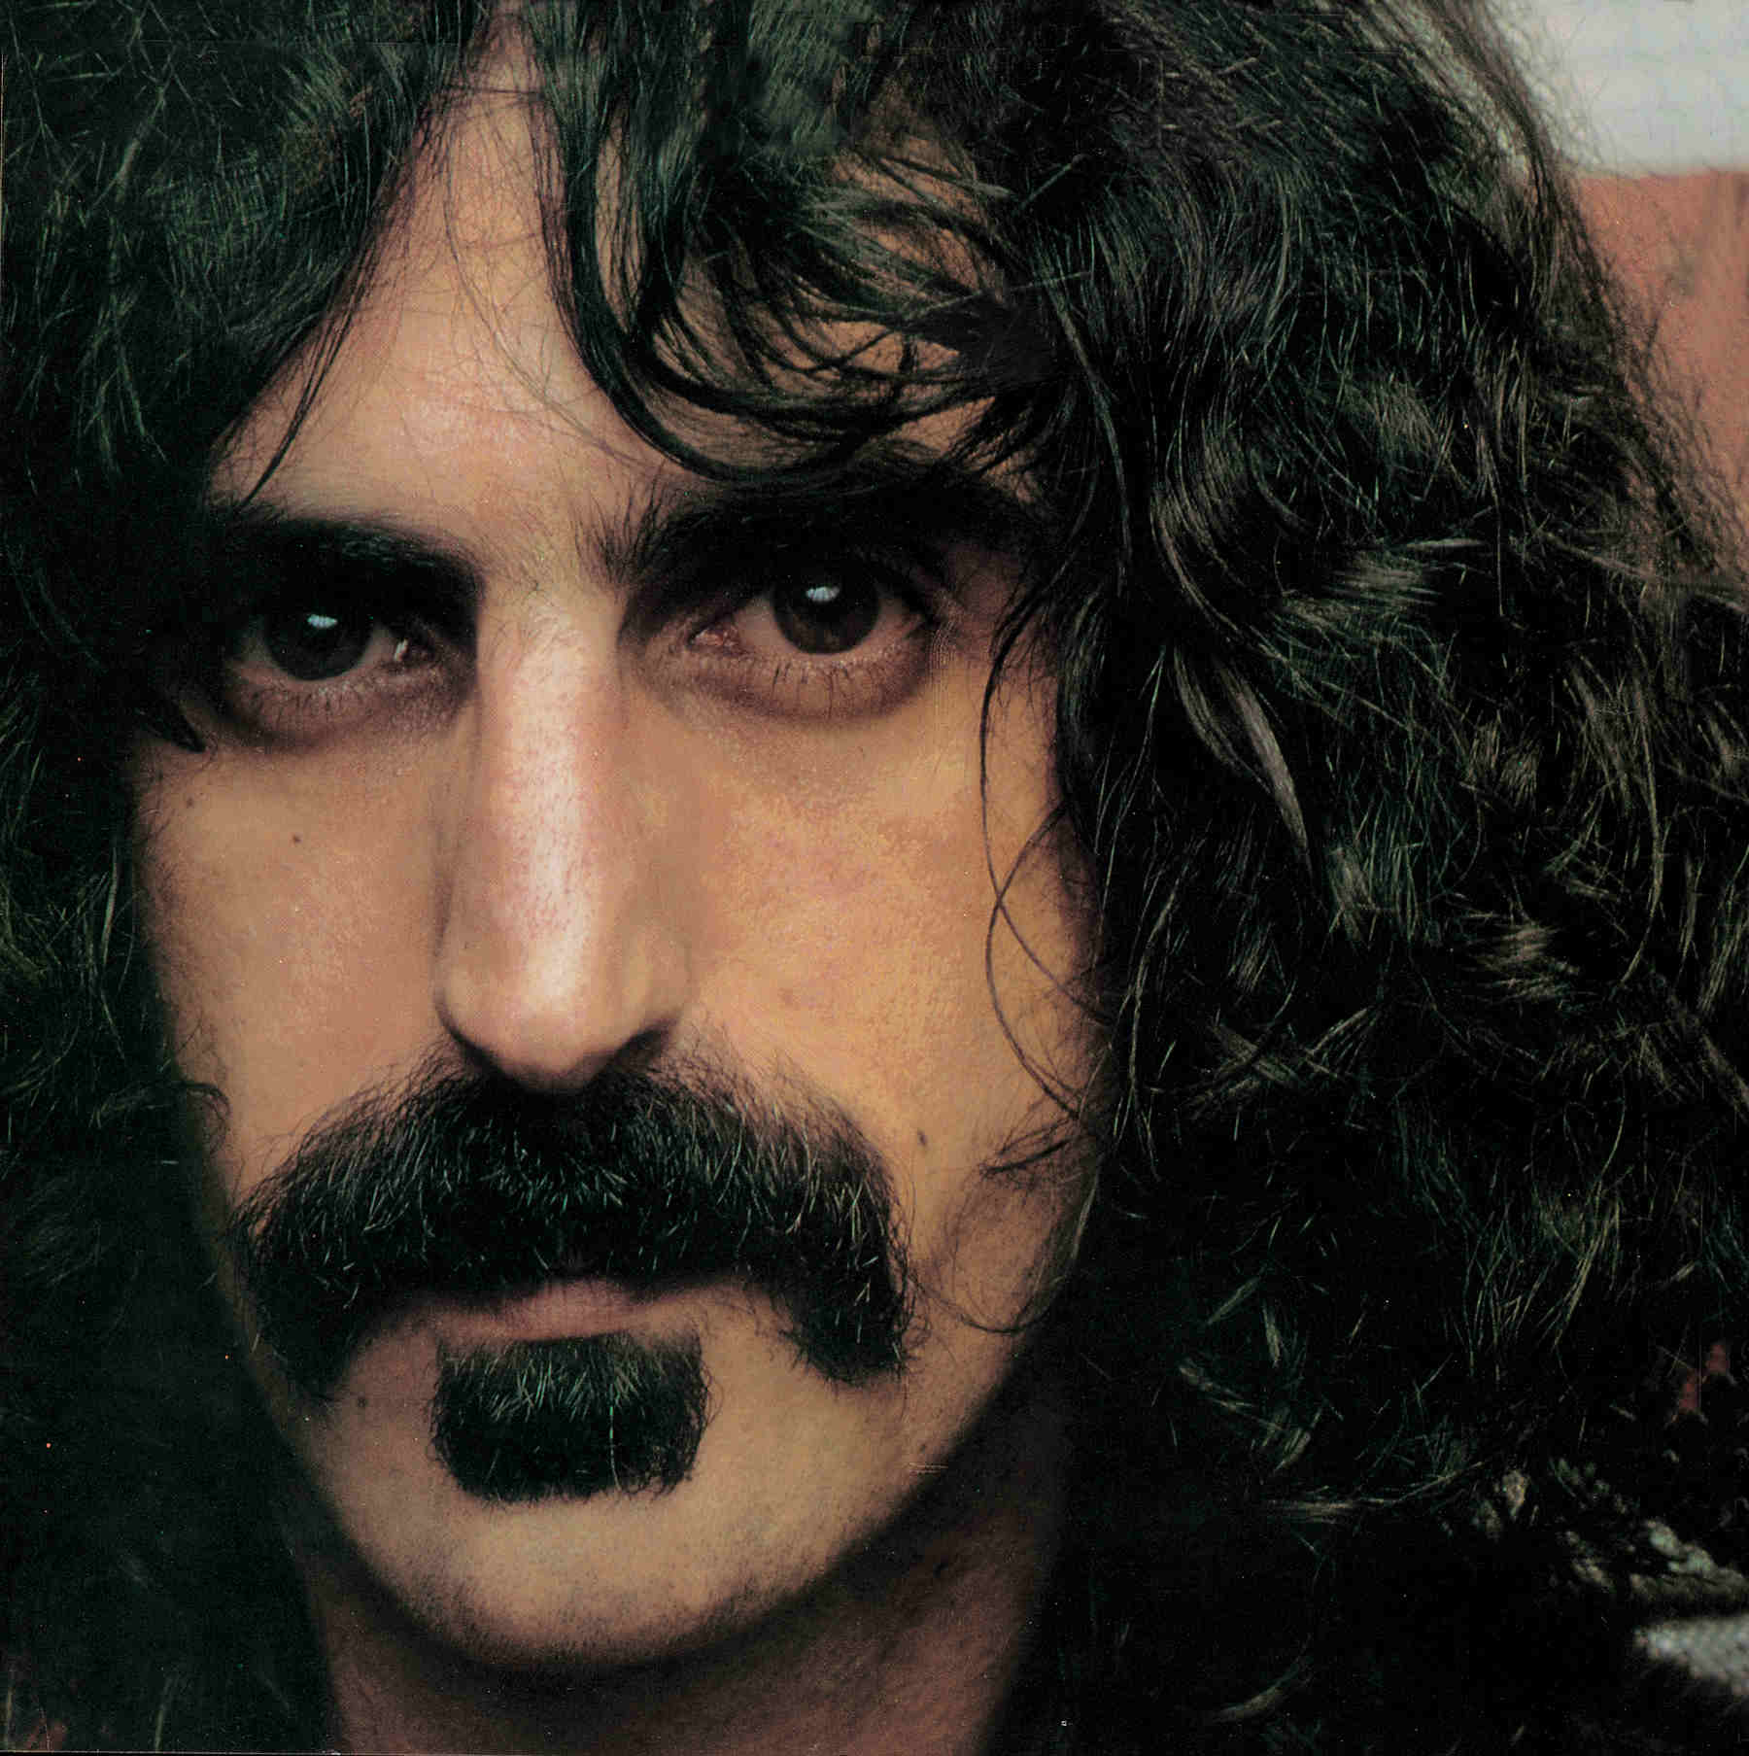
INNOVATION
“Without deviation, progress is impossible”
-Uncle Frank

Slide 18
INNOVATION
“No significant deviation”
The enemy of innovation

Slide 19
INNOVATION
Avoid significant deviation!
Make it part of the approved plan
When testing new BMPs, consider redundant measures or a significant margin of safety

Slide 20
INNOVATION
Avoid deviation!
Make it part of the approved plan
When testing new BMPs, consider redundant measures or a significant margin of safety

Slide 21
INNOVATION
When considered fully, it is likely that most E&SC professionals have employed ‘innovative technology or practices’ on their site

Slide 22
INNOVATION
Case Study:
Charlotte Premium Outlet Mall

Slide 23
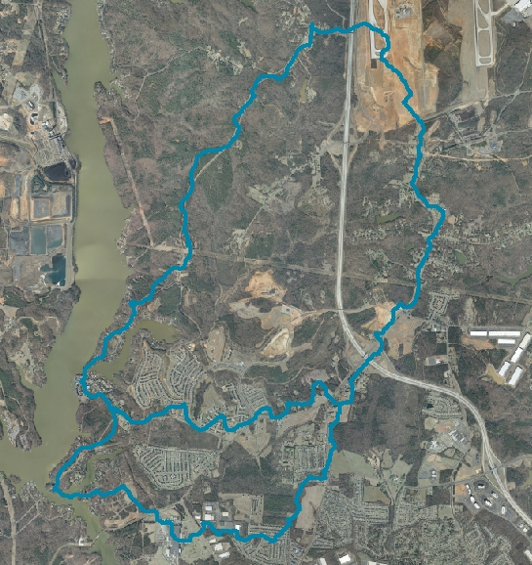
OUTLET MALL SITE
Problem:
A 60-acre Outlet Mall site proposed within the Lake Wylie Critical Area
seeking relief from
the 20-acre rule

Slide 24
OUTLET MALL SITE
Background:
Global Economic Crisis
Political pressure (jobs, jobs, jobs!)
Impossible timeline
Drains to Browns Cove on Lake Wylie
Sensitive watershed with ‘legacy impacts’ in the Critical Watershed

Slide 25
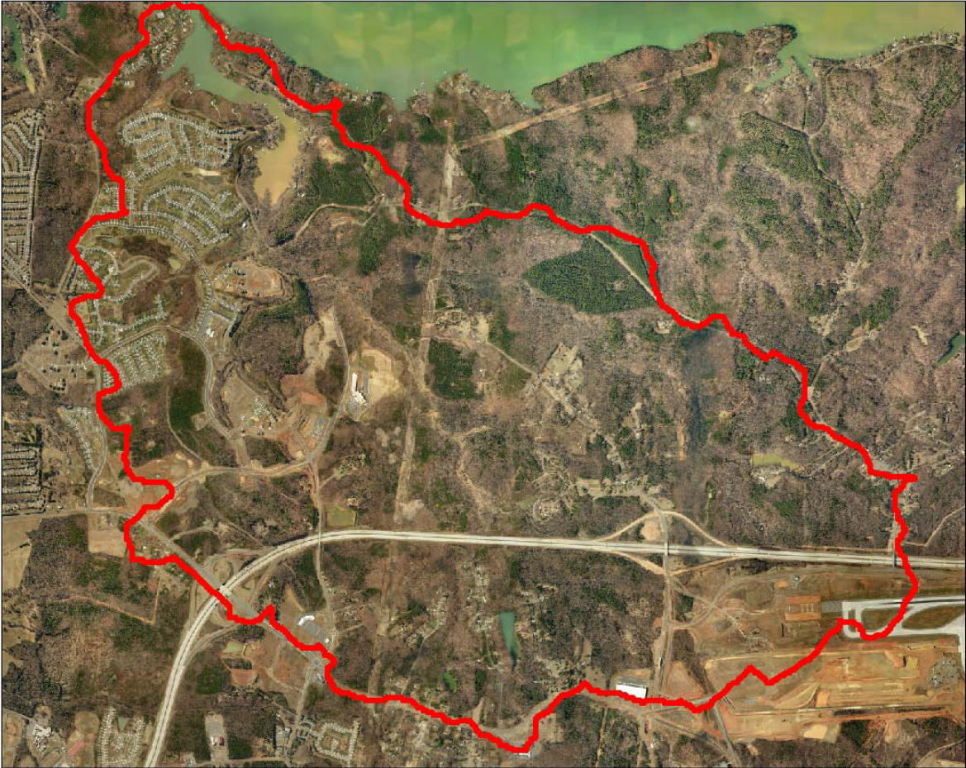

Slide 27
OUTLET MALL SITE
Solution (‘innovative techniques?’):
Adhere to 5-day stabilization requirement
Conduct turbidity/clarity measurements at discharge and mixing point
Submit logbooks to inspector electronically
Limit denuded areas to the extent possible
Overbuild basin

Slide 28
OUTLET MALL SITE
Solution (cont’d):
Install a ‘staged skimmer’
Skimmer discharge directed through filter bag
Install remote monitoring
Designate an onsite ‘erosion control manager’
Rock coffer forebays
Notes:
Would be helpful to pull Tanger basin data to describe extent of “overbuild”

Slide 29
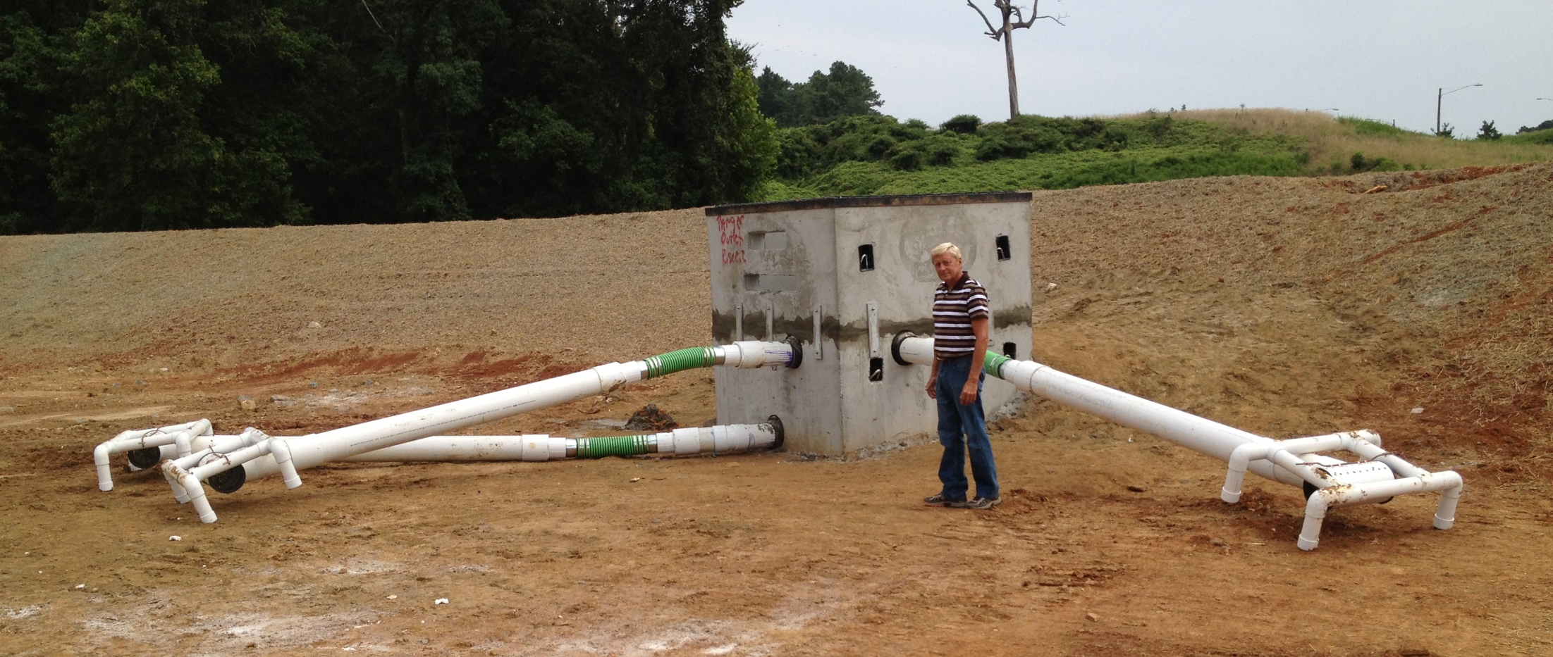
OUTLET MALL SITE
Staged Skimmer

Slide 30
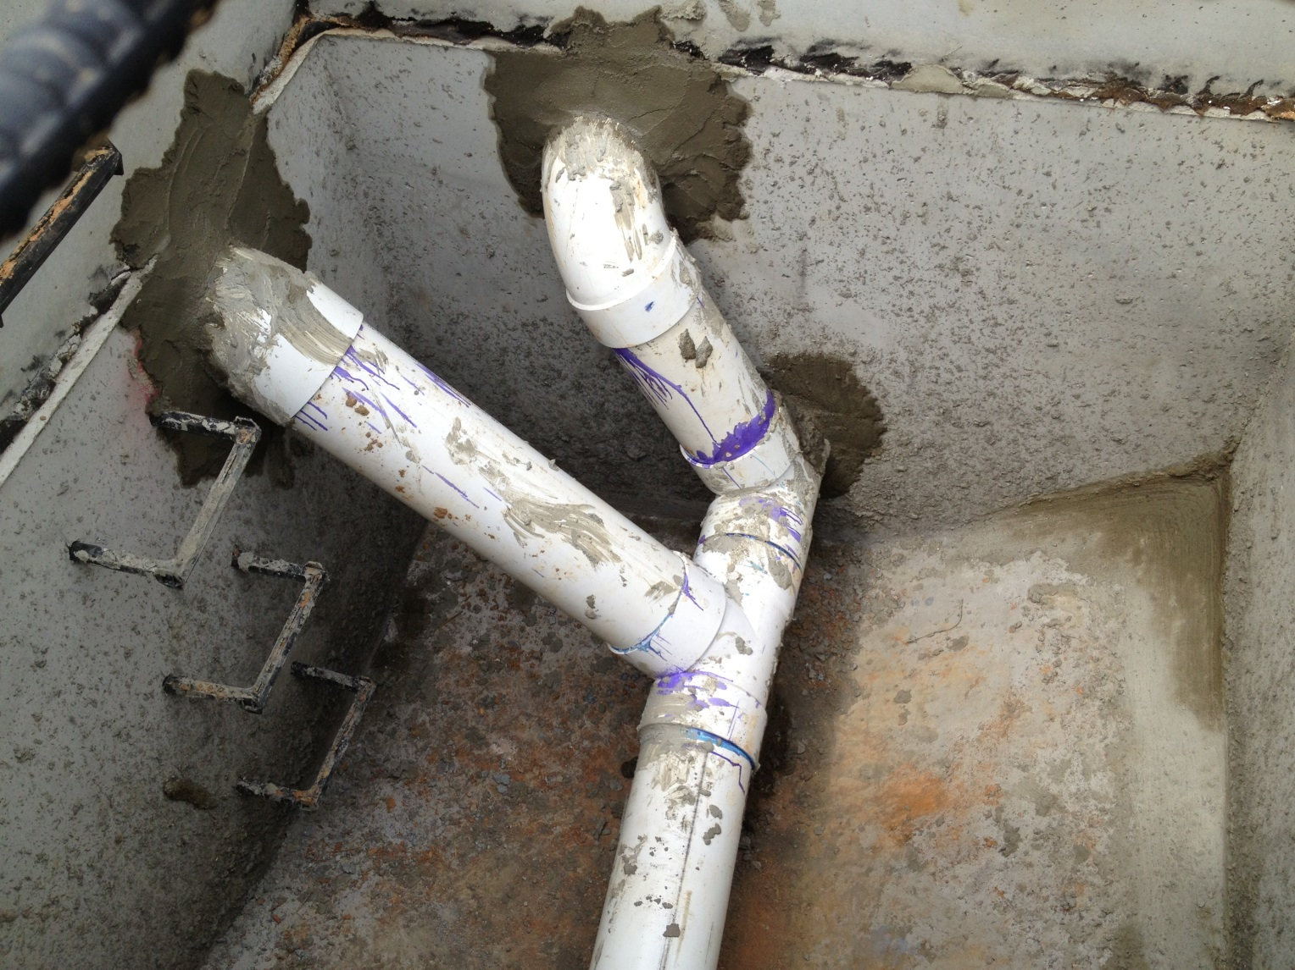
OUTLET MALL SITE
Skimmer Manifold

Slide 31
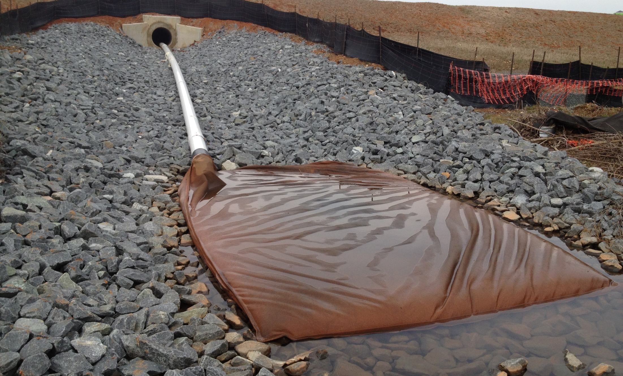
OUTLET MALL SITE
Filter bag at skimmer discharge

Slide 32
OUTLET MALL SITE

Slide 33
OUTLET MALL SITE
Automated Monitoring:
Continuous monitoring (24/7) for DO, pH, conductivity, temperature and turbidity on hourly basis
YSI 6820 Multi-parameter probe
Rain gauge and flow rates
Datalogger stored and transmitted all data to designated server so data could be accessed anywhere with an internet connection
Water quality ‘thresholds’ were set with alerts for appropriate staff depending on alert parameter
Battery and solar powered

Slide 34
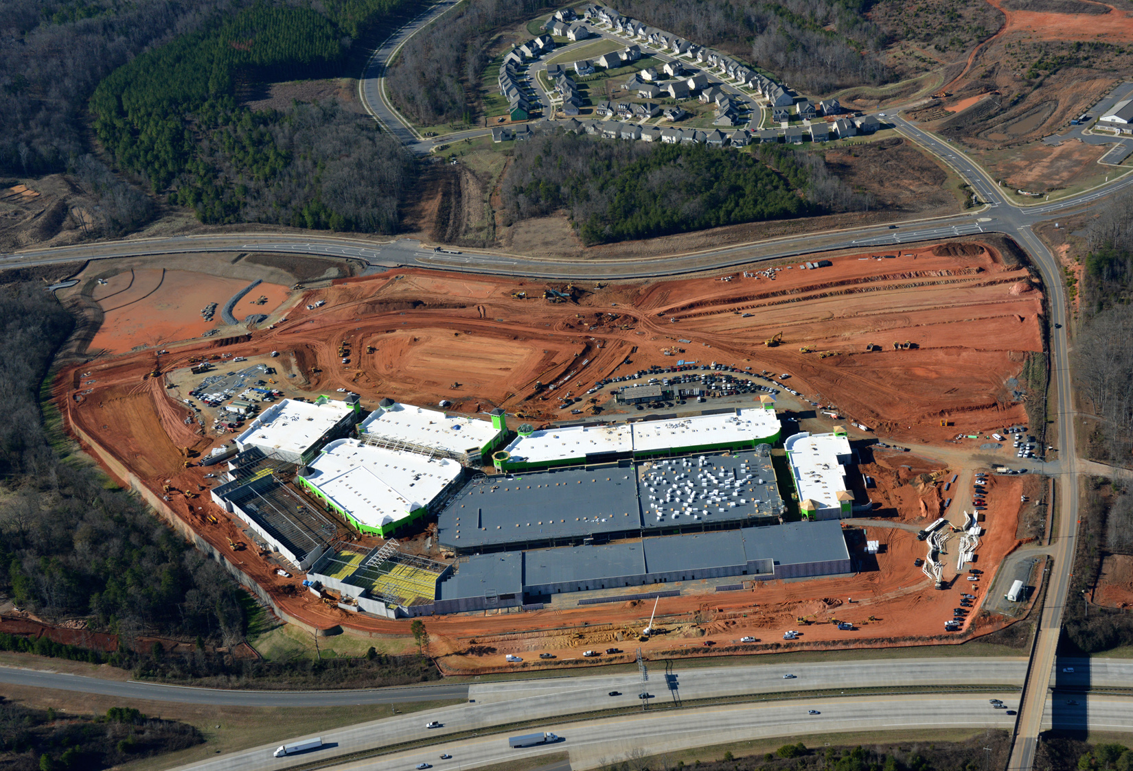
RIVERBEND
Skimmer Manifold

Slide 36
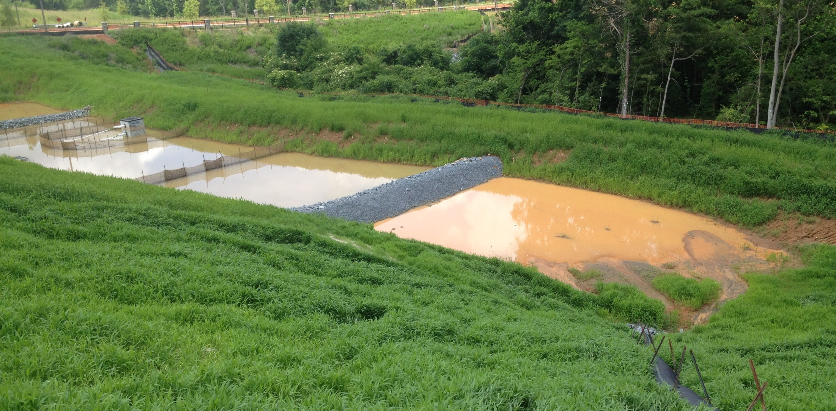
OUTLET MALL SITE
Effective forebays

Slide 37
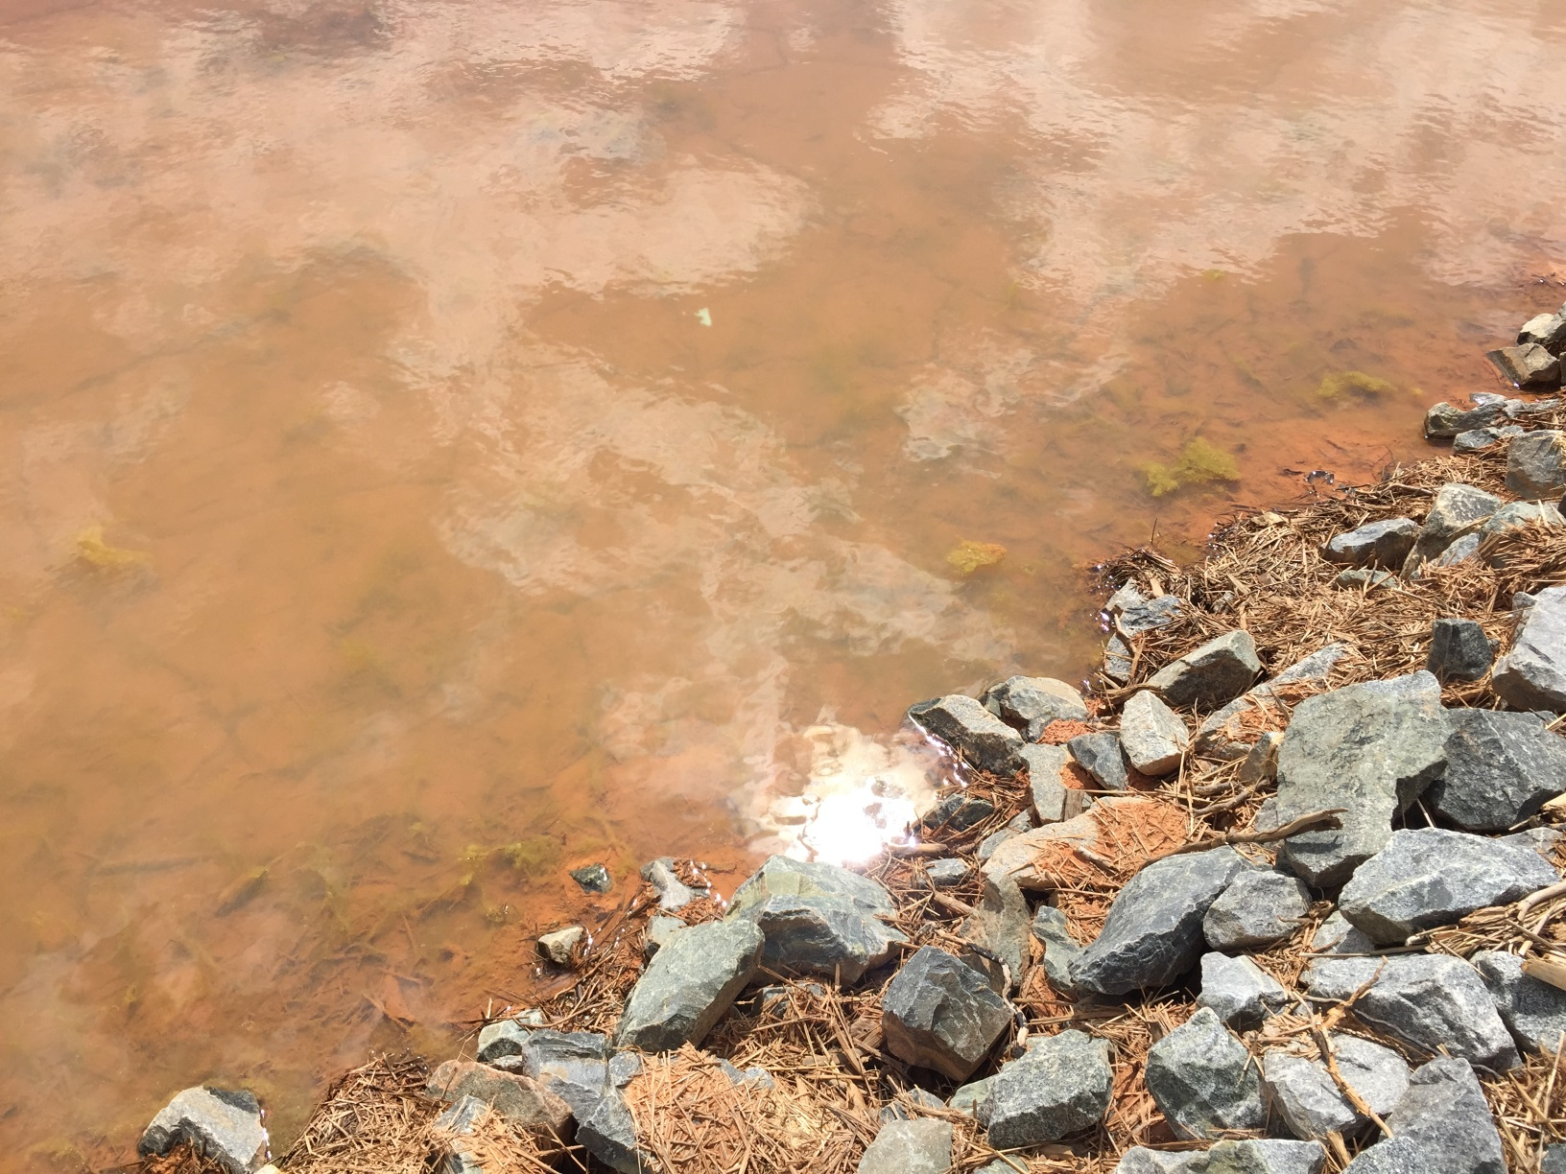
INNOVATION

Slide 38
OUTLET MALL SITE
Performance
Many practices became part of a new “Critical Watershed Checklist”
If you would like to see how the site performed, go to YouTube™ and search for my one-minute video titled “Tanger Discharge”

Slide 39
INNOVATION
Case Study #2:
Riverbend Commercial Subdivision

Slide 40
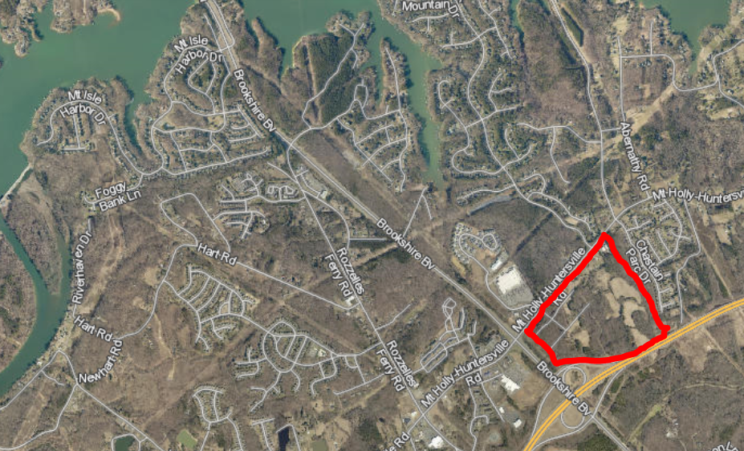
RIVERBEND SITE
Problem: A 100-acre commercial subdivision within the Lake Wylie Protected Area seeking relief from the 20-acre rule

Slide 41
RIVERBEND SITE
Background:
Very large Commercial Subdivision
Unique position within the Lake Wylie Protected Area
Subject to new ‘Critical Watershed Checklist developed from Outlet Mall Site

Slide 42
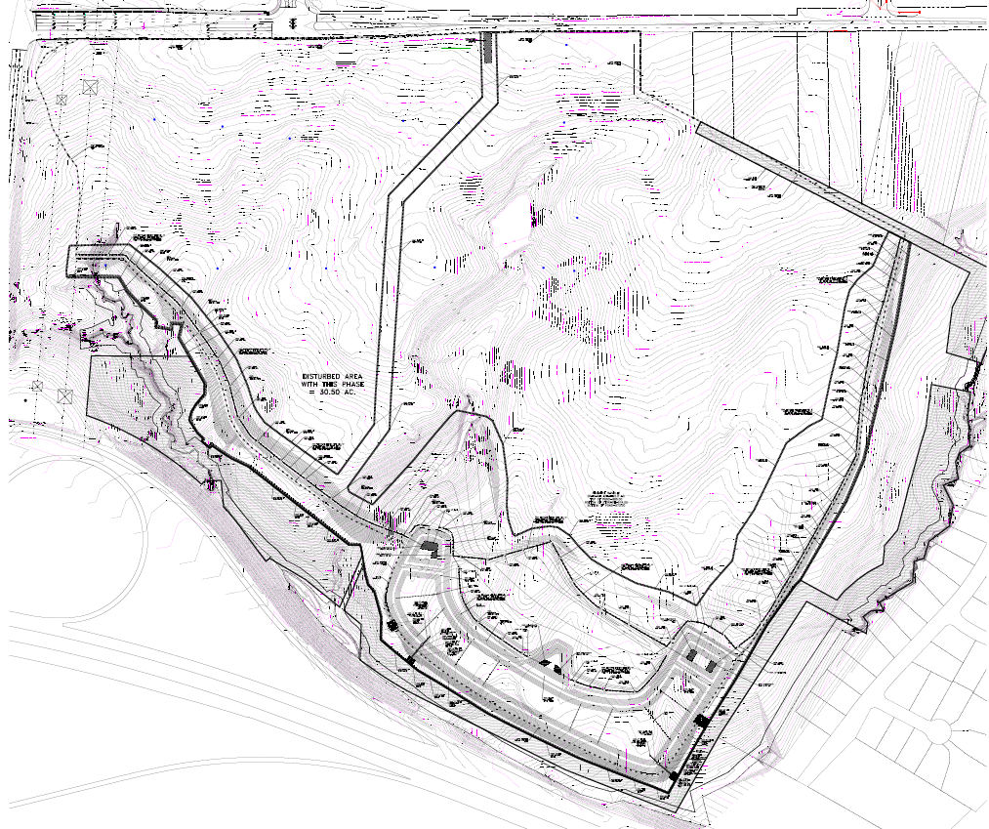

Slide 43
RIVERBEND SITE
Solution:
Adhere to new ‘Critical Watershed Checklist’
Conduct turbidity/clarity measurements at discharge and mixing point
Submit logbooks to inspector electronically
Limit denuded areas to the extent possible
Overbuild basin
Skimmer discharge directed through filter bag
Rock coffer forebays

Slide 44
Riverbend Site
Solution (cont’d):
Install a ‘staged skimmer’
Install remote monitoring*
Designate an onsite ‘erosion control manager’
* Receiving stream problems!

Slide 45
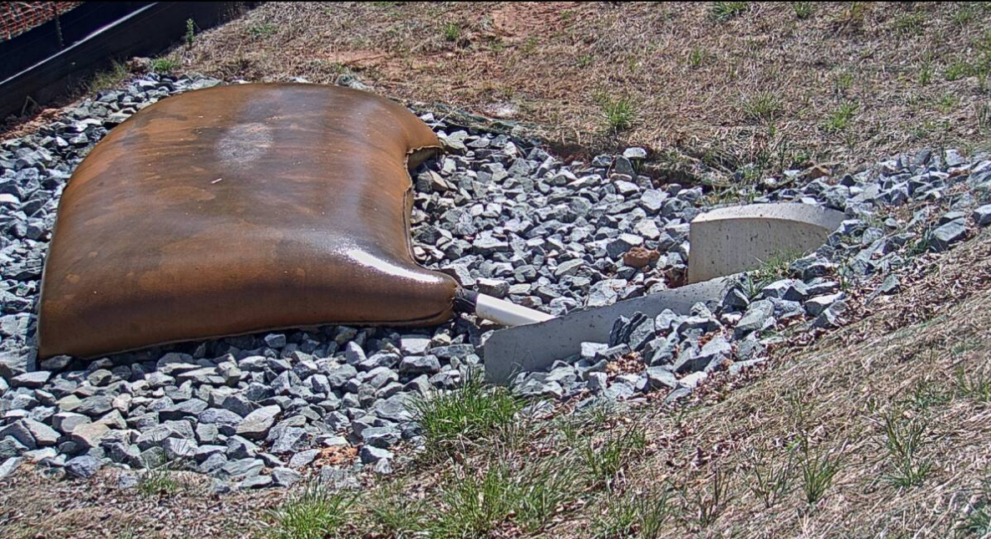
RIVERBEND SITE

Slide 46
INNOVATION

Slide 47
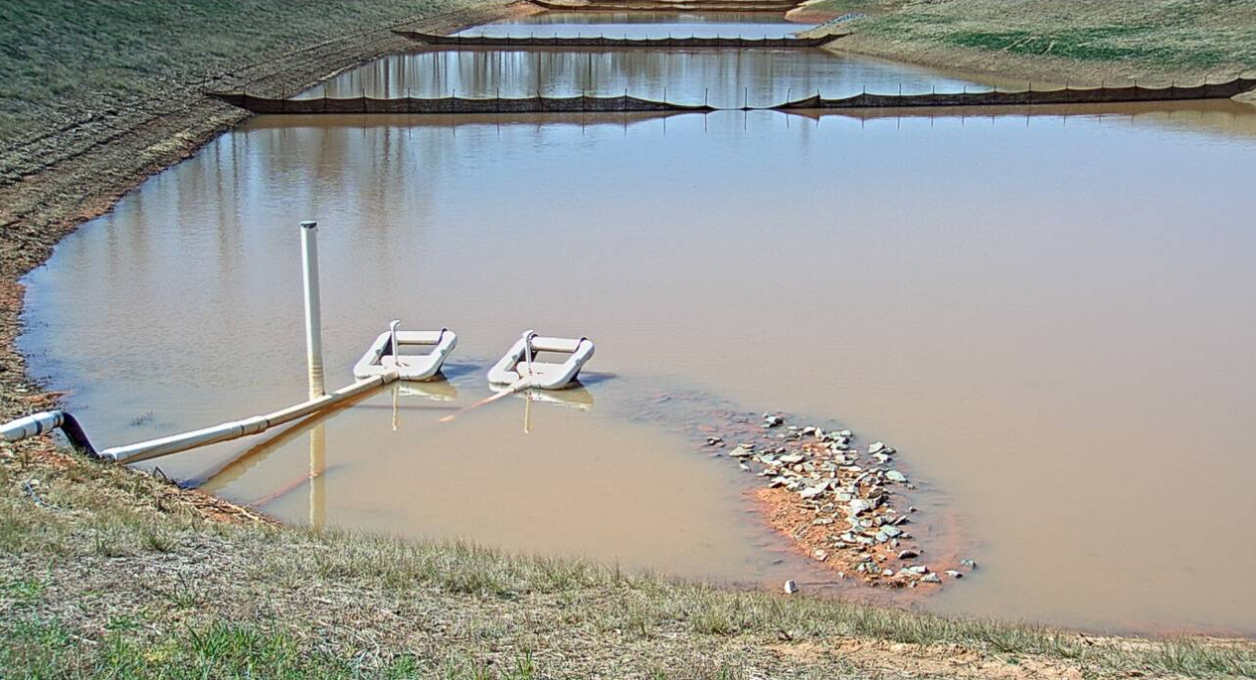
RIVERBEND SITE

Slide 48
RIVERBEND SITE
Automated monitoring option: Remote camera

Slide 49
RIVERBEND SITE
Remote Camera:
Axis P5624-E (720p resolution w/ 23X zoom and 360°pan)
Sierra Wireless Airlink RV50 (4G/LTE Modem)
Battery and solar powered
Programmed with ‘presets’
Real time web-accessible

Slide 50
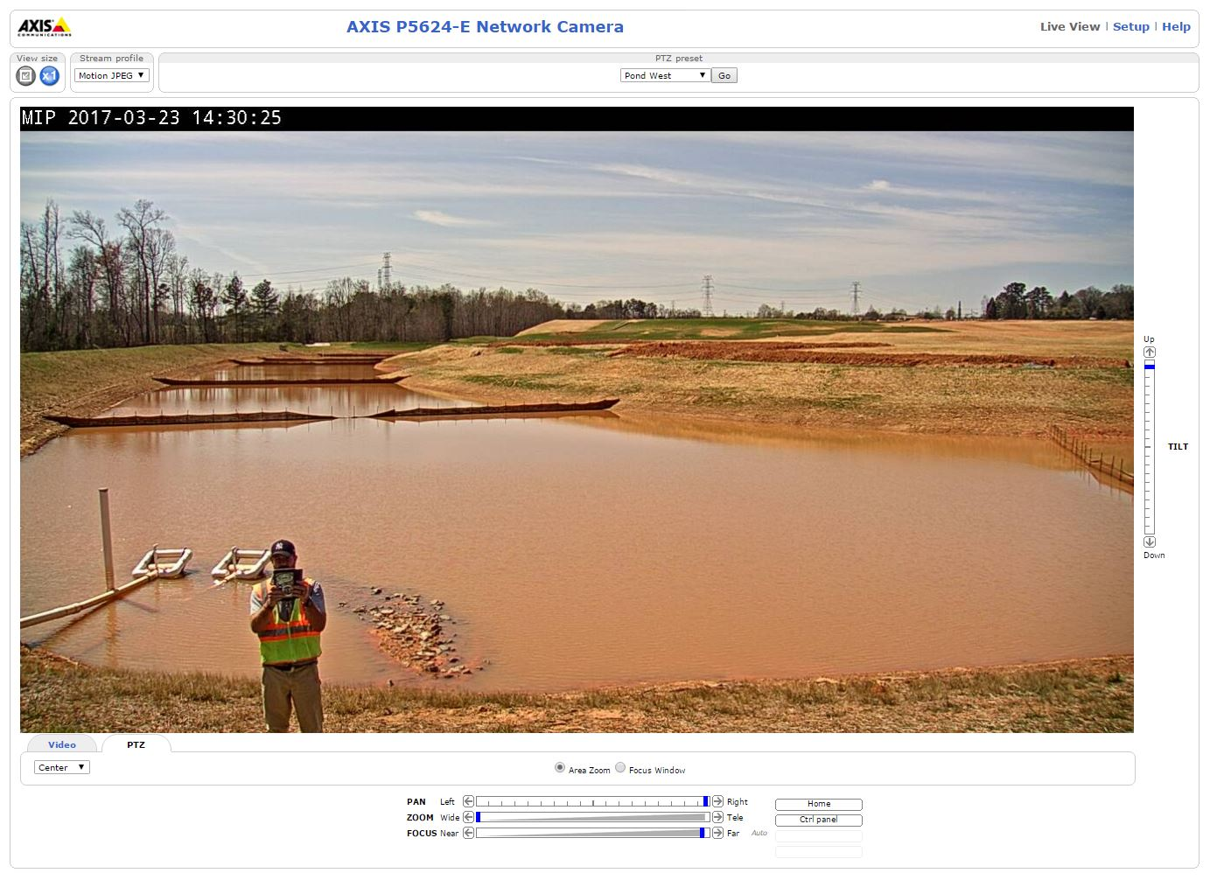

Slide 55
INNOVATION
Staff play a critical role in the innovative process
Plan review staff inspect measures in field
‘Cradle-to-grave’ dynamic
Relationship building

Slide 56
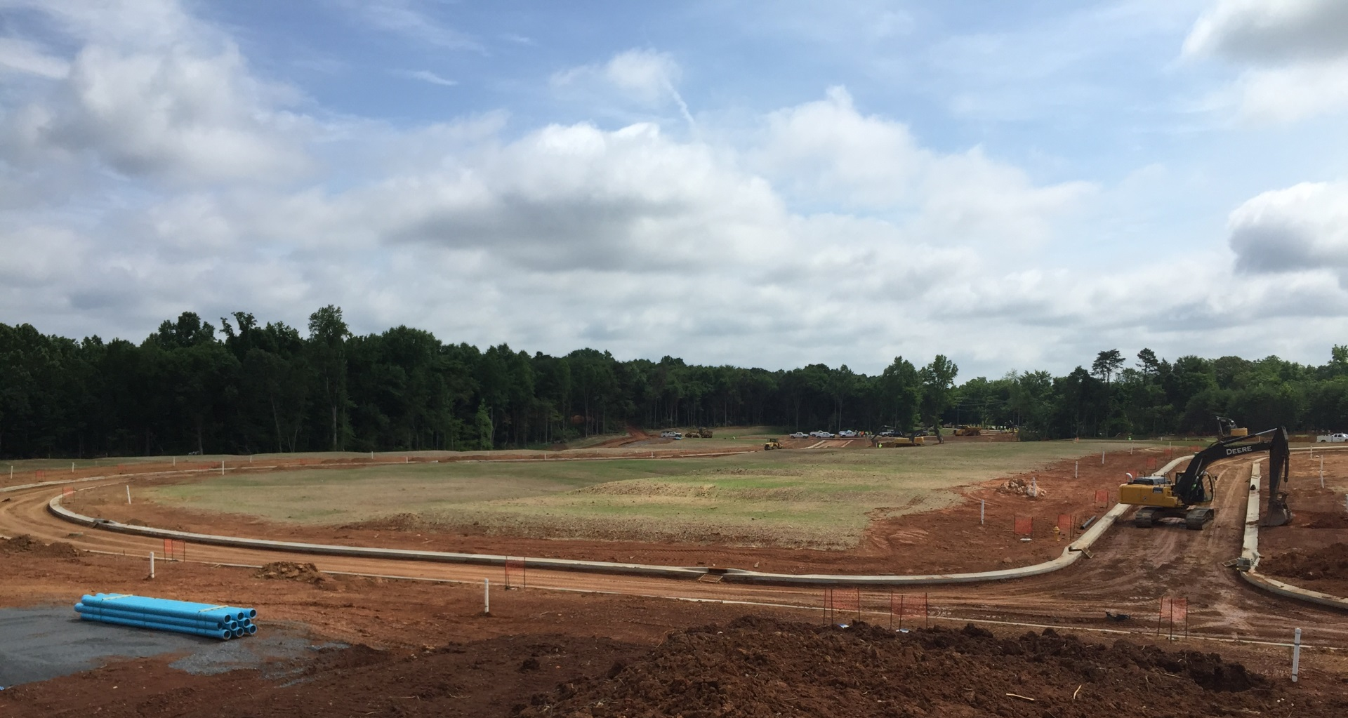
INNOVATION
5 day stabilization

Slide 57
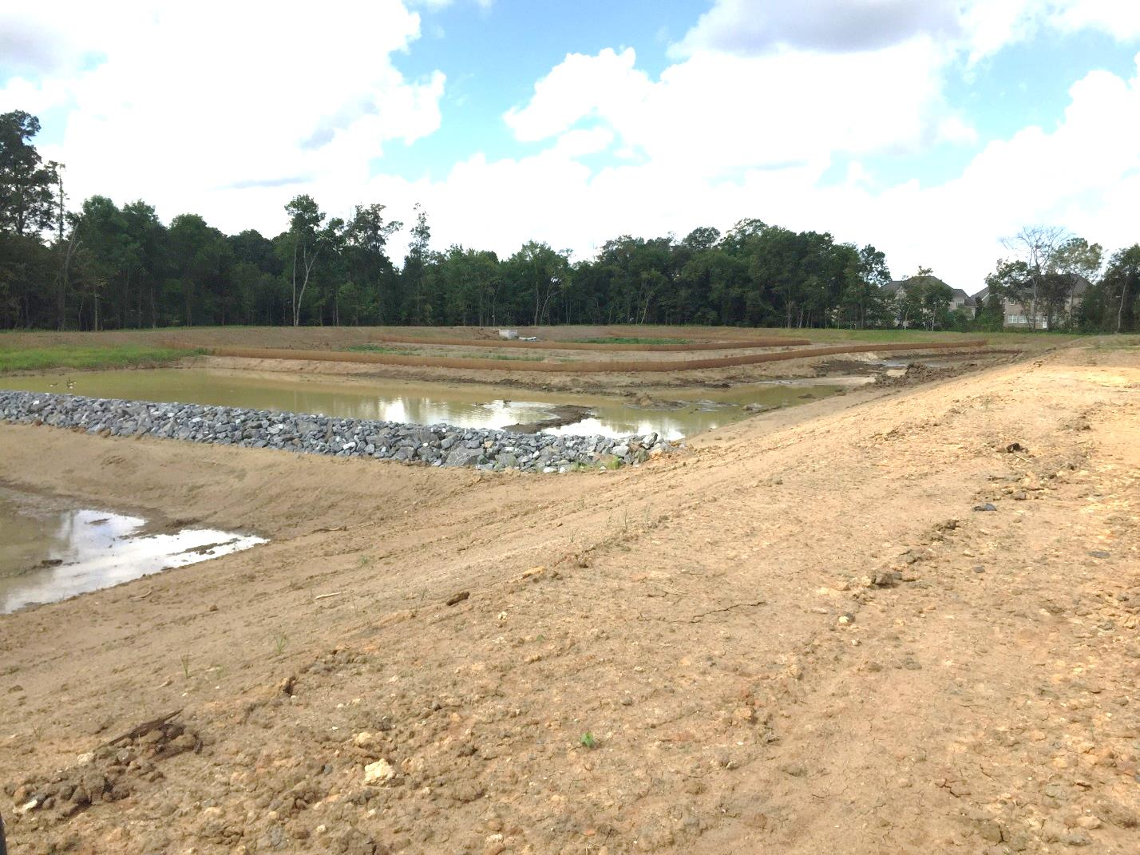
INNOVATION
Solving the PCSO + baffles problem…

Slide 58
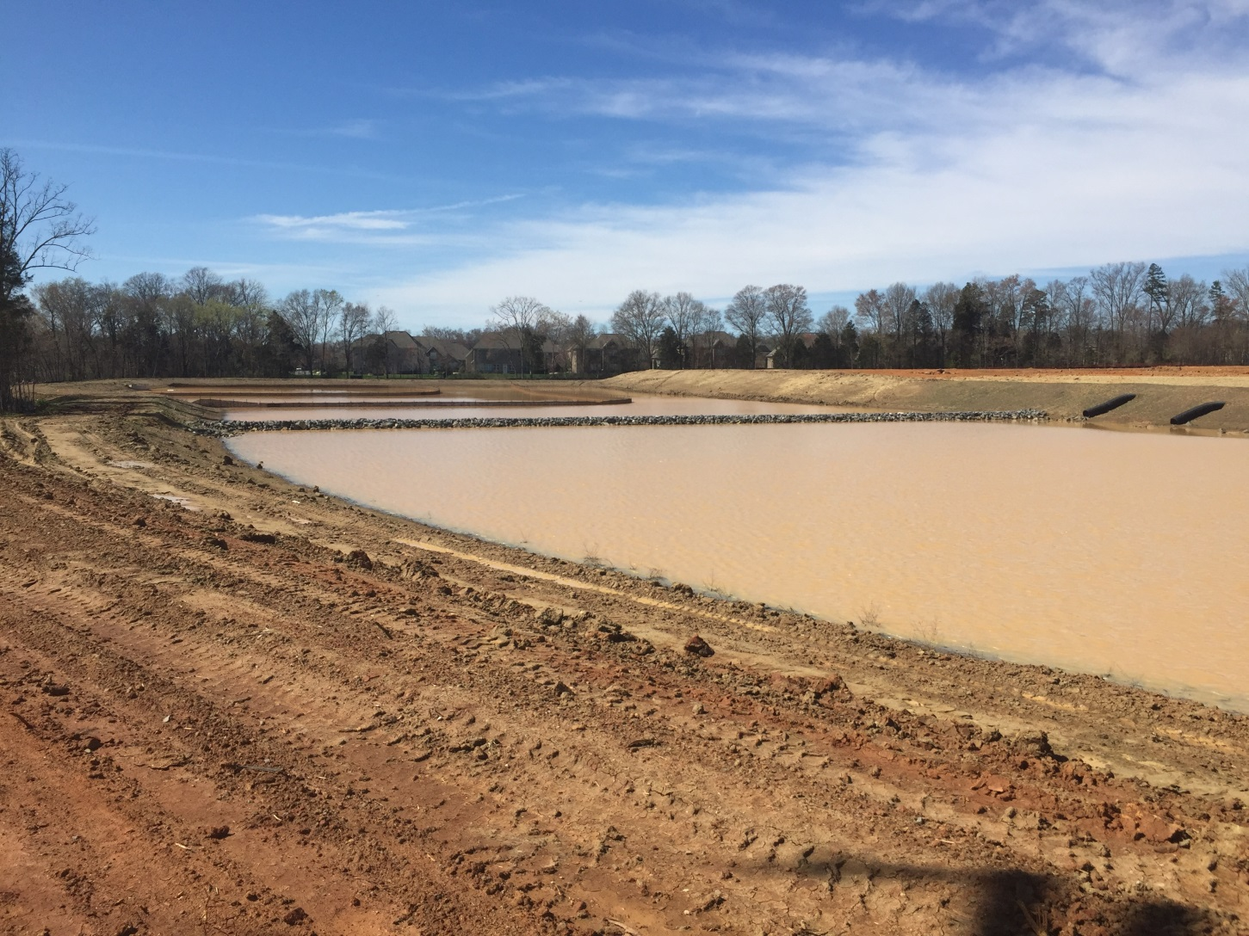
INNOVATION
Solving the PCSO + baffles problem…

Slide 59
Lengthy discharge?

Slide 60
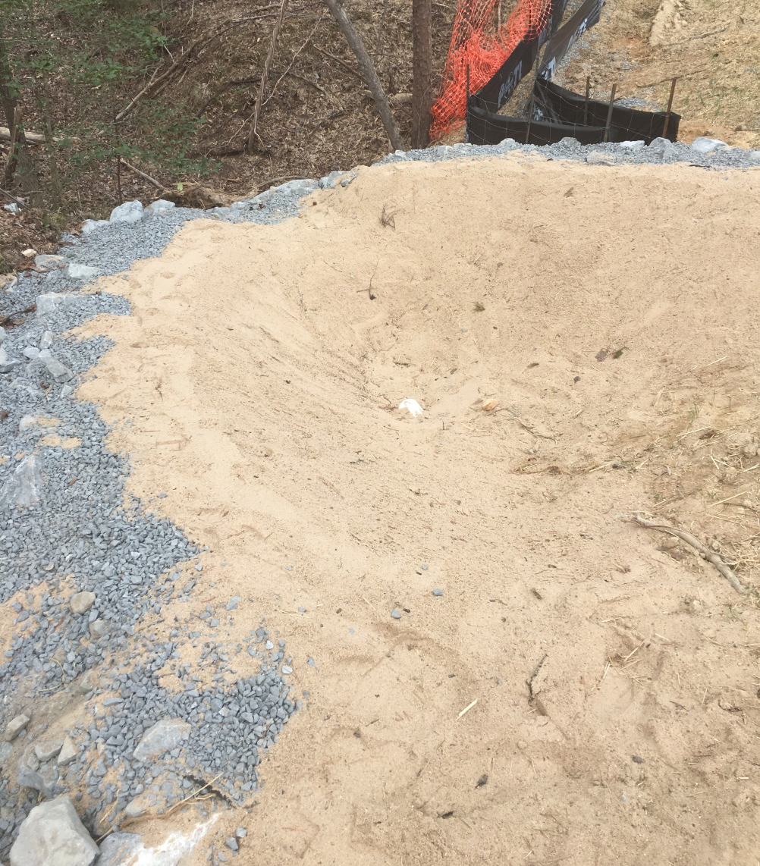
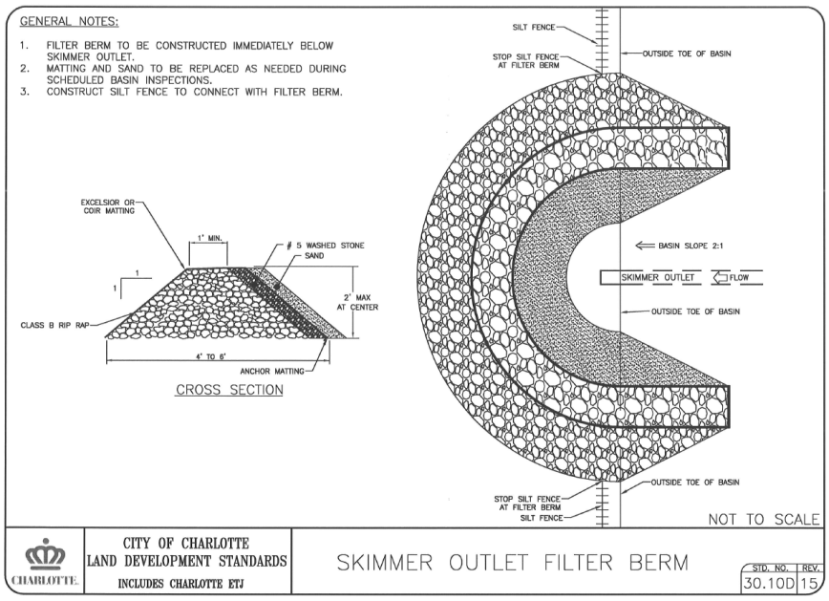
INNOVATION
Alternative to filter bag:

Slide 61
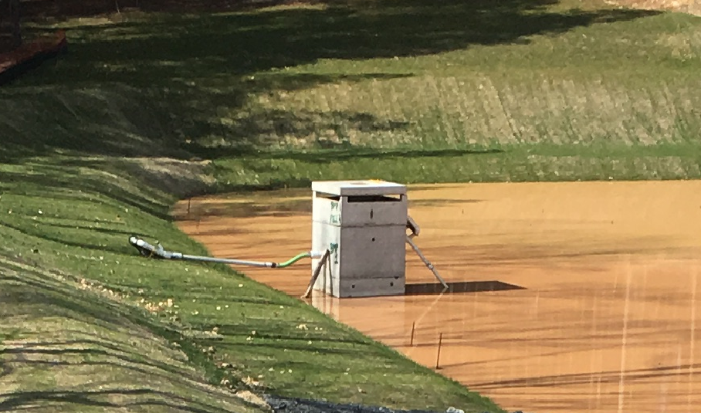
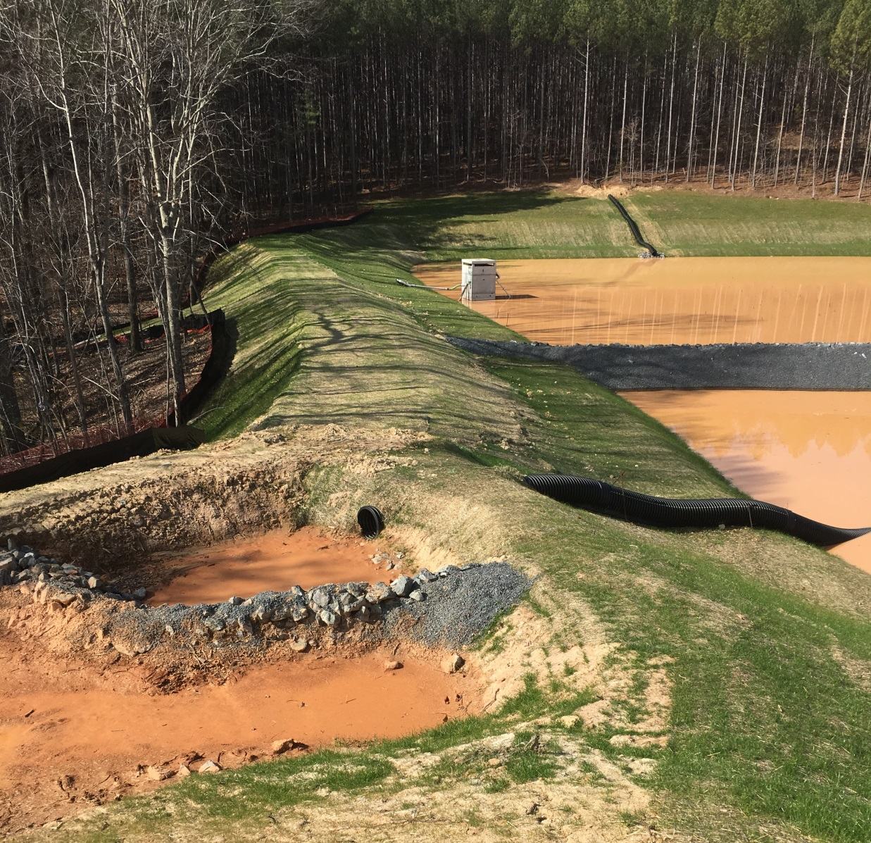
INNOVATION

Slide 62
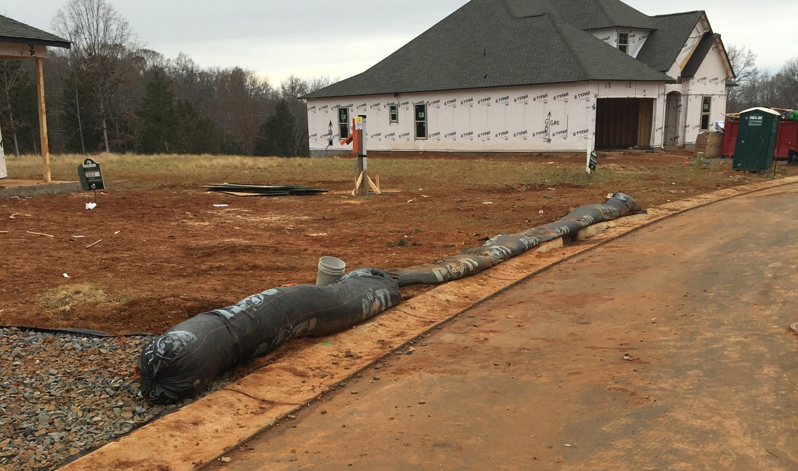
INNOVATION
New perimeter control?

Slide 63
INNOVATION

Slide 64
INNOVATION
In Summary
If you’re not getting better, you’re getting worse
Make sure plan reviewers get field time
Gain stakeholder support
Try something new, make it ‘above & beyond’
Capitalize on the ‘transition phases’
Monitor and refine…
Then test it again!
Ultimate goal: make it part of the toolbox

Slide 65
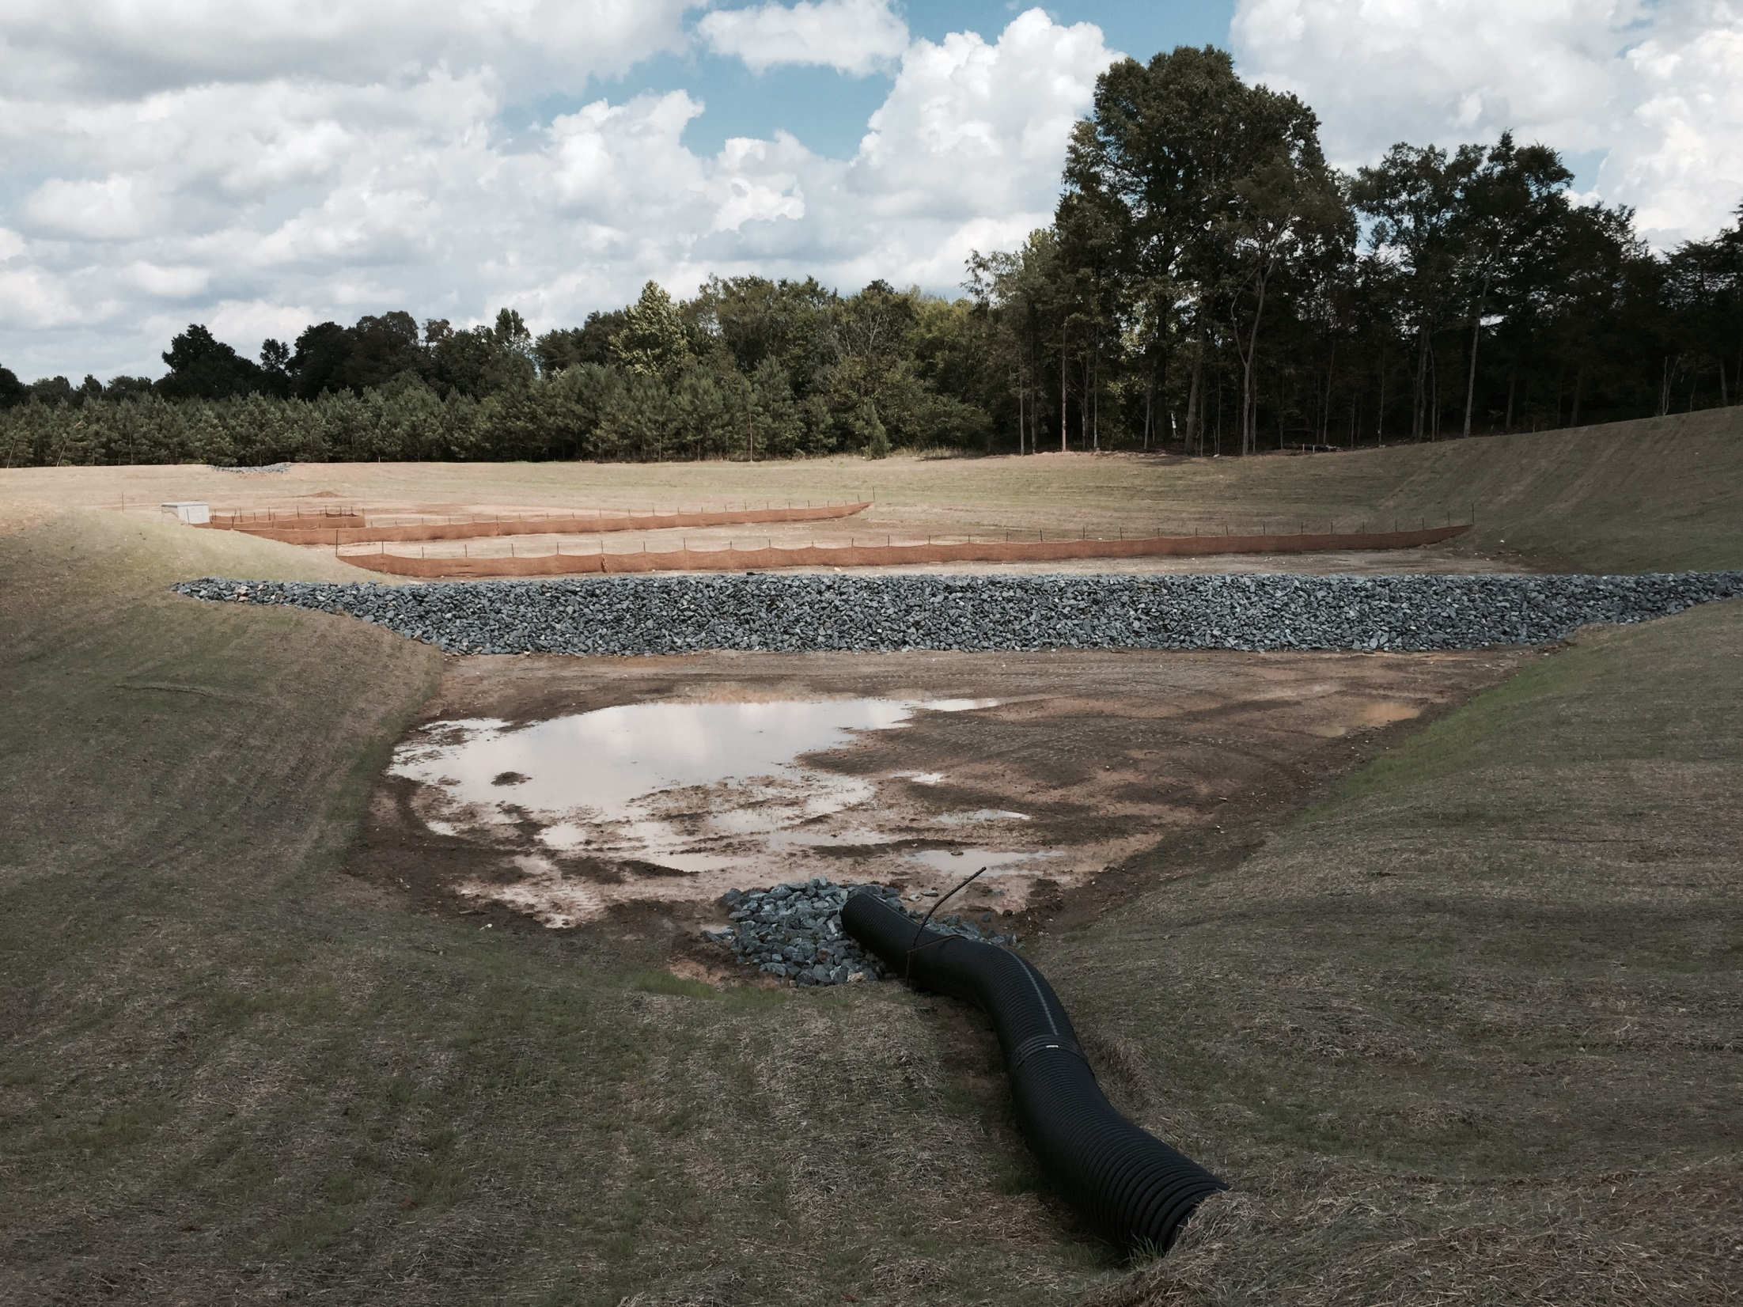
INNOVATION

Slide 66
THANK YOU!

Slide 67
LINKS
Live View Riverbend
Outlet Mall Discharge

