Slide 1
DEMLR Update to Mining Commission
October 13, 2026 - Mining Commission
Adam Parr
Deputy Director

Slide 2
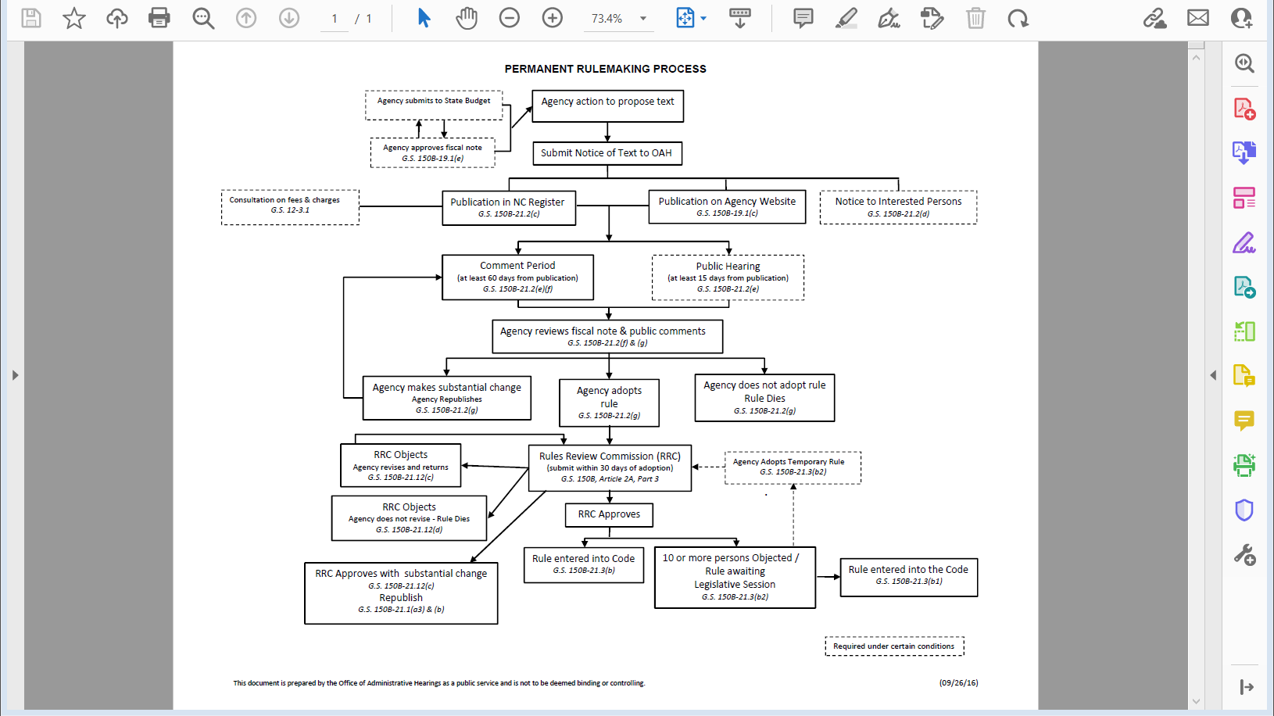
2017 Rules

Slide 3
Rules Review/Readoption – Status Update – 2027 Readoption
N.C. Gen. Stat. §150B-21.3A, adopted in 2013, requires state agencies to review existing rules every 10 years.
In May 2026, the Mining Commission readopted the rules from the 2017 readoption process.
The Mining Commission requested an exemption from the periodic review of existing rules beginning in 2027.
At the August 2026 meeting of the RRC the request for exemption was denied. Therefore, the Mining Commission must start the periodic review for 2027 and will need to file the determination reports by May 20, 2027.
Step 1 Agency Initial Determination Reports (Necessary/Unnecessary)
  Once approved by commission, report will be posted for a 60 day public comment period.
Step 2 RRC review of Agency Report
Step 3 RRC final Determination Reports
Department of Environmental Quality

Slide 4
Periodic Review and Expiration of Existing Rules
G.S. 150B-21.3A created by S.L. 2013-413.
Requires agencies to review its rules every 10 years.
Office of Administrative Hearings provides us a ‘report’ (excel spreadsheet) containing a listing of each rule.
Begin by classifying each rule as either Necessary or Unnecessary.
Mining Commission approves classifications for proceeding to 60-day public comment period (no hearing required).

Slide 5
Periodic Review and Expiration of Existing Rules G.S. 150B-21.3A
Receive and review all public comments on the rules and the classifications.
Rules that are Necessary = Readoption (Rulemaking)
Rules that are Unnecessary = Expire
Respond to all comments that are objections to a rule or the classification as defined in G.S. 150B-21.3A(a)(5). That response will be in the report itself. The Mining Commission is not required to respond to the individual commenter.

Slide 6
Periodic Review and Expiration of Existing Rules G.S. 150B-21.3A
Mining Commission makes final determination of the classifications and responses to public comment for submittal to the RRC.
If a comment is received objecting to the rule or the classification that was classified as Unnecessary, may need to change the classification to Necessary.
G.S. 150B-21.3A(c)(1) requires agencies to review the public comments and prepare a brief response addressing the merits of each comment to accompany the report filed for RRC review.
RRC’s authority to change the classification to Necessary if the comment has merit.

Slide 7
Periodic Review and Expiration of Existing Rules G.S. 150B-21.3A
The report, with the initial and final determinations and any public comments received are filed to the RRC.
Recently, the RRC approved June 2027 for the Mining Commission to complete this mandate.
This means the Mining Commission has to take final action and file to the RRC no later than May 20, 2027 in order to have the RRC review/approve at its June 2027 meeting.
Once approved by the RRC, the report, public comments & responses are submitted to the Joint Legislative Administrative Procedure Oversight Committee.

Slide 8
Periodic Review and Expiration of Existing Rules G.S. 150B-21.3A
Report becomes final if the Joint Legislative Administrative Procedure Oversight Committee meets or 61 days have passed once it was submitted to the Committee.
Unnecessary = Expire
Necessary = Readoption
Readoption is rulemaking. Preparing proposed amendments to existing rules, proposing repeal of a rule or creating new rules. FN developed & OSBM approval, 60-day comment period….
Readoption deadline to be established by the RRC….

Slide 9
Rules Review/Readoption – Status Update – Legislative Review
Legislative Review requires that;
  the Rules Review Commission (RRC) has approved the rules.
  The RRC has received 10 or more letters requesting that the rules undergo a legislative review.
The legislature will take up the review at the next regularly scheduled session.
  OAH will send the rules to legislature 25 days before the next regularly scheduled session.
The next session will be sometime in January, but the legislature had not set next year’s schedule.
Any legislator can introduce a bill to disapprove a rule. The bill must be introduced first 31 legislative days.
  Legislative Day is a day when either chamber meets
Rule will not become effective until either the bill is ratified, or the legislature adjourns.
If no bill is introduced, then the rules become effective after the 31st legislative day.
Department of Environmental Quality

Slide 10
2026-2027 Mining Commission Meeting Schedule
March 9, 2027 – 1 pm. Archdale Ground floor Hearing Room
September 28, 2027 – 1 pm. Archdale Ground floor Hearing Room
Department of Environmental Quality

Slide 11
AccessDEQ
AccessDEQ – Mining Application
Department of Environmental Quality

Slide 12
Mine Reclamation Award Discussion
Commission Discussion
Department of Environmental Quality

Slide 13
Questions
Adam Parr, PE
Deputy Director
Division of Energy, Mineral, and Land Resources
adam.parr@deq.nc.gov
919-707-9207
Department of Environmental Quality

