Slide 1
PAR Workshop, updated 2017
Compliance
Judgment,
SNC, and
PARs-
What Do I Do?
Presented by:
NC-DWR PERCS

Slide 2
Compliance Judgment, SNC, and PAR Workshop
Introduction to the Basics of Judging Compliance,
Dealing with SNC, and Compiling Annual Reports
Learn about and refresh yourself on:
How to Judge SIU Compliance
When are Industries Really Bad
What needs to be in the PAR
How to Fill Out All Those Forms
Who, What, and Where to Publish
What DWR Really Wants to See in a Narrative

Slide 3
Compliance Judgment, SNC, and PAR Workshop
Introduction to the Basics of Judging Compliance,
Dealing with SNC, and Compiling Annual Reports
Today’s Outline
1. Introduction-NPDES Requirement
2. Compliance Judgment
  SNC Definition
  SNC for Reporting/Permit Conditions
  SNC for Limits Violations
  Data Summary Form
  Compliance Judgment Examples

Slide 4
Compliance Judgment, SNC, and PAR Workshop
Introduction to the Basics of Judging Compliance,
Dealing with SNC, and Compiling Annual Reports
Today’s Outline (cont.)
3. IDSF
4. SNCR Form
5. PPS Form
6. Narrative
7. Waste Reduction
8. Public Notice
9. Enforceable Compliance Schedules (Orders)
10. Allocation Table

Slide 5
Introduction -NPDES Requirements
PART IV (from NPDES Permit)
OTHER REQUIREMENTS
D. Pretreatment Program Requirements
10. Pretreatment Annual Reports (PAR)
The permittee shall report to the Division in accordance with 15A NCAC 2H .0908. In lieu of submitting annual reports, Modified Pretreatment Programs developed under 15A NCAC 2H .0904 (b) may be required to meet with Division personnel periodically to discuss enforcement of pretreatment requirements and other pretreatment implementation issues.
For all other active pretreatment programs, the permittee shall submit two copies of a Pretreatment Annual Report (PAR) describing its pretreatment activities over the previous twelve months to the Division at the following address:
NC DENR / Division of Water Resources / Surface Water Protection Section
Pretreatment, Emergency Response, and Collection Systems (PERCS) Unit
1617 Mail Service Center
RALEIGH, NC 27699-1617

Slide 6
Introduction -NPDES Requirements (cont.)
These reports shall be submitted by March 1 of each year and shall contain the following:
a.) Narrative
A narrative summary detailing actions taken, or proposed, by the Permittee to correct significant non-compliance and to ensure compliance with pretreatment requirements;
b.) Pretreatment Program Summary (PPS)
A pretreatment program summary (PPS) on forms or in a format provided by the Division;
c.) Significant Non-Compliance Report (SNCR)
A list of Industrial Users (IUs) in significant noncompliance (SNC) with pretreatment requirements, and the nature of the violations on forms or in a format provided by the Division;

Slide 7
Introduction -NPDES Requirements (cont.)
d.) Industrial Data Summary Forms (IDSF)
Monitoring data from samples collected by both the POTW and the Significant Industrial Users (SIUs). These analytical results must be reported on Industrial Data Summary Forms (IDSF) or on other forms or in a format provided by the Division;
e.) Other Information
Copies of the POTW's allocation table, new or modified enforcement compliance schedules, public notice of IUs in SNC, a summary of data or other information related to significant noncompliance determinations for IUs that are not considered SIUs, and any other information, upon request, which in the opinion of the Director is needed to determine compliance with the pretreatment implementation requirements of this permit;

Slide 8
Introduction – NC Pretreatment Rules
from 15A NCAC 2H .0908(b)
Control Authorities with active approved pretreatment programs shall submit once per year a pretreatment report describing its pretreatment activities over the previous 12 months. Two copies of each pretreatment report shall be submitted to the Division by March 1 of each year for activities conducted for two six-month periods, January 1 through June 30 and July 1 through December 31 of the previous year. This annual report shall contain the following information in accordance with forms specified by the Division:
(1) a narrative summary of actions taken by the control authority to ensure compliance with pretreatment requirements;
(2) a pretreatment program summary on forms or in a format provided by the Division;

Slide 9
Introduction - NC Pretreatment Rules (cont.)
from 15A NCAC 2H .0908(b) (cont.)
(3) A list of industrial users in significant noncompliance with pretreatment requirements, the nature of the violations, and actions taken or proposed to correct the violations; on forms or in a format provided by the Division;
(4) An allocation table as described in Rule .0916(c)(4) listing permit information for all significant industrial users, including but not limited to permit limits, permit effective and expiration dates, and a comparison of total permitted flows and loads with Division approved maximum allowable loadings of the POTW, including flow, on forms or in a format provided by the Division;

Slide 10
Introduction - NC Pretreatment Rules (cont.)
from 15A NCAC 2H .0908(b) (cont)
(5) Other information which in the opinion of the Division Director is needed to determine compliance with the implementation of the pretreatment program, including, but not limited to, significant industrial user compliance schedules, public notice of industrial users in significant noncompliance, a summary of significant industrial user effluent monitoring data as described in Paragraphs (a) and (e) of this Rule, a summary of information related to significant non-compliance determination for industrial users that are not considered significant industrial users, and Long or Short Term Monitoring Plan data on forms or in a format provided by the Division;

Slide 11
Introduction - NC Pretreatment Rules (cont.)
40 CFR 403.12(i) Annual POTW reports
Updated list of SIUs (AT)
Compliance status (SNCR)
Summary of enforcement activities (PPS & narrative)
Summary of program changes (narrative & program info sheet)
Any other relevant information

Slide 12

Compliance Judgment

Slide 13
Compliance Judgment
Detection of Violations of ALL Types:
1. Limits
2. Reporting
3. Permit Conditions
References:
  DWR Approved Enforcement Response Plan (ERP) for Your POTW
  Comprehensive Guide, Chapter 7, Sections D and E
  Comprehensive Guide, Chapter 8
  PERCS web-site files “So your SIU has a limits violation-What do you do?” and “So your SIU has a reporting violation-What do you do?”

Slide 14
Compliance Judgment – What must be done
POTW must identify all violations in a timely fashion as outlined in your ERP (preferably monthly).
POTW must issue a Notice of Violation (NOV) for all violations.
Significant Noncompliance (SNC) is a way of separating out the more significant violations for escalated enforcement action.

Slide 15
Compliance Judgment - What must be done (cont.)
POTW must do a SNC determination at a minimum of every six months.
  It is strongly recommended that a preliminary SNC determination be done halfway through the six-month period, especially where there was SNC in the previous period.
The SNC determination must be within 30 days of receiving all the data for that period.
SNC determination and follow-up enforcement action for the January through June reporting period should be completed no later than September 1 of that same year.
SNC Determination and follow-up enforcement action for the July through December reporting period should be completed no later than March 1 of the following year.

Slide 16
Compliance Judgment - What must be done (cont.)
Repeat SNCs
  Repeat SNCs are a serious matter.
  If an Industry will be in SNC for a second consecutive period for the same parameter or requirement, the Division expects the POTW to take “appropriate action.”
  The typical choices for “appropriate action” are:
    modify permit
    place SIU on an enforceable compliance schedule
    SIU ceases discharge (on their own or by order of POTW)
    SIU dropped from POTW’s list of SIUs

Slide 17
Compliance Judgment - What must be done (cont.)
Repeat SNCs (cont.)
  The POTW should make every effort to take the “appropriate action” before the end of the second consecutive SNC Period.
  In those special cases where this is not possible, take the “appropriate action” within two months after the end of that second period. If this is not done, the Division may take enforcement action against the POTW for failure to take adequate enforcement.
  Call DWR to discuss extenuating circumstances

Slide 18
SNC Definition
So Not Cool?
Significantly Naughty Company?
Still Not Compliant?
Sustained negative component?
Seriously Not Cooperating?
Siempre No Comprenden?

Slide 19
SNC Definition
Significant Noncompliance is defined by 15A NCAC 2H .0903(b)(34) and Section 1.2(a)(35) of the NC Model Sewer Use Ordinance (SUO) as follows:
  ‘Significant Noncompliance’ or ‘SNC’ is the status of noncompliance of a significant industrial user when one or more of the following criteria are met:….

Slide 20
SNC Definition (cont.)
(A) Chronic violations of wastewater discharge limits, defined here as those in which sixty-six percent or more of all the measurements taken for the same pollutant parameter (not including flow) during a six-month period exceed (by any magnitude) a numeric pretreatment standard or requirement including instantaneous limits, as defined by 40 CFR Part 403.3(l);
Chronic SNC is when 66% or more are > limit!

Slide 21
SNC Definition (cont.)
(B) Technical Review Criteria (TRC) violations, defined here as those in which thirty-three percent or more of the measurements taken for the same pollutant parameter (not including flow) during a six-month period equal or exceed the product of the numeric pretreatment standard or requirement, including instantaneous limits, as defined by 40 CFR 403.3(l) multiplied by the applicable TRC; (TRC = 1.4 for BOD, TSS, fats, oil and grease, 1.2 for all other pollutants (except flow and pH));
TRC SNC is when 33% or more are > or = TRC value!

Slide 22
SNC Definition (continued)
(C) Any other violation of a pretreatment standard or requirement as defined by 40 CFR 403.3(l) (daily maximum, long-term average, instantaneous limit, or narrative standard) that the control authority (or POTW, if different from the control authority) determines has caused, alone or in combination with other discharges, interference or pass through (including endangering the health of POTW personnel or the general public);
(D) Any discharge of a pollutant or wastewater that has caused imminent endangerment to human health, welfare or to the environment or has resulted in either the control authority’s or the POTW’s, if different than the control authority, exercise of its emergency authority under 40 CFR Part 403.8(f)(1)(vi)(B) to halt or prevent such a discharge;

Slide 23
SNC Definition (continued)
(E) Failure to meet, within 90 days after the schedule date, a compliance schedule milestone contained in a pretreatment permit or enforcement order for starting construction, completing construction, or attaining final compliance;
(F) Failure to provide, within 45 days after the due date, required reports such as baseline monitoring reports, 90-day compliance reports, self-monitoring reports, and reports on compliance with compliance schedules;
(G) Failure to accurately report noncompliance;
(H) Any other violation or group of violations that the control authority or POTW determines will adversely affect the operation or implementation of the local pretreatment program.
Additionally, effective January 1, 2012, any industrial user which meets the criteria in Parts (C), (D), or (H) of this Subparagraph shall also be in SNC;

Slide 24

Compliance Judgment for Reporting
(includes permit condition)

Slide 25
Compliance Judgment for Reporting
(includes permit condition)
Applies to any kind of report or notification
1) Failure to collect self-monitoring samples
2) Failure to submit reports or follow permit conditions. Includes reports being late or incomplete as well as complete failure to submit report or follow IUP condition at all. Types of reports include but are not limited to:
sample results
flow monitoring reports
24 hour notification
resample and submit results within 30 days
properly operate pretreatment units
change in process
obtain Authorization to Construct
file application for IUP renewal
sludge management plans
slug/spill plans
TTO certification

Slide 26
SNC For Reporting/Permit Conditions
You only need to make this determination if there were violations
a) Miss due dates for compliance schedule milestones in IUP or order by more than 90 days
  Only required to apply this to due dates for:
    starting construction,
    completing construction, or
    attaining final compliance
  Can be applied to other major one-time reports like slug/spill plans

Slide 27
SNC For Reporting/Permit Conditions (cont.)
b) Miss due date for report in IUP or order by more than 45 days
  Applies to due dates for reports such as:
    Baseline monitoring reports,
    90-day compliance reports,
    Self-monitoring reports, and
    Reports on compliance with compliance schedules
  Can be applied to other routine reports like:
    TTO certification
    24 hour notifications, and
    Resampling

Slide 28
SNC For Reporting/Permit Conditions (cont.)
c) Inaccurately report noncompliance;
d) Any other violation or group of violations that the control authority or POTW determines will adversely affect the operation or implementation of the local pretreatment program.

Slide 29
SNC For Reporting/Permit Conditions (cont.)
Completed on a Six Month Basis, but really applies to each report
Examples:
1) An Industry is required by their IUP to sample monthly for 10 parameters and report the results to the POTW by the 20th day of the month following the month in which the samples were collected. The results of the samples collected in July, due August 20, are not received until October 23.

Slide 30
SNC For Reporting/Permit Conditions (cont.)
2) Industry fails to collect the required samples in November at all.
3) An Industry is required by their IUP to re-apply by February 1 (180 days before the IUP expires on August 1) and the application is not received until May 15.
Call DWR to discuss any extenuating circumstances
See Addendum for discussion and some examples of extenuating circumstances

Slide 31
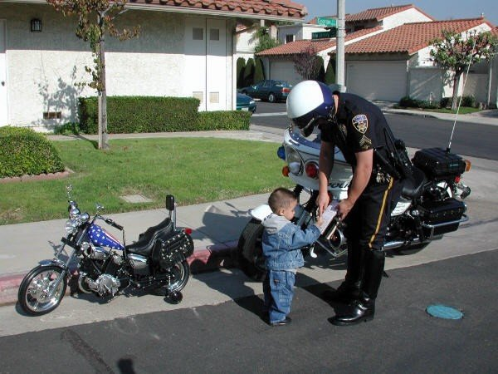
SNC for Limits Violations

Slide 32
SNC for Limits Violations
You only need to make this determination if there were violations
SNC for Limits Categories
a) Pass-through/Interference
b) Threat to Human Health, Welfare or the Environment
c) Emergency Suspension from such a Discharge

Slide 33
SNC for Limits Violations
SNC for Limits Categories (cont.)
d) Chronic Violations (those that exceed limit by any quantity)
e) Technical Review Criteria (TRC) Violations
(those that equal or exceed an adjusted limit by any quantity)
  Limit * 1.4 for BOD, TSS, fats, oils, and grease
  Limit * 1.2 for all other parameters, except pH

Slide 34
SNC for Limits Violations
SNC for Limits Categories (cont.)
f) Any other violation or group of violations that the control authority or POTW determines will adversely affect the operation or implementation of the local pretreatment program.

Slide 35
SNC for Limits Violations (continued)
Completed on a Six Month Basis
Calculated For Each Limit
  For Example:
  An Industry has both a daily maximum concentration limit as well as a monthly average concentration limit for BOD. At the end of the six month period, when calculating SNC for the parameter of BOD, you judge SNC for BOD separately for the daily max and the monthly average limits. (Note: was effective as of January 1, 2012).

Slide 36
SNC for Limits Violations (continued)
Forms Used For SNC
  Industrial Data Summary Forms (IDSF) or other forms or in a format provided by the Division;
  Compliance Judgment Worksheet (Ch. 7, North Carolina Comprehensive Guidance for Pretreatment Programs)
Other
  SNC for pH (no TRC required)
  SNC for Flow (flow is not a “pollutant”)
Call DWR to discuss extenuating circumstances
See Comp Guide for discussion of SNC for pH and flow, also see Addendum Questions 32-36 for more info on SNC evaluation for flow.
See Addendum for discussion and some examples of extenuating circumstances.

Slide 37
Data Summary Form

Slide 38
Data Summary Form

Slide 39
Data Summary Form

Slide 40
Data Summary Form

Slide 41
Data Summary Form

Slide 42
Data Summary Form

Slide 43
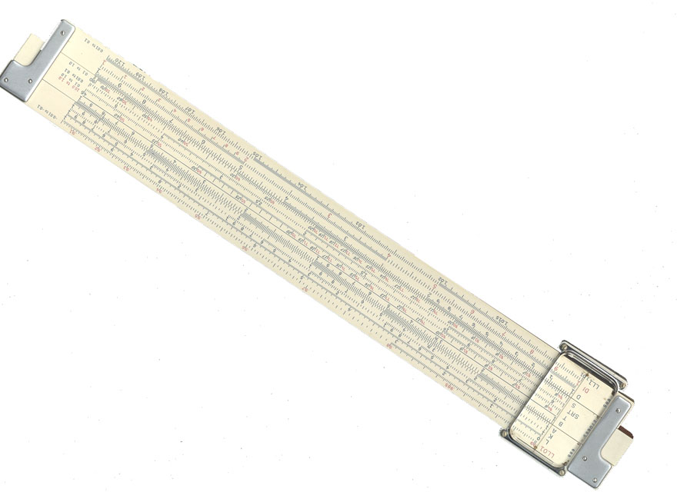
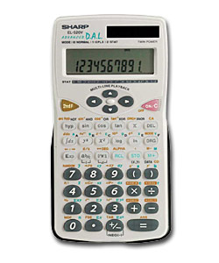

Limits Compliance Judgment Examples

Slide 44
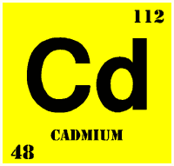
Example 1
WillPlateit Metal Finishers
1st 6-month period
Cadmium

Slide 46
Count- The number of daily or the number of average sample values used for checking compliance. (Daily values for this example)

Slide 50
8/12
66.7%
2/12
16.7%
Per ORC

Slide 51
Example 2
WillPlateit Metal Finishers
2nd 6-month period
Cadmium

Slide 56
6/10
60.0%
4/10
40.0%
Per ORC
Now What?

Slide 57

Example 3
WillPlateit Metal Finishers
2nd 6-month period
Nickel

Slide 59
2.86 or 2.856? Does it matter in this case?

Slide 60
2.86 or 2.856? Does it matter in this case?
Column 9: The Reported value is equal to the Limit.
This is not a violation!

Slide 61
2.86 or 2.856? Does it matter in this case?
Column 9: The Reported value is equal to the Limit.
This is not a violation!
Either 2.86 or 2.856 results in a TRC violation. Column 10: Reported value equal to or above TRC limit, is a violation

Slide 62
3/10
30.0%
2/10
20.0%
Per ORC

Slide 63
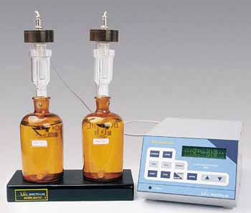
Example 4
Chicken Pluckers, Inc.
1st 6-month period
BOD

Slide 65
“Or” (separate)
As of 1/1/2012 NC will use “or”. Compliance for daily max & monthly (or other) average limits judged separately.
Potential for more SNC.

Slide 72
Per ORC
Only first time SNC, but don’t wait until after end of 2nd six months. If violations continue into beginning of 2nd six months, start planning ahead which option is best.
Is there even more?
Let’s look again.

Slide 73
Weekly industrial sampling is required in the IUP (because SIU flow and load is so large compared to MAHL).
Which is worse from your industries: A known violation or an unreported sampling event?

Slide 74
“Or” Options
Keep same daily max & monthly average limits
  No change to allocation table
  Have to perform SNC calculations treating daily & monthly limits separately
    Some POTWs may have to revise compliance judgment programs
  May cause more SIU violations and SNC
Remove monthly avg. Daily max = old monthly avg
  No change to allocation table
  Simplifies compliance judgment
  May cause more SIU violations and SNC

Slide 75
“Or” Options
    Remove monthly average limit and keep daily max limit
      a. Have to use higher daily max limit in allocation table. May reduce reserve; may cause over allocation.
      b. Simplifies compliance judgment
      c. Should not create more violations
      Note: Options 2 &3 may not be available for some categorical SIUs. Contact PERCS to discuss.

Slide 76
Data Summary Form as Limits Compliance Judgment Worksheet
Limit = 0.07 mg/l
TRC = 0.084
10 daily samples
6 Viol = 6/10 =60%
4 TRC = 4/10 = 40%

Slide 77

Industrial Data Summary Form (IDSF)

Slide 78
Industrial Data Summary Form (IDSF)
Summarizes All Data Collected for an Industry
1) SIU and POTW Sampling for Limited Parameters
2) SIU and POTW Sampling for “Monitoring Only”
Parameters
Required to Complete a Separate IDSF for Each Pipe at Each SIU
You May Use Your Own Form with Prior Division Approval of the Form

Slide 79
Industrial Data Summary Form (IDSF)
For Each Parameter, Include at Least One of the Following:
1) Maximum Concentration
2) Maximum Loading
3) Average Concentration
    Specifying what type of average
    If BDL, ½BDL, or 0 was used
4) Average Loading
If readily available, the Division prefers both maximum and average values

Slide 80
Industrial Data Summary Form (IDSF)
Blank sections indicate that there was no monitoring performed for particular parameter during a six-month period.
For “monitoring only” parameters, list “N/A” for not applicable in the % violations and % TRC violations rows (do not list “0”)

Slide 81
IDSF for SIUs with both daily and average limits
N/A because no IUP Limit for these Parameters

Slide 82
Why was this data not required? Discuss in narrative.

Slide 84
Data Summary Form as IDSF
Limit = 0.07 mg/l
TRC = 0.084
10 daily samples
6 Viol = 6/10 =60%
4 TRC = 4/10 = 40%

Slide 85
Significant Non-Compliance Report (SNCR)
List all IUs in SNC with any IUP requirement for the PAR Year
1) Limits Violations
2) Pass-Through and Interference
3) SNC for Reporting and/or IUP Conditions
Remember to attach copy of Historical SNC Report so DWR can review for repeat SNCs
POTW must still take that appropriate enforcement or other action for SIUs that will be in SNC for a second consecutive six month period
Remember, repeat SNCs are a serious matter.

Slide 87
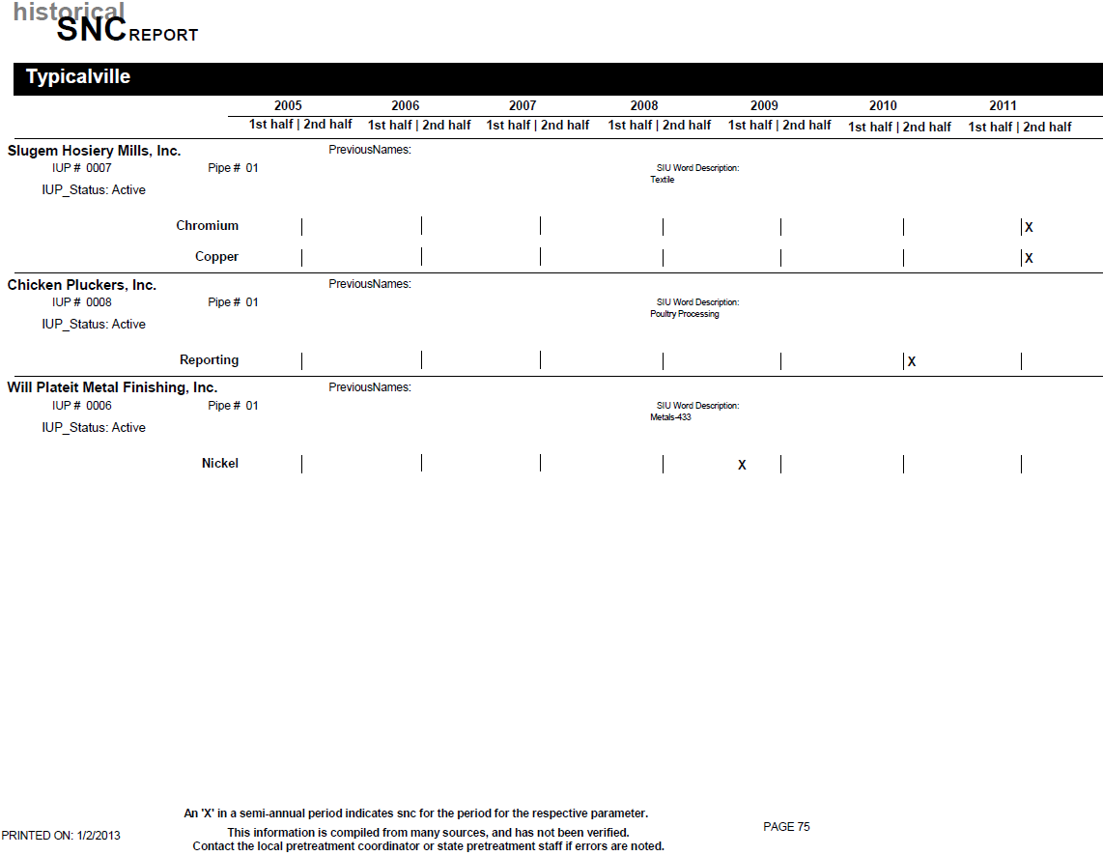

Slide 88
Pretreatment Performance Summary (PPS)
Form adapted to gather information for the EPA database
Counts # of:
  SIUs and CIUs
  NOVs and similar actions
  SIUs in SNC
  Public Notices
  Enforcement Cases
  Penalties Assessed and Collected
  Compliance Schedules

Slide 89
Pretreatment Performance Summary (PPS)-Explanations
Refer to Chapter 9, Section B, pg. 2-4, in Comprehensive Guide for help in completing PPS Form.
In addition to the Comprehensive Guide, the following comments further explain how to complete some of the lines of the PPS form.
Line # 5. Number of SIUs permitted and/or discharged during PAR year. Discuss new or dropped SIUs in narrative.
Line # 13. Total number of SIUs on a compliance schedule: This is the total number of industries on a compliance schedule as part of an enforcement action during the reporting period. These schedules are issued outside of, or separate from, the IUP. If an industry is on a compliance schedule that is part of an IUP, this is not included in the PAR. This type of compliance schedule is not considered an enforcement action that includes stipulated penalties, and it should therefore not be included.
Lines # 14,15,16,17. are based on number of events during PAR year, and do not include events occurring after PAR year.
Line # 20. Total amount of Civil Penalties collected: This is the actual amount in fines that was collected from the industries during this twelve month period. This can include collection of penalties assessed during prior reporting periods. A total of $1850 was assessed to the three industries in this PAR. Of this amount, only $850 was collected. However, an additional $500 was collected from Slugem for fines assessed during the period of July 1-December 31, 2012. The total fines actually collected totaled $1350 out of a possible $2350.
Line # 21. Number of SIUs from which penalties collected. This is the total number of industries that actually paid penalties during the year. Three of our industries were assessed penalties, and all three paid them.

Slide 90
Line # 5. Number of SIUs actually permitted and/or discharging during PAR year. Discuss new or dropped SIUs in narrative.

Slide 91
Chicken P. & Will Plateit
Chicken P.

Slide 92
Chicken P. & Will Plateit

Slide 93
Line # 13. Total number of SIUs on a compliance schedule:
This is the total number of SIUs on a compliance schedule as part of an enforcement action during the reporting period. These schedules are issued outside of, or separate from, the IUP. If an SIU is on a compliance schedule that is part of an IUP, this is not included in the PAR.
Chicken Pluckers on a schedule within the IUP and WillPlateit schedule not in effect until 2013

Slide 94
Lines # 14,15,16,17. are based on number of events during PAR year, and do not include events occurring after PAR year.

Slide 95
Line # 18. Permitted CIUs during PAR year
Will Plateit
Line # 19. CIUs in SNC during PAR year
Will Plateit

Slide 96
Line # 20. Total amount of Civil Penalties collected:
This is the actual amount in fines that was collected from the industries during this twelve month period. This can include collection of penalties assessed during prior reporting periods.

Slide 97
Line # 21. Number of SIUs from which penalties collected. This is the total number of industries that actually paid penalties during the year.

Slide 98
Narrative
Once upon a time in a far off place…….
Once upon a time in a far off place…..

Slide 99
Narrative
Recommended Outline for Narrative
Provided to:
  Help you organize your PAR Narratives.
  Help you determine what information is required or optional.
  Help you understand how information is checked
  Make it easier for us to find specific and useful information in the narratives.
Some information is optional. It has been noted or italicized in both the guidance text and in the examples.
This Guidance is available by e-mail, and on our web page.
http://deq.nc.gov/about/divisions/water-resources/water-resources-permit-guidance/pretreatment-guide/annual-report-guidance

Slide 100
Outline of a Typical Narrative:
1. General Information:
A. General Program Information.
B. General Permit Information.
2. IU Information:
A. IUs in SNC Information.
B. Orders and Schedule Information.
C. A to C and Construction Information.
D. SIUs with Missing Data.
Optional:
E. Enforcement Actions by POTW, and Industry Responses, for Non-SNC, Non-Order, Non-construction events
F. Other Information

Slide 101
Outline of a Typical Narrative (cont.):
If you have no IUs in SNC, on Orders, or having pretreatment construction activities, or missing data, your PAR Narrative may be as simple as the Division's two database items, with any corrections noted.
  Program Info. Sheet
  Historical SNC database sheet(s)
  Still need all other required PAR forms for your type of Program – Full versus Modified Programs!

Slide 102
Description of Narrative details:
General Information:
A. General Program Information:
1. Pretreatment Program Info. Sheet
(provided to you by the PERCS Unit with the end of year mailing)
  Status of Major Pretreatment Program Elements - LTMP/STMP, HWA, ERP, SUO, IWS - Are the dates and information correct, especially due dates?
  Include any needed corrections marked on the Info Sheet returned with the PAR
  Note, copies of the Program Info. Sheet are available upon request from the PERCS Unit.
2. Discuss Planned updates of major program elements in narrative.

Slide 103
Description of Narrative details:
General Information:
B. General Permit Information:
1. Did you have any permits expire before being
renewed ? LIST THEM, & WHY.
2. Did you have any SIU Permits that were Brand New, Dropped, or Changed Names during the Year ? Please list them.

Slide 104
Description of Narrative details:
General Information:
B. General Permit Information (cont.):
Optional
  Dates for these permit actions may be listed here as useful reference.
  We realize that some or all of these dates will have already been submitted to the Division with permit renewals, modifications, and drops.
  If you have permits that have been submitted to the Division and you have not received review letter back from the Division, you may note that here.
  For new permits, when did the permit become effective and when did the SIU actually begin discharge? Note, if a lag between these dates results in "missing" data, it must be explained (see "Missing" Data section below).

Slide 105
Description of Narrative details:
IU INFORMATION:
Please LIST alphabetically by IU name:
A. IUs in SNC Information:
1. All IUs in SNC MUST be included in the Narrative and listed on the SNCR Form !
2. Note the reason(s) and which six-month period(s) they were in SNC.
3. If SNC for limits, note if was due to chronic, TRC, or both. Information should match what is on your IDSF and SNCR Forms.
4. If SNC for something other than limits, such as: reporting, missing data/self monitoring, interference, pass-through, permit conditions, etc. please explain.

Slide 106
Description of Narrative details:
IU INFORMATION:
A. IUs in SNC Information: (cont.)
5. Enclose a copy of the Public Notice for SNC, or affidavit. If Public Notice is not in the PAR explain why not. PAR will not be considered complete until Public Notice is received.
6. Explain how a SNC situation was or will be resolved; such as: increased limit, shut down, installed or improved pretreatment, better operations, production changes, etc.
7. Explain how previous SNC situations were resolved if resolution occurred in this PAR year.

Slide 107
Description of Narrative details:
IU INFORMATION: (cont.)
B. Orders or Schedule Information: For SIUs on an Order of any kind (including Administrative Orders, Consent Orders, Compliance Schedules) at any time during the PAR year, include the following information:
1. A copy of the Order/Schedule with the PAR. If Order/Schedule has been modified since last submitted, include a new copy with the PAR.
2. Notes on all successfully completed Orders/Schedules.
3. Notes on all due dates in the Order/Schedule.
4. Notes on violations of any interim limits or due dates. Explain what and why and discuss penalties assessed and penalties collected. You may (optional) attach copies of NOVs and correspondence.

Slide 108
Description of Narrative details:
IU INFORMATION (cont.):
C. Pretreatment (AtoC) and Construction Info:
1. Narrative must include information on any SIUs who have submitted plans and specifications, requested an AtoC, or had construction activities on their pretreatment systems during the PAR year. This information will document or measure improvements to pretreatment facilities and the work of pretreatment coordinators towards improving the environment.
2. Please include the following information:
a. Brief description of what is, was, or will be constructed.
b. Approx. cost.
c. Date submitted and/or date of AtoC.
d. Date construction begun, or scheduled to began.
e. Date construction completed or scheduled to end.

Slide 109
Description of Narrative details:
IU INFORMATION (cont.):
D. SIUs with Missing Data:
1. Explain WHY any required sampling may "appear" to have not been done for any SIU. Missing data may be required to be repeated. Missed self-monitoring is a violation and may be considered SNC. Reasons for missing data are:
    A permit is issued (became effective) well before the actual discharge began.
    A Permit is officially dropped well after the actual discharge was stopped.
    Temporary shut downs / No process discharge.
    Missed self monitoring, "botched" sampling, act of god, act of nature, or other reason. (EXPLAIN !)

Slide 110
Description of Narrative details:
IU INFORMATION (cont.):
OPTIONAL:
E. POTW Enforcement Actions and SIU Response Information, for Non-SNC, Non-Order, Non-Construction, Non-missing data events:
1. Enforcement actions taken by the POTW, may include NOVs, meetings, extra inspections, increased monitoring, penalties assessed, penalties collected. Note, assessing penalties and collecting penalties should be documented as separate actions.
2. Briefly explain how SIU responded to the enforcement action(s). Information such as any known cause for the violations, and what the SIU has done or is doing to correct the problem. Did the SIU deny the problem, request a meeting, appeal the NOV, etc.

Slide 111
Description of Narrative details:
IU INFORMATION (cont.):
OPTIONAL:
F. Other Information:
1. Information on SIUs with minor violations may be listed in the narrative very briefly. This may be general and does not have to list the specifics about limits violations (note, the percent violations is already summarized on the IDSF form).
2. Any other information you think is important.

Slide 112
Narrative - Example:
Town of Typicalville (NPDES #NC0012345)
2013 PAR Narrative
GENERAL INFORMATION:
GENERAL PROGRAM INFORMATION:
AT, LTMP, HWA, SUO, ERP, IWS and Permits are up to date, except we now have enough Method 1631 mercury data to revise our HWA and resolve our over allocation. Plan to do this in the next 4 months.
All Dates on the Division's Database Program Info Sheet are correct
A copy of our Program Info sheet is enclosed with corrections.

Slide 113
Narrative - Example:
Town of Typicalville (NPDES #NC0012345)
2013 PAR Narrative
GENERAL INFORMATION (cont.):
GENERAL PERMIT INFORMATION:
No permits lapsed or expired prior to renewal
No new or Name Changes at any SIUs

Slide 114
Narrative - Example:
Town of Typicalville (NPDES #NC0012345)
2013 PAR Narrative
IU INFORMATION, listed alphabetically
Chicken Pluckers, Inc. ( IUP # 0008, Poultry)
SNC INFORMATION:
  This SIU was in SNC for TRC limit violations for BOD during January to June 2012.
  This SIU was also in SNC for reporting due to failure to complete all self-monitoring samples during January to June 2012.
  Copy of Public Notice is enclosed.

Slide 115
Narrative - Example:
Town of Typicalville (NPDES #NC0012345)
2013 PAR Narrative
IU INFORMATION, listed alphabetically
Chicken Pluckers, Inc. ( IUP # 0008, Poultry)
SNC INFORMATION (cont.):
  SNC Situation for BOD has been resolved. The SIU began an investigation into the source of the BOD violations in February, per our first NOV. Their efforts were intensified as the violations continued and more NOVs were issued. In the end they traced the source to problems in the Industry's pretreatment unit. Temporary repairs were completed in August, which enabled the SIU to come back into compliance during the second six-month reporting period (i.e., they still had some violations in July but overall not SNC – see IDSF)
  SNC situation for reporting has also been addressed. This Industry has hired new staff and is now properly sampling according to its permit requirements.

Slide 116
Narrative - Example:
Town of Typicalville (NPDES #NC0012345)
2013 PAR Narrative
Chicken Pluckers, Inc. (continued)
ORDERS AND SCHEDULE INFORMATION:
  Compliance Schedule added to permit to require installation of new pretreatment equipment.
  Copy of the Schedule submitted to the Division with a permit modification with new effective date of 9/30/12 .
  As noted above, the repairs to the treatment unit to address the BOD violations were “temporary” and so the SIU must still do more work to get a permanent solution.

Slide 117
Narrative - Example:
Town of Typicalville (NPDES #NC0012345)
2013 PAR Narrative
Chicken Pluckers, Inc. (continued)
A to C and CONSTRUCTION INFORMATION:
  An AtoC was issued to the Industry on 10/28/12 .
  Industry will install the following: new 100,000 gal EQ tank at head of pretreatment, upgrade chemical feeds and pH adjustment at approx. cost of $75,000
  The schedule requires that installation of equipment be completed by June 30, 2013.
MISSED DATA:
  SIU missed many BOD samples (see SNC discussion) and missed some other parameters a few times. NOVs issued, resampling required.

Slide 118
Narrative - Example:
Town of Typicalville (NPDES #NC0012345)
2013 PAR Narrative
Chicken Pluckers, Inc. (continued)
OPTIONAL:
ENFORCEMENT ACTIONS by POTW, and Industry responses, for Non-SNC, Non-Order, Non-Construction, Non-"missing" data events:
  NOVs and a penalty of $250 for each instance of SNC (a total of $500) were issued.
  The penalties were paid promptly. Overall, this Industry has been very cooperative with the Town in resolving all issues.
OTHER MISC. INFORMATION:
  This SIU had a couple violations for pH, but these did not constitute SNC (see IDSF for percent violations.) NOVs were issued per our ERP.

Slide 119
Narrative - Example:
Town of Typicalville (NPDES #NC0012345)
2013 PAR Narrative
Slugem Hosiery Mill, Inc. (IUP # 0007, Textile)
SNC INFORMATION:
  SIU was not in SNC this PAR Year
  Previous SNC situation, see 2011 PAR, was resolved with permit modification effective February 1, 2012. The POTW increased IUP limits for chromium and copper. The cause of the violations and SNC in 2011 was determined to be increased production and flow.
ORDERS AND SCHEDULE INFORMATION: None
A to C and CONSTRUCTION INFORMATION: None
MISSING DATA: Please note there is no monitoring for ammonia, mercury, or MBAS for the first six months as this is only an annual monitoring requirement

Slide 120
Narrative - Example:
Town of Typicalville (NPDES #NC0012345)
2013 PAR Narrative
Slugem Hosiery Mill, Inc. (IUP # 0007, Textile) - Cont.
OPTIONAL:
ENFORCEMENT ACTIONS by POTW, and Industry responses for Non-SNC, Non-Order, Non-Construction, Non-"missing" data events:
  The $500 penalty ($250 per SNC) assessed in the last PAR Year (2011) was paid on February 22, 2012.
  There were also two reporting violations for late sample reporting (two weeks late for March and 8 days late for October). NOVs were issued and penalties were assessed at ($50 each). Penalties were paid on May 5, and November 30, respectively.
  Overall, this Industry has been very cooperative with the Town in resolving all issues.
  A couple limit violations occurred in 2012, (see IDSF form, NOVs were issued), but overall the SIU was not in SNC for either six month period in 2012.

Slide 121
Narrative - Example:
Town of Typicalville (NPDES #NC0012345)
2013 PAR Narrative
Terrible Textiles. (IUP # 0009)
  As noted in the 2012 PAR, Terrible Textiles burned down on 12/1/2011 and the permit was formally dropped effective 12/31/2011. There was no monitoring, no data, and therefore no IDSF for this industry in this PAR.

Slide 122
Narrative - Example:
Town of Typicalville (NPDES #NC0012345)
2013 PAR Narrative
Will Plateit Metal Finishers, Inc. (IUP # 0006, 40CFR433)
  SNC INFORMATION:
  This SIU was in SNC for the parameter of Cadmium (Cd) for both the January 1-June 30, 2012, and the July 1-December 31, 2012, reporting periods.
  SIU was SNC for two periods in a row for Cadmium.
  In general, this Industry cannot identify or resolve the cause of their SNC. They also do not promptly pay the penalties. Several meetings between the Town and the Industry, as well as letters from our attorney have improved the industry’s cooperation, but have still been unable to determine the source or reason for the increased Cadmium levels. Consent Order issued to require resolution, with upfront penalty.
  Copy of Public Notice is enclosed.

Slide 123
Narrative - Example:
Town of Typicalville (NPDES #NC0012345)
2013 PAR Narrative
Will Plateit Metal Finishers, Inc. (IUP # 0006, 40CFR433) – Cont.
  ORDER/SCHEDULE INFORMATION:
  POTW and the SIU entered into a Consent Order (copy enclosed). Effective date of 2013, so not included on the PPS form.
  AtoC and CONSTRUCTION INFORMATION: None
  MISSING DATA: NONE
Optional - OTHER MISC. INFORMATION:
  The SIU filed both required semi-annual TTO certifications in lieu of monitoring for organics.

Slide 124
Narrative - Example:
Town of Typicalville (NPDES #NC0012345)
2013 PAR Narrative
Will Plateit Metal Finishers, Inc. (IUP # 0006, 40CFR433) – Cont.
OPTIONAL:
ENFORCEMENT ACTIONS by POTW, and Industry responses, for Non-SNC, Non-Order, Non-Construction, Non-"missing" data events:
  Several other NOVs were issued throughout the year.
  A penalty of $250 was issued for the Jan-Jun 2012 SNC. SIU failed to pay the penalty within the required 30 days. It was paid on September 30, 2012 after a strong letter from the POTW’s attorney indicating failure to pay would result in termination of service.
  Another $1000 penalty for the Jul-Dec SNC was incorporated into the Consent Order. It has not been collected, but documentation of collection will be included in our next PAR.

Slide 125
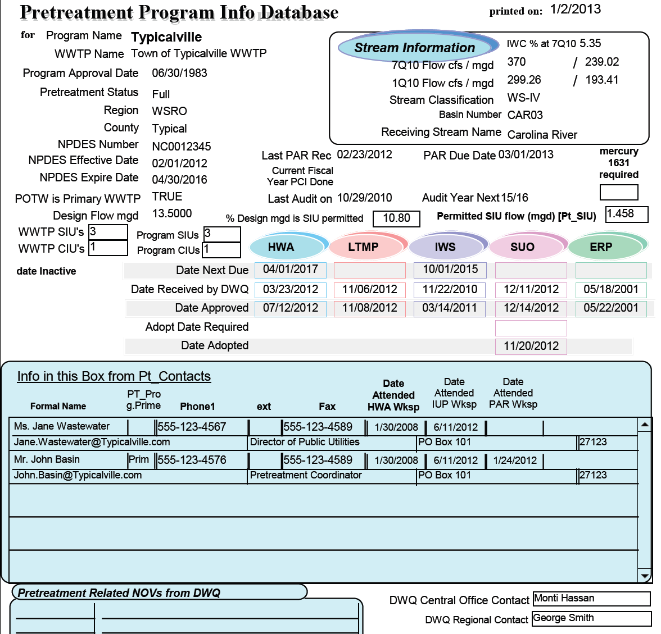
No Corrections Needed.

Slide 126


Waste Reduction:
Per .0916 of the Rule and G.S 143-215.1(g), required only to be submitted with IUP applications.
No longer required for the PAR!

Slide 127


Public Notice

Slide 128
Public Notice
Required to be done a minimum of once per year
  What is in your SUO?
  Largest Daily Newspaper Circulated in Area?
  Newspaper of General Circulation that provides meaningful public notice?
Generally completed in January or February for all SNC for Previous Year and Included in PAR due March 1;
Optional to complete Public Notice after each six month period, i.e., in July or August for January through June SNCs, and again in January or February for July through December SNCs
  may help SIU relations for SIUs in SNC for January through June for the POTW to issue Public Notice while problem is on-going instead of 6 months or more after they have fixed the problem

Slide 129
Public Notice (cont.)
Public Notice Must Include All IUs in SNC due to Limits Violations or Reporting or IUP Condition Violations
Along with the IU Names, the Public Notice should include:
  Periods of SNC (January - June or July –December)
  the Parameter(s), Reporting, or Specific IUP Condition
  OPTIONAL: any other discussion you want, for example how the SNC did not affect your WWTP or the environment, or how hard the SIU has worked to fix the problem, or how their negligence caused the problem in the first place, or how uncooperative they have been

Slide 130
Public Notice (cont.)
In PAR, either include Affidavit provided by Newspaper, or cut out the Public Notice from the newspaper (make sure the piece of the newspaper is large enough to include the Public Notice and the part of the page with the name of the paper and the date.
If unable to include Public Notice in PAR, explain in the narrative why it couldn’t be done earlier. Submit Copy of Affidavit or cut out from Newspaper ASAP. NOTE: PAR will not be considered complete until Public Notice is received.

Slide 131
PUBLIC NOTICE
OF SIGNIFICANT INDUSTRIAL
WASTEWATER PERMIT
VIOLATIONS
The Town of Typicalville, in accordance with Federal and State Regulations is hereby giving Public Notice. Listed below are Significant Industrial Users that were in significant noncompliance (SNC) with national pretreatment regulations, 40 CFR Part 403, and state pretreatment regulations, 15 NCAC 2H .0900, and local pretreatment regulations during the period of January 1 thru June 30, 2012; Will Plateit Metal Finishers, Inc.-Cadmium and Chicken Pluckers, Inc.-BOD, Reporting. And July 1 thru December 31, 2012; Will Plateit Metal Finishers, Inc.-Cadmium
A continuing effort is being made by all the listed industries to achieve compliance, including installation of new equipment and upgrading of existing equipment and continued progress is expected until full compliance can be attained.
Town of Typicalville, Department of Public Utilities, Jane Wastewater, Director.
January 17, 2013
Affidavit of Publication
The Typicalville Herald
Typicalville, N.C.
Personally appeared before me, a Notary Public of the
County of Typical, State of North Carolina, on
this the __17__day of ______January_____2013
_____Suzy Newsy_____
of The Typicalville Herald, who, bring duly sworn, state that
the notice entitled
PUBLIC NOTICE OF SIGNIFICANT
INDUSTRIAL WASTEWATER PERMIT VIOLATIONS
_______________________________________
a true copy of which is attached hereto, appeared in The
Typicalville Herald, a newspaper published in the Town of
Typicalville, County of Typical,
State of North Carolina, _____once____ a week for
_____one____week(s), on the following dates:
January 17___________ ______20___13_
______________________________20______
______________________________20______
______________________________20______
_______________________________________
The Typicalville (N.C.) Herald
of ______January___________2013
____Peter Public___
Notary Public

Slide 132
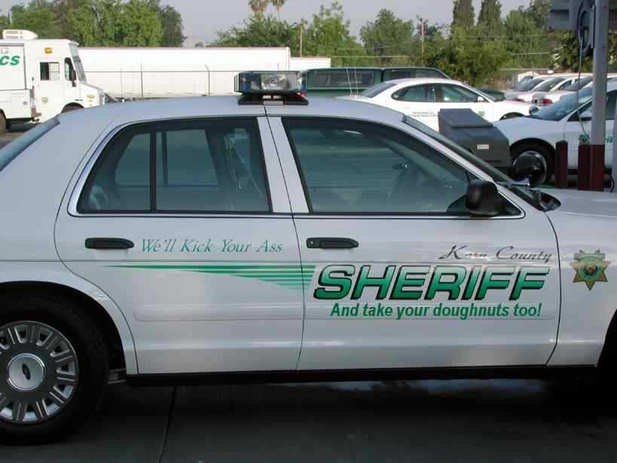
Enforceable Compliance Schedules

Slide 133
Enforceable Compliance Schedules
Two basic kinds
Signed by both POTW and SIU: Consent orders, Compliance Agreements, SOCs, etc,;
Signed by POTW only: Administrative Orders
  either when SIU refuses to agree to an order, or when SIU has failed to comply with original “consent” type order

Slide 134
Enforceable Compliance Schedules (cont.)
When to issue
Issued when SIU will be in SNC for second period in a row for same parameter/reporting violation
Can be issued earlier to help SIU avoid further violations (i.e. if you already know the violations will continue and you have a good idea of the steps the SIU must take to comply, then why wait to issue the order?)

Slide 135
Enforceable Compliance Schedules (cont.)
What’s in it
Up-front penalties to address violations up to the time of issuance of order.
Interim limits SIU can comply with, i.e., gets SIU back in “compliance” temporarily. These limits supercede IUP limits during term of order. These limits are the SIU’s “carrot.”
  Interim limits can be higher than categorical limits
  No over allocation without prior DWR approval

Slide 136
Enforceable Compliance Schedules (cont.)
What’s in it (cont.)
Schedule of items, each with a specific due date, that SIU will complete in order to return to compliance with original/final IUP limits. This is the POTW’s “carrot,” i.e. commitment from SIU to do specific things by specific dates.
  Specific items can vary greatly from SIU to SIU, and should be developed for each specific circumstance
Stipulated penalties for violations of conditions in order (limits, due dates, etc.). This is POTW’s “stick.”

Slide 137
North Carolina
County of Typical
In the matter of Town of Typicalville
Pretreatment Permit No. 0006
held by Will Plateit Metal Finishers, Inc.
CONSENT ORDER AND COMPLIANCE SCHEDULE
Pursuant to provisions of the Sewer User Ordinance of the Town of Typicalville, this Consent Order is made effective the 1st day of February, 2013, between Will Plateit Metal Finishers, Inc. (hereinafter the "User") and the Town of Typicalville (hereinafter the "Town").
The User and Town hereby stipulate and agree as follows:
1. User holds Town of Typicalville Pretreatment Permit No. 0006 (hereinafter the "Permit", which shall refer to User's existing permit and any subsequent renewals or modifications thereof) for the operations of existing pretreatment units and discharges from said treatment works into the Town's sewer system.
2. User has been unable to meet the permit limitations for Cadmium (Cd) set forth in its Permit.
3. Achievement of these limits will require resolution of existing problems in the present treatment train and possibly, development of alternative solutions to alleviate noncompliance, including but not limited to the construction of additional pretreatment facilities as well as the preparation of plans and specifications as necessary.
4. User hereby agrees to do and perform all of the following:

Slide 138
Meet and comply with all terms and conditions of the Permit (except as modified by the Order) provided, however, subject to the terms and conditions of the Consent Order, the following shall apply:
Parameter Daily Max (mg/L) Monitoring Frequency Detection Limit
Cadmium (Cd) 0.13 Weekly 0.002 mg/L
Unless and until Compliance is achieved, the User will undertake activities necessary to bring the User into Compliance in accordance with the following schedule:
COMPLIANCE SCHEDULE
Activities
Prepare an Engineering Report of process alternatives and/or pollution prevention/waste minimization alternative designed to achieve Compliance
Complete Pilot Studies or waste minimization studies and identify alternatives chosen to achieve Compliance
If required, submit necessary drawings and information to obtain any necessary permits and/or authorization to construct from the Town of Typicalville
Begin construction and/or implement identified process alternative(s), pollution prevention, and waste minimization alternatives.
Complete identified construction/pollution prevention/ waste minimization alternatives and/or process alternatives.
Complete analysis of implemented changes, including daily monitoring from April 1st to May 1st and make necessary modifications to optimize and obtain full operational status.
Achieve compliance with final (IUP) limit 0.07 mg/L.
Deadline for Completion
April 1, 2013
July 1, 2013
September 1, 2013
December 1, 2013
March 1, 2014
June 1, 2014
July 1, 2014

Slide 139
c. User shall perform each of the activities set forth in subparagraph (b) on or before the dates established thereby unless such dates are extended by agreement of User and the Town. The User may request such extensions for good cause, and the Town will not unreasonably withhold its consent to such extension.
d. User shall submit a comprehensive written report within five (5) days following each milestone date specified in subparagraph (b). Each such report shall be in narrative form, shall state in detail the activities undertaken since the last report to achieve Compliance, and shall indicate whether User has met the due date for the relevant milestone established in this Consent Order. If any report contains notice of failure to meet a milestone date, the report shall also include a statement explaining the cause of the failure, any remedial actions taken, and the probability of meeting the next milestone.
During any period of construction, User shall submit on or before the 10th day of each month, detailed construction progress reports stating therein in narrative form the work performed during the month and the percentage of completion of the project.
All reports required by the Consent Order shall be submitted to the Town by Certified Mail, Return Receipt Requested, addressed to:
Director of Public Utilities
Town of Typicalville
PO Box 123
Typcialville, NC 12345
e. The User shall pay the Town $1,000, no later than February 27, 2013, for the Significant Non-Compliance during the July through December 2012 reporting period.

Slide 140
e. Any violation of the terms of this Consent Order shall subject the User to the enforcement authority outlined in the Ordinance. Such action may include, but is not limited to such fines, penalties and assessments as may be set forth in the Code of Ordinance of the Town of Typicalville, as amended from time to time.
f. In lieu of other penalties, the following stipulated penalties shall apply for violations of the User's limits or failure to meet a milestone date under this Consent Order, or failure to achieve full compliance with Consent Order.
Violation of limits | $200 per day, per violation
Failure to collected required samples, meet compliance schedule deadlines, required reports, or other milestone dates contained herein | $200 per day, per violation
Failure to achieve full compliance with Final IUP limit at expiration of Order | $1,000 per day

Slide 141
g. Once Compliance is achieved, this Consent Order shall terminate and all obligations hereunder except any obligation to pay identified moneys to the Town shall expire. Upon termination of this Order, the User shall be subject to all terms of the Permit.
h. In the performance of activities under this Consent Order, User must otherwise follow the procedures, rules, regulations, ordinances, and statutes of the Town, State, and Federal governments as they may apply to User. Nothing contained herein shall be construed as a waiver thereof by the Town.
Signed on this 26th day of January 2013.
USER: Will Plateit Metal Finishers, Inc.
BY: William B Plateit
TITLE: President
TOWN: Town of Typicalville
BY: Jane Wastewater
TITLE: Director of Public Utilities
This Order expires July 11, 2014.

Slide 142
Allocation Tables (ATs)
Should be current as of December 31st, the last day of the end of the PAR Reporting Period
Includes Effective and Expiration Dates; May Include Permit Modification Date(s)
Includes Permit Limits For Each SIU and Pipe
Includes Information from Headworks Analysis (HWA)
  MAHL
  Uncontrollable Loading
  MAIL
Do YOU have any Over Allocations??? – Explain in Narrative!

Slide 143
Allocation Tables (ATs)

Slide 144
Allocation Tables (ATs) (cont.)

Slide 145
Allocation Tables (ATs) (cont.)
See narrative for resolution of mercury over allocation.

Slide 146
Allocation Tables (ATs) (cont.)

Slide 147
PARs due MARCH 1
NC DIVISION OF WATER RESOURCES
PERCS UNIT
1617 MAIL SERVICE CENTER
RALEIGH, NC 27699-1617
2 Copies
(Please send both copies to Central Office in Raleigh...We forward the second copy to the Region.)
PARs may be submitted electronically if sent as a single PDF!
Web site: http://deq.nc.gov/about/divisions/water-resources/water-resources-permits/percs

Slide 148

DWR Pretreatment Contacts
Fax: 919-807-6489
email: firstname.lastname@ncdenr.gov
Web site: http://deq.nc.gov/about/divisions/water-resources/water-resources-permits/percs
Monti Hassan- 919-807-6314:
  Chowan
  Hiwassee
  Little Tennessee
  Lumber
Sarah Bass- 919-807-6310:
  Broad
  Cape Fear
  Catawba
  Neuse
  New
  Roanoke
  Yadkin
  French Broad
  Tar Pamlico
Thank You!

