Slide 1
NPDES MS4 Permit Compliance Audits
November 9, 2018

Slide 2
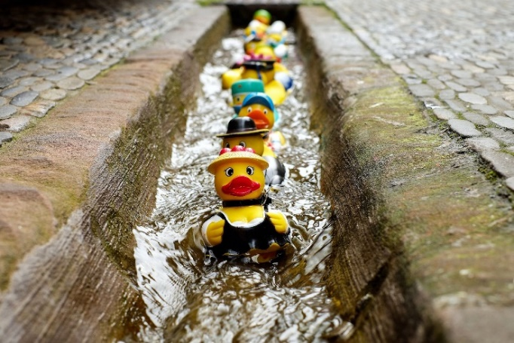
What is an MS4 Permit Compliance Audit?
An MS4 Audit is a structured review of the Stormwater Management Program to evaluate whether the MS4 is meeting the requirements specified in the
NPDES MS4 Permit & Stormwater Management Plan (SWMP)
AKA do you have your ducks in a row?
Department of Environmental Quality

Slide 3
Who Gets Audited?
Every permitted MS4 will be audited at least once every five years.
Department of Environmental Quality

Slide 4
How Do I Know If My MS4 is Being Audited?
The DEMLR MS4 5-year Audit Schedule
Lists the year the MS4 is scheduled to be audited
5-year schedule audits are part of each permit renewal process
EPA or DEMLR may also audit any MS4 at any time.
EPA/DEMLR will notify the MS4 of specific audit date(s) at least 30 calendar days prior.
Department of Environmental Quality

Slide 5
What Happens Before an MS4 Audit?
Notification
Specific audit date provided at least 30 days prior to audit
Preliminary Documentation Request
Current SWMP
Latest Annual Report
O-chart & associated program responsibilities
MS4 permitted area map with receiving waters
Formal agreements with other entities that implement MS4 Program
Scope of Audit Decided
May request additional information prior to audit
Department of Environmental Quality

Slide 6
What Does DEMLR Audit?
Specific MS4 Program components are audited for compliance with the Permit & SWMP:
Program administration is always evaluated
Some or all of the required six minimum measures will be evaluated
Public Education & Outreach
Public Involvement & Participation
Construction Site Runoff Controls (delegated ESC programs only)
Post-Construction Site Runoff Controls
Pollution Prevention & Good Housekeeping for Municipal Operations
TMDLs may be evaluated (if applicable)
Department of Environmental Quality

Slide 7
What Happens on the Day(s) of an MS4 Audit?
Office Interview
Program implementation questions & documentation review
Site Visits
MS4 industrial facility inspections
Construction site inspections (delegated ESC programs only)
Evaluates how MS4 program is run, not if sites are in compliance
Closing Conference
Preliminary summary of identified issues
Request for additional documentation
Department of Environmental Quality

Slide 8
How Long Does an MS4 Audit Take?
It Depends….
Availability of information
Size and complexity of the MS4 program
Number of minimum measures evaluated
Geographic distance between sites visited
Distance the auditor must travel to the MS4
Auditor will give you a general idea 30 days prior
Won’t be less than one day
Won’t be more than four days
Department of Environmental Quality

Slide 9
What Happens After an MS4 Audit?
After an audit, the MS4 should:
Receive an Audit Report within 60 days
Receive specific instructions to address audit issues
Self-audit any program areas that weren’t audited
Develop a SMART SWMP
Submit the SWMP to DEMLR for review and approval
Department of Environmental Quality

Slide 10
What is a SMART SWMP?
SMART SWMPs
Specific tasks
Measurable success
Attainable commitments
Relevant to the community
Time lines established
The SWMP provides all the information on how the MS4 will meet permit requirements over the permit term, and is developed utilizing the DEMLR MS4 Toolbox.
Department of Environmental Quality

Slide 11
What is the DEMLR MS4 Toolbox?
A Suite of Standardized MS4 Templates
Stormwater Management Plan (SWMP)
Annual Self Assessment (ASA)
MS4 Permit Compliance Audit Report
Baseline MS4 Permit
MS4 Toolbox
2019
Department of Environmental Quality

Slide 12
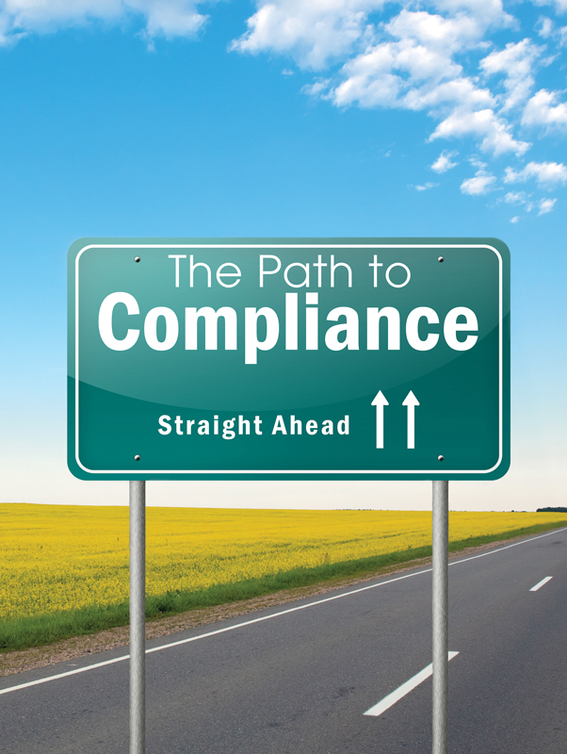
How Can We Meet Our Needs With Standard Templates?
Your SWMP
Identify Reporting Metrics
What you are going to do
How you want to measure success
Establish Specific Timelines
When you are going to do it (be specific)
Address Identified Deficiencies
Commit to fix what’s broken or missing
Annual Self Assessments
Evaluate progress in implementing the SWMP
Revise the SWMP if needed
Department of Environmental Quality

Slide 13
How Do You Ace an MS4 Audit?
Stage the meeting – staff, documents, GIS, etc. on hand
Know your Program (Permit, SWMP, Annual Reports, implementation)
Demonstrate the permitted program is implemented:
Enforceable local ordinances
Legal agreements with any external parties
MS4 mapping – storm sewer system & outfalls
Inspections, documentation, tracking, SOPs
Documented education, outreach & staff training programs
Dry weather screening
Department of Environmental Quality

Slide 14
What if You Don’t Ace the MS4 Audit?
The MS4 will likely be issued a Notice of Violation (NOV) with specific requirements to:
Submit a Council resolution to fund, implement and comply with the NPDESMS4 Permit conditions and requirements,
Obtain a new 5-year permit, and
Submit a 5-year SWMP detailing the path to full compliance.
Note: NOVs do not have penalties. If the NOV conditions are not met, a NOV-Recommendation for Enforcement is issued and penalties may be assessed. All NPDES MS4 permits are subject to federal and/or state compliance and enforcement, which can include civil penalties up to $37,500 per day for each violation. Any person who negligently and/or knowingly violates any permit condition may be subject to criminal penalties and/or imprisonment.
Department of Environmental Quality

Slide 15
What is DEMLRs Overall MS4 Audit Strategy?
DEMLR audits MS4 at least once every five years
MS4 develops and submits permit application and 5-year SWMP after the audit
DEMLR & MS4 negotiate SWMP components to define the compliant 5-year MS4 Program
The draft SWMP and Permit are sent out for public notice & 45-day comment period
DEMLR & MS4 collaborate to address comments and finalize the SWMP and Permit
MS4 receives the approved SWMP and new 5-year Permit
MS4 implements SWMP, submits annual self-assessments of SWMP progress (ASAs), requests approval of any SWMP changes
DEMLR reviews ASAs, negotiates and approves SWMP changes
Department of Environmental Quality

Slide 16
What’s Next?
Final MS4 Toolbox
SWMP, ASA, Audit Report, Baseline Permit in late 2018
Training for MS4s
5 sessions statewide in early 2019
DEMLR MS4 5-year Schedule Audits
Audits for permit reissuance/renewal begin early 2019
Department of Environmental Quality

Slide 17
Jeanette Powell, CPSWQ, CPESC MS4 Program Coordinator (919) 707-3620 jeanette.powell@ncdenr.gov
For MS4 Program questions and permit assistance, please contact:

