Slide 1
Water Supply Watershed Protection
– Density Averaging
January 2021

Slide 2
Water Supply Watershed Protection
Density Averaging – Summary
Session Law 2012-200 amended N.C.G.S. 143-214.5 to require that local governments allow for "density averaging" of non-contiguous parcels for purposes of complying with local Water Supply programs. Legislation allows for two non-contiguous parcels to be treated as one single parcel to meet the built-upon area/density requirements of the WSWP rules and local ordinances. These parcels can be under the same or separate ownership.
Department of Environmental Quality

Slide 3
Water Supply Watershed Protection
Points to Consider with Density Averaging
Local governments with Water Supply programs required to allow density averaging
If local ordinance prohibits density averaging, local governments should update ordinance to allow it. Please see 15A NCAC 02B .0623 (4) for ordinance revision/approval process.
If ordinance is silent on density averaging, better to update ordinance, but it is not required. Local governments should seek their legal counsel’s input on whether to administer law via ordinance or state statute.
Legislation sets NO timeline for compliance, but this is 2012 requirement. Local governments should consult their legal counsel to determine the most appropriate response to this legislation for their jurisdiction.
For local governments who revise their ordinances to allow density averaging, ordinance and associated process documentation must be approved by WSWP Coordinator.
Department of Environmental Quality

Slide 4
Water Supply Watershed Protection
Density Averaging – Order of Presentation
Regulatory Basis
II. Requirements for Local Governments that want to implement density averaging
Questions and Answers
Department of Environmental Quality

Slide 5
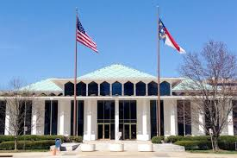
I. Regulatory Basis
NC General Statute 143-214.5 (d2), Items (1)-(8)
https://www.ncleg.net/enactedlegislation/statutes/html/bysection/chapter_143/gs_143-214.5.html
The following are minimum requirements needed to implement density averaging. Local governments may modify requirements (as long as they are not less stringent than state requirements) to help implement program successfully.
Department of Environmental Quality

Slide 6
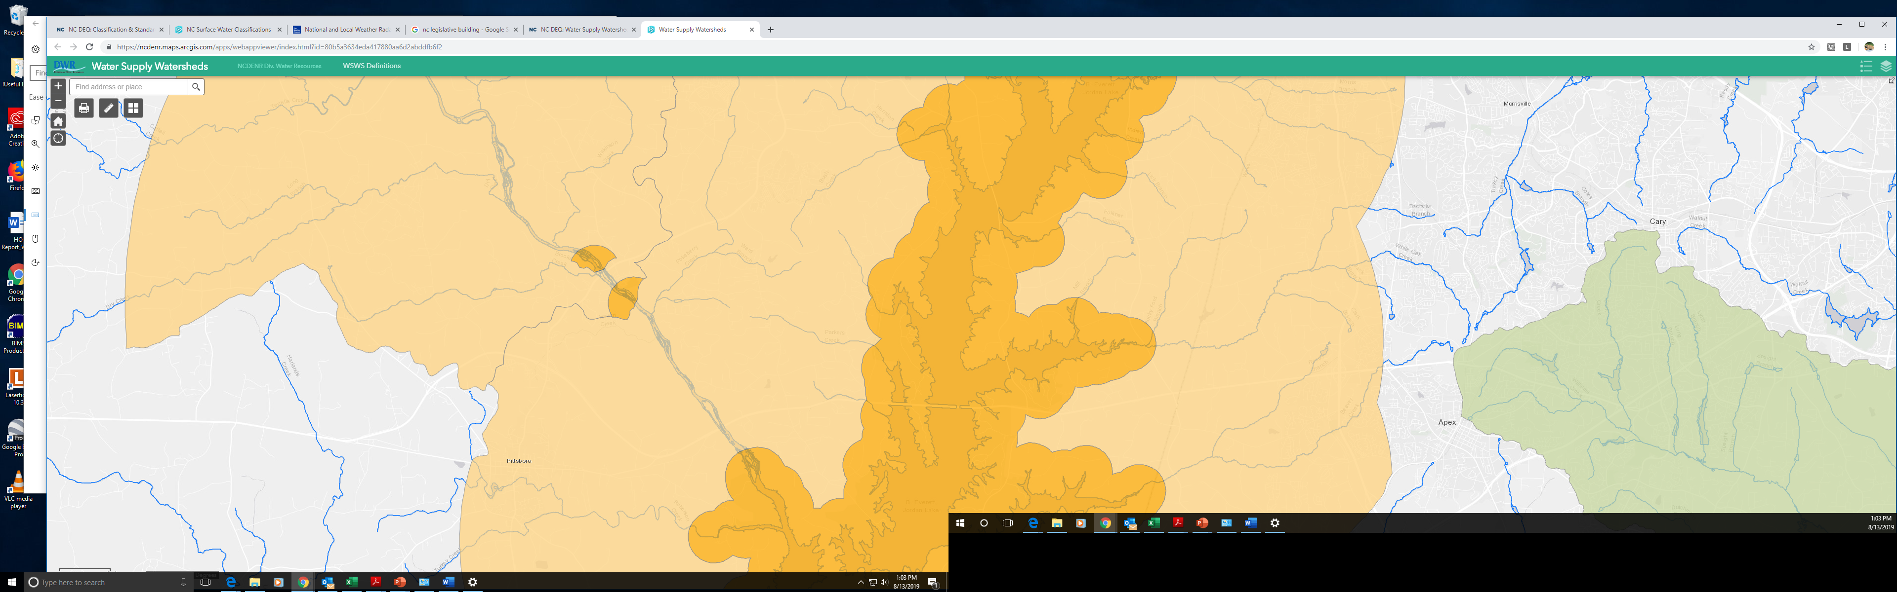
I. NC General Statute 143-214.5 (d2)
Local governments must allow applicants to average development density on up to two noncontiguous properties if all eight of the conditions described on the following slides are met.
Protected Area
Critical Area
Department of Environmental Quality

Slide 7
I. NC General Statute 143-214.5 (d2)(1)
Protected Area
Critical Area
Properties must be within the same water supply watershed
If only one property is in critical area, it must be the donating lot.
If both properties are in non-critical area, either can donate.
If both properties are in critical area, either can donate.
Please see following slides for examples.

Slide 8
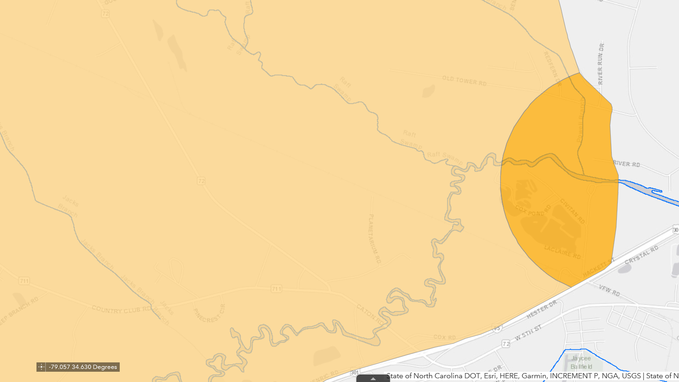
Built-Upon Area
Recipient
Built-Upon Area
Recipient
YES
YES
Built-Upon Area
Donor
Built-Upon Area
Donor

Slide 9
Built-Upon Area
Donor
NO
Built-Upon Area
Recipient
Built-Upon Area
Donor
Built-Upon Area
Recipient
YES

Slide 10
I. NC General Statute 143-214.5 (d2)(2)
Participating properties’ overall density average must meet applicable density or stormwater control requirements under 15A NCAC 02B .0200s and .0624.
For example, average of two parcels in WS-IV watershed following low density option CANNOT exceed 24 percent built-upon area (or 36 percent if not using curb and gutter).
Department of Environmental Quality

Slide 11
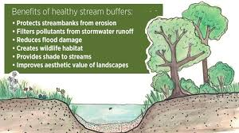
I. NC General Statute 143-214.5 (d2)(3)
Buffers on both participating properties must meet minimum water supply watershed protection requirements.
Department of Environmental Quality

Slide 12
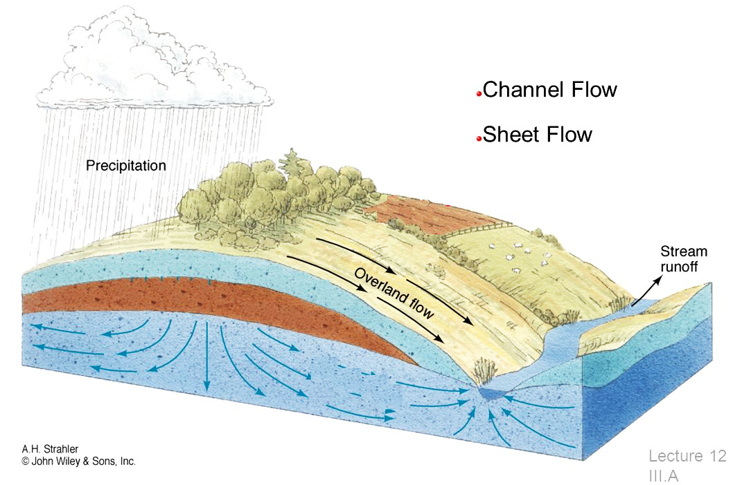
I. NC General Statute 143-214.5 (d2)(4)
Built-upon areas must be designed and located to do the following:
Minimize stormwater runoff impact to receiving waters
Minimize concentrated stormwater flow
Maximize use of sheet flow and flow length through vegetated areas
Department of Environmental Quality

Slide 13
I. NC General Statute 143-214.5 (d2)(5) and (7)
To the maximum extent practicable ….
Concentrated development areas should be in uplands away from surface waters and drainageways
Development permitted under density averaging and meeting applicable low density requirements shall transport stormwater runoff by vegetated conveyances.
Department of Environmental Quality

Slide 14
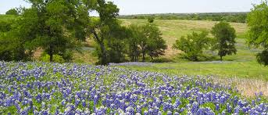
I. NC General Statute 143-214.5 (d2)(6)
There are two requirements for the portions of properties that will remain undeveloped:
It must remain in a vegetated or natural state in perpetuity.
A metes and bounds description and irrevocable limits on use must be recorded.
Department of Environmental Quality

Slide 15
I. NC General Statute 143-214.5 (d2)(6)
Properties (or portions of) that will remain undeveloped must either be:
  Managed by a homeowners’ association as a common area,
  Conveyed to the local government as a park or greenway,
  Placed under permanent conservation or farmland preservation easement, or
  Have long-term compliance handled by a local government through deed restrictions and electronic permitting mechanism.
  Note: Any one of the four items listed above can be used to meet this requirement.
Department of Environmental Quality

Slide 16

What is a Metes and Bounds Description?
Entire property with house, driveway and donated portion identified.
Boundaries or limits of a tract of land as described by reference to compass directions and distances between points on the land.
For example, portion of property denoted by blue square must be accurately described in metes and bounds
Portion of property donated to another
House and drive
Department of Environmental Quality

Slide 17
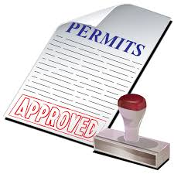
I. NC General Statute 143-214.5 (d2)(8)
Local Watershed Review Board or Board of Adjustment shall issue special use (or other) permit or certificate to ensure both properties considered together meet standards of watershed ordinance and potential owners have record of how watershed regulations applied to properties
Department of Environmental Quality

Slide 18
II. Recommendations for Local Government Ordinances
Local government ordinances should:
Define how density averaging will be documented and tracked to ensure all requirements for both donor and recipient parcels are publicly recorded and are irrevocable in perpetuity.
Provide standard enforcement protocols for parcel owners that violate conditions of special permit/certificate issued for density averaging.
  Include all NCGS 143-214.5(d2) conditions. Note that local government ordinances may be more stringent than statute.
Local governments should accurately track all averaging among different properties.

Slide 19
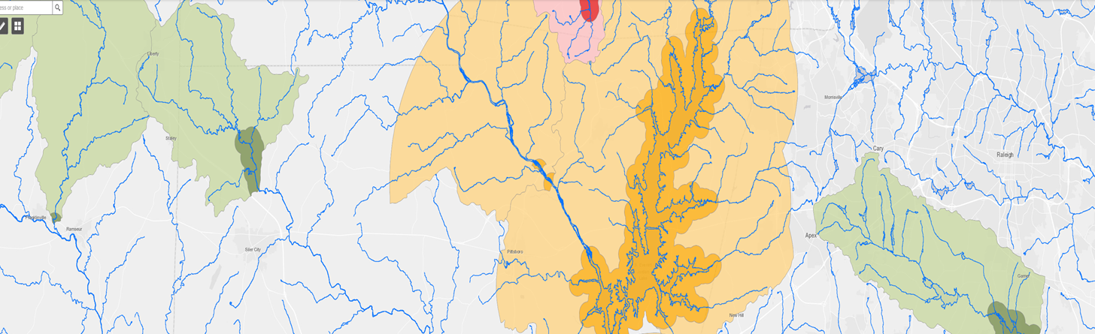
Q1: Can any one property exceed the density maximum within the critical area?
Yes. If both properties are located within the critical area, either property can donate and the receiving property will exceed the density maximum, but the donating property will be less than density maximum.
Note that a property in the non-critical area may not donate to a property in the critical area. In this case, only the property in the non-critical area will exceed the density maximum.

Slide 20
Q2: Can one property donate to more than one property?
Yes, as long as:
Each donated portion is separate and each portion is donated to only ONE recipient,
The deed of the donating property depicts the metes and bounds of all vegetated areas that have been donated and has marked them as built upon area (built-upon area) in addition to any actual built-upon area such as the house, driveway, patio, etc., and
The total of the existing (pavement, roof, etc.) and the donated built-upon area(s) cannot exceed the maximum built-upon area for the donating lot.
Please see next slides for examples.

Slide 21
Q2: Can one property donate to more than one property?
Donor
Recipient #1
Blue portion goes to recipient #1 who can exceed built-upon area by amount delineated in blue rectangle.
Orange portion goes to recipient #2 who can exceed built-upon area by amount delineated in orange rectangle.
Blue and Orange sections of donor are may not be built on or donated.
Recipient #2
House and Drive
Yes

Slide 22
Q2: Can one property donate to more than one property?
Recipient #1
Donor
Blue and Orange built-upon area donations cannot go to BOTH recipient #1 AND recipient #2
Blue and Orange built-upon area donations must go to EITHER recipient #1 OR recipient #2
Recipient #2
House and Drive
No!

Slide 23
Q2: Can one property donate to more than one property?
Recipient #1
Donor
On the donor property, the total area of the house/drive, the blue donation area, and the orange donation area may not exceed the maximum built-upon area allowed under the low density option in 15A NCAC 02B .0624.
Recipient #2
House and Drive

Slide 24
Q3: Can one property receive donations from more than one property?
Yes, as long as:
Each donation transaction is separate,
The deeds of the donating properties depict the metes and bounds of all vegetated areas that have been donated and have marked them as built-upon area in addition to any existing built-upon area such as the house, driveway, patio, etc.), and
For each donating lot, the total of any existing (pavement, roof, etc.) built-upon area and the donated area cannot exceed the maximum built-upon area allowed under the low density option in 15A NCAC 02B .0624.
Please see next slide for examples.

Slide 25

Q3: Can one property receive donations from more than one property?
Donor #1
Recipient
On each donor property, the area of the house/drive, and the blue or orange donation area may not exceed the maximum built-upon area allowed under the low density option in 15A NCAC 02B .0624.
House and Drive
Donor #2
House and Drive
House and Drive

Slide 26
Water Supply Watershed Density Limits per 15A NCAC 02B .0624
WS Classification | Location | Low Density built-upon area limit | High Density built-upon area limit
WS-I | Not applicable: Watershed shall remain undeveloped
WS-II | Critical Area | 6% | 6-24%
 | Balance of WS | 12% | 12-30%
WS-III | Critical Area | 12% | 12-30%
 | Balance of WS | 24% | 24-50%
WS-IV | Critical Area | 24% | 24-50%
 | Protected Area | 24% | 24-70%
Department of Environmental Quality

Slide 27
Q3: Can a developed property donate to another property?
      Yes, as long as the donating property has not reached the maximum built-upon area (whether existing or donated) under low density allowed on its property and is willing to stay below its built-upon area limit including the donation in perpetuity.
      Please see NCDEQ-DEMLR – Stormwater Program memo on density averaging …. https://files.nc.gov/ncdeq/Energy%20Mineral%20and%20Land%20Resources/Stormwater/WS-Density-Averaging-Memo-2018-02-20.pdf
Department of Environmental Quality

Slide 28

Q4: Can a buffer, conservation easement, or other portion of property that is required to remain undeveloped be donated?
No. Development is prohibited (or severely limited) on these areas, so they cannot be donated to a recipient property to be developed.
Yes
No
Stream
Buffer
Area
House and Drive
Department of Environmental Quality

Slide 29
Q5: Can a property that is exempt from Water Supply Watershed Program rules donate to another property?
No. Because the property is exempt, it is not part of the WSWP program and does not have any built-upon area to donate to another property.
However, if the “exempt” property agrees to abide by the density limits and other requirements of the WSWP program rules, a local ordinance could allow it to participate in density averaging.
Department of Environmental Quality

Slide 30
Paul Clark
Water Supply Watershed Protection Coordinator
paul.clark@ncdenr.gov
(919) 707-3642
January 2021

