Slide 1



5S Basics

Slide 2
Sound Familiar?
Workers waste time looking for things.
Most horizontal surfaces are covered.
Work space is crowded with parts, tools, paper, etc.
There is excess inventory.
There is excess equipment and tools.
Work area (shelves, floor, equipment, etc.) is dirty and dusty.
The floor is covered with wires and unused items.
The status of the work being performed is hard to discern because the work area is not visible.
Efforts to organize and clean do not seem to last very long.
5S is probably for you!

Slide 3
What is 5S?
5S focuses on organizing the workplace, keeping it clean and orderly, and maintaining the standardized conditions and discipline needed to do a good job.
Developed in Japan and stands for 5 Japanese words that start with the letter S:
  Seiri (sort)
  Seiton (straighten)
  Seiso (shine)
  Seiketsu (standardize)
  Shitsuke (sustain)

Slide 4
Benefits of a 5S program
Improved visibility of problem conditions.
Improved safety.
Reduced waste.
Improved morale.
Increased sense of ownership of the workspace.
Improved productivity – Less time spent searching for tools, materials, etc.
Decreased setup times.
Improved quality.
Improved maintenance.
Shorter lead times.
Better impression on customers/visitors.
New sense of discipline and order that carries over to all activities.

Slide 5
Seiri
sort

Slide 6
S1 - Sort
To sort and systematically discard items that are not needed in the workplace
Examples of unnecessary things:
  excess tools
  unneeded equipment
  excess furniture
  excess shelves
  obsolete work in progress
  broken tools & bits
  obsolete jigs and fixtures
  scrap
  excess raw materials.

Slide 7
S1 - Sort
Where to start:
Work space – Workbenches, tables, any horizontal surface tends to collect a variety of stuff.
Contingency part storage - Many times these places become a last refuge for broken parts, surplus items and things nobody is likely to use.
Shelves and Lockers - Shelves and lockers tend to collect things that nobody ever uses, like surplus, broken items, etc.
Passages and Corners - Dust and material not required seems to gather in corners.
Beside Pillars and Under Stairs - These places tend to collect unwanted materials.
Walls and Bulletin Boards – Remove:
  Out-dated notices which have lost their relevance
  Dust, torn notices, tape pieces
Floors – Pick up
  Defective parts
  Packing material
  Hardware
  Tools and tooling
  Any items dropped on the floor
Computer Hard Disk - Many unwanted, outdated, temporary files pile up

Slide 8
S1 - Sort
Red Tagging
Place a red tag on all items not required to complete the job.
The red tag usually includes the current date, number of items, and the category. Common red tag categories for a manufacturer include:
  Raw materials * Equipment
  Work-in-process * Maintenance supplies
  Finished goods * Office equipment or supplies
  Tools or fixtures * Other
Items in the red tag area are evaluated and dispersed:
  sold * recycled
  used in another work area * thrown away
  returned to operation (use this sparingly)
Do NOT move to some other hidden storage space

Slide 9
S1 - Sort
Implementation:
Take photos before you start!
Sort items by frequency of use (daily, weekly, monthly, rarely – but necessary)
Red Tag items that need further discussion or dispensation (use 3-month rule of thumb).
Move Red Tag items to central location.
Evaluate and dispose of Red Tag items – If items in the red tag area are not claimed or sold after one month, discard or recycle them.
Notes:
This is the most time-consuming of the 5S’s. Don’t short-change it. The better the initial sort, the easier the other steps become. Go back to this step often.

Slide 10
Seiton
set in order

Slide 11
S2 – Set in Order
To arrange necessary items in a neat and systematic manner so that they can be easily retrieved for use and to return after use.
Emphasizes:
functional placement of parts, tools and materials
clearly designated names and places
visual system
quick and easy retrieval of documents, parts and tools

Slide 12
S2 – Set in Order
A place for everything and everything in its place
This can be accomplished by
painting / color coding floors
outlining work areas and locations
labeling shelves, pipes, etc
removal of old and obsolete notes on notice boards
creating tool holders
creating shadow boards for tools
creating cabinets for materials used only occasionally
setting up modular shelving and cabinets for needed items such as trash cans, brooms, mops, and buckets.
Do we need specific areas for specific tasks?

Slide 13
S2 – Set in Order
  Ask yourself the following questions about each item…
  1. Why do I need it to do my job?
  2. Where should I locate this item?
  3. How many do I need?
  4. How will I know where to find it? or How will I know to order more?
Notes:
Note the first & third question. You are still sorting. Many of the steps can be done simultaneously.

Slide 14
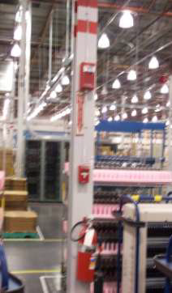
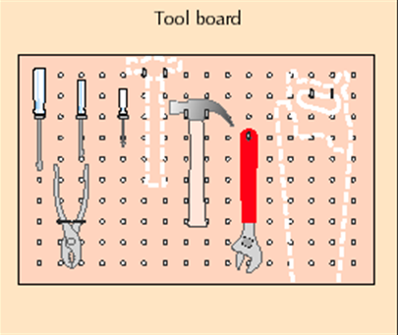
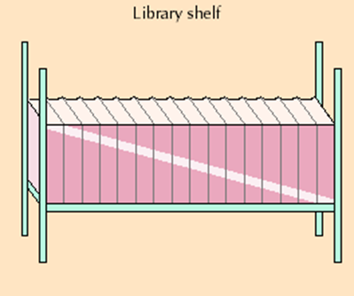
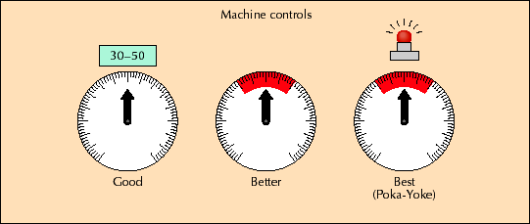
S2 – Set in Order
Examples of Visual Control

Slide 15
S2 – Set in Order
Visual Control
Points to remember in making visual control tools :
1) Make them easy to see from a distance
2) Put the display on the thing it is controlling
3) Make it so everyone can tell what is right and what is wrong
4) Make it so anybody can follow it and make necessary corrections easily
5) Work place should look brighter &
more orderly

Slide 16
S2 – Set in Order
Implementation:
Organize the physical layout
Make proper use of carts, containers, and holders
Locate items to reduce walking and motion. The more often something is used, the closer to the work space it should be.
Make the area safe
Make the area standard and visible
Notes:
Start by organizing the physical layout of the work area to improve visibility and workflow and reduce wasted steps and motion. This might include removing unnecessary doors, walls, and other barriers that inhibit visibility, movement, or travel. For example, removing doors from cupboards is often a good way to improve visibility and save time. Lay out the storage area along the wall to save space. 5S generally requires that almost nothing touch the floor other than table legs and equipment supports.
Use carts, containers, and tool holders to organize, move, and store tools, jigs, and measuring devices. Design storage areas with a wide entrance and shallow depth. Do not stack items together. Use racks and shelves when possible. Use small bins to organize small items. Use see-through/transparent covers and doors for visibility.
Move tools, supplies, materials, and reference materials as close as possible to the point of use and make sure that the items used most often are closest to the point of use. Store similar items together and different items in separate rows.
Identify safety issues and mitigate all significant risks. Some organizations make this step into a 6th ‘S’.
Clearly label items, shelves, and other areas to improve visibility. Use colors to quickly identify items. Use shadow boards for tools. Paint the floor to indicate where larger pieces of equipment should be stored and where people are to walk and not walk.

Slide 17
S2 – Set in Order
Guidelines
Frequency of Use
Storage Method
Things used once in the last 6-12 months.
Things used only once in the last 1-6 months.
Things used once a week.
Things used daily or hourly.
Store at a distance from the work station.
Store in central place.
Store near the work station.
Store at the work station in a visible location.

Slide 18
S2 – Set in Order
Guidelines
Criteria/ Consideration
Storage Method
Weight of items
Similar items
Items used for a single operation
Heavier items should be stored at lower levels.
Store in same place. Example: screws, oil, etc.
Store in same place. Example: tools needed for changing oil

Slide 19
S2 – Set in Order
Good Practices
Outlining and Placement Marks
    Mark boundaries of aisles, machines, process areas
    Follow straight line, right angle rule
    Nothing shall be kept outside the boundaries
Stands and shelves
    Keep only required number of stands and shelves
    Standardize height, size
    Provide casters where necessary so that it can be moved
Wires, Ducts, and Pipes
    Color code & show direction of flow
    When there are multiple connections – bundle the wires, label them and make sure that they are in straight line/right angle and firmly anchored
Tools
  Put tools in the order you need them
  Location of hand-tools should be such that they can be put away with one hand

Slide 20
Seiso
shine

Slide 21
S3 – Shine
To clean and inspect the workplace thoroughly so that there is no dirt on the floor, machines or equipment.
Seiso is cleaning, but also inspecting and simple repair and preventive maintenance.

Slide 22
S3 – Shine
Steps in the cleaning process:
increase the lighting in the work area
divide the area into zones
define responsibilities for cleaning
identify proper methods and tools for cleaning
provide protection for those doing the cleaning (gloves, dust-masks, etc)
repair any leaks on machines
clean machines, floors, walls and ceilings
paint machines, floors, walls and ceilings
identify the sources of dirt
try to eliminate the need to clean
inspect machines and tools while cleaning
if possible, perform some preventive maintenance while cleaning and inspecting (example: tightening hydraulic hoses)

Slide 23
S3 – Shine
The benefit of the shine step is that workers can more quickly see issues such as:
leaks,
contamination,
vibration,
fatigue,
breakage, and
misalignment.

Slide 24
S3 – Shine
Implementation:
NOTE: It is often better to do the shine step before or simultaneously with the set in order step.
Clean – Sweep, wash, clean, and shine everything around the work area, including the floor.
Arrange cleaning materials – Practicing 5S means that all employees should have their cleaning materials in a standard place close to the work area.
Notes:
This is because it is often better to clean and shine before putting things back in the work area. Particularly if this is the first time 5S is being implemented in an area.

Slide 25
S3 – Shine
Preventive measures should be taken to tackle problems of dust, grime, leakage etc. Root cause of the problem should be identified and it should be eliminated.
Devote 5 - 15 minutes every day to cleaning your work area
Participation of everyone is required
Attack hard to clean places regularly

Slide 26
Seiketsu
standardize

Slide 27
S4 – Standardize
To maintain a high standard of workplace organization by keeping everything clean and orderly at all times.
Standardization is necessary to detect abnormalities and unusual situations, so that people can react immediately.
Make it the Norm!

Slide 28
S4 – Standardize
Standards must be applied to:
work instructions
procedures
color-coding: gangways, pipes, directional marks, containers
coloration of surroundings
warning signs and marks
labels and name plates
visual management tools

Slide 29
S4 – Standardize
Implementation:
Create the standard for the work area – This includes listing the items and the number of items allowed in storage. This standard will be the basis for 5S audits.
Implement across all units – This new standard should be implemented across all similar units.
Create a standard cleaning procedure – The standard cleaning procedure should include a cleaning checklist and should be posted close to the work area. It should also define how often the area will be cleaned.
Be quick to revise the standards – It is important to not only have a standard, but to update it as often as needed.

Slide 30
Shitsuke
sustain

Slide 31
S5 – Sustain
To practice the 5S system continuously so that it becomes habitual and ingrained in the culture of the organization.
This means that everyone must
understand, obey, and follow the rules
eliminate bad habits
form good habits
maintain the improvements
look for opportunities to improve

Slide 32
S5 – Sustain
This can be achieved by:
education
learning on the job
making job descriptions, work instructions and schedules
performing audits using checklists
modeling the behavior that you desire from your employees
daily management attention and interest

Slide 33
S5 – Sustain
Many organizations find themselves with a dirty, cluttered shop only a few months after a 5S project. The tendency is to return to the old way of doing things.
Make sure that standard work for supervisors includes checking to ensure that the 5S discipline is being followed.

Slide 34
S5 – Sustain
Implementation:
Take and post before & after photos
Schedule regular audits
Learn from mistakes
Empower people to change to a new standard as needed
Develop the culture
Notes:
One simple way to encourage participation and improvement is to take photographs to document the improvement.
These audits should be done to provide accountability. Many organizations make it “standard work” for supervisors to “scorecard” work areas at least once per week. See the appendix for a suggested simple 5S scorecard.
When an area is found to be out of compliance with the 5S standard, ask “why” five times to address the system of causes for the problem. For example, people might have a bad habit of putting tools and papers on a table or desk when they should instead immediately put them away.
With respect to quickly changing standards, Bodek (2009) quotes Ohno, the former Vice President of Production at Toyota Motor Corporation, “Something is wrong if workers do not look each day, find things that are tedious or boring, and then rewrite the procedures. Even last month’s manual should be out of date.” One healthcare worker reported that “Our exam room was 5S’ed and they removed things that we need to keep in the room. I’d like to bring the items back in, but I know that violates the 5S concept. I wish I knew who to talk to about this.” This quote highlights the need to have involvement of the people in the “gemba” to create the standard, one person who visibly “owns” the standard, and a simple process for this person to change the standard as needed.
Ensure that 5S goes beyond just keeping the work area clean. Begin to develop a disciplined culture of keeping the work area up to 5S standards at all times. This involves developing the habit of always putting things back in the proper place, making sure that everything is always in the right place, and removing items of little or no value.

Slide 35
5S Checklist
Area:
Number of Problems |  | Rating Level |  |  |  |  | Date | Date | Date | Date | Date
5 or more |  | Level 0
3-4 |  | Level 1
2 |  | Level 2
1 |  | Level 3
none |  | Level 4
Category | Item |  |  |  |  |  | Level
Sort | Distinguish between what is needed and what is not needed
 | Unneeded equipment, tools furniture, etc. are present
 | Unneeded items are on walls, bulletin boards, etc.
 | Items are present in aisle ways, stairways, corners, etc.
 | Unneeded inventory, supplies, parts, or materials are present
 | Safety hazards (water, oil, chemical, machines) exist
Set in Order | A place for everything and everything in its place
 | Correct places for items are not obvious
 | Items are not in their correct places
 | Aisle ways, workplaces, equiment locations are not indicated
 | Items are not put away immeadiately after use
 | Height and quanity limits are not obvious
Shine | Cleaning, and looking for ways to keep clean and organized
 | Floors, walls, stairs, and surfaces are not free of dirt, oil and grease
 | Equipment is not kept clean and free of dirt, oil and grease
 | Cleaning materials are not easily accessible
 | Lines, labels, signs, etc. are not clean and unbroken
 | Other cleaning problems (of any kind) are present
Standardize | Maintain and monitor the first three categories
 | Necessary information is not visible
 | All standards are not known and visible
 | Checklists don't exist for all cleaning and maintenance jobs
 | All quantities and limits are not easily recognizable
 | How many items can't be located in 30 secs?
Sustain | Stick to the rules
 | How many workers have not had 5S training?
 | How many times last week was daily 5S not performed?
 | How many times are personal belongings not easily stored?
 | How many times are job aids not available or up to date?
 | How many times last week were daily 5S inspections not performed?
 | Total

Slide 36
Understanding the benefits of a 5S program
Tends to go through five stages:
Clean – People often assume that 5S is just cleaning up the work area.
Standard – People soon learn that 5S is about making this improved work process a standard work process and keeping it standard..
Improved – People then understand that 5S is about improving the standards for how work is done.
Visible – People understand that 5S is about making work more visible so that workers can focus on their work and so that anything out of place “screams” for immediate attention.
Disciplined – People finally understand that 5S is about developing and practicing a highly disciplined mindset for how work is done.
Notes:
Cleaning a work area is a good practice, but this is only the beginning of understanding a 5S effort.
This makes it easy to find things because everything has a place and everything is always in that place. However, clean and standard is just the beginning of understanding 5S
5S challenges people to always be looking for better ways to organize their work to make the work simple, visible, error-proof, and wasteless. When a better way is found, it becomes the new standard. However, 5S is more than just clean, standard, and improved.
A visual work area provides cues that help workers and supervisors immediately know the current status of the system and quickly identify if anything needs immediate attention.
In this stage, workers wholeheartedly embrace the concept and find that this discipline carries over into everything they do.

Slide 37
LITMUS TEST FOR 5S
30 SECOND RULE
Anyone should be able to find anything in their own workspace in less than 30 seconds, and anywhere else in the workplace in less than 5 minutes without talking to anyone, opening a book, or turning on a computer.
Notes:
Improved productivity – Less time spent searching for tools, materials, etc.
Easier to spot issues such as leaks

Slide 38
Examples

Slide 39
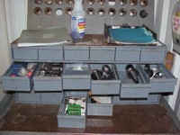
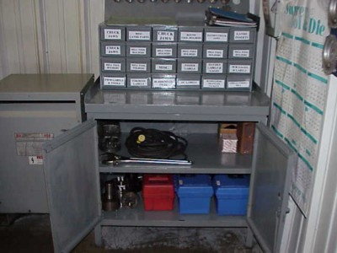
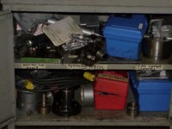
Before
After
After 5S - Cleaned, organized and drawers labeled (less time and frustration hunting)
Notes:
What else needs to be done?

Slide 40
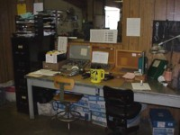
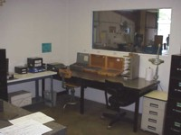
Before
After
Notes:
What else needs to be done?

Slide 41
Before
After

Slide 42
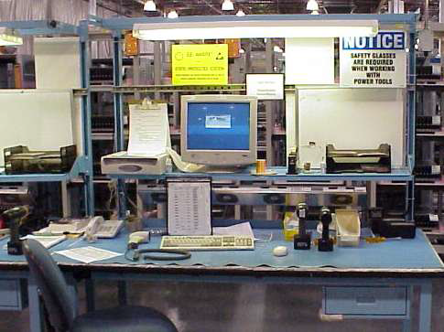
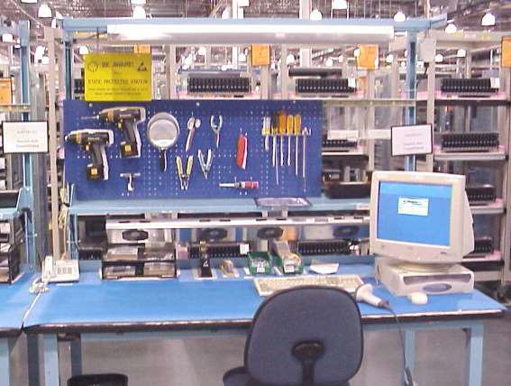
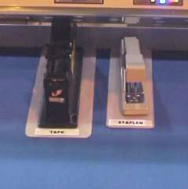
Before
After

Slide 43
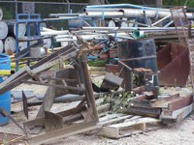
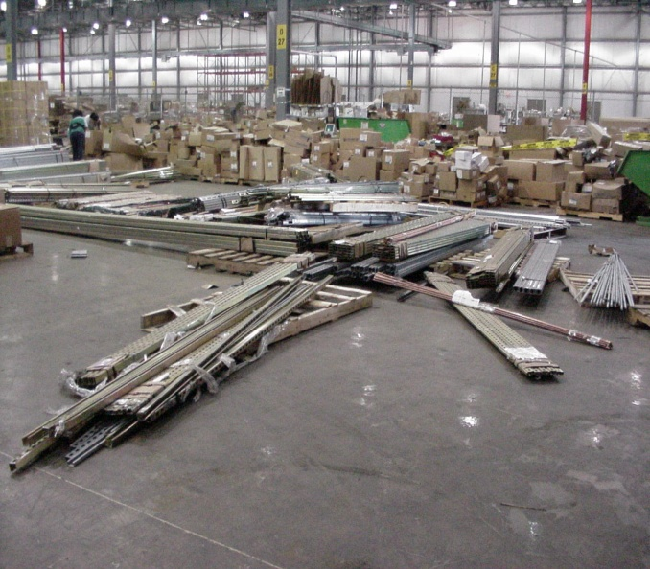
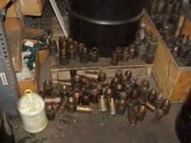
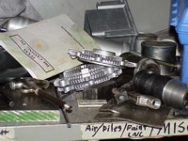
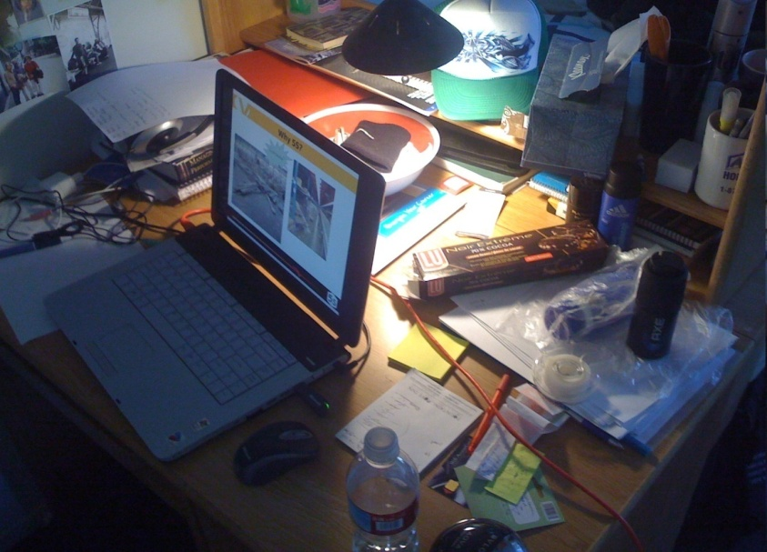
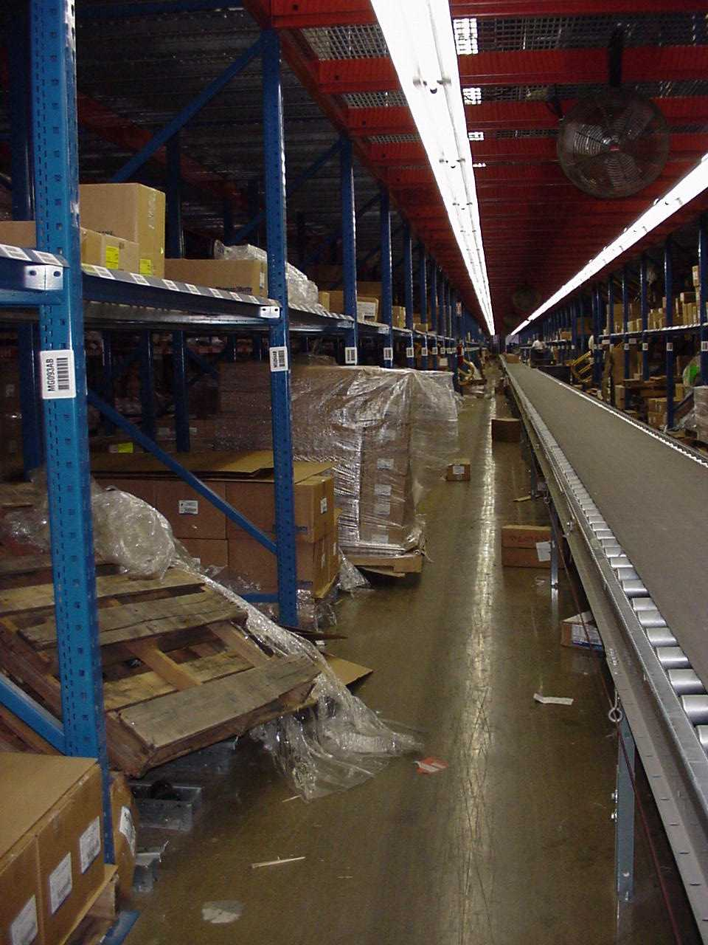
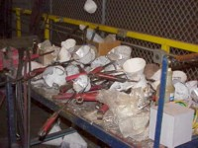
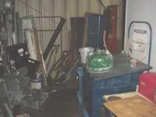
Before

Slide 44
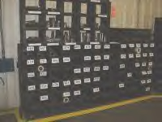
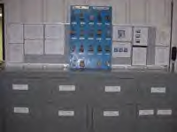
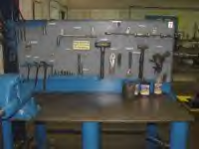
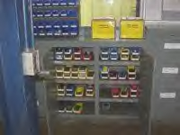
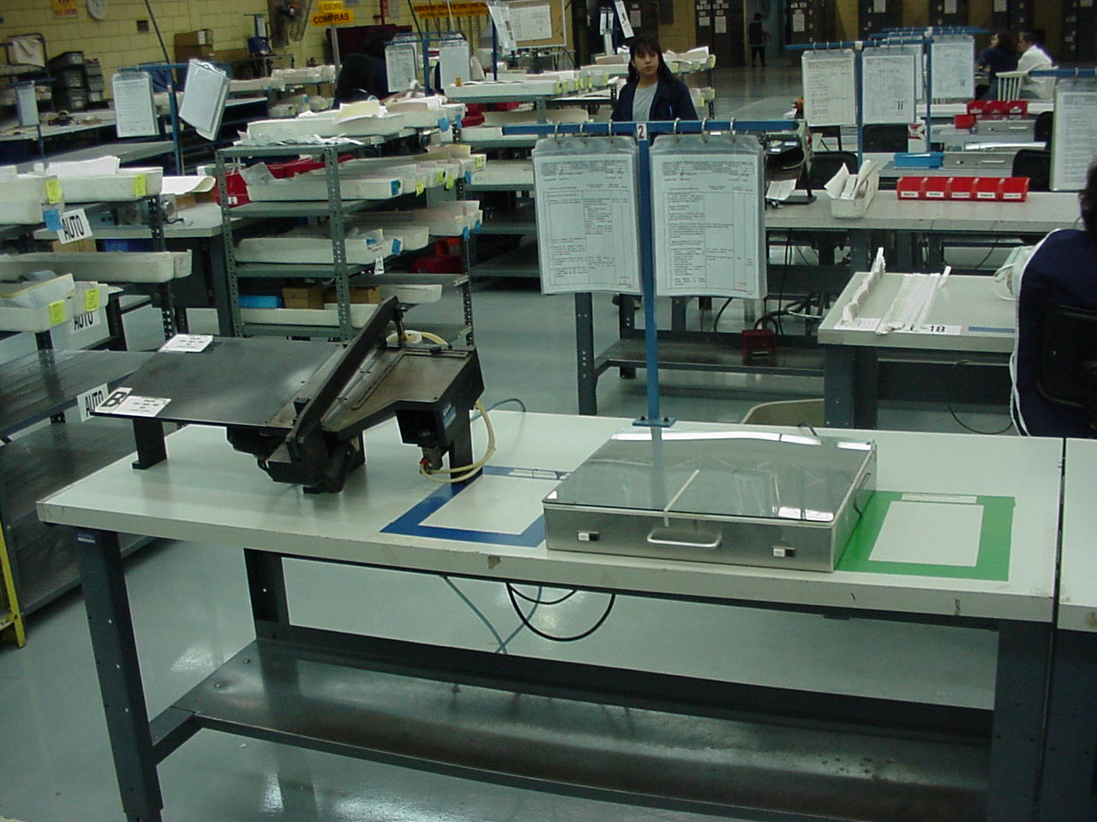
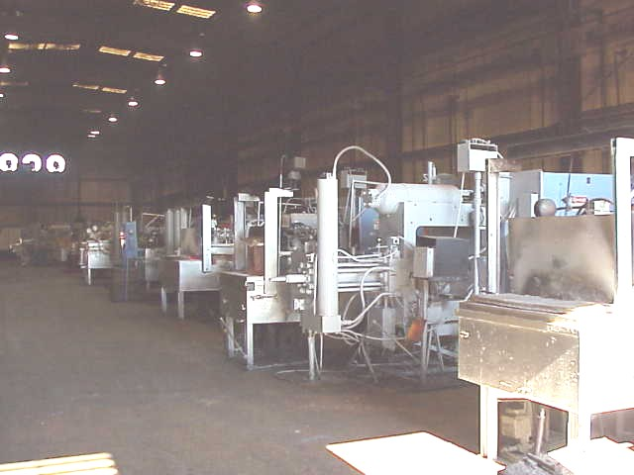
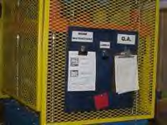
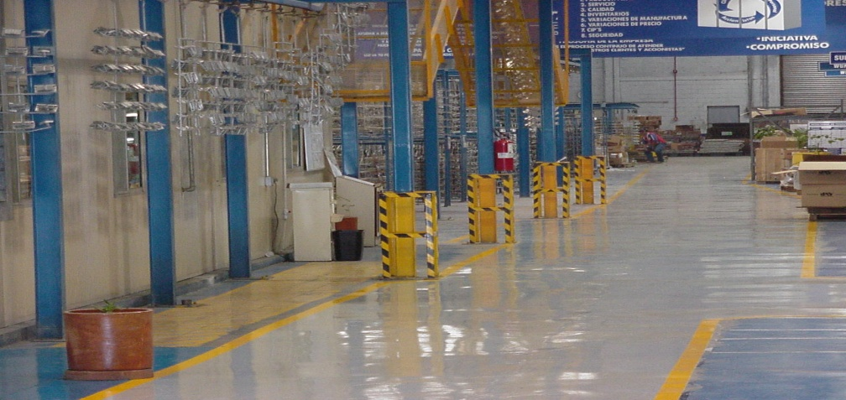
After

Slide 45
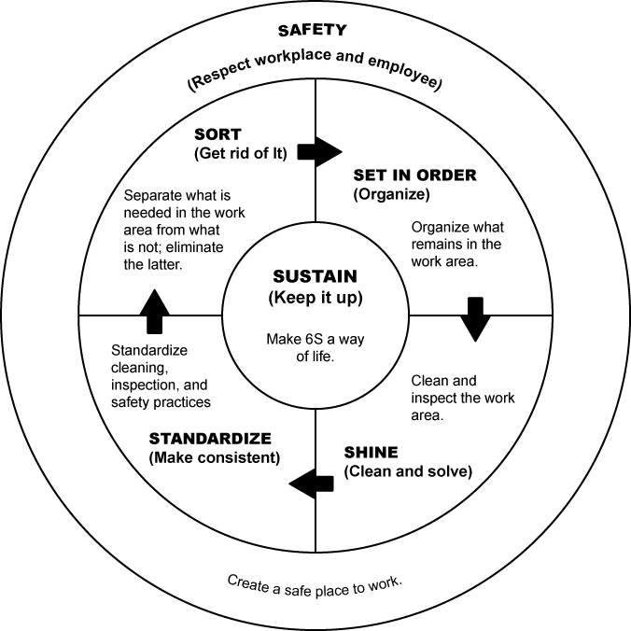
Questions?
Notes:
PDCA – Continuous Improvement
emphasize ongoing improvement, how this is not a one-time exercise, how there is always room for improvement, etc.

