Slide 1
Department of Environmental Quality Division of Waste Management Regulatory Update
May 17, 2016

Slide 3
Outline
DWM Overview
Sections and Programs
Department Information
ESI

Slide 4
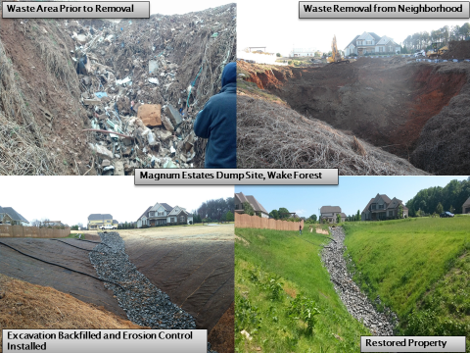
Division of Waste Management Mission
To prevent harmful releases of waste to the environment, and clean up existing contamination.
NC DEQ: Waste Management
Notes:
The primary purpose of the Division of Waste Management (DWM) is to protect public health and the environment by assuring that solid and hazardous wastes and underground storage tanks are managed properly, and that existing contamination is cleaned up.
Picture of DSCA inspector at a dry cleaning site demonstrating one of the key components of the Department’s mission (Customer Service).
The DSCA Compliance Unit administers a compliance inspection and enforcement program to ensure active dry-cleaning facilities and wholesale distribution facilities are compliant with applicable regulations. Through educational assistance and inspections, the Compliance Unit helps ensure that owners/operators understand and adhere to practices that prevent future releases of dry-cleaning solvent to the environment.

Slide 5
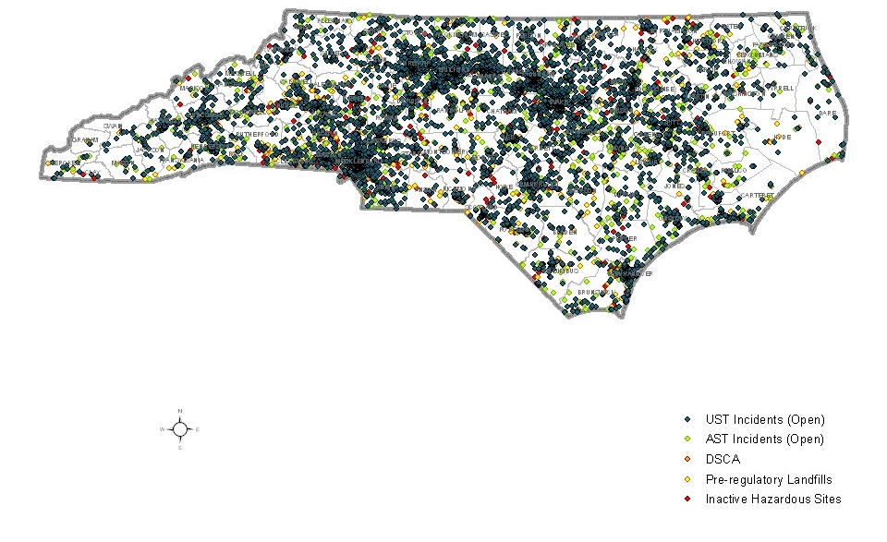
Currently known contamination sites in North Carolina
Includes the following (numbers are approximate):
1,881 | Inactive Hazardous Sites
667 | Pre-Regulatory Landfills
343 | Dry-Cleaning Solvent Cleanup Act (DSCA) Sites
7,912 | Underground Storage Tank (UST) Incidents
2,047 | Aboveground Storage (AST) Incidents
Numbers last updated July 2014
NC DEQ: Waste Management

Slide 6
Waste Management Summary Information
Contaminated land redeveloped in productive economic use: 49,071 acres
Private capital funding in Brownfields redevelopment: 1 billion
Number of inspections performed: 6867
Number of sites where active remediation is complete and controls are in place: 288
NC DEQ: Waste Management
Notes:
Legislation SB 734 Study the Use of Contaminated Properties
Expansion of risk based remediation of groundwater to all remediation programs in DENR. [Already in DryCleaning, pre-reg. landfill, HB 45 (industrial, onsite gw) and petroleum UST remediation.
Evaluate resources needed to over see remediation
Rules adopted by the EMC for gw be no more stringent than he lower of the fed. Or state Maximum Contaminant Levels.
Liability protection for innocent purchases of non-residential property who take actions consistent with due diligence and due care regarding investigations and contaminations found.
Other matters to further the goals of the study.
DENR to report to the ERC by Nov. 1st, 2014
Successes
State-funded risk-based cleanups at Pre-Regulatory Landfills.
Alternative water for 113 homes through Bernard Allen Fund
Active remediation completed and controls in place to protect human health and the environment at an additional 57 sites in state FY2013-14.
Award-winning cleanups at NC military bases (2014 Secretary of the Navy Environmental Restoration Team Award to the Marine Corps Air Station Cherry Point Partnering Team)
Recommendations
Seek funding for cleanup of orphan sites and resources to oversee cleanup of the highest risk sites.
Broaden use of privatized cleanup oversight by Registered Environmental Consultant (REC) program.

Slide 7
Relation to NC DEQ Goals
Maintain and improve water, land and air quality in NC
Prevention of releases
Cleanup of contamination
Instill and achieve excellence in customer service
Alignment of resources to priority areas
Electronic document management to improve access to information
Responsible stewards of state tax dollars and support for the growth of NC’s economy
Redevelopment of contaminated properties
Enhanced recycling venues (coal ash, electronics and other waste streams)
NC DEQ: Waste Management
Notes:
Number of sites where active remediation is in place and controls in place to protect public health and the environment- FY13-14 (1114)
Number of total inspections within the Division- FY 13-14 (7074)
Additional Division staff working in Brownfields and IHSB.
Increasing amounts of Division information available through electronic document management
Amount of contaminated land redeveloped into productive economic use- FY13-14 (2896 acres)
Number of Brownfields agreements- 47
Estimated private capital funding in Brownfields redevelopment- FY 13-14 (704 million)

Slide 8
Programs and Sections
NC DEQ: Waste Management

Slide 9
Core Program Areas
Superfund
Hazardous Waste
Solid Waste
Underground Storage Tanks
Petroleum releases above and below ground
Brownfields Redevelopment
NC DEQ: Waste Management
Notes:
Regional MSW landfill photo (Uwharrie, Montgomery County)

Slide 10
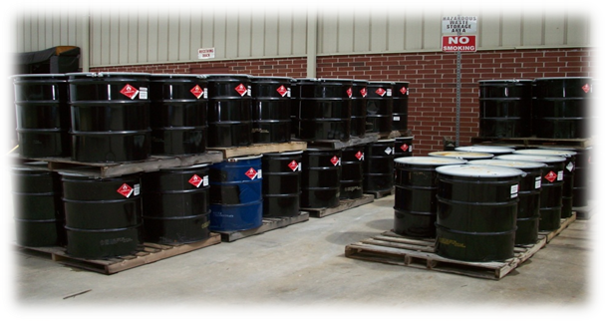
Hazardous Waste Program
Ensures the safe management of hazardous industrial waste by implementing federal regulations adopted under the Resource Conservation and Recovery Act and state requirements.
House Bill 74 (Rules Review process) started this month with initial rule determinations for several HW rule sets.
Definition of solid waste rule
NC DEQ: Waste Management

Slide 11
Revisions to the Definition of Solid Waste
Effective July 13, 2015 – On Federal Level
Effective December 1, 2015 – On State Level through temporary rule making
NC Permanent Rule should be effective June 2016 (but Temporary Rule stays in effect until Permanent Rule)
Changes to Federal Parts (260, 261) that NC incorporates by reference
Provides conditional exclusions from HW rules for certain hazardous secondary materials (spent materials, listed byproducts and listed sludges) when reclaimed following specific requirements

Slide 12
Reclaimed Materials Exclusion
NEW!
New Conditional Exclusions Effective December 1, 2015:
261.4(a)(23) – “Generator Controlled Exclusion”
Hazardous secondary material generated and legitimately reclaimed under the control of the generator
261.4(a)(24) – “Verified Recycler Exclusion”
Hazardous secondary material is generated and transferred to a verified reclamation facility
261.4(a)(27) – “Remanufacturing Exclusion”
Hazardous secondary material that is generated and transferred to another person for the purpose of remanufacturing

Slide 13
State Sectors FY16 (HW)
Never Inspected LQG & SQG Facilities
Prior NOV & Compliance Order Facilities
Hospitals
E-waste Facilities & CRT Handlers

Slide 14
EPA Region 4 RCRA Priorities 2016
Mining and Mineral Processing
Zinc Hazardous Waste used by Fertilizer Recycling Facilities
Organic Air Emissions:
264 and 265 subparts AA, BB, and CC
Notes:
RCRA National Priority Mining and Mineral Processing 2005-2015
Zinc Hazardous Waste used by Fertilizer Recycling Facilities
EPA supports the environmentally beneficial recycling of hazardous wastes and secondary materials. However, sham recycling and recycling not done in compliance with RCRA requirements can result in significant adverse impacts to human health and the environment. This continues to be an area of concern in 2015 and it will include a focus on zinc fertilizer manufacturing that uses hazardous waste in the production process.
Organic Air Emissions: 264 and 265 subparts AA, BB, and CC it was estimated that organic air emissions from hazardous waste units exceeded 2M tons a year.
Pathology Laboratories: Region 4 has found significant non-compliance with RCRA regulations in this sector for several years. Region 4 will continue to look at potential non-compliance in this sector in FY 2015.

Slide 15
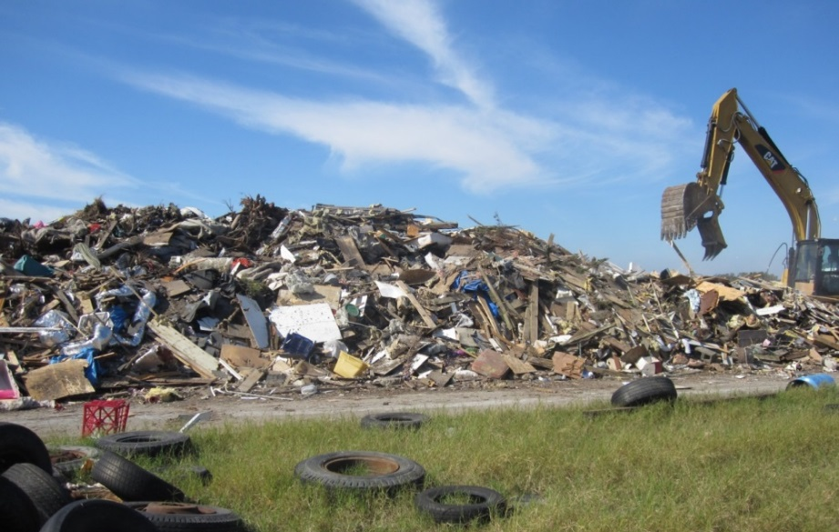
Solid Waste Program
Regulates safe management of solid waste through guidance, technical assistance, regulations, permitting, environmental monitoring and compliance evaluation.
Includes composting and land application, coal ash management, medical waste as well as industrial and sanitary waste streams.
EPA approved program designation in 1993.
NC DEQ: Waste Management

Slide 16
Solid Waste Program Legislation
Coal Ash S.L. 2014-122 (SB 729)
Coordinating with the Dept on impoundment risk classifications.
Reviewing permit applications for new industrial landfills for coal ash
Life-of-Site Permits S.L. 2015-241
Sanitary landfills and transfer stations
Franchise for life-of-site permits
New fee structure (no permit fees, higher annual fees)
NC DEQ: Waste Management
Notes:
Tire cleanup in Woodfin, NC on the bank of the French Broad
Increasing responsibilities of inspection staff include current focus on coal ash (structural fills), additional septage inspection requirements due to staff cuts, increasing facility numbers.
Permitting of alternative technologies: Providing a permit framework for new technologies like anaerobic digestion, pyrolysis, etc. New technologies do not fit the current rule framework.
Compliance rate: 97%

Slide 17
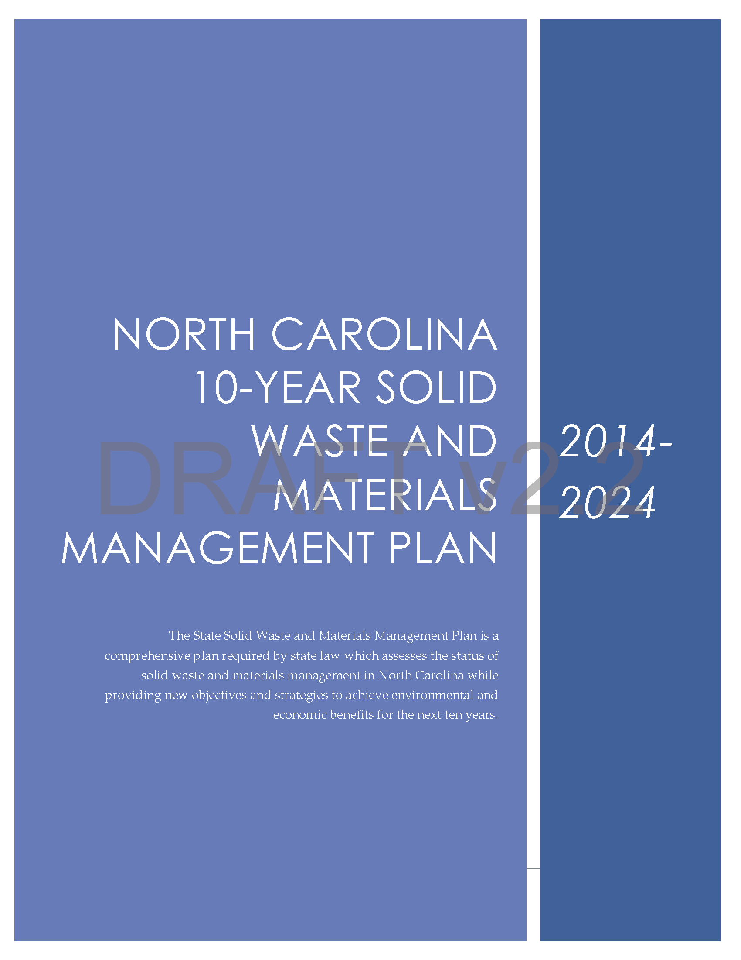
2014-2024 NC Solid Waste and Materials Management Plan (Draft)
Assessment of solid waste and materials management in North Carolina while providing new objectives and strategies to achieve environmental and economic benefits for the next ten years
Collaboration between NC DEQ: Environmental Assistance and Customer Service and Waste Management
NC DEQ: Waste Management
Notes:
Plan is being worked on by a team comprised of Solid Waste Section Branch managers and support staff, and by DEACS Scott Mouw and staff.

Slide 18
2014-2024 NC Solid Waste and Materials Management Plan
Themes in 2014-2024 Plan
Reducing disposal while maintaining robust oversight of waste management facilities.
“Materials Management” – maximizing recovery of commodities to feed to North Carolina’s economy.
Preparing for new challenges – new types of facilities, new waste streams, etc.
Improving the ability of NC to respond to disasters and infrastructure needs.
Expanding and improving customer engagement and support.
NC DEQ: Waste Management
Notes:
Increasing responsibilities of inspection staff include current focus on coal ash (structural fills), additional septage inspection requirements due to staff cuts, increasing facility numbers.
Permitting of alternative technologies: Providing a permit framework for new technologies like anaerobic digestion, pyrolysis, etc. New technologies do not fit the current rule framework.
Compliance rate: 97%

Slide 19
2014-2024 NC Solid Waste and Materials Management Plan
2014-2024 Plan Four Main Elements
Plan elements focus on material recovery processes and new industry practices while maintaining current environmental and public health standards.
Plan Elements Carry Out DEQ Mission by:
Emphasis on Customer Service, Technical Assistance, Education & Outreach
Promoting Economic Viability
Encouraging Collaboration & Stewardship to Protect Public Health and the Environment
NC DEQ: Waste Management
Notes:
Increasing responsibilities of inspection staff include current focus on coal ash (structural fills), additional septage inspection requirements due to staff cuts, increasing facility numbers.
Permitting of alternative technologies: Providing a permit framework for new technologies like anaerobic digestion, pyrolysis, etc. New technologies do not fit the current rule framework.
Compliance rate: 97%

Slide 20
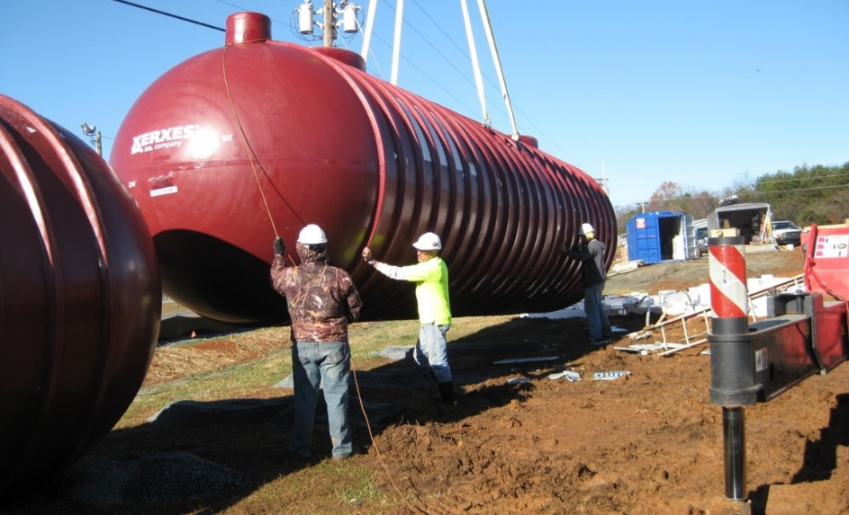
Underground Storage Tanks Program
Registers, permits, inspects and collects operating fees for regulated (commercial) underground storage tanks (USTs).
Oversees cleanups of releases from USTs.
Manages the resources of the Commercial and the Noncommercial Cleanup Funds.
Responds to releases of petroleum from other sources.
NC DEQ: Waste Management
Notes:
Leg. Changes – modified financial assurance requirement for Construction & Demolition landfills from a mon. of $2 million to a min. of $1 million to cover potential assessment and corrective action.
SB 729
Amend structural fill rules as necessary to implement the new provisions.
Moratorium on use of coal ash as structural fill until Aug. 2015 while DENR evaluates use of coal combustion residuals.
DENR and the EMC jointly review and report to the ERC by Jan. 15. 2015 on beneficial uses of coal combustion products in 15A NCAC 13B .1700 and 15A NCAC 27
Monitor EPA actions regarding use of coal ash as structural fill and other beneficial uses.
Transfers the waste rulemaking authority from the Commission for Public Health to the EMC.
DENR positions – DWM gets a few for permitting potential landfill and structural fill options, and long term inspections.

Slide 21
Superfund Program
Inactive Hazardous Sites
Created to protect public health and the environment from releases of uncontrolled and unregulated hazardous substances not addressed by other programs, and to facilitate the cleanup and reuse of sites contaminated by those releases.
Special Remediation
Dry-Cleaning Solvent Cleanup Act Program
Manufactured Gas Plant sites
Federal Remediation
Works with the EPA to investigate and respond at those sites that qualify for cleanup under CERCLA because of the magnitude of their impact, or because they require emergency action. Also work with DOD sites.
NC DEQ: Waste Management

Slide 22
Brownfields Program
Provides a mechanism for treating prospective developers of brownfield sites differently from the parties responsible for contaminating them, to encourage economic redevelopment.
Authorized by the state’s Brownfield Property Reuse Act and funded by EPA grant and State Fees.
NC DEQ: Waste Management

Slide 23
Brownfields
Brownfields Properties are:
Abandoned, idled, or underutilized properties at which redevelopment is hindered by actual environmental contamination or the possibility of environmental contamination.
Brownfields Activities
Property eligibility determinations
Technical site assessment guidance
Risk assessment/Risk management
Brownfields Agreement drafting and negotiation
Public notification and comment response
Risk mitigation implementation
Institutional controls, compliance assistance and monitoring
NC DEQ: Waste Management
Notes:
47 agreements completed in the last fiscal year.
As mentioned previously, additional staff resources have been dedicated to this program in 2014.
News items:
August 7, 2014
ReVenture Park Receives U.S.EPA's "Excellence in Site Reuse" Award
May 28, 2014 - represents $4 million dollars
EPA Selects 9 North Carolina Communities for New Brownfields Investment Grants to Boost Local Economics, Leverage Job Creation
The North Carolina communities receiving the FY14 grants are: Aberdeen; Dunn; High Point; Kinston; Salisbury; Sanford; Wilmington; Wilson; and the Upper Coastal Plain Council of Governments.

Slide 24
Brownfields Success
Before
An abandoned textile mill (circa 1888) and chromium electroplater (circa 1955).
NC DEQ: Waste Management

Slide 25
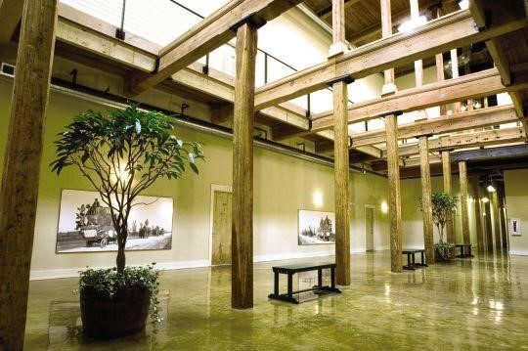
Brownfields Success
After
Alpha Mill Apartments, bordering uptown Charlotte with preservation of historic architectural heritage.
NC DEQ: Waste Management

Slide 26
Division / Department Regulatory Update
NC DEQ: Waste Management

Slide 27
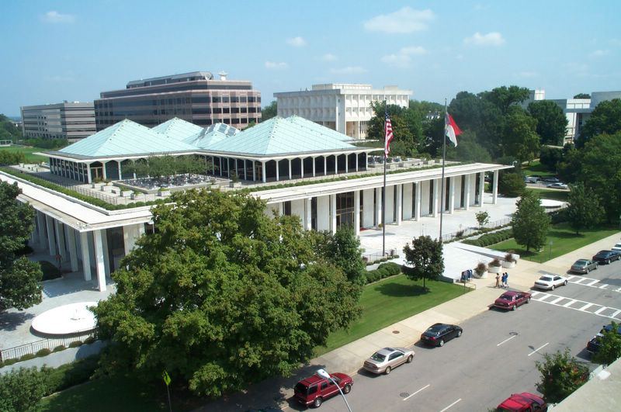
Division of Waste Management
Legislative Topics
Noncommercial Leaking Petroleum Underground Storage Tank Cleanup Fund – Phase Out
Commercial Leaking Petroleum Underground Storage Tank Cleanup Fund – Continuation Review
Solid Waste Landfill Permits – Life of Site
Brownfields Eligibility
Expansion of Risk Based Remediation
Department of Environmental Quality

Slide 28
High profile topics in NC this year (DWM)
Remediation consistency across all programs (General assembly report)
NC Electronics program (General assembly report)
General assembly – Waste working group meetings (aerosolization, landfill capacity)
Focus on efficiency, both for the rate of cleanups / agreements and the rate and timeliness of services- screen sites, identify and manage risks (in partnership with EPA)
Continued focus on Coal ash
Avian Influenza

Slide 29
Expanding Risk-based Remediation (HB 765, S.L. 2015-286))
Broaden the use of risk based remedies for addressing contaminated properties
Directed the Dept. to develop risk-based remedies that are consistent across all programs
Expand the role of Registered Env. Consultants for risk-based cleanups
NC DEQ: Waste Management
Notes:
SB 729
Amend structural fill rules as necessary to implement the new provisions.
Moratorium on use of coal ash as structural fill until Aug. 2015 while DENR evaluates use of coal combustion residuals.
DENR and the EMC jointly review and report to the ERC by Jan. 15. 2015 on beneficial uses of coal combustion products in 15A NCAC 13B .1700 and 15A NCAC 27
Monitor EPA actions regarding use of coal ash as structural fill and other beneficial uses.
Transfers the waste rulemaking authority from the Commission for Public Health to the EMC.
DENR positions – DWM gets a few for permitting potential landfill and structural fill options, and long term inspections.

Slide 30
Rules Review Required
Session Law 2013-413 requires existing rules be reviewed through G.S. 150B-21.3A
Environmental Management Commission (EMC) is authority for 15A NCAC 13C
13C – Groundwater and Waste Management Committee (GWWMC)
15A NCAC 13C - Rules established for Inactive Hazardous Substance or Waste Disposal Sites
15A NCAC 13A – Hazardous Waste rule set
15A NCAC 13B- Solid Waste rule set
Department of Environmental Quality
Notes:
Session law in 2013 required all state rules be reviewed.
Environmental Management Committee is the agency with authority for rule review regarding 15A NCAC 13C
Groundwater and Waste Management Committee has to give approval of the 13C rules to go before the EMC
13C includes the rules for the Inactive Hazardous Sites Program – the rules established for Inactive Hazardous Substance or Waste Disposal Sites.

Slide 31
Review Process
Three Step Process
Step 1: Agency Determination
(Initial determination and public comment period)
Step 2: Rules Review Commission (RRC) Review (Reviews agency’s report and makes final determination)
Step 3: Administrative Procedure Oversight (APO) Committee Consultation (Opportunity to review final determination before it becomes effective)
Department of Environmental Quality

Slide 32
Categories of Determinations
Step 1: Agency Determination
Unnecessary (Rule will expire and be removed from code)
Necessary without substantive public interest (Rule will remain in effect without further action)
Necessary with substantive public interest (Rule shall be readopted as if it was new in accordance with APA)
Department of Environmental Quality

Slide 33
NC DEQ- DEMLR
Update on stormwater rules readoption/amendment process
DEMLR staff meeting with Rules Review Commission staff on 5/20/2016 to discuss rule language changes as a result of public comments received and after further technical review
DEMLR staff to meet with EMC hearing officer on 5/26/2016 to discuss RRC staff feedback and next steps
If none of the rule language changes are considered substantial, the final rule package will be presented to the EMC at its July 14, 2016 meeting for adoption
By 7/20/2016, the final rule package will be submitted to the RRC for review
RRC will consider and approve the final rule package at its 8/18/2016 meeting
Proposed effective date of the stormwater rules will be 9/1/2016
NOTE: Along with the updated rules, DEMLR is also anticipate updating our technical design manual to be consistent with minimum design criteria that will be included in the rules.

Slide 34
DEMLR continued
Sediment Program:
Erosion and Sedimentation Control:
Currently in periodic rules review and readoption process
Stakeholder workgroup has been formed and will begin meeting this summer
Rules Readoption deadline is November 30, 2019
Recent Changes to the Sedimentation Pollution Control Act (SPCA)
Remission of Civil Penalties
First Time Assessments of Civil Penalties for Violators
First Time Recipients of Notices of Violations
New Exemption to the Sedimentation Pollution Control Act

Slide 35
Environmental Self Audit (H 765) SL 2015-286
US EPA approval
Timeline for correcting violations
Once in a 2yr period, no more than twice in a 5 yr period, no more than three times in a 10yr period
Does not apply to the Coal Ash Management Act

Slide 36
Additional thoughts

Slide 37
Wastes that we want to recycle but sometimes it is difficult to justify
Examples of problematic industrial waste
Lighting
Reduced regulations when recycled under RCRA Universal Waste rules
Cost of recycling can be expensive causing facilities to dispose instead of recycling
Swarf
Can be ignitable or mixed with oils
Low return when recycled
Filter cake
Can be a listed hazardous waste
If not hazardous and can meet beneficial use requirements, may be able to use as landfill alternate daily cover

Slide 38
Compliance Assistance Visits (CAVs) a.k.a. Technical Assistance
Can occur over email/phone or on-site
On-site visits can be scheduled at the facility’s convenience
Assist with achieving & maintaining compliance with the hazardous waste rules
Inspector may make recommendations on areas within the facility that are not identified as violations/action items
They may include waste minimization practices, recordkeeping tips, or container management options, etc.

Slide 39
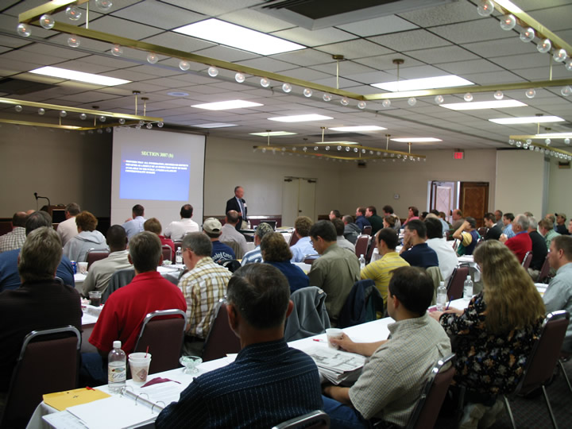
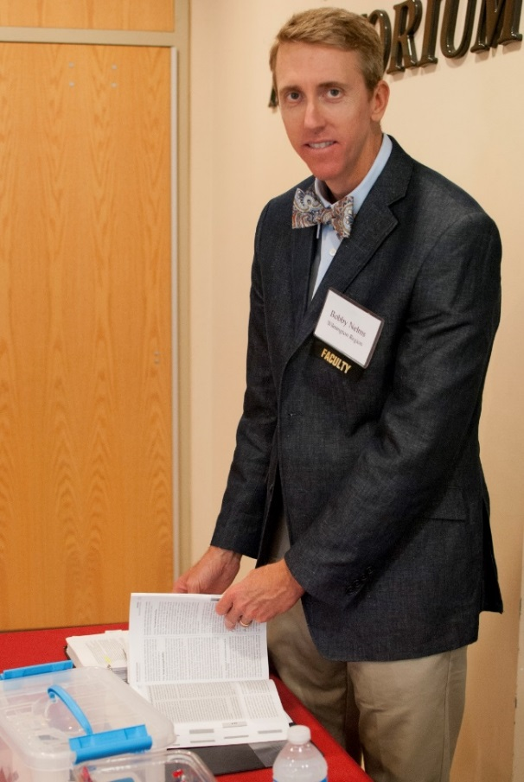
Hazardous Waste Workshops
In conjunction with the North Carolina Manufacturers Alliance, the Compliance Branch staff conducts five full day Hazardous Waste Workshops throughout the state
Check the NCMA website for details: http://www.myncma.org/
In 2015, regulatory compliance assistance was provided to 446 facility personnel through these workshops

Slide 40
The Importance of Auditing Waste Vendors

Slide 41
This company told clients their waste was being recycled or used to make products
When it was actually abandoned in a warehouse.

Slide 42
This company told clients that their CRTs were being recycled.
The CRTs were actually broken, the copper yokes were sold and the CRT leaded glass was abandoned. This warehouse was full of broken CRTs.

Slide 43
Waste Management
Michael E. Scott, Director
217 W. Jones Street
1464 Mail Service Center
Raleigh, NC 27699-1646
919-707-8246
http://portal.ncdenr.org/web/wm
Questions???
NC DEQ: Waste Management

