Slide 2
Tuesday

Slide 3
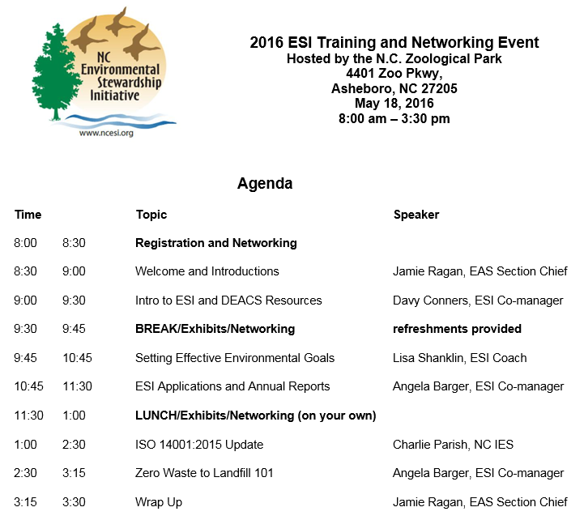
Wednesday

Slide 4
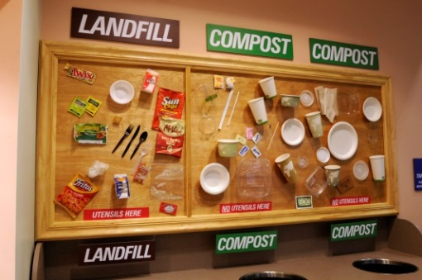
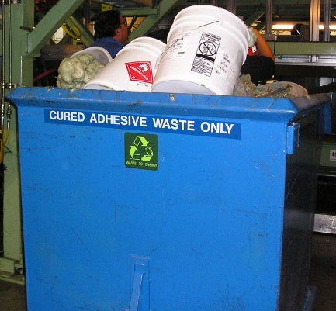
Cumulative Waste Reductions Reported by ESI Members
for Calendar Years 2004-2014
Examples of signage at NIEHS and Thomas Built Buses helped our members reduce waste going to landfill by 36,000 tons in 2014.
Notes:
Examples of signage at NIEHS and Thomas Built Buses helped our members recycle 46,350 tons.

Slide 5
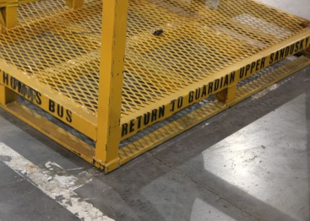
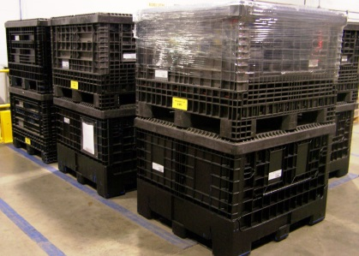
Cumulative Savings ($) Reported by ESI Members
for Calendar Years 2005-2014
Members reported over $2,000,000 in savings in 2014. Returnable packaging is one way to save.
Notes:
Over $800,000 in savings in 2013. Returnable packaging is one way to save.

Slide 6
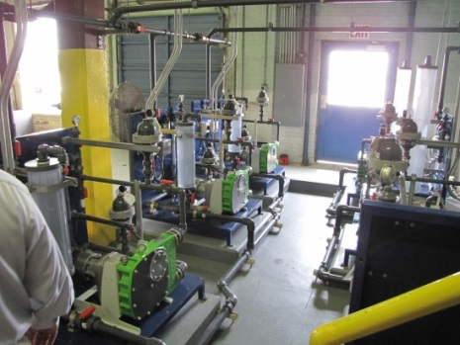
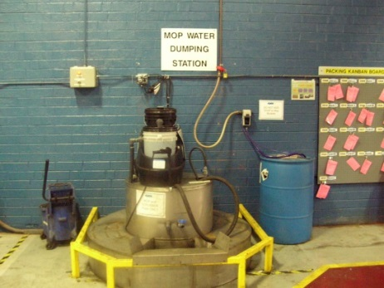
Cumulative Water Reductions Reported by ESI Members
for Calendar Years 2004-2014
ESI members saved over 2 billion gallons of water in 2014.
Notes:
ESI members saved enough water in 2013 to fill 25,000 home swimming pools.

Slide 7
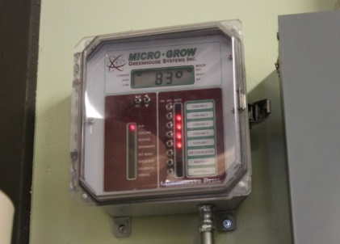
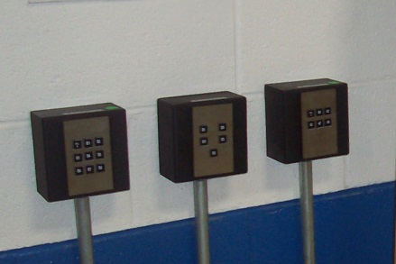
Cumulative Energy Reductions Reported by ESI Members
for Calendar Years 2005-2014
In 2014, projects like upgrading controls at the NC Zoo and Corning HMTC led to reducing almost 80,000 mmBtu.
Notes:
In 2013, projects like upgrading controls at the NC Zoo and Corning HMTC led to reducing 8.6 million mmBtu.

Slide 8
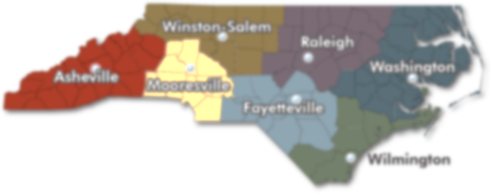
DEQ Regional Office
Assistance Coordinators
Asheville Regional Office Contact: Alison Davidson 828/296-4500 FAX 828/299-7043 Fayetteville Regional Office Contact: David Lee 910/433-3300 FAX 910/486-0707 Mooresville Regional Office Contact: Marcia Allocco 704/663-1699 FAX 704/663-6040 Raleigh Regional Office Contact: David Lee 919/791-4200 FAX 919/571-4718 | Washington Regional Office Contact: Lyn Hardison 252/946-6481 FAX 252/975-3716 Wilmington Regional Office Contact: Cameron Weaver 910/796-7215 FAX 910/350-2004 Winston-Salem Regional Office Contact: Marcia Allocco 336/776-9800 FAX 336/776-9797

Slide 9
Waste Reduction Partners – Who are we?
Volunteer team of 65 retired engineers and scientists
Perform no cost energy, water, “lean & green”, and solid waste assessments in North Carolina
Grant funded by local, state, and federal governments – funds used for administration and stipends for volunteers
FY2013-14 performance:
$1.75 million in utility savings
2.75 million gallons of water use reduction
6,790 tons of material diverted from landfills
162 clients assisted in 47 counties.
Since 2000 - $70 million in client savings
Sponsored by:
Triangle J Council of Governments
Land-of-Sky
Regional Council
State Energy Program
Division of Environmental Assistance & Customer Service
NC DENR
Division of Environment and Natural Resources
www.wastereductionpartners.org

Slide 10
Congratulations New Members
New Stewards
Stanley Black & Decker – Kannapolis DC
TE Connectivity – Burgess Rd
New Partners
Ajinomoto North America, Inc. - Raleigh, NC Plant
American Emergency Vehicles
Caterpillar-Clayton, NC
GENERAL ELECTRIC AVIATION - DURHAM ENGINE FACILITY
Iredell Fiber, Div. of Leggett & Platt
CMI Plastics
Linamar

Slide 11
Congratulations Renewing Members
Five Year Renewal
Rising Stewards
GKN Sintered Metals
Ten Year Renewal
Stewards
GKN Sanford Precision Forming

Slide 12
Stanley Black & Decker

Slide 13
TE Connectivity – Burgess Rd

Slide 14
All Stewards

Slide 15
Upcoming Training
New! Updated for 2015 Standard!
EMS 101 - 10/13/16; Raleigh
EMS Module 2 – 11/3/16; Raleigh
EMS Module 3 – 12/1/16; Raleigh
EMS Module 4 – 1/19/17; Raleigh
EMS Module 5 – 2/16/17; Raleigh
Internal Auditor – 3/16/17; TBD
EMS Follow-Up Workshop – 6/8/17; Raleigh

Slide 16
Zero Waste to Landfill 101
Learn the basics of launching and running a Zero Waste-to-Landfill program
Interactive and training-paced environment
Topics include
Getting started,
Green teams,
Dumpster dives (waste audits),
Tracking progress, and
Cost-effective approaches.
Valuable tools, resources, and examples to help you on your own ZWTL journey
Watch your email for the next date
or request one at your site

Slide 17
Lean and Green
Presentation with Activity
Intro to Lean concepts
Lean in Offices
On-site, Hands-on Events
Use Existing Lean Tools (Value Stream Maps) to help experienced Lean Practioners to see Green Wastes
Teach 5S to those looking to begin a ‘Lean’ program
Contact Angela to schedule yours!

Slide 18
NCMA
Environmental, Energy, Health and Safety School
August 8 – 9, 2016
McKimmon Center – NCSU
Raleigh, NC
www.myncma.org/EEHS_School

Slide 19
DEACS Services
* Personalized on-site EMS assistance
* EMS Gap Analysis
* Internal Audit Assistance
* Root Cause Determination Assistance
* 5S events
* Value Stream Mapping events
* Dumpster Dive (Waste Audit) Assistance
* Technical and Compliance Assistance
* Waste, Water, Energy Assessments
* Facilitation Assistance
* Zero Waste to Landfill Assistance

Slide 20
Coaches Contacts
Angela Barger: angela.barger@ncdenr.gov; (919) 707-8126
Davy Conners: davis.conners@ncdenr.gov; (919) 707-8131
Keyes McGee: keyes.mcgee@ncdenr.gov; (919) 707-8134
Ron Pridgeon: ron.pridgeon@ncdenr.gov; (919) 707-8143
Lisa Shanklin: lisa.shanklin@ncdenr.gov; (919) 707-8142
Jamie Ragan: jamie.ragan@ncdenr.gov; (919) 707-8141

Slide 21
Thank You Exhibitors!
DEACS
Eaton
NCDOL - Carolina Star
NCSU IES
WRP

