Slide 1

Overview of Recycling Markets
Scott Mouw
NC DEACS
ESI Members Meeting
May 2016

Slide 2


General Overview of Marketing Recyclables
Recycling encompasses multiple steps: collection, processing, and end-use
  Your immediate “market” may be a collection company or processor
  Each step entails profit-making by the parties involved
  Market prices at end-use not what generator likely to receive
Value of a material at any given stage affected by multiple factors, e.g.:
  Transportation logistics
  Amount of secondary processing required
  Quality and amount of the material
Final value determined by commodity markets, mostly global in nature.

Slide 3
General Factors Affecting Recycling Markets
Overall economic growth
Commodity demand
Export/Import
Currency values
Competition between virgin and recycled materials
Price of energy, affecting:
  Production
  Transportation

Slide 4
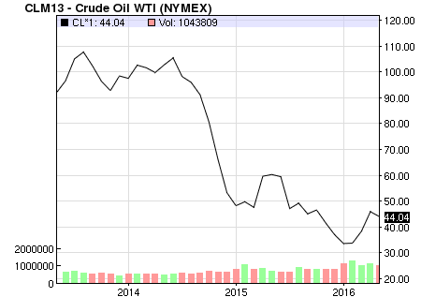
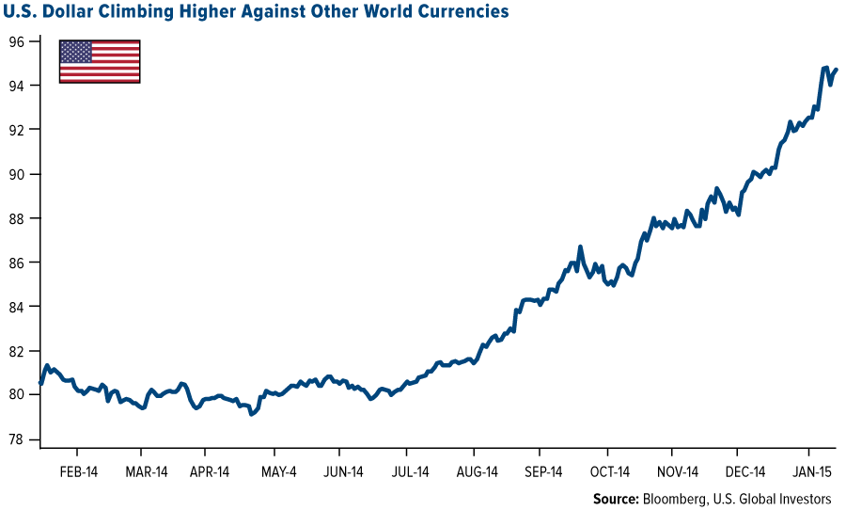

Recent Prominent Factors Affecting Recycling Markets
Price of oil
Transition in Chinese economy
Strong dollar

Slide 6
Cardboard and Office Paper Market Prices (in $/ton)

Slide 7
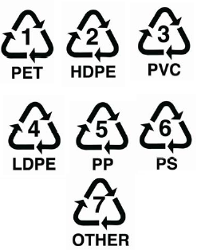
Plastics
North Carolina home to many plastic recyclers, covering a wide range of resins and products in various forms
  Very strong opportunities to find homes for plastics discards
  Best opportunities are for single resin, clean materials
Quantities and transport may be significant factors in local recycling options
Plastic recycling markets strongly track petroleum and natural gas pricing
  Swings in virgin resin capacity a strong factor
  Prices currently low, but long term likely on an upward trend

Slide 8
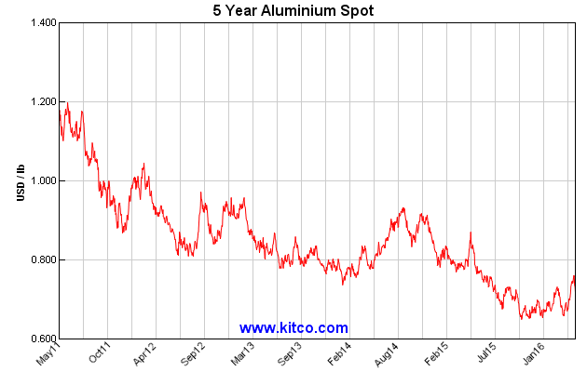
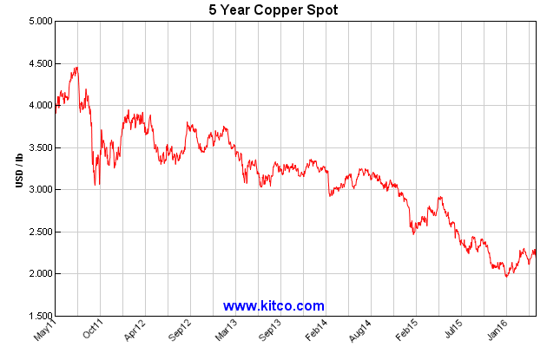
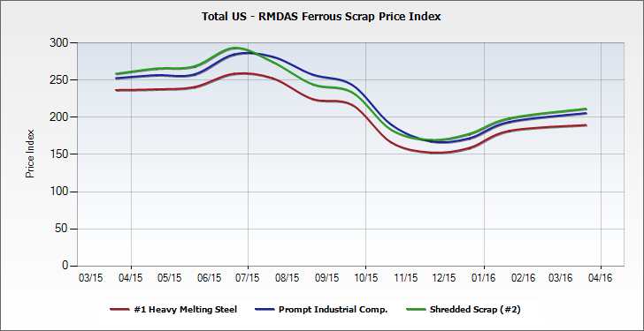
Metals
Robust number of scrap metal processors in North Carolina
Metal prices tend to be affected most by construction and automobile/transportation markets
  Export/Import, finished metal global competition, inventories significant factors
Ferrous prices creeping up
Non-ferrous prices on long decline and flat

Slide 9
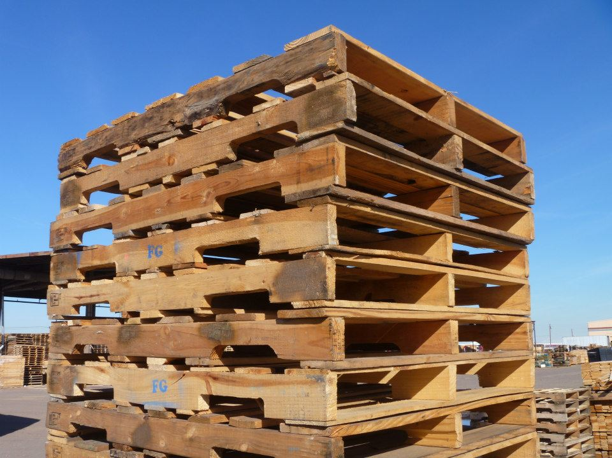
Examples of Materials with Localized Markets
Organics
  Compostable materials have negative market prices and do not travel far
  Localized infrastructure relies on tipping fees, hence “market pricing” is negative
  Wood waste as fuel or mulch also localized and is an historically flat market
  NC in pretty good shape with these markets
Pallets
  Recyclable pallets have had same basic pricing for years
  Mix of pallets is what is key – standard vs customized
  NC has very strong pallet recycling infrastructure

Slide 10
Markets for Specialized Materials
Specialized materials could include materials like
  Production by-product
  Processing wastes
  Customized dunnage
  Composites
In many cases, the best “market” is source reduction
  Take-back also sometimes an option
Immediate market will likely be a processor who can prepare the commodities for market
Volume may work against market options
Market pricing likely to be steady but negative

Slide 11
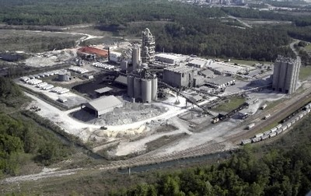
Fuel/Energy Markets
Waste to Energy plants
  All are out of state, some close to NC
  Negative pricing
Cement kilns
  Huge plants in SC accessible to NC generators
  Accessed through fuel blenders of both solid and liquid materials
  Btu value, contaminants are key factors
  Negative pricing, generally above landfill tipping fees

Slide 12
Emergence of Zero Waste Service Providers
Access to markets provided by growing number of singular service providers, e.g.: Pallet One and ICE
Traditional recyclers and waste haulers also active in this area,
e.g.:WM and Sonoco
PROS:
  Can be a one-stop shop for wide array of materials
  ZW service providers can consolidate specialize materials from scattered sources
CONS:
  Trading off possible market revenues for handling services

Slide 13
What Matters to Markets
Volume – e.g., “truckload quantities”
Quality
Price – positive or negative
Commitment
Ease of Access

Slide 14
Resources
NC Recycling Markets Directory
http://www.p2pays.org/dmrm/start.aspx
NC WasteTrader
http://www.ncwastetrader.org/home.aspx
DEACS and Waste Reduction Partners Staff
http://portal.ncdenr.org/web/deao/contacts
http://wastereductionpartners.org/

Slide 15
Some Tips For Navigating Markets
Determine your own needs, capacities, and goals, revisiting them from time to time
  Do you want to process and market individual materials, or…
  Do you want to let service providers/markets do the work?
Build in regular, periodic checks with vendors/markets, addressing:
  Market conditions
  Pricing
  Recyclability of materials
Stay in touch with peers and DEACS regarding status of markets and market options
Use NC WasteTrader for specialized materials

Slide 16

Thank You!
Scott Mouw
NC DEACS
scott.mouw@ncdenr.gov
919-707-8114

Slide 17
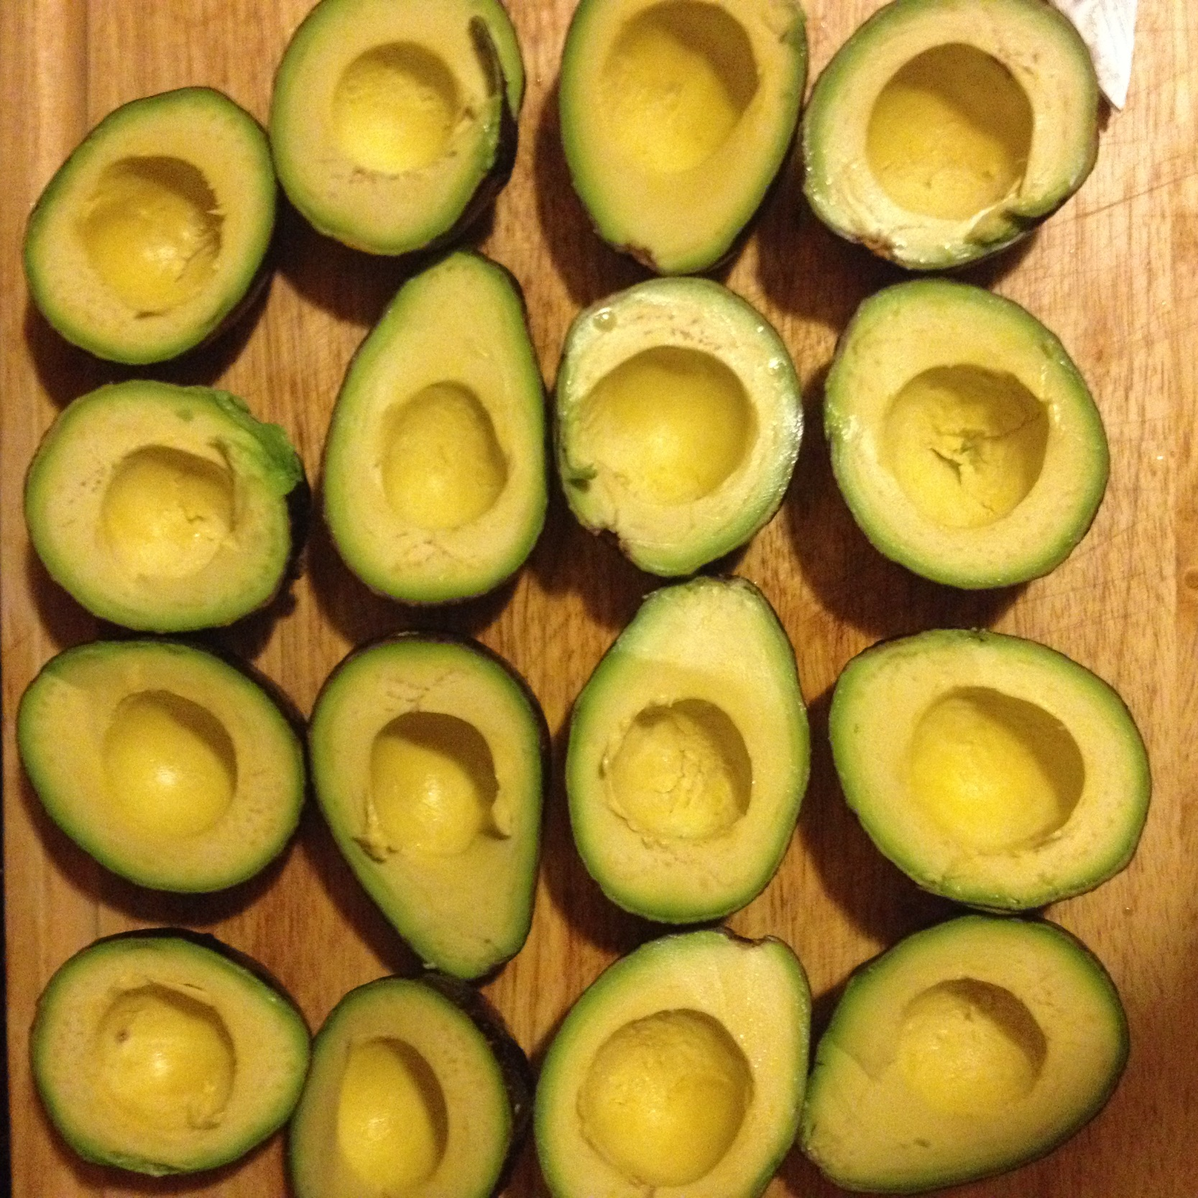
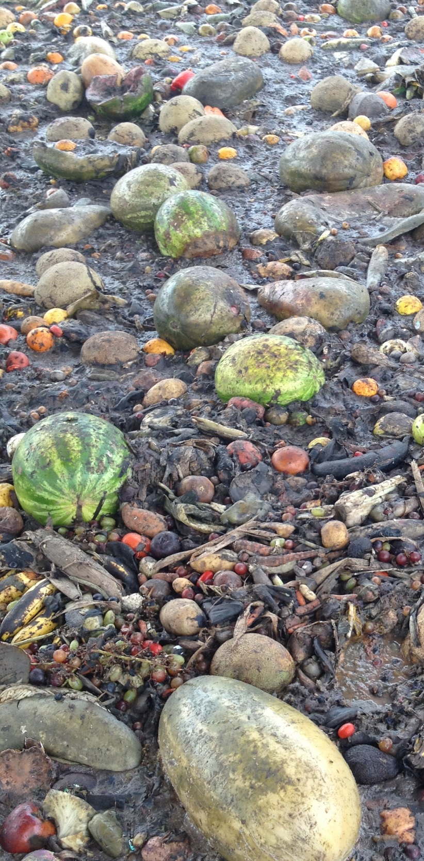

OUTLINE
Compost Benefits
Organics Recycling Overview
Composting 101
AD 101
Feedstocks
Considerations
Maps

Slide 18
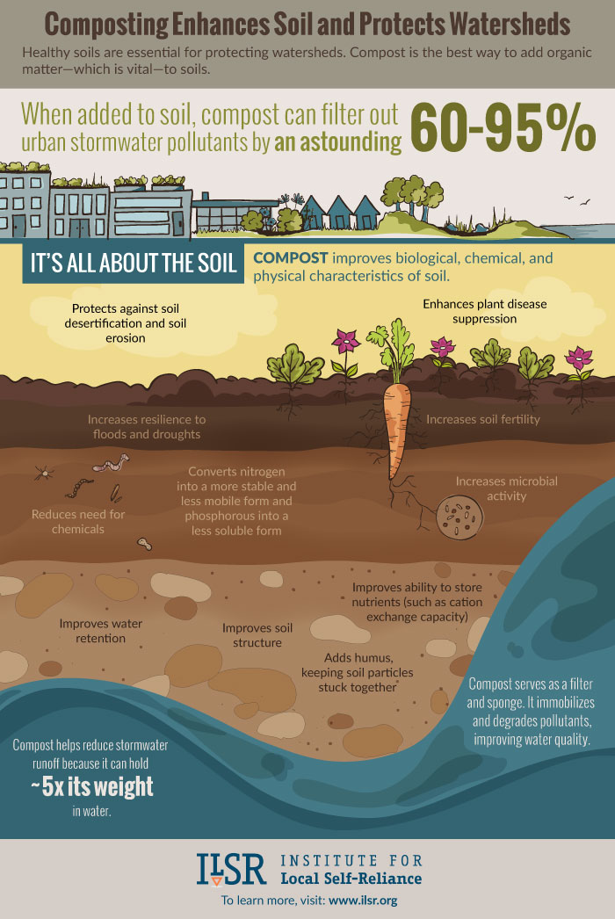
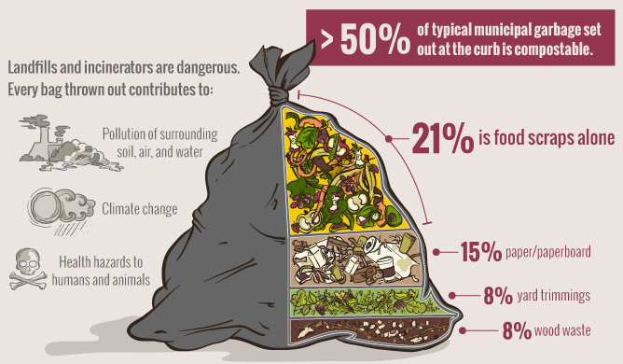

Slide 19
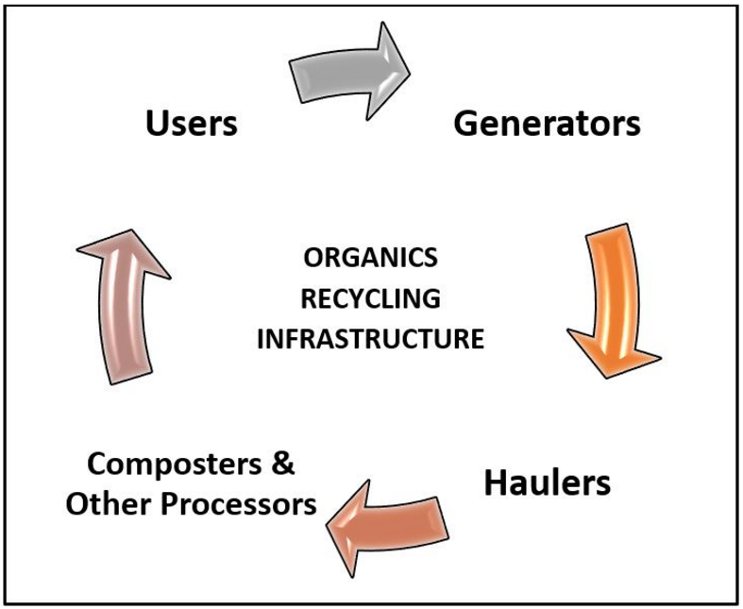

Slide 20

Composting 101
Collection
Feedstock Preparation
Active Composting
Curing & Screening
Quality Assurance
Compost Users

Slide 21
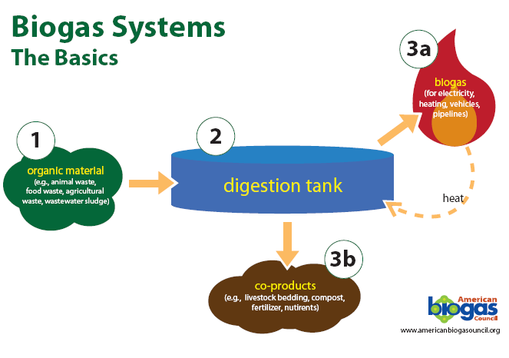

Slide 22
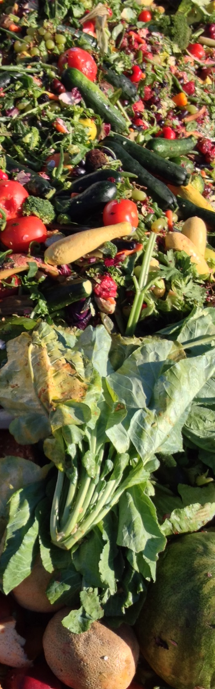
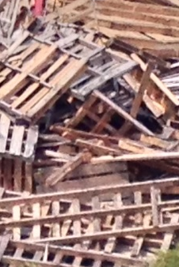
Feedstocks
Woody materials:
pallets, clean wood, dimensional wood
Cardboard
Food scraps
Sheetrock
Liquid Byproducts (AD)
Biosolids (Type 4)

Slide 23
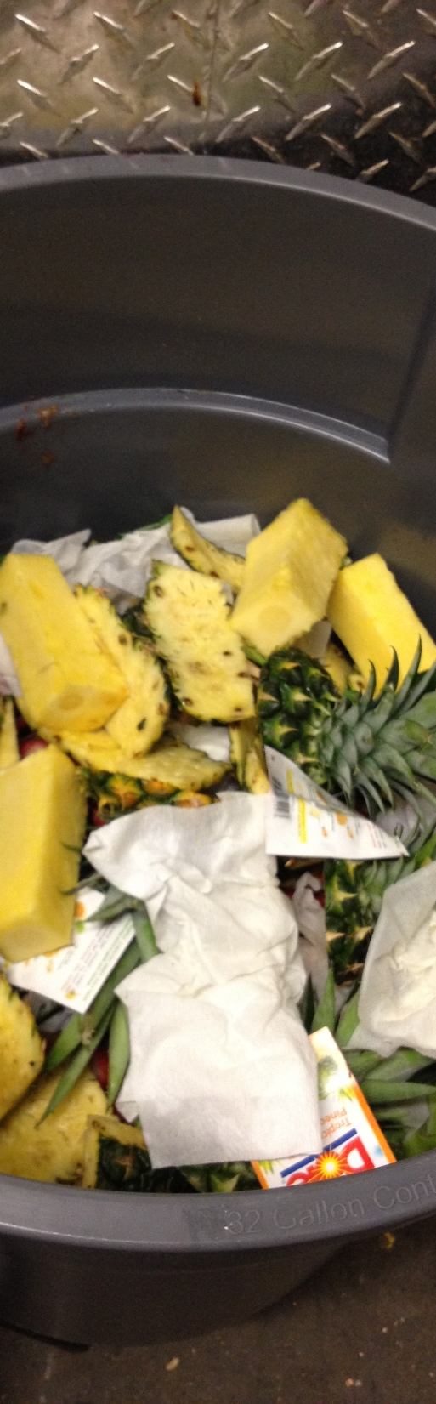
Considerations
Waste bill (frequency pulls, tonnage tips)
Composting costs
$26/ton average tipping fee (depends on feedstock)
Hauling costs (distance to composter/AD)
Contamination

Slide 24
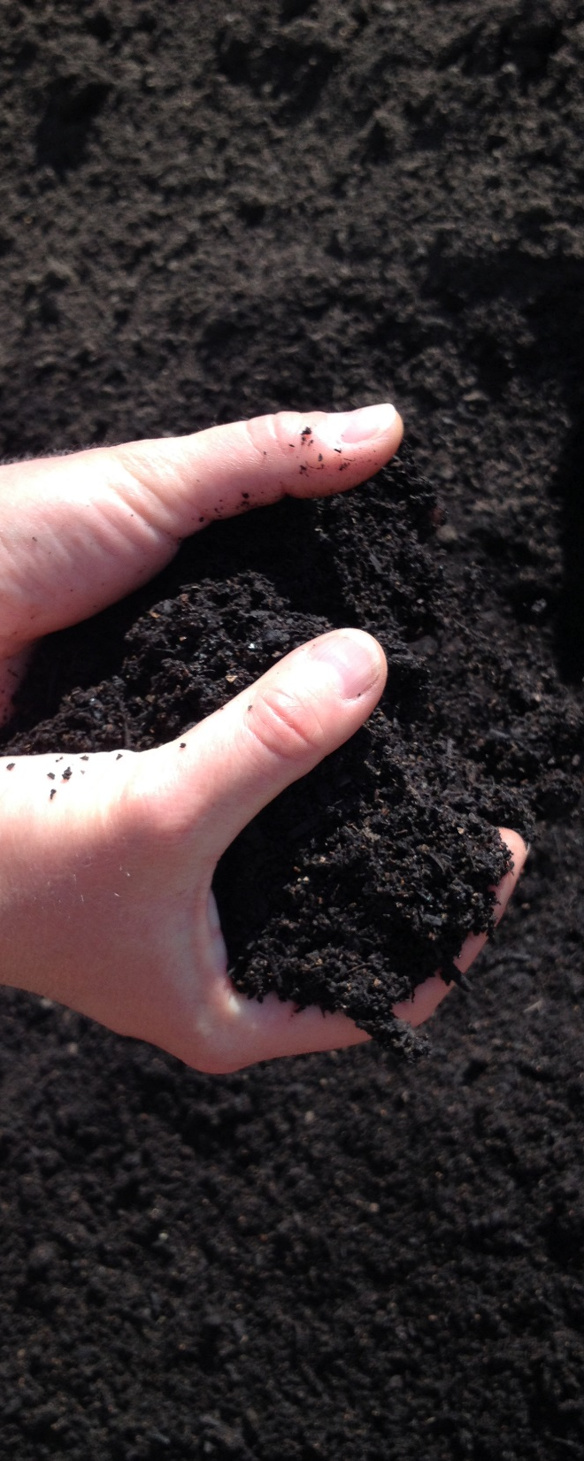

Compost Users
Nurseries
Sports Fields
Farms
Landscapers
Department of Transportation
Erosion / Sedimentation Control

Slide 25
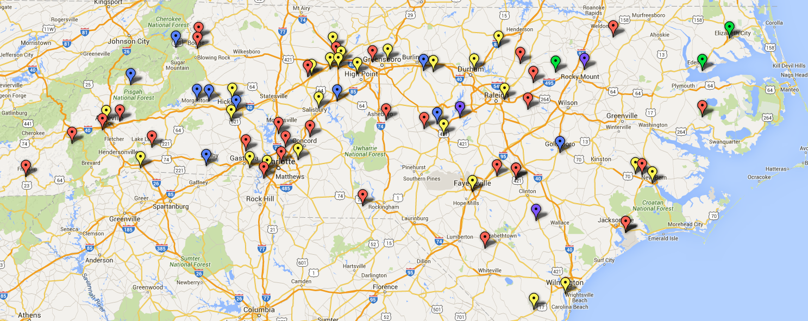
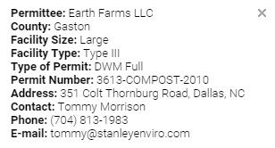
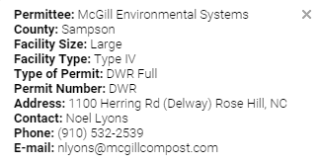
Permitted Composting Facilities

Slide 26
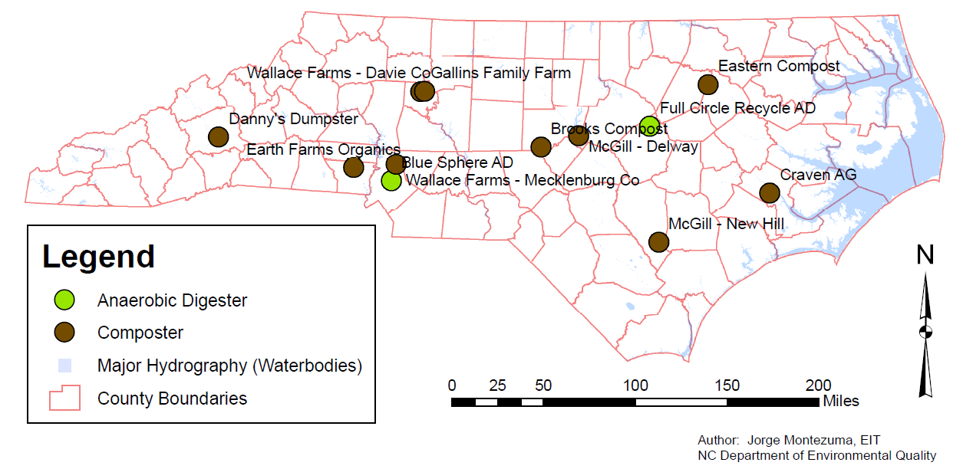
Permitted AD/Composting Facilities
Able to Accept Off-Site Food Scraps

Slide 27
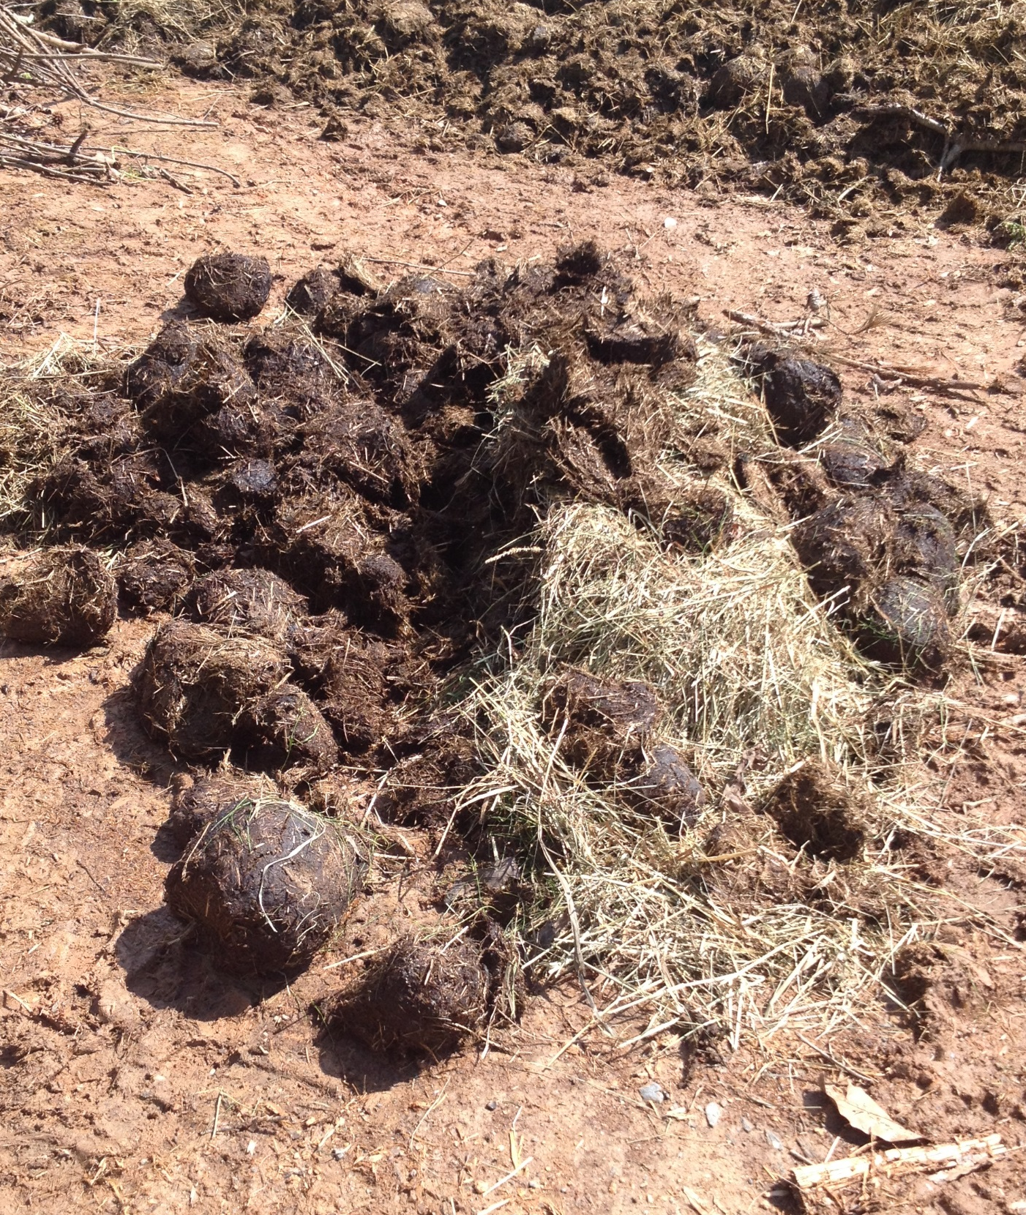
Jorge Montezuma, EIT
Organics Recycling Specialist
NCDEQ DEACS
jorge.montezuma@ncdenr.gov
919-707-8123

