Slide 1
Department of Environmental Quality
Division of Air Quality
N.C. Air Awareness

Slide 2


Slide 3
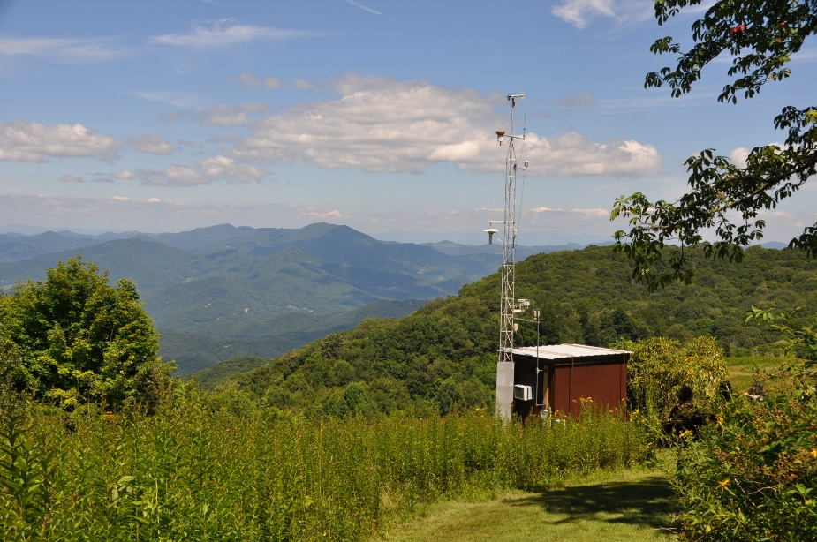
Division of Air Quality (DAQ)
DAQ is a division within the Department of Environmental Quality (DEQ).
DAQ’s Mission:
Protect and improve outdoor or ambient air quality in North Carolina for the health, benefit and economic well-being of all. DAQ utilizes regulatory and voluntary efforts to reach division goals.
To learn more: www.ncair.org.
N.C. Air Awareness is an education and outreach program within the Division of Air Quality.
    Program includes community, partnership and education projects.
    Focus on voluntary actions to help solve air pollution problems from cars and trucks.
    Provide free air quality education to future drivers.
Notes:
- Program can provide free educational materials to future drivers to help them save money, drive safely, and improve our environment.

Slide 4
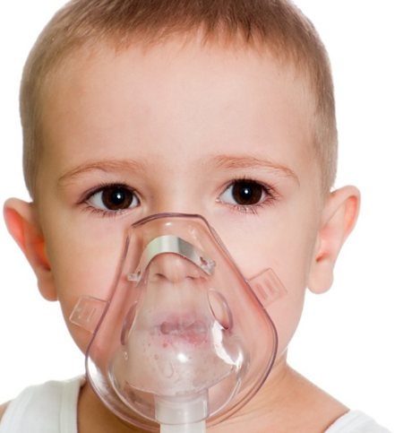
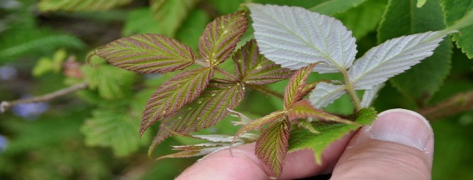
Why Do We Care about Air Pollution?
Human and Environmental Health Impacts
Asthma or respiratory problems are still one of the main reasons our students miss school and adults miss work.
Asthma or respiratory problems are the third ranking cause of hospitalization among those younger than 15 years of age.
Damaged crops and plants
Visibility = Lost Revenue and Tourism

Slide 5
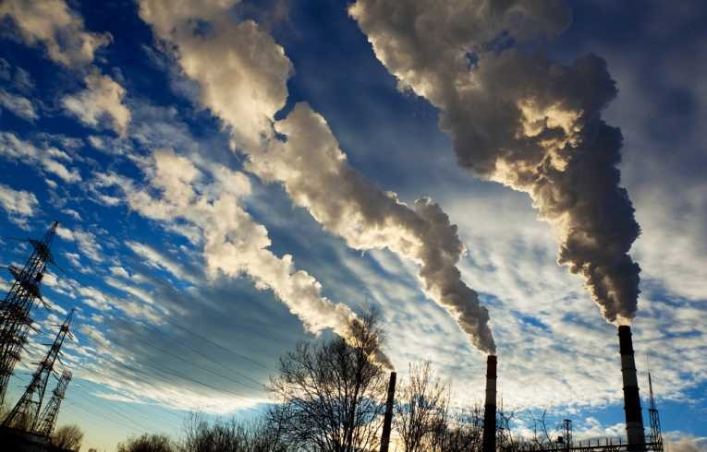
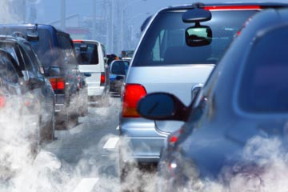

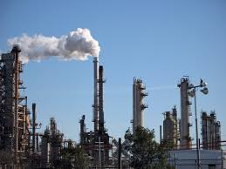
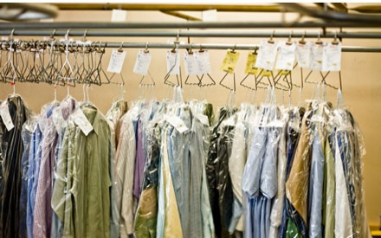
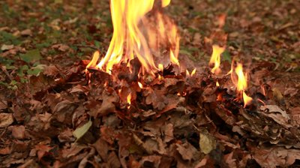


Where does air pollution come from?
Point Sources
      Electric power plants, refineries, industries, etc.
Area Sources
      Dry cleaners, paints, solvents, etc.
On-Road Vehicles - Mobile sources
      Cars, trucks, buses
Off-Road Vehicles - Mobile sources
      Airplanes, trains, construction equipment
Notes:
In general, there are numerous sources of air pollution, which can be divided into several categories
- Point Sources (electric power plants, refineries, pulp and paper mills, furniture manufacturing, breweries)
- Area Sources (dry cleaners, paints, solvents, etc.)
- On-Road Vehicles (cars, trucks, buses, etc.)
- Off-Road Vehicles (airplanes, trains, construction equipment, etc.)

Slide 6

What is in the Air?
Nitrogen 78%
Oxygen 21%
Argon 0.9%
Carbon Dioxide 0.04%
Other 0.06%
Notes:
What is in the air? Anyone know?
Nitrogen 78%
Oxygen 21%
Argon 0.9%
Carbon Dioxide 0.04%
Other 0.06%
Air also contains water vapors, which can vary in percentage.
- And have pollen, dust, volatile organic compounds, and other such things.
And, of course, air pollutants…

Slide 7

Six Criteria Air Pollutants !
As defined by the Environmental Protection Agency
Carbon monoxide (CO)
Sulfur dioxide (SO₂)
Lead (Pb)
Nitrogen Oxides (NOX)
Particulate Matter (PM_{2.5} and PM₁₀)
Ozone (0₃)
Notes:
The Clean Air Act requires the EPA to set National Ambient Air Quality Standards for the six criteria air pollutants listed:
These pollutants can harm your health and the environment.
Particulate matter and ozone (underlined) cause the most problems in North Carolina.
Where does air pollution come from…

Slide 8
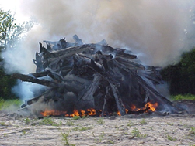

Main Pollutants of concern in NC
Particulate Matter Ground-level Ozone

Slide 9
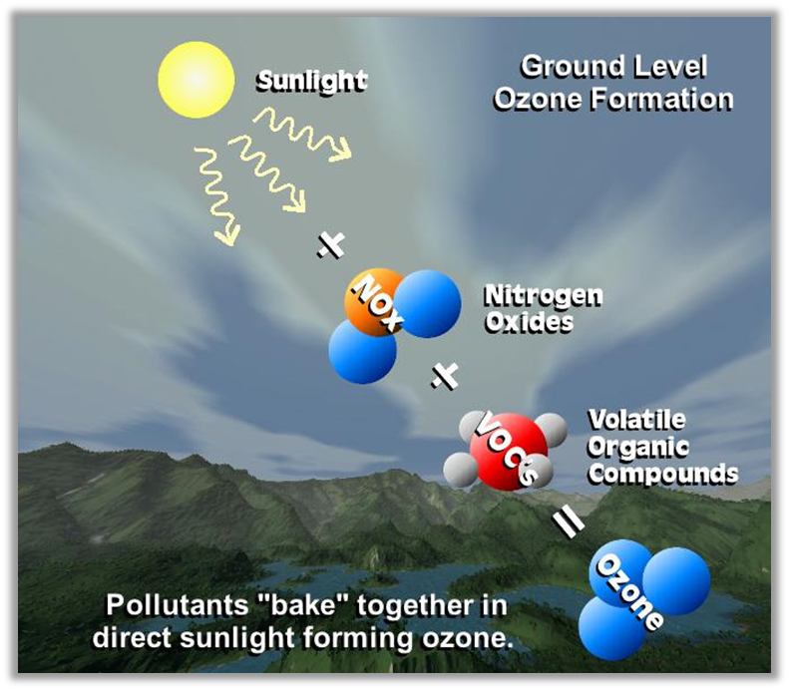
Link between NO_{X} and Ozone

Slide 10


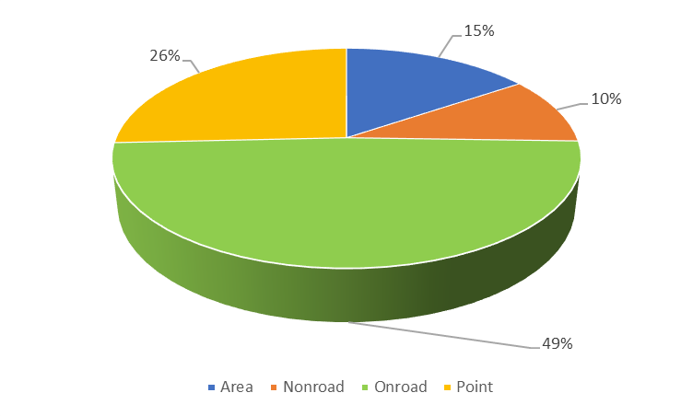




Sources of NOX in NC, 2014
Notes:
Area sources..residential burning and ships

Slide 11
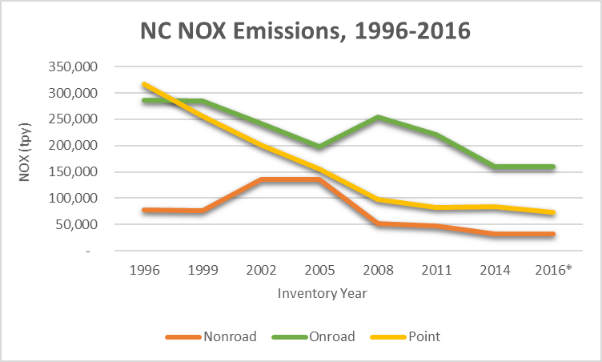
NC Air Quality is Improving!
Federal laws have required cleaner cars and fuels, resulting in cleaner air since 1971.
  The North Carolina Clean Smokestacks Act, and the work of local and regional governments, has also made North Carolina’s air cleaner
Notes:
The good news is …

Slide 12
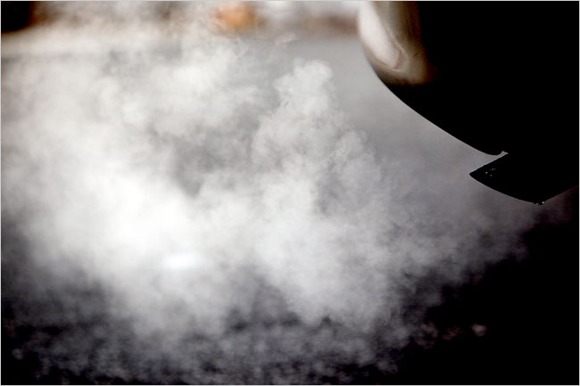
AND STILL
Cars and trucks are the leading cause of Ozone Pollution in NC
Notes:
Remind them that industry and factories, although often thought of as the main culprit, are not the biggest problem for us right now with respect to air pollution.
mobile sources are the number one source of ozone pollution in NC.

Slide 13
Emission Standards for Cars and Trucks
There are two sets of emission standards for vehicles in the United States – the California Standard and the EPA Standard. This activity focuses on the EPA standards
EPA Tier 2 emission standards began in 2004 and were phased in for model years 2004-2007. By the end of the implementation period (2007), all cars were required to meet a standard of 0.07 grams of NOx per mile
EPA Tier 3 emission standard began in 2017, with full implementation required by 2025
These standards only apply to new cars – old cars do not have to meet new emission standards. If you’re looking to buy a used car you may want to consider the impact it may have on air pollution emissions!
Check out the EPA Smog Rating on cars if you’re curious about the amount of smog-forming airborne pollutants a vehicle might be emitting

Slide 14
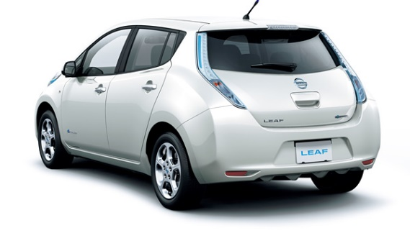
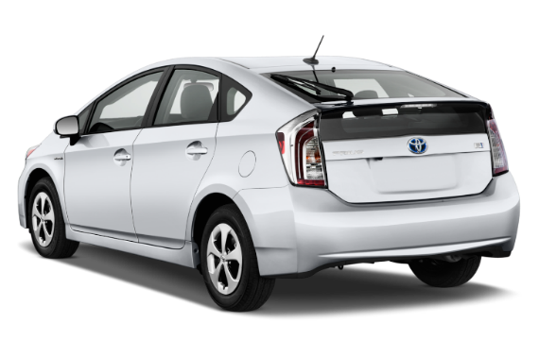
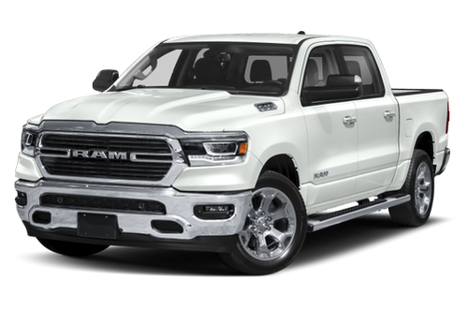
Vehicle Types
Gasoline
  NOX and GHGs
Diesel
  PM
Hybrid
Plug-in Hybrid
Plug-in Electric

Slide 15
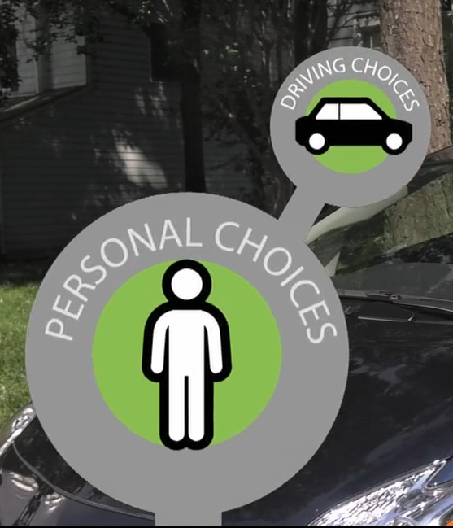
Personal Driving Choices
Car Choice
Vehicle Maintenance
Driving Strategies (How We Drive)
Alternative Transportation Methods
Notes:
There are personal choices that every individual can make when it comes to polluting on the road.
The type of car you choose to drive
Maintaining your vehicle and ensuring that the oil is changed, tire pressure is correct, etc
The way we handle our cars – smooth acceleration, no short stops, going the speed limit, not idling
Or even using Alternative transportation like carpooling or the bus!
These methods are not only good for the air, but also help new drivers to save money in repairs and stay safe on the road
Students can take what they learn about driving choices home to their families

Slide 16
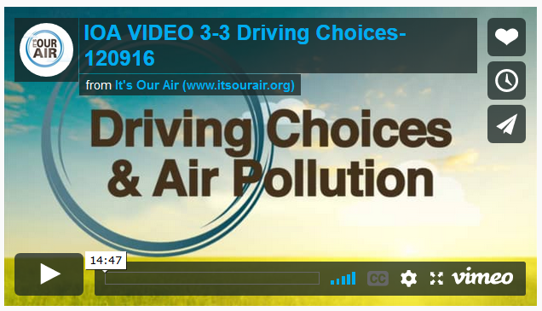
Driving Choices Videos
http://itsourair.org/3-3-driving-choices-and-calculating-car-emissions

Slide 17
Intro to Activity
Break into groups of 5
www.fueleconomy.gov
Comparing Emissions from different vehicles
  Grams of NO_{X} per year = Grams of NO_{X} per mile ✗ miles
  Pounds of NO_{X} per year = grams of NO_{X} ✗ 0.0022 grams/lb
  Tons of NO_{X} per year = lbs of NO_{X} / 2000 lbs/ton
Extra Credit - Miles per gallon tracking
  Data needed = Miles driven / time period / gallons for complete fill-up
  Example = 200 miles / 6.5 gallons = 30.8 mpg [**GREAT** unless you have a hybrid]
  Good diagnostic tool for car health
  APPs for phones too

Slide 18
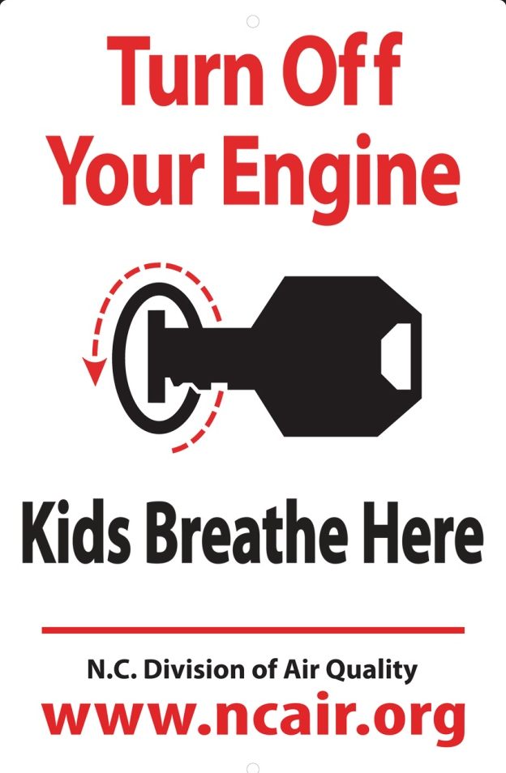
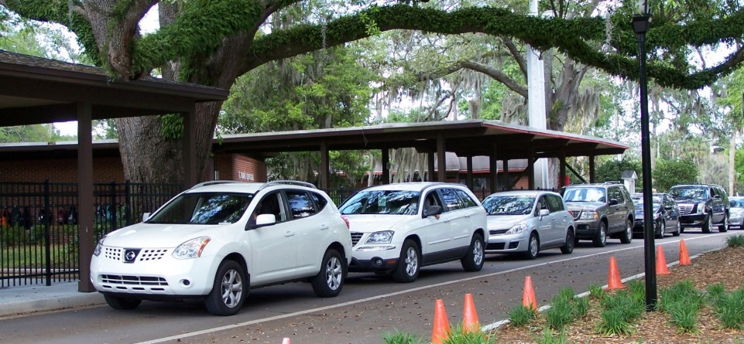
What else can you do for clean air?
Don’t Idle your Car
Wastes gas
Pollutes the air

Slide 19
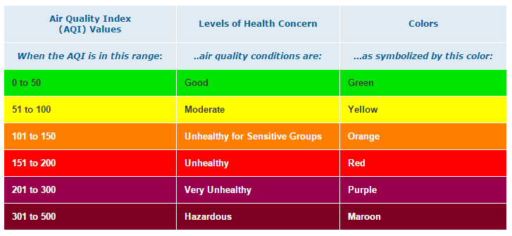
How do you protect your health?
Know the Air Quality Forecast!
The Air Quality Forecast (color code) is a tool that communicates the Air Quality Index (AQI) to the general public. Learn more about AQI at https://airnow.gov/index.cfm?action=aqibasics.aqi

Slide 20
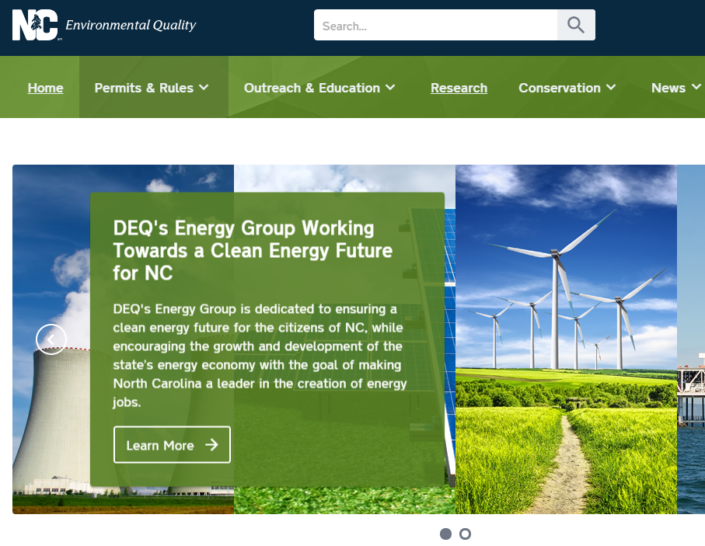
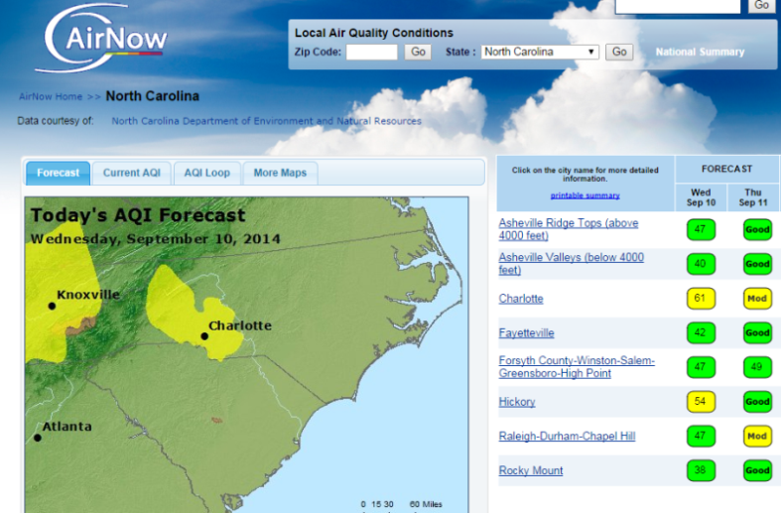




How do you protect your health?
Know the Air Quality Forecast!
1
2
EPA: www.airnow.gov
3
EnviroFlash: Air quality forecast to your inbox
deq.nc.gov
4
5
Get an app! mobile solutions
Television
WRAL & Univision

Slide 21
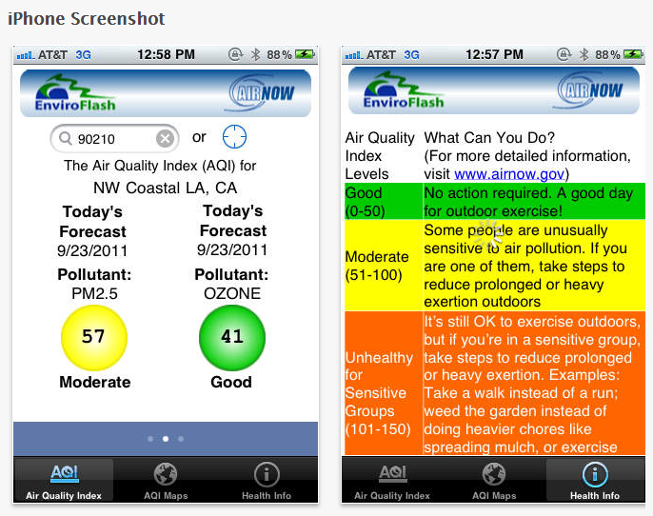



Mobile Apps
You can learn about the air quality forecast via a mobile app. For example https://itunes.apple.com/us/app/epa-airnow/id467653238?mt=8

Slide 22
Be a Steward for the Environment
Be aware!
Know the air quality color code.
Find your passion!
Learn about career choices.
Work hard!
Your work reflects who you are!
Get involved!
Take actions to improve air quality.

Slide 23

Thank You
Melissa Kennedy
melissa.kennedy@ncdenr.gov
(919) 707-8403
Robin Barrows
robin.barrows@ncdenr.gov
(919) 707-8445
NC Air Awareness
Air.Awareness@ncdenr.gov

