Slide 1
Department of Environmental Quality
2018 303(d) Listing and Delisting Update
EMC, November 8, 2018
Pam Behm, DWR Modeling and Assessment Branch

Slide 2
Outline
Review 2018 changes to 303(d) methodology
Review Integrated Report (IR) process and Clean Water Act (CWA) requirements
Review Draft 303(d) and IR results
Review public review process

Slide 3
Summary of Updates to 2018 303(d) Listing and Delisting Methodology
Updated data window: 2012-2016
  Adds 2 years of new data from 2016 303(d)
Added delisting language
Added process for small datasets
Updated methods for numerical assessment (added process flowcharts as appendix)

Slide 4
Integrated Reporting (IR) Categories
1
2
3
4
5
Meeting Criteria
Data Inconclusive
Exceeds Criteria
(“impaired”)
MC
Integrated Report
DI
305(b) Report
EC
NC Impaired Waters List
303(d) List

Slide 5
Clean Water Act – IR Requirements
Section 305(b)/303(d) of CWA
States required to submit to EPA every 2 years
No requirement for public review
No requirement for EPA approval

Slide 6
General Process for Integrated Report Development
Draft 303(d) list established first
During public review, anyone can request waterbody specific information – “fact sheet”
During EPA approval process, begin developing IR
Once EPA approves 303(d), then finalize IR
For 2018, Draft 303(d) and IR will have concurrent public review

Slide 7
NC State Statute
143B-282(c): The EMC shall implement the provisions of subsections (d) and (e) of 33 U.S.C. § 1313 by identifying and prioritizing impaired waters
Notes:
Here is the relevant statute that brings the EMC into the 303(d) process and was established in 1997 and confers authority to the EMC to establish the 303(d) assessment methodology.

Slide 8
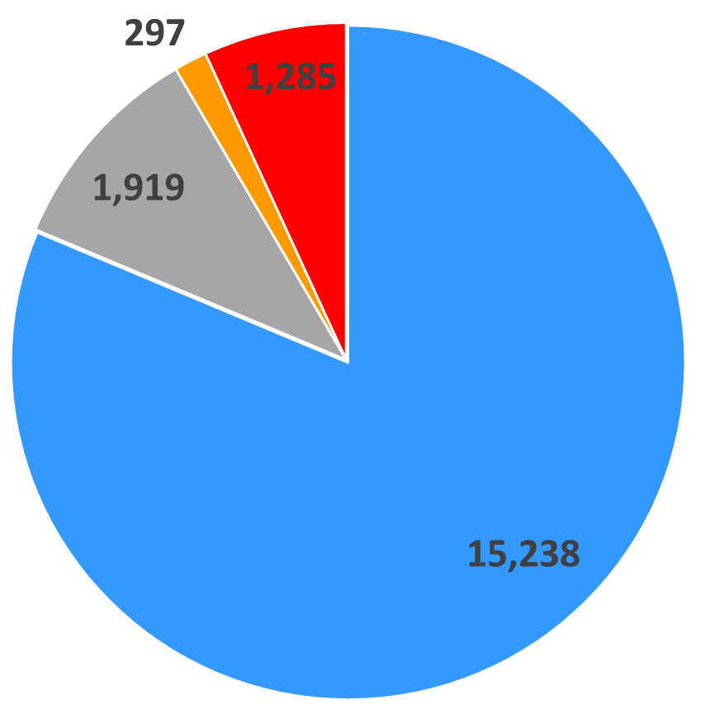
2018 Draft IR Distribution – Assessment Counts
Legend
# meeting criteria – 15,238
# inconclusive – 1,919
# impaired with TMDL – 297
# on 303(d) list – 1,285
Delistings – 94
New listings - 75

Slide 9
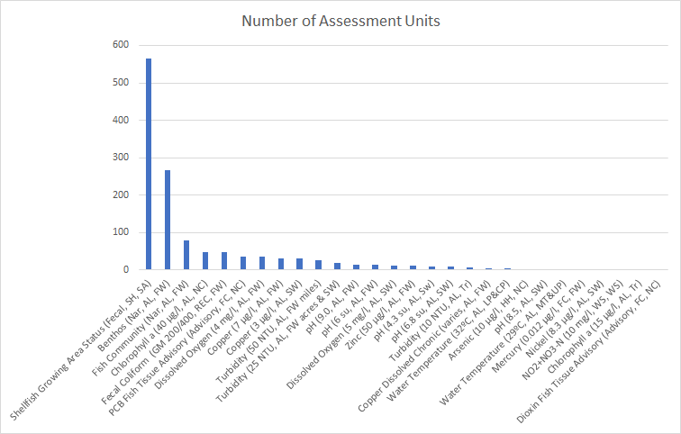
2018 Draft 303(d) Distribution – By Parameter

Slide 10
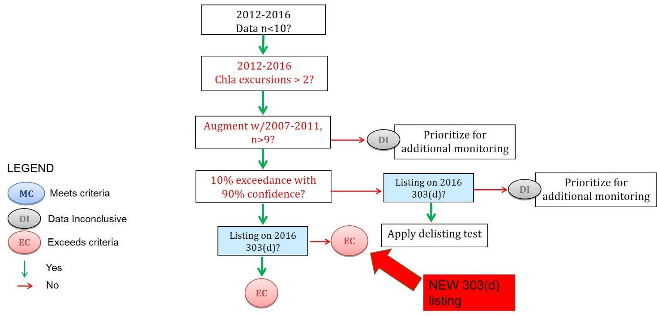
Draft 2018 Impact
Augmenting Small Datasets
10
NEW 303(d) listing
9
Notes:
7 chla
1 high pH – Lake tillery
1 low pH -
1 water temperature (Kings Mtn Res – Broad River Basin)

Slide 11
Draft 2018 Impact
Greater than 10% exceedance, less than 90% confidence
>10.01% Above Evaluation Level
>90% Confidence for Exceedance Rate
Listing on 2016 303(d)?
>3 excursions in new data years
DI
145
EC
16
LEGEND
EC
MC
>1 excursions in new data years
DI
19
New 303(d) listing
Meets criteria
DI
Data Inconclusive
Delisted
EC
Exceeds criteria
EC
4
Yes
No
Cannot be delisted, stays on 303(d)

Slide 12
Draft 2018 Impact
Less than 10% exceedance
>10% Above Evaluation Level
>70% Confidence in Meeting Criteria
Listing on 2016 303(d)?
<40% Confidence in Meeting Criteria
>2 excursions in new data years
MC
1,236
MC
DI
New Path to MC
90% Confidence for Exceedance Rate
<40% Confidence in Meeting Criteria
DI
LEGEND
>2 excursions in new data years
DI
MC
Meets criteria
Delisted
14
DI
Data Inconclusive
EC
EC
Exceeds criteria
Cannot be delisted, stays on 303(d)
0
Yes
No

Slide 13
Draft Impact of new Dissolved Metals Standards
# of stations with dissolved metals data - 30
# of new listings - 1
# of delistings (from previous total standard) - 36
# of confirmed listings - 4
Notes:
Copper, Cadmium, Lead, Zinc, Arsenic
# of new listings (copper) – UT to Locks Creek, cpf

Slide 14
Public Comment
Public Comment Materials Include:
  Draft 2018 303(d) List
  2018 303(d) Listing and Delisting Methodology
  Draft 2018 Integrated Report
  Integrated Report Category Assignment Procedure
  Raw Data
  Online Map

Slide 15
Next Steps / Timeline
60 day public comment period, respond to requests for information
For EPA submittal, required to respond to 303(d) comments only
Return to EMC in March, Information Item, report on comments/responses 303(d) related
Submit 303(d) to EPA before end of March
Continue IR Process
EPA working hard to stick to 30 day turnaround for approval, but tribal consultation also required

Slide 16

Thank You!
Contact Information:
Pam Behm
919-707-3687
pamela.behm@ncdenr.gov
Department of Environmental Quality

