Slide 1
PFAS Private Well Sampling Updates
North Carolina Department of Environmental Quality
February 28, 2023

Slide 2
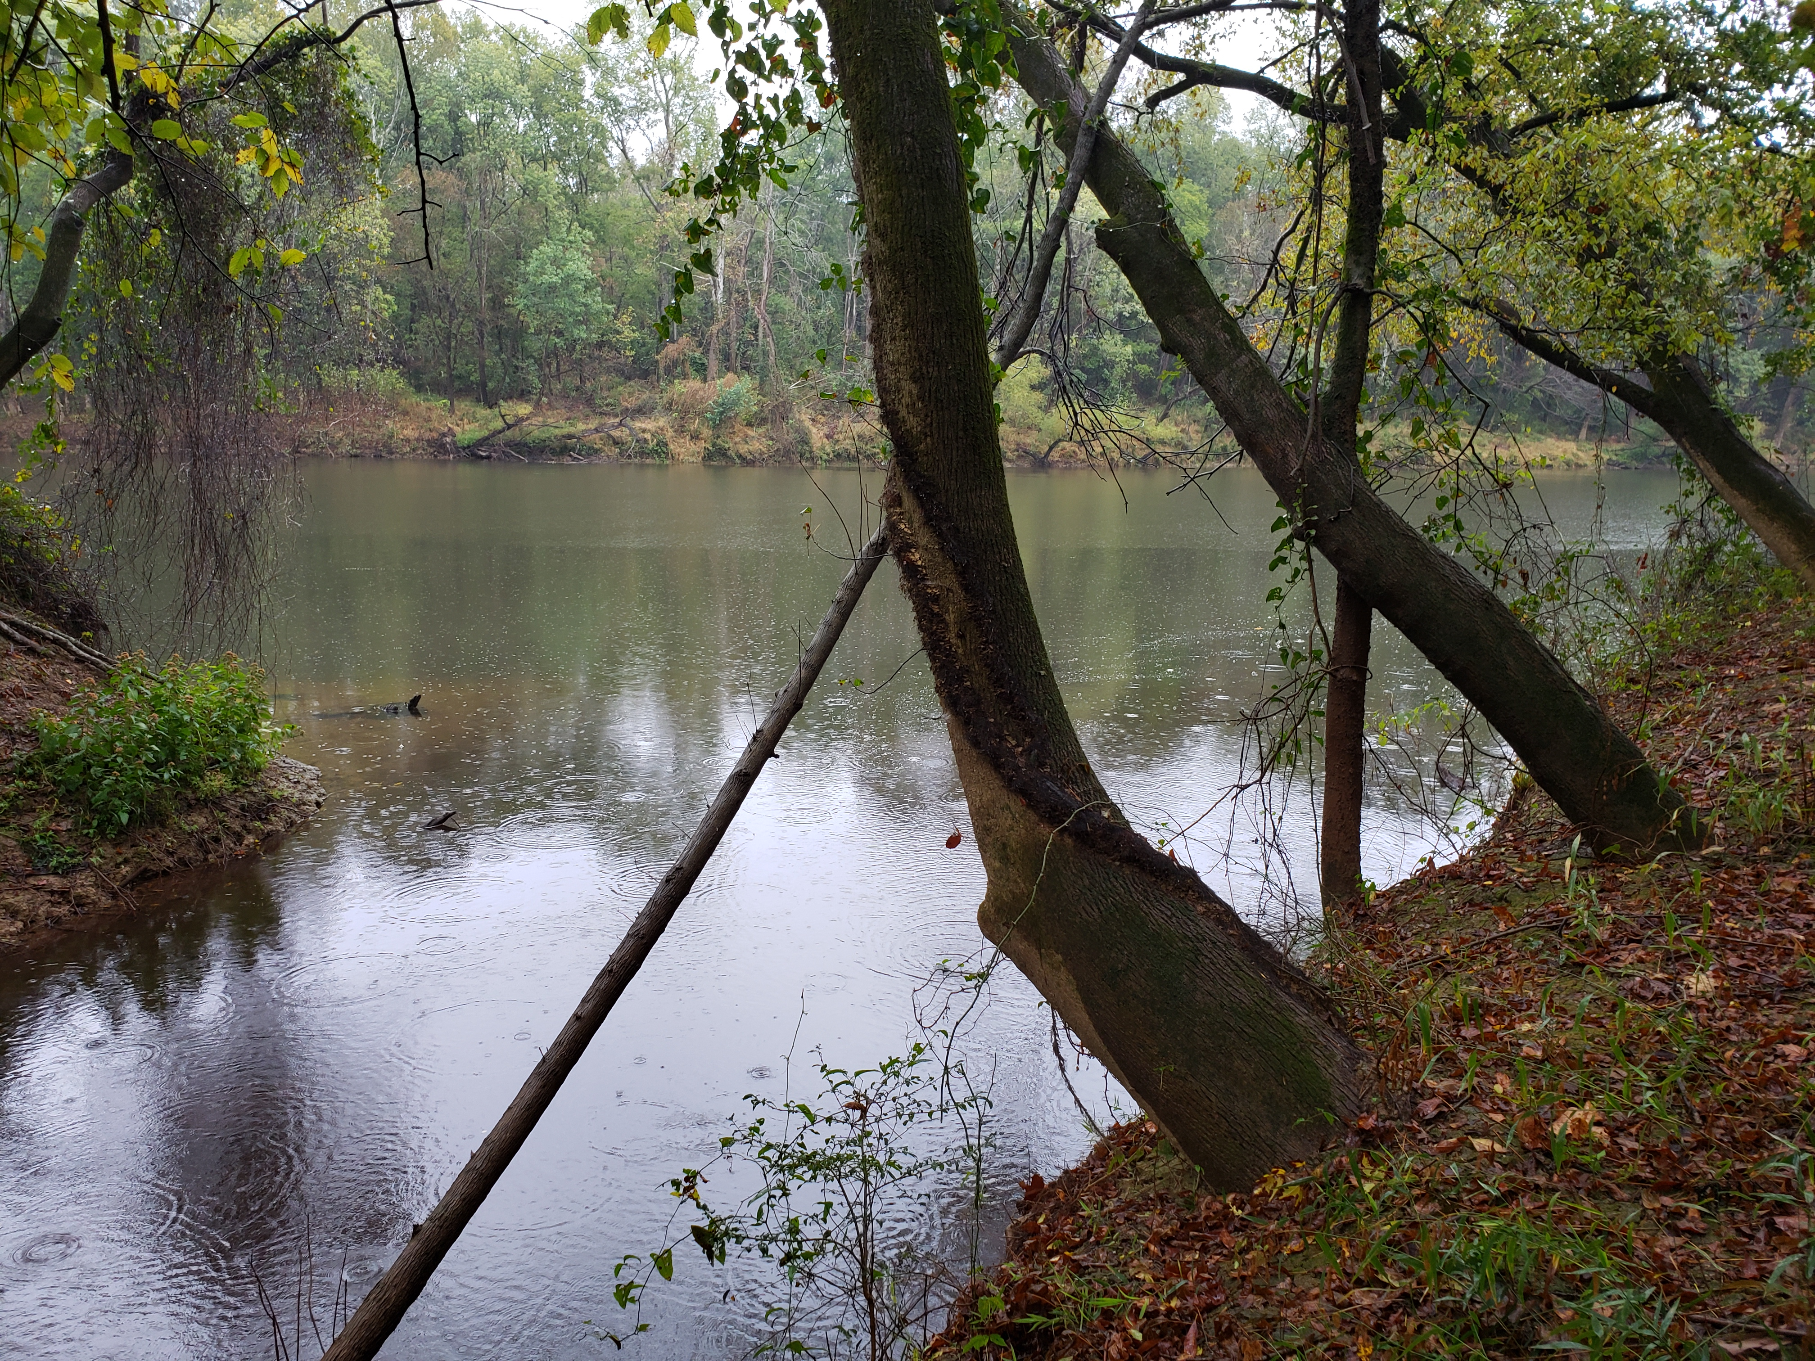
Discussion Topics
PFAS and GenX
Groundwater sampling
Alternate Water Options
Additional information

Slide 3
Emerging Compounds: GenX and PFAS
GenX = HFPO-DA or C3 Dimer Acid = C₆HF₁₁O₃
GenX is a trade name for a manmade, unregulated chemical used in manufacturing nonstick coatings and for other purposes.
  Is an emerging compound in a family of chemicals known as per- and polyfluoroalkyl substances (PFAS)
  Produced and emitted by one company in NC – Chemours (formerly Dupont)
  Has been discharged into the Cape Fear River for 30+ years.
  Until the past couple of years, labs couldn’t measure it.
Emerging compounds:
  No (or limited) specific limits in environmental regulations.
  Little is known about how they behave in the environment.
  Little known about their effects on human health and environment.
  In general, animal studies have found that animals exposed to PFAS at high levels resulted in changes in the function of the liver, thyroid, pancreas and hormone levels.
  EPA has set interim and final health goals for several PFAS (PFOA, PFOS, PFBS and Gen X)
  Presents significant challenge for regulatory agencies.
Notes:
Communicate risk

Slide 4
Emerging Compounds – GenX Case History in NC
Early-mid 2017: Focus on surface water issues
Mid 2017: Groundwater issues discovered
Mid-late 2017: Air emission contributions
Through 2018: Testing of emissions and drinking wells
Feb. 2019: Consent Order signed
Dec. 2019: Thermal Oxidizer
2019-Present: Ongoing private well testing around the plant
Early 2022: Lower Cape Fear Region well sampling

Slide 5
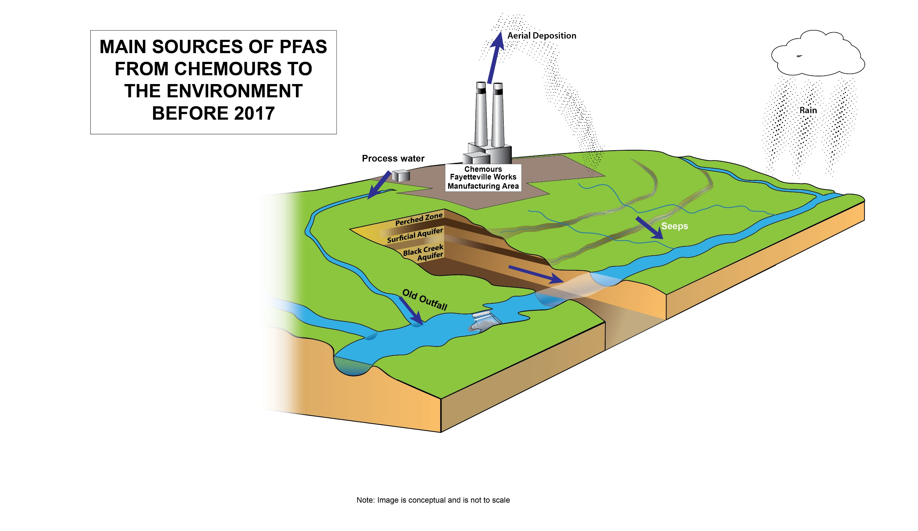

Slide 6
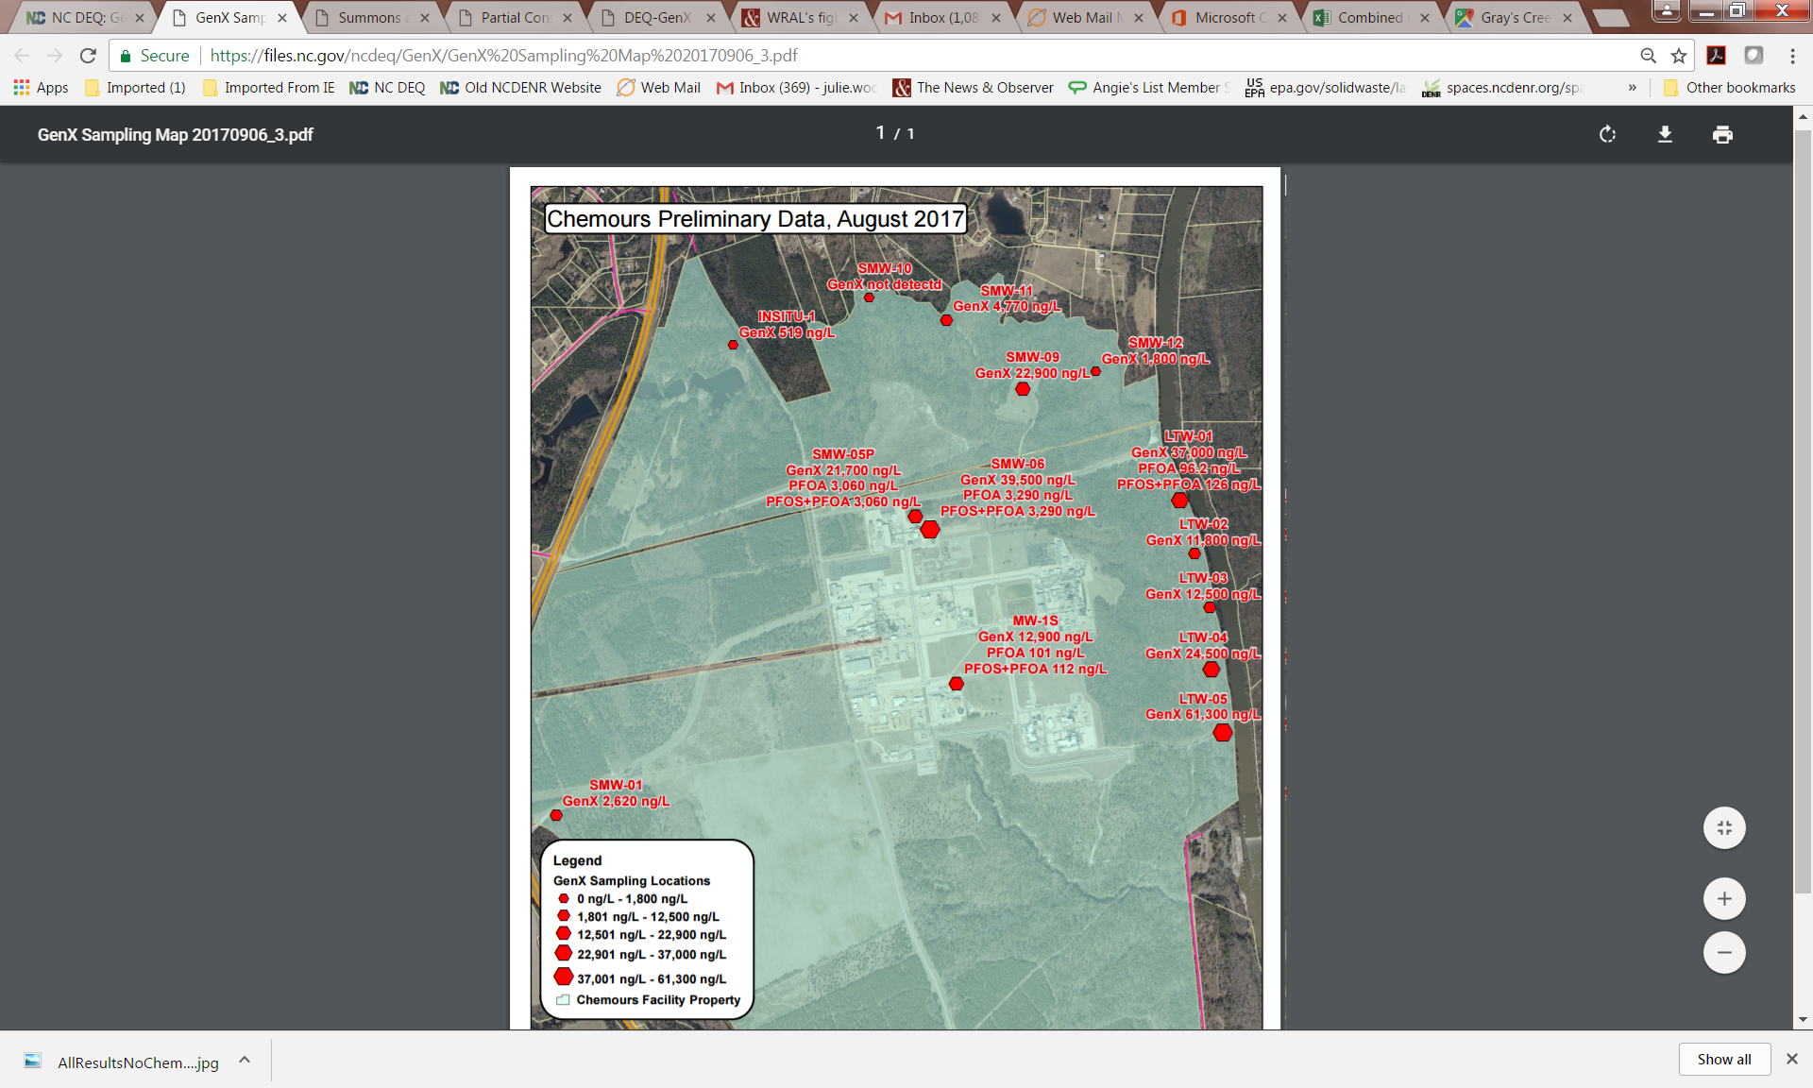
Groundwater Testing
Found high levels of PFAS compounds in onsite monitoring wells at the Chemours plant in Bladen County in 2017
In 2017, NCDHHS established a GenX drinking water health goal of 140 ng/L (ppt)
In 2022, EPA established a nationwide health advisory for GenX at 10ppt that has been incorporated into the Chemours Consent Order
DEQ tested wells on properties adjacent to Chemours first and found high levels
Asked Chemours to test additional wells in the area to determine extent of contamination
November 3, 2021: DEQ letter stating that Chemours is responsible for contamination of groundwater monitoring wells and water supply wells in New Hanover County and potentially other counties
Notes:
DEQ tested adjacent properties for an expanded suite of PFAS compounds

Slide 7
Chemours – Consent Order Feb. 2019
Addressing contamination
NC DEQ signed a Consent Order with Chemours Feb. 26, 2019: https://deq.nc.gov/news/hot-topics/genx-investigation
Consent Order included:
  Requirements to reduce air emissions and to achieve maximum reductions of all remaining PFAS contributions to the Cape Fear River on an accelerated basis, including groundwater.
  Notify and coordinate with downstream public water utilities when potential discharge of GenX compounds into the Cape Fear River.
  Sample wells and provide drinking water
  Additional penalties will apply if Chemours fails to meet
  the conditions and deadlines established in the order.

Slide 8
Implementing the
Chemours Consent Order
Addressing contamination
Per the 2019 Consent Order and 2020 Addendum, Chemours must also:
  Achieve control technology improvements and meet emissions reduction milestones;
  Determine which PFAS at what amounts are in wastewater and stormwater at the facility;
  Determine which PFAS at what amounts are in river sediment and downstream raw water intakes for drinking water plants;
  Take specific actions to address more than 90 percent of the PFAS entering the Cape Fear River through groundwater from the residual contamination on the site.
    As of 2022, the interim measures required by the Addendum are
    operational. The final design / implementation of the barrier wall and treatment system
    is underway.

Slide 9
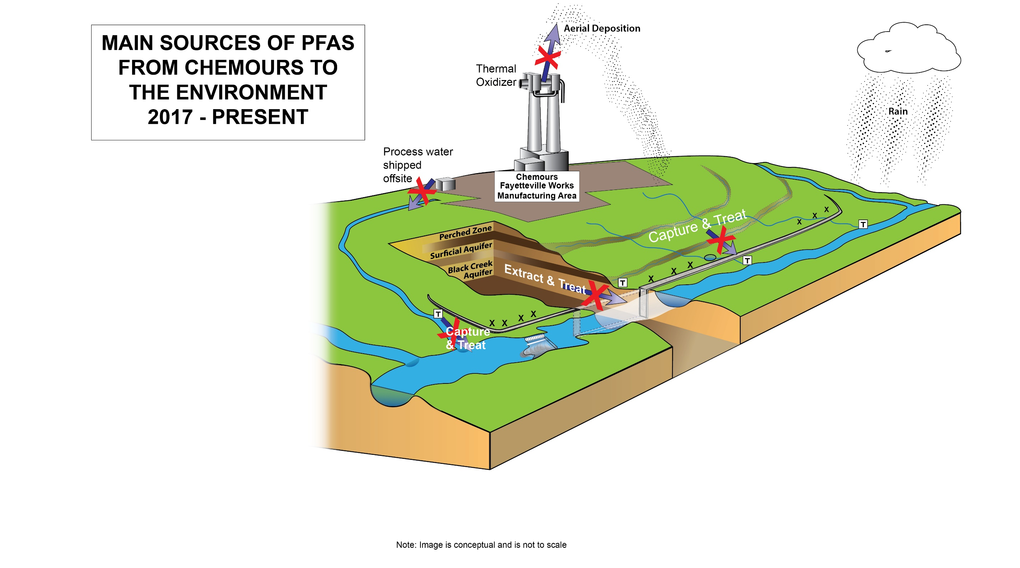

Slide 10
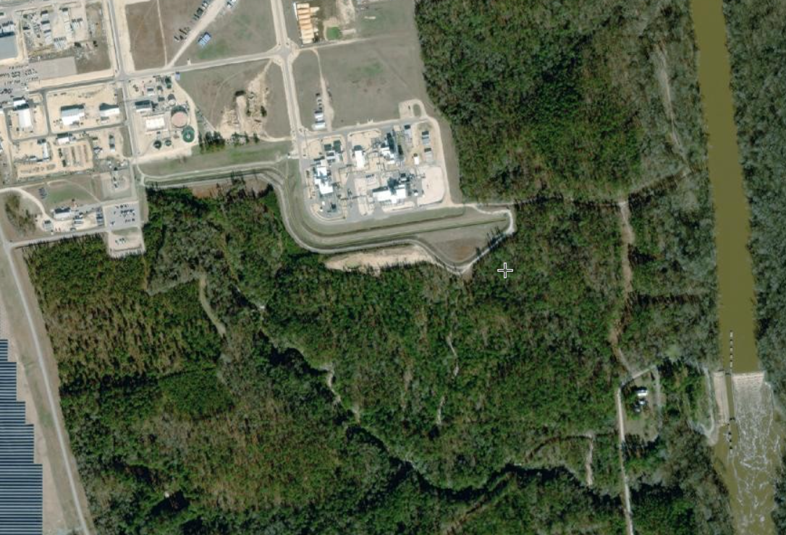
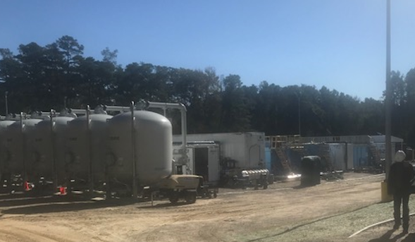
Consent Order and Remediation at Chemours:
Outfall 003 (old outfall 002)
10

Slide 11
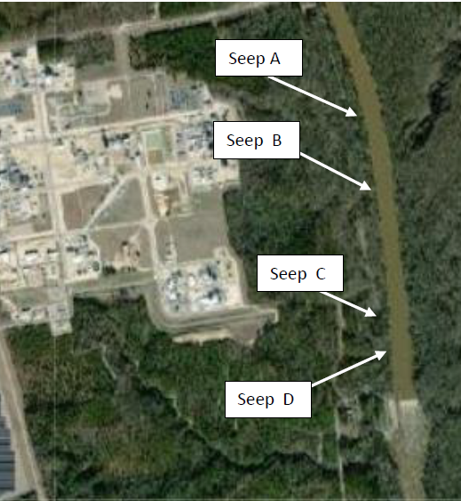
Consent Order and Remediation:
Flow Through Cells (seeps)
Per the 2019 Consent Order and 2020 Addendum, Chemours has installed in situ treatment systems to
remove PFAS from the seeps. These treatment systems consist of flow through cells containing granular
activated carbon.
There are four onsite seeps (A, B, C and D) that have been identified that discharge into the Cape Fear River. PFAS from the site reach the Cape Fear River from these seeps.
The four treatment systems were installed during late 2020 though late spring 2021.

Slide 12
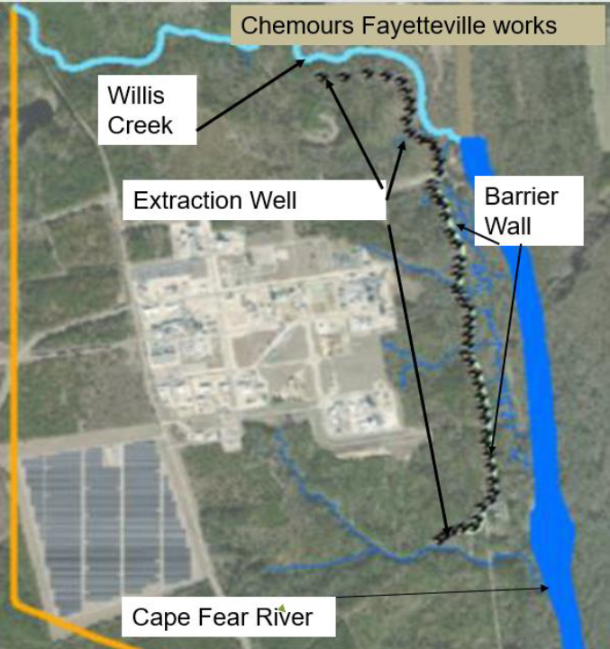
Barrier Wall: design
6,050 feet long and 75-100 feet deep. Keyed into Upper Cape Fear Confining Unit
Wall is approx. 36 inches thick
One-pass installation mixes soil and bentonite/cement mix continuously during construction

Slide 13
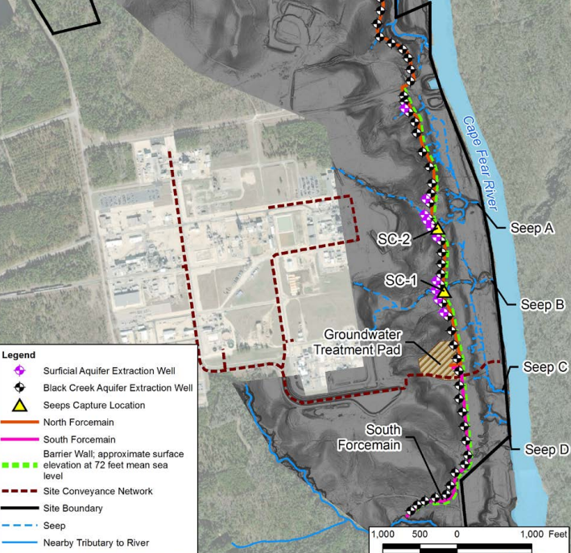
Groundwater extraction system
70 Extraction Wells – Wells are located along entire length of barrier wall and extending approx. 1,000 feet north of the termination of barrier wall.
Two force-mains to convey extracted groundwater to treatment system
Design total flow rate = 980 gpm

Slide 14
Chemours – Addressing Contamination
Consent Order Feb 2019 : Groundwater
Sample Wells and Provide Drinking Water for impacted private drinking water wells
Sample drinking water wells
  ¼ mile beyond the closest well that had PFAS levels above 10 parts per trillion
  Annually retest wells that were previously sampled
  Bottled water in 3 days if exceed a Consent Order limit
For those with GenX above 10 parts per trillion (New EPA Health Advisory):​
  Provide permanent drinking water supply
    Options: Public waterline connection where feasible, whole-building GAC filtration system, reverse osmosis (RO) units installed on every bathroom and kitchen sink
​For those with combined PFAS levels above 70 parts per trillion or ​any individual PFAS compound above 10 parts per trillion:​
  Provide, install and maintain up to three under-sink RO systems per residence​
Notes:
If water line, will pay water bills up to $75/mo for 20 years

Slide 15
Lower Cape Fear Region Well Sampling
November 3, 2021 letter from DEQ to Chemours
  https://deq.nc.gov/genx/consentorder/deq-notice-chemours-about-downstream-counties/download?attachment
Requirement to submit a plan within 90 days to conduct a comprehensive assessment of groundwater contamination in New Hanover County and other affected counties in accordance with 2L and the 2019 Consent Order.
Requirement to submit an updated drinking water compliance plan within 90 days pursuant to the Chemours Consent Order. The plan shall provide for sampling of drinking water wells in downstream counties to identify affected parties entitled to provision of replacement water supplies.
DEQ responded with additional comments to the Chemours drinking water
compliance plan on May 2, 2022, requiring further revision, expedited sampling and
shared recent DEQ groundwater data from the region.
Notes:
Public water not available east of the Cape Fear River – letter on DEQ website
Public water has been approved for those houses >140 ppt GenX west of the river in Bladen County – letter on DEQ website
Related FAQ Answer:
Chemours will pay water bills up to $75/mo for 20 years for those who receive public water

Slide 16
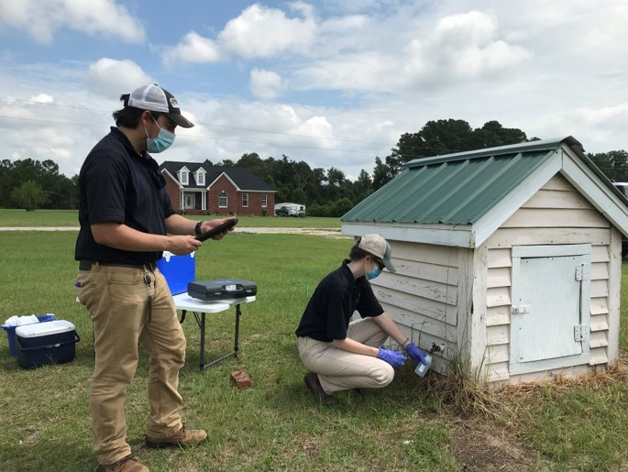
Sampling Your Drinking Water Well
  Most wells can be sampled without entering a residence.
  Personal protective equipment and social distancing guidelines are being used.
  To request well testing in the Lower Cape Fear Region, call Chemours at: 910-678-1100
  DEQ can also assist residents in the Lower Cape Fear with well sampling questions
  Parsons Environment and Infrastructure – known as “Parsons” – is the independent water testing contractor for Chemours.
  Parsons and Chemours are prioritizing private wells for sampling based on several criteria: proximity to the Cape Fear River, groundwater wells with known PFAS detections, and municipal water and sewer lines.
Notes:
Public water not available east of the Cape Fear River – letter on DEQ website
Public water has been approved for those houses >140 ppt GenX west of the river in Bladen County – letter on DEQ website
Related FAQ Answer:
Chemours will pay water bills up to $75/mo for 20 years for those who receive public water

Slide 17
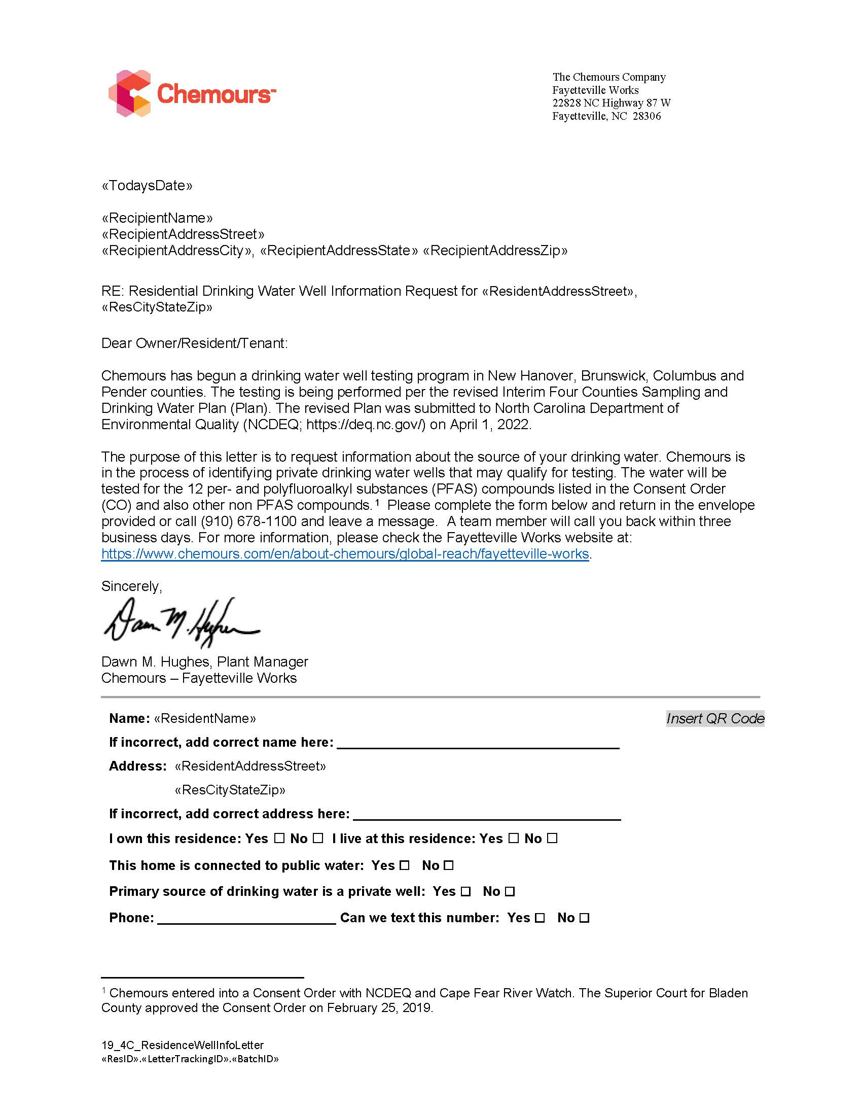
Letter to Private Well Users
Chemours has mailed out 100,000 letters to private well owners in the Lower Cape Fear Region
Letters are being sent to well owners based on initial criteria to include: proximity to the Cape Fear River and municipal water and sewer lines; known detections of PFAS in groundwater wells
These letters from Chemours ask for information about the private well and request contact information from the well owner to assist with scheduling sampling
2,277 properties are currently eligible for well sampling in Pender County. 1852 properties have been scheduled for sampling
Chemours is required to test for 12 PFAS compounds: PFMOAA, PMPA, PFO2HXA, PEPA, PFO3OA, PFO4DA, Nafion BP 1 (PS Acid), Nafion BP 2 (Hydro PS Acid), PFECA-G, PFO5DA, PFHpA, Gen X (HFPO-DA)

Slide 18
Updated Private Well Sampling Numbers
  Chemours has reported that 995 residences in the Lower Cape Fear Region qualify for alternate water (316 in Pender County).
  889 private wells have one of more of the Chemours attachment C PFAS at or above 10 ppt for a single compound or combined levels at or above 70ppt
  These residences qualify for three reverse osmosis filters. Chemours will cover the installation and maintenance costs for the filters for 20 years.
  106 private wells have the compound Gen X at or above 10 ppt
  These residences qualify for whole house granular activated carbon filtration systems or reverse osmosis units at every kitchen and bathroom sink or connection to municipal water.
  Chemours will cover the installation and maintenance costs for the filters for 20 years or the connection to municipal water (water bill is paid for 20 years up to $75/month for Gen X qualifying residences) if public water is feasible.
Notes:
Public water not available east of the Cape Fear River – letter on DEQ website
Public water has been approved for those houses >140 ppt GenX west of the river in Bladen County – letter on DEQ website
Related FAQ Answer:
Chemours will pay water bills up to $75/mo for 20 years for those who receive public water

Slide 19
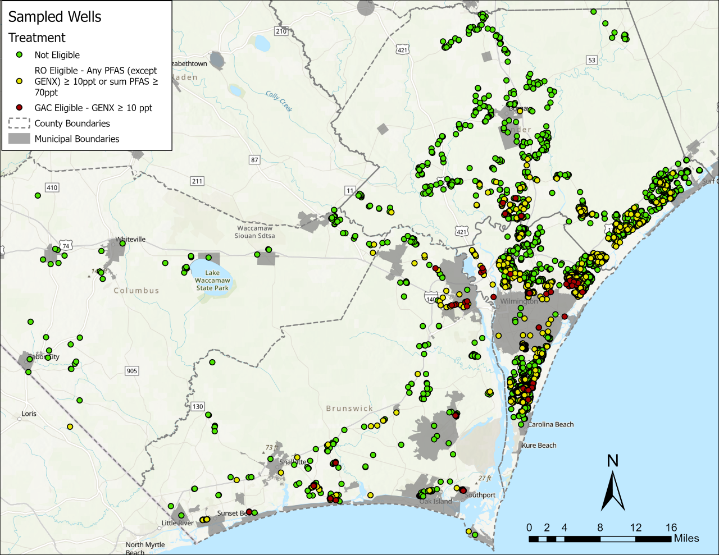
Lower Cape Fear Private Well Sampling

Slide 20
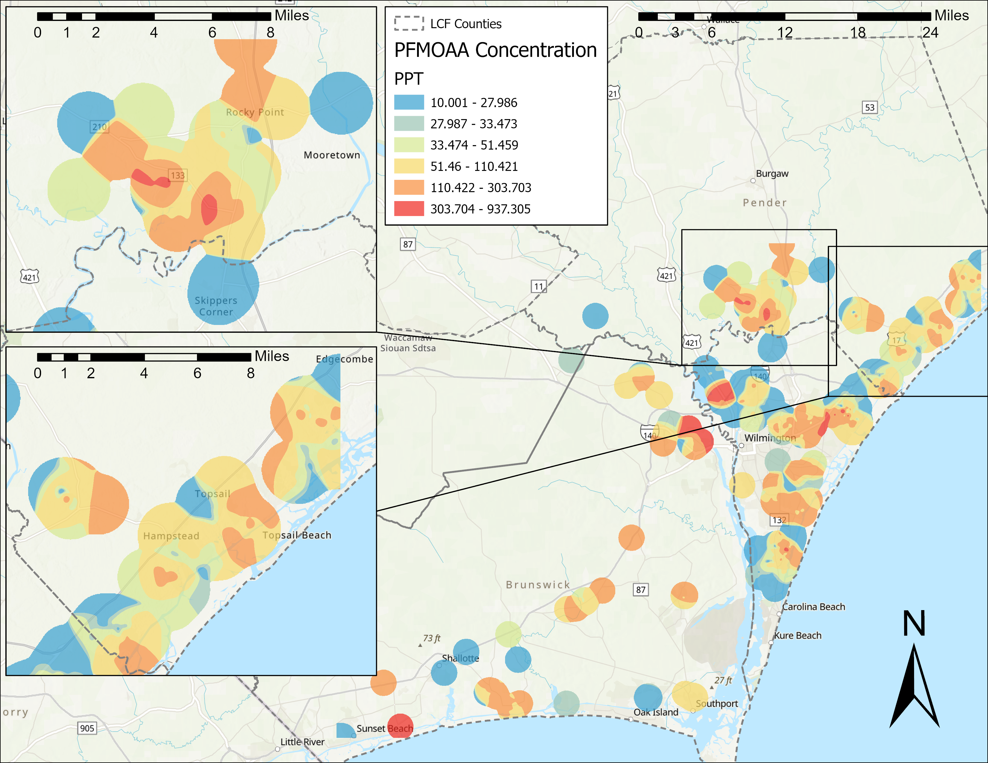
Lower Cape Fear Private Well Testing
PFMOAA concentrations
Source water locations

Slide 21
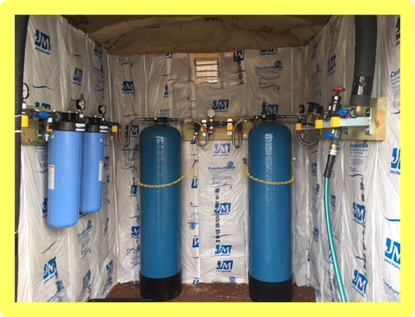
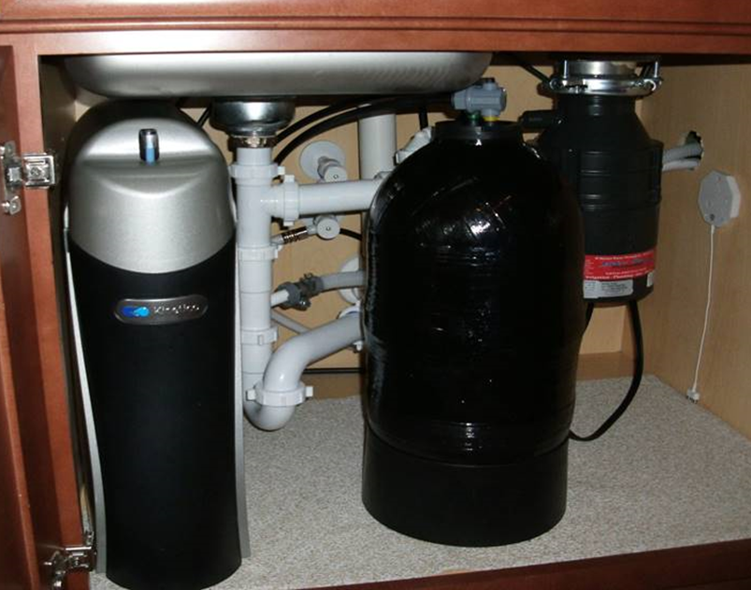
Next Steps if Chemours PFAS are detected
Installation of water treatment systems if Chemours PFAS are detected at or above 10ppt including GenX
  Two types of well water treatment systems are used
  Whole-house treatment (GAC) and under-the-sink (RO) versions
  DEQ has tested both
  systems for their
  effectiveness
  Maintenance
Whole-House Granular Activated Carbon system
Reverse Osmosis System

Slide 22
Bottled Water and Sampling Information
Well Sampling Results can take 4-6 weeks to receive
If a private well is tested by Chemours / Parsons and found to have Chemours PFAS above 10ppt bottle water will be provided to the resident within 3 days.
Chemours is using a new bottled water voucher system that may help some residents with their requests for different water volume sizes.
The voucher card would allow residents to purchase the type of water and size of container they prefer with pre-paid money voucher cards provided by Chemours.
The Consent order establishes timeframes for filter installation or connection to municipal water

Slide 23
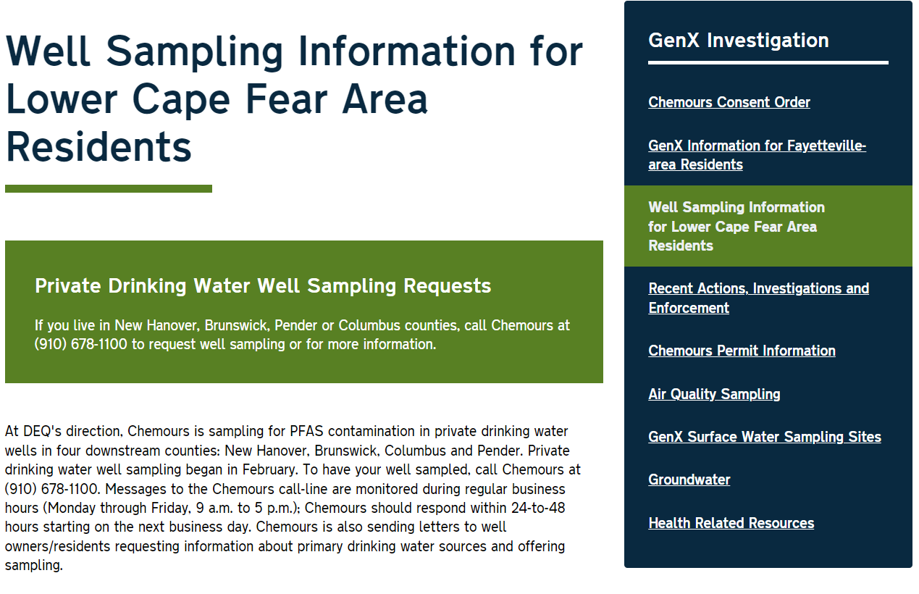
Online
Resources
DEQ website dedicated to Chemours / GenX Investigation
  https://deq.nc.gov/news/key-issues/genx-investigation
Website with specific Lower Cape Fear Region information
  https://deq.nc.gov/lowercapefear-wellsampling

Slide 24
Next Steps
Continued private well sampling in four Lower Cape Fear counties: New Hanover, Columbus, Pender and Brunswick. Please share recommendations on making the well testing information available to your community.
Evaluation of municipal water connections in coordination with local utilities.
Continued work on the current and proposed remediation systems at the Chemours plant to include the barrier wall and groundwater extraction system.
Additional environmental assessment in the lower Cape Fear Region-Aquifer recharge areas, biosolid sites, direct application or injection areas of Cape Fear River water, leaking water or sewer lines that convey water sources from the Cape Fear River

Slide 25
Waste Management
Michael E. Scott, Director
217 W. Jones Street
1464 Mail Service Center
Raleigh, NC 27699-1646
919-707-8246
DWM main number 919-707-8200
http://portal.ncdenr.org/web/wm
Questions???
NC DEQ: Waste Management

