Slide 1

Headworks Analysis Workshop
{Updated 05/2026}

Slide 2
Workshop Overview
Data needed for Headworks Analysis
Steps for Headworks Analysis
Documents Needed to Submit Headworks Analysis
Example of Typicalville HWA
Common Mistakes
Please save all questions until the end of each section (there will be a dedicated slide for questions)

Slide 3
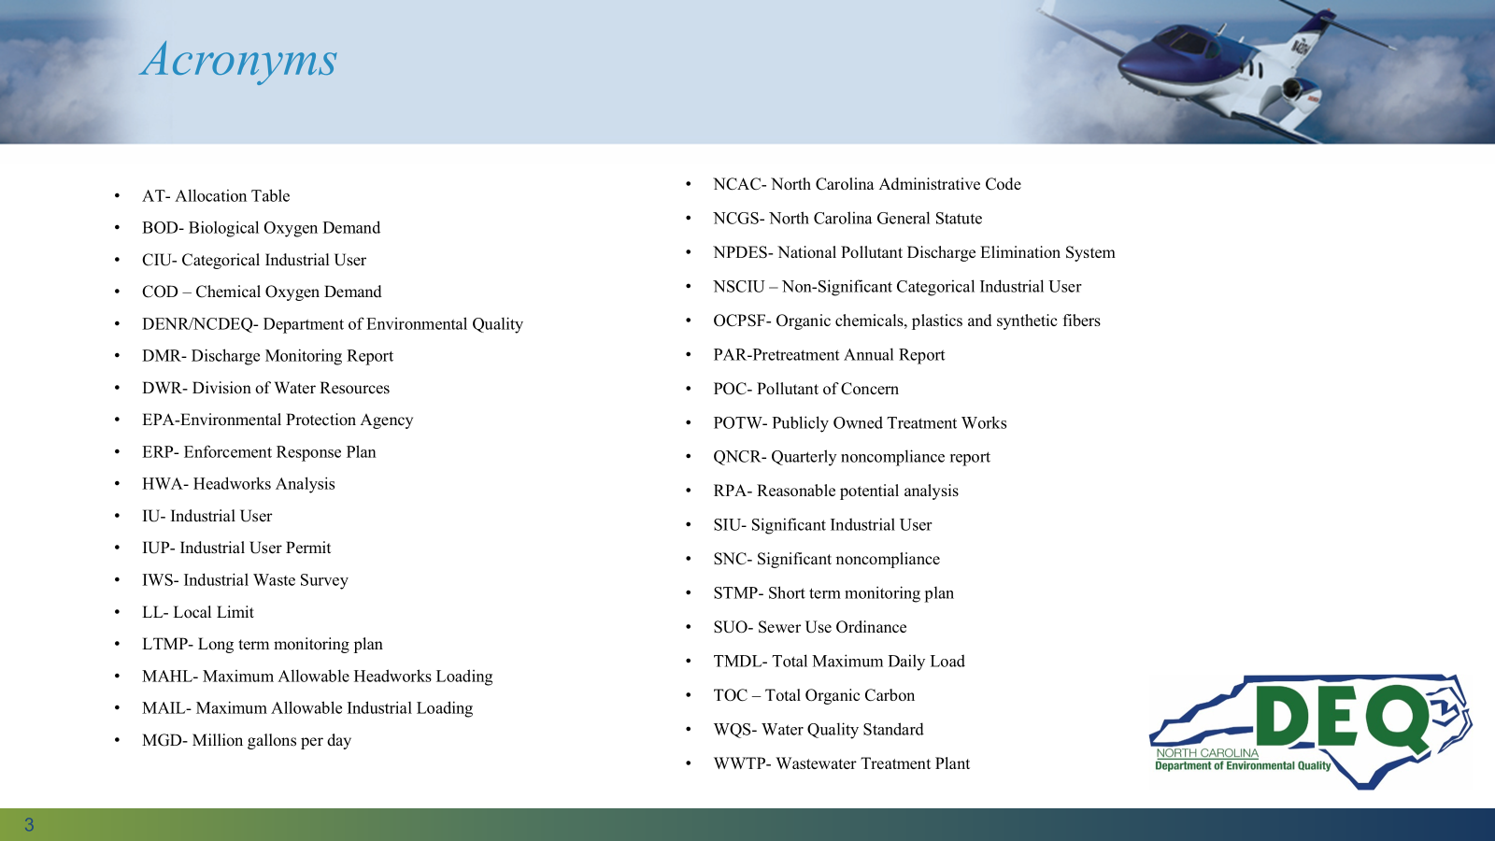
Pretreatment Acronyms

Slide 4
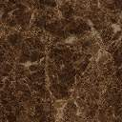

Typicalville
Commercial
SIUs
NPDES
Permit
Limits
WWTP
Aeration Basin
Clarifier
Disinfection
Digester
Influent
Residential
Water Quality Standards
Land Application
Standards

Slide 5
Data Needed for HWA
Determine HWA Data Time Period​
DMR & Long/Short Term Monitoring Data​
Site-Specific Water Quality Standards​
POTW Design Data for Conventional Pollutants​
SIU Load To POTW ​
Uncontrolled Load To POTW​
Sludge Data

Slide 6
Define HWA Time Period​
Based on number of influent and effluent data sets for the least frequently sampled Pollutants of Concern (POC)​
Data should be no more than 5 years old
A Technical Evaluation must be submitted 180 days after NPDES renewal
Division approved LTMP/STMP defines:​
Proper sampling locations​
Proper pollutants of concern​
Correct detection levels​
Frequencies​

Slide 7
Full Programs HWA Time Period: ​
Long Term Monitoring Plan
To provide adequate data set for HWA:
​
Need at least 12 sets of influent and effluent data for least sampled POC -​
Quarterly sampling data for 3 years ​
OR​
Monthly sampling data for 1 year​
Once define period, use all available data for entire 1 or 3 years, including DMR data​
Notes:
Last point – you don’t need to include ENTIRE data set for each point – we only want 12 total points for each POC

Slide 8
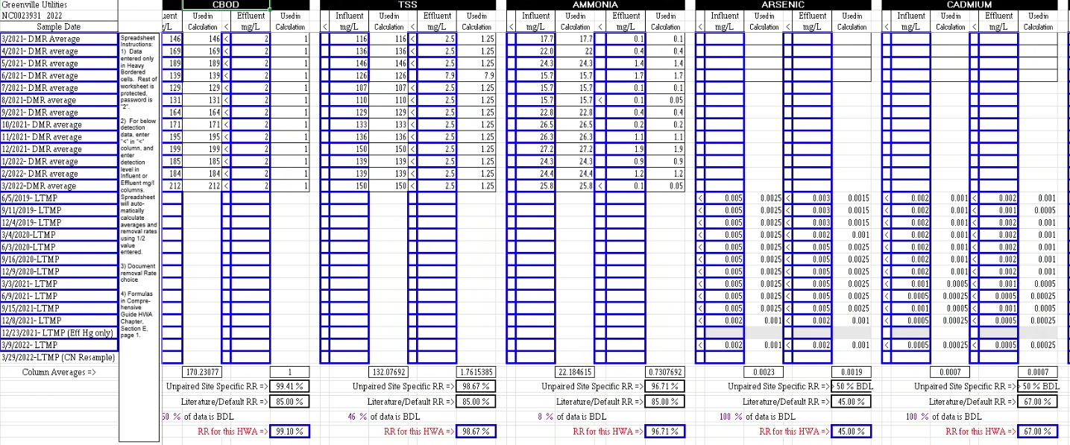
Example of removal rate spreadsheet – dmr vs ltmp data
Notes:
You only need 12 data points for each parameter and they don’t have to be from the same dates!

Slide 9
Modified Programs HWA Time Period: ​
Short Term Monitoring Plan​
To provide adequate data set for HWA: ​
Need at least 4 sets of influent and effluent data for least sampled POC​
Quarterly sampling data for 1 year​
  To cover all seasons​
Once define period, use all available data for entire 1 year, including DMR data​

Slide 10
Steps For Headworks Analysis
Gather POTW General NPDES Information​
Collect POTW Design Information​
Calculate Plant Removal Rates​
Determine Site-Specific WQS
  Use Fact Sheet (RPA) or Dissolved Metals Calculator ​
Calculate Allowable Pass Through Load​
Calculate Allowable Biological Inhibition Load​
Calculate Allowable Load Using Sludge Criteria ​
Develop Maximum Allowable Headworks Load​
Calculate SIUs Load to POTW​
Evaluate Uncontrolled Load to POTW​
Determine Maximum Allowable Industrial Load​
Allocate SIU Local Limits

Slide 11
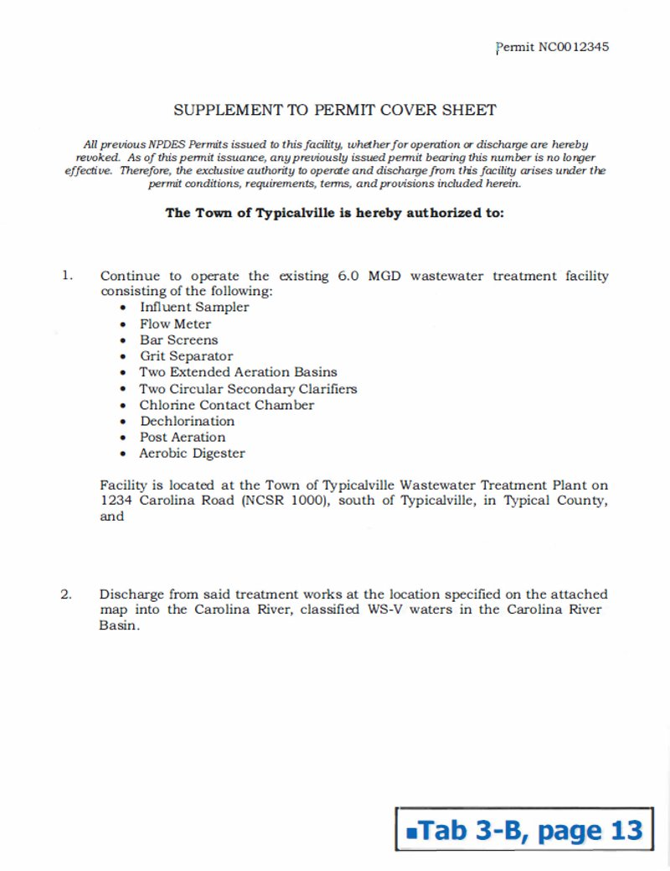
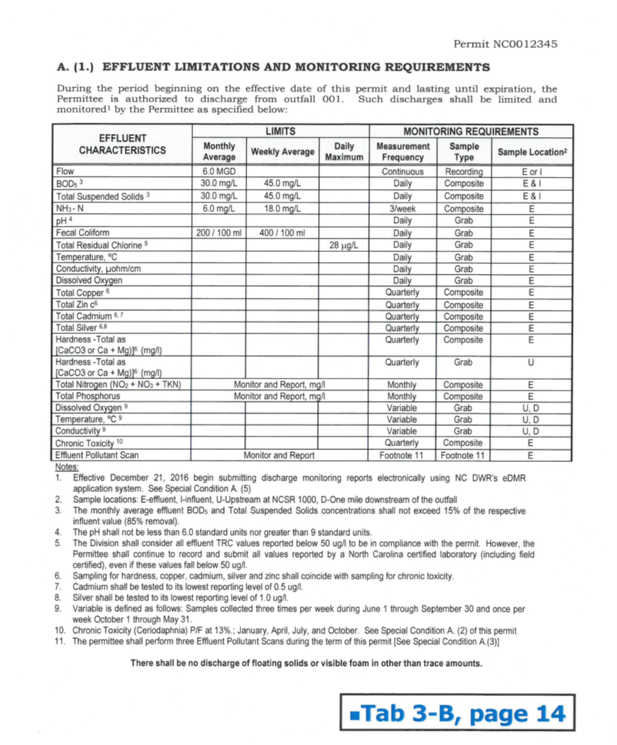

Slide 12
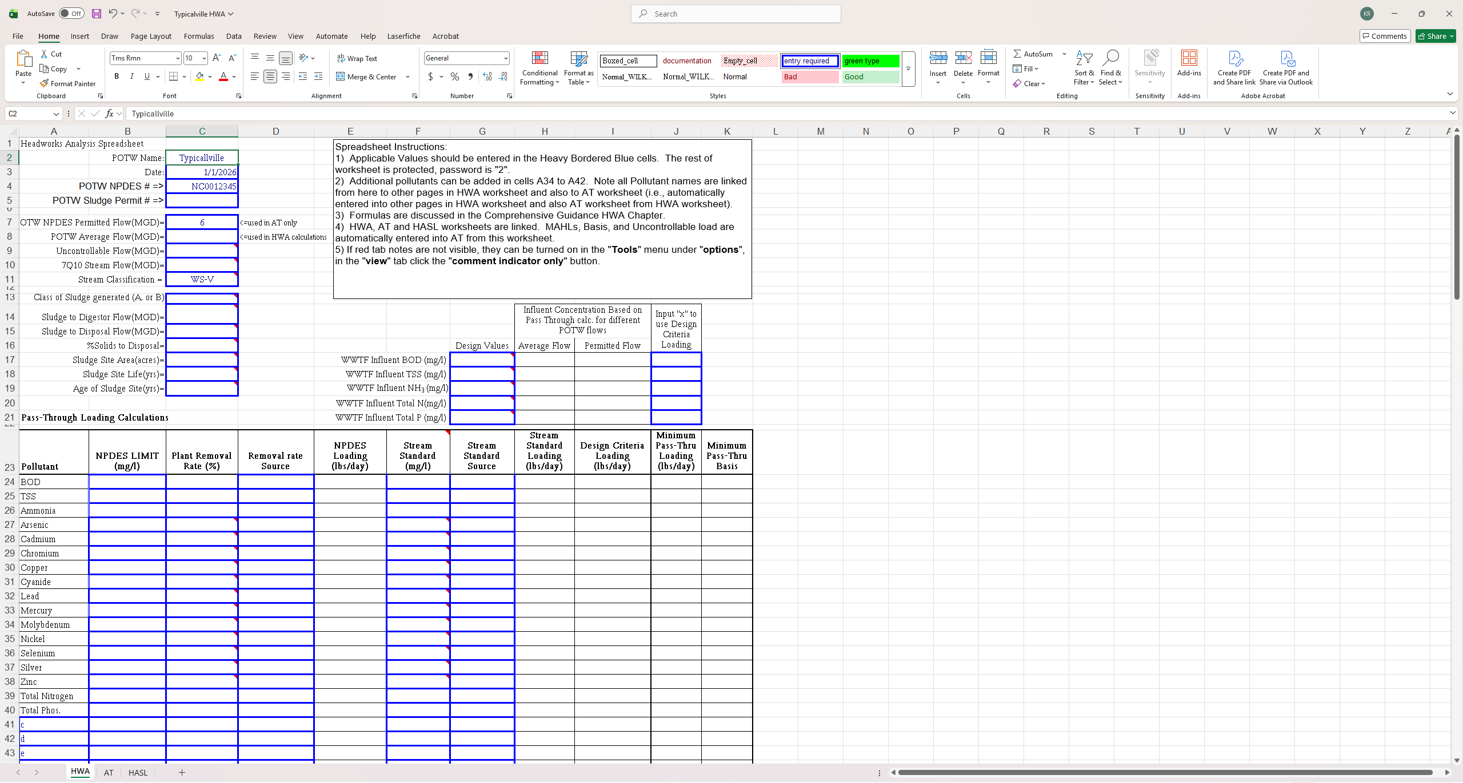

Slide 13
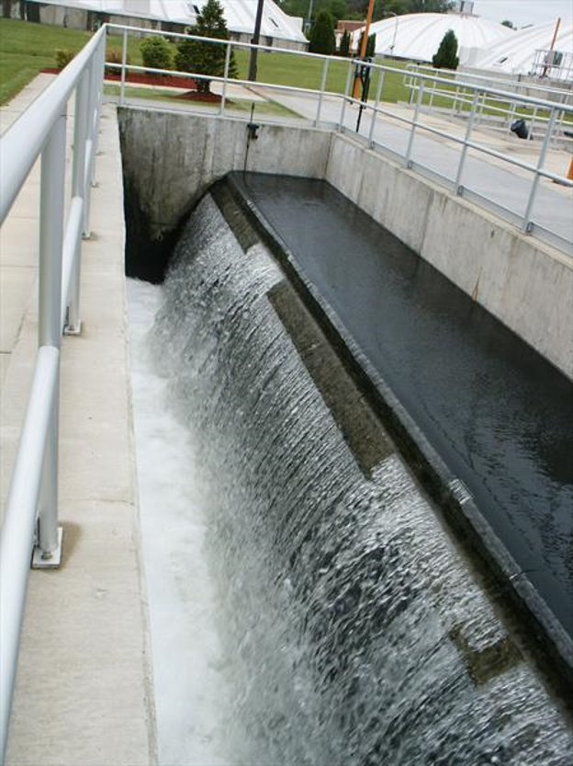
POTW Removal Rates​

Slide 14
What Do I Need To Calculate Removal Rates?
All DMR and LTMP/STMP data for HWA time period​
Removal Rate Equation​
Literature Removal Rates
Make sure to convert to mg/l
Notes:
12 points for full or 4 points for modified, either DMR average or LTMP/STMP. Formula next slide

Slide 15
Plant Removal Rates Calculation​
Removal Rate equation: ​
Using unpaired sampling data​
Mean Removal Rate, RR = ((C_{I}- C_{E})/ C_{I}) * 100​
RR = Removal Rate, %​
CI = Average Influent Concentration, mg/l​
CE = Average Effluent Concentration, mg/l​
Methodologies:​
Unpaired sampling (Division recommends)​
Paired sampling​
Decile approach​
Notes:
Unpaired usually works, water detention times vary. Paired for strange issues like negative removal rates.

Slide 16
Plant Removal Rates Calculation​
Use DMR data in Removal Rates Spreadsheet:
  To calculate average POTW flow
  To calculate average influent and effluent of BOD, TSS, and any other available pollutants
For Below Detection Level (BDL) data:
  Must use half detection levels for removal rate calculations if data is BDL
  Use of the correct silver detection level, 1 ug/l explained in silver letter (PQL letter ), allows for special considerations.
PQL Data Handling
Comp Guide
Notes:
Monthly averages

Slide 17
Plant Removal Rates Calculation​
Use LTMP/STMP data:
For rest of the metals and other POCs.
  Non-NPDES limits page POCs
  Copper, Cadmium, Chromium etc.
For Below Detection Level (BDL) data:
If there is Below Detection Level (BDL) data, ​enter “<“ sign in the “<“ column, ​and detection level in other cell
Notes:
Water quality standards, Inhibition canary, sludge land application concerns. NPDES limit requires reasonable potential.

Slide 18
Plant Removal Rates Calculation​
Enter 12 data points for every POC either using average DMR or LTMP (STMP would only be 4) ​
update spreadsheet as you receive LTMP/STMP results each quarter:​
  less typing at HWA time​
  verify met LTMP/STMP Detection Levels (DLs)… ​
  …and get sample re-analyzed before lab tosses sample​
  can review trends in data, outliers, etc.​
Notes:
This goes back to slide 8. For parameters required to be sampled per NPDES permit, you can choose to use DMR monthly averages for removal rates. For parameters sampled specifically per LTMP, report all data points within the LTMP period with their accompanying date sampled.

Slide 19

When Do I Use Literature RR vs unpaired site specific RR?​
Use literature RR if more than >50% of data is below detection level
Use literature RR if there is a small or misrepresentative data set
Use Unpaired Site Specific RR if less than <50% of data is below detection level
The Division checks to ensure correct Removal Rates were used!

Slide 22
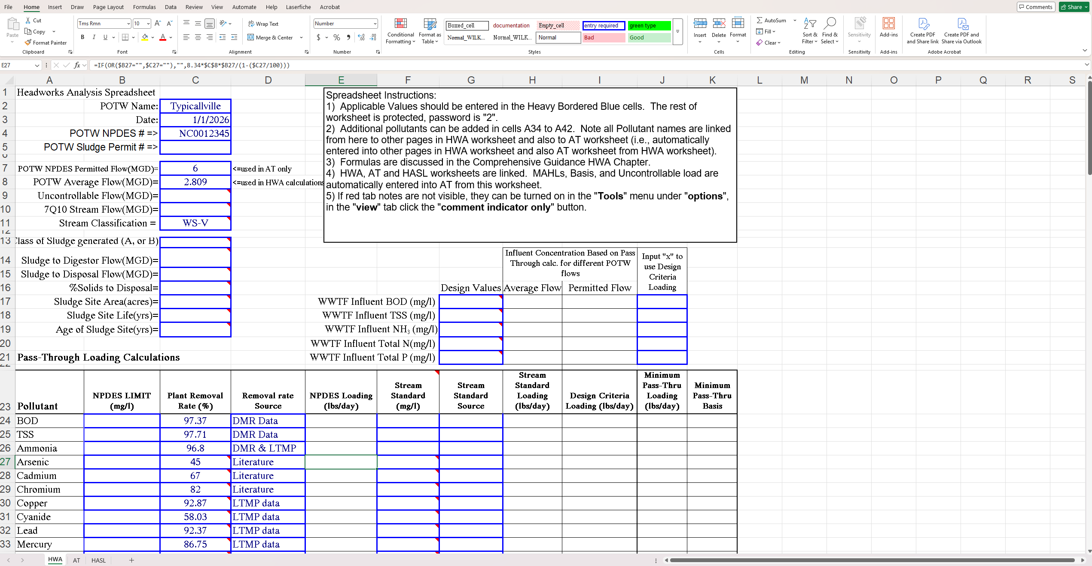
Notes:
Data types, DMR, MP, combo, literature

Slide 23
Questions about Removal Rates?

Slide 24
Pass Through Criteria
NPDES Limit
NC-WQS
Dissolved Metals Calculations (DMC)
Design

Slide 25
Three Limiting Criteria for Developing Maximum Allowable Headworks Load
1. Pass Through
  a. NPDES Limit
  b. NC-WQS/Dissolved Metals Calculations (DMC)
  c. Design
2. Biological Processes Inhibition
  a. Activated Sludge/Nitrification Inhibition
  b. Anaerobic Digester Inhibition
3. Sludge Quality - 503 Regulations
  a. Land Application
  b. Incinerator
  C. Landfill

Slide 26
Limiting Criteria
Pass Through
Bar Screen
Clarifier
Aeration Basin
1c
Aeration Basin
Grit
Removal
Filter
Digester
1b
Sludge
Chlorine/
UV Disinfect
1a
River Styx
Notes:
Design criteria is applied at the beginning of the process. NPDEs limit is applied at the effluent. Dissolved metals Criteria and water quality standards are applied in the stream.

Slide 27
What Do I Need To Calculate Pass Through Allowable Headworks Load (AHL)?
Current NPDES Permit Which parameters are limited?
  New NPDES limits expected/drafted?
NC-WQS/Dissolved Metals Calculations (DMC) -
  All parameters not limited in your NPDES
  Receiving Stream Classification
Pass Through Equation
Removal Rates
Average POTW Flow (NOT Permitted flow)

Slide 28
MAHL: Pass Through Criteria
Based on NPDES Limit
Maximum Allowable Headworks Loading (MAHL)
based on Passthrough/NPDES =
NPDES POTW Average
(8.34) Limit, mg/l Flow, mgd
(1 - POTW RR, as decimal)

Slide 29
Simple Pass Through Example based on NPDES Permit Limit
Commercial
SIU’s
NPDES
Permit
Limit=
1 mg/l
NPDES
Permit
WWTP
Limits
2 mg/l
Influent
50% RR
Water Quality Standards
Residential
Land Application
Standards
The other “1 mg/l” went into the sludge
Notes:
Bringing in 2 mg/l of influent and you have a 50 % removal rate. This would equate to 1 mg/l being discharged, in this case that mean your 1 mg/l permit limit. If you were to take in 4 mg/l, this would result in 2 mg/l being discharged. Therefore it would be an NPDES limit violation due to pass through.

Slide 30
Simple Pass Through Example based on NPDES Permit Limit
Commercial
SIU’s
NPDES
Permit
Limit=
1 mg/l
NPDES
Permit
WWTP
Limits
4 mg/l
Influent
75% RR
Water Quality Standards
Residential
Land Application
Standards
The other “3 mg/l” went into the sludge
Notes:
Bringing in 4 mg/l of influent and you have a 75 % removal rate. This would equate to 3 mg/l being discharged, in this case that mean your 1 mg/l permit limit. If you were to take in 8 mg/l, this would result in 2 mg/l being discharged. Therefore it would be an NPDES limit violation due to pass through.

Slide 31
NPDES Limits
If there is more than one limit for the same parameter, enter the most stringent
Many NPDES permits have more than just BOD, TSS and Ammonia limits, ensure all limits are in HWA
Pass through NPDES MAHLs are calculated in Excel
Watch units-
  50 ug/l = 0.05 mg/l

Slide 32
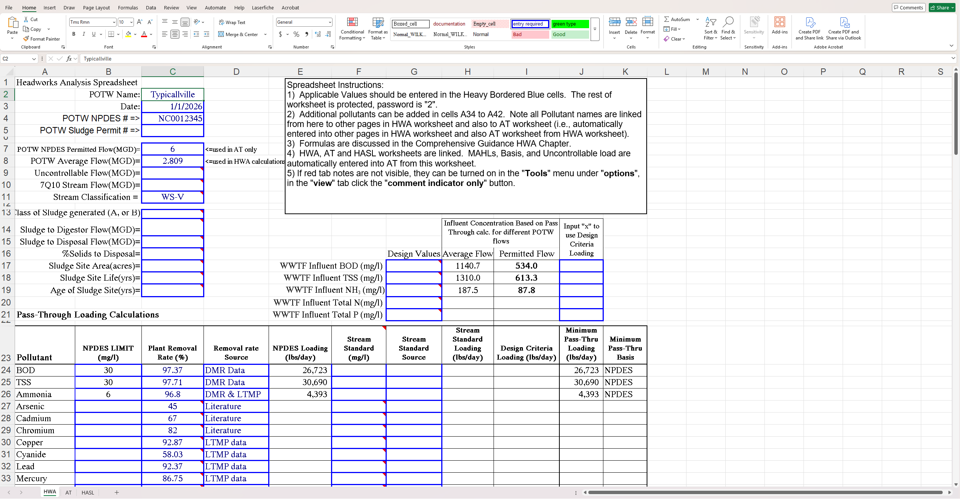

Slide 33
MAHL: Pass Through Criteria Based on Total Metal Allocated or WQS
Maximum Allowable Headworks Loading (MAHL)
based on Pass Through/WQS =
Total
Metal POTW Receiving
Allocated, Average + Stream
(8.34) mg/l Flow, mgd 7Q10, mgd
(1 - POTW RR, as decimal)

Slide 34
NPDES permit writers do a RPA
Hardness-Dependent Metals – Freshwater Specific
Reasonable Potential Analysis (RPA) is used
  A statistical methodology to determine the need for water quality based effluent limits in NPDES permit
  To estimate the highest predicted discharge concentration
  An important part of the RPA process is calculating the hardness dependent metals WQS
  To calculate the allowable effluent concentration (permit limit) for each pollutant

Slide 35
Permitting – RPA
Hardness-Dependent Metals – Freshwater Specific
Information needed to perform RPA
  7Q10, critical low flow (found in fact sheet)
    Ensure conversion from CFS to MGD in HWA (MGD = 0.646 * CFS)
  Effluent and upstream hardness
  Permitted flow
  Receiving stream classification
Combined hardness is calculated as follows:
(Permitted flow, cfs * avg effluent hardness, mg/l) + (7Q10, cfs * avg upstream hardness, mg/l)
(Permitted flow, cfs + 7Q10, cfs)

Slide 36
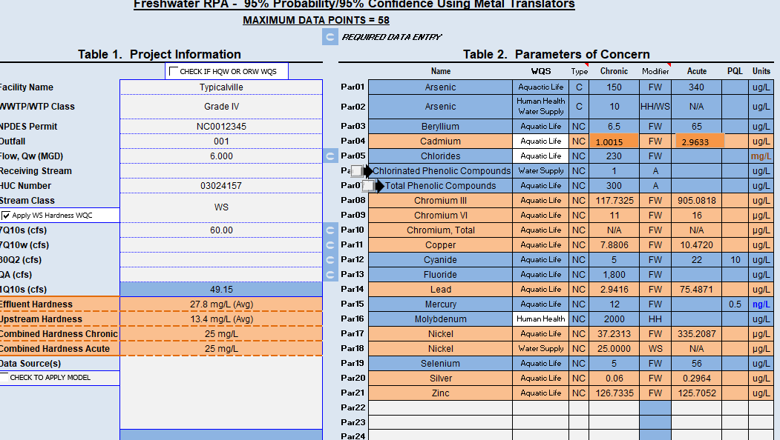

Slide 37
When to use RPA vs DMC
The fact sheet from your most recently renewed NPDES Permit provides a RPA that can be used for the HWA.
All RPAs from 2017 or before can not be used and the DMC must be used instead.
If there is updated hardness data available than the data in the RPA, use the Dissolved Metals Calculator (DMC).

Slide 38
DMC Notes
How to use the DMC:
Fill in values under the 5 following yellow boxes: average stream flow, receiving stream summer 7Q10, NPDES flow limit, average upstream hardness, and average effluent hardness.
Choose the chronic values in the total metal column as the stream standard for each parameter unless otherwise noted in your NPDES permit. The acute values are the next limiting factor and can be used instead. Use of acute values should be discussed with the Division. Once there are selected values for each parameter, input the values in the HWA under the column "Stream Standard". Convert to mg/L in the HWA.
In the "Stream Standard Source" column in the HWA, "standard" should be written for the grey compounds and "calculated" should be written for the white compounds.

Slide 39
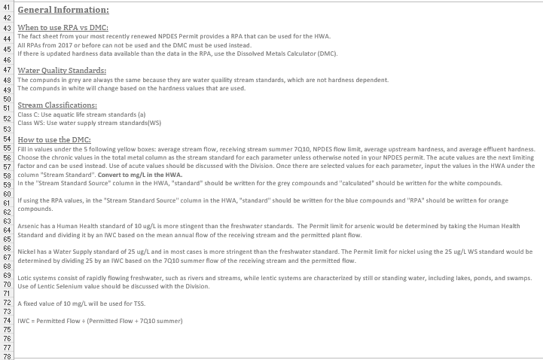
Notes:
Make sure to say literature value is 25

Slide 40
Stream Standards
Class C
Use aquatic life stream standards (a)
Use mores stringent human health for Arsenic
Use Chromium VI Criteria
Water Supply
Use water supply stream standards (WS)
Use more stringent Nickel Criteria
Trout Waters
Use more stringent Cadmium Criteria
Water Quality Standards:
The compounds in grey are always the same because they are water quality stream standards, which are not hardness dependent.
The compounds in white will change based on the hardness values that are used.

Slide 41
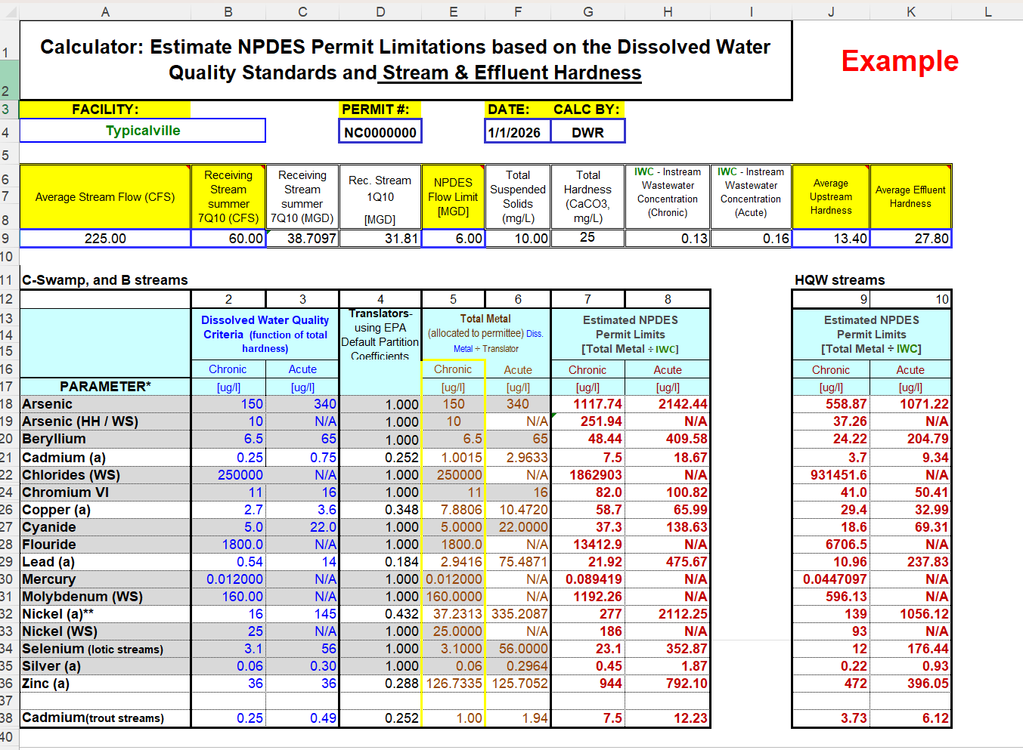

Slide 42
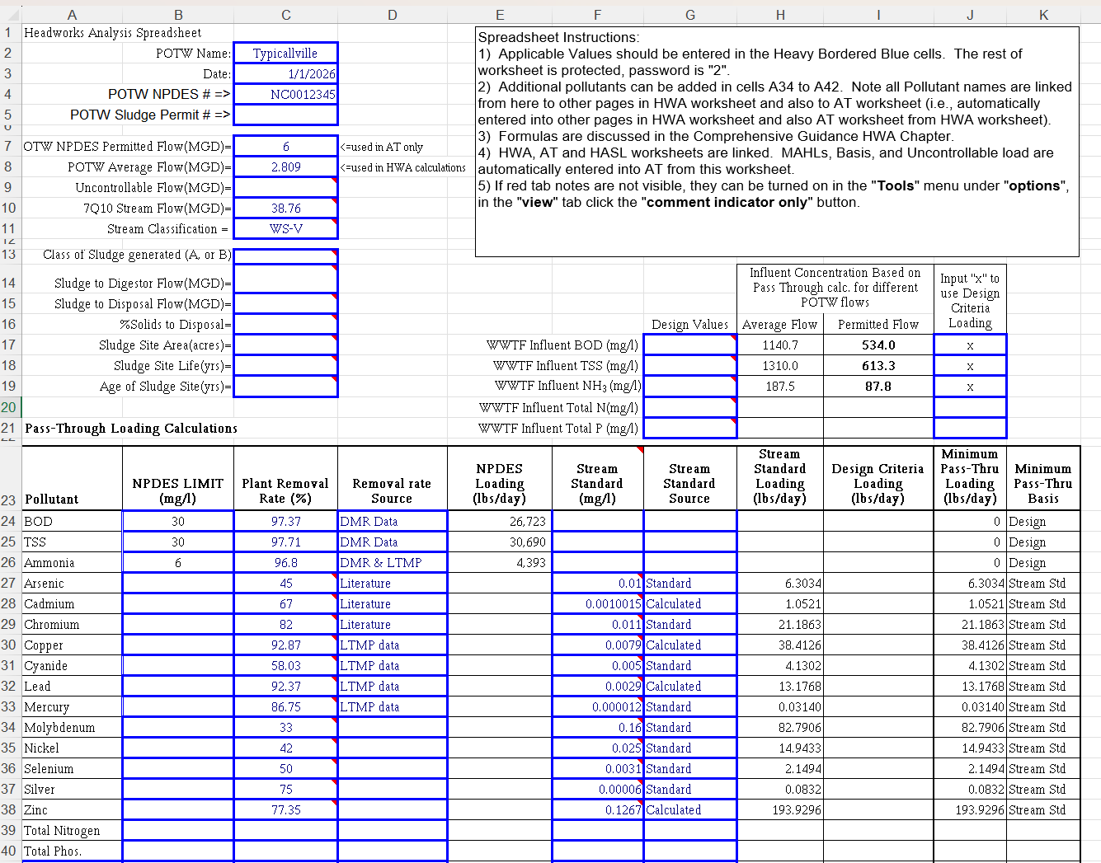

Slide 43
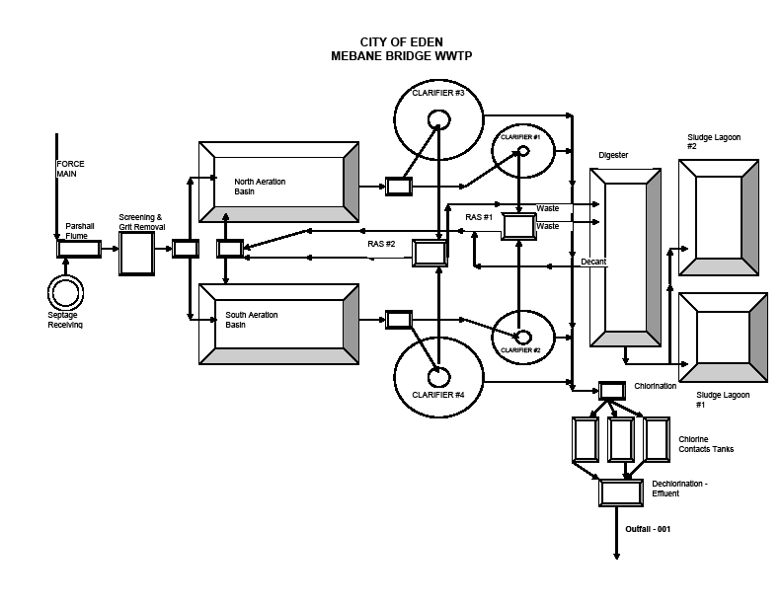
Design
Typicalville WWTP

Slide 44
MAHL: Conventional/Design Pollutants
The engineers who designed your POTW designed it to be able to treat a specific target or “design” influent value for selected parameters and still meet your NPDES limit.
Most/all POTWs have Design for BOD+TSS
Some/many have Design for NH3
Some/fewer have Design for Total Phosphorus (TP), and maybe even Total Nitrogen (TN)

Slide 45
MAHL: Conventional/Design Pollutants
MAHL_{Design} =
(8.34)(Design Influent, mg/l) (Design flow, MGD)
Use average not max or peak
Design values,
Where are my Design values?
O&M Manual
Plans and Specs
Engineer’s Calculations

Slide 46
MAHL: Conventional/Design Pollutants
All NC POTWs must enter Design Criteria in HWA for all parameters with Design Criteria
NPDES limit < Design value, use NPDES limit as MAHL
NPDES limit > Design value, use Design value as MAHL
If there is more than 1 design criteria, use most stringent
In order to select Design as MAHL, put X in cells

Slide 47
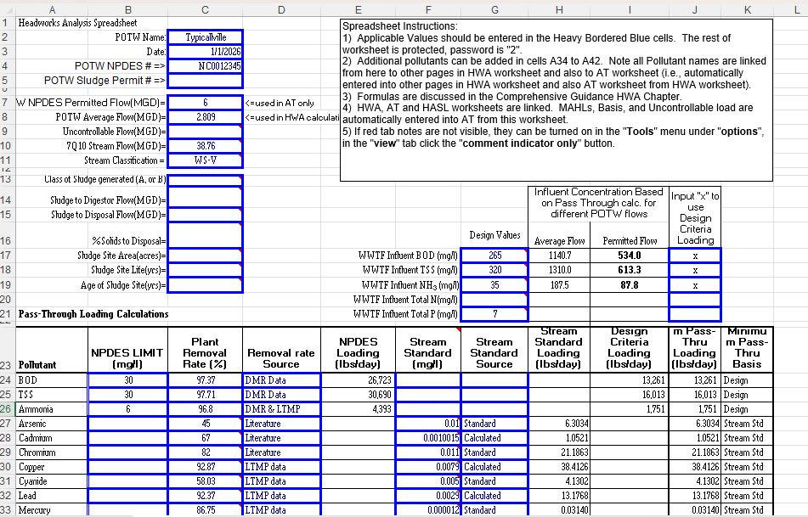

Slide 48
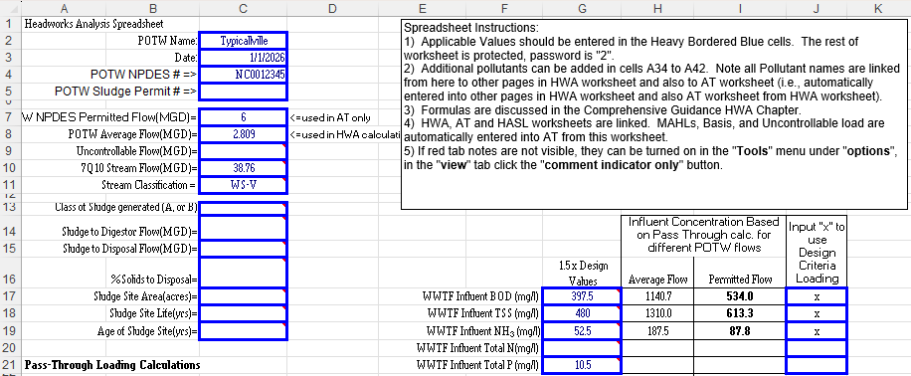
MAHL: Conventional/Design Pollutants
Sometimes a WWTP can treat wastewater better than the design criteria set by the engineer
  Reference the December 2007 HWA Design Memos
  Plant must be older than 8 years old to use design multiplier
Typicalville used the design multiplier of 1.5
  If multiplier is used, discuss in narrative

Slide 49
Higher removal rates lead to higher MAHL

Slide 50
Questions about Pass Through criteria?

Slide 51
Break

Slide 52
Biological processes Inhibition
Aeration
Basin

Slide 53
Limiting Criteria
Biological Process Inhibition
Bar Screen
2a and 2b
Clarifier
Aeration Basin
Aeration Basin
Grit
Removal
2c
Filter
Digester
Sludge
Chlorine/
UV Disinfect
River Styx

Slide 54
What do I need to calculate biological inhibition HWA loading
Basic understanding of WWTP microorganisms​​
Wastewater Biological Treatment Units​​
    Activated Sludge, Aeration Basin, etc.​​
    Trickling Filter​​
    Carbonaceous vs. Nitrogenous/Nitrification​
Sludge Biological Treatment Units​
  Only if have Anaerobic Digester​
Inhibition Formula​
Literature Inhibition Criteria​
LTMP/STMP data from basins ​
(+anaerobic digesters)

Slide 55
MAHL: Inhibition Criteria
Based on Activated Sludge/Nitrification
Maximum Allowable Headworks Loading (MAHL)
based on Secondary Treatment Inhibition =
Secondary Inhibition POTW Average
(8.34) Criteria, mg/l Flow, mgd
(1 - Primary RR, as decimal)
No primary Clarifiers? - just use 0
Notes:
This is the actual formula in the spreadsheet
Mention that we will go over primary clarifiers at the end

Slide 56
Inhibition Loading for Nickel based on Nitrification Inhibition
Commercial
SIU’s
WWTP
NPDES
Permit
Limits
2.809 MGD
Activated Sludge
0.25 mg/l
(5.8568 lbs/day) Influent
Residential
Land Application
Standards
Notes:
The 5.8568 lbs/day is the MAHL for Nickel based on Inhibition for nitrification

Slide 57
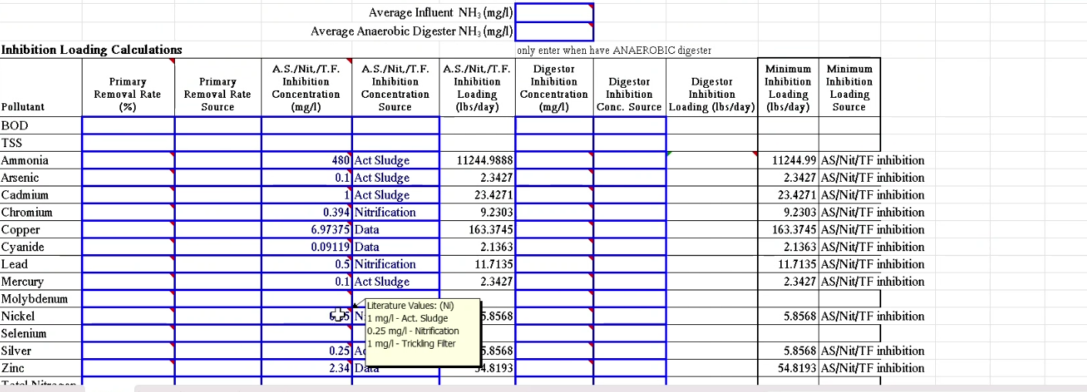
Notes:
These valuea re in the HWA excel sheet. Pick nitrification if plant does nitrify and you have verification. If you do not have that pick activated sludge unless you have a trickling filter

Slide 58
Which Inhibition Values Do I use?
Activated Sludge Inhibition
All POTWs must evaluate for Activated Sludge Inhibition
Nitrification Inhibition:
POTWS who have an NPDES permit limit for ammonia
Nitrogenous bacteria
  Does LTMP data suggest WWTP nitrifies?
  Ask the ORC - does POTW Nitrify?
Must use lower of Activated Sludge or Nitrification Inhibition Criteria (if there is nitrification)
Notes:
If you have a trickling filter, use trickling filter inhibition

Slide 59
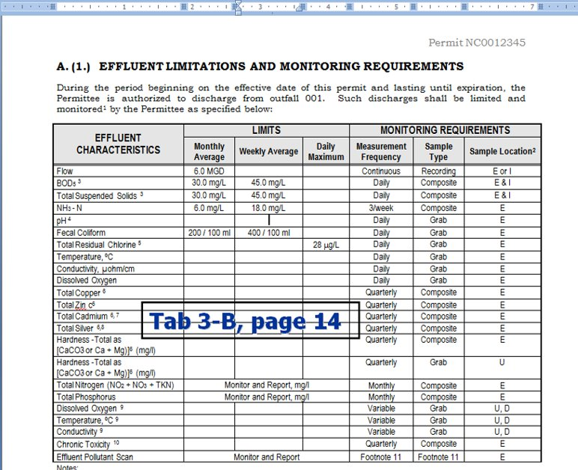

Slide 60
Notes:
There is nitrifying since Ammonia is being removed

Slide 61
No Literature Inhibition Criteria Load?
If there is no literature biological inhibition criteria for a POC, site-specific inhibition criteria does not need to be developed (Ex: BOD, TSS, Molybdenum, Selenium)
  L/STMP- Do not have to sample for these POCs at the biological process locations such as the aeration basin or influent to anaerobic digestors
    Or other inhibition related locations like primary clarifier effluent

Slide 62
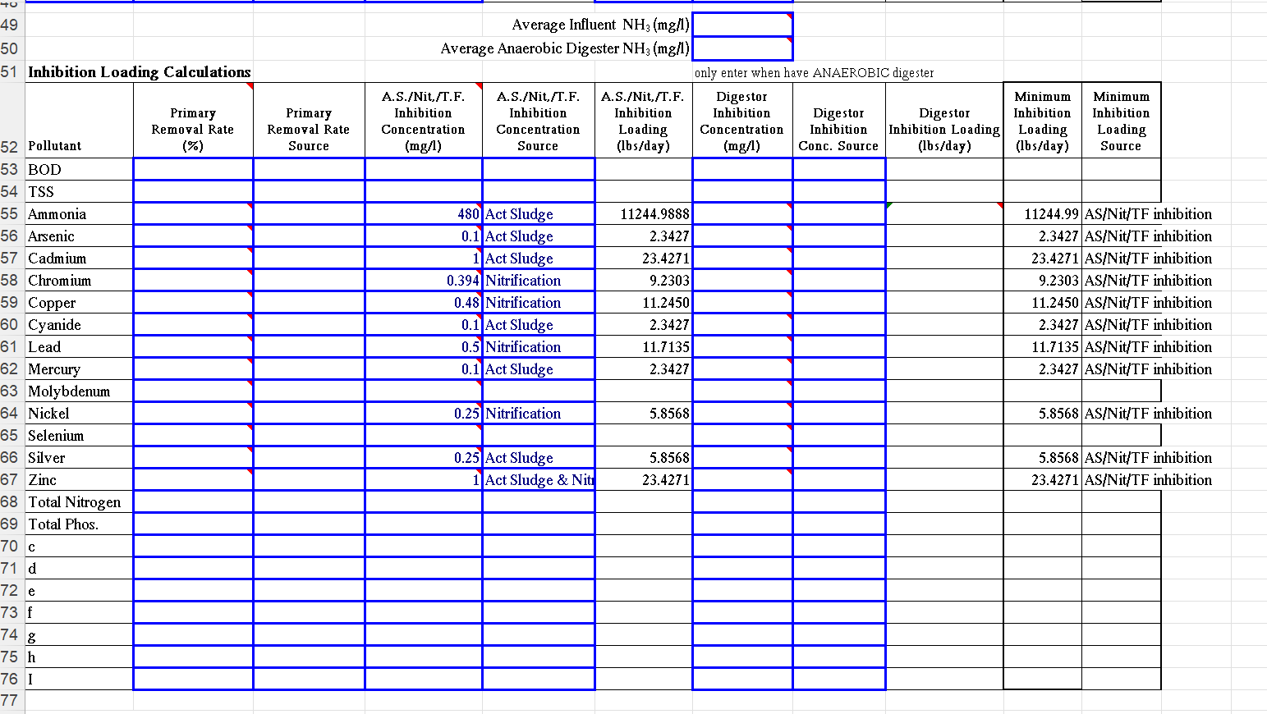
This is what it looks like if all literature values were used.

Slide 63
Site Specific vs literature inhibition criteria
If LTMP data suggests POTW is acclimated to higher levels of site-specific concentration than traditional literature values, ask ORC:​
Is POTW meeting all permit limits and conditions?​
Were there NPDES or Toxicity violations?​
Were any effluent parameters (usually BOD, TSS NH3) elevated above normal for no other apparent reason?​
Was there foaming?​
Were there fluctuations in the DO?​
Did the bugs die?​
If POTW is not meeting permit limit and conditions, then contact the pretreatment staff.​

Slide 64
Notes:
Start with chromium – our data is all less than the NC nitrification value so we would stick with the 0.394 mg/l
For the copper we decided to use the average of all of the data. You could choose to use one of the higher values. In this case the sludge standard will be the most limiting so it doesn’t really matter if we use 7 or 10. However, if we did use the literature nitrification inhibition of 0.48 mg/l, it would become the limiting factor so we do want to use a site specific value so we’re not limited unreasonably.
Cyanide I choose to use the high value of 0.15. For activated sludge the value is 0.1, but for nitrification its 0.34 mg/l, so after reviewing the DMRs I feel confident that 0.15 mg/l is protective.
For zinc we used the average of all of the data. There was a high value of 3.85 mg/l on 10/5/2016

Slide 65
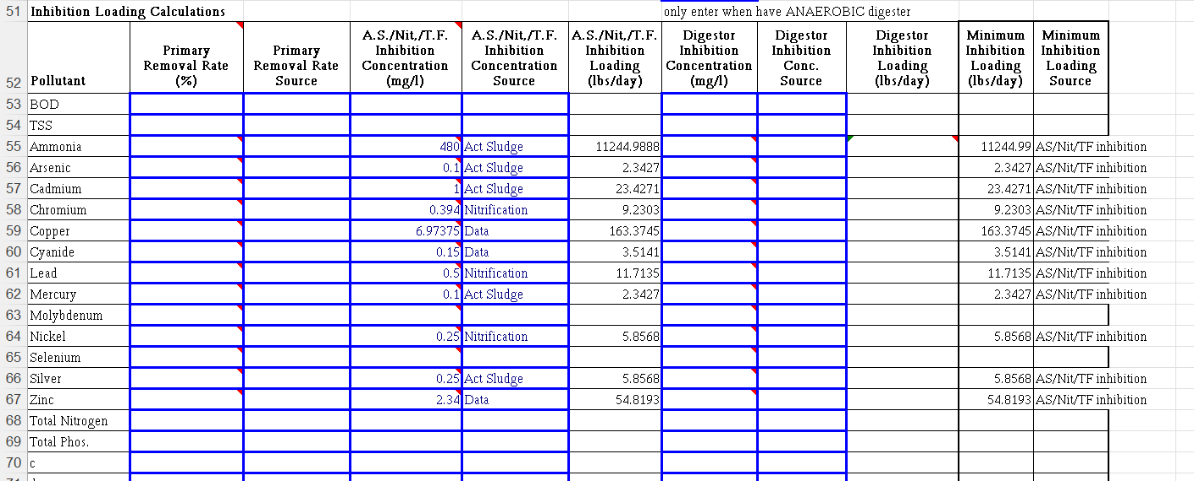

Slide 66
Primary Clarifier Removal
Quarterly LTMP/STMP sampling at primary clarifier effluent (PCE)
  Sample before any return flows
  Same detection levels as influent/effluent
  Only required for parameters with
  literature inhibition criteria
Use with WWTP influent data to calculate primary removal rates
  BDL Data? – same as WWTP removal rates regarding use of literature removal rates
If there is no Primary Clarifier, leave cells blank in the HWA spreadsheet
Notes:
Only required for parameters with lit inhibition criteria – so you don’t need it for Mo, Se, etc.

Slide 67
Review HWA Spreadsheet
Enter sludge to Digestor Flow if applicable
Enter Literature inhibition criteria
Activated sludge, Nitrification, or Data source
Ammonia is different than other POCs
  In most cases it is taken into consideration in the design of the facility

Slide 68
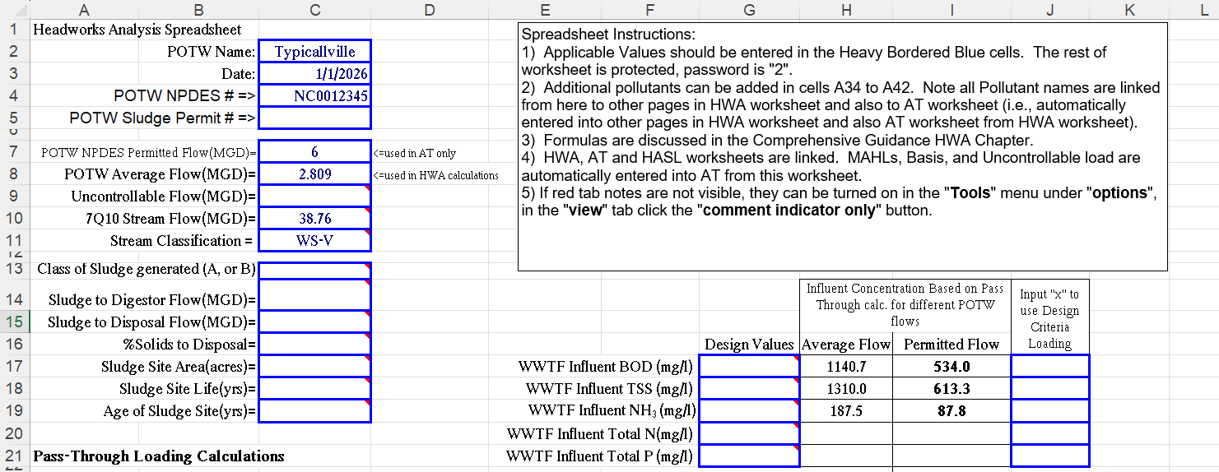
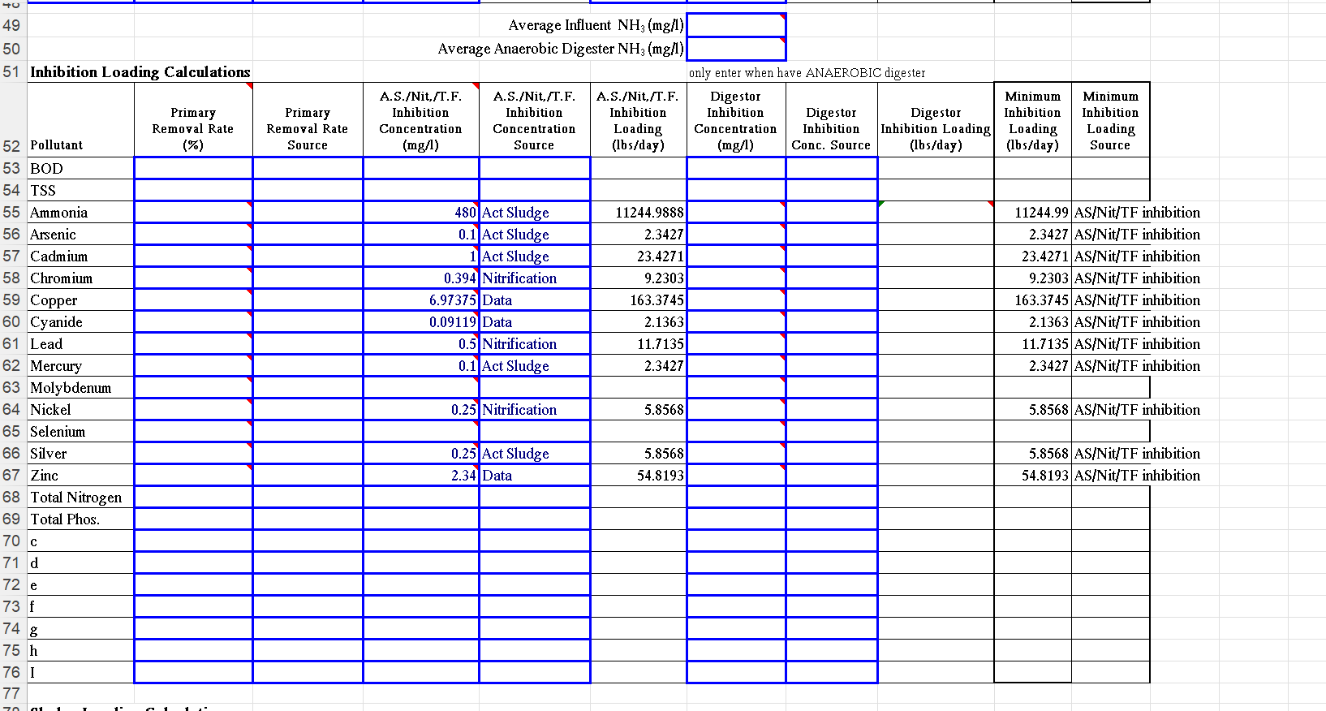

Slide 69
Questions about inhibition?

Slide 70
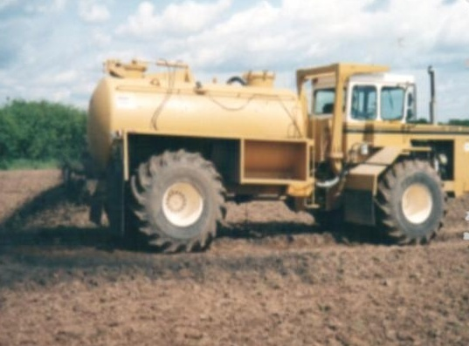
Sludge criteria – 503 Regulations

Slide 71
HWA limiting criteria sludge 503 regulations
Bar Screen
Clarifier
Aeration Basin
Aeration Basin
Grit
Removal
Filter
3a
3b
Digester
Sludge
Chlorine/
UV Disinfect
River Styx
Notes:
Future flow for this section will reference flow to the digestor.

Slide 72
What do I need to calculate sludge load?
Copy of selected pages of current Sludge Permit
Copy of selected pages of current Annual Sludge Report
Site Life
Sludge Formulas
Notes:
If composter then agreement with them.

Slide 73
Sludge use and disposal methods
Land Application/Compost:
Limits: Arsenic, cadmium, copper, lead, mercury, molybdenum, nickel, selenium, zinc
Incineration (relatively small number of POTWs)
Limits: Arsenic, beryllium, cadmium, chromium, lead, mercury, nickel
Municipal Solid Waste Landfill:
No pollutants limits. Requirements in 40 CFR 257, 258, and 261 apply.

Slide 74
MAHL: Based on Land App/Compost
Using Ceiling Concentration Limits
Maximum Allowable Headworks Loading (MAHL)
based on Sludge Ceiling Limits =
Sludge Percent Sludge
Ceiling Solids as average mgd
(8.34) Limit, mg/kg decimal to disposal
(POTW RR as decimal)
- Sludge Specific Gravity assumed to be 1,
same as water.
Notes:
Concentration, how much solid, flow to digestor.

Slide 75
Sludge loading for nickel – based on 503.13 sludge Regulation
Commercial
SIUs
SIU’s
WWTP
NPDES
Permit
Limits
2.809 MGD
0.186 mg/l
(4.3668 lbs/ day) Influent
42% RR
Residential
Given:
420 mg/kg std. from permit
1164.9 acres permitted
4.4 % solids
0.0119 MGD flow to disposal
Digester
Water Quality Standards
Land Application
Standards
Notes:
Concentration, acres, percent, flow to digestor “not all flow”.

Slide 76
MAHL: Based on Land Application
Using Cumulative App Limit
Maximum Allowable Headworks Loading (MAHL)
based on Cumulative Sludge Limit =
(Cumulative application rate in lbs/acre)(SA in acres)
(SL, years)(POTW RR as decimal)(365 days/year)
(Cumulative Applic. Limit)(Total Permitted Acres)
(Site Life)(Removal Rate)(365/year)
Notes:
Rate formula = where we are in the life cycle of the site. Limit = When do we need to stop based on parameter accumulation.

Slide 77
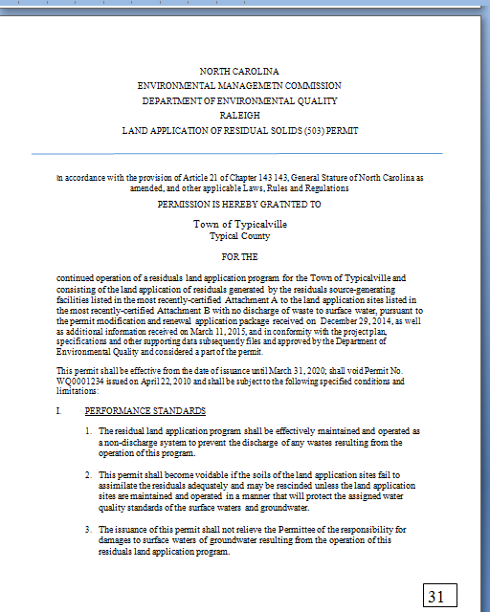
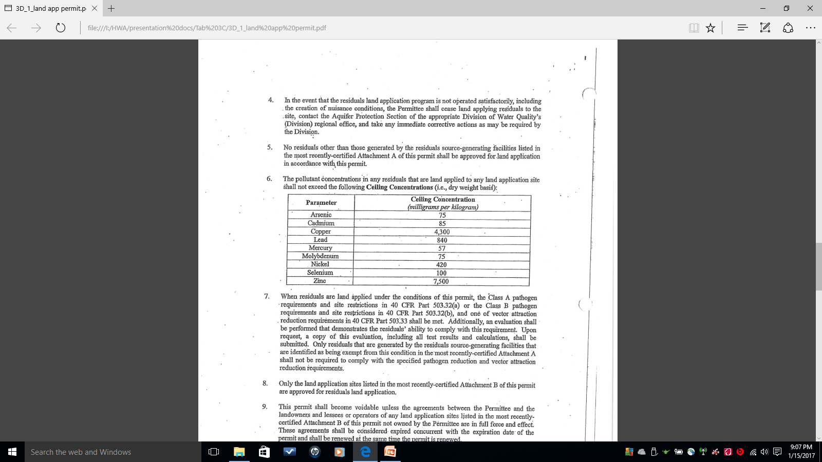
Notes:
Cut?

Slide 78
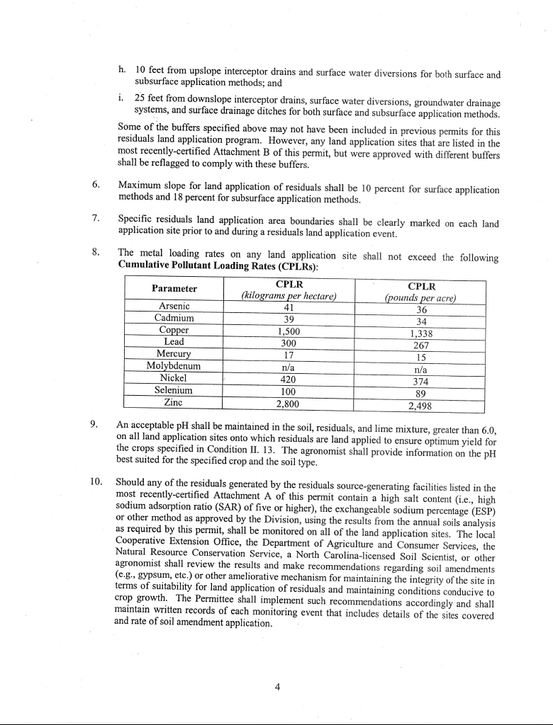

Slide 79
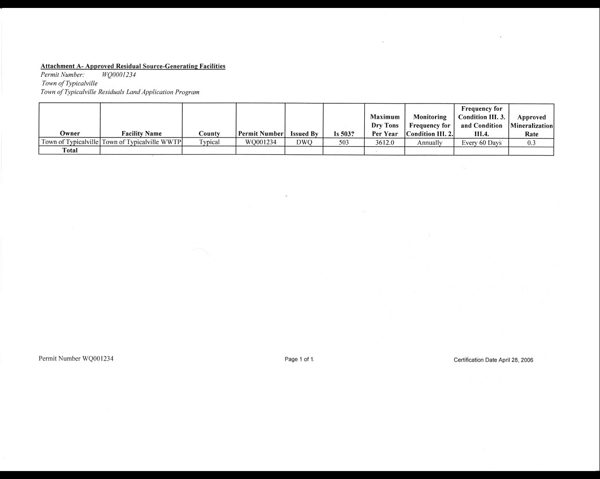
If Attachment A of Sludge Permit shows additional sludge sources, acres in Attachment B must be adjusted accordingly. For POTW in this situation please Discuss apportionment issue with staff.
Notes:
Additional sources like those outside the POTW. Or multiple internal points possible creating varied composition.

Slide 80
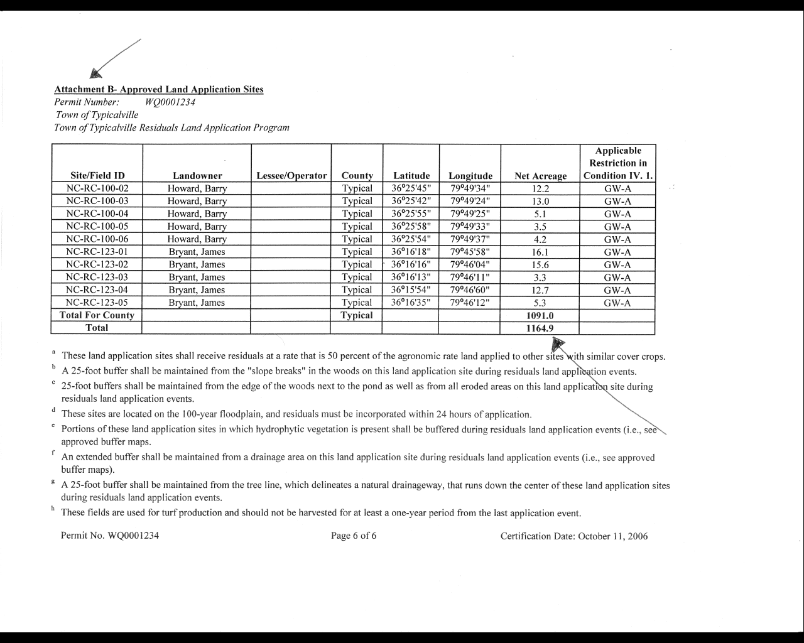
If Attachment A of Sludge Permit shows additional sludge sources, acres in Attachment B must be adjusted accordingly. For POTW in this situation please discuss apportionment issue with staff.
Notes:
Total and total for county are different. Different compositions may want to be applied to different fields.

Slide 81
Notes:
MGD number from earlier

Slide 82
Notes:
Earlier 4.4% came from this report for sludge calcs

Slide 83
Review HWA Spreadsheet
Note: If POTW incinerates, contact pretreatment staff to discuss requirements
Enter values for:
  Sludge permit number
  Class of sludge disposal
    A for compost; B for land application
  Sludge flow and % solids to disposal
  Site life
    Can calculate by dividing annual load on most heavily loaded field by cumulative limit
      Can be used if it is a reasonable value
    Most POTWS use 20 to 50 years
Notes:
All the pieces are ready next slide has sheet. Incineration gets air quality involved.

Slide 84
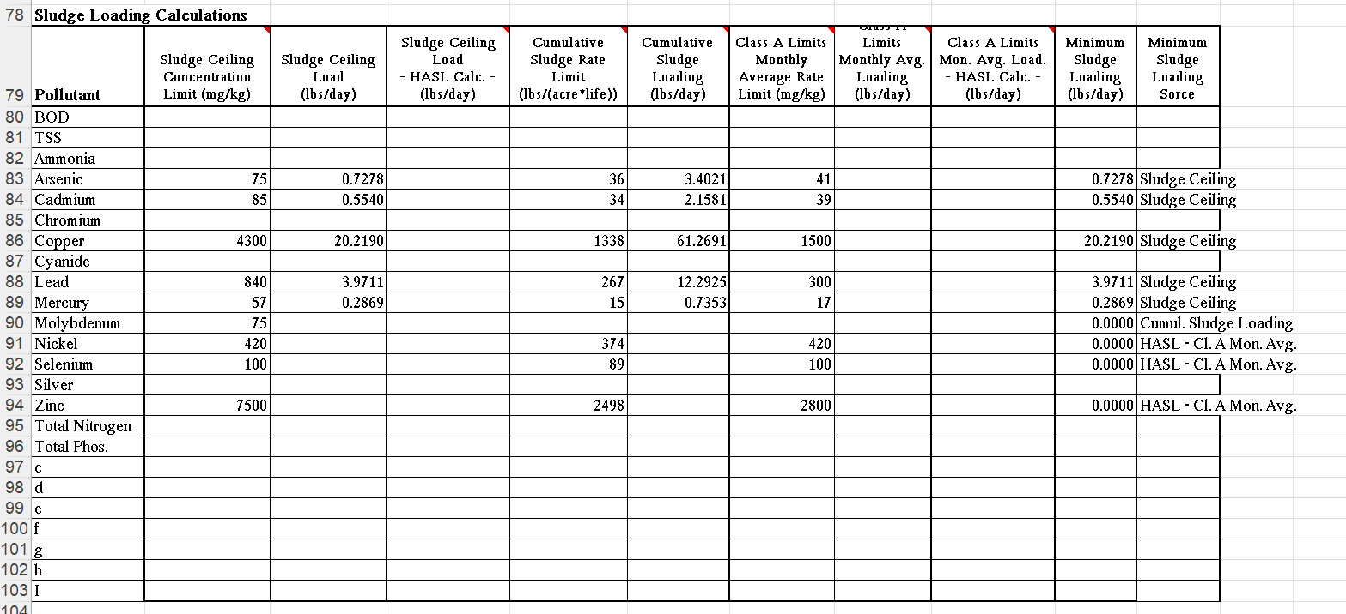
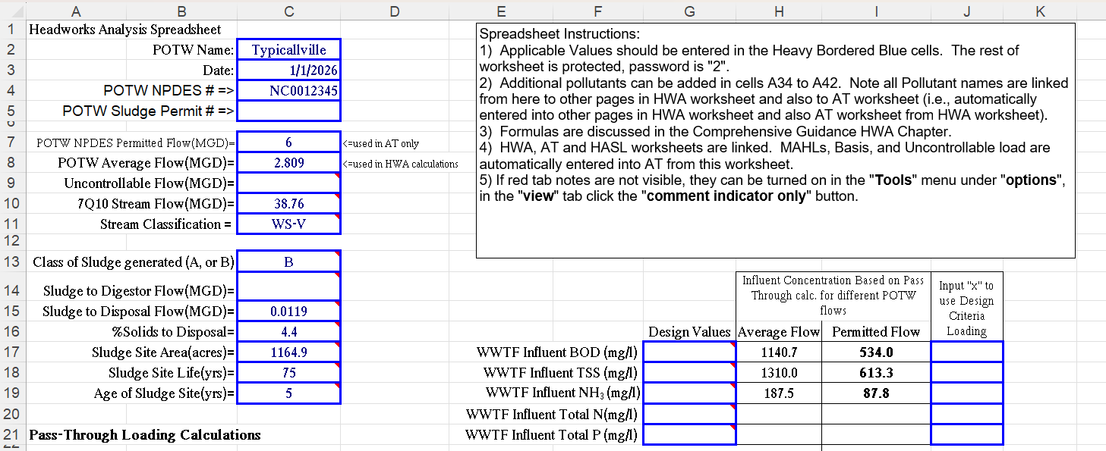
Sludge loading calculations are automatically generated using previous values
Input these values from sludge permit and/or annual sludge report

Slide 85
Notice to Composters
The previous example was for land applied sludge or “Class B”
If you compost your sludge, also called “Class A” or “Distribution and Marketing,” entering “A” will automatically adjust HWA worksheet to use the applicable standards.

Slide 86
Questions about Sludge?

Slide 87
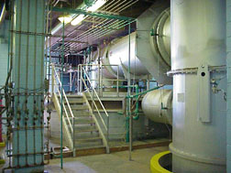
Maximum Allowable Headworks Loading (MAHL)
Determines the amount of the pollutant the POTW can treat based on the most restrictive criteria

Slide 88
A note about Basin associations
If you are in a Basin Association and have Nitrogen and/or Phosphorous limits/allocations
  Best practice for calculating allocations is as follows
    Back-calculate from the limits to calculate concentration allotted and use that to calculate allocations for permittees
    This allows you to permit your SIUs without using the allocation of your co-permittees

Slide 89
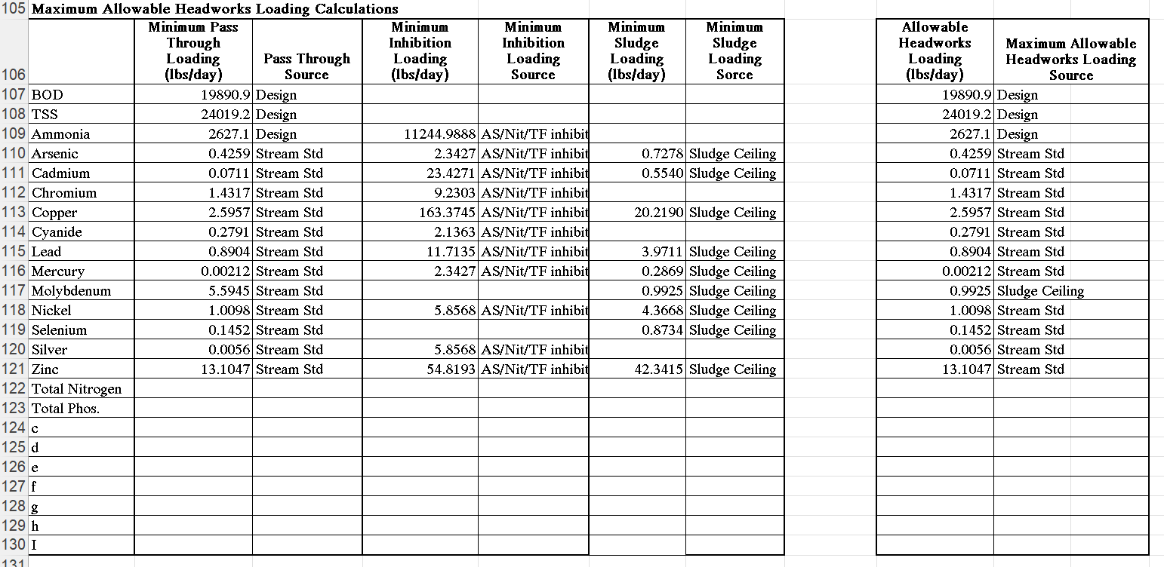

Slide 90
Uncontrollable Load
Commercial
Non-SIUs
SIUs
WWTP
NPDES
Permit
Limits
Aeration Basin
Clarifier
Disinfection
Digester
Influent
Water Quality Standards
Land Application
Standards
Residential
90

Slide 91
Determine Uncontrolled Load
Everything that contributes to POTW not covered in SIU Permit
  Residential
  Non-Residential, but not SIU, for example:
      Commercial
      Hospitals, Funeral Homes
      Doctors, Dentists
      Car Repair/Wash Centers
      Inflow/Infiltration
      ALL Non-SIUs

Slide 92
Uncontrolled load may be determined in two ways
Mass Balance Method
Sum of SIU load for each POC
Subtract total SIU load from POTW Influent load
Sampling Method
Sample for uncontrolled pollutants per LTMP

Slide 93
What do I need to calculate uncontrollable load
Average Influent values from removal rate spreadsheet
Average SIU values form SIU data summaries
Average uncontrollable values from uncontrollable data summary, if available
SIU uncontrollable mass balance spreadsheet

Slide 94
Choosing uncontrollable value to be used in hwa
Compare uncontrollable mass balance, sampling and literature values and choose one for HWA
  When choosing, keep in mind which one is more:
    Reasonable?
    Representative?
    Conservative?
      For uncontrollable, “larger” is more conservative

Slide 95
Uncontrolled Mass balance troubleshooting
Inaccurate flow or pollutant data
    In particular, SIU flow data
Limited data set
Widely variable detection levels
Inflow and Infiltration
Degradation of the pollutant in the collection system
Conservative/non-conservative pollutant

Slide 96
Uncontrolled sampling troubleshooting
Sample location not really “uncontrolled”
  1 house and 27 restaurants
  new subdivision (low flow toilets, no sewer leaks)
  No commercial and/or non-SIU
  Inaccurate sample collection
May need >1 sampling point or larger data set
Flow may be too low
BOD will degrade in the collection system

Slide 97
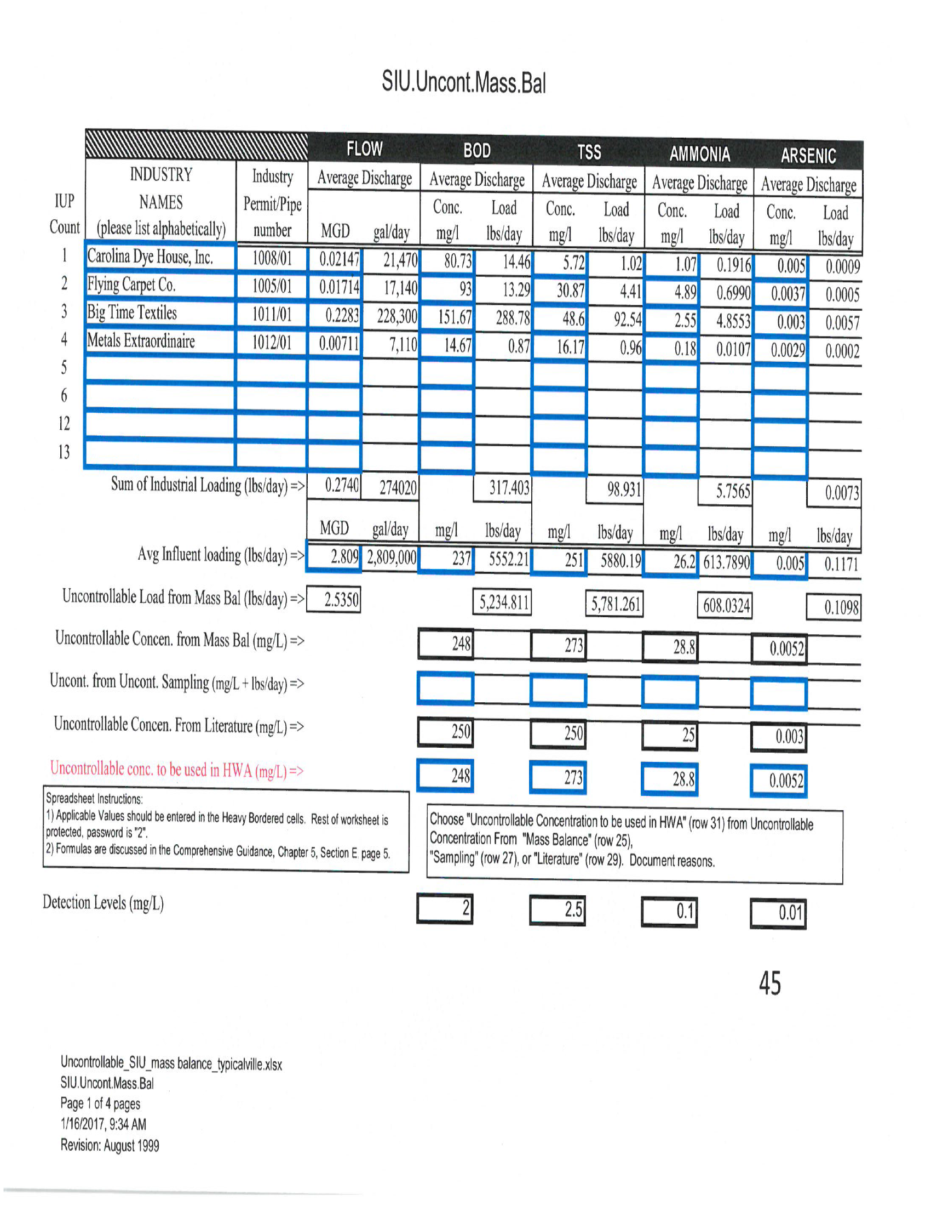
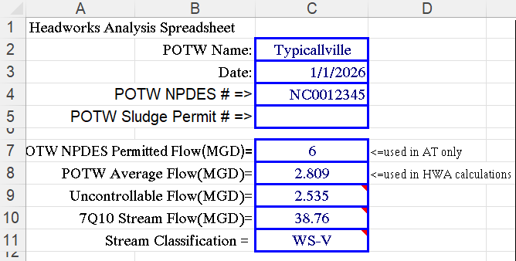
250

Slide 98
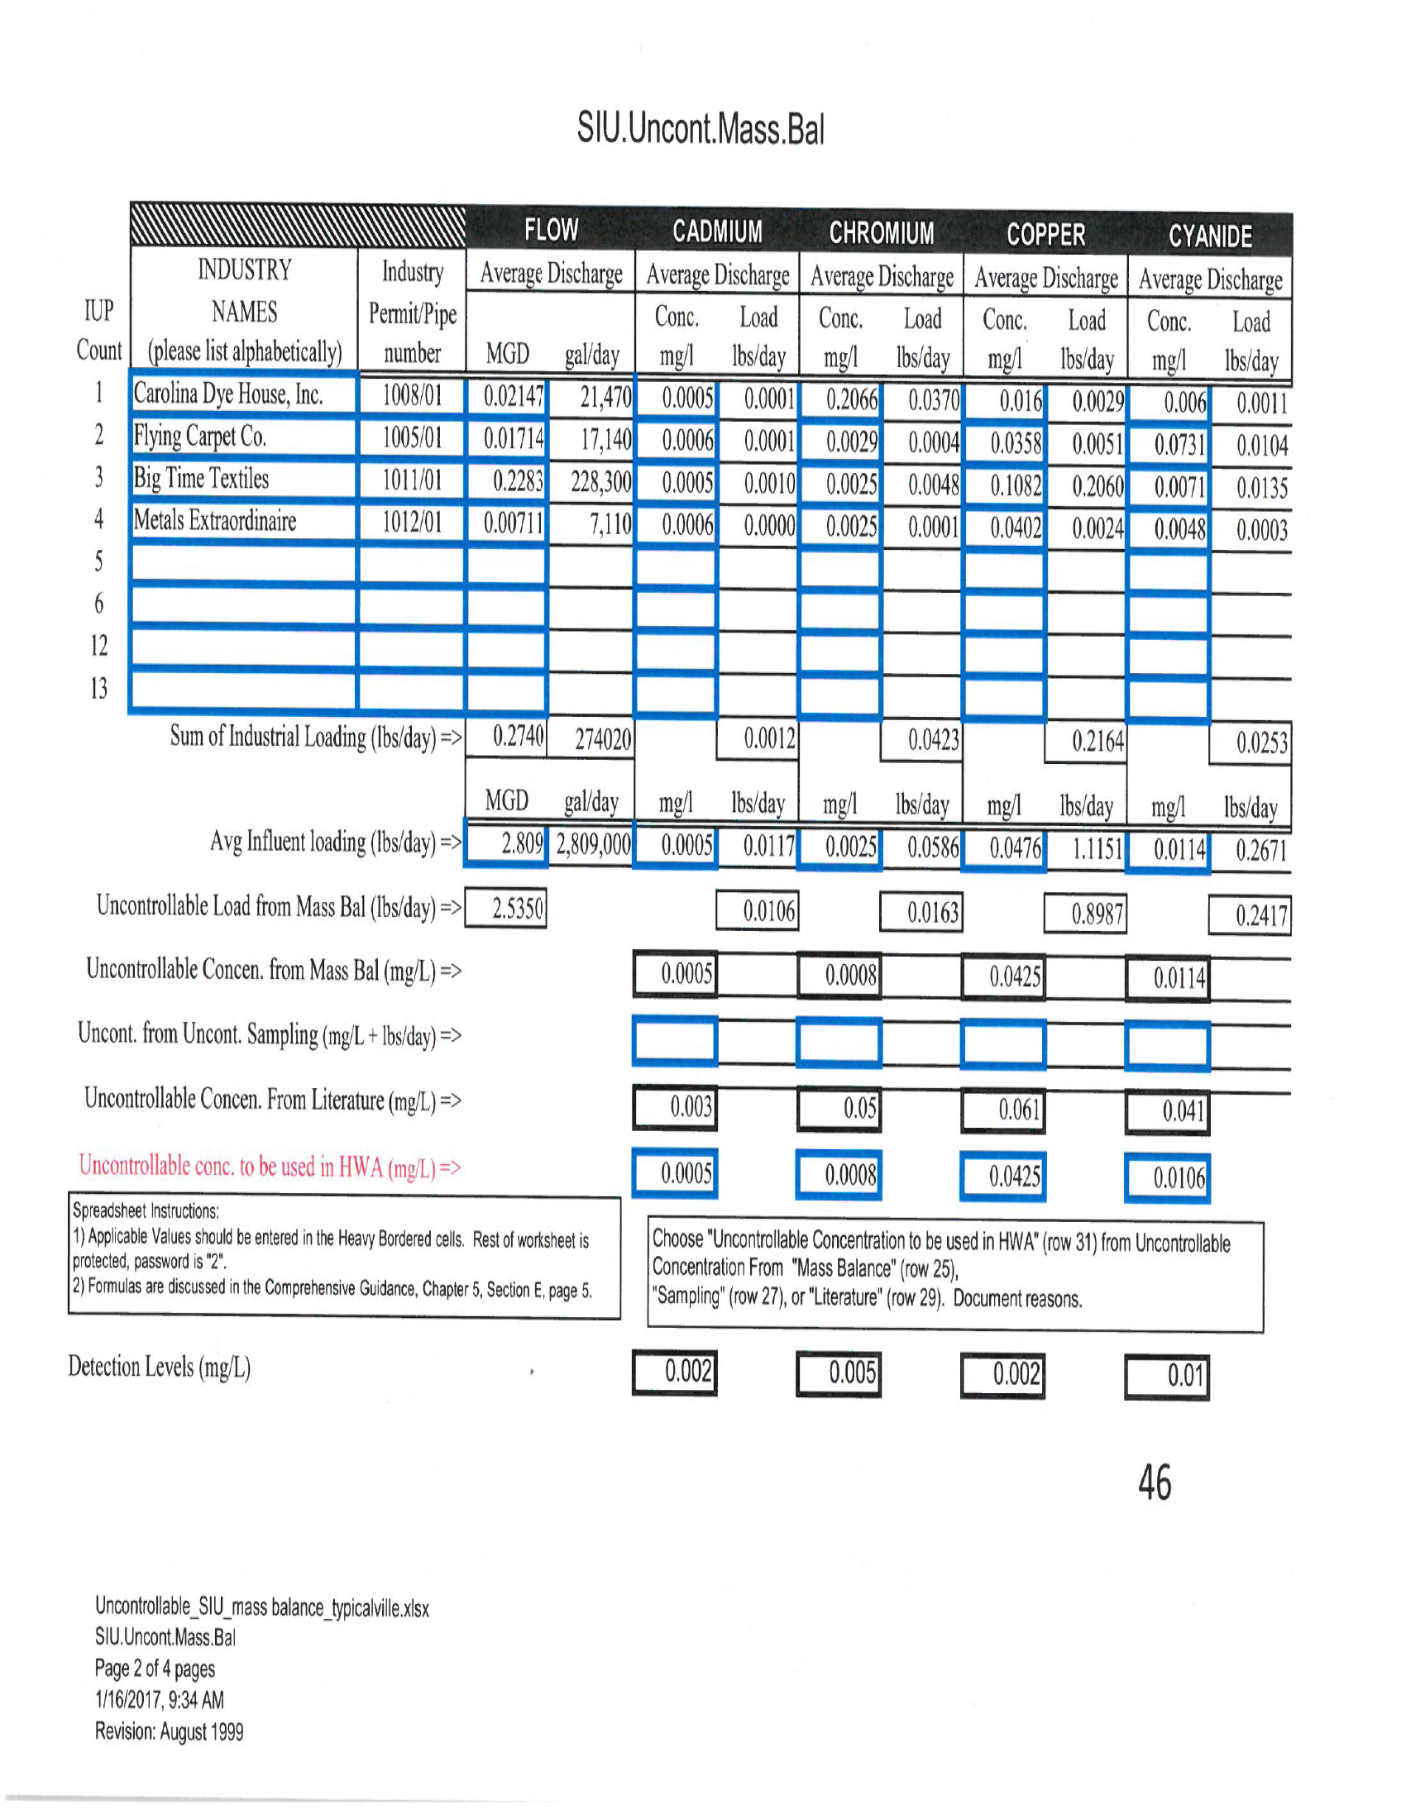
Do not average
0.003
0.05
0.061
Notes:
Talk about how you cannot average values ex:Cyanide

Slide 99
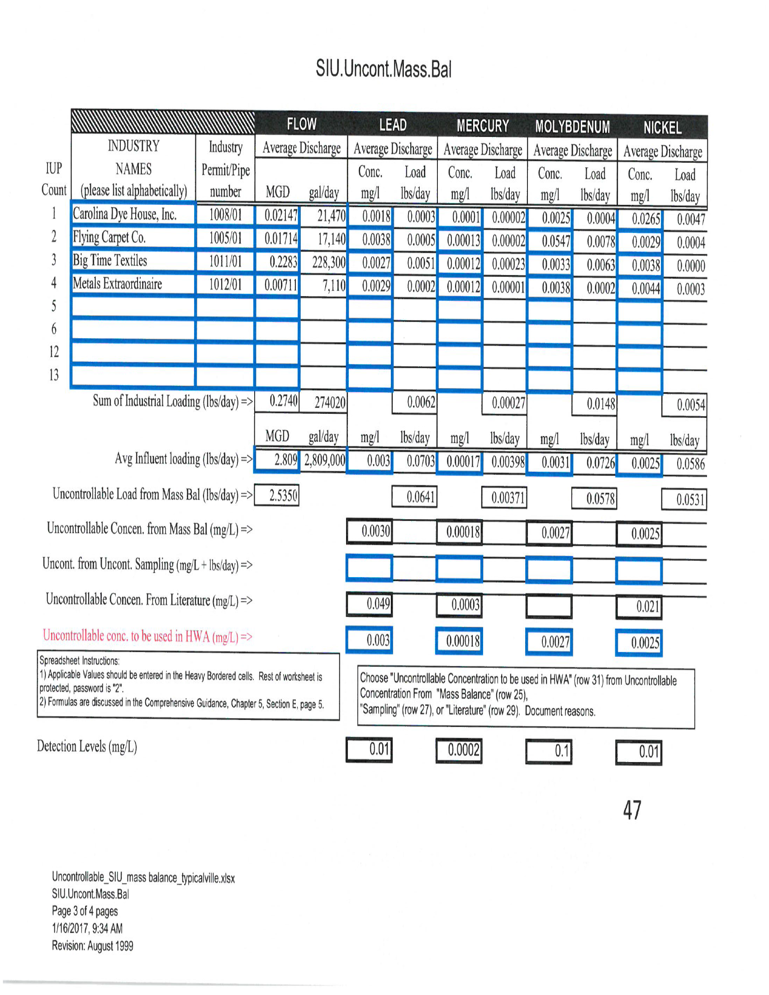
0.049
0.0003
0.021

Slide 100
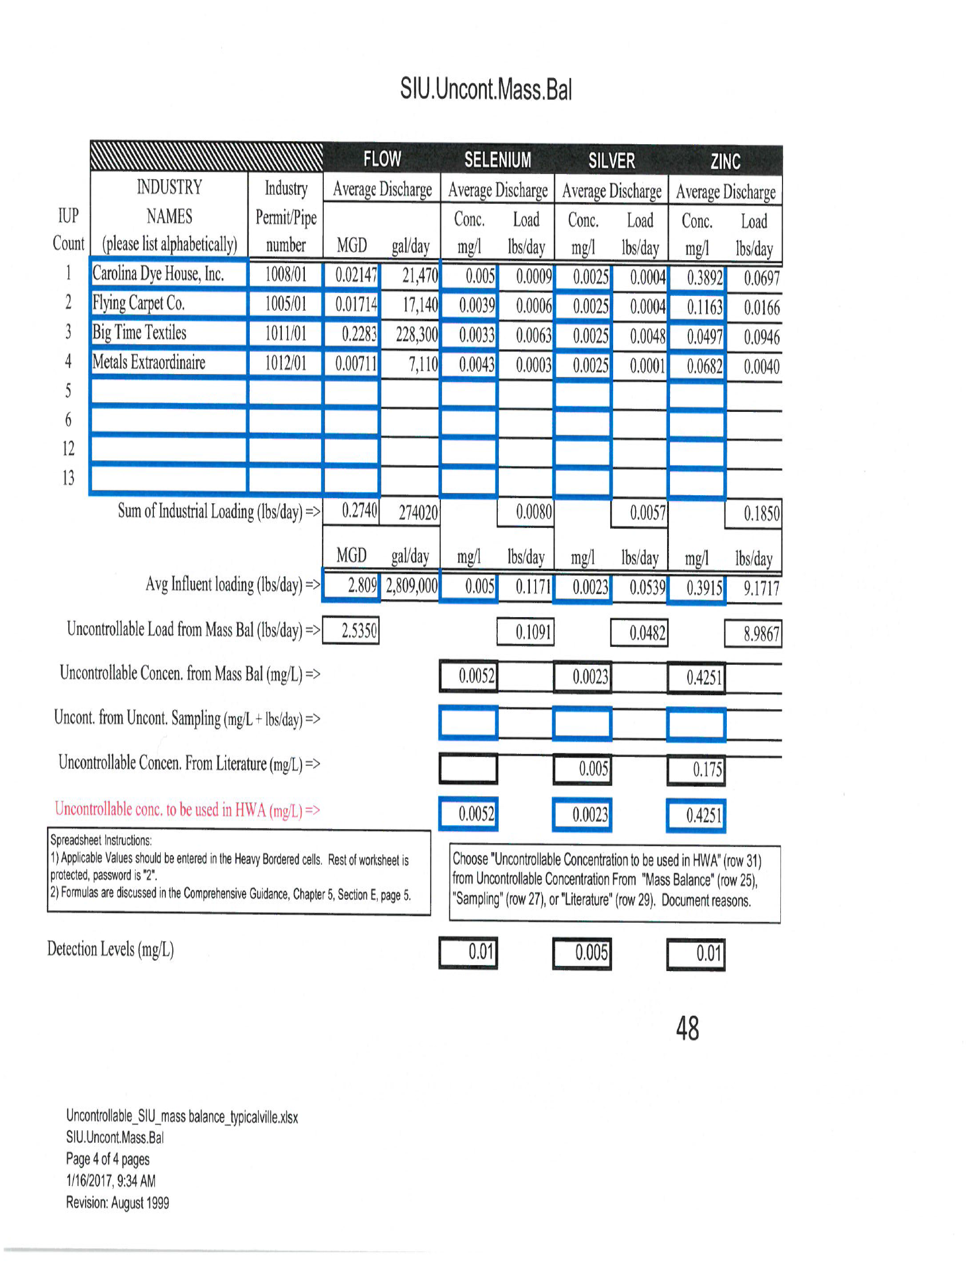
0.005

Slide 101
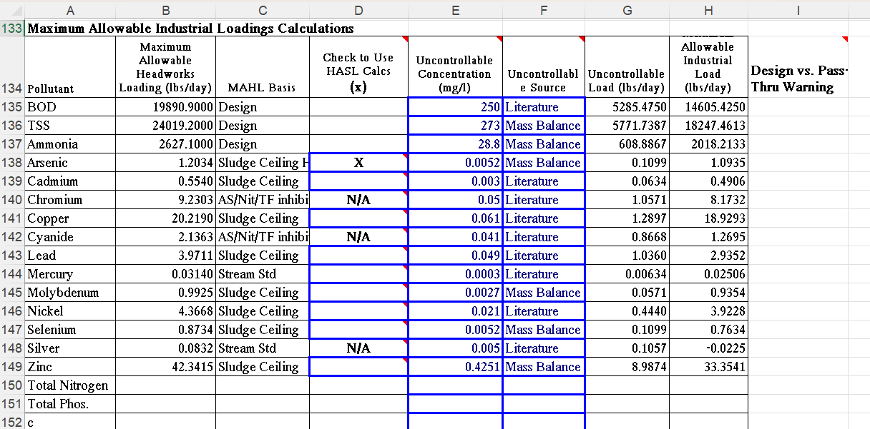

Slide 102
Uncontrollable as Zero
If all the influent data for a particular pollutant of concern is all less than the current best available detection level.
If the program does sampling of the collection system and sample results less than the current best detection level can be averaged as zeros.
There may be other circumstances under which the uncontrollable concentration can be considered zero, but they will be evaluated on a case-by-case basis.

Slide 103
Maximum Allowable industrial loading (MAIL)
Determines the Amount of MAHL Available to your Industries

Slide 104
Maximum allowable industrial loading
MAIL= MAHL – UNC Load – SF
MAIL = Maximum Allowable Industrial Loading, lbs/day
MAHL = Maximum Allowable Headworks Loading, lbs/day
SF = Safety Factor, if desired
Review HWA Spreadsheet to see if there are any negative numbers
  IF there are, either do uncontrollable sampling or adjust limits in IUPs

Slide 105
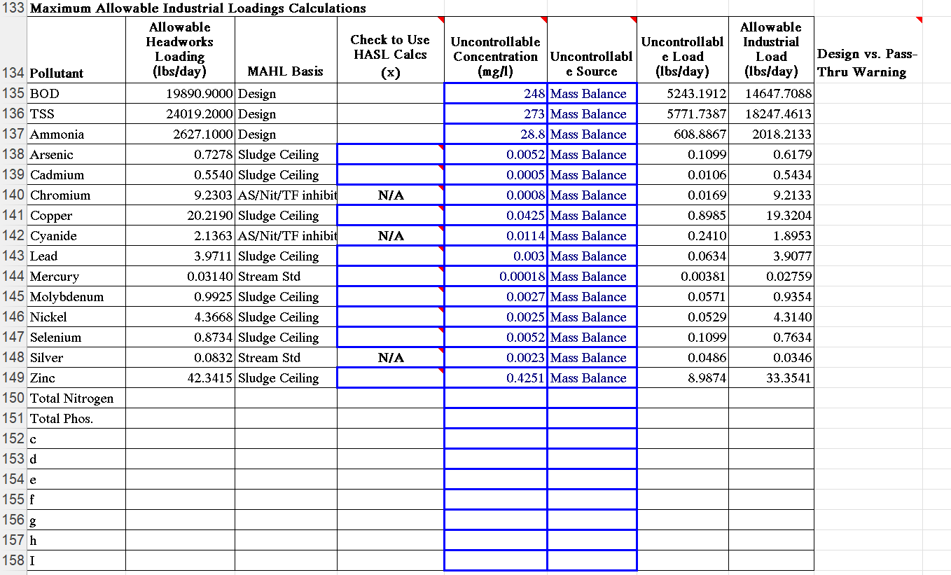

Slide 106
Questions about MAHL/mail?

Slide 107
Allocating the MAIL to your Industries
SIU’s

Slide 108
Safety Factor/MAHL Reserve
Any Negative numbers?
Reserve for future growth
Buffer against SIU IUP violations
Uncertainty in HWA Calculations
Leave 20-30% MAIL still available
Leave 20-30% MAHL still available
Notes:
20-30% is not a strict requirement

Slide 109
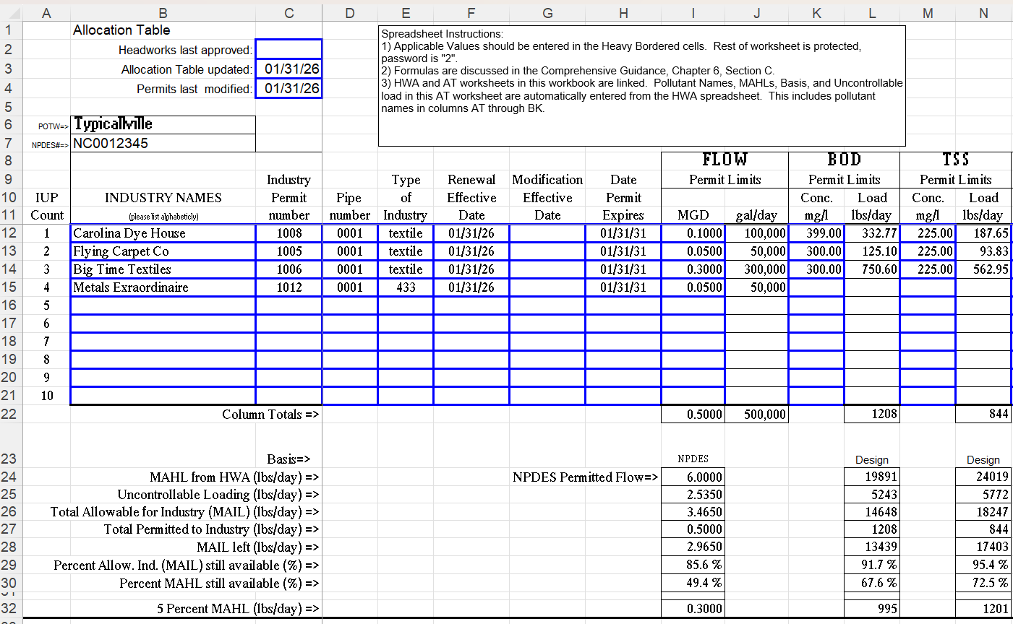

Slide 110
What to do when over allocated?
Ask yourself, should you be over allocated?
  For example, if MAHL based on NPDES limit, are you violating that
Any types, missing/changed formulas?
Review choices for all previous values
  Are there any other choices you can make
Can you lower SIU limits
Specifically
  Is Inhibition Limiting
    Can you use site-specific Inhibition criteria
  Is Sludge Limiting
    Can you use lower site life? Can you perform a HASL Worksheet

Slide 111
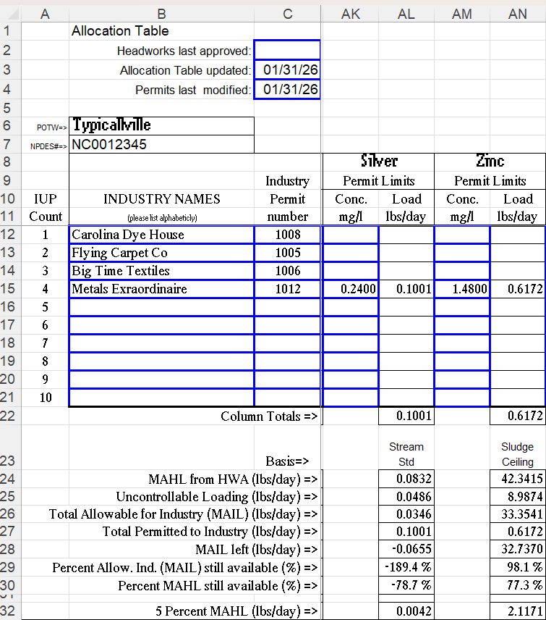

Slide 112
Typicalville Over Allocated for silver
Why is Typicalville over allocated?
  Silver MAHL based on stream standard
  Is Typicalville violating that limit. Check calculator and silver effluent data
Can/should Typicalville lower SIU limits
The Division recognizes that the stream standard for silver causes overallocation in some cases

Slide 113
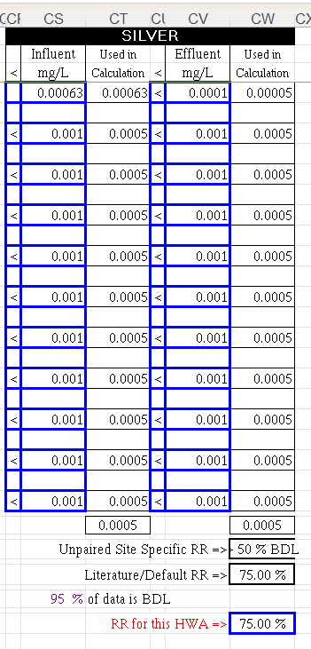
Notes:
The DMC for silver is 0.06 ug/l which is below the detection limit of 0.001 mg/l, that can lead to an appearance of an over allocation in some cases.

Slide 114
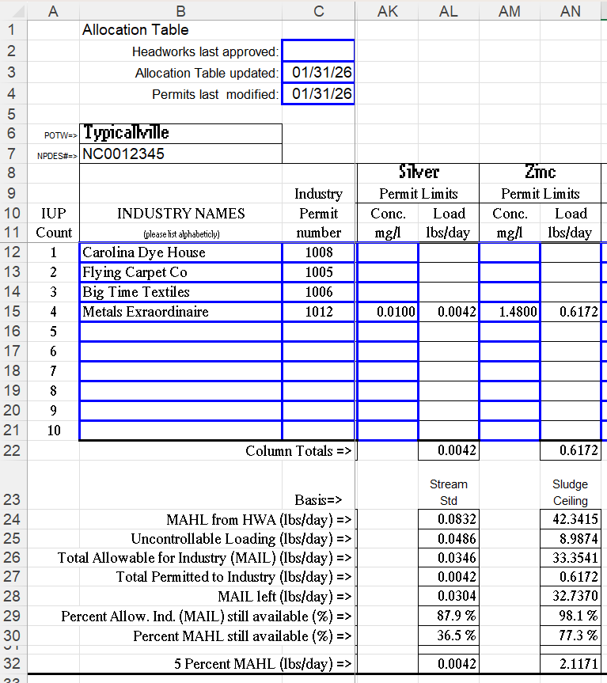
Notes:
0.01 was used because Typicalville looked at what the industry was discharging and said that they could meet a lower limit. So they removed some of their allocation.

Slide 115
Headworks Addendum for Sludge Loading

Slide 116
Hasl worksheet
Reevaluates MAHL for Sludge Criteria by taking into consideration:
Historical WWTP Performance Data
Historical Sludge Report Data
Applicable Sludge Criteria
Only applicable for pollutants over allocated based on sludge criteria
Class A sludge will not require a HASL

Slide 117
What do I need for a hasl
Copy of current Sludge Permit
Copy of Annual Sludge Report
POTW Influent Data from removal Rate calculations
HASL Worksheet and Calculations

Slide 118
Hasl – step 1
Check POC to assure that the available land does not exceed 80% of the cumulative loading rate
From current Annual Sludge Report, locate Land Application Field Summary Reports.
Review “Cumulative lbs/acre” values for HASL POC for each field.
Identify field with highest cumulative lbs/acre for HASL POC – Pretreatment’s “most heavily Loaded field”
Enter value in ”Cumulative loading data” column of HASL worksheet
Any flags? Contact Pretreatment staff
For the Pretreatment World, the “most heavily loaded field” is the field with the highest cumulative lbs/acre for that pollutant.

Slide 119
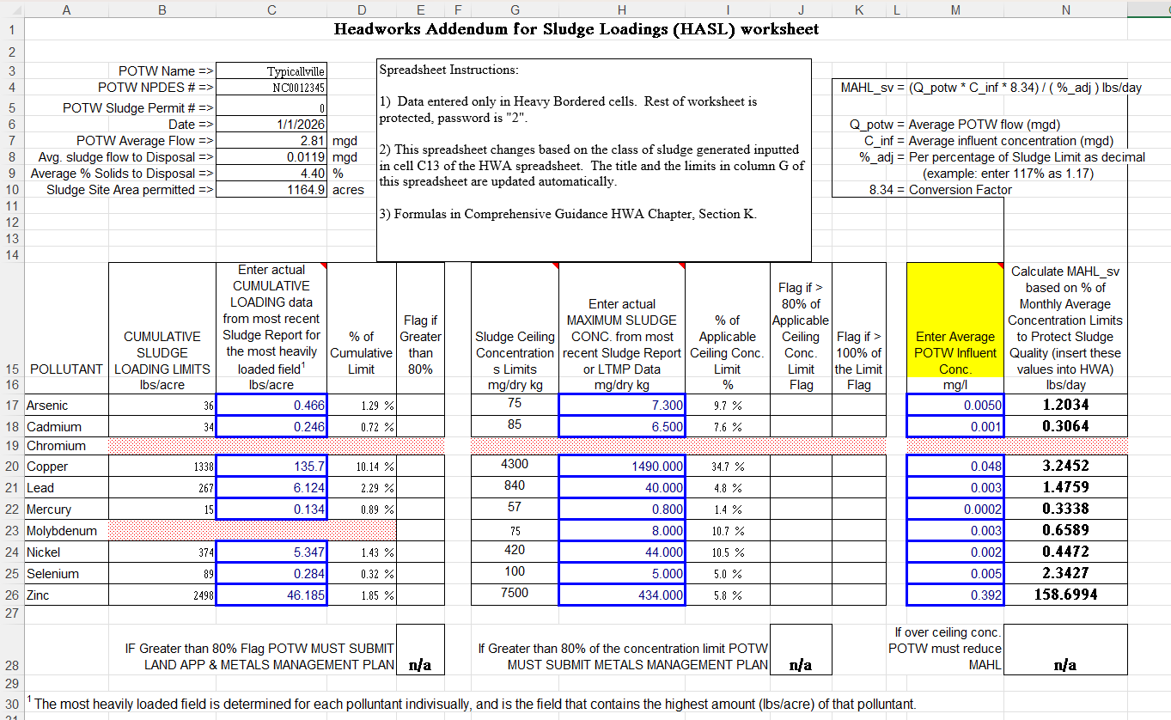

Slide 120
Hasl – step 2
Check POC to assure that sludge does not exceed 90% of the sludge ceiling limit
From current Annual Sludge Report, locate Annual Residual Sampling Summary Forms
Review “mg/kg dry weight” values for HASL POC for each sample.
Identify highest “mg/kg dry weight”
Enter value in “Maximum Sludge Concentration” column of HASL worksheet
Any flags?

Slide 122
Hasl – step 3
A new sludge MAHL is calculated using historical POTW influent and % of ceiling concentration
Locate HWA Removal Rate Calculations
Identify Average Influent value for HASL POC
Enter value in “Average POTW Influent Concentration” column of HASL worksheet
HASL Spreadsheet will calculate HASL sludge AHL

Slide 123
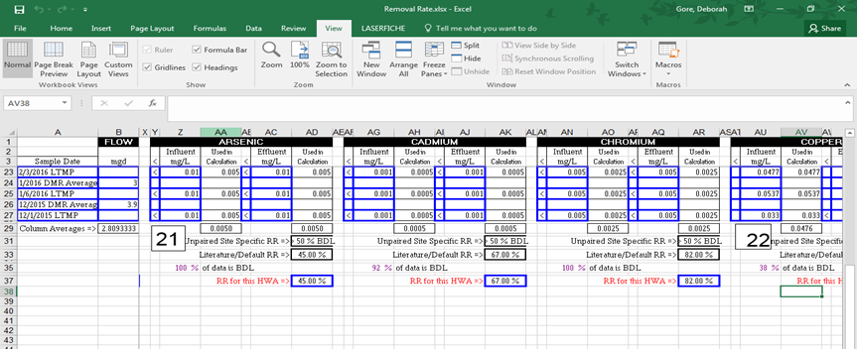
Get the average influent concentrations from the removal rate spreadsheet

Slide 124
Notes:
Cadmium rounds up from 0.0005 to 0.001

Slide 125
Now what?
Does HASL indicate any flags?
  If yes, do metals management plan, or contact pretreatment staff
Are there any sludge violations?
  If yes, cannot use Sludge/HASL, contact pretreatment staff
  If there are no flags or sludge violations, the HASL can be used

Slide 126
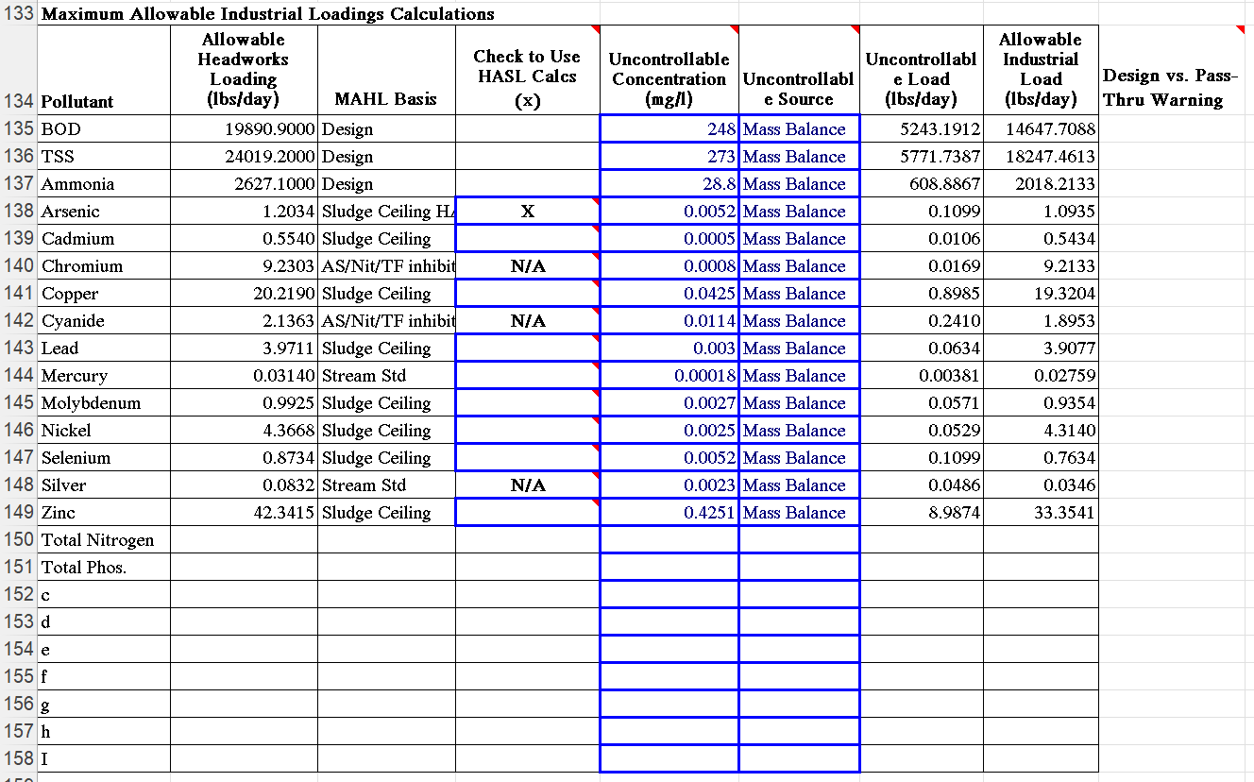
Notes:
Arsenic was the only POC that had an overallocation so a HASL was used for this parameter. The allowable load for arsenic went from 0.6179 to 1.0935

Slide 127
Questions about Allocation table or HASL?

Slide 128
Narrative
Develop a comprehensive narrative that incorporates all relevant information which includes useful details to improve context, understanding and completeness
Be as descriptive as possible
Include general information about your POTW
  Are there problems with certain POCS? Are there sludge loading problems?
Discuss certain problems that SIUs may have
Why did you make certain decisions
  Explain if you needed to do a HASL
  Site specific vs literature inhibition values, uncontrollable values, stream standards, etc.
Why did you choose to include extra information (if any)
Notes:
If you wonder about whether to include it, write it down.

Slide 129
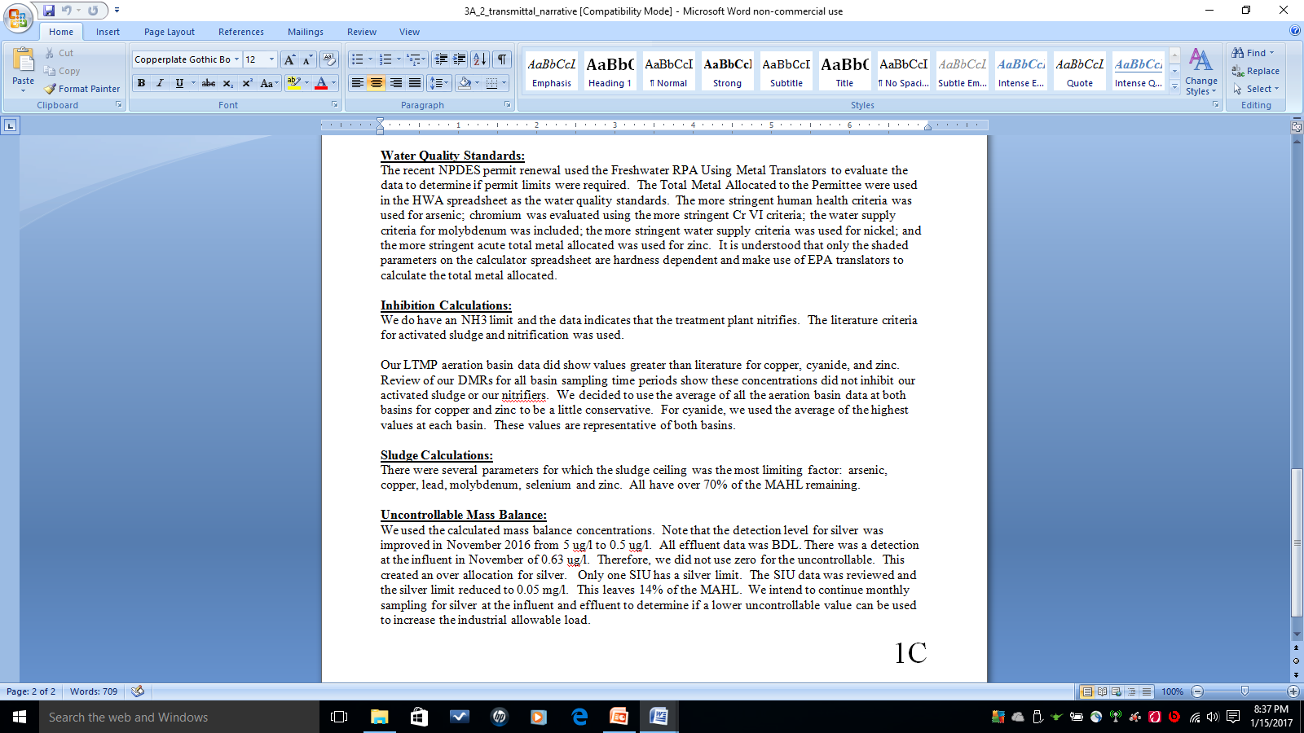
Narrative
Notes:
RPA for metals. No ammonia limit so literature. Elevated levels for some metals but no inhibition.

Slide 130
Documents Needed to Submit HWA
Transmittal Letter
Removal Rates calculation Spreadsheet
HWA.AT.HASL Spreadsheet
Organized Data Summaries
  DMR/LMTP/STMP, Uncontrolled Sampling
  Related LTMP sampling
Mass Balance Spreadsheet
Plant Design Documentation
Copy of applicable pages from Land Application or Composting Permit
Copy of applicable Sludge report
Explanation/Discussion of Choices (Narrative)
Notes:
Preferred division sheets, it makes it easier for us to review these.

Slide 131
NPDES Municipal permitting Unit Pretreatment Staff
Mike Montebello - NPDES Permitting Branch Chief
  michael.montebello@deq.nc.gov
  919-707-3624
Karen Preston – Municipal Unit Supervisor
  Karen.preston@deq.nc.gov
  919-707-3871
Pretreatment Staff
NPDES Municipal Permitting Unit Office - Archdale Building, 9th floor
keyes.mcgee@deq.nc.gov 919-707-3626
natalie.gorensek@deq.nc.gov 919-707-3660
ricky.kuntz@deq.nc.gov 919-707-3636
matthew.nevills@deq.nc.gov 919-707-9019
stephanie.zorio@deq.nc.gov 919-707-9074

