Slide 1
MCM 3: Illicit Discharge Detection and Elimination
March 26, 2019

Slide 2
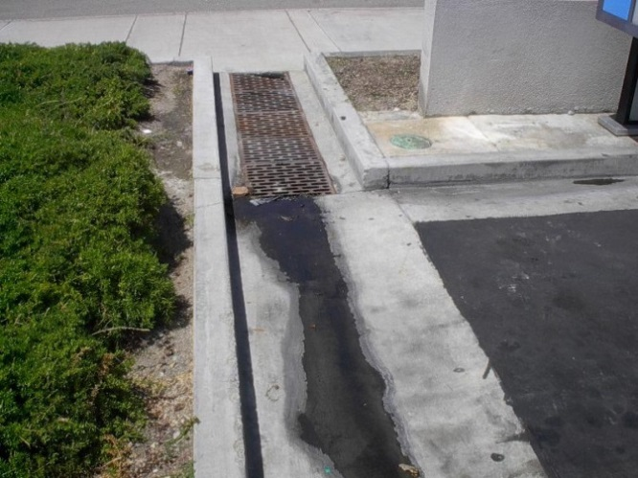
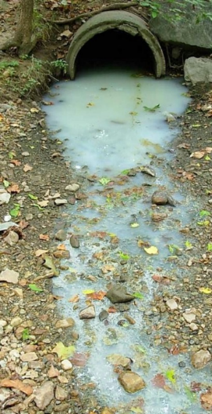
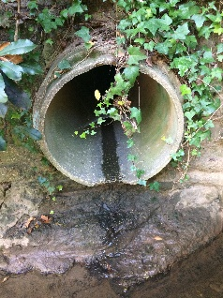
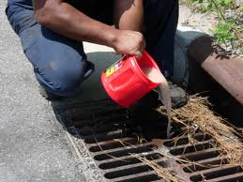
What is an Illicit Discharge?
An illicit discharge is any discharge, dumping or spill into an MS4 that is not composed entirely of stormwater, except for allowable non-stormwater discharges and discharges resulting from firefighting activities.
Department of Environmental Quality
Notes:
82 days

Slide 3
Allowable Non-Stormwater Discharges
Non-Stormwater Discharge | Water Quality Impacts
Water line and fire hydrant flushing | Incidental
Landscape irrigation | Incidental
Diverted stream flows | Incidental
Rising groundwater | Incidental
Uncontaminated groundwater infiltration | Incidental
Uncontaminated pumped groundwater | Incidental
Uncontaminated potable water sources | Incidental
Foundation drains | Incidental
Air conditioning condensate | Incidental
Irrigation waters | Incidental
Springs | Incidental
Water from crawl space pumps | Incidental
Footing drains | Incidental
Lawn watering | Incidental
Residential and charity car washing | Possible
Flows from riparian habitats and wetlands | Incidental
Dechlorinated swimming pool discharges | Incidental
Street wash water | Possible
Flows from firefighting activities | Incidental
Notes:
82 days

Slide 4
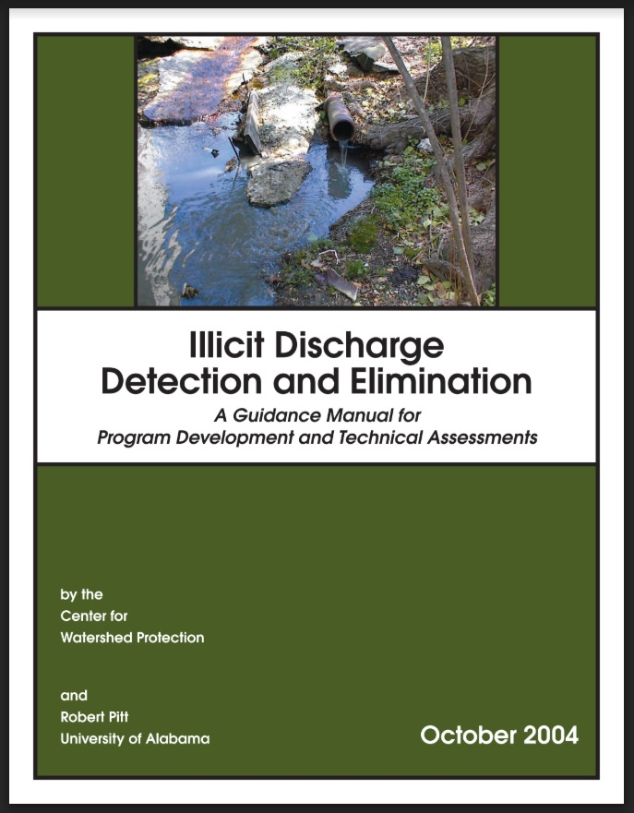
Overview of IDDE Program Components
Required Program Components:
MS4 Map
Ordinance/ Regulatory Mechanism
IDDE Plan
IDDE Tracking
Staff Training
IDDE Reporting
Department of Environmental Quality
Notes:
82 days

Slide 5
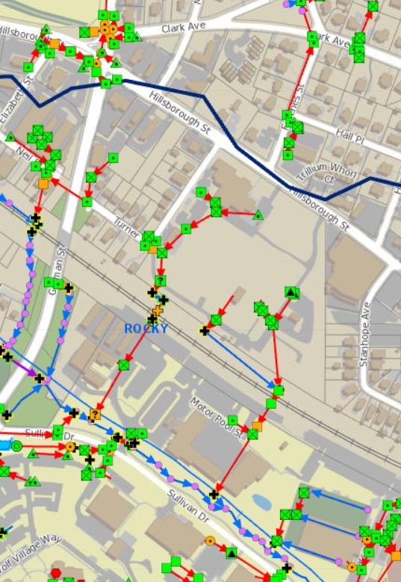
IDDE MS4 Map
MS4 Mapping Requirements:
Stormwater Conveyances
Flow Direction
Major Outfalls
Waters of the U.S.
Department of Environmental Quality
Notes:
82 days

Slide 6
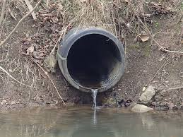
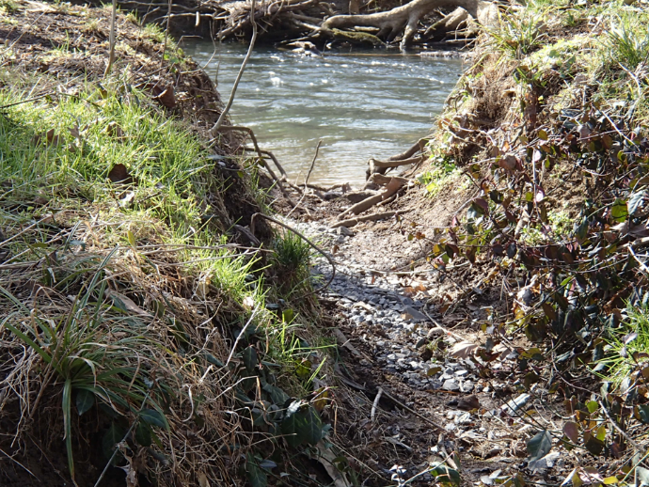
IDDE Program: MS4 Map
Outfall: The point where a MS4 discharges to waters of the U.S.
Major Outfalls:
Zoning | Conveyance Type | Size
Non-Industrial | Circular Pipe | 36-inch Diameter
Non-Industrial | Not a Circular Pipe | Drainage Area > 50 ac
Industrial | Circular Pipe | 12-inch Diameter
Industrial | Not a Circular Pipe | Drainage Area > 2 ac
Department of Environmental Quality
Notes:
82 days

Slide 7

IDDE Ordinance / Regulatory Mechanism
Ordinance/ Regulatory Mechanism Requirement:
An IDDE ordinance or other regulatory mechanism that provides legal authority to prohibit, detect, and eliminate illicit connections and discharges, illegal dumping, and spills into the MS4. The mechanism shall include enforcement procedures and actions.
Department of Environmental Quality
Notes:
82 days

Slide 8

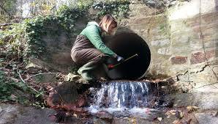
IDDE Plan
IDDE Plan Requirement:
Maintain and implement a written IDDE plan to detect and address illicit discharges, illegal dumping and any non-stormwater discharges identified as significant contributors of pollutants to the MS4.
The plan shall provide standard procedures and documentation to:
Locate priority areas likely to have illicit discharges,
Conduct routine dry weather outfall inspections,
Identify illicit discharges and trace sources,
Eliminate the source(s) of an illicit discharge, and
Evaluate and assess the IDDE Program.
Department of Environmental Quality
Notes:
82 days

Slide 9
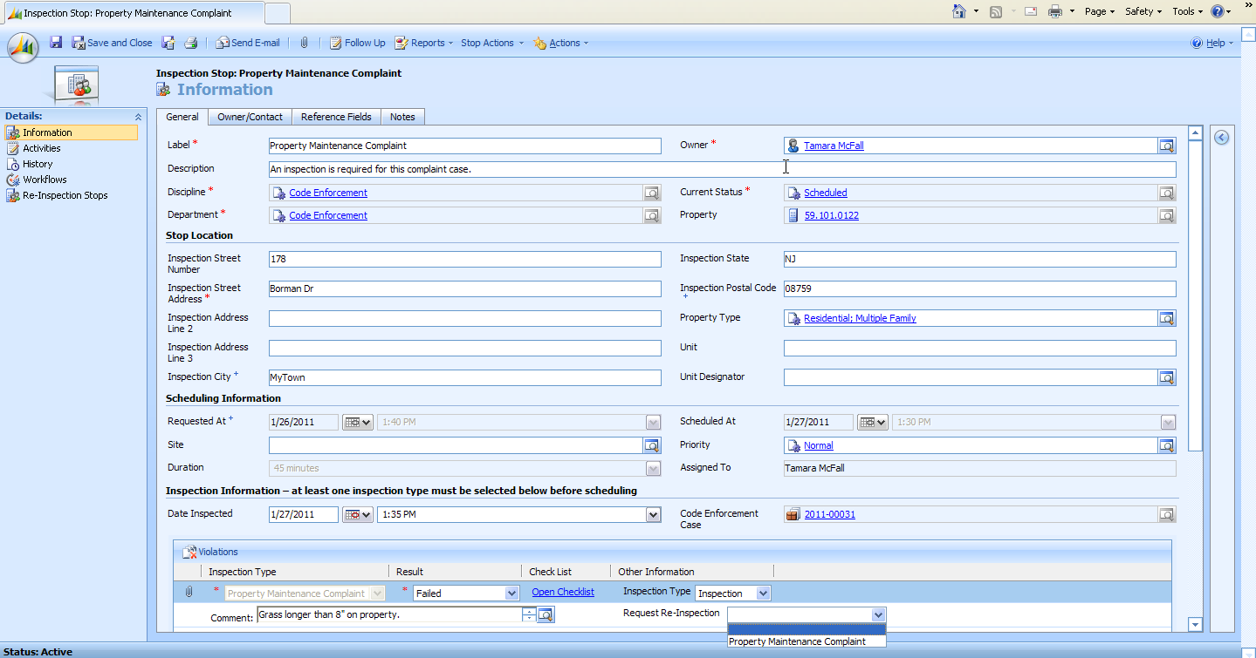
IDDE Tracking
IDDE Tracking Requirement:
A mechanism for tracking and documenting the date(s) an illicit discharge, illicit connection or illegal dumping was observed; the results of the investigation; any follow-up of the investigation; the date the investigation was closed; the issuance of enforcement actions; and the ability to identify chronic violators.
Department of Environmental Quality
Notes:
82 days

Slide 10

Municipal Staff Training
Staff Training Requirement:
Train municipal staff and contractors who, as part of their normal job responsibilities, may observe an illicit discharge, illicit connection, illegal dumping or spills.
Each staff training event shall include:
How to identify and report
Specific documentation (agenda/materials, date, staff, etc.)
Notes:
82 days

Slide 11
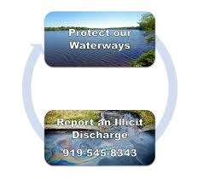

IDDE Reporting Mechanism
IDDE Reporting Requirements:
Provide a mechanism for the public and staff to report illicit discharges, illegal dumping and spills, and:
Publicize it to facilitate effective reporting.
Manage it to provide rapid response by appropriately trained personnel.
Department of Environmental Quality
Notes:
82 days

Slide 12
Jeanette Powell
MS4 Program Coordinator
(919) 707-3620 jeanette.powell@ncdenr.gov

