Slide 1
Industrial Waste Survey (IWS)
Pretreatment Consortium Meeting
April 14, 2005
Revised: April 2026
Deborah Gore
PERCS Unit

Slide 2

Industrial Waste Survey - IWS
Survey all industries connected to the POTW

Slide 3
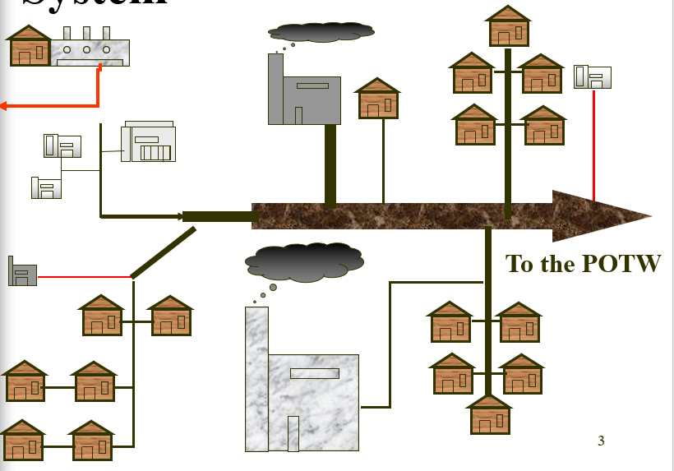
Investigating your Collection System

Slide 4
Why do you want to do an IWS?
Identify potential sources of impact to your WWTP that could cause
  Reduction in plant efficiency
  Damage to WWTP and collection system
  Failure of NPDES limit
  Fish Kill
Reevaluate current permit holders
Communicate with business community

Slide 5
Why do you have to do an IWS?
40 CFR 403.8 (f) (2)
  (i) Identify and locate all possible IUs
  (ii) Identify the character and volume of pollutants
  (iii) Notify IUs of applicable PT stnds
15A NCAC 2H .0905 incorporates 40 CFR 403.8
15A NCAC 2H .0906 requires an IWS for initial program approval
DEQ requires that the IWS is continuously updated and available for review by inspectors
Notes:
#2 – and states that implementation of a pretreatment program includes on-going waste survey activities.
#4 – Old boiler plate: Part III, B, 2

Slide 6
Snapshot vs. Continuous
Snapshot Survey identifies the SIUs that exist at the time of the survey
  Done initially as part of program approval
Thereafter, continuous survey with periodic summaries to the Division
  “Continually” become informed of new users connecting, and make SIU determination then
  Resurvey IUs from previous IWS to evaluate for changes

Slide 7
Snapshot Survey Steps
Compile an initial list of potential IUs (Ch. 3, Sect C)
  NC Manufacturers Register
  Water billing records
  Sewer connection permits
  Local telephone directory
  Business license records
  Chamber of Commerce roster
  Standard listing of industries

Slide 8
Snapshot Survey Steps (cont)
Evaluate initial list
  Identify potential Categorical Users
  Eliminate Users unlikely to have process discharge
  Create a revised initial list
Send short forms to users on revised list
Notes:
#1 Water bills, sewer connection permits, NC Manufacturing Guide, telephone book, business license records, chamber of commerce rosters.
#2, 2 – such as Churches, apartment Complexes, video rentals,

Slide 9
Snapshot Survey Steps
Evaluate short forms
  Identify potential SIUs
  SIC Code (https://www.osha.gov/data/sic-search or https://www.naics.com/search/)
  Business performed
  Water usage
  Compile list to be sent long forms
Follow-up on non-responses.
Notes:
#2 with phone Call or visit; then repeat evaluation step
There’s lots of information in Chapter 3 of the Guidance Manual on evaluating the responses on the forms and you can always call us with questions.

Slide 10
10

Slide 11
Snapshot Survey: Steps
Send long forms to potential SIUs
Evaluate long forms (Ch.3, Sect C)
  Inspect if warranted
  Develop SIU permit if SIU
  Develop local permit if non-SIU control is warranted
Notes:
#2 with phone Call or visit; then repeat evaluation step
There’s lots of information in Chapter 3 of the Guidance Manual on evaluating the responses on the forms and you can always call us with questions.

Slide 12
Summary to the Division
Sources used for developing initial list
Procedure used to create revised list
Number of short forms sent
Chart of users sent short & long forms
  Name of industry
  Type of business
  Type of permit needed or rationale why not permitted
  Indication of inspection
Description of activities for on-going continuous IWS activities for next 5 year cycle

Slide 13
IWS Checklist
Name of Municipality
IWS CHECKLIST
Date
Industry Name
(include all industries sent short forms and all industries in NC Manufacturers Register)
Check if
Not in Service Area or not in business
(X)
Check if No Sewer Service
(X)
Date short form was received
Date of site visit
Date long form was received
Check if Domestic Flow only
(X)
If Non-Domestic Flow Discharge
Approx. process or other non-domestic Flow
(gpd)
Description of Business
Explanation of why SIU permit is or isn’t needed (i.e. Non contact cooling water or metal finishing or non-categorical, <25,000 gpd & <5% MAHL)

Slide 14
Continuous Survey Procedures
Methods to “stay in loop” so can perform continuous survey throughout the interim
  Have a list of new business licenses sent to you on a regular basis
  Have a list of new sewer customers sent to you on a regular basis
  Receive info from Chamber of Commerce
  Participate in municipal committee reviewing new projects in community
Send short/long IWS form and make SIU determination for each new User
Notes:
After an initial snapshot survey has been done the POTW must develop procedures to continually update their list of industrial users

Slide 15
Continuous Survey Procedures (cont.)
Consider need to concentrate on particular types of businesses
  Dentists (mercury & silver)
  Laundries (phosphorus)
  Radiator/Auto repair shops (chrome & copper, oils, coolants, parts washers)
  Restaurants (oil & grease)
  Printers (inks, washing printing machines, dye wastes)
  Cabinet, Furniture & Sign Makers (stains, lacquers, paints, stripping materials)
Notes:
After an initial snapshot survey has been done the POTW must develop procedures to continually update their list of industrial users

Slide 16
Continuous Survey Procedures (cont)
Add new industries that were surveyed in the interim to the chart
Resurvey everyone surveyed in the previous IWS submission at least once every 5 years
Talk about any special survey projects
Continuously update
Notes:
After an initial snapshot survey has been done the POTW must develop procedures to continually update their list of industrial users

Slide 17
Make sure you have:
Identified the sources used to develop the initial list. Use at least two sources.
Described criteria used to eliminate users from list (by type of business)
Discussed how the survey is completed in satellite communities
Summarized the POTWs procedures for becoming aware of new and changed industrial users
Notes:
#1 One being the NC Manufacturing Guide

Slide 18
Make sure you have (cont):
Confirmed that industries that indicated discharge other than domestic are not SIUs.
Confirmed that companies that work with metal are not covered by any metal finishing, die casting, molding or forming regulations (433, 464, 465, 467, 468 or 471).
Notes:
After an initial snapshot survey has been done the POTW must develop procedures to continually update their list of industrial users

