Slide 1
Continuity of Operations Plan (COOP)
Department of Environmental Quality
Marine Fisheries
Training| Michael S. Loeffler| July 2025

Slide 2
Continuity of Operations Plan (COOP)
What is the COOP and why should I Care?
Executive Order 298 Dec 21, 2023 supersedes and replaces Executive Order No. 78.
Business Continuity Plan (BCP): A plan that details how an individual organization will ensure it can continue to perform its Essential Functions during a wide range of emergencies. (FEMA)
Continuity of Operations Plan (COOP) – An effort within individual organizations to ensure they can continue to perform their Essential Functions during a wide range of emergencies, including localized acts of nature, accidents, and technological or attack-related emergencies. (FEMA)
Department of Environmental Quality

Slide 3
Continuity of Operations Plan (COOP)
Purpose:
Outlines priorities and procedures to restore essential DMF operations following events that disrupt normal business functions.
Examples:
  Extreme weather events (hurricanes, floods, etc.)
  Pandemic disease outbreaks
  Specific problems to specific areas (e.g., flooding of a LAN room)
Department of Environmental Quality

Slide 4
Continuity of Operations Plan (COOP)
Scope
Applies to DMF processes and operations by location.
DMF staff located in the Wilmington and Washington Regional Offices (WIRO and WARO, respectively) fall under the regional office COOPs. Once these offices are re-established by the regional office administrator, DMF program critical processes and priorities will restart operations.
Addresses:
  Normal business services
  Services provided during emergency situations
Department of Environmental Quality

Slide 5
Continuity of Operations Plan (COOP)
Objectives:
Ensures continuous performance of DMF essential functions during an emergency.
Ensures safety to DMF employees.
Protects essential equipment, records, and other assets.
Reduces disruption of operations.
Minimizes damage and losses.
Achieves orderly recovery from emergency operations.
Identifies relocation sites and ensures operational and managerial requirements are met before an emergency occurs.
Department of Environmental Quality

Slide 6
Continuity of Operations Plan (COOP)
Training
DMF employees must be aware of the plan and how to implement during an event that disrupts operations.
  This power point
  Staff meeting discussions by team leaders
  Updated personal contact information
The division conducts an annual review and updates when necessary.
The plan is tested through scheduled and unscheduled events:
  Tabletop exercises (scheduled)
  Snow days (unscheduled)
  Power outage (scheduled and unscheduled)
Hard copies* of the COOP will be distributed to be maintained at the office and home locations:
  Director
  Deputy Director
  Section Chiefs
  Other identified staff
*The COOP contains confidential information and is only shared and accessed by authorized individuals.
Department of Environmental Quality

Slide 7
Continuity of Operations Plan (COOP)
Essential Functions (Business Processes)
Statewide Critical - affects large portion of the state´s population or statewide core functions and needs to be restored within one (1) week or serious consequences will threaten the future of the mission.
  Zero (0) functions identified in DMF
Agency Critical - affects department´s core functions and needs to be restored within one (1) week. These processes must be restored or replaced by alternate processes from one week to one month to ensure a minimal level of service to citizens. Can be delayed until support systems (e.g. computer, phone service, and transportation) are restored.
  Eight (8) functions identified in DMF
Program Critical - affects a program´s core functions and needs to be restored within one (1) week to a time not exceeding one (1) month.
  30 functions identified in DMF
Non-Critical - little or no impact on core functions - Can be delayed for longer than one (1) month without serious consequence to the mission. These processes are not included in this COOP
  DMF did not identify any, but if not listed as agency or program critical, would be considered non-critical
Department of Environmental Quality

Slide 8
Continuity of Operations Plan (COOP)
Agency Critical Essential Functions
COOP Development and Activation
Compliance (provide law enforcement communications)
Compliance (monitoring for fisheries regulations and public health regulations by land, water, and air)
Laboratory Operations and Analysis
Health Safety - Recreational Waters, Certified Shellfish/Crustacea Plants, & Harvesting
Public Information Office (Communication)
Technical IT Support (Computers, Software and IT Infrastructure)
Facilities (division-owned)
Department of Environmental Quality

Slide 9
Continuity of Operations Plan (COOP)
Program Critical Essential Functions
Vessel, Vehicle and Heavy Equipment Outfitting & Maintenance | Commercial Fisheries Statistics Programs - Trip Ticket Program | Permit Program
GIS Program | Commercial Fisheries Statistics Program - Quota Monitoring | Construct and Maintain Artificial Reefs
Accounts Receivable and Payable | Commercial Fisheries Statistics – Logbooks | Socio-Economic Program
Budget Planning and Analysis | Recreational Fisheries Statistics - North Carolina Coastal Angling Program | Support to the Marine Fisheries Commission
Purchasing Services | Recreational Fisheries Statistics - Tagging Program | Federal Aid
Warehouse Operations | Recreational Fisheries Statistics - Creel Surveys | Fishery Management Plans
Human Resources | Commercial License Program | Fishery Stock Assessments
Fishery Biological Data Collection | Coastal Habitat Protection Plan | Public Trust/Submerged Lands Program
Biological Database Management | Recreational License Program | Capital and Repair/Renovation Coordination
Shellfish Lease Program | Systems Development and Coordination | Mapping Shellfish Habitat
Department of Environmental Quality

Slide 10
Continuity of Operations Plan (COOP)
Essential Functions (Business Processes)
  Each function has an assigned business owner – a section chief
Succession of Order
  Necessary in case the primary, key contacts are unavailable or unable to execute their duties.
  Division Level (in order):
    Director (Environmental Division Director)
    Deputy Director (Environmental Program Manager I)
    Marine Patrol Chief (MF Law Enforcement Director)
    Administrative and Maintenance Section Chief (Business Officer II)
    Shellfish Sanitation & Recreational Water Quality Section Chief (Environmental Program Supervisor II)
After the first notification by the Director/Deputy Director, additional contacts are identified through a call tree following the chain of command to the following (each section is to maintain a call tree so that all employees are notified).
  Section Chief (Essential Functions Leader and Team Leader)
  Section Chief notifies next in line
  Supervisors notify employees
Note: Supervisors and employees are to keep each other informed of their status

Slide 11
Continuity of Operations Plan (COOP)
Location | First | Second | Third | Fourth
All Locations | Director/Deputy Director | Marine Patrol Colonel | Administrative and Maintenance Section Chief | Shellfish Sanitation Recreational Water Quality Section Chief
Morehead City – Headquarters | Director/Deputy Director | Marine Patrol Colonel | Administrative and Maintenance Section Chief | Shellfish Sanitation Recreational Water Quality Section Chief
Morehead City – Central District Office | Shellfish Sanitation & Recreational Water Quality Section Chief | Fisheries Management Southern District Manager | Marine Patrol Captain | Fisheries Management Environmental Program Supervisor I
Elizabeth City | Fisheries Management Northern District Manager | Fisheries Management Environmental Program Supervisor I | Senior* Conservation Biologist II | Senior* DMF Employee
Manteo | Marine Patrol Captain | Fisheries Management Environmental Program Supervisor I | Senior* Conservation Biologist II | Senior * DMF Employee
South River | Marine Mechanic Supervisor I | Senior Research Vessel Captain | Senior* DMF Employee
WIRO/WARO | Regional Office Manager | Environmental Program Supervisor I | Marine Patrol Captain (WIRO), Senior* Conservation Biologist II (WARO) | Senior* Conservation Biologist II (WIRO), Senior* DMF Employee (WARO)
Succession of Order by Location
Department of Environmental Quality
*Senior = length of state service

Slide 12
Continuity of Operations Plan (COOP)
Essential Functions (Business Processes) Teams
Responsible for leading, maintaining, response, and recovery
Team | Team Leader
DMF Administration and Management Team | Director and Deputy Director
DMF Administrative and Maintenance Services Team | Administrative and Maintenance Services Section Chief
DMF COOP Team | Director and Deputy Director
DMF DIT Information Technology Team | DIT DMF Section Chief
DMF Fisheries Management Team | Fisheries Management Section Chief
DMF Habitat and Enhancement Team | Habitat and Enhancement Section Chief
DMF Law Enforcement Team | Marine Patrol Colonel (Section Chief)
DMF License and Statistics Team | License and Statistics Section Chief
DMF Public Information Team | Public Information Officer
DMF Shellfish Sanitation & Recreational Water Quality Team | Shellfish Sanitation & Recreational Water Quality Team Section Chief
Department of Environmental Quality

Slide 13
Continuity of Operations Plan (COOP)
Reconstitution
Once transfer of essential functions (business processes) has occurred, DMF will provide a status report for the following:
  DMF staff
  Employee displacement reports
  Emergency response
  Damage assessment and security of facilities
  IT systems
  Vital records assessment
  Priority recovery efforts
  Situation reports
Department of Environmental Quality

Slide 14
Continuity of Operations Plan (COOP)
Alternate or Reduced Facility Operations
If one or more offices become inaccessible, essential business functions and operations will be transferred or replicated.
The Director, Deputy Director, and Essential Function's Team Leader will coordinate to transfer processes.
Morehead City Headquarters | Morehead City – Central District Office | Elizabeth City | Manteo | South River
1. Employee homes (teleworking) | 1. Employee homes (teleworking) | 1. Employee homes (teleworking) | 1. Employee homes (teleworking) | 1. Employee homes (teleworking)
2. DMF Central District Office | 2. DMF Headquarters | 2. Manteo | 2. Elizabeth City | 2. DMF Headquarters
3. DEQ Regional Office (WARO or WIRO) | 3. DEQ Regional Office (WARO or WIRO) | 3. DEQ Regional Office (WARO) |  | 3. DMF Central District Office
4. DEQ Headquarters | 4. DEQ Headquarters
Note: DMF staff located in the WIRO and WARO fall under the regional office COOPs’ alternative worksites. Most likely first alternative worksite will be employee homes.
Department of Environmental Quality

Slide 15
Continuity of Operations Plan (COOP)
Summary
Essential functions leaders and team leaders need to understand their role in implementing the plan.
Circumstances (disasters) can place any employee in charge of operations (succession of order).
Use opportunities such as snow days, power outages, etc. to test call trees and the plan.
Department of Environmental Quality

Slide 16
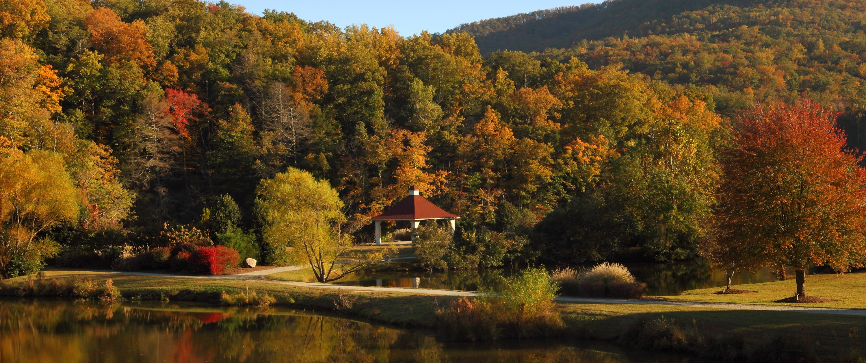
Department of Environmental Quality

