Slide 1
Compliance Judgment, SNC, and PARs
What Do I Do?
PAR Workshop 2024
January 29th, 2025
Presented by:
Division of Water Resources
NPDES Municipal Permitting Unit - Pretreatment
Notes:
If questions are not specific to presentation please save until the end and we also will have a question specific session February 12. If you only want to ask questions you can feel free to drop off the call for about an hour and then join back on

Slide 2
Compliance Judgment, SNC, and PAR Workshop
Introduction to the Basics of Judging Compliance,
Dealing with SNC, and Compiling Annual Reports
Learn about and refresh yourself on:
How to Judge SIU Compliance
When are Industries Really Bad
What needs to be in the PAR
How to Fill Out All Those Forms
Who, What, and Where to Publish
What DWR Wants to See in a Narrative

Slide 3
Compliance Judgment, SNC, and PAR Workshop
Introduction to the Basics of Judging Compliance,
Dealing with SNC, and Compiling Annual Reports
Today’s Outline
1. Introduction-NPDES Requirement
2. Compliance Judgment
  SNC Definition
  SNC for Reporting/Permit Conditions
  SNC for Limits Violations
  Data Summary Form
  Compliance Judgment Examples

Slide 4
Compliance Judgment, SNC, and PAR Workshop
Introduction to the Basics of Judging Compliance,
Dealing with SNC, and Compiling Annual Reports
Today’s Outline (cont.)
3. IDSF
4. SNCR Form
5. PPS Form
6. Narrative
7. Waste Reduction
8. Public Notice
9. Enforceable Compliance Schedules (Orders)
10. Allocation Table

Slide 5
Introduction -NPDES Requirements
These reports shall be submitted by March 1 of each year per your NPDES Permit:
Submit in PDF format
Via email
To the Central Office
Paper copy must be kept at the POTW and be available for review during an inspection
NCDEQ is currently working towards full electronic submittal to be in compliance with the EPA. This is a work in progress and the regulated community will be updated once further steps have been taken.

Slide 6
Introduction -NPDES Requirements (cont.)
These reports shall be submitted by March 1 of each year and shall contain the following:
a.) Narrative
A narrative summary detailing actions taken, or proposed, by the Permittee to correct significant non-compliance and to ensure compliance with pretreatment requirements;
b.) Pretreatment Program Summary (PPS)
A pretreatment program summary (PPS) on forms or in a format provided by the Division;
c.) Significant Non-Compliance Report (SNCR)
A list of Industrial Users (IUs) in significant noncompliance (SNC) with pretreatment requirements, and the nature of the violations on forms or in a format provided by the Division. Note, for the 2024 PAR no SNC historical data will be provided by DWR;
Notes:
New system is up and running and for next year hoping to be able to supply historical SNC data

Slide 7
Introduction -NPDES Requirements (cont.)
d.) Industrial Data Summary Forms (IDSF)
Monitoring data from samples collected by both the POTW and the Significant Industrial Users (SIUs). These analytical results must be reported on Industrial Data Summary Forms (IDSF) or on other forms or in a format provided by the Division;
e.) Other Information
Copies of the POTW's allocation table, new or modified enforcement compliance schedules, public notice of IUs in SNC, a summary of data or other information related to significant noncompliance determinations for IUs that are not considered SIUs, and any other information, upon request, which in the opinion of the Director is needed to determine compliance with the pretreatment implementation requirements of this permit;

Slide 8
Introduction – NC Pretreatment Rules
[North Carolina Administrative Code (NCAC)]

Slide 9
Introduction – NC Pretreatment Rules
from 15A NCAC 2H .0908(b)
Control Authorities with active approved pretreatment programs shall submit once per year a pretreatment report describing its pretreatment activities over the previous 12 months. Two copies of each pretreatment report shall be submitted to the Division by March 1 of each year for activities conducted for two six-month periods, January 1 through June 30 and July 1 through December 31 of the previous year. This annual report shall contain the following information in accordance with forms specified by the Division:
(1) a narrative summary of actions taken by the control authority to ensure compliance with pretreatment requirements;
(2) a pretreatment program summary on forms or in a format provided by the Division;
Notes:
§ 143 Article 21. Water and Air Resources Part 1. Organization and Powers Generally; Control of Pollution. § 143-215.1. Control of sources of water pollution; permits required.

Slide 10
Introduction - NC Pretreatment Rules (cont.)
from 15A NCAC 2H .0908(b) (cont.)
(3) A list of industrial users in significant noncompliance with pretreatment requirements, the nature of the violations, and actions taken or proposed to correct the violations; on forms or in a format provided by the Division;
(4) An allocation table as described in Rule .0916(c)(4) listing permit information for all significant industrial users, including but not limited to permit limits, permit effective and expiration dates, and a comparison of total permitted flows and loads with Division approved maximum allowable loadings of the POTW, including flow, on forms or in a format provided by the Division;

Slide 11
Introduction - NC Pretreatment Rules (cont.)
from 15A NCAC 2H .0908(b) (cont.)
(5) Other information which in the opinion of the Division Director is needed to determine compliance with the implementation of the pretreatment program, including, but not limited to, significant industrial user compliance schedules, public notice of industrial users in significant noncompliance, a summary of significant industrial user effluent monitoring data as described in Paragraphs (a) and (e) of this Rule, a summary of information related to significant non-compliance determination for industrial users that are not considered significant industrial users, and Long or Short Term Monitoring Plan data on forms or in a format provided by the Division;

Slide 12
Introduction - NC Pretreatment Rules (cont.)
40 CFR 403.12(i) Annual POTW reports
Updated list of SIUs (AT)
Compliance status (SNCR)
Summary of enforcement activities (PPS & narrative)
Summary of program changes (narrative & program info sheet)
Any other relevant information

Slide 13
Compliance Judgment

Slide 14
Compliance Judgment
Detection of Violations of ALL Types:
1. Limits
2. Reporting
3. Permit Conditions
References:
  DWR Approved Enforcement Response Plan (ERP) for Your POTW
  Comprehensive Guide, Chapter 7, Compliance & Inspection, Sections D and E
  Comprehensive Guide, Chapter 8, Enforcement
  Pretreatment’s Annual Report web-site files “So your SIU has a limits violation-What do you do?” and “So your SIU has a reporting violation-What do you do?”
Notes:
Chapter 7, Section D - Compliance Judgement Discussion, Section E – Compliance Judgement Special Case Discussion

Slide 15
Compliance Judgment – What must be done
POTW must identify all violations in a timely fashion as outlined in your ERP (preferably monthly).
POTW must issue a Notice of Violation (NOV) for all violations.
Significant Noncompliance (SNC) is the way to separate out the more significant violations for escalated enforcement action.

Slide 16
Compliance Judgment - What must be done (cont.)
POTW must do an SNC determination at a minimum of every six months.
  It is strongly recommended that a preliminary SNC determination be done halfway through the six-month period, especially where there was SNC in the previous period.
The SNC determination must be within 30 days of receiving all the data for that period.
SNC determination and follow-up enforcement action for the January through June reporting period should be completed no later than September 1st of that same year.
SNC Determination and follow-up enforcement action for the July through December reporting period should be completed no later than March 1st of the following year.

Slide 17
Compliance Judgment - What must be done (cont.)
Repeat SNCs
  Repeat SNCs are a serious matter.
  If an Industry will be in SNC for a second consecutive period for the same parameter or requirement, the Division and EPA expect the POTW to take “appropriate action.”
  The typical choices for “appropriate action” are:
    modify permit
    place SIU on an enforceable compliance schedule (compliance schedule with stipulated penalties)
    SIU ceases discharge (on their own or by order of POTW)
    SIU dropped from POTW’s list of SIUs

Slide 18
Compliance Judgment - What must be done (cont.)
Repeat SNCs (cont.)
  The POTW should make every effort to take the “appropriate action” before the end of the second consecutive SNC Period.
  In those special cases where this is not possible, take the “appropriate action” within two months after the end of that second period. If this is not done, the Division may take enforcement action against the POTW for failure to take adequate enforcement.
  Call DWR to discuss extenuating circumstances

Slide 19
SNC Definition

Slide 20
SNC Definition
Significant Noncompliance is defined by 15A NCAC 2H .0903(b)(31) and Section 1.2(a)(35) of the NC Model Sewer Use Ordinance (SUO) as follows:
    “Significant Noncompliance” or “SNC” is the status of noncompliance of a significant industrial user when one or more of the following criteria are met:….

Slide 21
SNC Definition (cont.)
(A) “Chronic violations” of wastewater discharge limits, defined here as those in which sixty-six percent or more of all the measurements taken for the same pollutant parameter (not including flow) during a six-month period exceed (by any magnitude) a numeric pretreatment standard or requirement including instantaneous limits, as defined by 40 CFR Part 403.3(l);
Chronic SNC is when 66% or more are > limit!

Slide 22
SNC Definition (cont.)
(B) “Technical Review Criteria” (TRC) violations, defined here as those in which thirty-three percent or more of the measurements taken for the same pollutant parameter (not including flow) during a six-month period equal or exceed the product of the numeric pretreatment standard or requirement, including instantaneous limits, as defined by 40 CFR 403.3(l) multiplied by the applicable TRC; (TRC = 1.4 for BOD, TSS, fats, oil and grease, 1.2 for all other pollutants (except flow and pH));
TRC SNC is when 33% or more are > or = TRC value!

Slide 23
SNC Definition (continued)
(C) Any other violation of a pretreatment standard or requirement as defined by 40 CFR 403.3(l) (daily maximum, long-term average, instantaneous limit, or narrative standard) that the control authority (or POTW, if different from the control authority) determines has caused, alone or in combination with other discharges, interference or pass through (including endangering the health of POTW personnel or the general public);
(D) Any discharge of a pollutant or wastewater that has caused imminent endangerment to human health, welfare or to the environment or has resulted in either the control authority’s or the POTW’s, if different than the control authority, exercise of its emergency authority under 40 CFR Part 403.8(f)(1)(vi)(B) to halt or prevent such a discharge;

Slide 24
SNC Definition (continued)
(E) Failure to meet, within 90 days after the schedule date, a compliance schedule milestone contained in a pretreatment permit or enforcement order for starting construction, completing construction, or attaining final compliance;
(F) Failure to provide, within 45 days after the due date, required reports such as baseline monitoring reports, 90-day compliance reports, self-monitoring reports, and reports on compliance with compliance schedules;
(G) Failure to accurately report noncompliance;
(H) Any other violation or group of violations that the control authority or POTW determines will adversely affect the operation or implementation of the local pretreatment program.

Slide 25
Compliance Judgment for Reporting
(includes permit condition)
Applies to any kind of report or notification:
Failure to collect self-monitoring samples
Failure to submit reports or follow permit conditions. Includes reports being late or incomplete as well as a complete failure to submit a report or follow IUP condition at all. Types of reports include but are not limited to:
sample results
flow monitoring reports
24-hour notification
resample and submit results within 30 days
properly operate pretreatment units
change in process
obtain authorization to Construct
file application for IUP renewal
sludge management plans
slug/spill plans
TTO certification
TOMP compliance assessment

Slide 26
SNC For Reporting/Permit Conditions (cont.)
POTW Prerogative:
H) Any other violation or group of violations that the control authority or POTW determines will adversely affect the operation or implementation of the local pretreatment program.

Slide 27
SNC For Reporting/Permit Conditions (cont.)
To be completed on a Six-Month Basis, but really applies to each report
  Examples:
  1) An Industry is required by their IUP to sample monthly for 10 parameters and report the results to the POTW by the 20th day of the month following the month in which the samples were collected. The results of the samples collected in July, due August 20, are not received until October 23.

Slide 28
SNC For Reporting/Permit Conditions (cont.)
  2) Industry fails to collect the required samples in November at all.
  3) An Industry is required by their IUP to re-apply by February 1 (180 days before the IUP expires on August 1) and the application is not received until May 15.
Call Pretreatment Staff to discuss any extenuating circumstances
See PAR Guidance for discussion and some examples of extenuating circumstances

Slide 29
SNC for Limits Violations
For any typical violations, the POTW must make a determination based on the following categories that may elevate a violation to SNC:
SNC for Limits Categories
  a) Pass-through/Interference
  b) Threat to Human Health, Welfare or the Environment
  c) Emergency Suspension from such a Discharge
  *The POTW must provide evidence to justify making this
  determination.

Slide 30
SNC for Limits Violations
SNC for Limits Categories (cont.)
  d) Chronic Violations (those that exceed limit by any quantity)
    66% or more of all measurements during the 6-month period.
  e) Technical Review Criteria (TRC) Violations
  (those that equal or exceed a TRC adjusted limit by any quantity)
    Limit * 1.4 for BOD, TSS, fats, oils, and grease
    Limit * 1.2 for all other parameters, except pH
    33% or more of all measurements during the 6-month period.

Slide 31
SNC for Limits Violations
SNC for Limits Categories (cont.)
  H) Any other violation or group of violations that the control authority or POTW determines will adversely affect the operation or implementation of the local pretreatment program.

Slide 32
SNC for Limits Violations (continued)
Completed on a Six Month Basis
  Calculated For Each Limit
    For Example:
  An Industry has both a daily maximum concentration limit as well as a monthly average concentration limit for BOD. At the end of the six-month period, when calculating SNC for the parameter of BOD, you judge SNC for BOD separately for the daily max and the monthly average limits.

Slide 33
SNC for Limits Violations (continued)
Forms Used For SNC
  Industrial Data Summary Forms (IDSF) or other forms or in a format provided by the Division;
  Compliance Judgment Worksheet (Ch. 7, North Carolina Comprehensive Guidance for Pretreatment Programs)
Other
  SNC for pH (no TRC required)
  SNC for Flow (flow is not a “pollutant”)
Call Pretreatment Staff to discuss extenuating circumstances
See PAR Guidance for discussion of SNC for pH, flow, and some examples of extenuating circumstances.

Slide 34
Data Summary Form

Slide 35
Data Summary Form

Slide 36
Data Summary Form

Slide 37
Data Summary Form

Slide 38
Data Summary Form

Slide 39
Data Summary Form

Slide 40
Examples

Slide 41
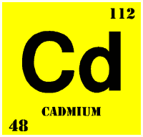
Example 1
WillPlateit Metal Finishers
1st 6-month period
Cadmium

Slide 43
Count- The number of daily or the number of average sample values used for checking compliance.
(Daily values for this example)

Slide 47
8/12
66.7%
16.7%
2/12
Per ORC

Slide 48
Example 2
WillPlateit Metal Finishers
2nd 6-month period
Cadmium

Slide 53
60.0%
6/10
4/10
40.0%
Per ORC
Now What?

Slide 54
Separate Judgment
Please note:
Compliance for daily max & monthly (or other) average limits are judged independently and equally weighted.
More compliance violations are a potential for more SNC determinations.

Slide 55
Setting Pollutant Limits Options
Different limit configurations may have an effect on SNC determinations
Keep same daily max and monthly average limits
  No change to allocation table
  Must perform SNC calculations treating daily & monthly limits separately
    Some POTWs may have to revise compliance judgment software programs
  May cause more SIU violations and SNC
Remove monthly avg. Daily max = old monthly avg
  No change to allocation table
  Simplifies compliance judgment
  May cause more SIU violations and SNC
  Note: Options 2 & 3 may not be available for some categorical SIUs.
  Contact Pretreatment Staff to discuss.

Slide 56
Setting Pollutant Limits Options
    Remove monthly average limit and keep daily max limit
      a. Have to use the higher daily max limit in allocation table.
          May reduce reserve; may cause over-allocation!
      b. Simplifies compliance judgment
      c. Should not create more violations
4. Keep different daily max and monthly average limits
  The allocation table will use monthly averages
  Too conservative limits can cause SNC problems
  Must perform SNC calculations treating daily & monthly limits separately
    Some POTWs may have to revise compliance judgment software programs
      Note: Options 2 & 3 may not be available for some categorical SIUs. Contact Pretreatment Staff to discuss.

Slide 57
Data Summary Form as Limits Compliance Judgment Worksheet
Limit = 0.07 mg/l
TRC = 0.084
10 daily samples
6 Viol = 6/10 =60%
4 TRC = 4/10 = 40%

Slide 58
Industrial Data Summary Form (IDSF)

Slide 59
Industrial Data Summary Form (IDSF)
Summarizes All Data Collected for an Industry:
  1) SIU and POTW Sampling for Limited Parameters
  2) SIU and POTW Sampling for “Monitoring Only” Parameters
Required to Complete a Separate IDSF for Each Pipe for Each SIU
    Third party software developers have created solutions for data collection.
You May Use Your Own Form with Prior Division Approval of the Form

Slide 60
Industrial Data Summary Form (IDSF)
For Each Parameter, Include at Least One of the Following:
  1) Maximum Concentration
  2) Maximum Loading
  3) Average Concentration
      Specifying what type of average
      If BDL - was ½BDL, or 0 used
  4) Average Loading
If readily available, the Division prefers both maximum and average values

Slide 61
Industrial Data Summary Form (IDSF)
Blank sections indicate that there was no monitoring performed for a particular parameter during a six-month period.
For “monitoring only” parameters - list “N/A” for not applicable in the % violations and % TRC violations rows (do not list “0”)

Slide 62
IDSF for SIUs with both daily and average limits
N/A because no IUP Limit for these Parameters

Slide 63
Why was this data not required? Discuss in narrative.

Slide 64
Notes:
Note any comments in the narrative, for example, a surrogate parameter.

Slide 65
Significant Non-Compliance Report (SNCR)

Slide 66
Significant Non-Compliance Report (SNCR)
List all IUs in SNC with any IUP requirement for the PAR Year
  1) Limits Violations
  2) Pass-Through and Interference
  3) SNC for Reporting and/or IUP Conditions
POTW must still take that appropriate enforcement or other action for SIUs that will be in SNC for a second consecutive six-month period
Remember, repeat SNCs are a serious matter.

Slide 67
Notes:
*if none that were in SNC put none don’t leave it blank* The expectation here is that a schedule of compliance is created to resolve SNC issues.

Slide 68
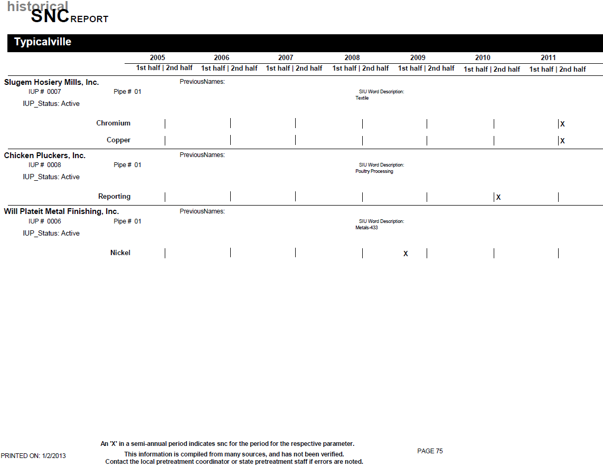
Note, the Division did not provide an SNC Report for the 2024 PAR
Notes:
Our new system is up and running and hopefully we will have it ready for next year!

Slide 69
Pretreatment Performance Summary (PPS)
Form adapted to gather information for the EPA database
Counts # of:
  SIUs and CIUs
  NOVs and similar actions
  SIUs in SNC
  Public Notices
  Enforcement Cases
  Penalties Assessed and Collected
  Compliance Schedules
Notes:
Logic does not have a place in this portion of Pretreatment information. Only actions in 2024.

Slide 70
Pretreatment Performance Summary (PPS)-Explanations
Line # 5. Number of SIUs permitted and/or discharging during the PAR year. Discuss new or dropped SIUs in narrative.
Line # 12. An SIU is in SNC if they fail to meet a compliance schedule milestone within 90 days of the scheduled date for starting construction, completing construction or attaining final compliance; if progress reports required by the compliance schedule are over 45 days late; or there are violations of any interim limits meeting the chronic or TRC definition of SNC.
Line # 15. This is the total number of industries on a compliance schedule as part of an enforcement action during the reporting period. If the compliance schedule was entered into in July 2023, it would be counted on the PPS form in 2023 and 2024 and subsequent PARs years until the schedule is completed or expires. These schedules are issued outside of, or separate from, the IUP. If an industry is on a compliance schedule that is part of an IUP, this is not included in the PAR. This type of compliance schedule is not considered an enforcement action that includes stipulated penalties, and it should therefore not be included.
Lines # 16,17,18,19, 20. are based on number of events during PAR year, and do not include events occurring after PAR year.
Line # 19. Total amount of Civil Penalties collected: This is the actual amount in fines that was collected from the industries during this twelve-month period. This can include COLLECTION of penalties assessed during prior reporting periods.
Line # 20. Number of SIUs from which penalties collected. This is the total number of industries that actually paid penalties during the year.

Slide 71
Line # 5. Number of SIUs actually permitted and/or discharging during PAR year. Discuss new or dropped SIUs in narrative.

Slide 72
Will Plateit
Will Plateit

Slide 73
Will Plateit

Slide 74
Since schedule not in effect until the next year!

Slide 75
Lines # 16, 17, 18 are based on number of events during PAR year, and do not include events occurring after PAR year.

Slide 76
Line # 19 is the actual amount in fines that was collected from the industries during this twelve month period. This can include collection of penalties assessed during prior reporting periods.

Slide 77
Line # 20 is the total number of industries that actually paid penalties during the year.

Slide 78
Narrative

Slide 79
Narrative
Recommended Outline for Narrative
Guidance is provided to:
  Help you organize your PAR Narratives.
  Help you determine what information is required or optional.
  Help you understand how information is checked
  Make it easier for us to find specific and useful information in the narratives.
Some information is optional. It has been noted or italicized in both the guidance text and in the examples.
This Guidance is available by e-mail, and on our web page.
  http://deq.nc.gov/about/divisions/water-resources/water-resources-permit-guidance/pretreatment-guide/annual-report-guidance
Notes:
Mention that updates to the website are being made now.

Slide 80
Outline of a Typical Narrative:
1. General Information:
A. General Program Information.
B. General Permit Information.
2. IU Information:
A. IUs in SNC Information.
B. Orders and Schedule Information (Please get this to us, we do need them).
C. A to C and Construction Information.
D. SIUs with Missing Data.
Optional:
E. Enforcement Actions by POTW, and Industry Responses, for Non-SNC, Non-Order, Non- construction events
F. Other Information
Notes:
Keep like stuff together. We don’t want all of your email correspondence with your industries.

Slide 81
Outline of a Typical Narrative (cont.):
If you have no IUs in SNC, on Orders, or having pretreatment construction activities, or missing data, your PAR Narrative may be as simple as the Division's two database items, with any corrections noted.
  Program Information Sheet
  Historical SNC database sheet(s) (not supplied for 2024 PAR)
  Still need all other required PAR forms for your type of Program – Full versus Modified Programs!

Slide 82
Description of Narrative details:
General Information:
A. General Program Information:
1. Pretreatment Program Info. Sheet
(provided to you by the Pretreatment Staff with the end-of-year emailing)
  Status of Major Pretreatment Program Elements - LTMP/STMP, HWA, ERP, SUO, IWS - Are the dates and information correct, especially due dates?
  Include any needed corrections marked on the Info Sheet returned with the PAR
  Note, copies of the Program Info. Sheet are available upon request from the Pretreatment Staff.
2. Discuss Planned updates of major local program elements
in narrative.

Slide 83
Description of Narrative details:
General Information:
B. Permit(s) General Information:
1. Did you have any permits expire before being
renewed? LIST THEM, & WHY.
    Did you have any SIU Permits that were Brand New, Dropped, or Changed Names during the Year? Please list them.
    This is a good time to confirm that all issued IUPs have been received and reviewed by the Central Office.

Slide 84
Description of Narrative details:
General Information:
B. Permit(s) General Information (cont.):
Optional
  Dates for these permit actions may be listed here as useful reference.
  We realize that some or all of these dates will have already been submitted to the Division with permit renewals, modifications, and drops.
  If you have permits that have been submitted to the Division and you have not received review letter back from the Division, you may note that here.
  For new permits, when did the permit become effective and when did the SIU actually begin discharge? Note, if a lag between these dates results in "missing" data, it must be explained (see "Missing" Data section below).

Slide 85
Description of Narrative details:
IU INFORMATION:
Please LIST alphabetically by IU name:
A. IUs in SNC Information:
1. All IUs in SNC MUST be included in the Narrative and listed on the SNCR Form!
2. Note the reason(s) and which six-month period(s) they were in SNC.
3. If SNC for limits, note if was due to chronic, TRC, or both. Information should match what is on your IDSF and SNCR Forms.
4. If SNC for something other than limits, such as: reporting, missing data/self monitoring, interference, pass-through, permit conditions, etc. please explain.

Slide 86
Description of Narrative details:
IU INFORMATION:
A. IUs in SNC Information: (cont.)
5. Enclose a copy of the Public Notice for SNC, or affidavit. If Public Notice is not in the PAR explain why not. PAR will not be considered complete until Public Notice is received.
6. Explain how a SNC situation was or will be resolved; such as: increased limit, shut down, installed or improved pretreatment, better operations, production changes, etc.
7. Explain how previous SNC situations were resolved if resolution occurred in this PAR year.
Notes:
If the affidavit is not in on time to submit the PAR, it can be sent in later on a separate document as soon as possible.

Slide 87
Description of Narrative details:
IU INFORMATION: (cont.)
B. Orders or Schedule Information: For SIUs on an Order of any kind (including Administrative Orders, Consent Orders, Compliance Schedules) at any time during the PAR year, include the following information:
1. A copy of the Order/Schedule with the PAR. If Order/Schedule has been modified since last submitted, include a new copy with the PAR.
2. Notes on all successfully completed Orders/Schedules.
3. Notes on all due dates in the Order/Schedule.
4. Notes on violations of any interim limits or due dates. Explain what and why and discuss penalties assessed and penalties collected. You may (optional) attach copies of NOVs and correspondence.
5. The Division might request a separate copy of the Administrative Orders, Consent Orders, and/or Compliance Schedules.

Slide 88
Description of Narrative details:
IU INFORMATION (cont.):
C. Pretreatment (A-to-C) and Construction Info:
1. Narrative must include information on any SIUs who have submitted plans and specifications, requested an A-to-C, or had construction activities on their pretreatment systems during the PAR year. This information will document or measure improvements to pretreatment facilities and the work of pretreatment coordinators toward improving the environment.
2. Please include the following information:
a. Brief description of what is, was, or will be constructed.
b. Approx. cost.
c. Date submitted and/or date of A-to-C.
d. Date construction began, or is scheduled to begin.
e. Date construction completed or scheduled to end.
Notes:
POTW needs to have detailed construction information.

Slide 89
Description of Narrative details:
IU INFORMATION (cont.):
D. SIUs with Missing Data:
1. Explain WHY any required sampling may "appear" to have not been done for any SIU. Missing data may be required to be repeated. Missed self-monitoring is a violation and may be considered SNC.
Some reasons for missing data are:
    A permit is issued (became effective) well before the actual discharge begins.
    A Permit is officially dropped well after the actual discharge was stopped.
    Temporary shut downs / No process discharge.
    Missed self monitoring, "botched" sampling, act of god, act of nature, or other reason. (EXPLAIN !)

Slide 90
Description of Narrative details:
IU INFORMATION (cont.):
OPTIONAL:
POTW Enforcement Actions and SIU Response Information, for Non-SNC, Non-Order, Non-Construction, Non-missing data events:
1. Enforcement actions taken by the POTW, may include NOVs, meetings, extra inspections, increased monitoring, penalties assessed, and penalties collected. Note, assessing penalties and collecting penalties should be documented as separate actions.
2. Briefly explain how SIU responded to the enforcement action(s). Information such as any known cause for the violations, and what the SIU has done or is doing to correct the problem. Did the SIU deny the problem, request a meeting, appeal the NOV, etc.?
Notes:
Address the POTW’s need to follow ERP and make consistent decisions with enforcement response.

Slide 91
Description of Narrative details:
IU INFORMATION (cont.):
OPTIONAL:
F. Other Information:
1. Information on SIUs with minor violations may be listed in the narrative very briefly. This may be general and does not have to list the specifics about limits violations (note, the percent violations is already summarized on the IDSF form). Minor violations can be an indicator of future major violations.
2. Any other information you think is important.

Slide 92
Narrative - Example:
Town of Typicalville (NPDES #NC0012345)
2013 PAR Narrative
GENERAL INFORMATION:
GENERAL PROGRAM INFORMATION:
AT, LTMP, HWA, SUO, ERP, IWS, and Permits are up to date. You can explain the status of these program elements in regard to DWR’s review.
Are all Dates on the Division's Database Program Info Sheet correct?
A copy of our Program Info sheet is enclosed with corrections.
Optional reporting of voluntary emerging compound information on a spreadsheet (provided by the Division upon request).
Notes:
-version for industries for emerging compounds, there is a specific sheet for POTW data that should be used

Slide 93
Narrative - Example:
Town of Typicalville (NPDES #NC0012345)
2013 PAR Narrative
GENERAL INFORMATION (cont.):
GENERAL PERMIT INFORMATION:
No permits lapsed or expired prior to renewal
No new or Name Changes at any SIUs

Slide 94
Narrative - Example:
Town of Typicalville (NPDES #NC0012345)
2013 PAR Narrative
IU INFORMATION, listed alphabetically
Chicken Pluckers, Inc. ( IUP # 0008, Poultry)
SNC INFORMATION:
  This SIU was in SNC for TRC limit violations for BOD during January to June 2024.
  This SIU was also in SNC for reporting due to failure to complete all self-monitoring samples during January to June 2024.
  Copy of Public Notice is enclosed.

Slide 95
Narrative - Example:
Town of Typicalville (NPDES #NC0012345)
2013 PAR Narrative
IU INFORMATION, listed alphabetically
Chicken Pluckers, Inc. ( IUP # 0008, Poultry)
SNC INFORMATION (cont.):
  SNC Situation for BOD has been resolved. The SIU began an investigation into the source of the BOD violations in February, per our first NOV. Their efforts were intensified as the violations continued and more NOVs were issued. In the end they traced the source to problems in the Industry's pretreatment system. Temporary repairs were completed in August, which enabled the SIU to come back into compliance during the second six-month reporting period (i.e., they still had some violations in July but overall not SNC – see IDSF)
  SNC situation for reporting has also been addressed. This Industry has hired new staff and is now properly sampling according to its permit requirements.

Slide 96
Narrative - Example:
Town of Typicalville (NPDES #NC0012345)
2013 PAR Narrative
Chicken Pluckers, Inc. (continued)
ORDERS AND SCHEDULE INFORMATION:
  Compliance Schedule added to permit to require installation of new pretreatment equipment.
  Copy of the Schedule submitted to the Division with a permit modification with new effective date of 9/30/24.
  As noted above, the repairs to the treatment unit to address the BOD violations were “temporary” and so the SIU must still do more work to get a permanent solution.

Slide 97
Narrative - Example:
Town of Typicalville (NPDES #NC0012345)
2013 PAR Narrative
Chicken Pluckers, Inc. (continued)
A to C and CONSTRUCTION INFORMATION:
  An AtoC was issued to the Industry on 10/28/24.
  Industry will install the following: new 100,000 gal EQ tank at head of pretreatment, upgrade chemical feeds and pH adjustment at approx. cost of $75,000
  The schedule requires that installation of equipment be completed by June 30, 2025.
MISSED DATA:
  SIU missed many BOD samples (see SNC discussion) and missed some other parameters a few times. NOVs issued, resampling required.

Slide 98
Narrative - Example:
Town of Typicalville (NPDES #NC0012345)
2023 PAR Narrative
Chicken Pluckers, Inc. (continued)
OPTIONAL:
ENFORCEMENT ACTIONS by POTW, and Industry responses, for Non-SNC, Non-Order, Non-Construction, Non-"missing" data events:
  NOVs and a penalty of $250 for each instance of SNC (a total of $500) were issued.
  The penalties were paid promptly. Overall, this Industry has been very cooperative with the Town in resolving all issues.
OTHER MISC. INFORMATION:
  This SIU had a couple violations for pH, but these did not constitute SNC (see IDSF for percent violations.) NOVs were issued per our ERP.

Slide 99
Narrative - Example:
Town of Typicalville (NPDES #NC0012345)
2024 PAR Narrative
Slugem Hosiery Mill, Inc. (IUP # 0007, Textile)
SNC INFORMATION:
  SIU was not in SNC this PAR Year
  Previous SNC situation, see 2023 PAR, was resolved with permit modification effective February 1, 2024. The POTW increased IUP limits for chromium and copper. The cause of the violations and SNC in 2023 was determined to be increased production and flow.
ORDERS AND SCHEDULE INFORMATION: None
A to C and CONSTRUCTION INFORMATION: None
MISSING DATA: Please note there is no monitoring for ammonia, mercury, or MBAS for the first six months as this is only an annual monitoring requirement

Slide 100
Narrative - Example:
Town of Typicalville (NPDES #NC0012345)
2024 PAR Narrative
Slugem Hosiery Mill, Inc. (IUP # 0007, Textile) - Cont.
OPTIONAL:
ENFORCEMENT ACTIONS by POTW, and Industry responses for Non-SNC, Non-Order, Non-Construction, Non-"missing" data events:
  The $500 penalty ($250 per SNC) assessed in the last PAR Year (2023) was paid on February 22, 2024.
  There were also two reporting violations for late sample reporting (two weeks late for March and 8 days late for October). NOVs were issued and penalties were assessed at ($50 each). Penalties were paid on May 5, and November 30, respectively.
  Overall, this Industry has been very cooperative with the Town in resolving all issues.
  A couple of limit violations occurred in 2024, (see IDSF form, NOVs were issued), but overall the SIU was not in SNC for either six month period in 2024.

Slide 101
Narrative - Example:
Town of Typicalville (NPDES #NC0012345)
2024 PAR Narrative
Terrible Textiles. (IUP # 0009)
  As noted in the 2023 PAR, Terrible Textiles burned down on 12/1/2023 and the permit was formally dropped effective 12/31/2023. There was no monitoring, no data, and therefore no IDSF for this industry in this PAR.

Slide 102
Narrative - Example:
Town of Typicalville (NPDES #NC0012345)
2024 PAR Narrative
Will Plateit Metal Finishers, Inc. (IUP # 0006, 40CFR433)
  SNC INFORMATION:
  This SIU was in SNC for the parameter of Cadmium (Cd) for both the January 1-June 30, 2024, and the July 1-December 31, 2024, reporting periods.
  SIU was SNC for two periods in a row for Cadmium.
  In general, this Industry cannot identify or resolve the cause of their SNC. They also do not promptly pay the penalties. Several meetings between the Town and the Industry, as well as letters from our attorney have improved the industry’s cooperation, but have still been unable to determine the source or reason for the increased Cadmium levels. Consent Order issued to require resolution, with upfront penalty.
  Copy of Public Notice is enclosed.

Slide 103
Narrative - Example:
Town of Typicalville (NPDES #NC0012345)
2024 PAR Narrative
Will Plateit Metal Finishers, Inc. (IUP # 0006, 40CFR433) – Cont.
  ORDER/SCHEDULE INFORMATION:
  POTW and the SIU entered into a Consent Order (copy enclosed). Effective date of 2025, so not included on the PPS form.
  A-to-C and CONSTRUCTION INFORMATION: None
  MISSING DATA: NONE
Optional - OTHER MISC. INFORMATION:
  The SIU filed both required semi-annual TTO certifications in lieu of monitoring for organics. TOMP is active and updated.

Slide 104
Narrative - Example:
Town of Typicalville (NPDES #NC0012345)
2024 PAR Narrative
Will Plateit Metal Finishers, Inc. (IUP # 0006, 40CFR433) – Cont.
OPTIONAL:
ENFORCEMENT ACTIONS by POTW, and Industry responses, for Non-SNC, Non-Order, Non-Construction, Non-"missing" data events:
  Several other NOVs were issued throughout the year.
  A penalty of $250 was issued for the Jan-Jun 2024 SNC. SIU failed to pay the penalty within the required 30 days. It was paid on September 30, 2024 after a strong letter from the POTW’s attorney indicating failure to pay would result in termination of service.
  Another $1000 penalty for the Jul-Dec SNC was incorporated into the Consent Order. It has not been collected, but documentation of collection will be included in our next PAR.

Slide 105
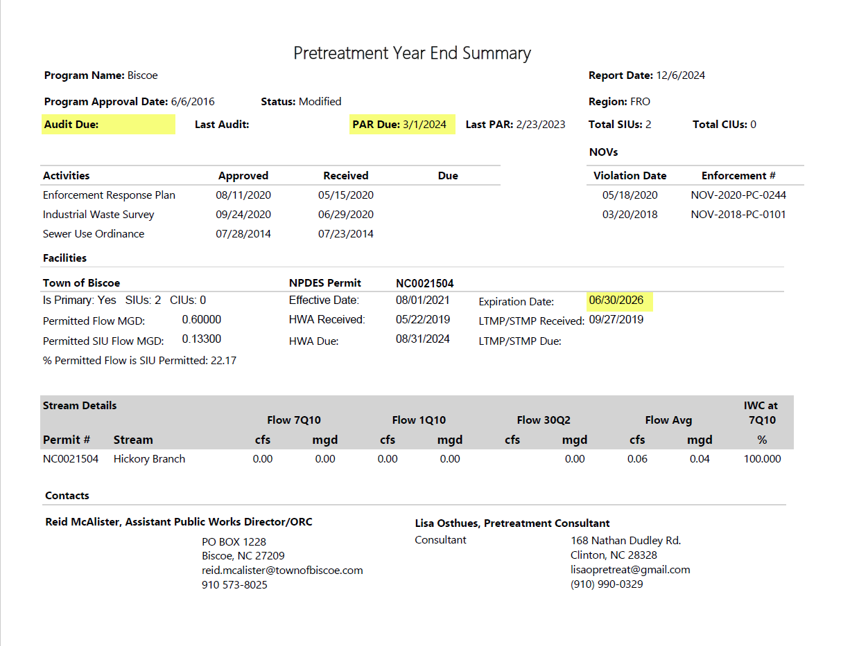
Typicalville
06/30/1983
Full
WSRO
3
Fdjdajadjklfds;ff;f;f;f;f;f;f;f;f;f;f;f;f;f;f;f;f;f;f;f;f;f;f;f;f;f;f;f;f;f;f;f;f;f;f;f;f;f;f;f;f;f;f;f;f;f;f;f;f;f;f;f;f;f;f;f;f;f;fjsakdlffadsjklfdjklsfdasjkl
Typicalville
NC0012345
13.5000
1.458
10.80
NC0012345
Carolina River
370
239.02
299.26
193.41
5.35
Ms. Jane Wastewater, Director of Public Utilities
Mr. John Basin, Pretreatment Coordinator
No Corrections Needed.
PO Box 101
Typicalville, NC 27123
Jane.Wastewater@Typicalville.com
555-123-4589
Fdjdajadjklfds;ff;f;f;f;f;f;f;f;f;f;f;f;f;f;f;f;f;f;f;f;f;f;f;f;f;f;f;f;f;f;
PO Box 101
Typicalville, NC 27123
John.Basin@Typicalville.com
555-123-4589

Slide 106
Waste Reduction:
Per .0916 of the Rule and G.S 143-215.1(g), required only to be submitted with IUP applications.
No longer required for the PAR!

Slide 107
Public Notice

Slide 108
Public Notice
Required to be done a minimum of once per year
  What is in your SUO?
  Largest Daily Newspaper Circulated in Area?
  Newspaper of General Circulation that provides meaningful public notice?
Generally completed in January or February for all SNC for Previous Year and Included in PAR due March 1;
Optional to complete Public Notice after each six month period, i.e., in July or August for January through June SNCs, and again in January or February for July through December SNCs
  may help SIU relations for SIUs in SNC for January through June for the POTW to issue Public Notice while problem is on-going instead of 6 months or more after they have fixed the problem

Slide 109
Public Notice (cont.)
Public Notice Must Include All IUs in SNC due to Limits Violations or Reporting or IUP Condition Violations
Along with the IU Names, the Public Notice should include:
  Periods of SNC (January - June or July –December)
  the Parameter(s), Reporting, or Specific IUP Condition
  OPTIONAL: any other discussion you want, for example how the SNC did not affect your WWTP or the environment, or how hard the SIU has worked to fix the problem, or how their negligence caused the problem in the first place, or how uncooperative they have been
Notes:
Can be positive or very critical

Slide 110
Public Notice (cont.)
In PAR, either include Affidavit provided by Newspaper, or cut out the Public Notice from the newspaper (make sure the piece of the newspaper is large enough to include the Public Notice and the part of the page with the name of the paper and the date.
If unable to include Public Notice in PAR, explain in the narrative why it couldn’t be done earlier. Submit Copy of Affidavit or cut out from Newspaper ASAP. NOTE: PAR will not be considered complete until Public Notice is received. Can be accepted as a supplemental document to the PAR.

Slide 111
PUBLIC NOTICE
OF SIGNIFICANT INDUSTRIAL
WASTEWATER PERMIT
VIOLATIONS
The Town of Typicalville, in accordance with Federal and State Regulations is hereby giving Public Notice. Listed below are Significant Industrial Users that were in significant noncompliance (SNC) with national pretreatment regulations, 40 CFR Part 403, and state pretreatment regulations, 15 NCAC 2H .0900, and local pretreatment regulations during the period of January 1 thru June 30, 2012; Will Plateit Metal Finishers, Inc.-Cadmium. And July 1 thru December 31, 2012; Will Plateit Metal Finishers, Inc.-Cadmium
A continuing effort is being made by all the listed industries to achieve compliance, including installation of new equipment and upgrading of existing equipment and continued progress is expected until full compliance can be attained.
Town of Typicalville, Department of Public Utilities, Jane Wastewater, Director.
January 17, 2013
Affidavit of Publication
The Typicalville Herald
Typicalville, N.C.
Personally appeared before me, a Notary Public of the
County of Typical, State of North Carolina, on
this the __17__day of ______January_____2013
_____Suzy Newsy_____
of The Typicalville Herald, who, bring duly sworn, state that
the notice entitled
PUBLIC NOTICE OF SIGNIFICANT
INDUSTRIAL WASTEWATER PERMIT VIOLATIONS
_______________________________________
a true copy of which is attached hereto, appeared in The
Typicalville Herald, a newspaper published in the Town of
Typicalville, County of Typical,
State of North Carolina, _____once____ a week for
_____one____week(s), on the following dates:
January 17___________ ______20___13_
______________________________20______
______________________________20______
______________________________20______
_______________________________________
The Typicalville (N.C.) Herald
of ______January___________2013
____Peter Public___
Notary Public

Slide 112
Enforceable Compliance Schedules

Slide 113
Enforceable Compliance Schedules
Two basic kinds
  Signed by both POTW and SIU: Consent orders, Compliance Agreements, SOCs, etc,;
  Signed by POTW only: Administrative Orders
    either when SIU refuses to agree to an order, or when SIU has failed to comply with original “consent” type order

Slide 114
Enforceable Compliance Schedules (cont.)
When to issue
  Issued when SIU will be in SNC for second period in a row for same parameter/reporting violation
  Can be issued earlier to help SIU avoid further violations (i.e. if you already know the violations will continue and you have a good idea of the steps the SIU must take to comply, then why wait to issue the order?)

Slide 115
Enforceable Compliance Schedules (cont.)
What’s in it
  Up-front penalties to address violations up to the time of issuance of order.
  Interim limits SIU can comply with, i.e., gets SIU back in “compliance” temporarily. These limits supersede IUP limits during term of order. These limits are the SIU’s “carrot.”
    Interim limits can be higher than categorical limits
    No over allocation without prior DWR approval

Slide 116
Enforceable Compliance Schedules (cont.)
What’s in it (cont.)
  Schedule of items, each with a specific due date, that SIU will complete in order to return to compliance with original/final IUP limits. This is the POTW’s “carrot,” i.e. commitment from SIU to do specific things by specific dates.
    Specific items can vary greatly from SIU to SIU, and should be developed for each specific circumstance
  Stipulated penalties for violations of conditions in order (limits, due dates, etc.). This is POTW’s “stick.”

Slide 117
North Carolina
County of Typical
In the matter of Town of Typicalville
Pretreatment Permit No. 0006
held by Will Plateit Metal Finishers, Inc.
CONSENT ORDER AND COMPLIANCE SCHEDULE
Pursuant to provisions of the Sewer User Ordinance of the Town of Typicalville, this Consent Order is made effective the 1st day of February, 2025, between Will Plateit Metal Finishers, Inc. (hereinafter the "User") and the Town of Typicalville (hereinafter the "Town").
The User and Town hereby stipulate and agree as follows:
1. User holds Town of Typicalville Pretreatment Permit No. 0006 (hereinafter the "Permit", which shall refer to User's existing permit and any subsequent renewals or modifications thereof) for the operations of existing pretreatment units and discharges from said treatment works into the Town's sewer system.
2. User has been unable to meet the permit limitations for Cadmium (Cd) set forth in its Permit.
3. Achievement of these limits will require resolution of existing problems in the present treatment train and possibly, development of alternative solutions to alleviate noncompliance, including but not limited to the construction of additional pretreatment facilities as well as the preparation of plans and specifications as necessary.
4. User hereby agrees to do and perform all of the following:
Notes:
Examples of CO or CS are NOT sufficient to craft your document. You must have the town’s attorney review.

Slide 118
Meet and comply with all terms and conditions of the Permit (except as modified by the Order) provided, however, subject to the terms and conditions of the Consent Order, the following shall apply:
Parameter Daily Max (mg/L) Monitoring Frequency Detection Limit
Cadmium (Cd) 0.13 Weekly 0.002 mg/L
Unless and until Compliance is achieved, the User will undertake activities necessary to bring the User into Compliance in accordance with the following schedule:
COMPLIANCE SCHEDULE
Activities
Prepare an Engineering Report of process alternatives and/or pollution prevention/waste minimization alternative designed to achieve Compliance
Complete Pilot Studies or waste minimization studies and identify alternatives chosen to achieve Compliance
If required, submit necessary drawings and information to obtain any necessary permits and/or authorization to construct from the Town of Typicalville
Begin construction and/or implement identified process alternative(s), pollution prevention, and waste minimization alternatives.
Complete identified construction/pollution prevention/ waste minimization alternatives and/or process alternatives.
Complete analysis of implemented changes, including daily monitoring from April 1st to May 1st and make necessary modifications to optimize and obtain full operational status.
Achieve compliance with final (IUP) limit 0.07 mg/L.
Deadline for Completion
April 1, 2025
July 1, 2025
September 1, 2025
December 1, 2025
March 1, 2025
June 1, 2025
July 1, 2025

Slide 119
c. User shall perform each of the activities set forth in subparagraph (b) on or before the dates established thereby unless such dates are extended by agreement of User and the Town. The User may request such extensions for good cause, and the Town will not unreasonably withhold its consent to such extension.
d. User shall submit a comprehensive written report within five (5) days following each milestone date specified in subparagraph (b). Each such report shall be in narrative form, shall state in detail the activities undertaken since the last report to achieve Compliance, and shall indicate whether User has met the due date for the relevant milestone established in this Consent Order. If any report contains notice of failure to meet a milestone date, the report shall also include a statement explaining the cause of the failure, any remedial actions taken, and the probability of meeting the next milestone.
During any period of construction, User shall submit on or before the 10th day of each month, detailed construction progress reports stating therein in narrative form the work performed during the month and the percentage of completion of the project.
All reports required by the Consent Order shall be submitted to the Town by Certified Mail, Return Receipt Requested, addressed to:
Director of Public Utilities
Town of Typicalville
PO Box 123
Typcialville, NC 12345
e. The User shall pay the Town $1,000, no later than February 27, 2025, for the Significant Non-Compliance during the July through December 2024 reporting period.

Slide 120
f. Any violation of the terms of this Consent Order shall subject the User to the enforcement authority outlined in the Ordinance. Such action may include, but is not limited to such fines, penalties and assessments as may be set forth in the Code of Ordinance of the Town of Typicalville, as amended from time to time.
g. In lieu of other penalties, the following stipulated penalties shall apply for violations of the User's limits or failure to meet a milestone date under this Consent Order, or failure to achieve full compliance with Consent Order.
Violation of limits | $200 per day, per violation
Failure to collected required samples, meet compliance schedule deadlines, required reports, or other milestone dates contained herein | $200 per day, per violation
Failure to achieve full compliance with Final IUP limit at expiration of Order | $1,000 per day

Slide 121
h. Once Compliance is achieved, this Consent Order shall terminate and all obligations hereunder except any obligation to pay identified moneys to the Town shall expire. Upon termination of this Order, the User shall be subject to all terms of the Permit.
i. In the performance of activities under this Consent Order, User must otherwise follow the procedures, rules, regulations, ordinances, and statutes of the Town, State, and Federal governments as they may apply to User. Nothing contained herein shall be construed as a waiver thereof by the Town.
Signed on this 26th day of January 2025.
USER: Will Plateit Metal Finishers, Inc.
BY: William B Plateit
TITLE: President
TOWN: Town of Typicalville
BY: Jane Wastewater
TITLE: Director of Public Utilities
This Order expires July 11, 2026.

Slide 122
Allocation Tables (ATs)
Should be current as of December 31st, the last day of the end of the PAR Reporting Period
Includes Effective and Expiration Dates; May Include Permit Modification Date(s)
Includes Permit Limits For Each SIU and Pipe
Includes Information from Headworks Analysis (HWA)
  MAHL
  Uncontrollable Loading
  MAIL
  Do YOU have any Over Allocations??? – Explain in Narrative!

Slide 123
Allocation Tables (ATs)

Slide 124
Allocation Tables (ATs) (cont.)

Slide 125
Allocation Tables (ATs) (cont.)
See narrative for resolution of mercury over allocation.

Slide 126
Allocation Tables (ATs) (cont.)

Slide 127
Do you have good news?
Please share with us! We would love to hear from you.

Slide 128
PARs due MARCH 1
NC DIVISION OF WATER RESOURCES
NPDES Municipal Permitting Section
1617 MAIL SERVICE CENTER
RALEIGH, NC 27699-1617
Send a Copy
(Please send to Central Office in Raleigh...We forward the copy to the Region.)

Slide 129
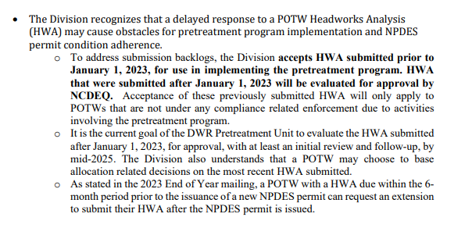
HWA Backlog and Approvals
Please keep this EOY Mailing with your pretreatment documents. The wording included effectively states that any HWA SUBMITTED PRIOR TO JANUARY 1, 2023, IS ADMISTRATIVELY APPROVED.
If you fall into this category: for “approval date” on the next updated HWA please list “administratively approved on XX/XX/XXXX” (list the date you received your EOY letter).
Notes:
This does not mean that if the Division is reviewing documents for the POTW and finds error in your HWA (prior to 2023) that we may not ask you to fix them for completeness's sake.

Slide 130
Division Pretreatment Contacts
Natalie Gorensek: (919) 707-3660
Ricky Kuntz : (919) 272-4307
Keyes McGee: (919) 707-3626
Matthew Nevills: N/A
Karen Preston (Supervisor): (919) 707-9123
Email: firstname.lastname@deq.nc.gov
Physical Address: 1617 Mail Service Center
Raleigh, NC 27699-1617
Website:
https://deq.nc.gov/about/divisions/water-resources/water-quality-permitting/municipal-npdes-pretreatment-and-collection-system/pretreatment

