Slide 1
MCM 6: Pollution Prevention & Good Housekeeping
March 26, 2019

Slide 2
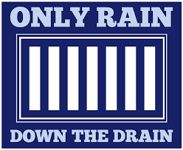

What is Pollution Prevention / Good Housekeeping (PP/GH)?
A comprehensive suite of O&M programs to prevent and minimize pollutants in stormwater runoff from municipal facilities and operations. The seven required programs are:
Municipal Facilities Operation and Maintenance Program
Spill Response Program
MS4 Operation and Maintenance Program
Municipal SCM Operation and Maintenance Program
Pesticide, Herbicide and Fertilizer Management Program
Vehicle and Equipment Maintenance Program
Pavement Management Program
Department of Environmental Quality
Notes:
82 days

Slide 3

PP/GH: Municipal Facilities O&M Program
Requirements for facilities that are owned / operated by the permittee and have the potential for generating polluted stormwater runoff:
Maintain a current inventory of facilities
Perform facility inspections
Perform routine maintenance
Establish specific frequencies, schedules, & documentation
Provide staff training
  General stormwater awareness
  Pollution prevention & good housekeeping practices
Department of Environmental Quality
Notes:
82 days

Slide 4
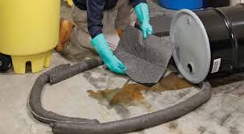
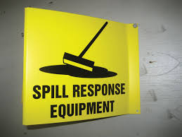
PP/GH: Spill Response Program
Requirements for facilities and operations that store and/or use materials that have the potential to contaminate stormwater runoff if spilled:
Maintain written spill response procedures
Provide spill response training for staff
Department of Environmental Quality
Notes:
82 days

Slide 5
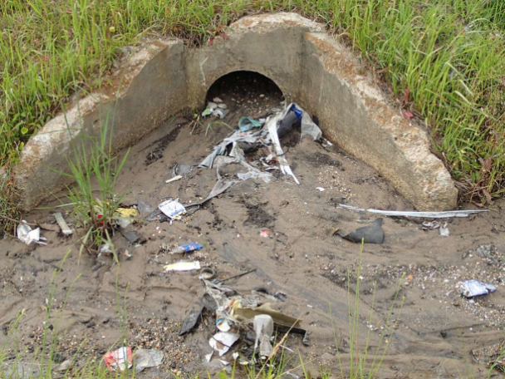
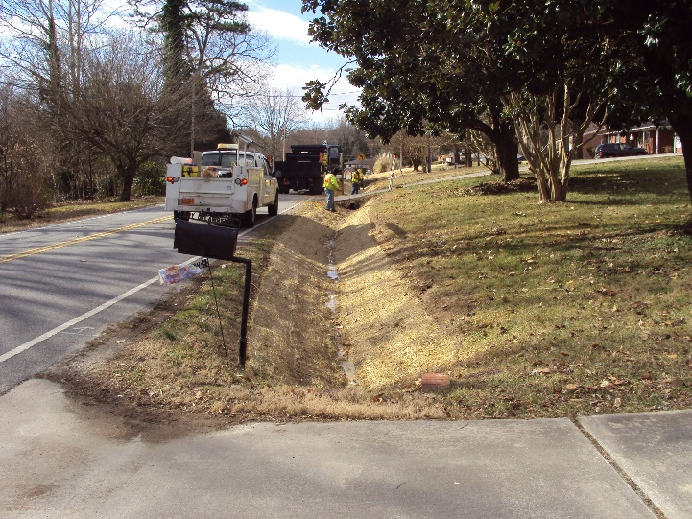
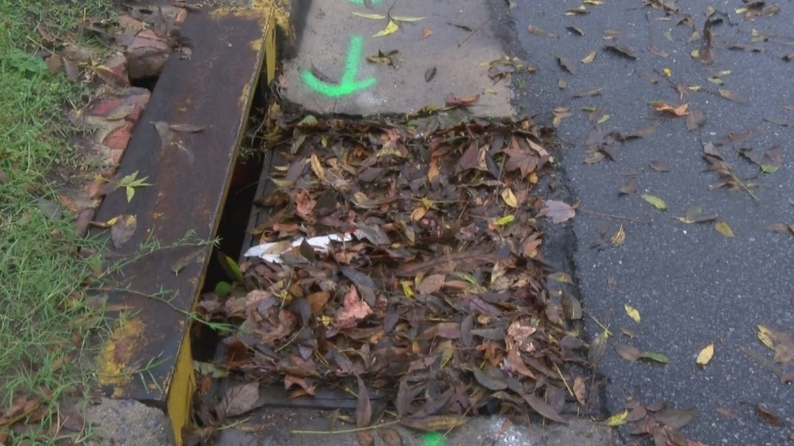
PP/GH: MS4 O&M Program
Requirements to minimize pollutants in the stormwater collection system:
Provide staff training on stormwater awareness and pollution prevention
Perform MS4 inspections
Maintain the collection system including catch basins and conveyances
Establish specific frequencies, schedules, and documentation
Notes:
82 days

Slide 6
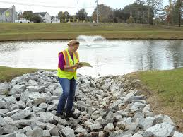
PP/GH: Municipal SCM O&M Program
Requirements for municipally owned, operated, and/or maintained SCMs installed for compliance with the post-construction program:
Maintain a current inventory of municipal SCMs
Perform SCM inspections
Perform SCM maintenance
Establish specific frequencies, schedules, & documentation
Department of Environmental Quality
High Point, NC
Notes:
82 days

Slide 7
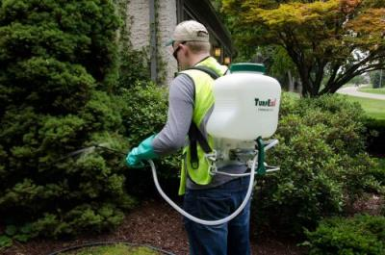
PP/GH: Pesticide, Herbicide & Fertilizer Management Program
Requirements for municipal staff who apply pesticides, herbicides and fertilizers to minimize water quality impacts from landscape chemicals:
Provide routine staff training
  Pollution prevention
  Chemical use, storage & handling
Ensure compliance with permit & applicator certifications
Department of Environmental Quality
Notes:
82 days

Slide 8
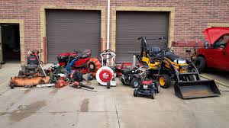
PP/GH: Vehicle & Equipment Maintenance Program
Requirements to prevent and minimize contamination of stormwater runoff from areas used for municipal vehicle and equipment maintenance and/or cleaning:
Comply with required NPDES industrial permits
Provide routine pollution prevention training for staff
Perform routine inspections
Establish specific frequencies, schedules & documentation
Department of Environmental Quality
Notes:
82 days

Slide 9

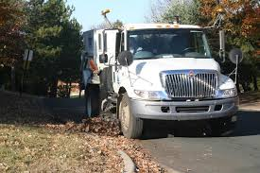
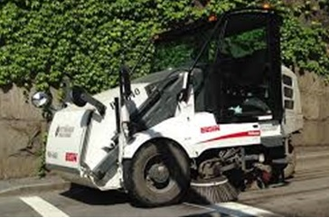
PP/GH: Pavement Management Program
Requirements to reduce pollutants in stormwater runoff from municipally owned streets, roads, and parking lots:
Control litter, leaves & debris
Control particulate and fluid pollutants from vehicles
Establish specific frequencies, schedules & documentation
Department of Environmental Quality
Notes:
82 days

Slide 10
Jeanette Powell
MS4 Program Coordinator
(919) 707-3620 jeanette.powell@ncdenr.gov

