Slide 1
Water Allocation Committee IBT Update May 2015
Two Requests Currently in Process
Kerr Lake Regional Water System
New Certificate (increase of grandfathered transfer), following change to G.S. 143-215.22L(w) (from Session Law 2014-120)
Union County
New Certificate, following G.S. 143-215.22L(c-n)

Slide 2
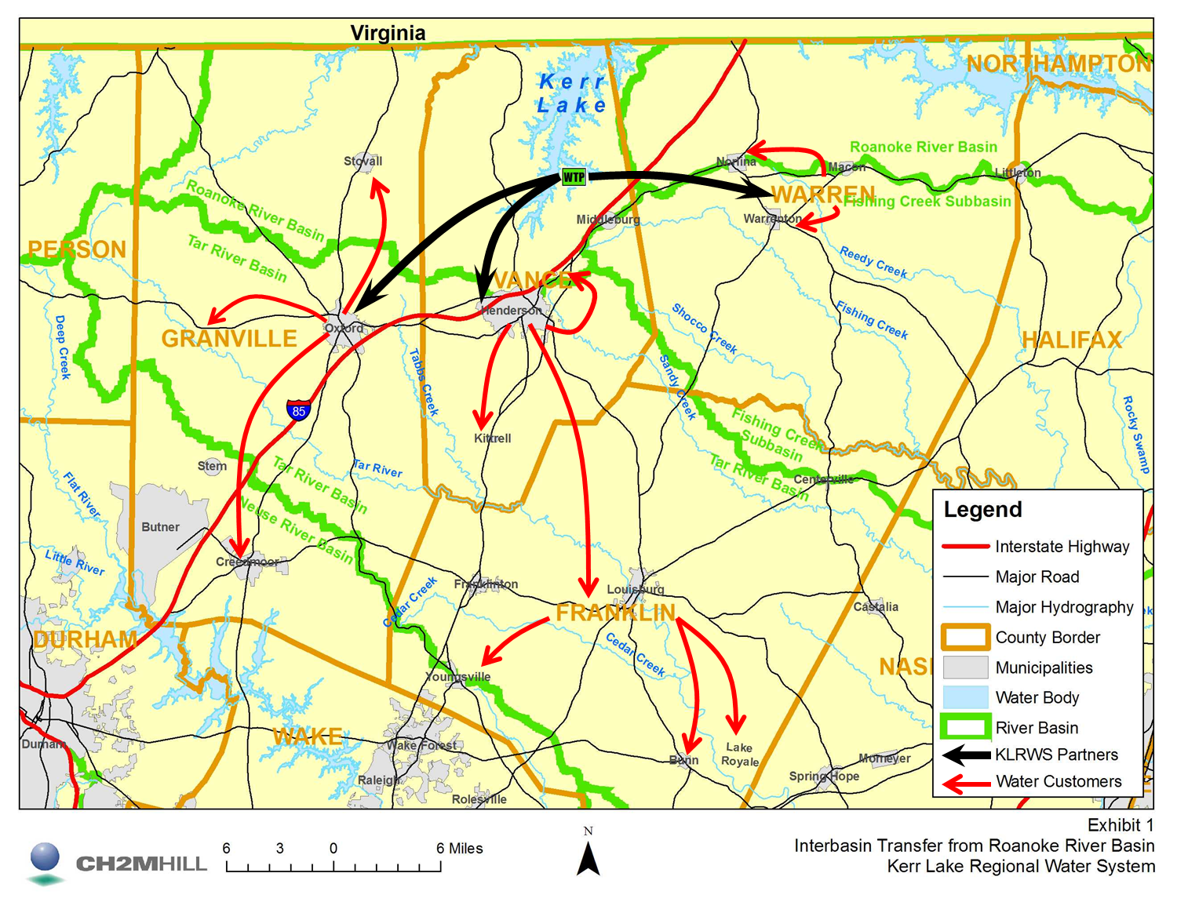
Kerr Lake Regional Water System
Primary Partners
City of Henderson
City of Oxford
Warren County
City of Henderson operates WTP
Water sales to 12 additional communities/water users in Vance, Warren, Granville, and Franklin Counties

Slide 3
Proposed Project Description
Primary Applicant: |  | Kerr Lake Regional Water System
Source Basin: |  | Roanoke
Receiving Basins: |  | Tar, Fishing Creek, Neuse
Grandfathered Allowance: |  | 10 MGD (max day)
Existing IBT (2013 data): |  |  | 4.64 MGD (avg day/max mth)
 | Roanoke to Tar: |  |  | 3.63 MGD
 | Roanoke to Fishing Creek: |  |  | 0.82 MGD
 | Roanoke to Neuse: |  |  | 0.19 MGD
Total Requested IBT (2045 Demands): |  |  | 14.2 MGD (avg day/max mth)
 | Roanoke to Tar: |  |  | 10.7 MGD
 | Roanoke to Fishing Creek: |  |  | 1.7 MGD
 | Roanoke to Neuse: |  |  | 1.8 MGD

Slide 4
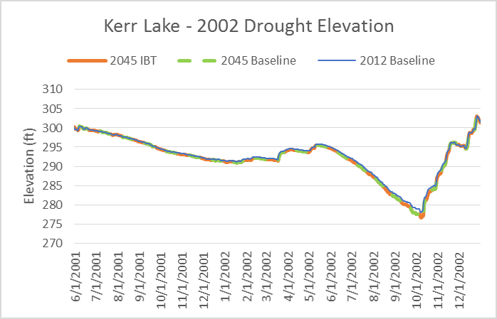
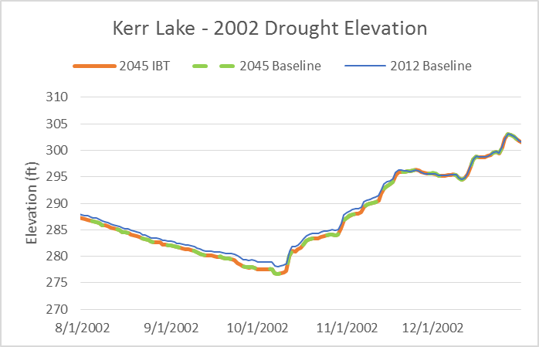
Summary of Modeling Scenarios
Reduction of initial projected demands and IBT
USACE allocation of 20 mgd not projected to be exceeded by 2060
Modeled results show no impact of transfer
Lake levels during extreme drought
Low flow duration
Hydropower

Slide 5
Project Timeline
January 2009 NOI Submitted by KLRWS
March/April 2009 Series of Public Meetings
October 2014 Draft EA submitted to DWR
January 2015 EA submitted to State Clearinghouse for Public Comment
March 2015 Public Hearing for Petition
July 2015 Determination by EMC
September 2014 Revision of Roanoke River Basin Hydrologic Model
March 2015 Petition submitted for Public Comment

Slide 6
Public Hearing
Required Hearing
March 31 @ 6:30: City of Henderson – City Hall
Hearing Officer: Ms. Jessica Godreau
Public Comment Period for Hearing:
March 31 – April 30
http://www.ncwater.org/?page=294

Slide 7
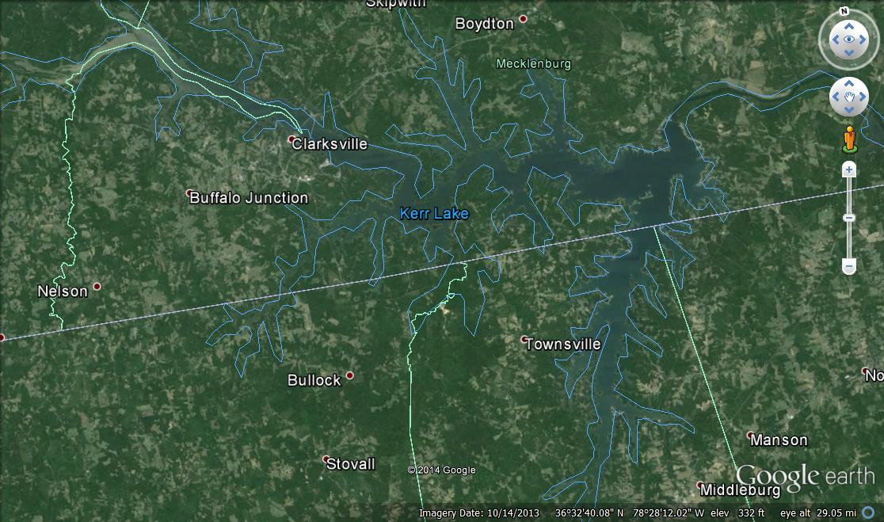
IBT Process § 143-215.22L.(w) Requirements for Coastal Counties and Reservoirs Constructed by the United States Army Corps of Engineers
I. Applicant submits Notice of Intent to file a petition
II. Applicant prepares environmental document (EA) pursuant to State Environmental Policy Act (SEPA)
NCDENR submits document to State Clearinghouse for public comment (30-day period)
Adequacy Determination
III. NCDENR publishes a Petition in the NC Register
WTP
Comments accepted for 30 days following hearing
Public hearing for Petition request
NCDENR prepares written response to comments (i.e., hearing officer’s report)
EMC ISSUES FINAL DETERMINATION
Notes:
Main points:
Long process
Multiple public input points
NCDENR must determine adequacy of environmental document
Settlement discussions

Slide 8
Proposed Project Description
Primary Applicant: | Union County
Source Basin: | Yadkin
Receiving Basins: | Rocky
Grandfathered Allowance: | N/A
Total Requested IBT (2050 Demands): |  | 23 MGD (avg day/max mth)

Slide 9
Project Timeline
August 2013 NOI Submitted by Union County
October 2013 Series of Public Meetings
February 2015 Draft EIS submitted to DWR
July 2015 EIS submitted to State Clearinghouse for Public Comment;
Hearing Officer assignment for public hearings
November 2015 Adequacy determination for EIS
August 2015 Public hearing for EIS

Slide 10
IBT Process § 143-215.22L
I. Applicant submits Notice of Intent to file a petition.
30 days notice of public meetings
3+ Public meetings
II. Applicant submits draft environmental document (EIS or EA)
30 days notice of public hearing
EMC public hearing
Comments accepted for 30 days after hearing
EMC prepares written response to comments
EMC determines adequacy of environmental document
Settlement discussions, if requested.
III. Applicant submits petition to EMC
EMC issues Draft Determination within 90 days of receiving petition
Public notice of draft determination and 30-day notice of hearings
2+ public hearings held within 60 days of issuing draft determination
Comments accepted for 30 days after last hearing
EMC prepares written response to comments
EMC issues final determination
Notes:
Main points:
Long process
Multiple public input points
EMC must determine adequacy of environmental document
Settlement discussions

Slide 11
Contact Information
Kim Nimmer
NCDENR - Division of Water Resources
Kim.Nimmer@ncdenr.gov
919-707-9019

Slide 12
Kerr Lake IBT public comments
Nearly 300 comments received
Primary issues identified in comments:
Notification process for public hearing
EIS should be prepared instead of EA
Opposed to IBT

Slide 13
Kerr Lake Public Hearing Notification
The state statute (143-215.22L) requires that a public notice be published in a newspaper of general circulation in the source river basin and a newspaper of general circulation in the receiving river basin
Franklin Times (receiving basin) on 3/5/15
Daily Herald (source basin) on 3/5/15
Mecklenburg Sun (source basin) on 3/4/15
Addn’l: Henderson Daily Dispatch (source basin) ran two front page articles
DENR distributed news release on 3/24/15 to all NC media

