Slide 1
Department of Environmental Quality
Interbasin Transfer Program Update
Water Allocation Committee July 12, 2017

Slide 2
IBT Update
One Request Currently in the Process
  Pender County
    New Certificate, following G.S. 143-215.22L(w) (Requirements for Coastal Counties)
Department of Environmental Quality

Slide 3
Proposed Project Description
Primary Applicant: | Pender County
Source Basin: | Cape Fear River
Receiving Basin: | Northeast Cape Fear River, South River, & New River
Grandfathered Allowance: | N/A
Total Requested IBT (2045 Demands): | 14.5 MGD (avg day/max mth)
    New Certificate, following G.S. 143-215.22L(w)
Department of Environmental Quality

Slide 4
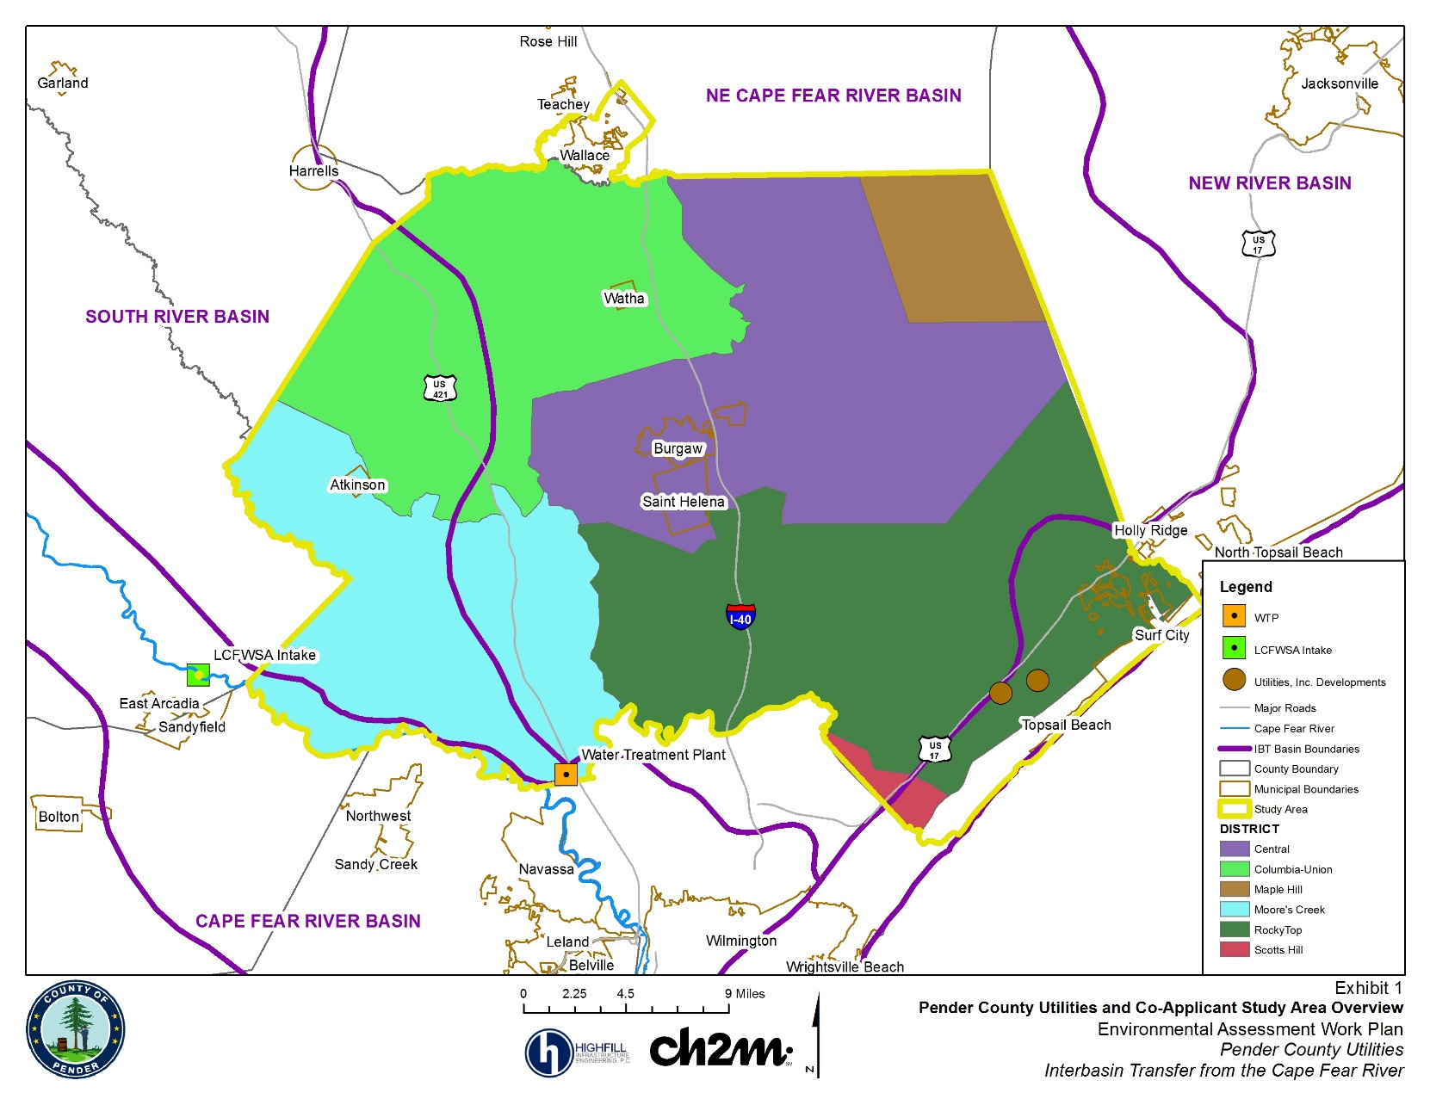
Pender County and IBT Basins

Slide 5
IBT Process § 143-215.22L(w)
Requirements for Coastal Counties
I. Applicant submits Notice of Intent to file a petition
II. Applicant submits draft environmental document (EA) pursuant to State Environmental Policy Act (SEPA)
Applicant submits EA to NCDEQ for review and comment
NCDEQ issues finding of no significant impact (FONSI)
EA and FONSI published for 30-day review/comment period through State Clearinghouse
III. Applicant submits petition
NCDEQ prepares written response to comments
Public notice of petition and 30-day notice of hearing
Comments accepted for 30 days after hearing
Public hearing on the petition
EMC issues final determination

Slide 6
Recent Actions and Current Status
FONSI signed by DWR Director – April 2017
EA and FONSI published for review in State Clearinghouse – May 2017
Draft Petition, Draft Water Conservation Plan, and Draft Drought Management Plan – reviewed by DWR, comments provided, documents in process of being finalized
Department of Environmental Quality

Slide 7
Contact Information
Kim Nimmer
NCDEQ - Division of Water Resources
kim.nimmer@ncdenr.gov
919-707-9019
Department of Environmental Quality

