Slide 1
Department of Environmental Quality
Interbasin Transfer Program Update
Water Allocation Committee November 8, 2017

Slide 2
IBT Update
One Certificate Request Currently in the Process
  Pender County
    New Certificate, following G.S. 143-215.22L(w) (Requirements for Coastal Counties)
Department of Environmental Quality

Slide 3
Proposed Project Description
Primary Applicant: | Pender County
Source Basin: | Cape Fear River
Receiving Basin: | Northeast Cape Fear River, South River, & New River
Grandfathered Allowance: | N/A
Total Requested IBT (2045 Demands): | 14.5 MGD (avg day/max mth)
    New Certificate, following G.S. 143-215.22L(w)
Department of Environmental Quality

Slide 4
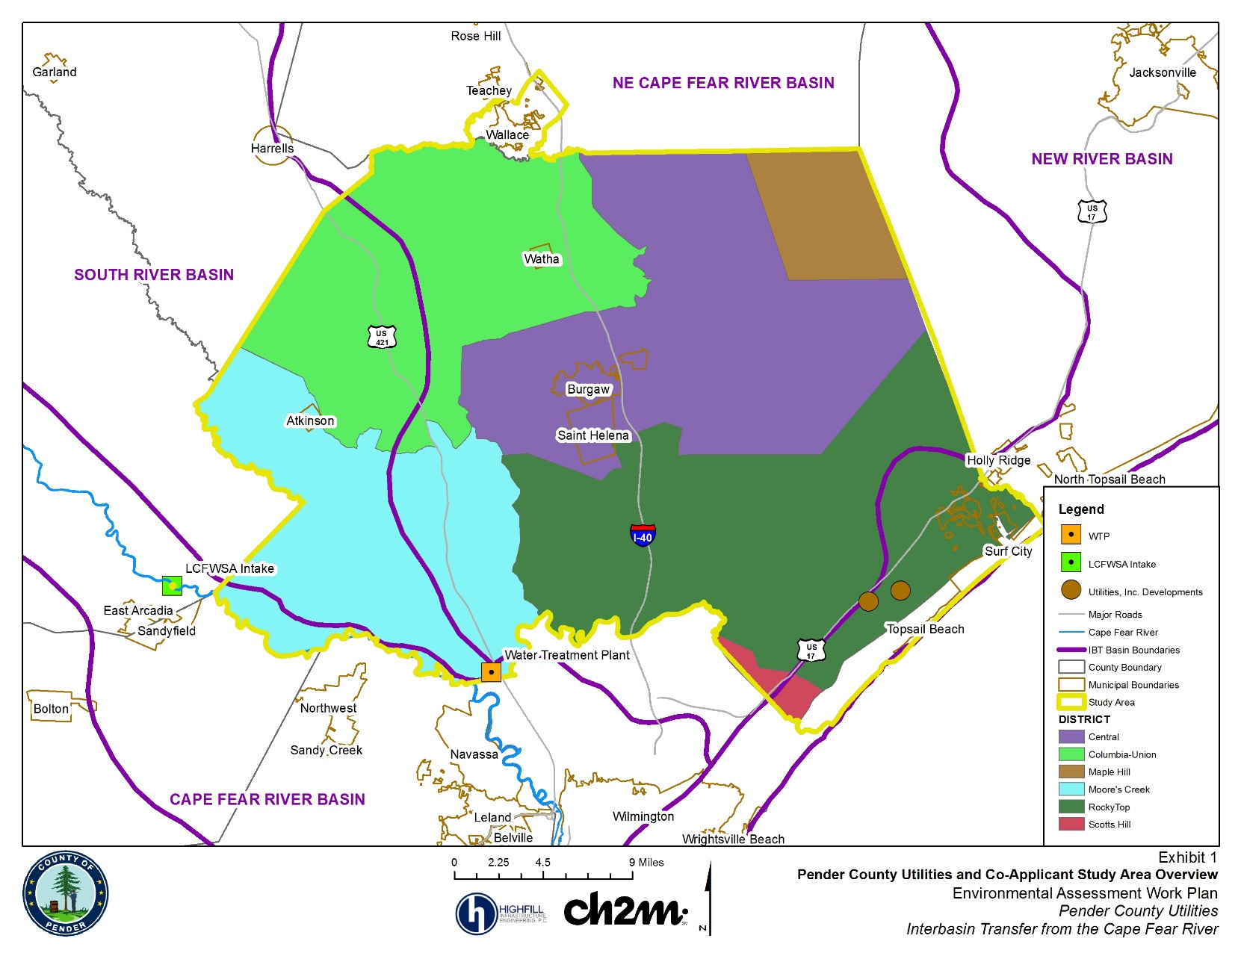
Pender County and IBT Basins

Slide 5
Pender County Utilities Water Supply System
IBT needed due to growth
  coastal access and vicinity to Wilmington
  economic development along US 17 corridor
  system expansion to move residents off groundwater – 70 miles of water lines being constructed this year, 200 miles planned over next 20 years
Co-applicants on IBT certificate (currently rely on groundwater):
  Town of Burgaw
  Town of Topsail Beach
  Town of Surf City
  Town of Wallace
  Utilities, Inc.
Department of Environmental Quality

Slide 6
IBT Process § 143-215.22L(w)
Requirements for Coastal Counties
I. Applicant submits Notice of Intent to file a petition
II. Applicant submits draft environmental document (EA) pursuant to State Environmental Policy Act (SEPA)
Applicant submits EA to NCDEQ for review and comment
NCDEQ issues finding of no significant impact (FONSI)
EA and FONSI published for 30-day review/comment period through State Clearinghouse
III. Applicant submits petition
NCDEQ prepares written response to comments
Public notice of petition and 30-day notice of hearing
Comments accepted for 30 days after hearing
Public hearing on the petition
EMC issues final determination

Slide 7
Recent Actions and Current Status
Final EA submitted for DWR review – January 2017
FONSI signed by DWR Director – April 2017
EA and FONSI published for review in State Clearinghouse – May 2017
Petition, Water Conservation Plan, and Drought Management Plan – reviewed by DWR, comments provided, documents in process of being finalized
Once documentation is determined to be adequate, the documents will be published for public review through State Clearinghouse and 30-day notice will be provided regarding a public hearing
Department of Environmental Quality

Slide 8
Contact Information
Kim Nimmer
NCDEQ - Division of Water Resources
kim.nimmer@ncdenr.gov
919-707-9019
Department of Environmental Quality

