Slide 1
Fiscal Year 23-24 Annual Report Summary
Delonda Alexander, NCDEQ
Special Remediation Branch Head

Slide 2
Annual Report
The Division is required by General Statute to provide a report on the status of efforts by various programs including the DSCA Program.
The report covers the previous fiscal year (FY) – this year’s report covers FY 23-24 which spans July 1, 2023 until June 30, 2024.
The report is typically presented to the legislature in April/May the following year – i.e. the 23-24 FY report will be submitted April/May 2025
The final document when posted can be found online at:
https://www.deq.nc.gov/about/divisions/waste-management/science-data-and-reports/waste-management-legislative-reports

Slide 3
Funding - Income
The DSCA Fund is made up of receipts from:
Sales and Use Tax – approx. 97%
Solvent Tax – approx. 1.5%
Petitioner Reimbursement – approx. 1.5%

Slide 4
Funding - History

Slide 5
Solvent Tax Revenue

Slide 6
Sales and Use Tax

Slide 7
Funding - Disbursements
The DSCA Fund disburses funds for:
Contract payments – approx. 77%
DSCA and supporting staff – approx. 20%
Hazardous waste generation fees – approx. 1.7%
County well permit fees – approx. 1.3%

Slide 8
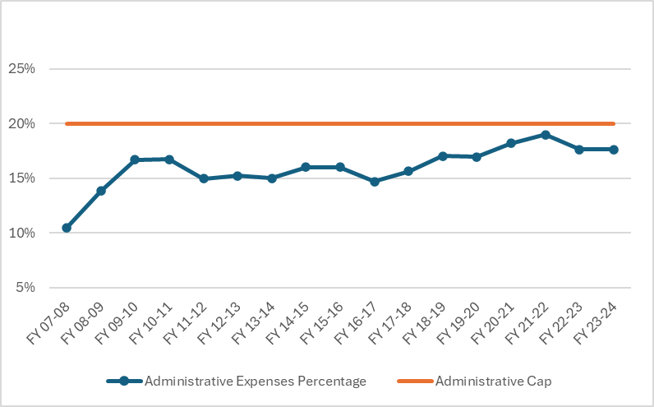
Administrative Cap

Slide 9
Dry-Cleaning Facilities Subject to Inspection
2013 | 580
2014 | 565
2015 | 537
2016 | 516
2017 | 499
2018 | 488
2019 | 469
2020 | 403
2021 | 370
2022 | 376
2023 | 358

Slide 10
Compliance Stats – FY23-24
FY23-24 started with 358 facilities subject to inspection; ended with 331 facilities
Conducted 9 outreach visits; total to date 95
Conducted 361 inspections at 343 facilities; compliance rate 92%
Issued 55 checklists/corrective action letters; 4 Notice of Violations (NOV)
Inspected 5 facilities seeking entry into cleanup program
Mailed 148 Perc calendars to facilities
Mailed 217 self-inspection checklist packets to petroleum/alternative solvent facilities

Slide 11
Sites in the DSCA Program (7/1/23-6/30/24)
Certification Status | FY 2023-2024 | Cumulative
Contaminated Sites | 15 | 577
Certified | 15 | 527
Determined Ineligible | - | 4
Not Certified | - | 46
Certified Sites Pending Closure | 14 | -
Certified Sites Closed | 2 | 135
Classifications of Certified Sites | Number of Sites | Percentage
Abandoned | 361 | 69
Wholesale Distribution | 3 | 1
Operating | 163 | 30
Small Size (1-4 employees) | 91 | 56
Medium Size (5-9 employees) | 42 | 26
Large Size (>10 employees) | 30 | 18

Slide 12
Known Dry-Cleaning Solvent Contaminated Sites

Slide 13
DSCA Site Cleanup Stats
Accomplishments | FY 2023-24 | Cumulative
Water Supply Provided
Municipal Water Connection - residences | 1 | 67
Municipal Water Connection - businesses | 1 | 14
Temporary Water Supplied - residences | 2 | 34
Temporary Water Supplied - businesses | 1 | 7
Number of DSCA sites involved | - | 25
Vapor Intrusion (VI) Mitigated
VI Control System Installed - residences | 1 | 23
VI Control System Installed - businesses | 1 | 93
Number of DSCA sites involved | 1 | 73
Active Remediation Implemented
Number of DSCA Soil Remediations Implemented | 1 | 111
Number of DSCA sites involved | 1 | 99
Number of DSCA Groundwater Remediations Implemented | - | 77
Number of DSCA sites involved | - | 56

