Slide 1
DSCA PFAS Pilot Study Overview
Delonda Alexander, NCDEQ
Special Remediation Branch Head

Slide 2
Introduction
Florida Department of Environmental Protection (FDEP) conducted a limited study in 2019 that indicated that polyfluoroalkyl substances (PFAS) can be associated with the waste streams of dry cleaners
To evaluate whether PFAS contamination poses a significant concern at sites in NC, the Dry-Cleaning Solvent Cleanup Act (DSCA) Program will conduct limited sampling for PFAS at selected sites as part of a pilot study
NCGS 143-215.104N(a)(7) authorizes fund expenditures for “other activities reasonably required to protect public health and the environment” – these expenditures are being made at a certified facility pursuant to an assessment and remediation agreement

Slide 3
Site Selection
10-15 existing DSCA sites will be selected
Sites will represent a range of facility types including:
Active vs. historical operations
With and without wet-wash laundry operations
At least one solvent distribution/wholesale facility
Sites will represent range of conditions including:
Different geology and hydrogeology
Variable chlorinated solvent concentrations
At least one petroleum solvent release site
Will avoid sites in Bladen, Brunswick, Colombus, Cumberland, New Hanover, Pender, Robeson and Sampson counties that are associated with GenX/PFAS contamination

Slide 4
Sampling Approach for Each Site
Minimum of 2 groundwater samples will be collected during one sampling event
One sample from an upgradient monitoring well and one sample from the well exhibiting the highest solvent concentration
Quality Assurance/Quality Control (QA/QC) samples will be collected including an equipment blank and a field blank
Samples will be analyzed by an accredited laboratory using EPA Method 1633 for 40 specific PFAS compounds
Results compared to various standards including EPA maximum contaminant levels (MCLs), NC Interim Maximum Allowable Concentrations (IMACs) and the lab quantitation limit

Slide 5
DEQ PFAS Signature Tool
A tool for evaluating PFAS signatures which can help to identify potential sources
Based upon PFAS source, there are different signatures, including long-chain and short-chain carbon compounds
The tool provides a pie chart of the PFAS signature based upon compounds detected
PFAS signatures can be compared across samples to see patterns or lack of similarity

Slide 6
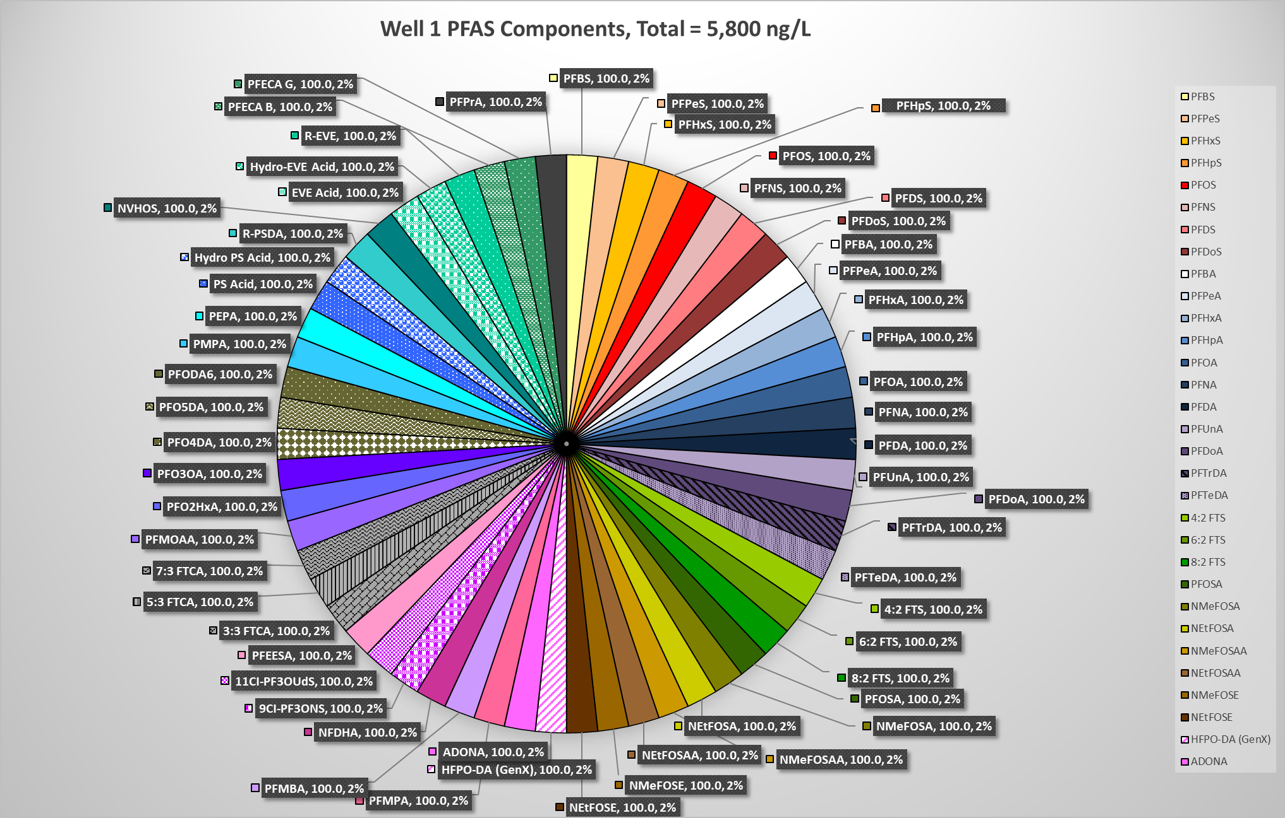
DEQ PFAS Signature Tool - Example

Slide 7
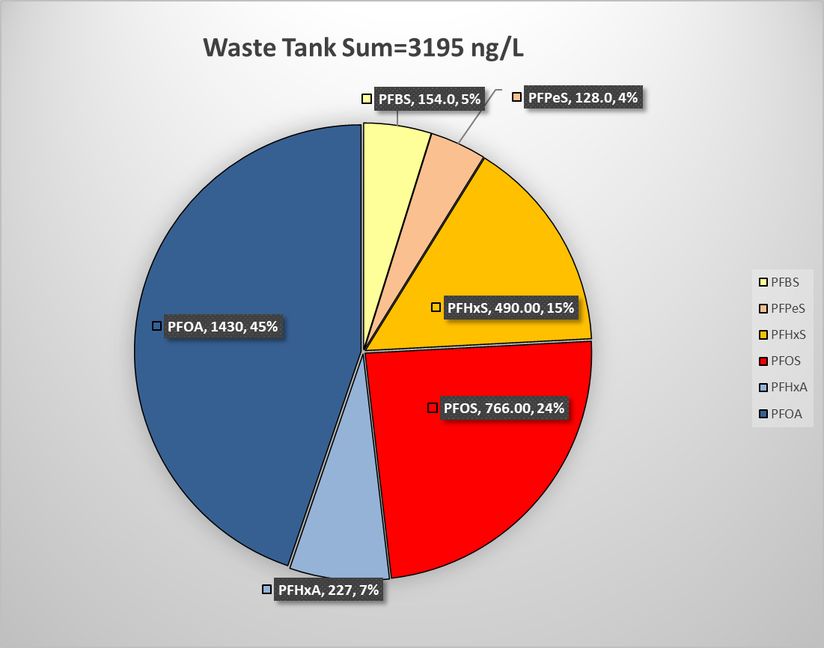
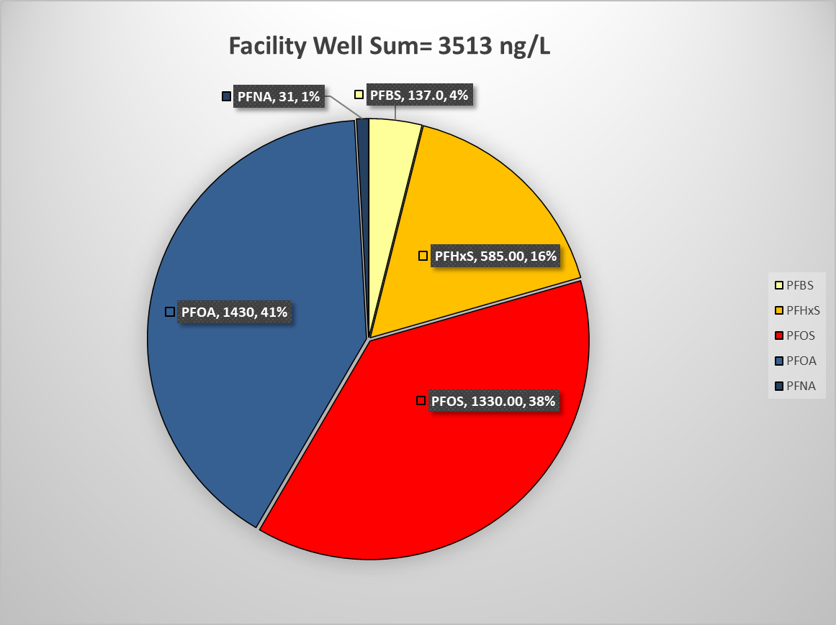
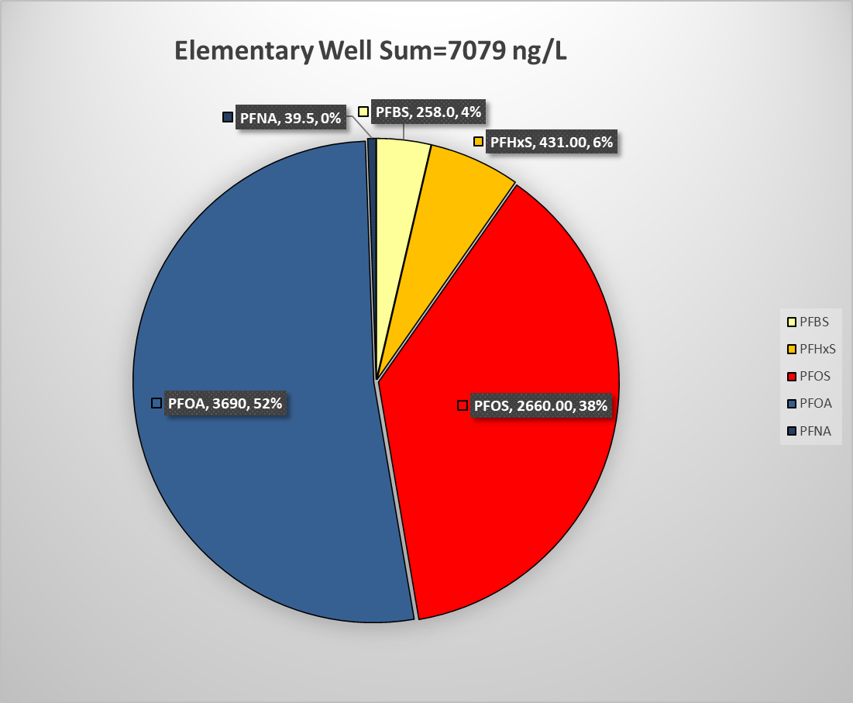

Slide 8
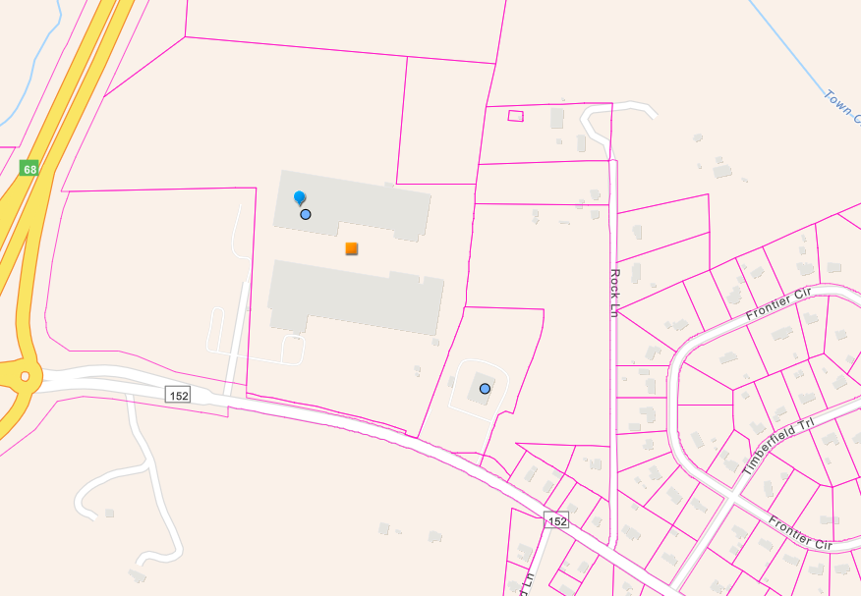
Signatures: Source and Receptor (Parcels)
9
Source
7
1
2
4
3
6
5
1/17/24
Total PFAS
MW 3 = 14,000 ng/L
MW 2 = 2,000
MW 5 = 76
Wells 2, 3, and 5 have most similar signatures
Signatures onsite do not correlate well with offsite WSWs
Receptors

Slide 9
Additional Tasks Possible
Collection of samples from raw or spent solvent, separator water, potable water prior to wet wash and/or wet wash discharge water
Additional sample downgradient of a source area to look at potential degradation/transformation products
Use of total oxidizable precursor (TOP) assay to look at unknown PFAS precursors that may be converted into related PFAS chemicals through oxidation – recent study shows these precursors may be high at laundry facilities

Slide 10
Potential Actions Based on Results
For sites where PFAS are identified at concentrations above background and EPA MCLs and NC IMACs:
Identify locations and usage of water supply wells in the site vicinity
Collect samples from water supply wells used for drinking water if they appear threatened and analyze using EPA Method 537.1
Health risk evaluation (HRE) performed by DEQ toxicologist
If alternative water supply is deemed necessary and PFAS concentrations appear potentially attributable to the dry-cleaning release, DSCA Program will provide alternative water supply and discuss with Bernard Allen Fund Program if funding available for other alternative supply
If alternative water supply is deemed necessary and PFAS concentrations do not appear to be related to the dry-cleaning release, the DSCA Program will refer the matter to the Bernard Allen Fund Program
If surface water bodies used as drinking water sources are threatened by PFAS contamination, surface water samples may be collected

Slide 11
Future Implications
Based on the results of the pilot study, the DSCA Program will evaluate if PFAS is a significant concern at dry-cleaning sites
If PFAS is a concern, a PFAS sampling strategy will be developed for existing DSCA remediation sites
Future PFAS sampling at DSCA sites will likely focus on water supply wells in the site vicinity
Goal is to minimize PFAS-related expenditures where possible
Will use existing monitoring wells to evaluate if sufficient to characterize PFAS plume
Site closure can be pursued with PFAS impacts managed under DSCA’s current risk-based closure process

Slide 12
Timeline
May 2025 – site selection
June 2025 – sampling begins
September 2025 – sample result evaluation and application of DEQ PFAS signature tool
November 2025 – final report on pilot study completed

