Slide 1
Introduction to PFAS
PFAS overview
Results of FDEP dry-cleaner study
Assessment challenges and solutions
Notes:
By able to move logo

Slide 2
PFAS Overview
PFAS
PFOS
PFOA
PFAS = Per- and polyfluoroalkyl substances
Family of thousands of chemicals
PFOS and PFOA most widely studied, recently designated as hazardous substances by EPA
EPA recently announced Maximum Contaminant Levels (MCLs) for drinking water for six PFAS
GenX/HFPO-DA
PFHxS
PFBS
PFNA

Slide 3
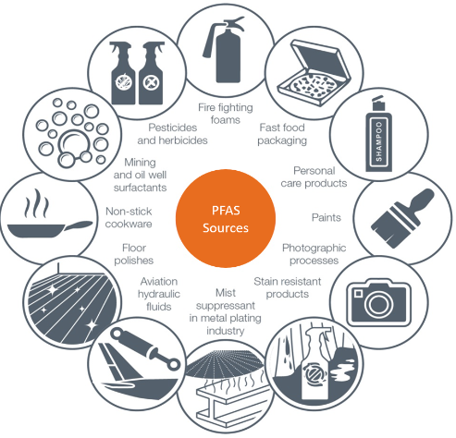
PFAS Sources
Use beginning in 1940s
Highly stable and resistant to heat, water, and oil
Textile industry uses:
Water, oil, soil, and heat resistance
Improved cleanability
Wetting or antifoaming
Breathable moisture barrier
Certain PFAS banned in the US, but others still in use, and are present in many imported products
Referred to as “forever chemicals”
Source: Eurofins
Key Sources in the Environment
Primary: industry, fire fighting
Secondary: wastewater treatment plants, septic systems, landfills
Notes:
-Forever chemicals – Strong carbon-fluorine bond. Don’t break down in the environment and can build up or bioaccumulate in humans and animals.
-Textile mills use PFAS to impart outdoor gear, clothing, household fabrics, carpets, and other textile products with water, oil, soil, and heat resistance; improve cleanability of oil- and water-based stains; as a wetting or antifoaming agent when dyeing and bleaching, and as a breathable moisture barrier to wind and rain
-PFOS and PFOA were voluntarily phased out beginning in early 2000s, but other PFAS continue to be used. PFAS may also be present in imported products. Recent EPA rule requires reporting of articles containing PFAS imported into the US between now and 2015, but lots of exceptions. Plus, as far as dry-cleaning sources go, who knows when someone purchased a product.

Slide 4
FDEP PFAS Dry-Cleaner Study
FDEP Study of 10 sites
Soil and groundwater samples:
Dry-cleaning machines
Sewer lines
Drainfield areas
Hydraulically upgradient
Raw materials/waste stream samples:
Virgin solvent sources
Spent solvent sources
Wet wash sources
Notes:
No other known studies specifically focusing on PFAS at dry-cleaners, lot of conclusions based on this one study

Slide 5
FDEP PFAS Dry-Cleaner Study
Groundwater Concentrations | PFOS (ng/L)
Celebrity | 716
Cinderella | 1,520
Classic | 355
Dolphin | 130
DW | 561
IP | 3,480
Jasper | 2,000
Moses | 139
NorthTrail | 340
TOQ | 40.1
Median for FDEP sites | 458
Median for primary release sites | 45,700
Median for secondary release sites | 95
Median for no release sites | 30
FDEP Conclusion: Although urban background PFAS may provide some contribution to PFAS concentrations in groundwater, dry-cleaning and/or wet laundry activities are also contributing to elevated PFAS concentrations found in the vicinity of the pilot project facilities.
Perspective: Median PFOS groundwater concentrations at FDEP sites two orders of magnitude below primary release sites.
EPA MCL for PFOS 4 ng/L
Johnson, et al, October 2022
Primary release sites (fire-training areas, manufacturing plants)
Secondary release sites (biosolids application, treated wastewater use, landfills)
No release sites (no known sources)
Notes:
Global Distributions, Source-Type Dependencies, and Concentration Ranges of Per- and Polyfluoroalkyl Substances in Groundwater - PMC (nih.gov)

Slide 6
FDEP PFAS Dry-Cleaner Study
Source | Virgin solvent sources | Spent solvent sources | Wet wash sources
PFOS (ppt) | <15 | 0.77 | 1.74
 | <15 | 2.33 | 1.08
 | <16.67 | 9.52 | 1.12
 | <80 | 11.34 | <2.06
 | <80 | 13.87 | 2.36
 | <80 | <16.67 | 2.8
 | <80 | 31.77 | 3.06
 | <80 | 52.01 | 3.22
 | <80 | 56.83 | 14.88
 | <80 | 66.58 | 21.2
 | 2,284.1* | <80 | 24.6
 |  | <80 | <80
 |  | 97.7 | <80
 |  | 100.2 | <80
 |  | 121.9 | 128
 |  | 421.9 | 279
 |  | 2,901.2
 |  | 16,597.6
 |  | 18,549.4
 |  | 19,639.9
 |  | 21,452.2
Low | <15 | 0.77 | 1.74
High | 2,284.1* | 21,452.2 | 279
Virgin solvent source samples:
Dry-cleaning solvents
Spotting agents
Detergents
Spent solvent source samples:
Spent solvent from machine drain
Haz waste storage containers
Water after the condenser/separator process
Wet wash source samples:
Potable water prior to wet laundry
Wet laundry wastewater discharge
Sanitary sewer
* = Raw petroleum solvent mixed with soap prior to use.
Notes:
3-6% PFAS in AFFF – 3 – 6E10

Slide 7
PFAS Assessment Challenges
Ubiquitous sources
Meticulous sampling protocols
Limited analytical methods
Large number of compounds
Lack of degradation can lead to large plumes
Transformational products
Evolving regulatory environment
Low regulatory standards
Notes:
This is just assessment challenges, don’t even get me started on remediation challenges!

Slide 8
PFAS Assessment
Assessing in the presence of ubiquitous sources is not new – NCDEQ does not require remediation to below anthropogenic background levels
NCDEQ has indicated a risk-based approach can be used for PFAS - alternative water supply is an easy fix for drinking water pathway
Contaminant transport follows principals similar to chlorinated solvents
Sampling protocols are becoming more routine
Notes:
Other ubiquitous sources - Naturally occurring metals in soil and groundwater, Vapor intrusion/indoor sources, Anthropogenic background concentrations of PAHs, PCBs, and/or Dioxins

Slide 9
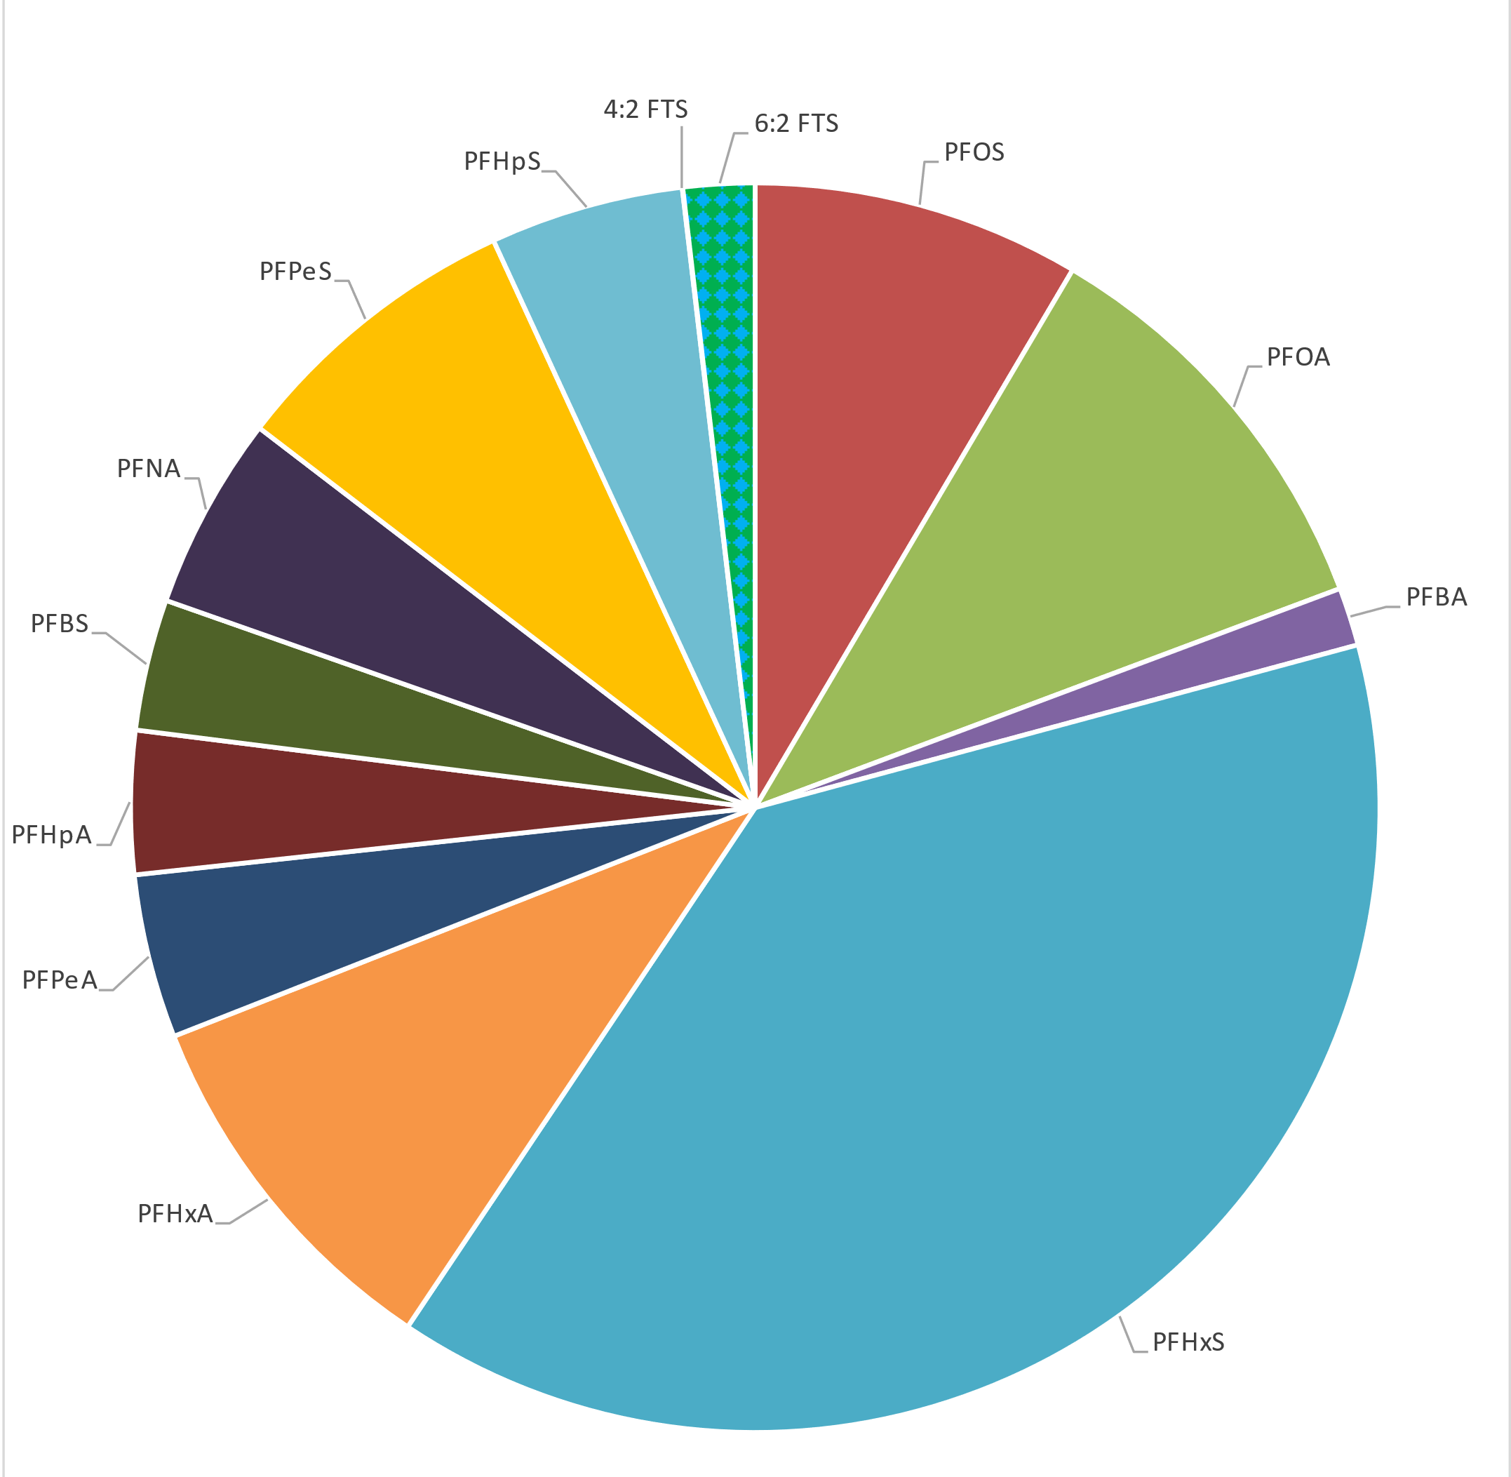
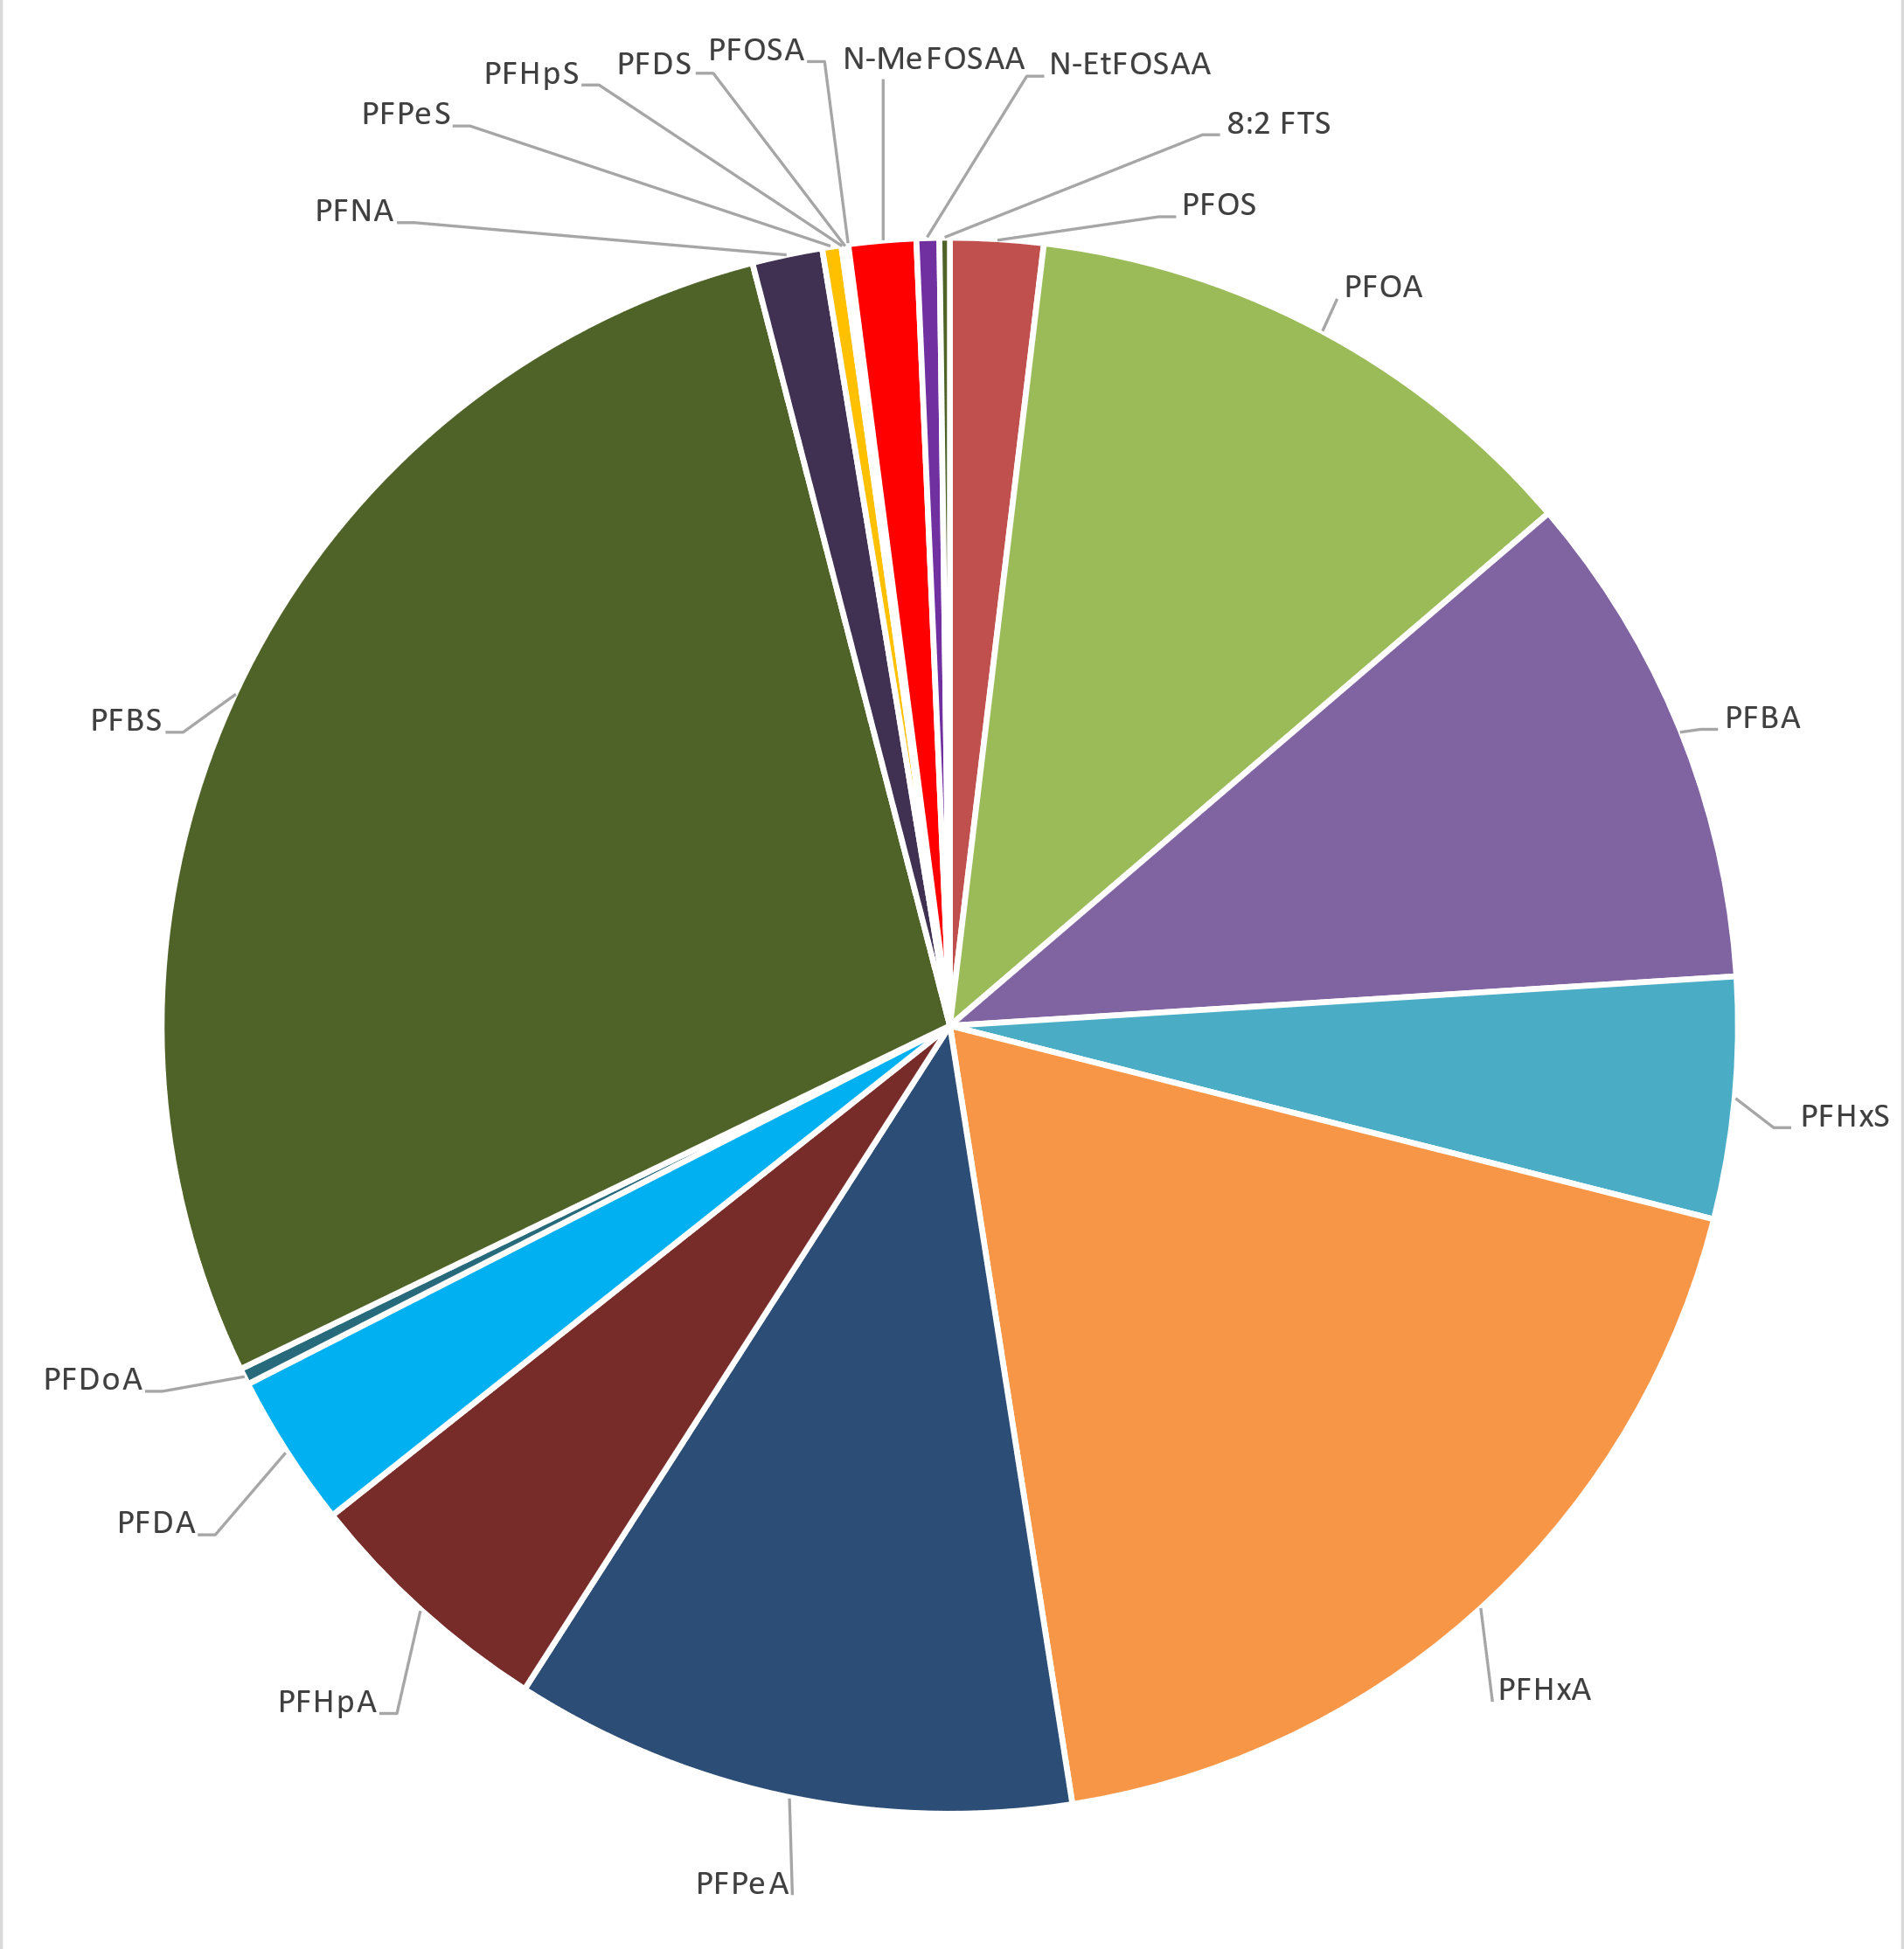
PFAS Forensics
Chemicals Signatures
Indicator Chemicals
Metal Plating
PFOS
F-53B, F-53
Textile Surface Coatings
MeFOSAA
EtFOSAA
Landfills/WWTP
n:2 FTUCA
n:3 FTCA
Food Packaging
PAPs/diPAPs
Fire Training Site
Landfill Site
New Analytical Tools & Source Database Development
FDEP Dry-cleaning Study Data
Notes:
Reference Battelle high-res non-targeted analysis
Multiple lines of evidence approach needed – sound familiar

Slide 10
Science and policy are evolving rapidly - stay tuned!

