Slide 1
One Hour Koretizing
202 Falls Road
Rocky Mount, North Carolina
Site ID: DC640008
2019 photo, facing west

Slide 2
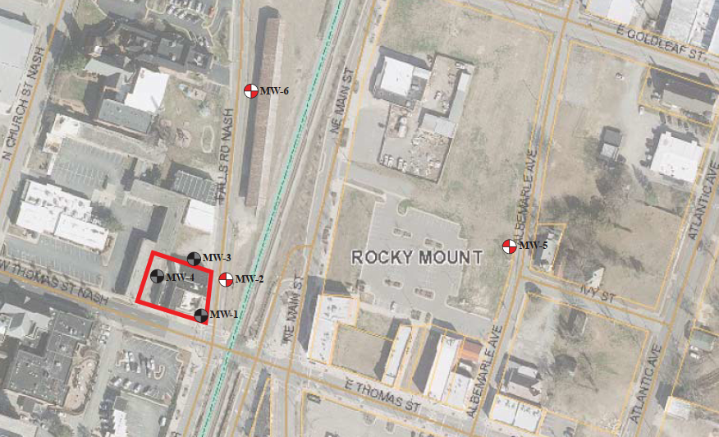
Area and Site Map
Now Rocky Mount
Event Center
Building construction began early 1900s
PCE dry-cleaning operations ~1955-2013
One Hour Koretizing 1981-2013
Release identified in 2015
Notes:
The site is located at the intersection of West Thomas Street and Falls Road, very close to the border between Nash and Edgecomb counties. This aerial is not updated, there is now a convention center. GW flow is toward the east

Slide 3
Groundwater Contamination at the Site
Groundwater concentration of 110,000 ug/L in temporary well inside building (2015)
Extent of highest impacts limited laterally (historic max 1,300 ug/L in permanent MW)
BDL
PCE concentration (ug/L) in
monitoring well
PCE concentration (ug/L) in
temporary point
BDL = below detection limits
Groundwater flow: east
23
BDL
BDL
110,000
280
BDL
4,100
80
Notes:
Though a temporary monitoring well installed inside the building had PCE at 110,000 ug/L , PCE concentrations in permanent monitoring wells were several orders of magnitude lower. This suggested that the impacts to groundwater are limited laterally , likely due to fine-grained soils (silts and clays)

Slide 4
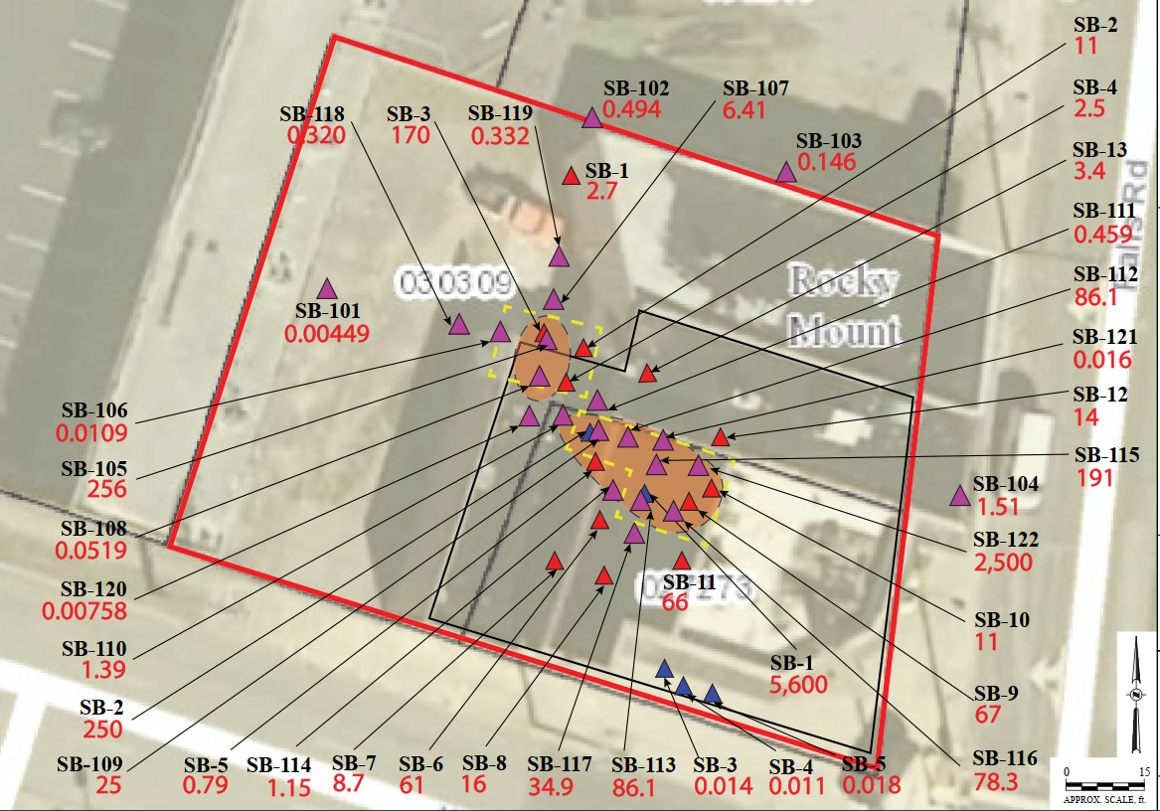
Soil Contamination at the Site
Significant soil (5,600 mg/kg) impacts identified in 2016 inside the building
Conducted additional soil sampling to better delineate impacts and define excavation
Soil concentration > 170 mg/kg
(C_{sat}, Saturation concentration for PCE)
Notes:
Significant soil contamination was identified in 2016 at samples collected inside the building, with a maximum concentration of 5,600 mg/kg. This concentration well exceeds the PCE saturation concentration, the concentration at which PCE would be “oozing out” (technical term lol) of soil, of 170 mg/kg. Subsequent investigations delineated the extent of the Csat exceedances, and identified a second area of Csat exceedances out the back door of the former cleaners.

Slide 5
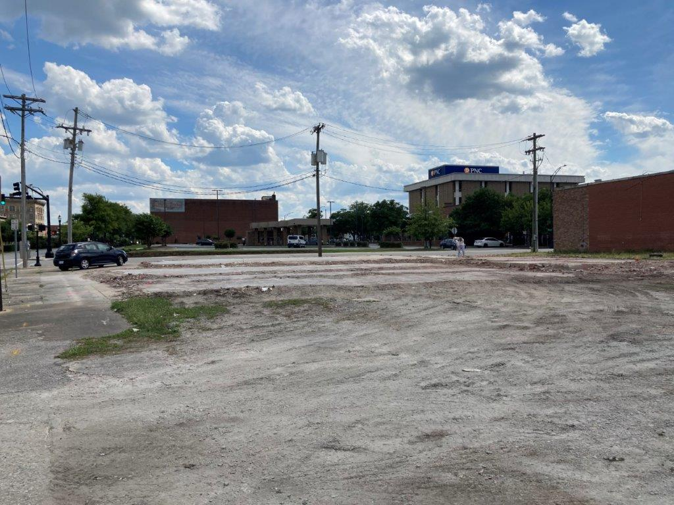
Site Redevelopment
Learned in June 2021 that the property owner was in the process of demolishing the site buildings. Slab left in place at DSCA request.
Opportunity to address grossly impacted soil impacts prior to Site redevelopment.
2019, facing west
2021, facing southwest
Notes:
Site orientation. Prior to demolition, the site building appeared to be building that had multiple iterations of add ons. This can be seen on the remaining slab, where there were multiple heights of the slab and walls between them.
Leaving the slab in place was critical as we assessed remedial options. Had the slab been removed, it would have allowed rainwater to infiltrate directly to groundwater. With soil that is saturated with PCE, a little bit of water running through the soils would have quickly degraded the water quality. To date, groundwater impacts had been very limited due to the presence of the building, which prevented water infiltration in the area of greatest soil impacts.
The redevelopment of the site gave a cost-effective opening to address the highest subsurface impacts. A number of possibilities were considered in the assessment of remedial options.

Slide 6
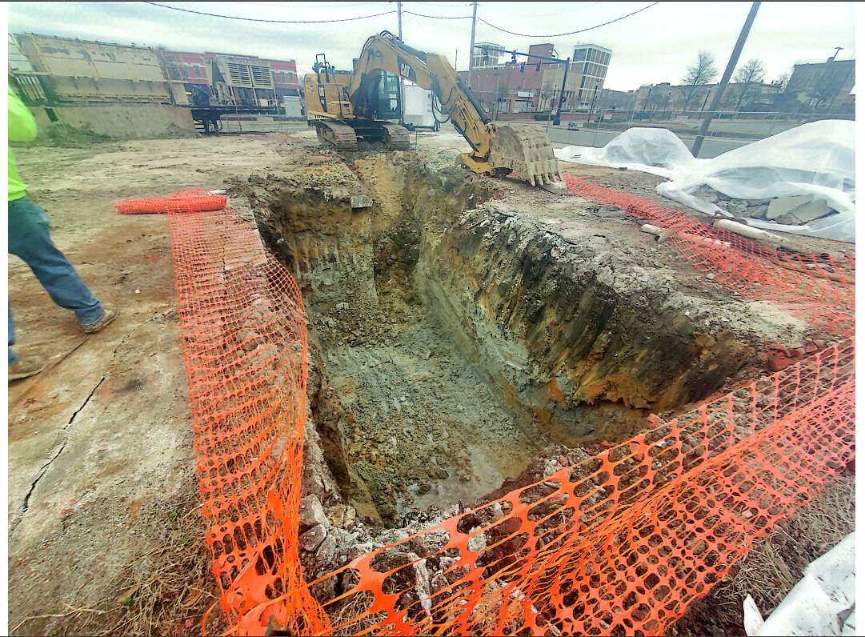
Selected Remediation: Excavation
Why? Shallow groundwater, delineated soil impacts, redevelopment imminent, cost
Scope: Remove soil impacts > Csat concentrations
Cost savings: On-site thermal remediation prior to offsite disposal
Addressing groundwater impacts: Added remedial amendment (permanganate) at base of excavation prior to backfill
Concrete
stockpiles
Thermal
desorption
unit
Water at
base of
excavation
Notes:
Excavation was selected as a cost-effective and fast way to address the soil impacts, as the soil impacts were delineated in two small areas, and the water table was less than 10 feet deep, meaning the impacts could be reached with “standard” construction equipment. Soils above the saturation concentration were targeted, to allow removal of the greatest mass and prevent “oozing” into the water table. However, simply excavating soils impacted with these concentrations would have been prohibitively expensive, with T&D costs ranging from ~$450/ton (if concentrations are less than 60 mg/kg) to > $1,000/ton (if concentrations were > 60 mg/kg). Treatment isn’t cheap , but at less than $200 per ton, followed by disposal as non-haz soils in a lined landfill, it is less than other alternatives. In addition, it allowed direct access to the area with the highest groundwater concentrations (above 100,000 ug/l), and permanganate was placed in the bottom of the excavation to address groundwater impacts.
During the course of the excavation, a mottled gray soil was encountered at about 5 feet bgs. Though water was only starting to come in at the base of the excavation, the “gleyed” soils indicated that the water table has been several feet higher, either seasonally or during various “wet periods”. The water table fluctuations will help get the permanganate into the groundwater and further enhance remediation at the site.

Slide 7
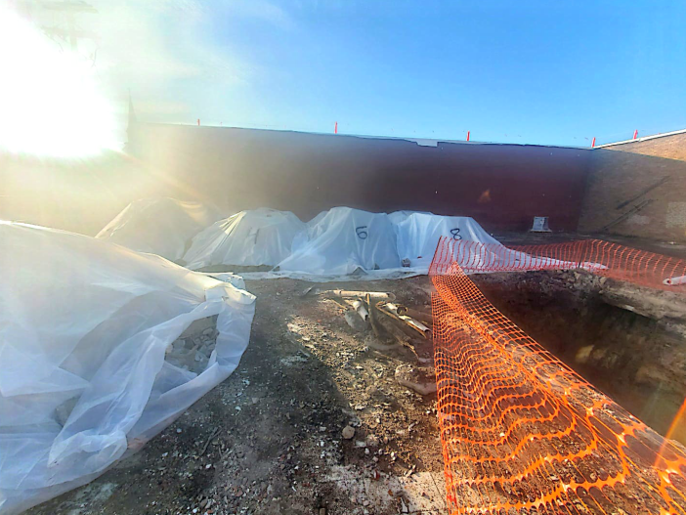
Selected Remediation: Excavation
Why? Shallow groundwater, delineated soil impacts, and redevelopment imminent
Scope: Remove soil impacts > Csat concentrations
Cost savings: On-site thermal remediation prior to offsite disposal
Addressing groundwater impacts: Added remedial amendment (permanganate) at base of excavation prior to backfill
Treated soil stockpiles,
pending analytical results
and offsite T&D
Notes:
Treatment piles, post thermal treatment . Staged on plastic and covered pending analytical results to confirm efficacy of steam distillation treatment

Slide 8
Selected Remediation: Excavation
Why? Shallow groundwater, delineated soil impacts, and redevelopment imminent
Scope: Remove soil impacts > Csat concentrations
Cost savings: On-site thermal remediation prior to offsite disposal
Addressing groundwater impacts: Added remedial amendment (permanganate) at base of excavation prior to backfill
Permanganate in the base of
the excavation.
Notes:
Treatment piles, post thermal treatment . Staged on plastic and covered pending analytical results to confirm efficacy of steam distillation treatment

Slide 9
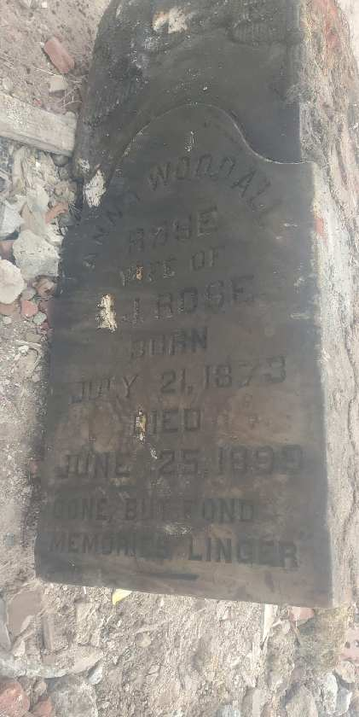
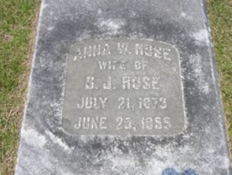
Dealing with the Unexpected
Anna Woodall Rose
Wife of DJ Rose
Born July 21, 1873
Died June 25, 1899
Headstone in a current cemetery
FOUND IN EXCAVATION
Notes:
A headstone was unearthed during the excavation! Due to the potential for human remains, work was immediately stopped until we could determine whether this could have been someone’s final resting place. Within 2 hours, thanks to FindAGrave.com as well as an AECOM archaeologist, we were able to obtain the NC Office of State Archaeology’s concurrence that this was a discarded headstone and that the excavation could continue.
At the archaeologist’s direction, the found headstone was destroyed prior to disposal, so that no one else would have to go through such a fire drill!

Slide 10
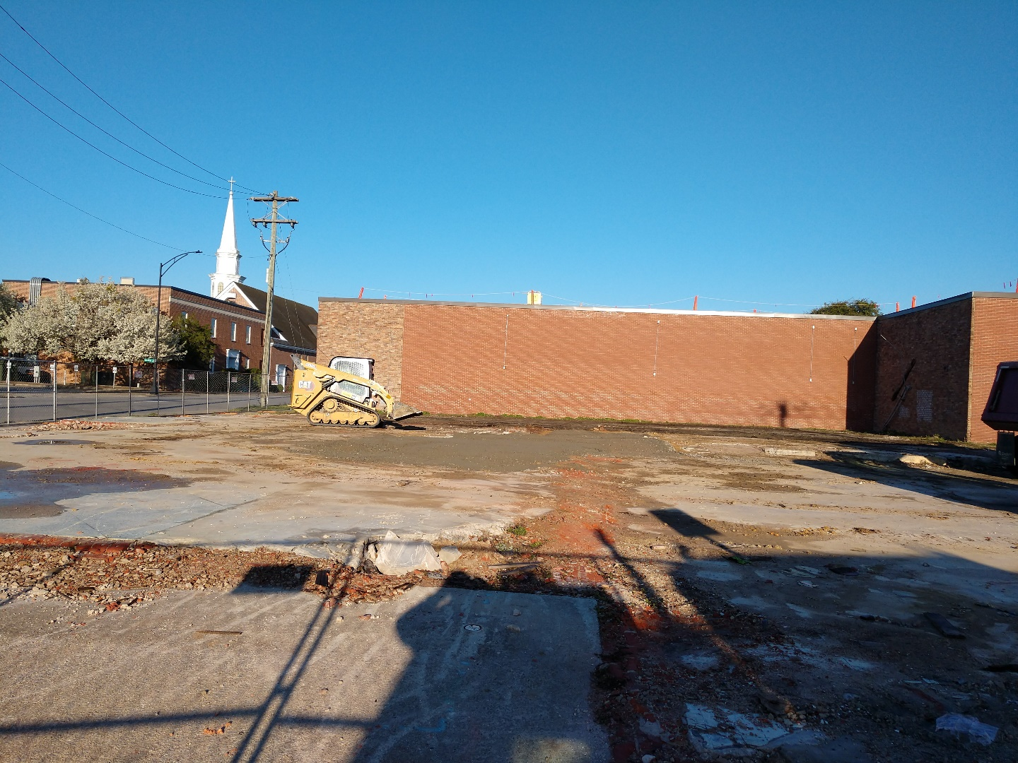
Next Steps
Once redevelopment is complete, reinstall permanent monitoring wells onsite
Backfill complete
Notes:
Next steps are to reinstall monitoring wells, after site redevelopment is complete to allow long term monitoring of the plume.

